Slide 1


NYU Summer Machine Learning Program
Presenter Name Here
Date Here

Slide 2

Linear Classification
Day 4

Slide 3
Learning Objectives
Formulate a machine learning problem as a classification problem
Identify features, class variable, training data
Visualize classification data using a scatter plot.
Describe a linear classifier as an equation and on a plot.
Determine visually if data is perfect linearly separable.
Formulate a classification problem using logistic regression
Binary and multi-class
Describe the logistic and soft-max function
Logistic function to approximate the probability
Use sklearn packages to fit logistic regression models
Measure the accuracy of classification
Adjust threshold of classifiers for trading off types of classification errors. Draw a ROC curve.
6/3/2019

Slide 4
Outline
Motivating Example: Classifying a breast cancer test
Linear classifiers
Logistic regression
Fitting logistic regression models
Measuring accuracy in classification
6/3/2019

Slide 5
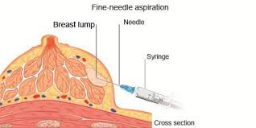
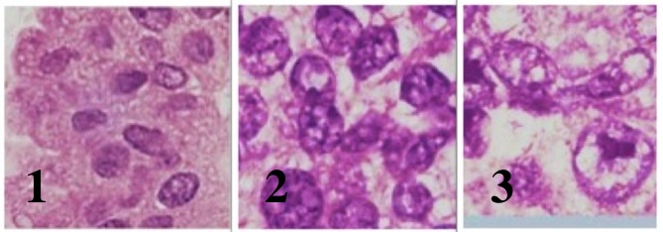
Module 1 – Before Lab
Example - Diagnosing Breast Cancer
Fine needle aspiration of suspicious lumps
Cytopathologist visually inspects cells
Sample is stained and viewed under microscope
Uses many features:
Size and shape of cells, degree of mitosis, differentiation, …
Diagnosis is not exact and if uncertain, use a more comprehensive biopsy
Additional cost and time
Stress to patient
Determines if cells are benign or malignant
Can machine learning provide better rules?
6/3/2019

Slide 6
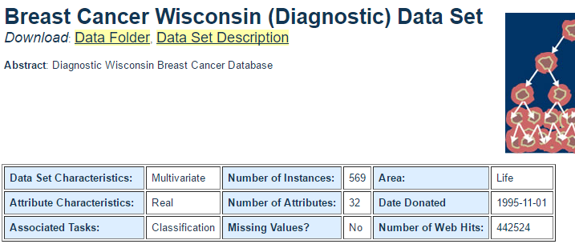
Module 1 – Before Lab
Data
Sample ID (code number)
Clump thickness
Uniformity of cell size
Uniformity of cell shape
Marginal adhesion
Single epithelial cell size
Number of bare nuclei
Bland chromatin
Number of normal nuclei
Mitosis
Univ. Wisconsin study, 1994
569 samples
10 visual features for each sample
Ground truth determined by biopsy
6/3/2019

Slide 7
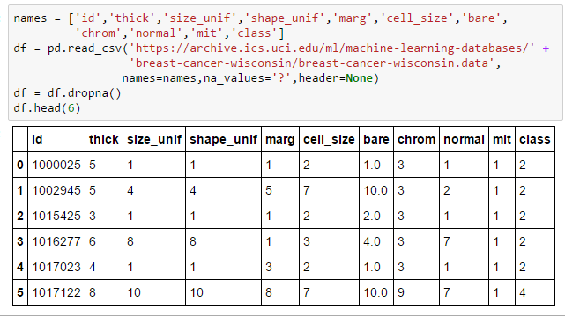
Module 1 – Before Lab
Loading The Data
Follow standard Pandas routine
Drop missing values
Class 2 is benign
Class 4 is malignant
6/3/2019

Slide 8
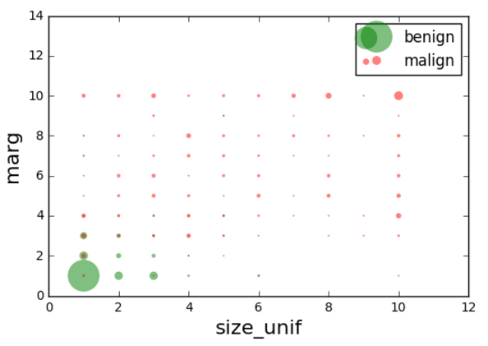
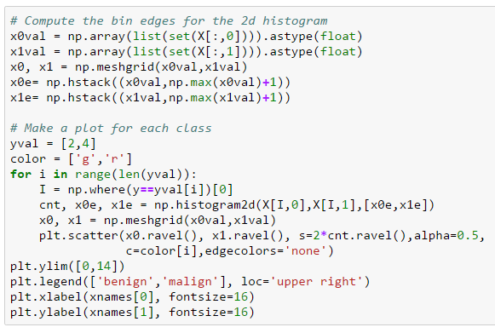
Module 1 – Before Lab
Visualizing the Data – In Google Colab Notebook
Make circle size proportional to count
Many gymnastics to make this plot in python
6/3/2019

Slide 9
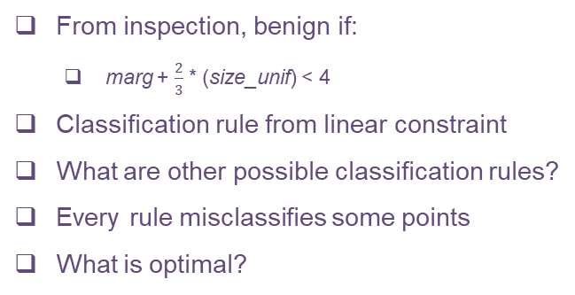
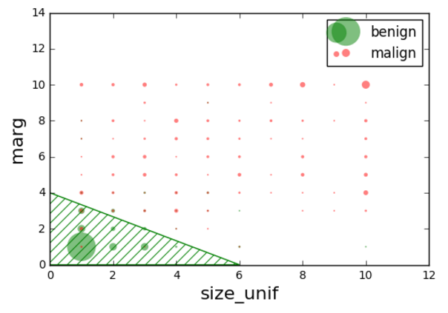
Module 1 – After Lab
A Possible Rule
6/3/2019

Slide 10
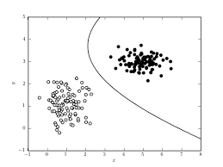
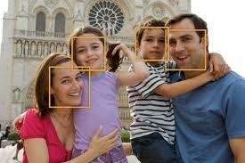
Module 2 – Before Lab
What is Classification?
Given features 𝒙, determine its class label, 𝑦 = 1,…,𝐾
Many applications:
Face detection: Is a face present or not?
Reading a digit: Is the digit 0,1,…,9?
Are the cells cancerous or not?
Is the email spam?
Equivalently, determine classification function: 𝑦’ = 𝑓(𝒙) ∈ {1,…,𝐾}
Like regression, but with a discrete response
May index {1,…,𝐾} or {0,…,𝐾−1}
6/3/2019

Slide 11
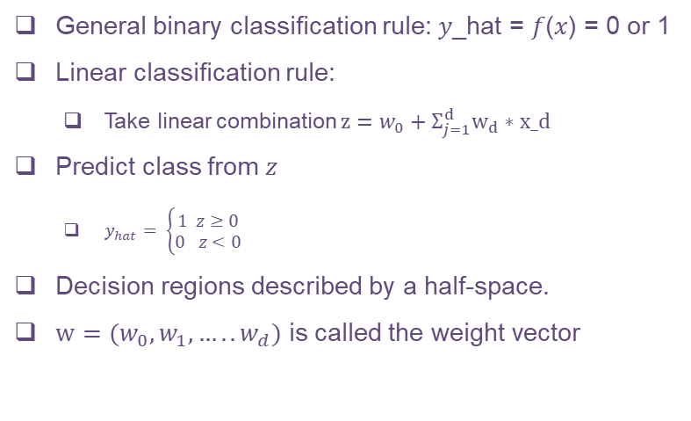
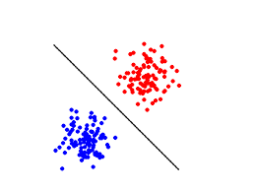
Module 2 – Before Lab
Linear Classifier
6/3/2019

Slide 12
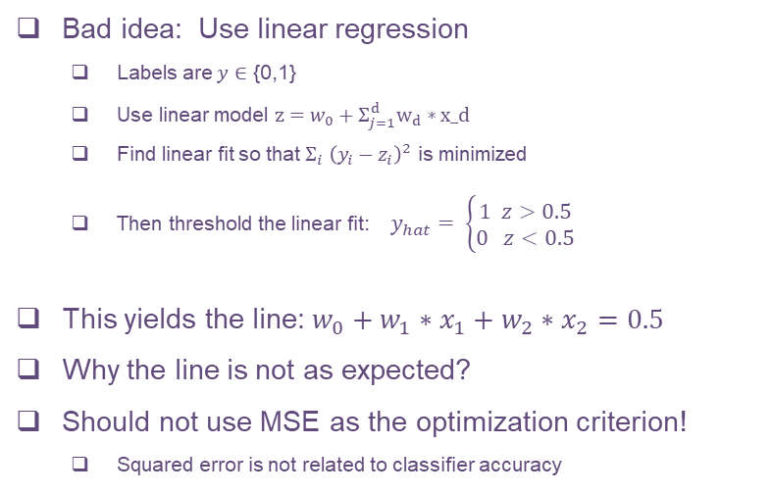
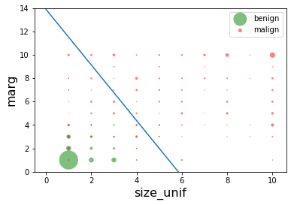
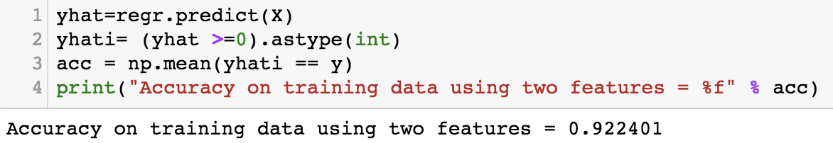
Module 3
Bad Idea – Using Linear Regression for Classification
6/3/2019

Slide 13
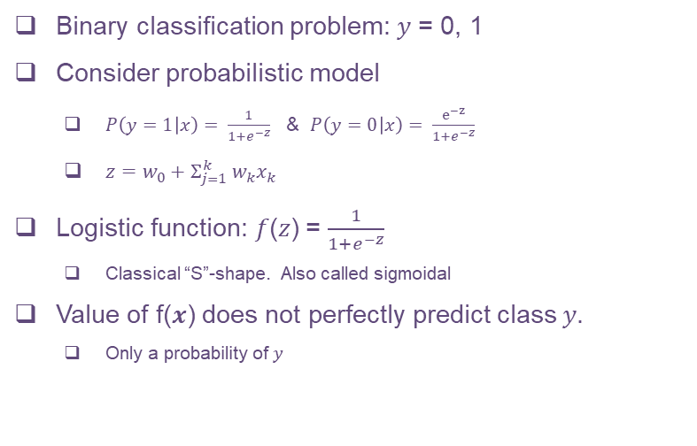
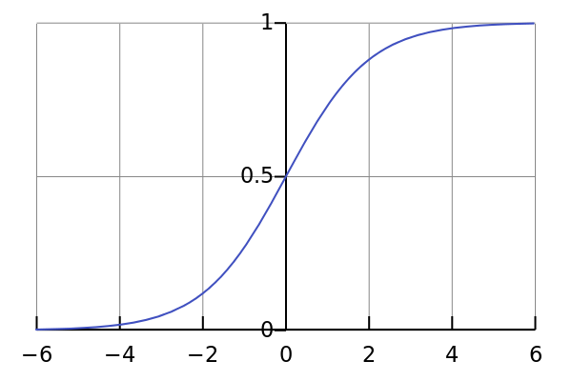
Module 3
Logistic Model for Binary Classification
6/3/2019

Slide 14
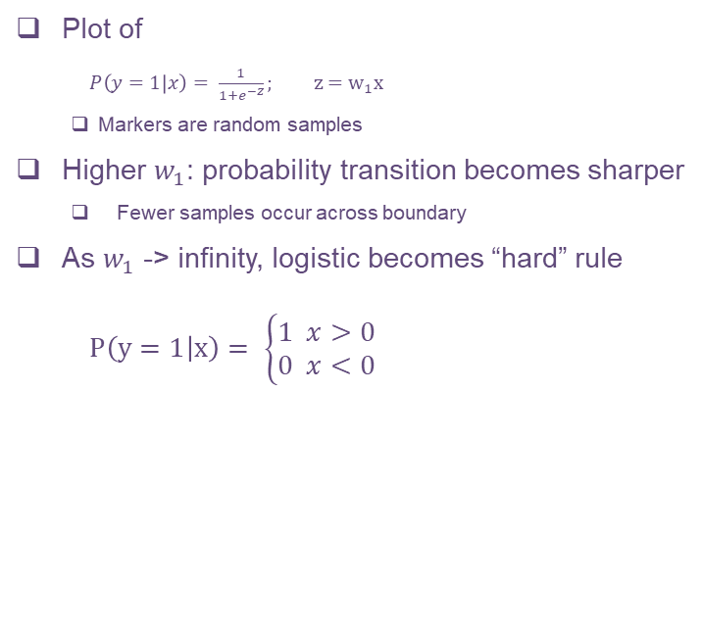
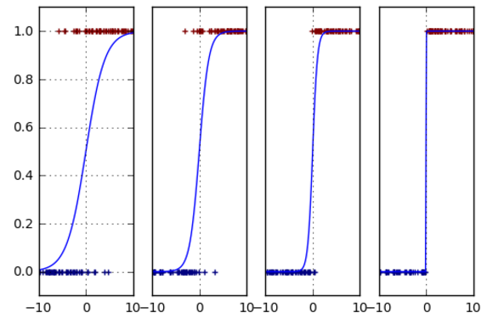
Module 3
Logistic Model as a “Soft” Classifier
6/3/2019

Slide 15
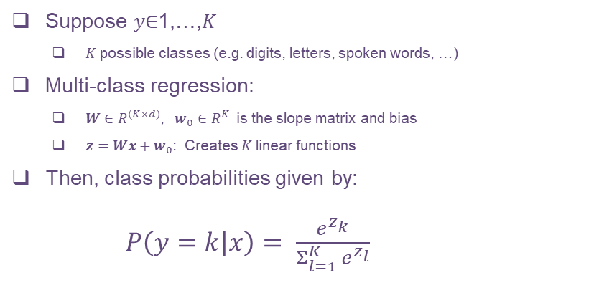
Module 4
Multi-Class Logistic Regression
6/3/2019

Slide 16
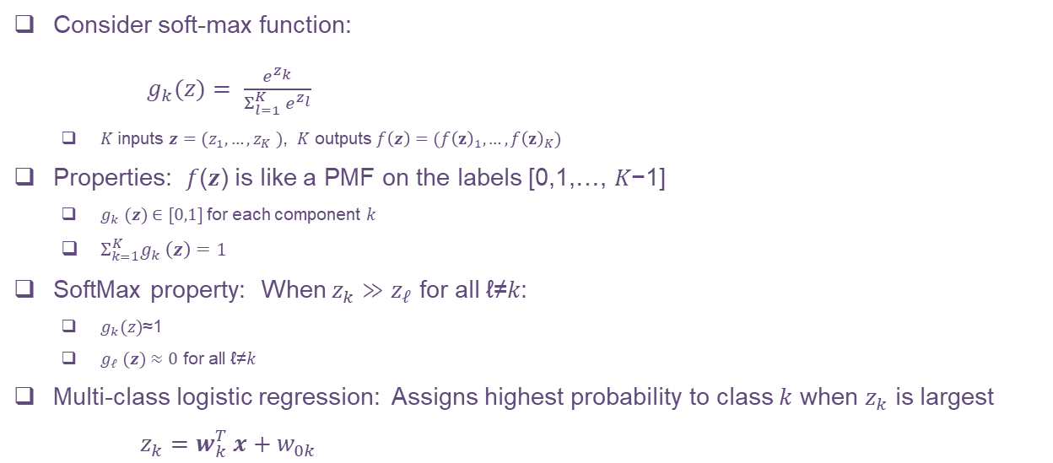
Module 4
SoftMax Operation
6/3/2019

Slide 17
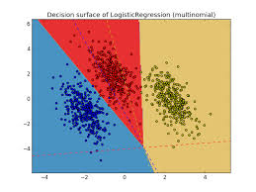
Module 4
Multi-Class Logistic Regression Decision Regions
Each decision region defined by set of hyperplanes
Intersection of linear constraints
Sometimes called a polytope
6/3/2019

Slide 18
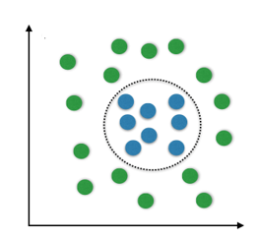
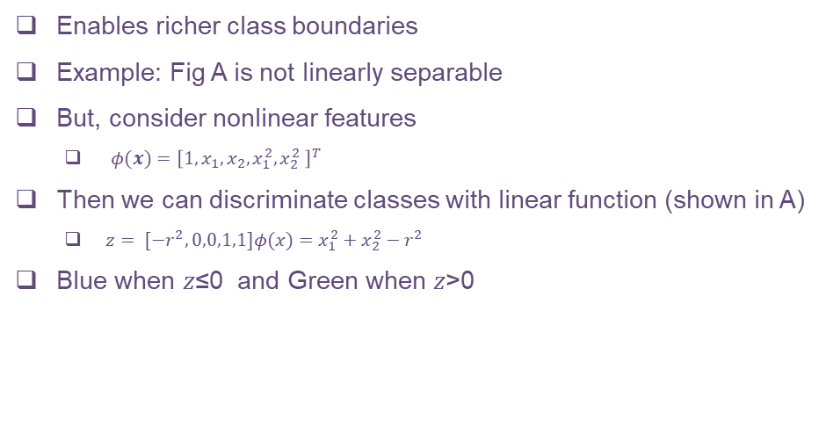
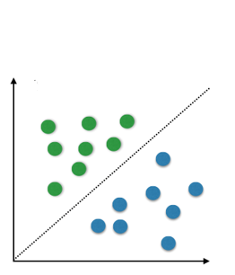
Module 4
Using Transformed Features
A
B
6/3/2019

Slide 19
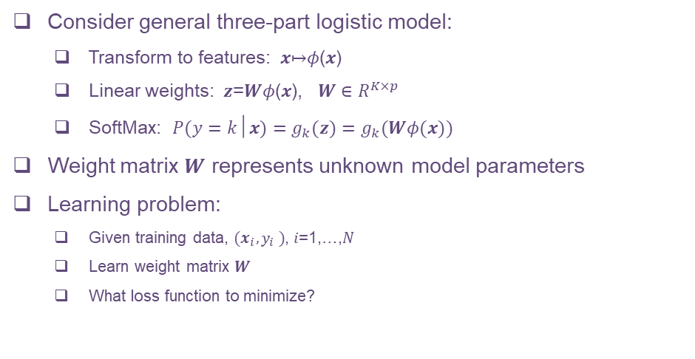
Module 6
Learning the Logistic Model Parameters
6/3/2019

Slide 20
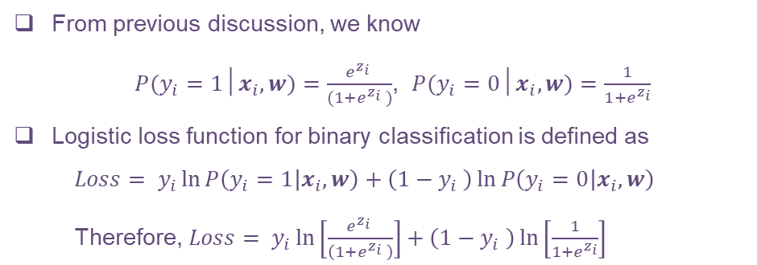
Module 6
Logistic Loss Function for Binary Classification
6/3/2019

Slide 21
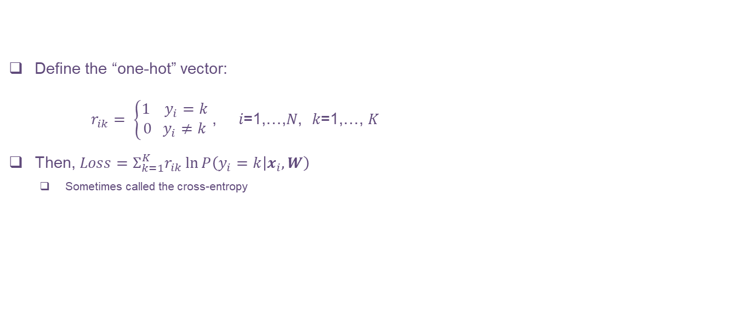
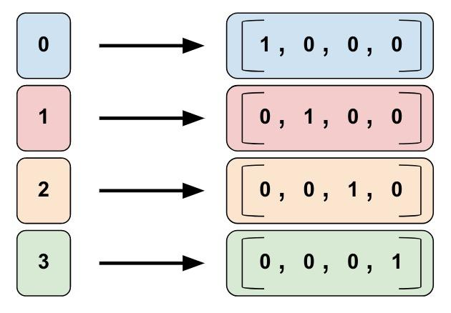
Module 6
One-Hot Log Likelihood for Multi-Class Classification
6/3/2019

Slide 22
Non-linear Optimization
Motivation:
We have been using closed-form solution to solve regression/classification problems
Closed form solution is not always the best:
Computation efficiency: operations like inverting a matrix is not efficient
Example: Closed-form solution to linear regression
Calculating the inverse is expensive when there are many variables
For more complex problems, like neural network, a closed form solution is not always available
Need an optimizer to find an optimal solution
6/3/2019

Slide 23
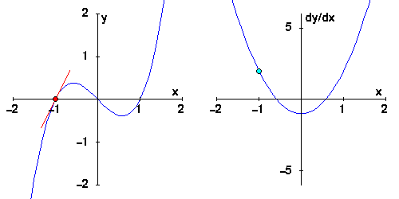
Introduction to Derivatives
The slope of a function tells us the rate of change:
Formula for average rate of change :
Derivative of a function gives us the instantaneous rate of change
For a 1-dimensional function,
6/3/2019

Slide 24
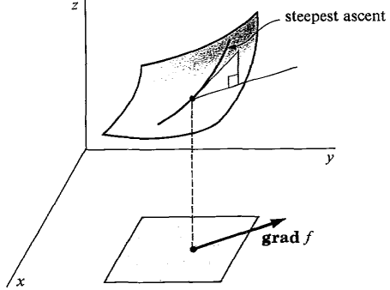
Gradient
In a two dimensional function , we can take derivative in more than one direction
Directional derivative: rate of change of a function in one particular direction Example: ,
Gradient: A vector that points to the direction of maximum increase
6/3/2019

Slide 25
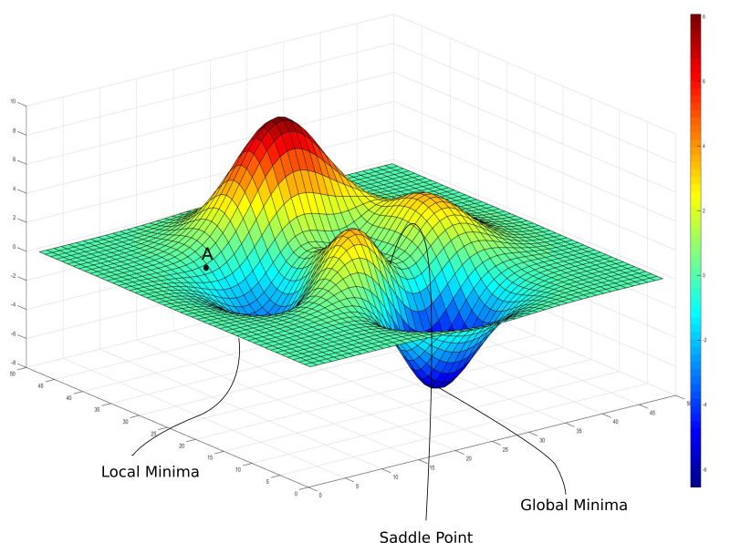
Visualizing Weight Space
We may visualize the loss function as surface in a multi-dimensional space
Locally, the function may be viewed as a paraboloid
There are local minima that we would want to avoid because they are not the optimal solution
6/3/2019

Slide 26
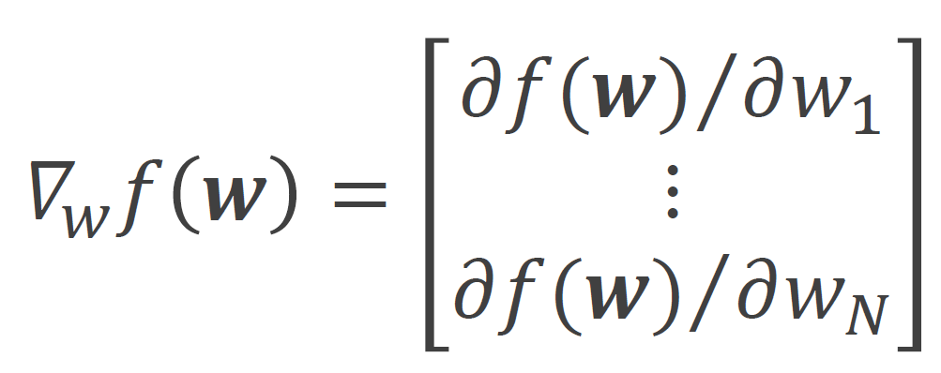
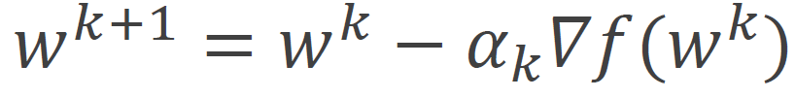
Gradient Descent
A common non-linear optimization algorithm
Key Idea: For each iteration
Calculate the gradient of the objective function with respect to the weights
2. Update the weights by taking a step opposite to the gradient
where is called the learning rate: how big of a step you take
6/3/2019

Slide 27
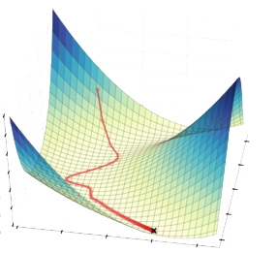
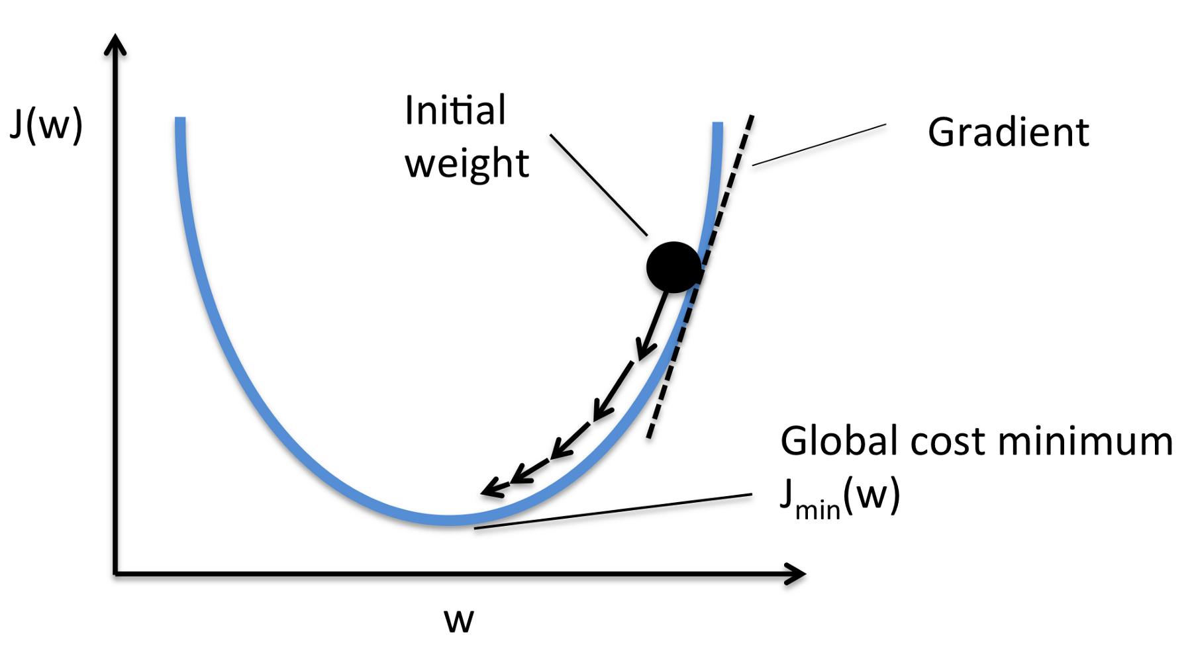
Gradient Descent Illustrated
1-Dimensional
2-Dimensional
6/3/2019

Slide 28
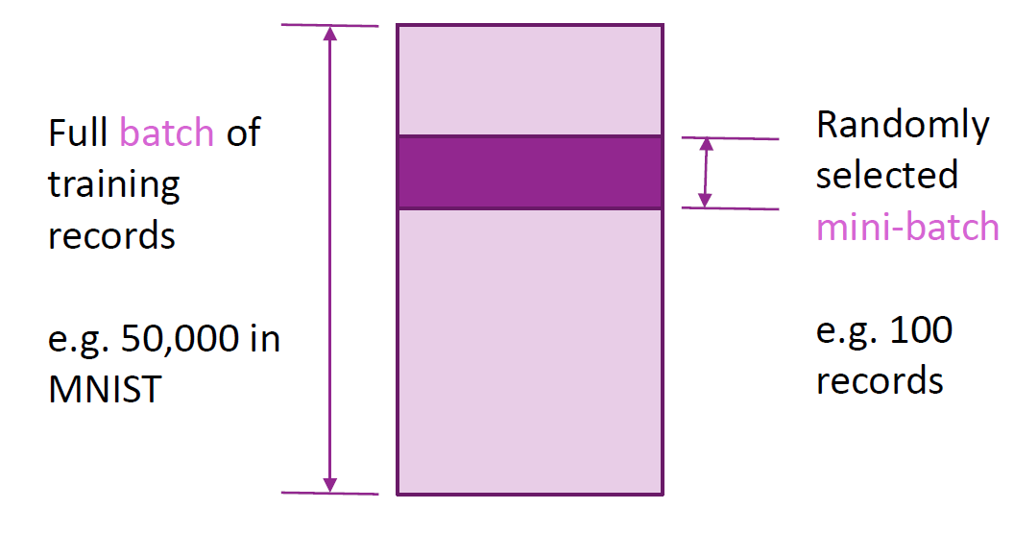
Stochastic Gradient Descent (SGD)
A variant of the standard gradient descent
In standard gradient descent, gradient is calculated using all training examples
Gradient computation is expensive when data size is very large
Stochastic Gradient Descent
In each step:
1. Select random small “mini-batch”
2. Evaluate gradient on mini-batch
Has the added benefit that:
Manifold is changing: do not get stuck in a local minimum
6/3/2019

Slide 29
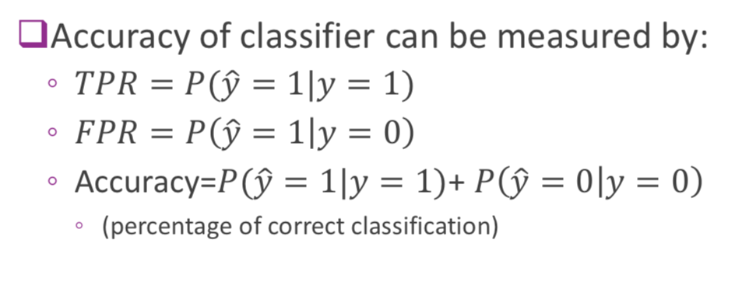
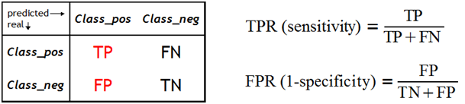
Errors in Binary Classification
There are two types of errors here:
Type I error (False Positive or false alarm): Decide 𝑦̂ =1 when 𝑦=0
Type II error (False Negative or missed detection): Decide 𝑦̂ =0 when 𝑦=1
To keep the errors in check we measure the accuracy of the classifier, with the help of a confusion matrix, True Positive Rate and False Positive Rate.

Slide 30
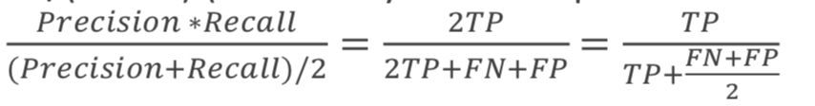

Other Metrics to measure the error rates:
The most commonly used ones are:
Recall/Sensitivity/TPR = TP/(TP+FN) (How many positives are detected among all positive?)
Precision = TP/(TP+FP) (How many detected positive is actually positive?)
F1-score =
Accuracy = (TP+TF)/(TP+FP+TN+FN) (percentage of correct classification)
Implications:
Sensitivity
Specificity
We need to find a good trade off between Sensitivity and Specificity

Slide 31
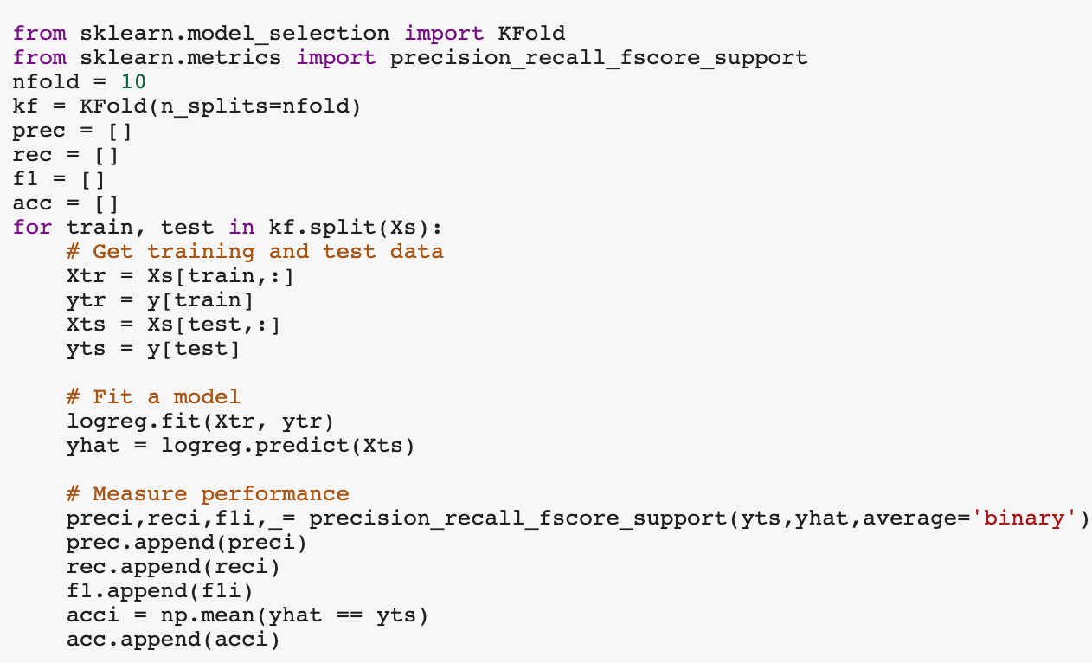
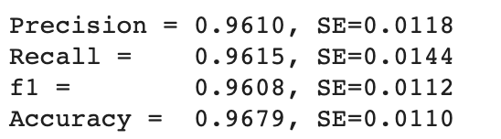
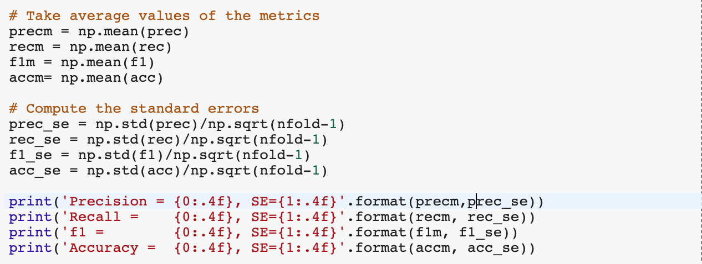
Breast Cancer Example:
Measuring the accuracy on test data
Using 10 fold cross-validation
Sklearn has built-in functions for CV
The following is the output:

Slide 32

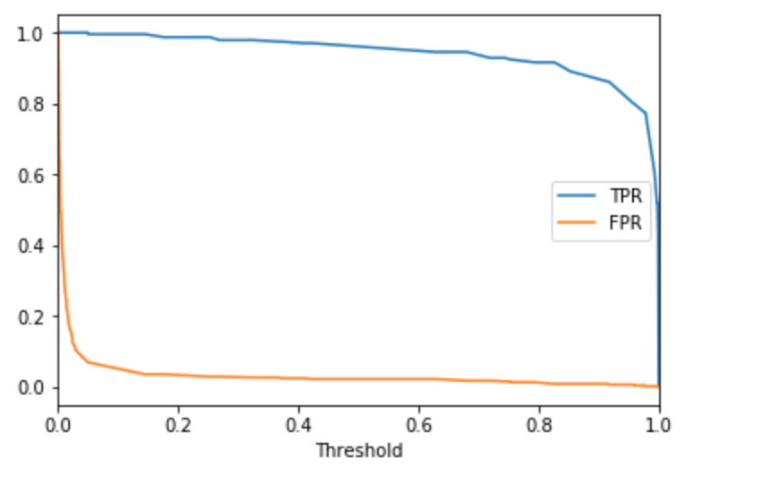
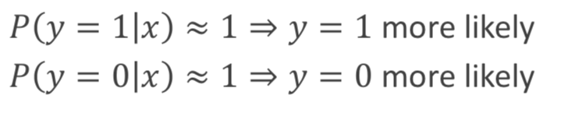
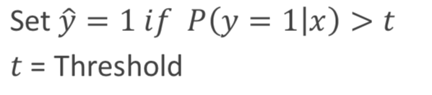
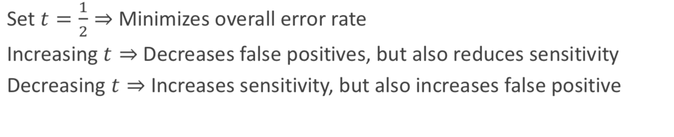
Hard Decisions:
Logistic classifier outputs a soft label:
We can obtain a hard label by thresholding:
How to set threshold?

Slide 33
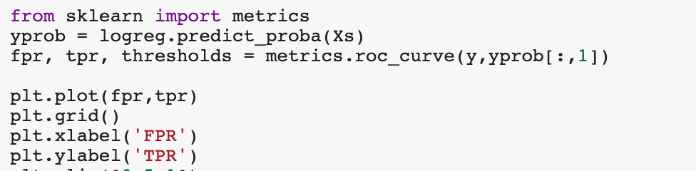
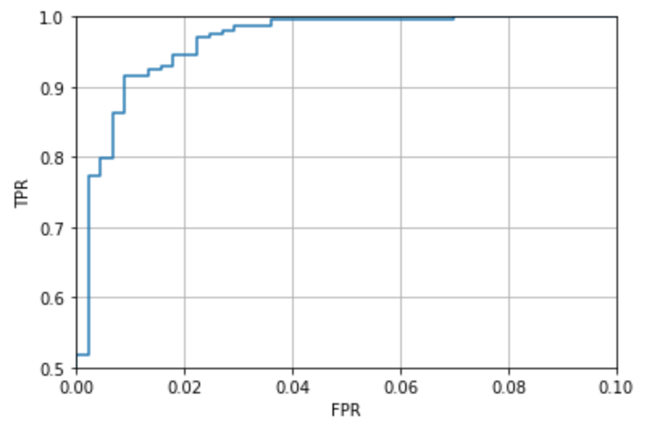
ROC (Receiver Operating Characteristics) Curve
Varying threshold obtains a set of classifier
Trade off between FPR (1-specificity) and TPR (sensitivity)

Slide 34
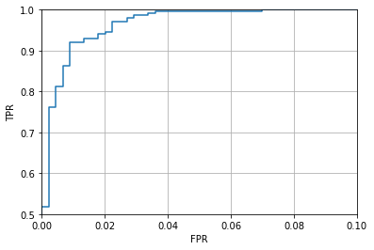

AUC (Area Under the Curve)
We can choose a particular threshold based on the desired trade-off between the TPR and FPR, but it may not be appropriate to evaluate the performance of a classifier for a fixed threshold.
AUC is a measure of goodness for a classifier that is independent of the threshold.
A method with a higher AUC means that under the same FPR, it has higher TPR.
AUC ranges between 0 and 1. 1 being the best and the highest.
We should report average AUC over cross validation folds.

Slide 35
Why the hype today?
Thank You!
6/3/2019

