Slide 1
City Traffic Navigation System Using Graph Data Structure
Mini Project Presentation
Developed to optimize urban route planning using graph algorithms
Deployed Link: https://urbanpulse-navigation-production.up.railway.app/
GitHub: https://github.com/Tejakiran24/Mini_Project.git

Slide 2
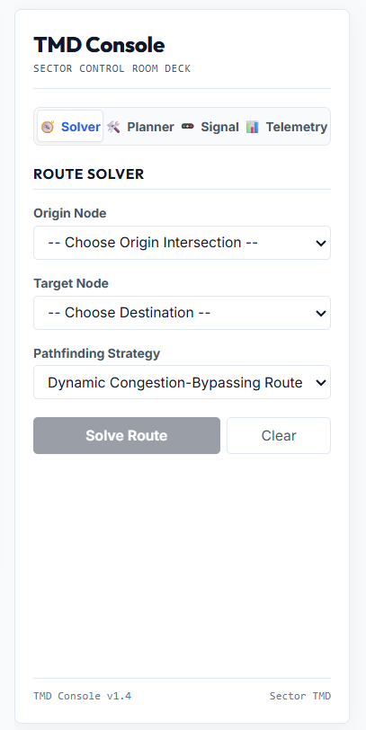
Problem Statement
Rapid urbanization causes traffic congestion and increased travel time.
Traditional navigation methods fail to adapt to dynamic traffic conditions.
Users need an efficient system to identify optimal routes.
Goal: Minimize travel time and improve navigation efficiency.

Slide 3
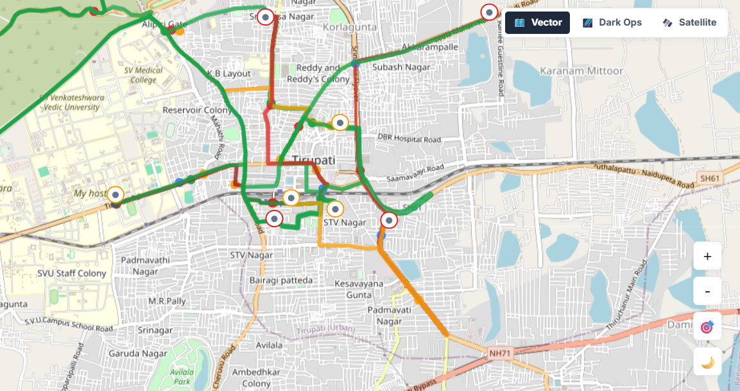
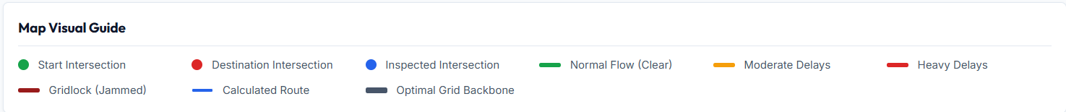
Methodology / Approach
Represent city roads as a weighted graph.
Vertices represent intersections and locations.
Edges represent roads with distance or travel-time weights.
Apply Dijkstra's Algorithm to compute shortest paths.
Display routes through an interactive web interface.

Slide 4
Technologies and Features
Frontend: React.js, HTML, CSS, JavaScript
Backend: Node.js and Express.js
Mapping: OpenStreetMap / Leaflet
Deployment: Railway
Features: Route visualization, shortest path calculation, responsive UI

Slide 5
Results and Conclusion
Successfully identifies optimal routes between locations.
Reduces travel distance and navigation complexity.
Demonstrates practical use of graph data structures.
Future Scope: Real-time traffic APIs, predictive analytics, voice navigation.
Conclusion: Graph algorithms enable efficient smart-city transportation solutions.

Slide 6
Thank You

