Slide 1
Pattern recognition for printed material
Shreyas Rao: 190929004
Tejal V Shetty: 190929006
Saurabh Patel: 190929138
Chirag Shetty: 190929210

Slide 2

Outline
1. Introduction
2. Literature survey
3. Discussion of base paper
4. Method/Algorithm
5. Result with Discussion
6. Conclusion and future scope
7. References
8. Contributions
9. Demonstration

Slide 3
Introduction
The recognition of patterns is important for the classification, sorting and searching of the required patterns in large textile industries.
Uses:
Helps in maintaining a database across all branches of the industry
Individual designers recognize the patterns used by professionals/ other designers
Requires algorithms to differentiate between different colours of the same pattern, and minute details that are hard to detect for the untrained eye

Slide 4
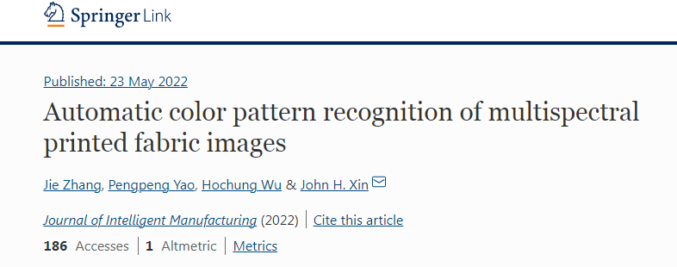
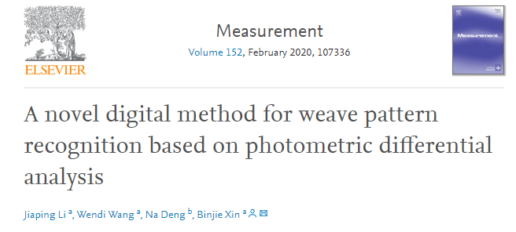
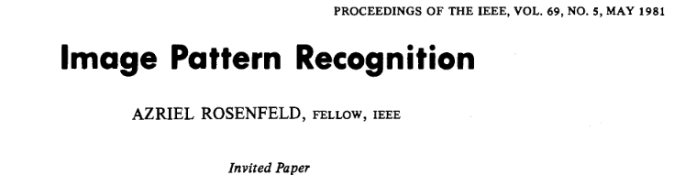
Literature survey

Slide 5
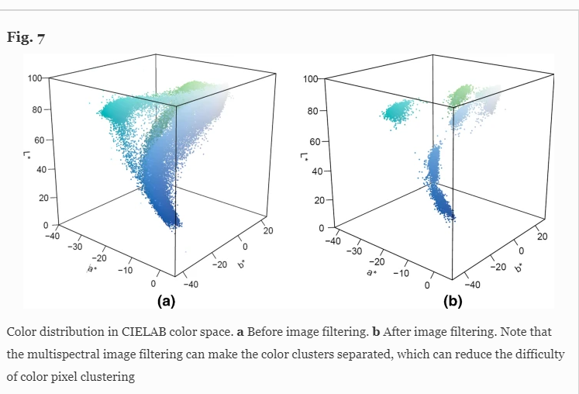
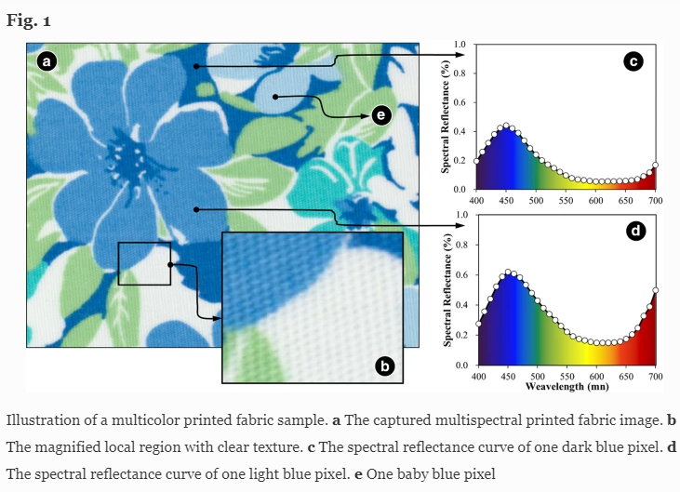
Discussion of base paper
Multispectral images with high data density
3D distribution of color space

Slide 6
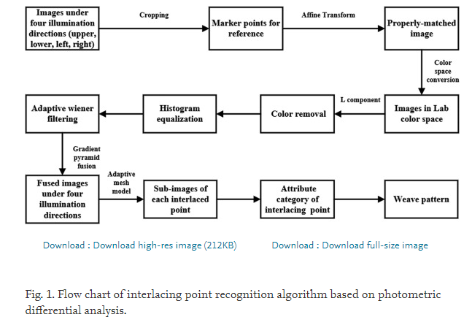
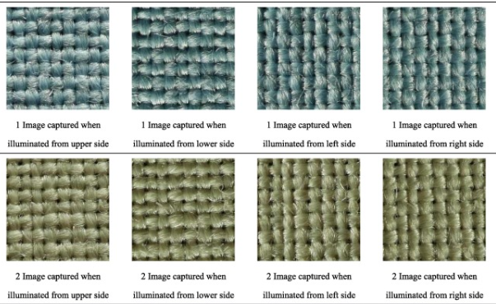
Discussion(continued)
Multiple images for one pattern, 4-sided lighting
Weave pattern detection

Slide 7
Method/Algorithm – Major steps
Input image is taken using a phone camera
Dataset is present on the computer/server and more images can be appended easily
Image histogram calculated and compared with those of all images in the dataset
If no matches are found, or there’s more than one match, feature matching is used to find the correct match

Slide 8
Method/Algorithm-Details
Simple methods are used since the dataset is large. New computations are required for each pattern
Assumptions
Input image is taken with ambient environmental lighting using the inbuilt flash of the phone
Image is oriented correctly(Can be accounted for by checking the features by rotating the input image but computational intensity increases)

Slide 9
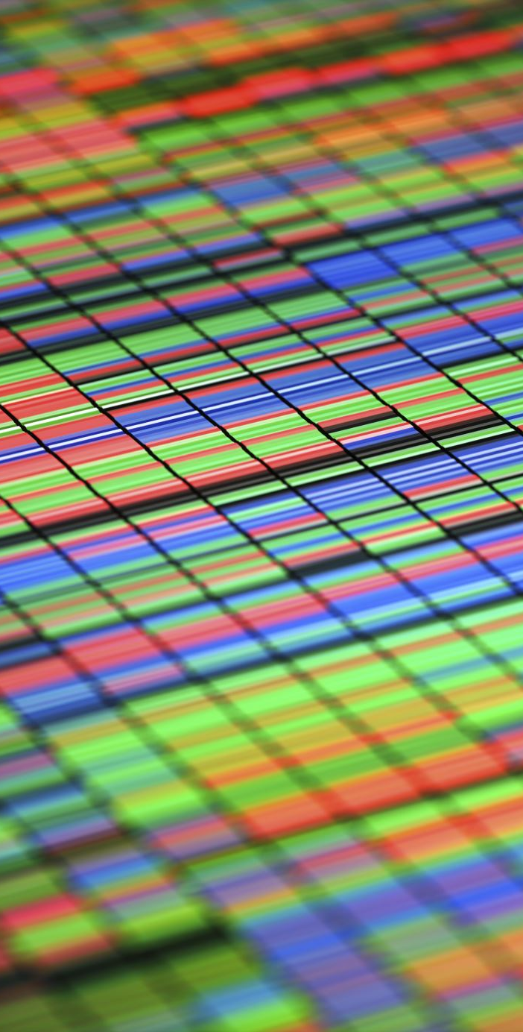
Method/Algorithm - Part 1
Histogram computation of the Red, green and blue channels together
The distribution of pixel intensities is normalized to display the percentage out of 100, for the respective bins
Bins - The pixels in a particular range
Difference between both histograms for each of the bins gives the accuracy

Slide 10
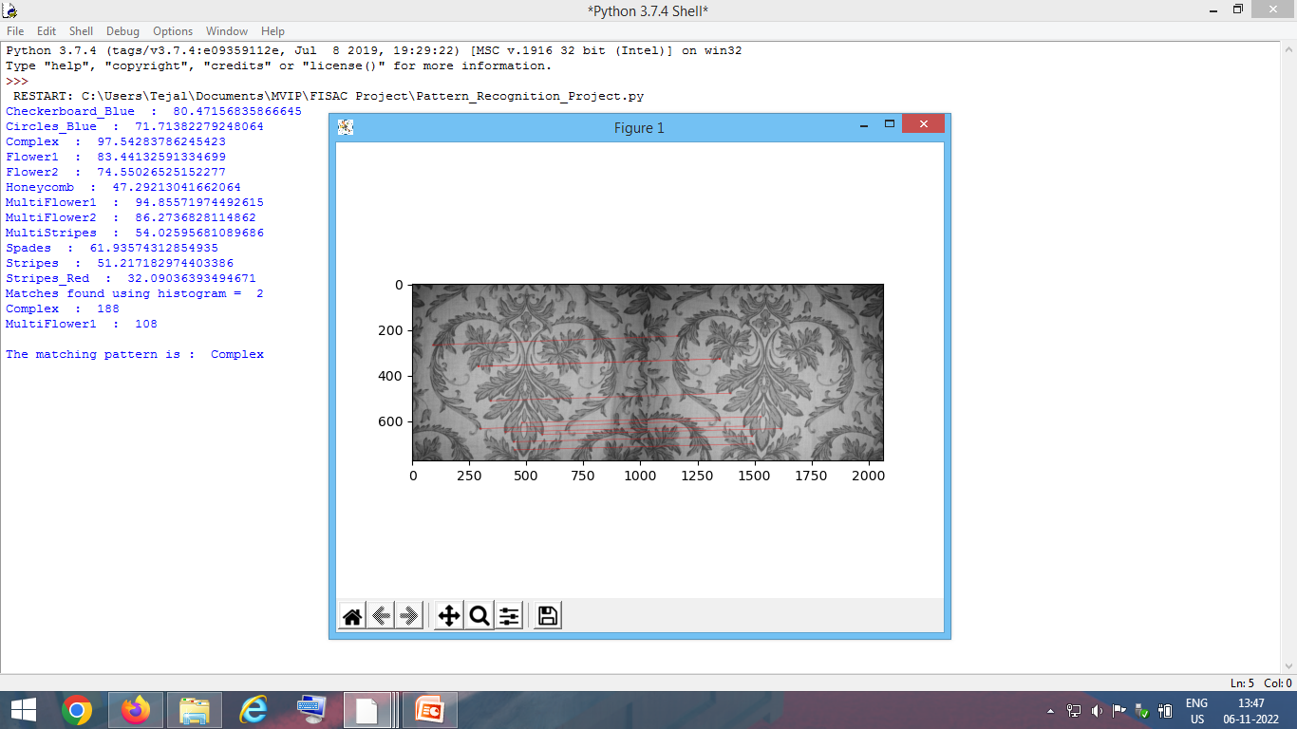
Method/Algorithm - Part 2
Brute force feature matching
Computationally expensive, so higher resolution images take a lot of time to be processed
Orb matching gives the features that are a match in both images
Higher number of matches implies a better fit for the pattern template

Slide 11
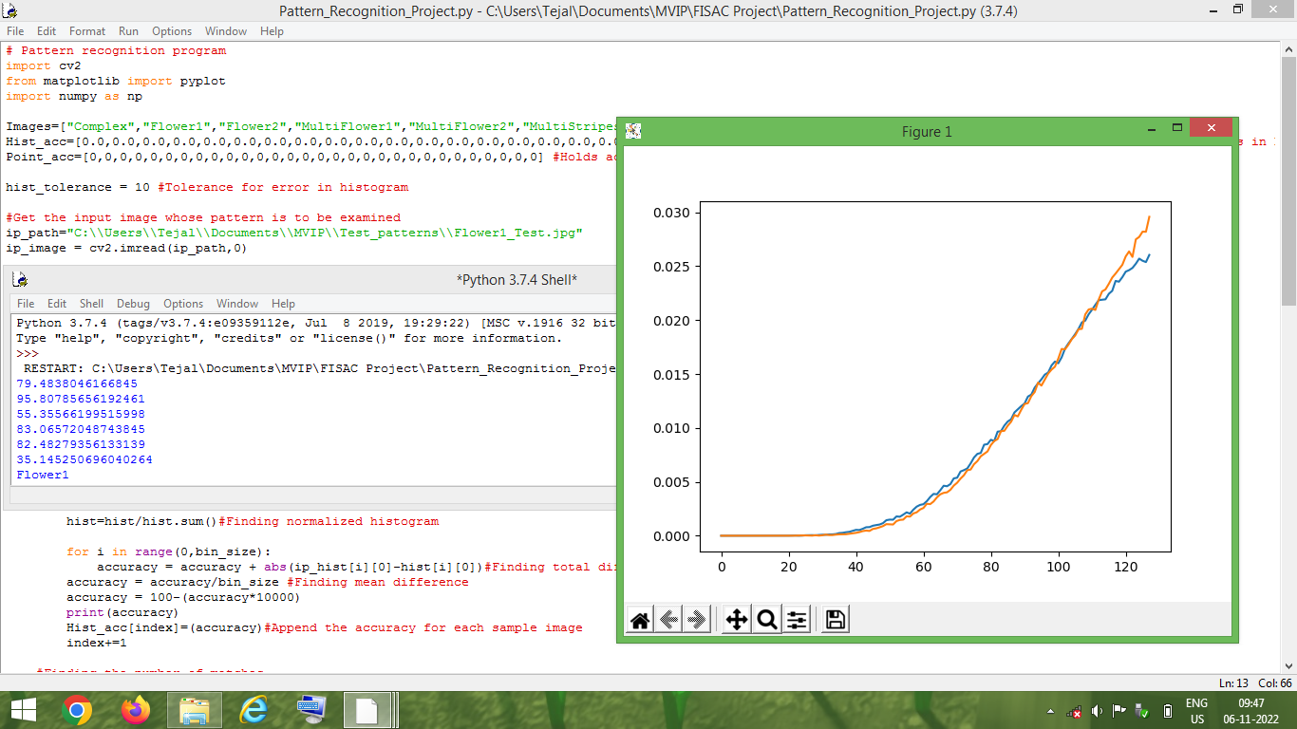
Result - Histogram
Histogram matching providing the correct match

Slide 12
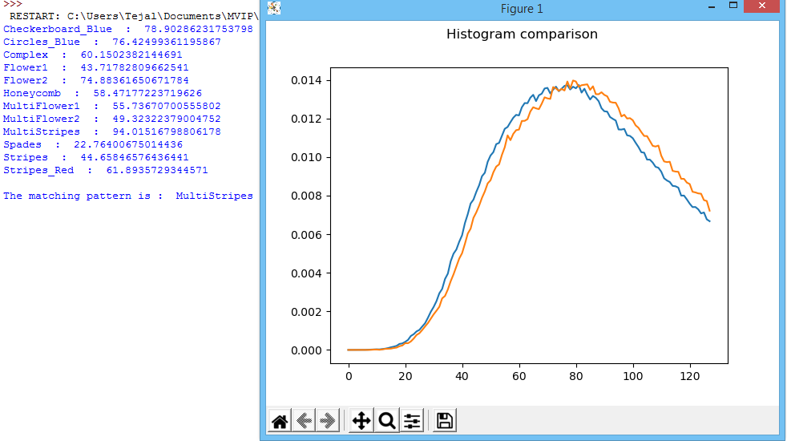
Result(continued) - Histogram
Number of bins used =128

Slide 13
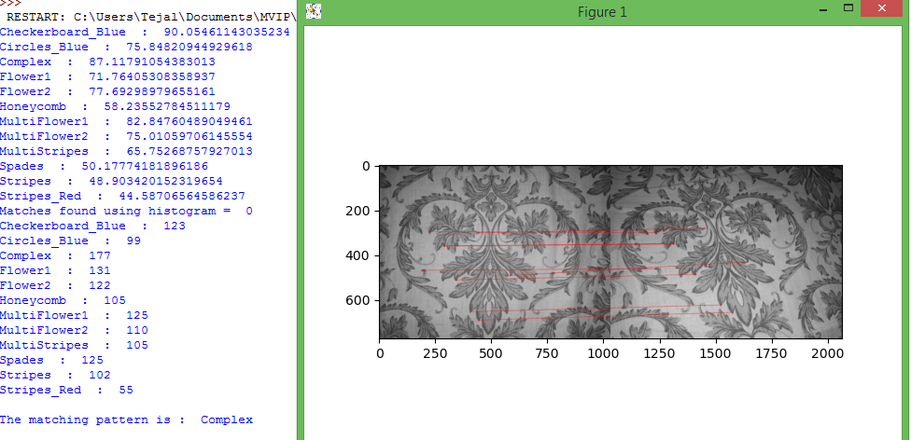
Result(continued) – Feature matching
Feature matching providing the correct match

Slide 14
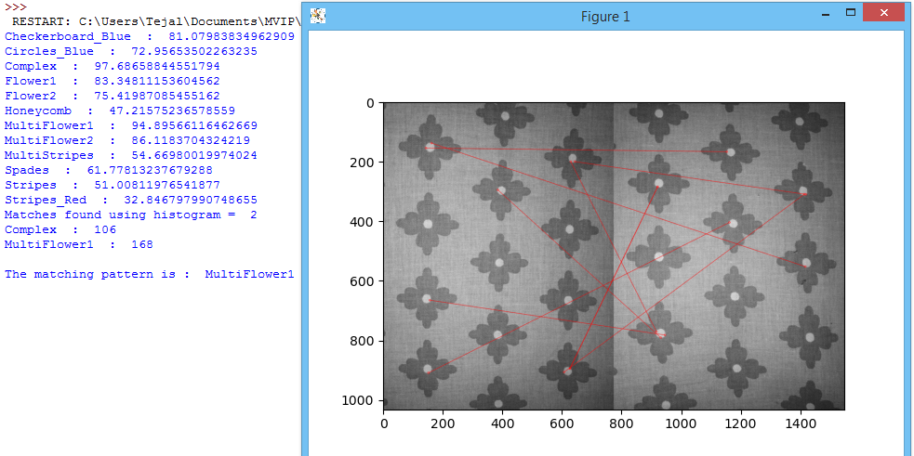
Result(continued) – Feature matching
10 closest matches are mapped out

Slide 15

Conclusion
Patterns are recognized based on either the colours or the features present in a short period of time
Not perfect due to the limited dataset(only one image per pattern), and due to the simplicity of the algorithm
Future scope :
Larger dataset, more computational power would lead to better matches
Can be applied to recognize animal pelt patterns, leaf patterns, etc., that can aid in the classification and recognition of endangered species/rare variants
Can be applied for recognition of architectural patterns, ancient painting styles in different cultures, etc.

Slide 16
References
Rosebrock, Adrian. “OpenCV Image Histograms ( Cv2.calcHist ) - PyImageSearch.” PyImageSearch, 28 Apr. 2021, pyimagesearch.com/2021/04/28/opencv-image-histograms-cv2-calchist.
“OpenCV: Feature Matching.” OpenCV: Feature Matching, docs.opencv.org/4.x/dc/dc3/tutorial_py_matcher.html. Accessed 6 Nov. 2022.
Zhang, J., Yao, P., Wu, H. et al. Automatic color pattern recognition of multispectral printed fabric images. J Intell Manuf (2022). https://doi.org/10.1007/s10845-022-01947-8
Jiaping Li, Wendi Wang, Na Deng, Binjie Xin. A novel digital method for weave pattern recognition based on photometric differential analysis. Measurement, Volume 152 (2020) https://doi.org/10.1016/j.measurement.2019.107336

Slide 17

Contributions
Shreyas Rao: Documentation, Dataset generation, Algorithm
Tejal V Shetty: Research, Algorithm, Coding
Saurabh Patel: Coding, Documentation, Dataset processing
Chirag S Shetty : Research, Dataset generation and processing, Coding

Slide 18
Thank you
- Demonstration

