Slide 1

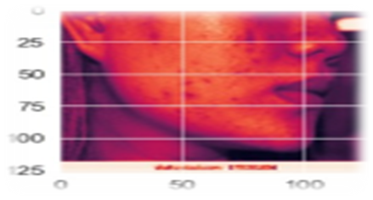
Bansilal Ramnath Agarwal Charitable Trust’s
VISHWAKARMA INSTITUTE OF TECHNOLOGY, PUNE
(An Autonomous Institute affiliated to Savitribai Phule Pune University)
Department of Electronics and Telecommunication Engineering
Vision based dermatological disease(acne) detection
Description: In this model, the acne disorder is detected using machine learning and computer vision techniques. Different techniques and algorithms have been implemented on the model
Novelty:
Efficient and accurate
Real time detection
Low computation time
Specifications:
F1 score: DT- 86.63%, LGBM- 97.23%
Accuracy: DT- 86%, LGBM- 97%
Results:
Actual label: Acne vulgaris
Predicted label: Acne vulgaris
Block diagram and photographs:
Processor based system
Camera
Display Device
Classification
Student Details: Tejal Salunke, Riddhi Selkar, Shivangi Shardul
Supervisor: Prof. Jyoti Madake

