Slide 1

Full-Stack Development Project Roadmap
This project roadmap outlines key steps for implementing a robust full-stack application.
Ankit Kant Saxena
Rahul Jangra
Tejal Thaware
Vidyanshu

Slide 2

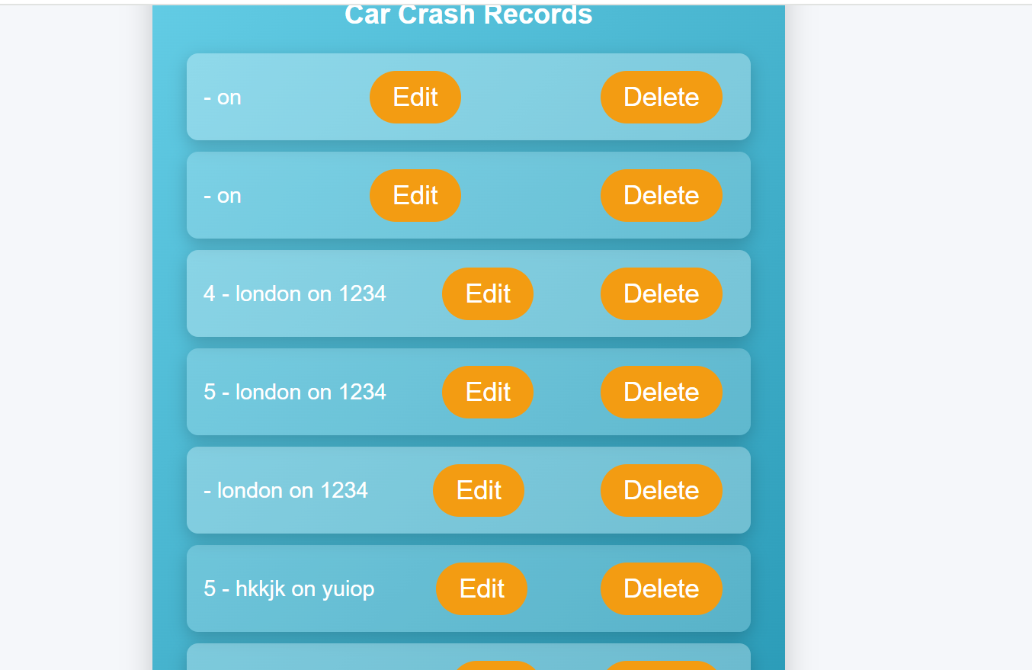
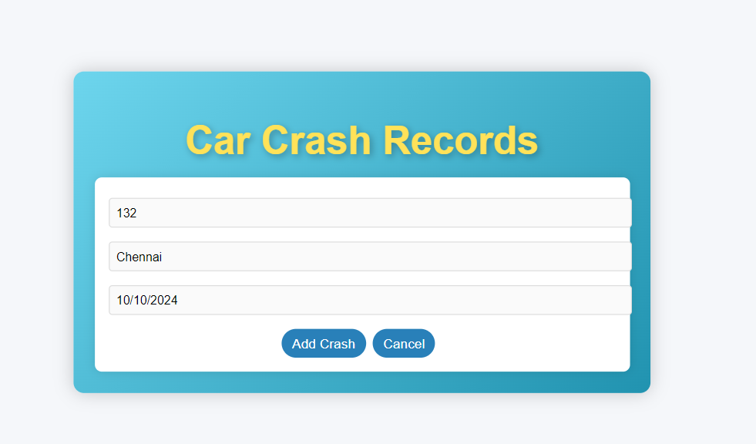
Frontend Implementation
1
UX Design Analysis
Thoroughly reviewed provided UX designs. Identify key components and user interactions.
2
Component Architecture
Designed a modular component structure. Ensure reusability and maintainability of UI elements.
3
Responsive Implementation
Developed responsive layouts. Ensure cross-browser compatibility and mobile-first approach.
4
State Management
Implement efficient state management. Use Redux or Context API for complex state scenarios.

Slide 3

Database Design and Implementation
SQL Database
NoSQL Database
Hybrid Approach
Suitable for structured data with complex relationships. Use PostgreSQL for ACID compliance and scalability.
Ideal for unstructured or semi-structured data. Consider MongoDB for flexibility and horizontal scaling.
Combine SQL and NoSQL databases. Leverage strengths of both for optimal performance and flexibility.

Slide 4

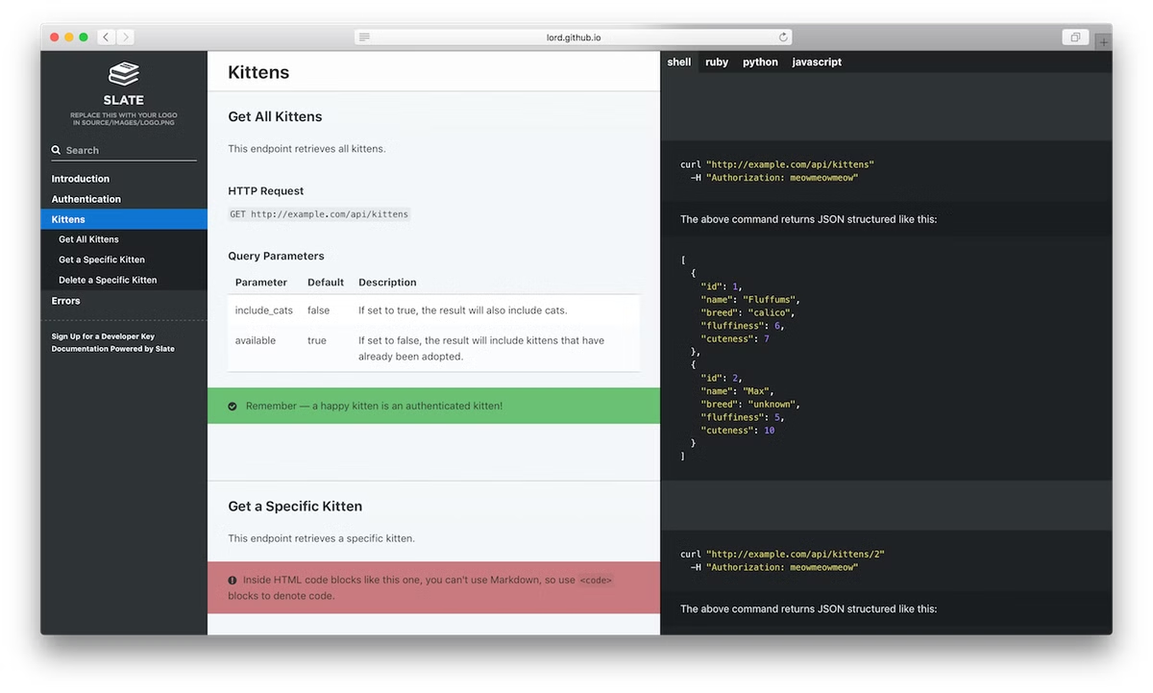
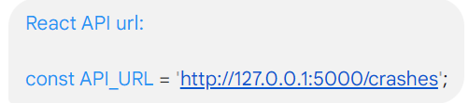
API Design and Implementation
RESTful Architecture
Designed APIs following REST principles. Ensure proper use of HTTP methods and status codes.
GraphQL Integration
Consideedr GraphQL for flexible data querying. Implement resolvers for efficient data fetching.
Authentication & Authorization
Implemented JWT-based authentication. Set up role-based access control for secure API endpoints.
API Documentation
Used Swagger comprehensive API documentation. Include request/response examples and authentication details

Slide 5





Performance Optimization and Security
Code Optimization
Implement lazy loading and code splitting. Optimize database queries and use appropriate indexing.
Caching Strategy
Implement Redis for server-side caching. Use service workers for client-side caching of static assets.
Security Audit
Conduct regular security audits. Use tools like OWASP ZAP to identify and fix vulnerabilities.
Performance Monitoring
Set up application performance monitoring. Use tools like New Relic or Datadog for real-time insights.

Slide 6


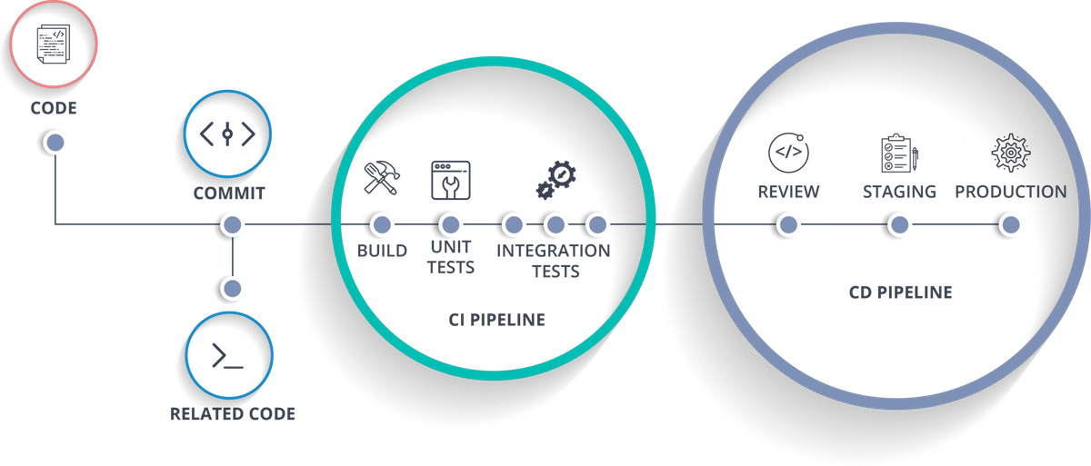



CI/CD and Best Practices
Version Control
Use GitLab for version control. Implement feature branching and pull request reviews.
Testing
Achieve 50%+ unit test coverage. Implement integration and end-to-end tests using Jest and Cypress.
Containerization
Use Docker for consistent deployments. Create separate containers for frontend, backend, and database services.
Cloud Deployment
Set up continuous deployment to cloud platforms. Use GitLab CI/CD for automated build and deploy pipelines.

Slide 7
GitLab Branching and Best Practices
Effective GitLab branching is crucial for collaborative development, ensuring clean code, efficient workflows, and robust project management.
Here's a breakdown of key best practices:
• **Feature Branching:** Create dedicated branches for each new feature or bug fix. This isolates changes, simplifies reviews, and minimizes merge conflicts.
• **Pull Requests:** Before merging changes into the main branch, initiate a pull request. This allows for code reviews by team members, ensuring code quality and adherence to project standards.
• **Linting and Code Style:** Implement linting tools (e.g., ESLint, Prettier) to enforce consistent code style and prevent common errors.
• **Merging Strategies:** Employ strategies like "rebase" or "merge" to integrate changes from feature branches into the main branch. Choose the appropriate approach based on project requirements.
• **Technical Documentation:** Maintain thorough project documentation, including API specifications, deployment guidelines, and coding standards. This ensures project clarity and facilitates future development.

