Slide 1
welcome

Slide 2

INTELLIGeNT CROP Recommendation SYSTEM

Slide 3
NAME OF GROUP MEMBER :
Group Members Roll no. Class
Tejal Survase 39 LY.B.Tech(CSE)
Mayuri Swami 40 LY.B.Tech(CSE)
Siddhi Velapure 41 LY.B.Tech(CSE)
Ratan Kore 42 LY.B.Tech(CSE)
Prapti Atkale 03 LY.B.Tech(CSE)

Slide 4
Content :
Introduction
Objective
Problem Statement
Requirements
Inputs
Future Scope

Slide 5
INTRODUCTION :
We propose an Intelligent Crop Recommendation system using Machine Learning that predicts crop suitability by factoring all relevant data such as temperature, rainfall, location, and soil condition. This system is primarily concerned with performing AgroConsultant's principal role, which is to provide crop recommendations to farmers

Slide 6
Objective : To build a robust model to give correct and accurate prediction of crop sustainability in a given state for the particular soil type and climatic conditions : Provide recommendation of the best suitable crops in the area so that the farmer does not incur any losses. Provide profit analysis of various crops based on previous years data.

Slide 7
Problem Statement :
Failure of farmers to decide on the best suited crop for his land using traditional and nonscientific methods is a serious issue for a country where approximately 50 percent of the population is involved in farming. Both availability and accessibility of correct and up to date information hinders potential researchers from working on developing country case studies. With resources within our reach we have proposed a system which can address this problem by providing predictive insights on crop sustainability and recommendations based on machine learning models trained considering essential environmental and economic parameters.

Slide 8
Requirements :
For the purposes of this project we have used three popular algorithms: Linear regression, Logistic regression and Neural network. All the algorithms are based on supervised learning. Our overall system is divided into three modules:
Profit analysis
Crop recommender
Crop Sustainability predictor

Slide 9
Inputs :
We propose an Intelligent Crop Recommendation system using Machine Learning that predicts crop suitability by factoring all relevant data as the following
Temperature
Soil
Rainfall

Slide 10

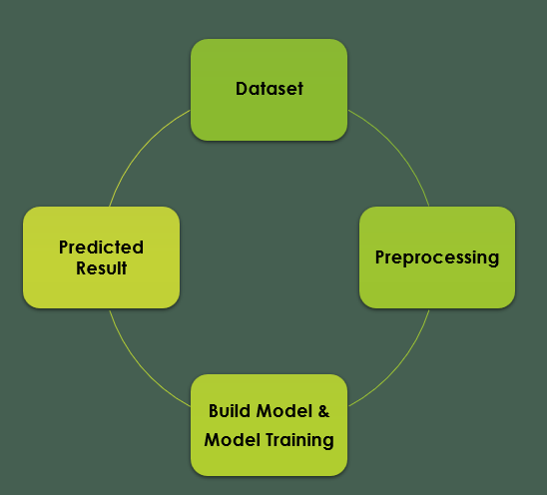
Proposed Work Flow

Slide 11

Crop recommendation system model

Slide 12
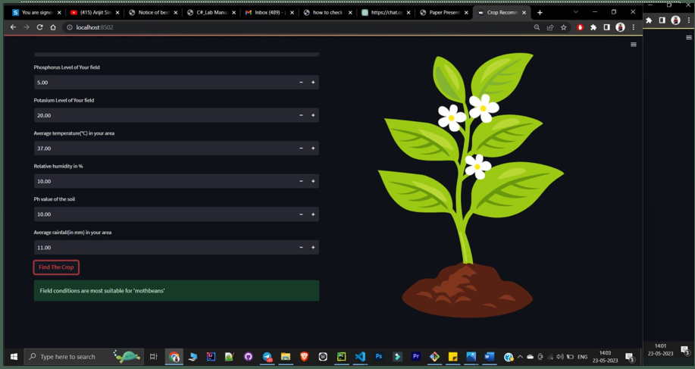
Parameters used for prediction and output

Slide 13
Future Scope :
An application or a Website holding all the parameters of Crop & Fertilizer Recommendation along with Crop Disease Identification Systems would be more helpful for the farmer to gather all information at a single site A soil analysis and recommendation system is used to determine the level of nutrients found in a soil sample. this system evaluates crop content and soil fertility status and plan a nutrient management program. Finally, this system gives recommendations of crop required to stay more profitable in agriculture

Slide 14


Thank you

