Slide 1
Milestone 4
SDN-Based Intelligent Traffic Management System with Enhanced
Emergency Response Features for Adverse Road and Weather Conditions
Demo: Drive-Link-For-Demostration
By: Teja Venkata Sai Naveen, Vuddagiri Padmaja, Kakulavarapu Surya Vardhan, Vunukonda

Slide 2
Introduction
Road accidents caused by adverse weather conditions such as fog and snow present significant challenges to road safety and emergency response efforts.
Reduced visibility and dangerous driving conditions increase the likelihood of accidents that requires efficient emergency response systems.
Conventional communication systems has vehicle-to-vehicle notification that lack in providing timely alerts and coordinating emergency responses during harsh weather conditions.
This leads to increased risks for drivers and delays in emergency services' ability to respond effectively.
The primary motivation behind our project is to enhance road safety in adverse weather conditions.
We aim to reduce the number of accidents and improve emergency response times via implementing advanced technologies.
Our primary objective is to develop a Software-Defined Networking (SDN) based intelligent traffic management system.
This system will integrate the SOS system in vehicles with government infrastructure to enhance emergency response capabilities.

Slide 3
Related Work
Khatri et al. (2021): Discusses ML models and techniques for VANET-based traffic management, focusing on scalability, security and real-time processing challenges.
Rajkumar & Santhosh Kumar (2024): Surveys communication techniques for ITS in IoT-based smart cities highlight the importance of reliable and low-latency communication for real-time data exchange.
Rammohan (2023): Explores C-V2X technology's role in revolutionizing ITS, emphasizing its impact on road safety, traffic efficiency and transportation system management.

Slide 4
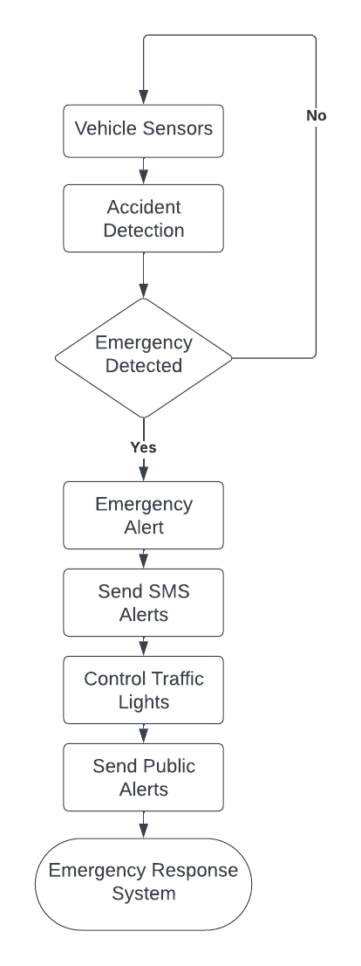
Methodology
System Design: Design an SDN-based intelligent traffic management system that integrates the SOS system in vehicles with government infrastructure to enhance emergency response capabilities.
Communication Enhancement: Use SMS/MMS and GPS technology to deliver real-time alerts and location-specific information to relevant authorities.
Implementation and Testing: Develop the system using python programming language and test it in simulated and real-world environments to ensure effectiveness and reliability.

Slide 5
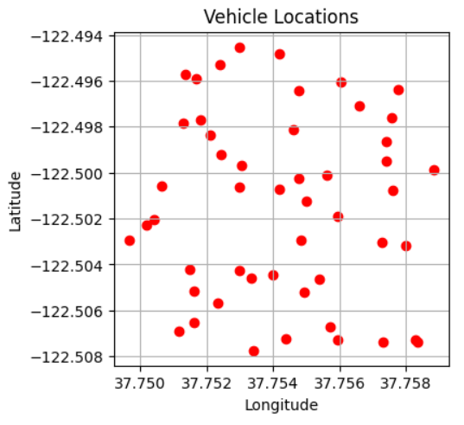
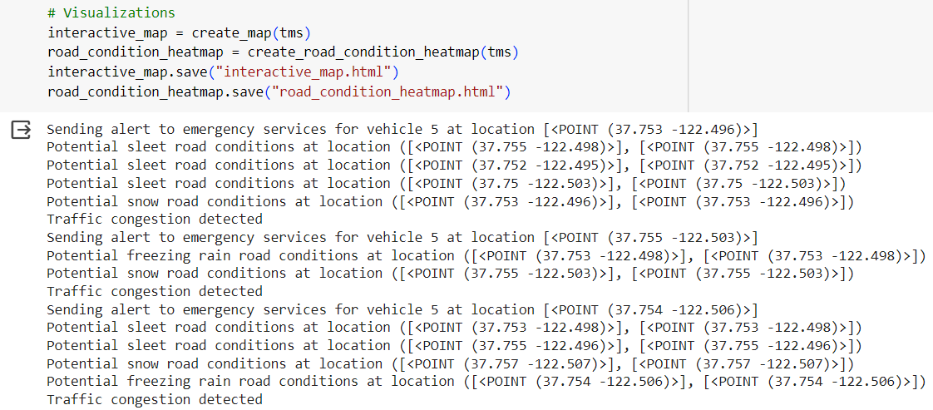
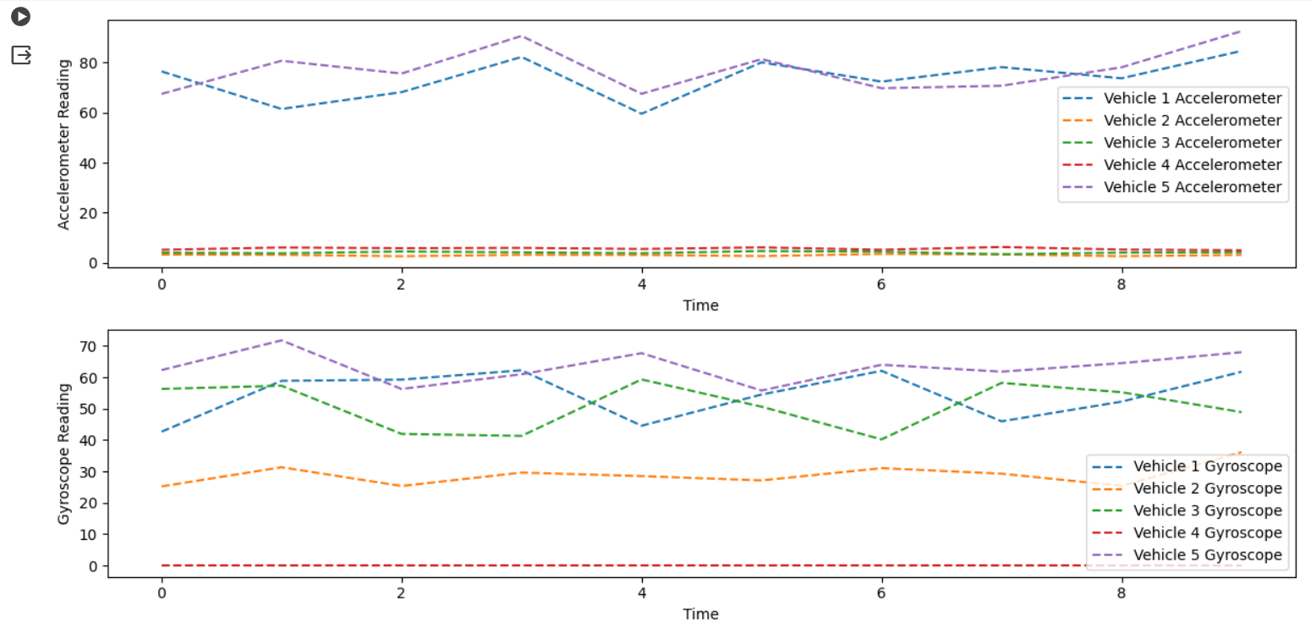
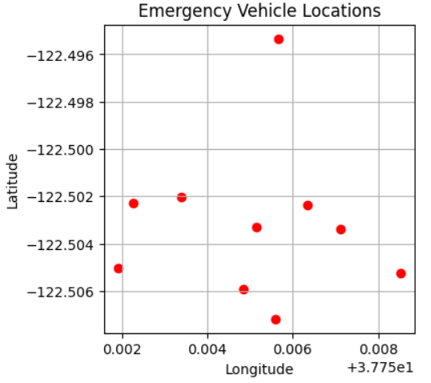
Location & SOS Demo

Slide 6
Discussion
Effectiveness of Communication Technologies: The use of SMS/MMS and GPS technology proved to be effective in delivering real-time alerts and location-specific information to relevant authorities.
Impact of Dynamic Traffic Management: The implementation of SDN for dynamic traffic management aided the efficient movement of emergency response teams, improving overall response times.
System Reliability and Scalability: The system demonstrated reliability in simulated and real-world environments

Slide 7
Conclusion & Future work
The SDN-based intelligent traffic management system with increased emergency response features has shown promise in increasing road safety and emergency response in bad weather. Real-time notifications and dynamic traffic management have been achieved by linking the SOS system in automobiles with government infrastructure and using sophisticated communication technologies. The technology is reliable and scalable enough to handle several cars and emergencies after comprehensive testing and assessment. User feedback has helped improve system functioning and usability.
Future work for this project is to include noting of time stamp in the SOS signal when accident has occurred, so the emergency team knows the priority of situation.

Slide 8
Acknowledgements
We would like to express our sincere gratitude for contribution to the development and completion of this project. We acknowledge the valuable support and guidance provided by our instructor Dr. Billy Kihei. We also appreciate the efforts of the team members for designing, developing and testing the system. These authors of the referenced research papers has inspired and guide our project Khatri et al. (2021), Rajkumar & Santhosh Kumar (2024) and Rammohan (2023).

Slide 9
References
Khatri, S., Vachhani, H., Shah, S., Bhatia, J., Chaturvedi, M., Tanwar, S., & Kumar, N. (2021). Machine learning models and techniques for VANET based traffic management: Implementation issues and challenges. Peer-to-Peer Networking and Applications, 14, 1778-1805.
Rajkumar, Y., & Santhosh Kumar, S. V. N. (2024). A comprehensive survey on communication techniques for the realization of intelligent transportation systems in IoT based smart cities. Peer-to-Peer Networking and Applications, 1-46.
Rammohan, A. (2023). Revolutionizing Intelligent Transportation Systems with Cellular Vehicle-to-Everything (C-V2X) technology: Current trends, use cases, emerging technologies, standardization bodies, industry analytics and future directions. Vehicular Communications, 100638.

Slide 10
Additional Materials
https://ryu.readthedocs.io/en/latest/getting_started.html
https://ernie55ernie.github.io/sdn/2019/03/25/install-mininet-and-ryu-controller.html
https://github.com/sdnds-tw/awesome-sdn
https://github.com/martimy/flowmanager

