Slide 1
Dashboard Design Summary
Task 3 – Data Analyst Internship
Name: Teja Prasad
Tool Used: Power BI

Slide 2
Dataset Used
Name: Expanded Superstore Dataset
Source: Generated for sales analysis
Fields: Order Date, Sales, Profit, Region, Category, Product, etc.

Slide 3
Key KPIs Tracked
Total Sales
Total Profit
Average Profit per Order
Number of Orders
Sales Growth %

Slide 4
Visualizations Included
Cards for KPI Summary
Line Chart for Time-Series Analysis
Stacked Column Chart: Sales by Category across Regions
Pie Chart: Sales Distribution by Segment
TreeMap: Top Performing Products
Table: Detailed view of Sales and Profit
Scatter Plot: Quantity vs Profit

Slide 5
Filters and Interactivity
Slicers for Region, Category, Segment, and Order Date
Interactive charts and dynamic filtering
Navigation menu using bookmarks and buttons

Slide 6
Dashboard Theme and Design
Minimal and clean theme applied
Uniform font and color scheme
Consistent layout and alignment
Hover tooltips and responsive elements

Slide 7
Key Insights
Technology category had highest sales contribution
West region showed the most consistent growth
Sub-categories like Phones and Chairs were top performers
Profit margins varied significantly by category

Slide 8
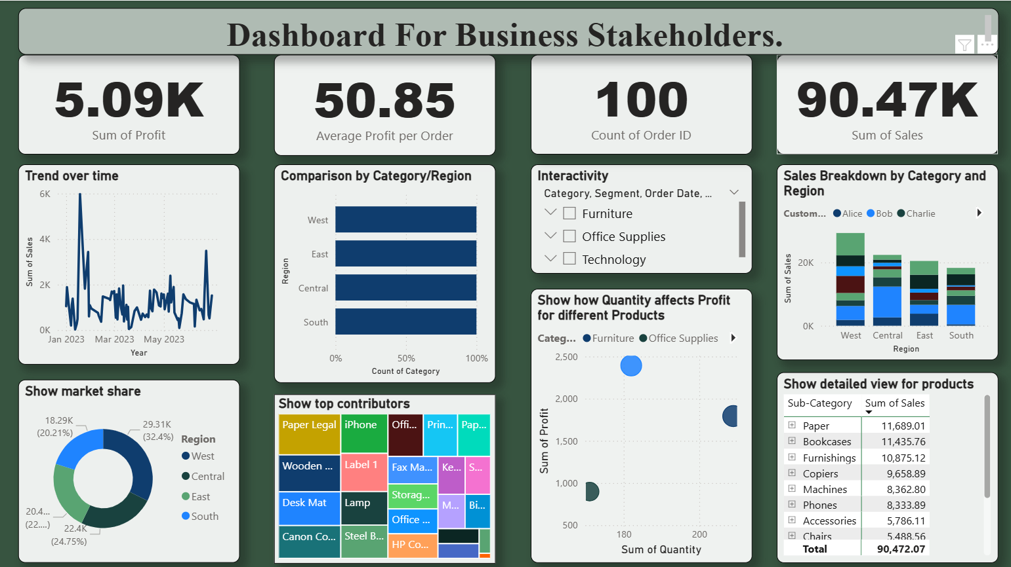

Slide 9
Conclusion
The dashboard offers an interactive and clear summary of business performance.
Helps stakeholders make informed decisions using visual insights.
Built with Power BI using clean and reusable design components.

