Slide 1
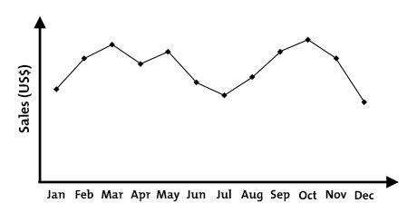

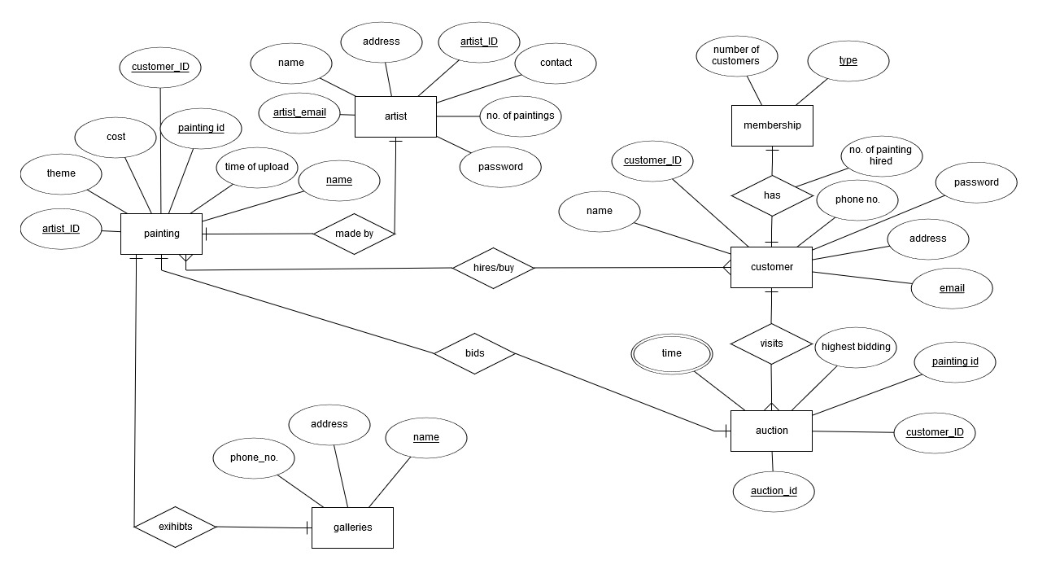
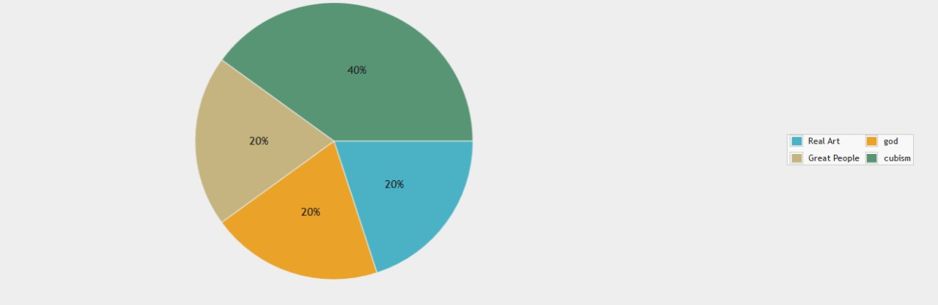
E-commerce of paintings
Vineet Pardhi(36) Tejas paranjape (35) Vaibhav Pudke(40)
Purpose
Methodology
The system must be able to manage the details of customers , paintings and those paintings which are currently rented to customers.
Customers are categorized as B(Bronze),G(Gold),S(Silver) and P(Platinum). These membership entitle a customer to a discount of 0% , 10% , 5% ,and 15%
Respectively, and other privileges .Each painting is allocated monthly rental price defined the owner. The owner is then paid 50% of the customer rental price.
Some reports required from the system are:
For each customer, a report showing an overview of all the paintings that they have hired or have currently rented.
How do membership get decided:
Bronze: Everyone
Silver: Above 5 paintings hired
Gold: Above 15 paintings hired
Platinum: Above 30 paintings hired
Diamond: Above 50 paintings hired
Auctions :
A real time auction system is added in the website.
The artist selects his/her painting and starts an auction for the same. The highest bidder after the end time passes is the winner of the auction and if there is no bidder then the painting remains unsold
Motivation
To design an efficient database management system to facilitate the hiring and buying of paintings by customers.
Auction of famous paintings can also be held if the owner of the painting wishes to sell the same.
Objectives
To make customers able to hire paintings and bid at auctions at their will and if they have the highest bid then they get the painting.
The artists should be able to easily upload their paintings and start auctions.
The database should be well oiled to execute commands easily and should be at least in the 2NF form
Artist will easily be able to earn money on a monthly basis, and they will gain access to a huge worldwide market.Customers who like to keep changing the painting on their walls will also benefit from the rental services.
This will lead to a growth in the painting business.
Even galleries will be able to hire different painting
Technology used
Front-End
HTML
CSS
JavaScript
jQuery
Bootstrap
ADVANTAGES
Local galleries can also be roped in to enable an easy transaction between the customer and the artist .
Also, trends can be predicted from what the customer are buying
For example, if a customer buys three nature paintings then he can be shown advertisement of nature paintings.
DRAWBACKS
There is no proper way to confirm if the artist actually has the painting which he has uploaded online, and also if he actually owns the same.
Also, when a customer rents a painting, then there is always a possibility that he may not return the painting or damage it.
REFRENCE
www.artzolo.com
https://www.w3schools.com/
ER Diagram
Server Side
PHP
MySQL
Results
The pie chart given below shows the proportion of the number of paintings in every theme. The theme that has the greatest number of paintings is trending
.
This presentation poster was designed by FPPT.
Notes:
Download more poster presentation templates from FPPT.com

