Slide 1
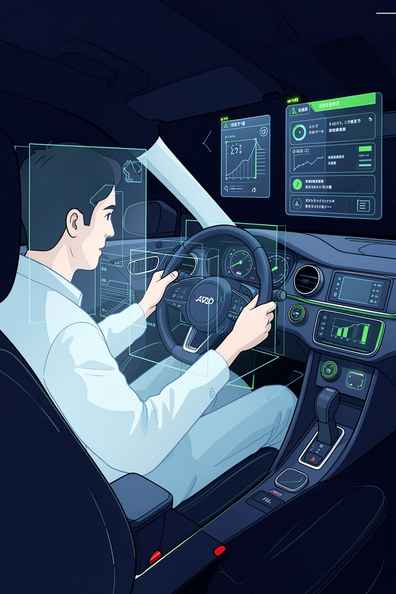
AI-Based Driver Drowsiness and Distraction Detection System Using Computer Vision
Mini Project
Student Name: [Student Name]
Roll Number: [Roll Number]
Department: B.Tech CSE (AI & ML)
College: [College Name]
Academic Year: 2024-2025

Slide 2
Introduction
Driver fatigue and distraction are critical road-safety concerns
Computer vision enables continuous, non-intrusive driver monitoring
The proposed system uses a webcam and AI/computer-vision techniques to identify unsafe driving conditions in real time
Combines facial landmark analysis, head-pose estimation, and object detection

Slide 3








Problem Statement
Driver Drowsiness
Fatigue Indicators
Prolonged eye closure and reduced alertness leading to impaired driving.
Visible signs like yawning or excessive blinking that signal driver fatigue.
Head Distraction
Excessive Head Movement
Driver's gaze or head orientation is directed away from the road for extended periods.
Frequent or jerky head movements (up/down, left/right) indicating inattention.
Mobile Phone Usage
Delayed Response
Detection of phone handling or interaction while the vehicle is in motion.
Slower than normal human reaction times to critical road events or hazards.

Slide 4
Objectives
01
02
Monitor driver behavior in real time using a webcam
Detect prolonged eye closure and drowsiness using Eye Aspect Ratio (EAR)
03
04
Detect yawning using Mouth Aspect Ratio (MAR)
Detect head movement and distraction using head-pose estimation
05
06
Detect mobile phone usage using YOLO11n object detection
Generate immediate voice alerts for unsafe conditions
07
08
Maintain comprehensive event history and logging
Calculate and display driver safety score

Slide 5

Proposed System Architecture
Webcam Input
Capture & Preprocess
Face Detection
Event Classification

Slide 6









Technologies Used
Python
OpenCV
MediaPipe Face Landmarker
Core programming language for the entire system
Real-time computer vision processing and dashboard rendering
Facial landmark detection and face mesh extraction
NumPy
YOLO11n
Ultralytics
Numerical computations for EAR, MAR, and head-pose calculations
Lightweight object detection for mobile phone detection
YOLO model framework and utilities
Pygame
Pyttsx3
CSV
Real-time dashboard and visualization interface
Text-to-speech voice alert generation
Event logging and data persistence

Slide 7
Drowsiness Detection Using Eye Aspect Ratio (EAR)
Methodology
MediaPipe Face Landmarker extracts 468 facial landmarks
Eye landmarks (6 points per eye) are identified
Eye Aspect Ratio (EAR) is calculated using vertical and horizontal eye distances
Formula
Where p1-p6 are the eye landmark coordinates
Detection Logic
Normal eye: EAR ≈ 0.3-0.4 (open)
Closed eye: EAR < 0.22 (threshold)
If EAR < 0.22 for ≥ 2.0 seconds → Drowsiness detected
Voice alert: "Wake up! Please keep your eyes open."

Slide 8
Yawning Detection Using Mouth Aspect Ratio (MAR)
Methodology
Mouth landmarks (20 points) are extracted from the face mesh
Mouth Aspect Ratio (MAR) is calculated using vertical and horizontal mouth distances
Yawning is detected when mouth opens significantly
Formula
Where p1-p8 are the mouth landmark coordinates
Detection Logic
Normal mouth: MAR ≈ 0.1-0.2 (closed)
Open mouth: MAR > 0.40 (threshold)
If MAR > 0.40 for ≥ 1.0 second → Yawning detected
Voice alert: "You appear tired. Please stay alert."

Slide 9
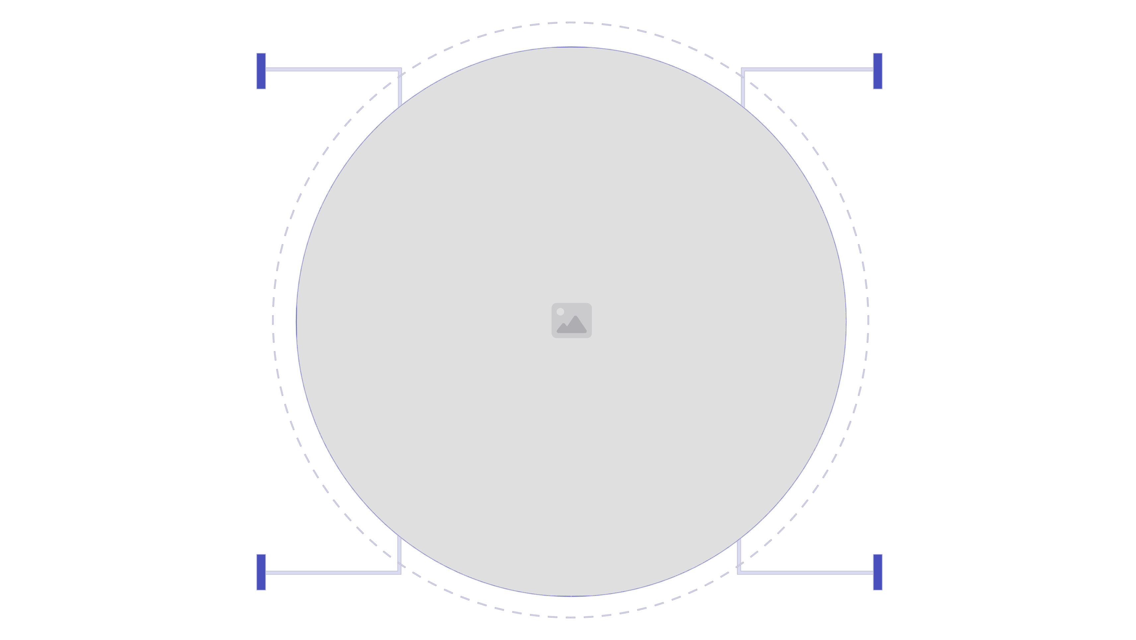
Head Pose and Distraction Detection
Methodology
Facial landmarks are used as 2D image points
A 3D face model (68-point or similar) is used as reference
OpenCV solvePnP estimates head orientation in 3D space
Yaw (left-right), Pitch (up-down), and Roll (tilt) angles are calculated
Head Pose Angles
Yaw: Horizontal head rotation (left/right)
Pitch: Vertical head rotation (up/down)
Roll: Head tilt (clockwise/counterclockwise)
Distraction Detection Thresholds
Yaw > 20° → Looking away from road (left/right)
Pitch > 15° → Looking up/down
Duration ≥ 2.0 seconds → Distraction detected
Voice alert: "Please keep your eyes on the road."
Visual representation of different head pose angles and their associated distraction levels:
FORWARD
LEFT
Green — neutral pose
Yellow — yaw left
RIGHT
UP
Yellow — yaw right
Red — pitch up

Slide 10
Mobile Phone Detection Using YOLO11n
Methodology
YOLO11n (You Only Look Once v11 nano) is used for real-time object detection
The model is pre-trained on COCO dataset with 80 object classes
The system specifically monitors for the "cell phone" class
Bounding boxes are drawn around detected phones
Detection Parameters
Model: YOLO11n (lightweight, real-time capable)
Confidence threshold: 0.50 (50% minimum confidence)
Detection duration: ≥ 1.5 seconds required for alert
Bounding box visualization: Red rectangle around detected phone
Alert Logic
If phone detected for ≥ 1.5 seconds → Phone usage detected
Voice alert: "Warning! Mobile phone detected. Please stop using your phone while driving."
Safety score penalty: -15 points

Slide 11





Alert and Event Management System
Detection Events and Voice Alerts
Drowsiness Detection
Voice Alert: "Wake up! Please keep your eyes open."
Yawning Detection
Voice Alert: "You appear tired. Please stay alert."
Distraction Detection
Voice Alert: "Please keep your eyes on the road."
Mobile Phone Detection
Voice Alert: "Warning! Mobile phone detected. Please stop using your phone while driving."
Event Processing Pipeline
Detect Event
Alert Generation
Update Score
Log Event
Event Logging Details
Date: YYYY-MM-DD
Time: HH:MM:SS
Event: Type of detection (Drowsiness, Yawning, Distraction, Phone)
Duration: How long the condition persisted (seconds)

Slide 12
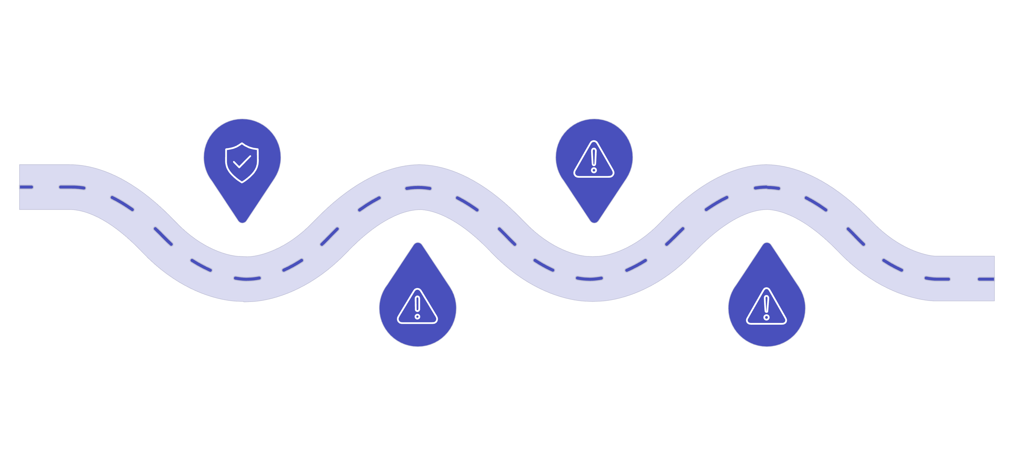
Safety Score System
Initial Score: 100 points
Penalty Structure:
Event Type | Penalty Points
Drowsiness | -15 points
Yawning | -5 points
Distraction | -10 points
Mobile Phone Usage | -15 points
Safety Status Classification:
Score Range | Status | Color
80–100 | SAFE | Green
60–79 | MODERATE | Yellow
40–59 | WARNING | Orange
0–39 | HIGH RISK | Red
This is the project's implemented scoring mechanism. It is not a medically or scientifically validated risk assessment tool. The score provides a relative measure of driver behavior during the monitoring session.
SAFE
WARNING
80–100 score
40–59 score
MODERATE
HIGH RISK
60–79 score
0–39 score

Slide 13
Real-Time System Dashboard
The OpenCV-based dashboard displays the following information in real time:
Driver Status Indicators:
  Current driver state (ALERT, DROWSY, YAWNING, DISTRACTED, PHONE_DETECTED)
  Real-time video feed with facial landmarks overlay
  Eye Aspect Ratio (EAR) value and status
  Mouth Aspect Ratio (MAR) value and status
Head Pose Information:
  Yaw angle (degrees)
  Pitch angle (degrees)
  Roll angle (degrees)
  Head direction indicator (FORWARD, LEFT, RIGHT, UP, DOWN)
Detection Counters:
  Drowsiness count
  Yawning count
  Distraction count
  Phone detection count
Safety Metrics:
  Current safety score (0-100)
  Safety status (SAFE, MODERATE, WARNING, HIGH RISK)
  Status color indicator (green, yellow, orange, red)
Phone Detection Status:
  Phone detected: Yes/No
  Confidence score (0-100%)
  Bounding box visualization

Slide 14
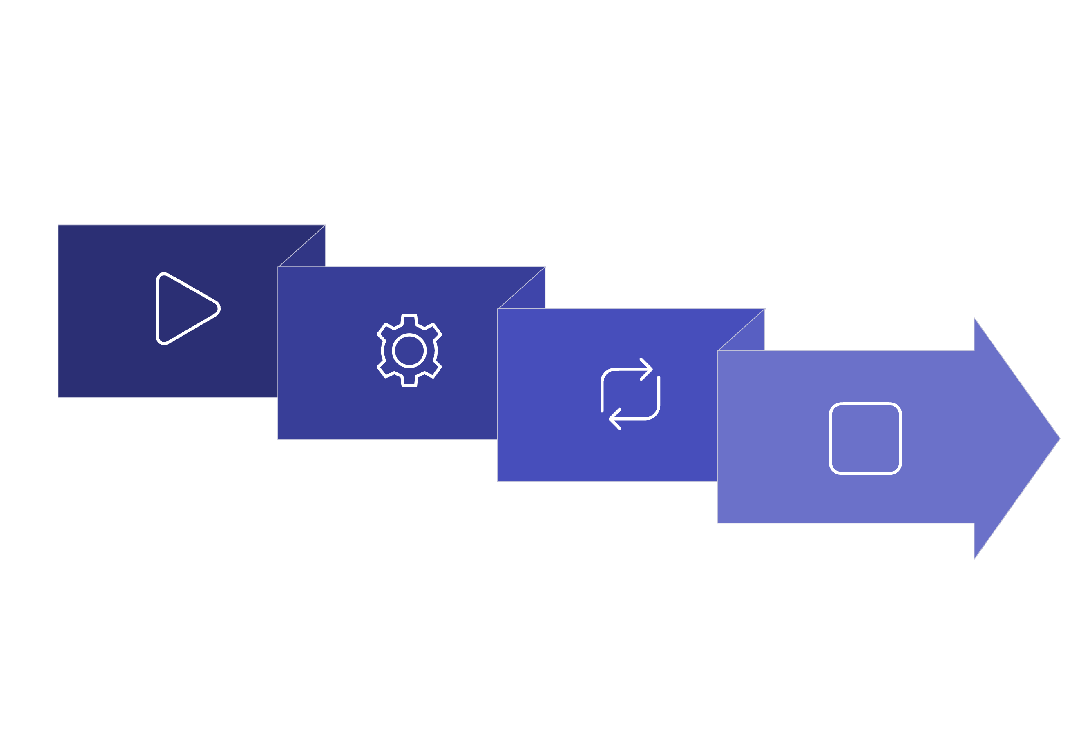
Complete Working Flow
This flowchart illustrates the end-to-end execution of the driver monitoring system, from initialization to real-time event processing and user feedback.
Initialize Models
STOP
START → Init
MAIN LOOP

Slide 15
















Conclusion and Future Scope
Conclusion
The system provides real-time, non-intrusive monitoring of driver behavior using computer vision
It combines multiple AI/ML techniques: facial landmark analysis, head-pose estimation, and object detection
Detects four critical unsafe driving conditions: drowsiness, yawning, distraction, and mobile phone usage
Provides immediate voice alerts to warn the driver of unsafe conditions
Maintains a comprehensive event history with timestamps and durations
Displays a real-time safety dashboard with driver status and safety score
Demonstrates practical application of MediaPipe, OpenCV, and YOLO in automotive safety
Future Scope and Enhancements
Infrared/night-time monitoring for low-light driving conditions
Improved robustness under varying lighting conditions and camera angles
Driver-specific calibration for personalized threshold adjustment
Advanced temporal deep-learning models (LSTM, Transformer) for better context awareness
Integration with vehicle CAN bus systems for automated safety responses
Cloud-based monitoring and analytics for fleet management
GPS/location-based emergency notification to nearby authorities
Evaluation on larger-scale public datasets (e.g., NTHU-DDD, Columbia Gaze Tracking)
Multi-modal sensor fusion (thermal, radar) for enhanced detection

