Slide 1




Team Details
Team Name : Maxipedia
Leader Name : Tejas Rana
Domain Chosen : AI/ML
Problem Statement : Multimodal Synthetic-Media Forensics & Provenance Reasoning

Slide 2


Problem Analysis
Typical detector
An investigator must know
Media file
Single classifier
“Fake, 92%”
What evidence suggests manipulation?
Where do the inconsistencies occur?
How was the media processed?
Can its claimed origin be trusted?
No evidence · no location in the media · no origin trail
Partial manipulation that a binary label cannot describe
Voice swap
Genuine footage carrying a synthetic voice
Region replaced
Edited or blended face / object region
Timestamps altered
Creation and modification times conflict
Re-encoded copies
Several generations of compression and editing
Core challenge
Hard constraint
24-hour prototype
Treat media as a web of interconnected evidence — visual, audio, metadata and provenance — instead of a binary classification.
No reliance on an external deepfake API or fake-or-real classifier as the decision-maker; pretrained models may only be one evidence source.
Working vertical slice: ingestion → forensic analysis → evidence correlation → timeline → provenance → investigator review.

Slide 3
Proposed Solution & Key Features
Evidence pipeline: independent checks feed one fusion step
5 parallel checks
Media ingestion
SHA-256
Visual
Findings store
one finding schema for every check
Evidence fusion
group · weigh · supports vs contradicts
Final assessment
Likely manipulated
Likely authentic
Inconclusive
Audio
Audio-video sync
Metadata
Provenance
Key features
One schema, one finding per piece of evidence
Evidence, not a label: one finding per check, tied to a frame, region or time range
Five independent layers: visual, audio, A/V sync, metadata, provenance
Uncertainty-aware fusion that can answer “inconclusive”
Counterfactual toggle: remove evidence, watch the verdict change
Adaptive analysis: cheap screening, deep checks only where flagged
Visual
Face region shows blending artifacts in frames 120–145
Audio
Synthetic-speech indicators (e.g.=between 00:08 and 00:12)
Sync
Lip movement and audio inconsistent in an interval
Metadata
Encoder tags consistent with a later re-export
Provenance
SHA-256 match / mismatch, changed Merkle segments

Slide 4
Technical approach & Innovation
Adaptive analysis: cheap screening decides where expensive checks run
Ingest budget
cap length · make a proxy
Screening
low-res suspicion curve
Scheduler
top-K intervals · pad · merge
Deep checks
full resolution · flagged only
Live timeline
curve first · deep fills in
investigator clicks “Analyze deeper here”
Always on the whole file: SHA-256, Merkle tree, metadata
Technology stack
Approach
Innovation / USP
Media: ffmpeg, ffprobe, exiftool, c2patool
Vision: OpenCV, MediaPipe Face Mesh
Audio: spectrograms, AASIST (optional)
Provenance: SHA-256, Ed25519
Delivery: web investigator workspace
Every check emits the same finding schema
Only fusion weighs evidence: supports vs contradicts
Per-check reliability weights and an explicit abstain state
Merkle tree shows exactly which segment changed
LLM wording only from structured evidence
An evidence graph, not “Fake, 92%”
No external classifier as decision-maker
Honest “inconclusive” with coverage and limits
Counterfactual toggle and attack mode prove the reasoning
Signed, hash-chained chain of custody

Slide 5
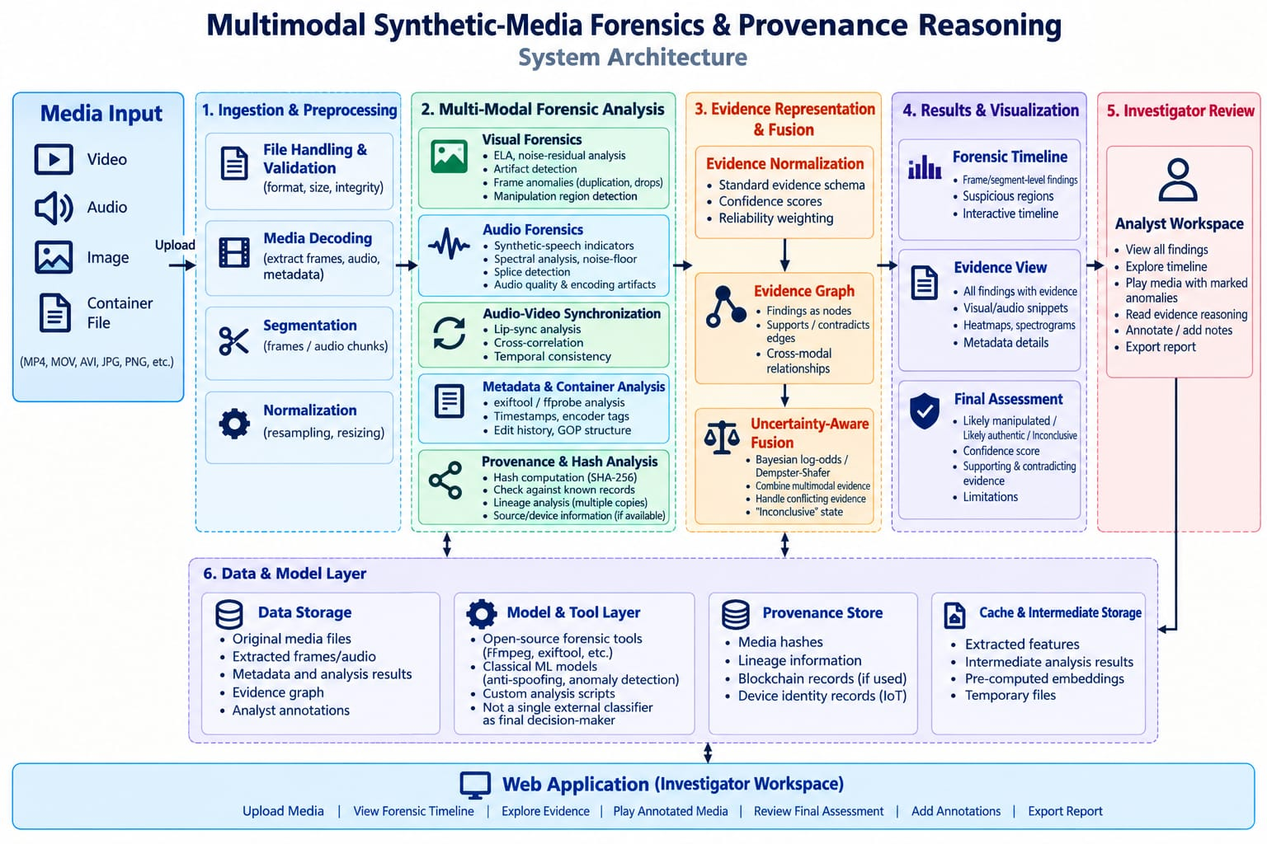
System Architecture

Slide 6
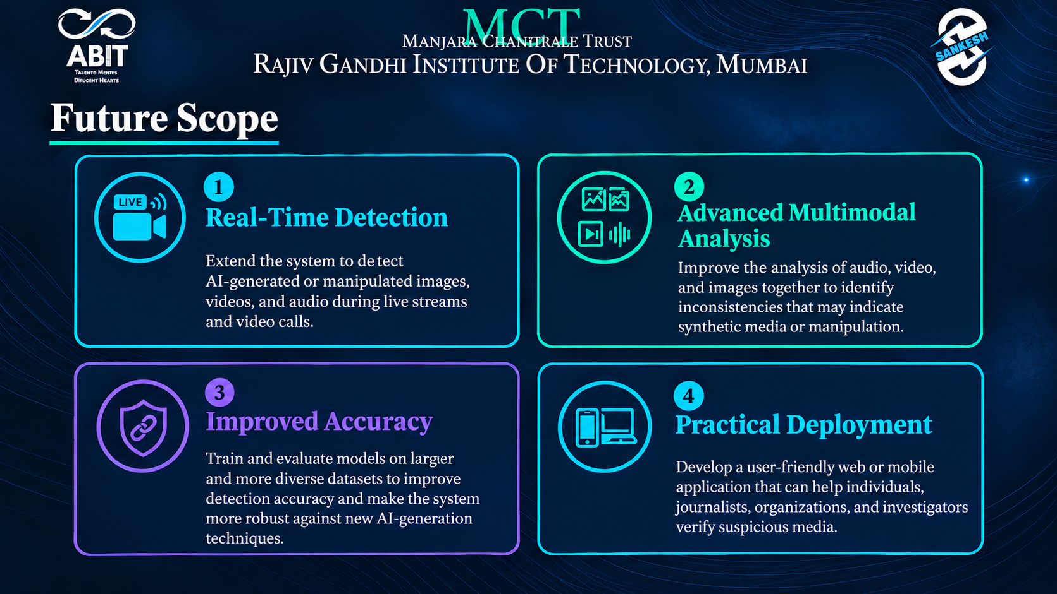
Impact & Future Scope
Convergence
Impact
Cybersecurity + Blockchain
Anchor media hash and provenance records
Threat intelligence
Known hashes, previous versions (optional)
Users: digital forensic investigators, fraud and security teams, newsrooms
Turns “Fake, 92%” into evidence an investigator can inspect and challenge
Catches partial manipulation: cloned voice, replaced region, edited metadata
Tamper-evident chain of custody builds trust in the report
Practical on longer, high-resolution files through adaptive screening
CodeAstra 2.0
Media Forensics Platform
Future scope
Near term
Attack mode: re-compress, resize, add noise
Results table on the test set
Mid term
Capture-device signing (phone or ESP32)
Blockchain anchoring on a testnet
Extended
Speaker-embedding consistency check
Multi-copy lineage view
IoT capture identity
Trusted device signs the hash at capture
Web application
Investigator workspace and report export

