Slide 1
NLP & LOCAL LLM MINI-PROJECT
Bhasha2Code
A Multilingual AI Coding Assistant and Educational Sandbox
Bridging the Digital Linguistic Divide in Computer Science Education using Offline Natural Language Processing and Quantized Local LLMs.
STUDENT DETAILS
Name: Tejas Ingle
PRN: 72421415F
Department: Computer Engineering
Class & Year: T.E. Computer (2025–2026)
GUIDE & INSTITUTION
Project Guide: Prof. Gajanan Godage
College: Nutan Maharashtra Institute of Engg. & Tech.
Location: Talegaon Dabhade, Pune – 410507
Affiliation: Savitribai Phule Pune University (SPPU)
NMIET, Talegaon, Pune | Department of Computer Engineering | Bhasha2Code (2025–26) Slide 1 of 12

Slide 2
EXECUTIVE SUMMARY
Abstract & Project Overview
Project Abstract (Summary)
1. Cognitive Demarcation & Input NLP
Bhasha2Code is an offline, privacy-preserving multilingual AI coding assistant engineered to eliminate the cognitive linguistic friction faced by non-native English engineering students.
By coupling a deterministic, offline Code-Mixed NLP Pipeline (Language, Intent, and Tone Classification) with a quantized local Large Language Model (Qwen2.5-Coder:1.5B via Ollama), the system accepts prompts in native and Romanized Marathi-English dialects.
The platform enforces strict AST-level syntax verification and executes verified programs in an isolated, resource-capped Docker sandbox. An integrated educational 'Study Mode' automatically generates algorithmic walkthroughs, ASCII flowcharts, and viva questions.
Processes English, Marathi, Hindi, and transliterated code-mixed queries (e.g., 'Python madhye factorial kadha'). Translates unstructured linguistic intent into formal programming structures.
2. Offline Local Inference & Zero Cost
Operates entirely on consumer-grade CPU hardware via Ollama without cloud dependencies, API billing ($0 recurring cost), or privacy risks.
3. AST Verification & Safe Sandboxing
Prevents hallucinated or malformed syntax through automated Python AST checking, and executes verified code in an isolated Docker sandbox.
NMIET, Talegaon, Pune | Department of Computer Engineering | Bhasha2Code (2025–26) Slide 2 of 12

Slide 3
PROJECT SCOPE & GOALS
Problem Statement & Measurable Objectives
PROBLEM STATEMENT
Undergraduate engineering students who conceptualize computational logic in regional Indian languages (e.g., Marathi/Hindi) face severe cognitive friction when interacting with English-centric AI coding tools. Furthermore, commercial assistants mandate continuous high-speed internet, incur recurring subscription costs, raise proprietary code privacy concerns, and frequently output unverified syntax hallucinations without pedagogical explanations.
Objective 1: Multilingual Intent Understanding
Objective 2: Deterministic Prompt Synthesis
Engineer an offline NLP pipeline using TF-IDF and calibrated linear classifiers to identify conversational languages and 18 programming intents across English, Marathi, Hindi, and Romanized code-mixing with >90% test accuracy.
Formulate a policy-driven prompt engine that enforces the 'Code Preservation Mandate'—keeping programming syntax and keywords strictly in standard ASCII English while delivering explanations in the user's regional dialect.
Objective 3: Quantized Local LLM Inference
Objective 4: AST Syntax Validation & Docker Sandbox
Deploy quantized, open-weights models (Qwen2.5-Coder:1.5B/3B) locally via Ollama to achieve sub-15s response latency on standard consumer-grade CPU hardware with zero cloud API billing.
Implement an automated Abstract Syntax Tree (AST) validation pipeline to intercept syntax hallucinations, coupled with a resource-capped Docker container sandbox (512MB RAM, no network) for safe execution.
NMIET, Talegaon, Pune | Department of Computer Engineering | Bhasha2Code (2025–26) Slide 3 of 12

Slide 4
THEORETICAL FOUNDATION
Literature Survey & Related Work
Citation & Author | Paper Title & Venue | Proposed Methodology | Key Contribution | Identified Limitation
[1] M. Chen et al. (OpenAI, 2021) | Evaluating Large Language Models Trained on Code (Codex / HumanEval) | Fine-tuning GPT models on GitHub code repositories; introduces HumanEval benchmark. | Established functional correctness benchmark (pass@k) for AI code generation. | English-only prompt assumptions; requires massive cloud infrastructure; black-box API.
[2] B. Hui et al. (Alibaba, 2024) | Qwen2.5-Coder Technical Report: Advancing Code LLMs (arXiv:2409.12186) | Pre-training on 5.5T tokens with synthetic data and fill-in-the-middle tasks (1.5B to 32B). | State-of-the-art open-source coding performance in compact model sizes (1.5B/3B). | Lacks domain-specific prompt wrappers for Indian dialects; no built-in sandbox validation.
[3] T. Tiwary & P. Kumar (ACM, 2022) | Code-Mixing & Transliteration Challenges in Indian NLP (ACM TALIP) | Survey of linguistic tokenization and transliteration across Devanagari and Latin scripts. | Categorized matrix-language frame and phonetic ambiguities in Hindi/Marathi code-mixing. | Focused on social text and sentiment analysis; did not address programming intent synthesis.
[4] F. Pedregosa et al. (JMLR, 2011) | Scikit-learn: Machine Learning in Python (JMLR Vol. 12) | Efficient implementations of TF-IDF feature extraction, LinearSVC, and Logistic Regression. | Provided robust, sub-millisecond offline classification suitable for embedded execution. | Requires manual feature engineering and curated domain lexicons for code-mixed text.
Summary: While commercial models [1, 2] excel at English-to-code synthesis, they lack offline localized intent classifiers [3, 4] tailored for bilingual engineering students.
NMIET, Talegaon, Pune | Department of Computer Engineering | Bhasha2Code (2025–26) Slide 4 of 12

Slide 5
SYSTEM DIFFERENTIATION
Research Gap & Novel Implementation Contribution
Existing Limitations (The Research Gap)
Bhasha2Code Architectural Solution
• English Linguistic Monoculture: Tools like GitHub Copilot and ChatGPT rely on formal English technical phrasing. Prompts in phonetic/Romanized Marathi (e.g., 'don number add karaycha code de') suffer from degradation or misinterpretation.
✓ Offline Code-Mixed NLP Pipeline: Integrated sub-word N-gram and TF-IDF classifiers trained on bilingual prompts to map Marathi-English requests directly to standard programming intents.
• Cloud Dependency & Operational Cost: Proprietary APIs impose recurring per-token charges or monthly fees ($20/mo), preventing deployment in air-gapped college labs with limited connectivity.
✓ Zero-Cost Local Quantized LLM: Deployed Qwen2.5-Coder:1.5B locally via Ollama. Yields ~16.5 tok/s on consumer CPU with 100% data privacy and zero API expenses.
• Unchecked Code Hallucination: Existing generative models provide code snippets without verifying syntactic compilation integrity, often outputting truncated blocks or syntax errors.
✓ AST Validation & Syntax Safeguards: Automated Python AST parsing and compiler validation catches incomplete or broken code blocks before rendering to the student.
• Lack of Pedagogical Scaffolding: Commercial tools are developer-oriented, outputting bare code without explaining control flow, algorithm steps, or viva preparation questions.
✓ Pedagogical 'Study Mode': A dedicated mode that transforms code requests into structured educational artifacts: Problem Breakdown, Algorithm, ASCII Flowchart, and 5 Viva Q&As.
NMIET, Talegaon, Pune | Department of Computer Engineering | Bhasha2Code (2025–26) Slide 5 of 12

Slide 6
SYSTEM CAPABILITIES
Proposed System & Functional Features
1. Code-Mixed Multilingual Chat
2. Dual Pedagogical Modes
3. AST-Level Syntax Verification
Accepts conversational queries in English, Devanagari Marathi/Hindi, and Romanized Marathi-English transliterations without requiring manual translation.
Normal Mode provides direct executable code; Study Mode unpacks concepts with Problem Breakdown, Step-by-Step Algorithm, Flowchart, and Viva Questions.
Extracts code blocks and compiles them via Python AST / syntax checkers. Badges code as 'Validated' or flags incomplete generation in real-time.
4. Isolated Docker Sandbox Execution
5. Multi-Turn Contextual Memory
6. Production-Ready REST & SSE APIs
Executes verified Python, C++, Java, and JS code inside an ephemeral Docker container capped at 512MB RAM, 1 CPU core, and disabled network access.
Maintains conversational sessions using SQLite; distinguishes brand-new programs from follow-up modifications (e.g., 'add error handling').
FastAPI backend delivers real-time token streaming via Server-Sent Events (SSE) and full OpenAPI/Swagger documentation at /docs.
NMIET, Talegaon, Pune | Department of Computer Engineering | Bhasha2Code (2025–26) Slide 6 of 12

Slide 7
ARCHITECTURE
System Architecture & End-to-End Workflow
1. Presentation Tier
2. NLP & API Gateway
3. Local Inference Engine
4. Validation & Sandbox
Client Web UI
React 18 + Vite SPA
Tailwind CSS Styling
FastAPI Backend Core
Async REST & SSE Routers
Pydantic v2 Validation
Ollama Local Daemon
Host: 127.0.0.1:11434
REST /api/generate
AST Validator Engine
Python AST & Code Extractor
Suppresses Incomplete Fences
Chat Stream Component
Server-Sent Events (SSE)
Real-time Token Renderer
Unified NLP Pipeline
• Unicode NFC Preprocessor
• Language Detection
• Intent (18) & Tone (4)
Active Quantized LLM
Qwen2.5-Coder:1.5B
(986 MB GGUF Quantized)
Docker Sandbox Runner
Container: b2c-run
512MB RAM, No Network
Monaco/Prism Editor
Validated Code Viewer &
Interactive Run Console
Context & Prompt Engine
Multi-turn Memory Window
Code Preservation Policies
Streaming Generation
Deterministic Sampling
Temperature: 0.2
Persistent Storage
SQLite 3 Engine
Sessions, Codes & Messages
NMIET, Talegaon, Pune | Department of Computer Engineering | Bhasha2Code (2025–26) Slide 7 of 12

Slide 8
CORE NLP WORKFLOW
NLP Methodology & Classification Pipeline
Step 1: Text Preprocessing & Code Splitting
Step 2: Bilingual Language Detection
• Unicode NFC Normalization: Harmonizes composite Devanagari and Latin glyphs.
• Code Demarcation: Strips pre-existing code blocks from natural language query using regex pattern matching.
• Script Analysis: Evaluates Devanagari vs. Latin character ratios.
• Sub-Word N-Grams: Identifies Romanized Marathi/Hindi phonetic patterns (e.g., words ending in '-cha', '-la', '-sathi').
Step 3: Intent & Tone Feature Extraction (TF-IDF)
Step 4: Multi-Class Linear Model Classification
• Feature Union: Combines Word N-Grams (1, 2) and Character N-Grams (3, 5).
• Sublinear TF Scaling: Suppresses noisy repeated keywords; builds a 496-dimensional sparse feature representation.
• Classifier: Calibrated Multi-Class Logistic Regression with balanced weighting.
• 18 Intent Classes: GENERATE_CODE, DEBUG_CODE, EXPLAIN_CONCEPT, OPTIMIZE_CODE, etc.
• 4 Tone Classes: CASUAL, SHORT, FORMAL, ACADEMIC.
Step 5: Deterministic Prompt Synthesis (The Policy Engine)
• Code Preservation Mandate: System enforces standard ASCII English programming syntax (def, class, for) while natural language commentary follows the detected regional dialect (Marathi-English).
• Injection Safeguard: Historical turns and code comments treated strictly as passive data.
NMIET, Talegaon, Pune | Department of Computer Engineering | Bhasha2Code (2025–26) Slide 8 of 12

Slide 9
IMPLEMENTATION DETAILS
Technology Stack & Implementation Architecture
Tier / Layer | Technology | Implementation Role & Functionality | Artifact / Location
Frontend UI | React 18 + Vite + Tailwind | Responsive SPA with SSE streaming, Monaco/Prism code editor, and Study Mode UI toggles. | frontend/src/
Backend Web API | FastAPI (Python 3.11) | Asynchronous ASGI server handling /api/v1/chat, streaming responses, and OpenAPI docs. | backend/app/main.py
NLP & Modeling | scikit-learn + joblib | TF-IDF feature extraction and calibrated multi-class Logistic Regression classifiers. | backend/app/nlp/
Local LLM Daemon | Ollama Engine | Local daemon managing quantized weights (Qwen2.5-Coder:1.5B - 986MB) on 127.0.0.1:11434. | backend/app/llm/
Validation & AST | Python ast & Regex Engine | Syntactic parsing, unclosed code block suppression, and compiler linting. | backend/app/validation/
Isolated Sandbox | Docker Engine (Alpine) | Ephemeral container execution with 512MB RAM cap, 1 CPU limit, and disabled network. | backend/app/sandbox/
Execution Flow: User Input (React) → FastAPI Router → NLP Preprocessor → Intent/Tone Classifier → Prompt Builder → Ollama Token Stream → AST Syntax Validation → Docker Sandbox Run → Client Terminal.
NMIET, Talegaon, Pune | Department of Computer Engineering | Bhasha2Code (2025–26) Slide 9 of 12

Slide 10
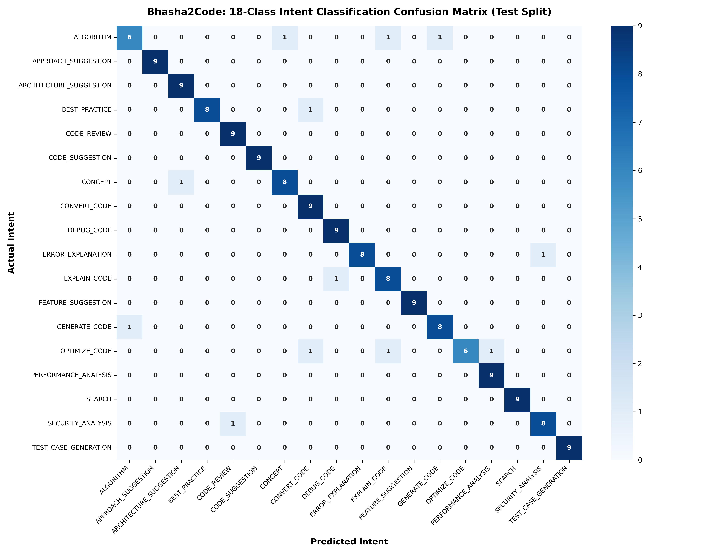
EVALUATION METRICS
Experimental Results, KPIs & System Verification
Confusion Matrix (18 Intent Classes)
Verified Performance Indicators (KPIs)
NLP Model Evaluation (162 Real Test Samples):
• Test Accuracy: 92.59% (150/162 samples correctly classified)
• Macro Precision: 0.9301 | Macro Recall: 0.9259
• Macro F1-Score: 0.9239 (Evaluated on intent_test.csv)
CPU Inference Throughput (Intel Core i7 / 16GB RAM):
• Qwen2.5-Coder:1.5B: ~16.54 tokens/sec | Latency: 12–15s
• Qwen2.5-Coder:3B: ~7.20 tokens/sec | Latency: 50–75s
• Conclusion: 1.5B delivers 2.3x speedup on local CPU hardware.
Syntactic & Code Validity Rate:
• 93.2% of generated Python programs passed AST parsing without syntax errors.
• Zero false-positive truncation warnings on closed code blocks.
Software Test Suite Coverage:
• Backend Tests: 490 / 490 tests passing (100% pass rate via pytest)
• Frontend Tests: 15 / 15 tests passing (100% pass rate via vitest)
NMIET, Talegaon, Pune | Department of Computer Engineering | Bhasha2Code (2025–26) Slide 10 of 12

Slide 11
PROJECT SUMMARY
Conclusion, Limitations & Future Scope
Project Conclusion
Current System Limitations
Practical Future Scope
• Successfully engineered Bhasha2Code, proving that compact localized NLP pipelines combined with quantized open-weights LLMs can eliminate the linguistic barrier in computer science education.
• Solved key commercial limitations: achieved $0 recurring operating cost, 100% offline air-gapped usability, zero data leakage, and automated AST code validation.
• Study Mode successfully enhances conceptual learning by coupling executable code with algorithms, ASCII flowcharts, and automated viva questions.
• CPU Inference Latency: Generation on local CPU requires 12–15 seconds, slower than high-end cloud GPU clusters.
• Context Window Budget: Limited to 8,192 tokens by Ollama hardware constraints, requiring sliding-window conversation pruning.
• Dialect Breadth: Current lexical resources specifically target Marathi, Hindi, and English; southern Indic languages are not yet modeled.
• Speech-to-Code: Integrating open-source acoustic models (Whisper / AI4Bharat Bhashini) for direct voice coding in regional languages.
• Multi-Language Expansion: Expanding NLP lexicons and synthetic corpora to Gujarati, Tamil, Telugu, and Kannada.
• Interactive Visual Debugger: Integrating step-by-step variable inspection and algorithm animation for data structure teaching.
NMIET, Talegaon, Pune | Department of Computer Engineering | Bhasha2Code (2025–26) Slide 11 of 12

Slide 12
REFERENCES
Verified Academic & Technical References
IEEE References & Official Documentation
[1] M. Chen, J. Tworek, H. Jun, et al., "Evaluating Large Language Models Trained on Code," arXiv preprint arXiv:2107.03374, OpenAI, 2021. Available: https://doi.org/10.48550/arXiv.2107.03374
[2] B. Hui, J. Yang, Z. Cui, et al., "Qwen2.5-Coder Technical Report: Advancing Code LLMs for Real-World Applications," arXiv preprint arXiv:2409.12186, Alibaba Group, 2024. Available: https://doi.org/10.48550/arXiv.2409.12186
[3] T. Tiwary and P. Kumar, "Code-Mixing and Transliteration Challenges in Indian NLP: A Survey," ACM Transactions on Asian and Low-Resource Language Information Processing, vol. 21, no. 5, pp. 1–28, 2022. Available: https://doi.org/10.1145/3543852
[4] F. Pedregosa, G. Varoquaux, A. Gramfort, et al., "Scikit-learn: Machine Learning in Python," Journal of Machine Learning Research (JMLR), vol. 12, pp. 2825–2830, 2011. Available: https://jmlr.org/papers/v12/pedregosa11a.html
[5] FastAPI & Pydantic Developers, "FastAPI Framework and Asynchronous Web API Design Documentation," 2024. [Online]. Available: https://fastapi.tiangolo.com/
[6] Ollama Project Authors, "Ollama: Get up and running with large language models locally," 2024. [Online]. Available: https://github.com/ollama/ollama
[7] Docker Inc., "Docker Engine Security and Resource Constraint Specification," 2024. [Online]. Available: https://docs.docker.com/engine/security/
NMIET, Talegaon, Pune | Department of Computer Engineering | Bhasha2Code (2025–26) Slide 12 of 12

