Slide 1

COEP Technological University, Pune
Department of Computer Science and Engineering
Intelligent AIOps Framework for Predictive CI/CD Pipeline Management and Autonomous Resource Optimization
M.Tech Dissertation
Tejas Annasaheb Jagtap
M.Tech (Information Security) • MIS: 712442021
Guide: Dr. V. K. Pachghare
Department of Computer Science and Engineering | COEP Technological University, Pune
1

Slide 2
Contents
1. Introduction & Motivation
2. Literature Survey & Research Gap
3. Problem Statement & Objectives
4. Proposed System Architecture
5. Methodology: Data & the Three ML Models
6. Evaluation Results (XGBoost, Autoencoder, LSTM)
7. System Integration: FastAPI Orchestrator
8. Predictive Autoscaler & Decision Algorithm
9. Comparison with Related Work
10. Conclusion, Future Scope & Publications
Department of Computer Science and Engineering | COEP Technological University, Pune
Department of Computer Science and Engineering | COEP Technological University, Pune
2
2

Slide 3
Introduction
▪ Modern software delivery depends on CI/CD pipelines (Jenkins) and container orchestration with Kubernetes.
▪ These systems generate large volumes of build logs and infrastructure metrics every day.
▪ Traditional monitoring is reactive - it responds only after a failure or overload has already occurred:
  – Build failures are discovered only after the build runs and wastes compute.
  – Log issues are found by manually reading thousands of log lines.
  – Kubernetes HPA adds pods only after CPU has already crossed a threshold.
AIOps (AI for IT Operations): apply Machine Learning to make these operations predictive and self-optimizing.
Department of Computer Science and Engineering | COEP Technological University, Pune
3

Slide 4
Motivation
▪ Frequent build failures cause deployment delays and wasted compute.
▪ Manual root-cause analysis of logs is slow, tedious and error-prone.
▪ Reactive autoscaling introduces scaling lag - over-provisioning (cost) or degradation (SLA breach).
▪ Need: one self-learning framework that:
  – Predicts build failures early from historical build patterns.
  – Detects log anomalies automatically, in real time.
  – Forecasts resource demand and scales proactively.
  – Closes the loop predictions drive automatic Kubernetes actions.
Prior research treats these as three separate problems - no unified, closed-loop system exists.
Department of Computer Science and Engineering | COEP Technological University, Pune
4

Slide 5
Literature Survey
Sr. | Paper | Work Done | Limitation
1 | ML-Based Autoscaling for Cloud Resource Orchestration (J. Grid Computing, 2024) | Compares ML models for predicting cluster load for autoscaling. | Autoscaling only; no CI/CD or log integration.
2 | Time-series K8s Autoscaling using Prophet + LSTM (Frontiers in CS, 2025) | Hybrid Prophet + LSTM forecast for proactive scaling. | No CI/CD signals or log anomalies; scaling in isolation.
3 | Deep Learning for Multivariate Time-Series Anomaly Detection (AI Review, 2025) | Survey of autoencoders / VAEs for anomaly detection. | Survey only; no concrete DevOps application.
Department of Computer Science and Engineering | COEP Technological University, Pune
5

Slide 6
Literature Survey (contd.)
Sr. | Paper | Work Done | Limitation
4 | Towards Optimization of Anomaly Detection in DevOps (IST, 2023) | Evaluates anomaly-detection techniques for DevOps monitoring. | Runtime anomalies only; no CI/CD build prediction.
5 | AI-Enhanced Platform Engineering for CI/CD (2025) | Proposes AI integration for CI/CD optimization. | Conceptual —-no trained models, no validation.
6 | Predictive Failure Analysis in CI Pipelines using Ensemble Trees (IJACS, 2025) | Ensemble tree models for CI build-failure prediction. | Limited dataset; no anomaly detection or scaling.
7 | Agentic AIOps: From Reactive to Autonomous Operations (2025) | Framework for closed-loop / autonomous AIOps. | Conceptual closed loop; no concrete models shipped.
Department of Computer Science and Engineering | COEP Technological University, Pune
6

Slide 7
Research Gap
▪ Existing studies address each problem in isolation:
  – Build-failure prediction, or
  – Log anomaly detection, or
  – Predictive autoscaling.
▪ No single framework unifies all three signal types.
▪ Reactive Kubernetes HPA still dominates - predictive scaling is rare in practice.
▪ Very few works build a true closed loop: prediction → decision → automatic Kubernetes action → feedback.
Gap: an integrated, closed-loop AIOps framework linking Jenkins → ML → Kubernetes in one loop.
Department of Computer Science and Engineering | COEP Technological University, Pune
7

Slide 8
Problem Statement
“To design and implement an intelligent, closed-loop AIOps framework that proactively predicts CI/CD pipeline failures, detects anomalies in Jenkins logs in real time, forecasts infrastructure workload, and autonomously optimizes Kubernetes resources through predictive autoscaling.”
Department of Computer Science and Engineering | COEP Technological University, Pune
8

Slide 9
Research Objectives
1. Develop a data-collection framework for CI/CD build data and cluster metrics. ✓
2. Build ML models for failure prediction, log anomaly detection and CPU forecasting. ✓
3. Implement a FastAPI-based AIOps orchestrator serving all models via unified APIs. ✓
4. Design a predictive autoscaling engine for Kubernetes driven by ML outputs. ✓
Department of Computer Science and Engineering | COEP Technological University, Pune
9

Slide 10
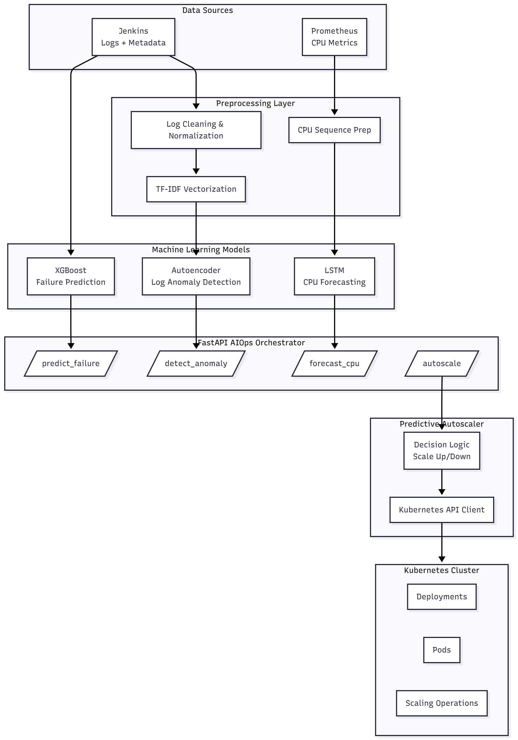
Proposed System Architecture
▪ Closed-loop pipeline with four layers:
▪ 1. Data Collectors
  – Jenkins REST API → build metadata + console logs.
  – Prometheus HTTP API → CPU / memory metrics.
▪ 2. ML Layer — three models:
  – XGBoost → build-failure prediction.
  – TF-IDF + Autoencoder → log anomaly detection.
  – LSTM → CPU workload forecasting.
▪ 3. AIOps Orchestrator (FastAPI) — loads all models, exposes REST endpoints.
▪ 4. Predictive Autoscaler — decision engine → Kubernetes Python client.
▪ Scaling actions change cluster state → new metrics feed back into the next cycle.
Department of Computer Science and Engineering | COEP Technological University, Pune
10

Slide 11
Methodology: Data Pipeline & Collection
Synthetic training dataset
Live data-collection infrastructure
▪ 600 Jenkins builds — 68% SUCCESS, 23% FAILURE, 9% UNSTABLE.
▪ 600 console logs with class-distinctive vocabulary.
▪ 10,080 CPU points — daily / weekly patterns + noise + spikes.
▪ Reproducible, with labelled ground truth for evaluation.
▪ Jenkins REST collector — build metadata + console logs.
▪ Prometheus collector — CPU / memory queries.
▪ Real-time streaming collector with configurable interval.
▪ Same pipeline works against real Jenkins / Prometheus instances.
Department of Computer Science and Engineering | COEP Technological University, Pune
11

Slide 12
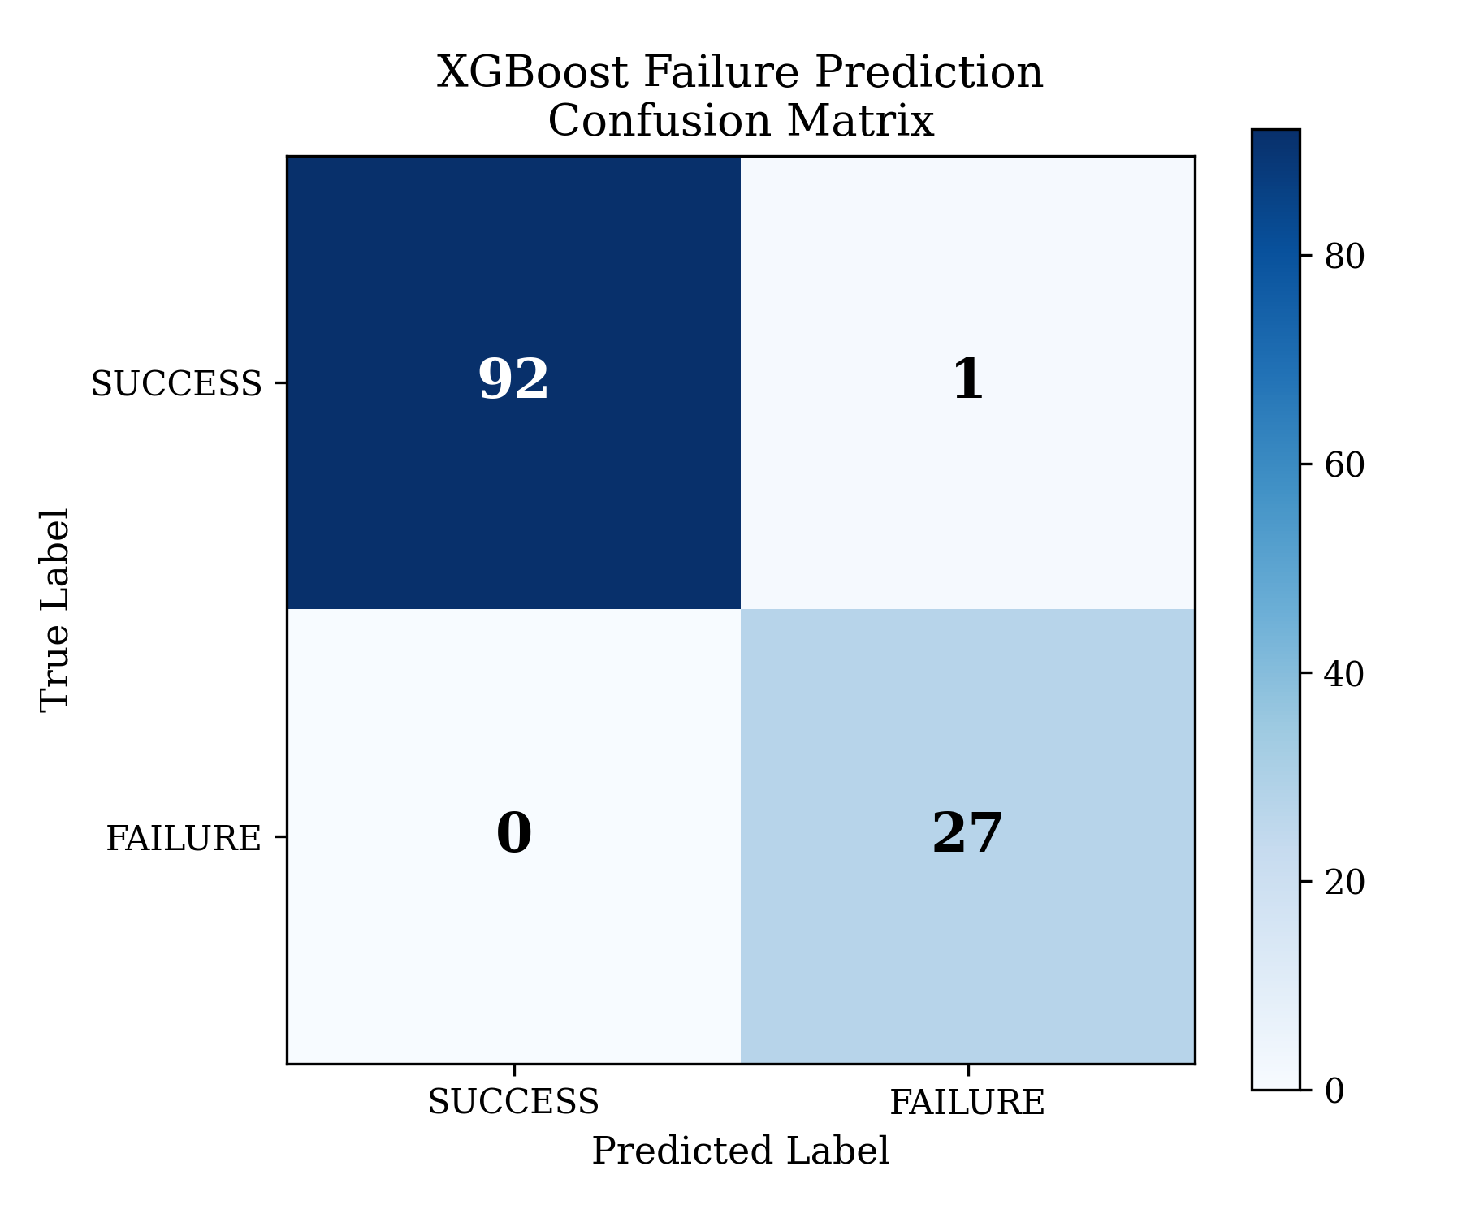
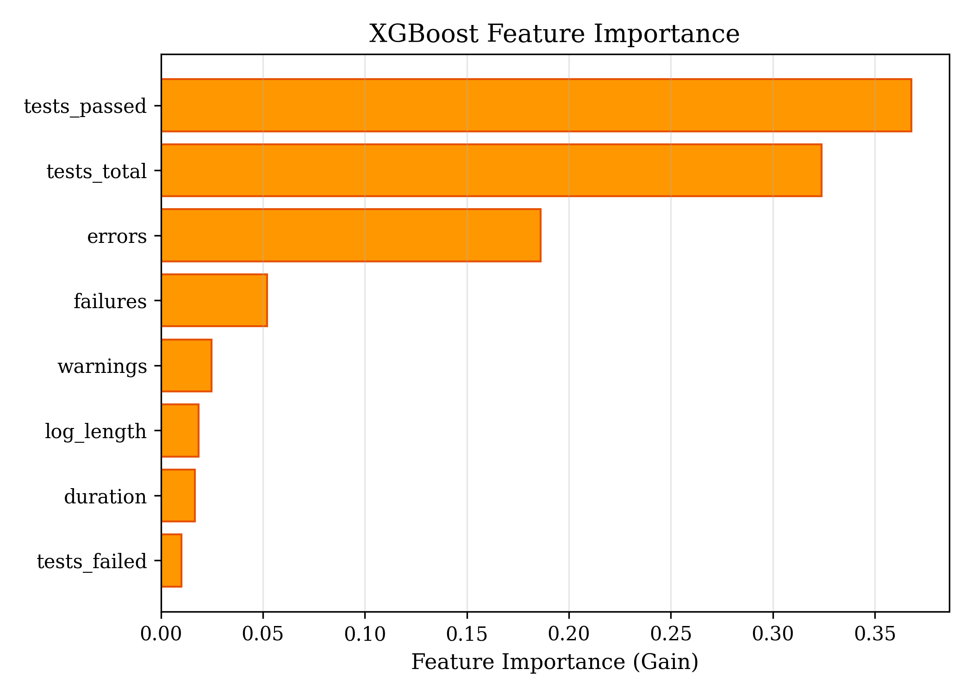
Model 1: XGBoost — Failure Prediction
▪ Gradient-boosted ensemble of 100 trees.
▪ Input: 8 build features — duration, warnings, errors, failures, log length, tests failed / passed / total.
▪ Output: failure probability (0–1).
▪ 80/20 stratified split + 5-fold cross-validation.
▪ CV F1 = 0.975 ± 0.009 → stable, no overfitting.
Metric | Value
Accuracy | 99.2%
Precision | 96.4%
F1-Score | 0.982
Feature importance confirms real signal: test results and error counts dominate — consistent with empirical CI studies.
Department of Computer Science and Engineering | COEP Technological University, Pune
12

Slide 13
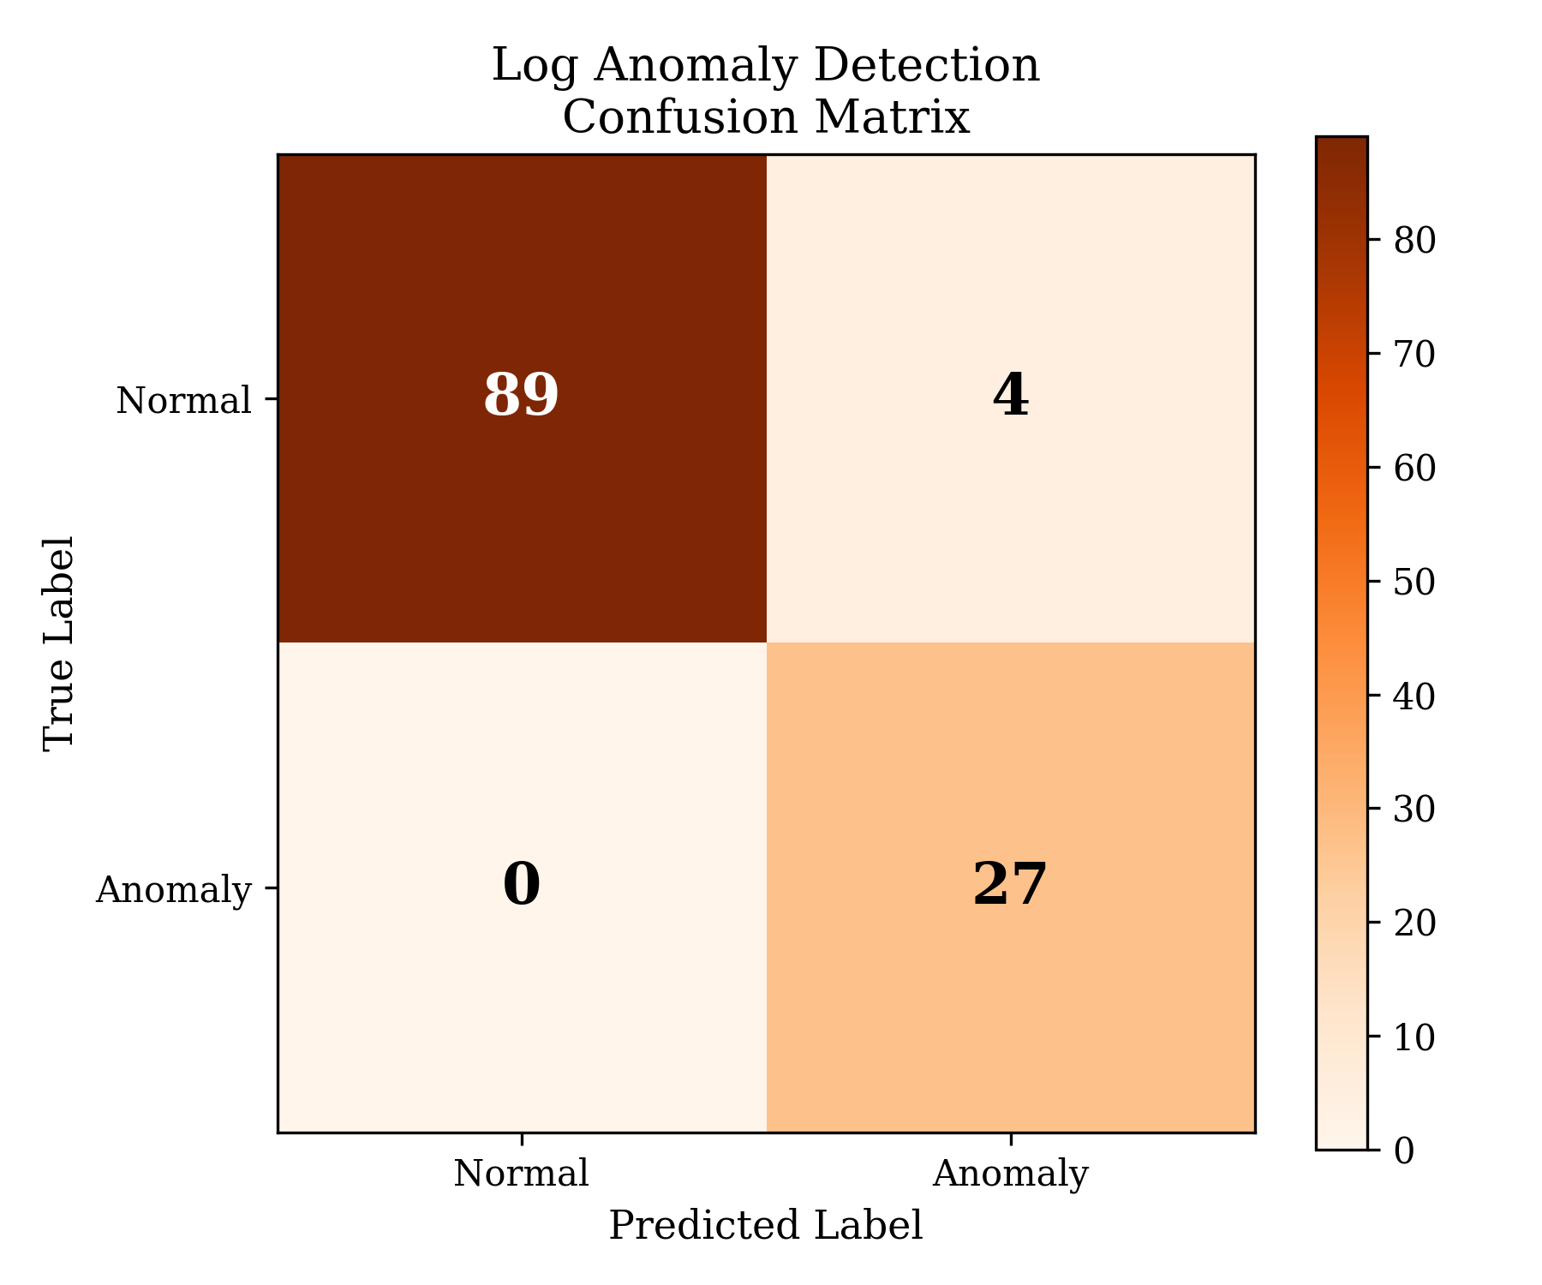
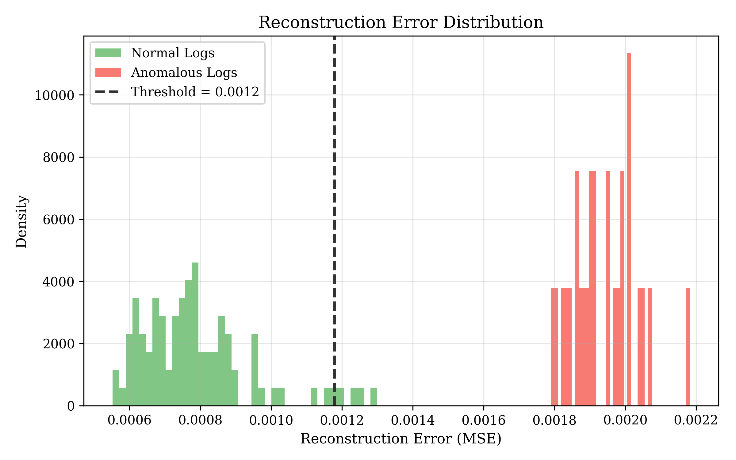
Model 2: TF-IDF + Autoencoder — Log Anomaly Detection
▪ Two-stage, fully unsupervised pipeline (no labels needed).
▪ Stage 1: TF-IDF vectorization — 500 features, n-gram 1–2.
▪ Stage 2: Autoencoder 500 → 128 → 64 → 32 → 64 → 128 → 500.
▪ Trained on normal logs only — learns what “normal” looks like.
▪ Anomaly = high reconstruction error (MSE above threshold).
▪ Threshold = 95th percentile of normal reconstruction errors.
Metric | Value
Accuracy | 96.7%
Precision | 87.1%
F1-Score | 0.931
Error distribution shows clean separation between normal and anomalous logs.
Department of Computer Science and Engineering | COEP Technological University, Pune
13

Slide 14
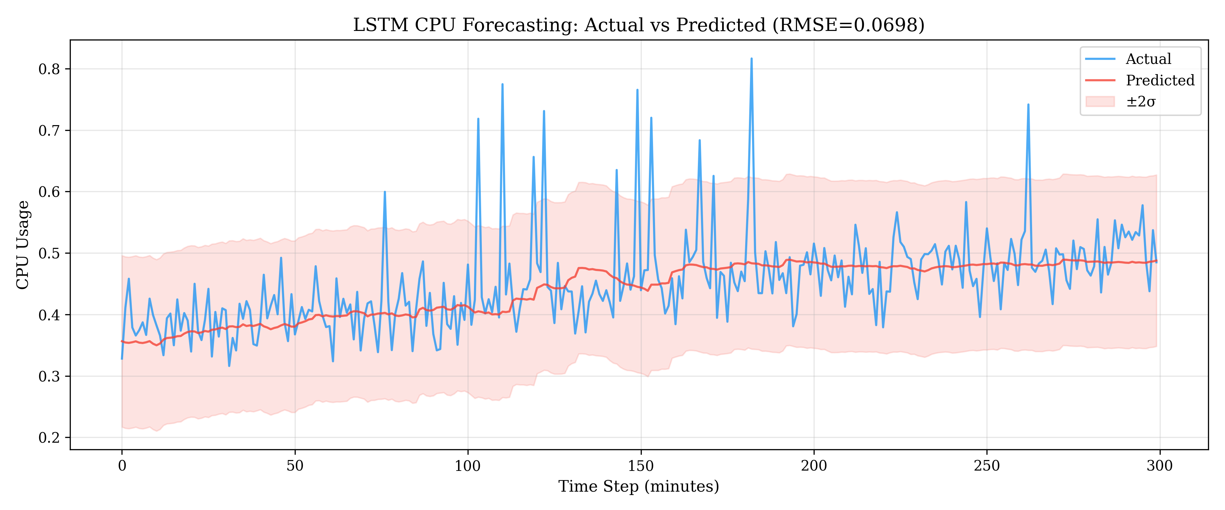
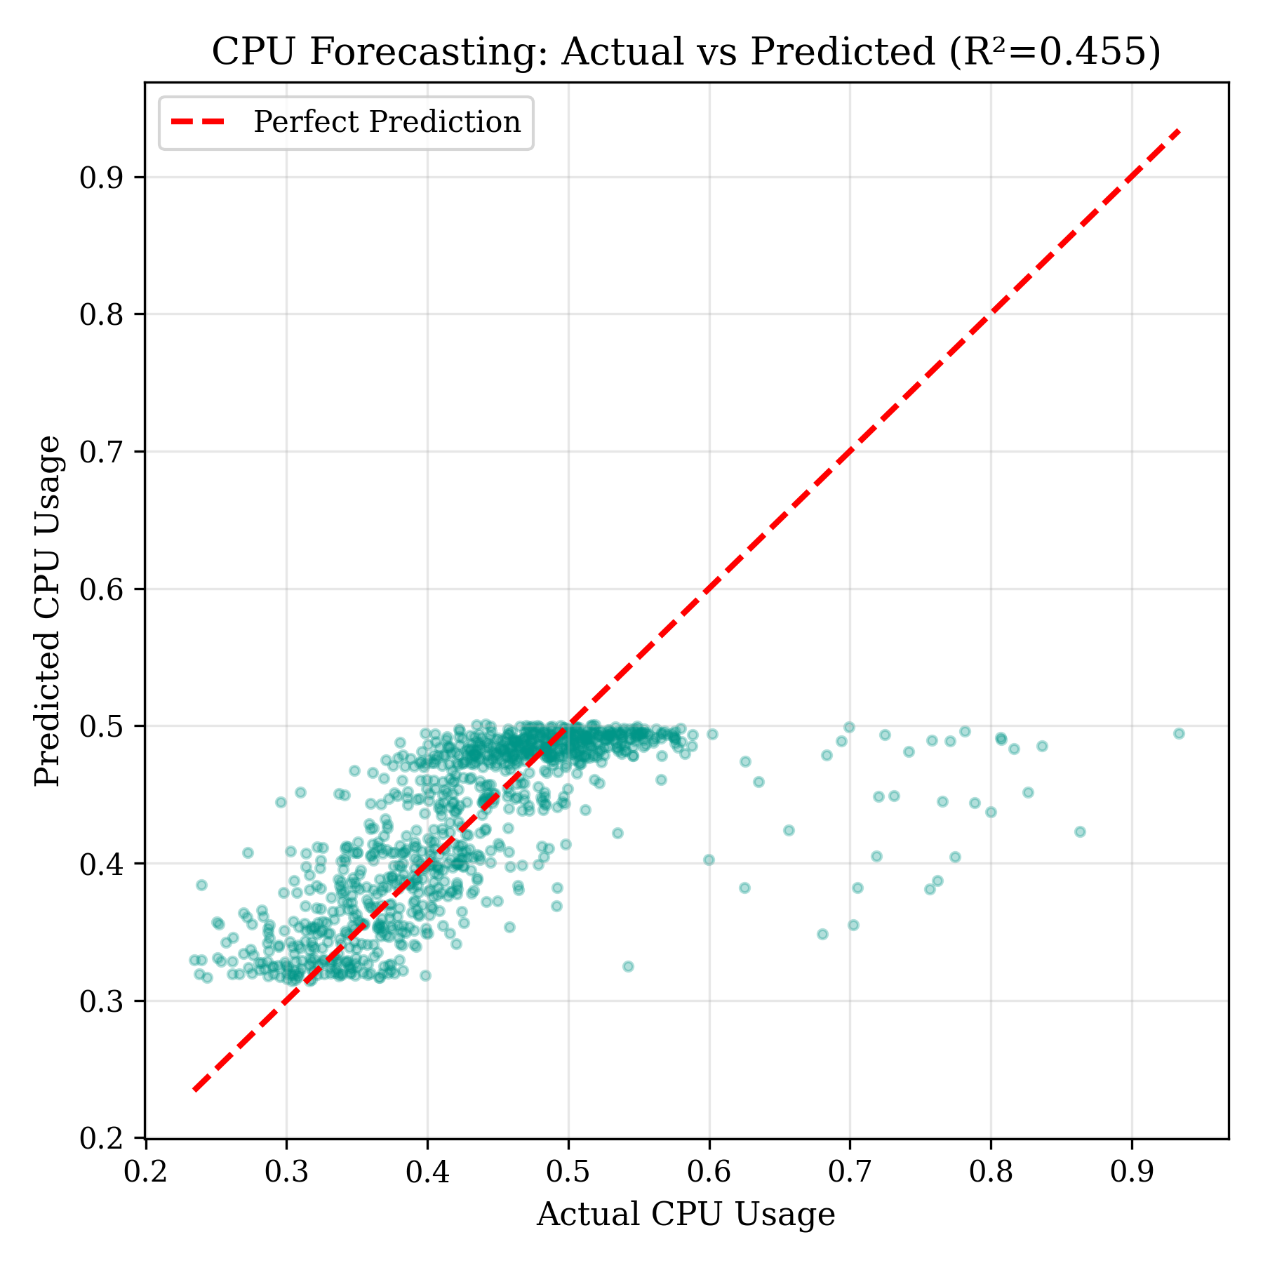
Model 3: LSTM — CPU Workload Forecasting
▪ Input: last 60 minutes of CPU usage (sliding window).
▪ Output: CPU usage 10 minutes ahead — the lead time the autoscaler needs.
▪ Architecture: LSTM(128) → LSTM(64) → Dense(32, ReLU) → Dense(1) with dropout.
▪ MAPE 9.68% — under the 10% rule-of-thumb for good forecasts.
▪ Model tracks the trend and smooths unpredictable spikes.
Metric | Value
MSE | 0.0049
MAE | 0.0433
RMSE | 0.0698
MAPE | 9.68%
Department of Computer Science and Engineering | COEP Technological University, Pune
14

Slide 15
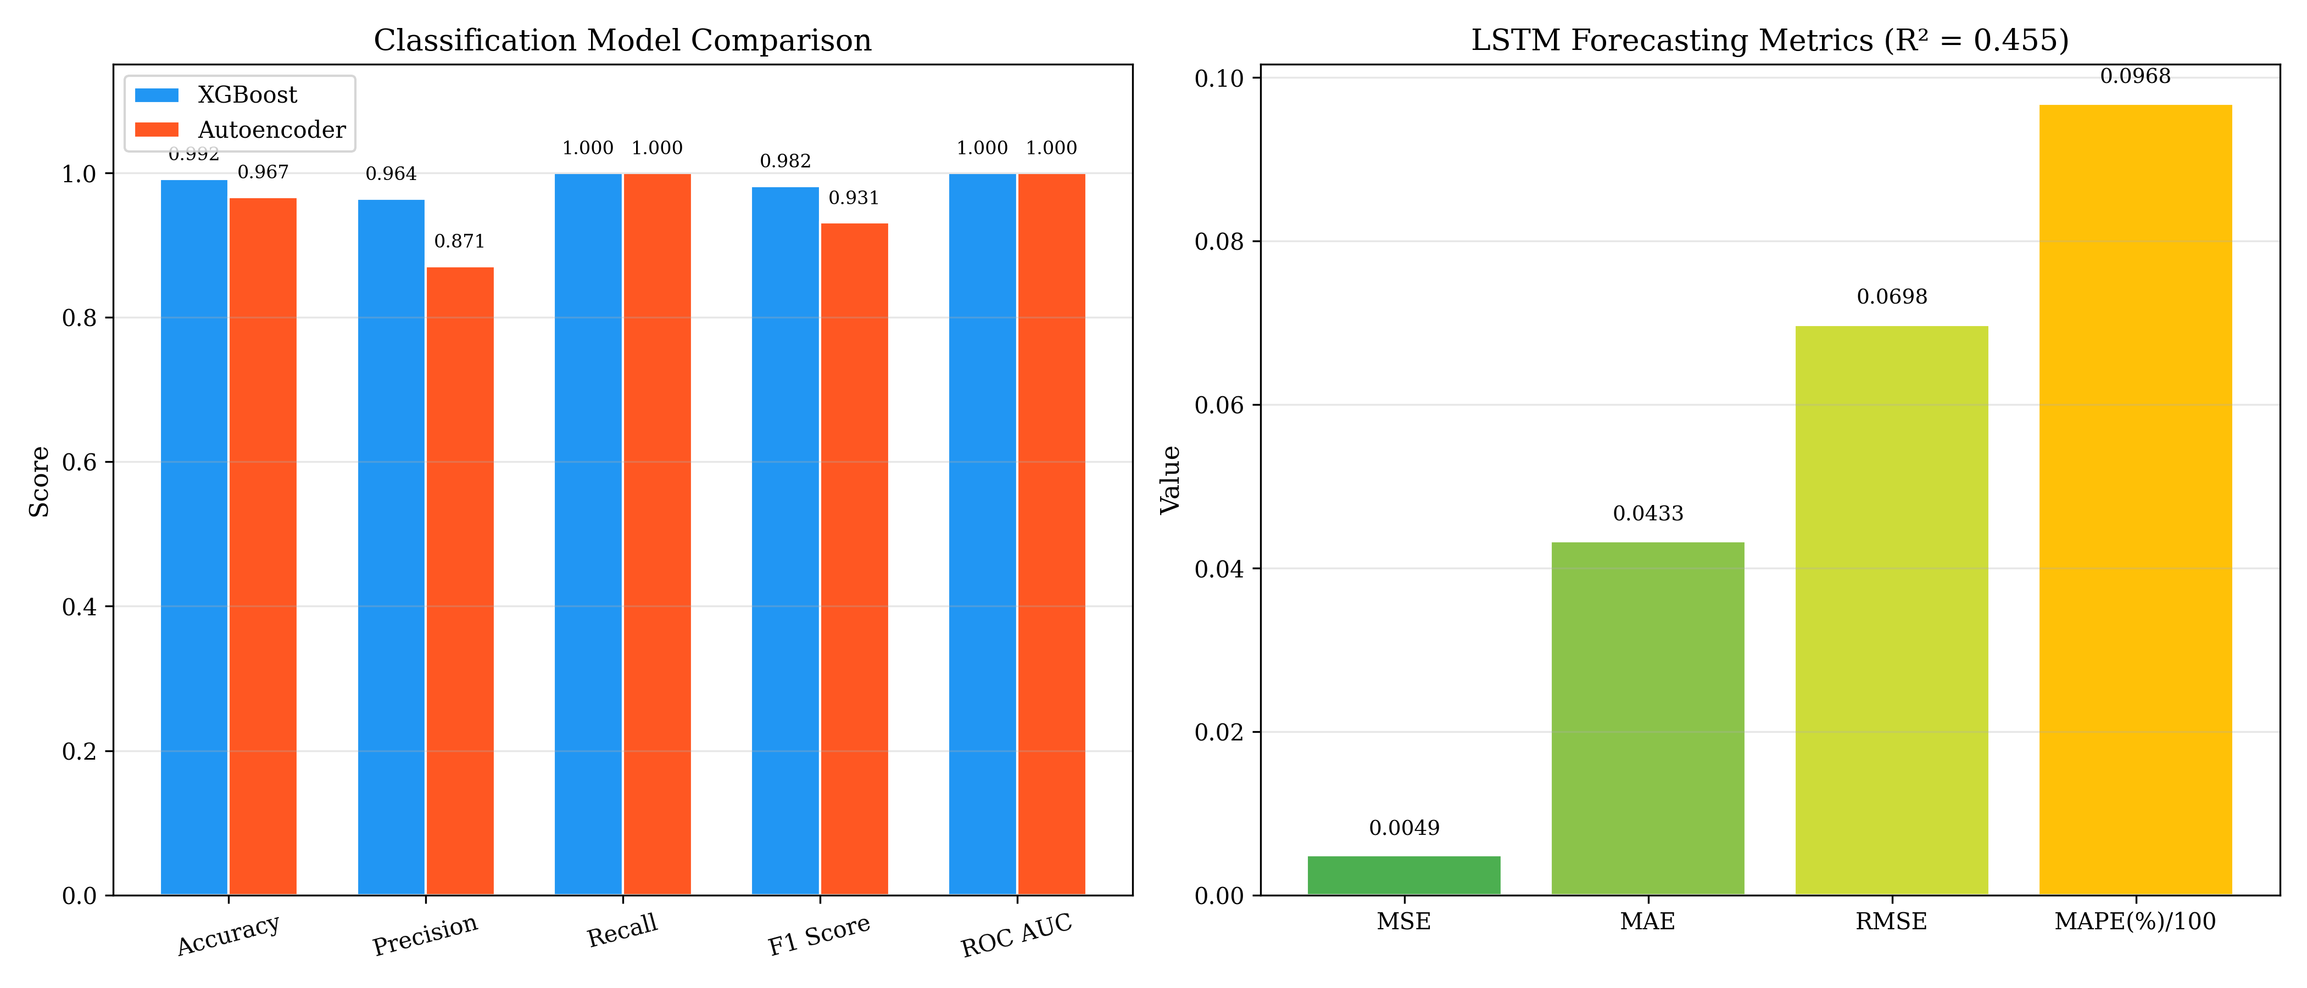
Combined Model Performance Summary
Module | Algorithm | Key Metric
Failure Prediction | XGBoost | F1 = 0.982
Anomaly Detection | TF-IDF + Autoencoder | F1 = 0.931
CPU Forecasting | LSTM | RMSE = 0.070
Department of Computer Science and Engineering | COEP Technological University, Pune
15

Slide 16
System Integration: FastAPI Orchestrator
▪ A single FastAPI service loads all three models into memory at startup and serves them via REST.
▪ Async endpoints with typed Pydantic request / response schemas.
▪ Models cached in memory → millisecond-scale inference.
▪ Live Swagger UI at /docs for interactive testing.
▪ Health checks + graceful startup / shutdown via lifespan events.
REST Endpoint | Backed by
POST /predict_failure | XGBoost
POST /detect_anomaly | Autoencoder
POST /forecast_cpu | LSTM
POST /autoscale | Decision Engine
One unified API layer connects models → decisions → Kubernetes actions.
Department of Computer Science and Engineering | COEP Technological University, Pune
16

Slide 17
Predictive Autoscaler — Decision Algorithm
Priority-based policy (each scaling cycle)
Why predictive? (vs. Kubernetes HPA)
1. Anomaly detected → raise ALERT (non-blocking).
2. Failure probability > 0.6 → HOLD — don’t scale a likely-failing build.
3. Predicted CPU ≥ 0.7 → SCALE UP (+2 replicas).
4. Predicted CPU ≤ 0.3 → SCALE DOWN (−1 replica).
5. Otherwise → MAINTAIN.
Aspect | HPA (reactive) | Proposed
Trigger | Current CPU | Forecast (t + 10 min)
Timing | After the spike | Before the spike
Signals | CPU only | CPU + failures + log anomalies
CI/CD aware | No | Yes (HOLD rule)
The 10-minute forecast gives Kubernetes lead time to add pods before the load arrives.
Department of Computer Science and Engineering | COEP Technological University, Pune
17

Slide 18
Comparison with Related Work
Study | Failure Pred. | Log Anomaly | Predictive Scaling | Closed Loop
DeepLog / log-based detection (Du et al.) | ✗ | ✓ | ✗ | ✗
Guruge & Priyadarshana (2025) | ✗ | ✗ | ✓ | ✗
Da Silva et al. (2025) | ✗ | ✗ | ✓ | ✗
Zota et al. (2025, agentic AIOps) | ✗ | ✗ | ✗ | ✓
Proposed Framework | ✓ | ✓ | ✓ | ✓
The proposed framework is the only one integrating all four capabilities in a single closed-loop architecture.
Department of Computer Science and Engineering | COEP Technological University, Pune
18

Slide 19
Conclusion
▪ Built a unified, closed-loop AIOps framework: three ML models + FastAPI orchestrator + predictive Kubernetes autoscaler.
▪ XGBoost predicts build failures : F1 = 0.982
▪ TF-IDF + Autoencoder detects log anomalies unsupervised : F1 = 0.931.
▪ LSTM forecasts CPU — RMSE = 0.070, MAPE = 9.68% — enabling proactive scaling.
▪ Predictive autoscaling acts on forecasts, overcoming the lag of reactive Kubernetes HPA.
Department of Computer Science and Engineering | COEP Technological University, Pune
19

Slide 20
Future Scope
▪ Validate on real-world CI/CD datasets and live Jenkins / Prometheus data.
▪ Add automatic retraining to handle concept drift as pipelines evolve.
▪ Replace TF-IDF with transformer-based log embeddings (e.g. LogBERT) for richer context.
▪ Benchmark against Kubernetes HPA under production-scale load.
▪ Build a monitoring dashboard for predictions, alerts and scaling actions.
▪ Extend to multi-service dependencies and memory / network forecasting.
Department of Computer Science and Engineering | COEP Technological University, Pune
20

Slide 21
References
[1] I. Pintye et al., “Enhancing ML-Based Autoscaling for Cloud Resource Orchestration,” Journal of Grid Computing, 2024.
[2] P. B. Guruge and Y. H. P. P. Priyadarshana, “Time-Series Forecasting-Based Kubernetes Autoscaling Using Prophet and LSTM,” Frontiers in Computer Science, 2025.
[3] M. A. Yahya et al., “Deep Learning for Multivariate Time-Series Anomaly Detection: A Survey,” Artificial Intelligence Review, 2025.
[4] A. Hrusto, “Towards Optimization of Anomaly Detection in DevOps,” Information and Software Technology, 2023.
[5] P. Mathew and A. Baswareddy, “Predictive Failure Analysis in CI Pipelines Using Ensemble Trees,” IJACS, 2025.
[6] M. Du et al., “DeepLog: Anomaly Detection and Diagnosis from System Logs,” ACM CCS, 2017.
[7] Y. Zota et al., “A Practical Framework for Agentic AIOps,” 2025.
[8] Kubernetes Documentation, “Horizontal Pod Autoscaler,” 2024.
Department of Computer Science and Engineering | COEP Technological University, Pune
21

Slide 22
Thank You
Tejas Annasaheb Jagtap • M.Tech (Information Security) • COEP Technological University, Pune
Department of Computer Science and Engineering | COEP Technological University, Pune
22

