Slide 1

Intelligent AIOps Framework for Predictive CI/CD
Pipeline Management and Autonomous Resource
Optimization
Tejas Annasaheb Jagtap
MTech Information Security
712442021
Guide: Dr. V. K. Pachghare
Dept of Computer Science and Engineering
COEP Technological University, Pune
1

Slide 2
Contents
Introduction
Literature Survey
Research Gap
Problem Statement
Research Objectives
Proposed High Level System Design
Phase-II: Implementation & Evaluation
Synthetic Data Generation
Model Training (XGBoost, Autoencoder, LSTM)
Evaluation Results
Future Plan (Phase-III)
References
Dept of Computer Science and Engineering
COEP Technological University, Pune
2

Slide 3
Introduction
Modern software systems rely heavily on continuous integration and continuous deployment (CI/CD) pipelines for rapid delivery
These pipelines generate massive volumes of logs and metrics
DevOps teams struggle with:
Unpredictable build failures wasting time and resources
Manual debugging of thousands of log lines
Reactive (not proactive) Kubernetes scaling decisions
AIOps (AI for IT Operations) integrates Machine Learning + Automation to enhance CI/CD reliability and infrastructure management
Dept of Computer Science and Engineering
COEP Technological University, Pune
3

Slide 4
Motivation
Frequent build failures lead to deployment delays and wasted compute
Manual root-cause analysis is slow and error-prone
Traditional autoscaling in Kubernetes reacts AFTER resource spikes occur
DevOps teams spend significant effort analyzing logs and failures
Need for an automated, self-learning system that:
Predicts failures early using historical build patterns
Detects anomalies in logs immediately using ML
Allocates resources proactively based on forecasts
Reduces operational burden and improves delivery speed
Dept of Computer Science and Engineering
COEP Technological University, Pune
4

Slide 5
Literature Survey
Sr. | Paper Name | Work Done | Limitations
1 | Enhancing ML-Based Autoscaling for Cloud Resource Orchestration (2024) | Evaluates ML models for autoscaling; compares architectures for predicting load. | Focuses on autoscaling alone; no CI/CD or log integration.
2 | Time-series Forecasting-Based K8s Autoscaling Using Prophet and LSTM (2025) | Hybrid Prophet+LSTM approach for cluster metric prediction and scaling. | No CI/CD signals or log anomalies; evaluates autoscaling in isolation.
3 | Deep Learning for Multivariate Time-Series Anomaly Detection (2025) | Survey of autoencoders, VAEs for anomaly detection; benchmarks thresholds. | Survey-level; no concrete DevOps pipeline application for CI logs.
Dept of Computer Science and Engineering
COEP Technological University, Pune
5

Slide 6
Sr. | Paper Name | Work Done | Limitations
4 | Towards Optimization of Anomaly Detection in DevOps (2023) | Evaluates anomaly detection techniques for DevOps monitoring. | No CI/CD build prediction; focuses only on runtime anomalies.
5 | AI-Enhanced Platform Engineering: Revolutionizing CI/CD Pipelines (2025) | Proposes AI integration for CI/CD optimization and resource management. | Conceptual framework; no trained models or experimental validation.
6 | Predictive Failure Analysis in CI Pipelines Using Ensemble Trees (2025) | Ensemble tree models for CI build failure prediction from metadata. | Limited dataset; no anomaly detection or predictive scaling integration.
7 | Empirical Analysis on CI/CD Pipeline Evolution: Failures and Bottlenecks (2024) | Identifies common failure causes, temporal patterns, and bottlenecks. | Descriptive study; no automated ML solutions proposed.
Dept of Computer Science and Engineering
COEP Technological University, Pune
6

Slide 7
Research Gap
No unified AIOps framework combining:
Build failure prediction
Log anomaly detection
CPU forecasting
Predictive autoscaling
Lack of predictive autoscaling
Limited real-world CI/CD datasets
Lack of closed-loop automation integrating Jenkins → ML → Kubernetes.
Dept of Computer Science and Engineering
COEP Technological University, Pune
7

Slide 8
Problem Statement
"To design and implement an intelligent AIOps-based framework that can proactively predict CI/CD pipeline failures, detect anomalies in Jenkins logs in real time, and autonomously optimize Kubernetes resources through predictive autoscaling."
Dept of Computer Science and Engineering
COEP Technological University, Pune
8

Slide 9
Research Objectives
To Develop Data Collection Framework for CI/CD and Cluster Metrics
To Build Machine Learning Models for Failure Prediction, Anomaly Detection, and CPU Forecasting
To Implement a FastAPI-Based AIOps Orchestrator for Intelligent Decision-Making
To Design a Predictive Autoscaling Engine for Kubernetes Using ML Outputs
Dept of Computer Science and Engineering
COEP Technological University, Pune
9

Slide 10
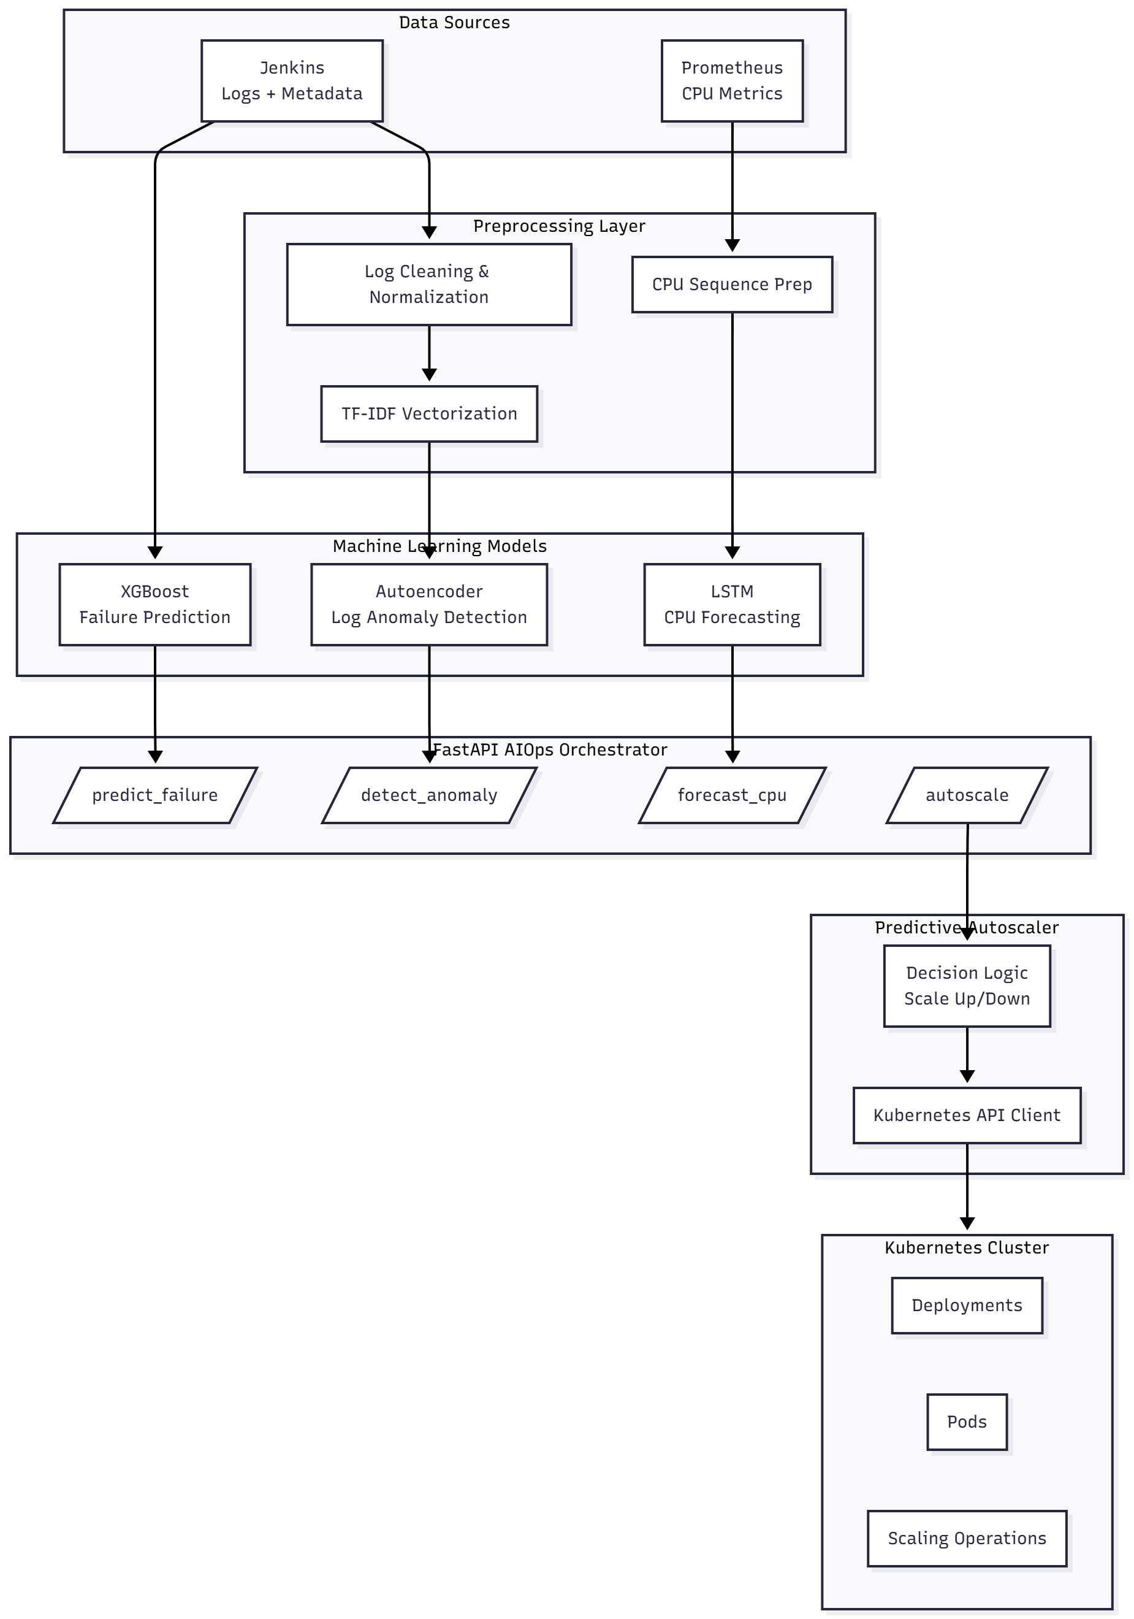
Proposed High Level System Design
Components:
Data Collectors
Jenkins API for logs + metadata
Prometheus for CPU metrics
ML Layer
XGBoost: Failure prediction
TF-IDF based Autoencoder: Log anomaly detection
LSTM: CPU forecasting
AIOps Orchestrator
FastAPI-based inference layer
Predictive Autoscaler
Kubernetes API for scaling decisions
Dept of Computer Science and Engineering
COEP Technological University, Pune
10

Slide 11
Phase-II: Data Pipeline & Collection
Synthetic Data Generation (generate_synthetic_data.py):
600 Jenkins build records with realistic metadata
600+ console log files (success, failure, unstable patterns)
10,000+ CPU time-series data points with daily/weekly patterns
Data Collection Infrastructure:
Jenkins REST API collector for build metadata and logs
Prometheus HTTP API collector for CPU/memory metrics
Real-time streaming collector with configurable intervals
Data preprocessing pipelines:
TF-IDF vectorization (500 features, ngram 1-2, sublinear TF)
MinMaxScaler normalization for CPU time-series
Feature extraction from build metadata (8 features)
Dept of Computer Science and Engineering
COEP Technological University, Pune
11

Slide 12
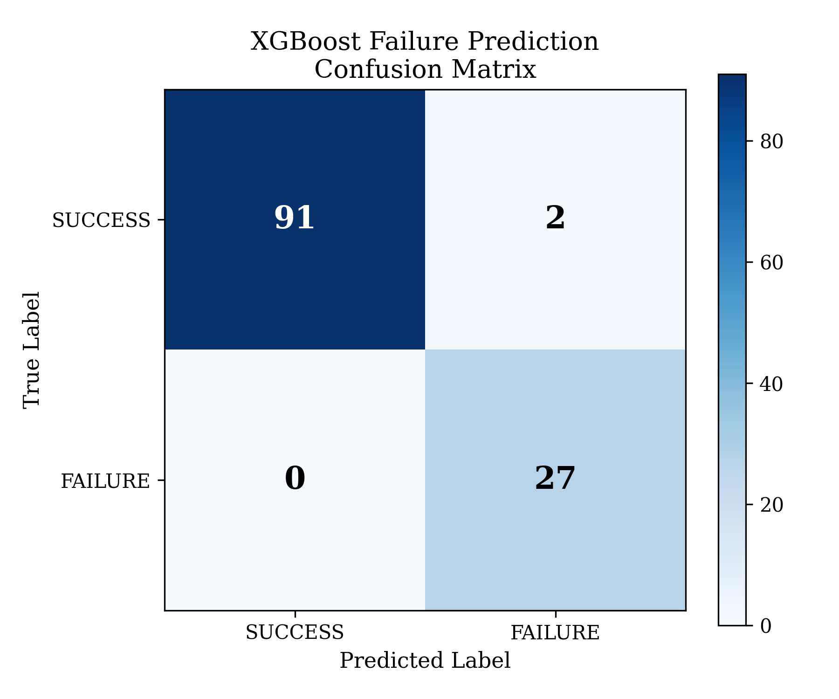
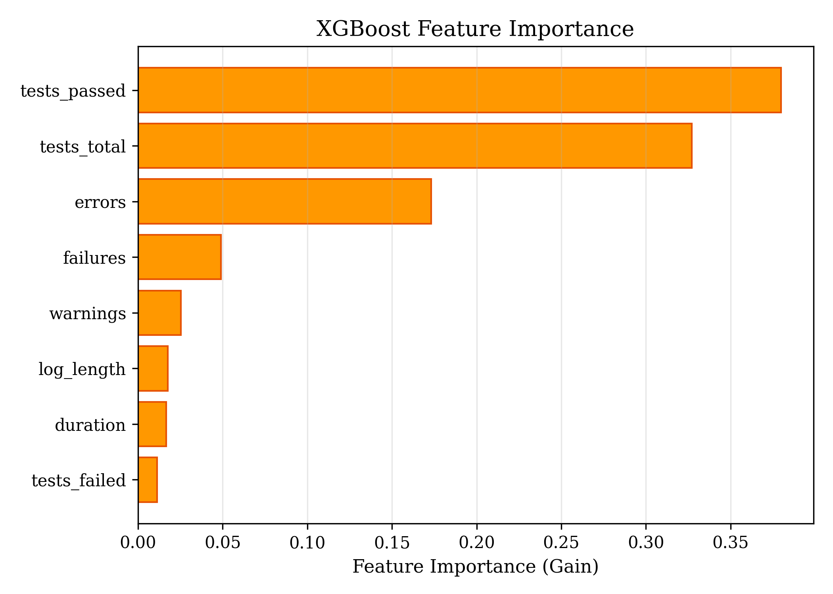
Model 1: XGBoost — Failure Prediction
Metric | Value
Accuracy | 98.33%
Precision | 93.10%
Recall | 100.00%
F1-Score | 96.43%
ROC AUC | 100.00%
Gradient boosted ensemble of 100 decision trees
Input: 8 features (duration, errors, warnings,
failures, log_length, tests_failed/passed/total)
Output: Failure probability (0–1)
Handles class imbalance via scale_pos_weight
80/20 stratified train-test split
5-Fold Cross Validation: 99.0% ± 0.6% accuracy
Dept of Computer Science and Engineering
COEP Technological University, Pune
12

Slide 13
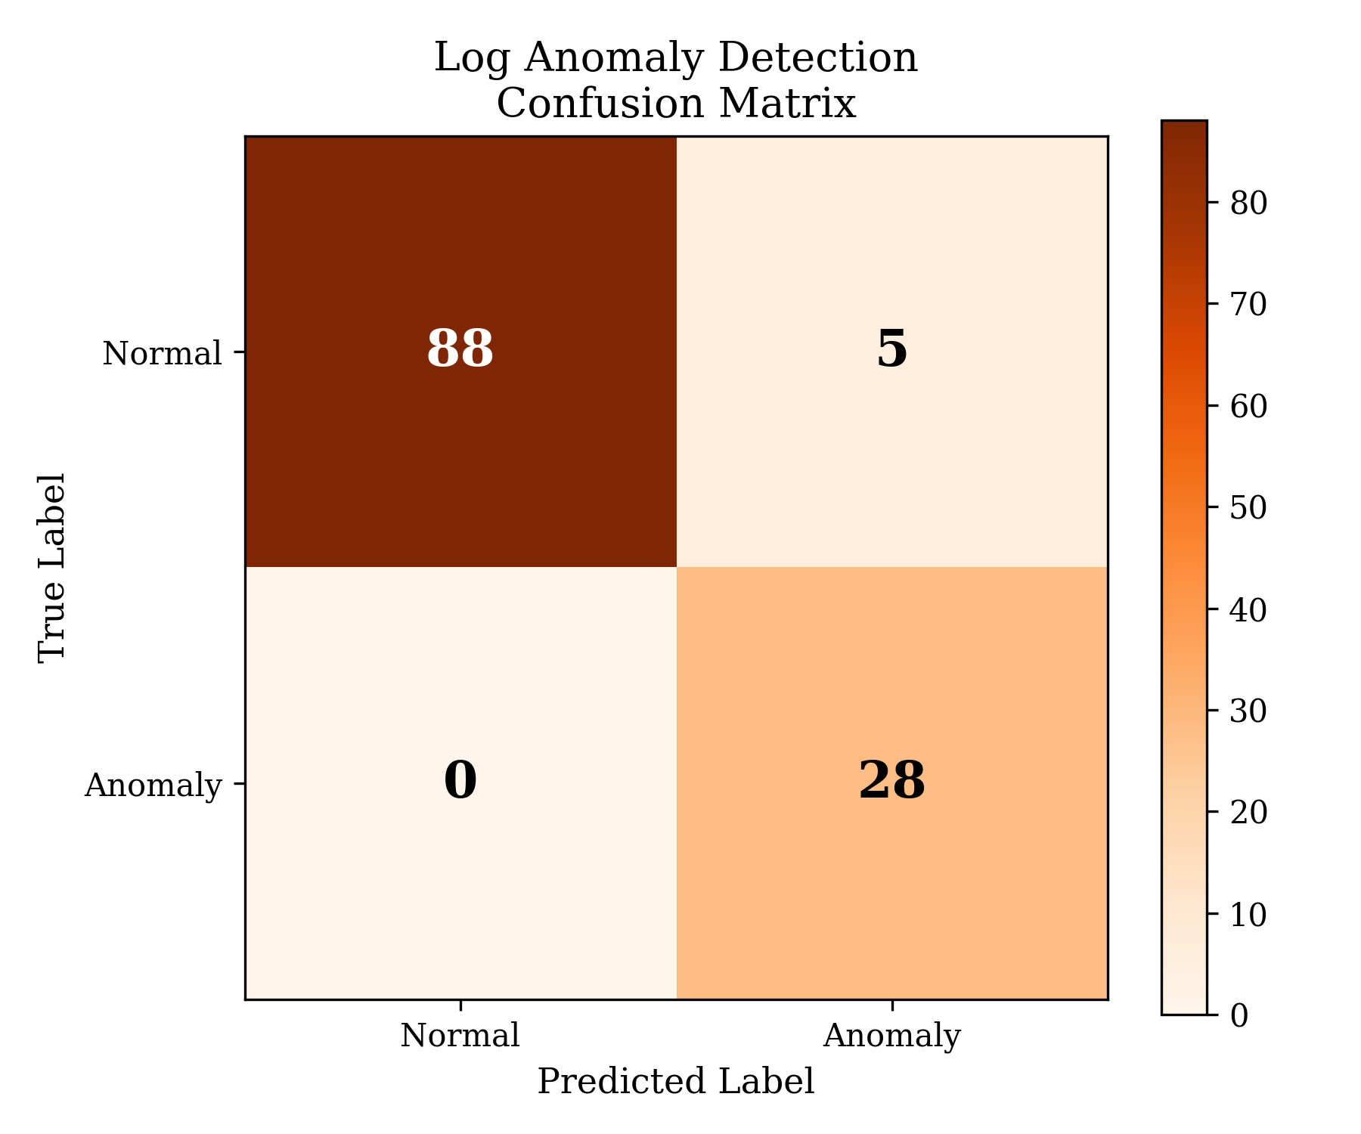
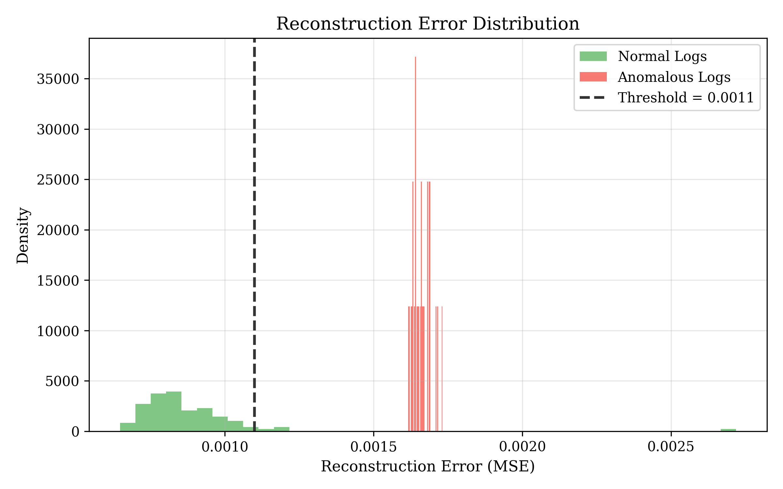
Model 2: TF-IDF + Autoencoder — Anomaly Detection
Metric | Value
Accuracy | 95.87%
Precision | 84.85%
Recall | 100.00%
F1-Score | 91.80%
ROC AUC | 98.92%
Two-Stage Pipeline:
Stage 1: TF-IDF vectorization (500 features)
ngram range (1,2), sublinear TF scaling
Stage 2: Autoencoder neural network
Architecture: 500→128→64→32→64→128→500
Trained on normal logs only (unsupervised)
Anomaly = high reconstruction error
Threshold: 95th percentile of normal errors
Dept of Computer Science and Engineering
COEP Technological University, Pune
13

Slide 14
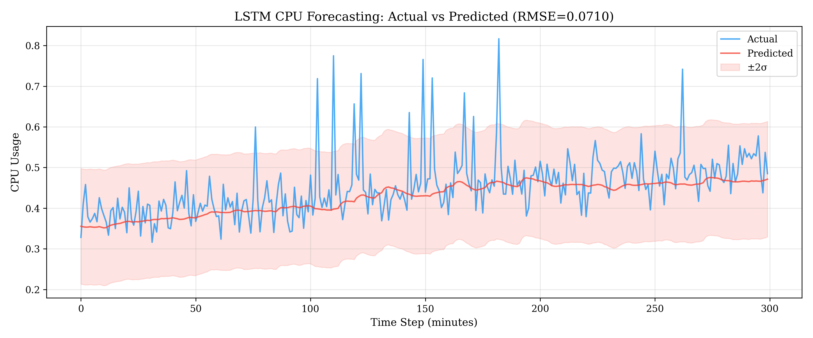
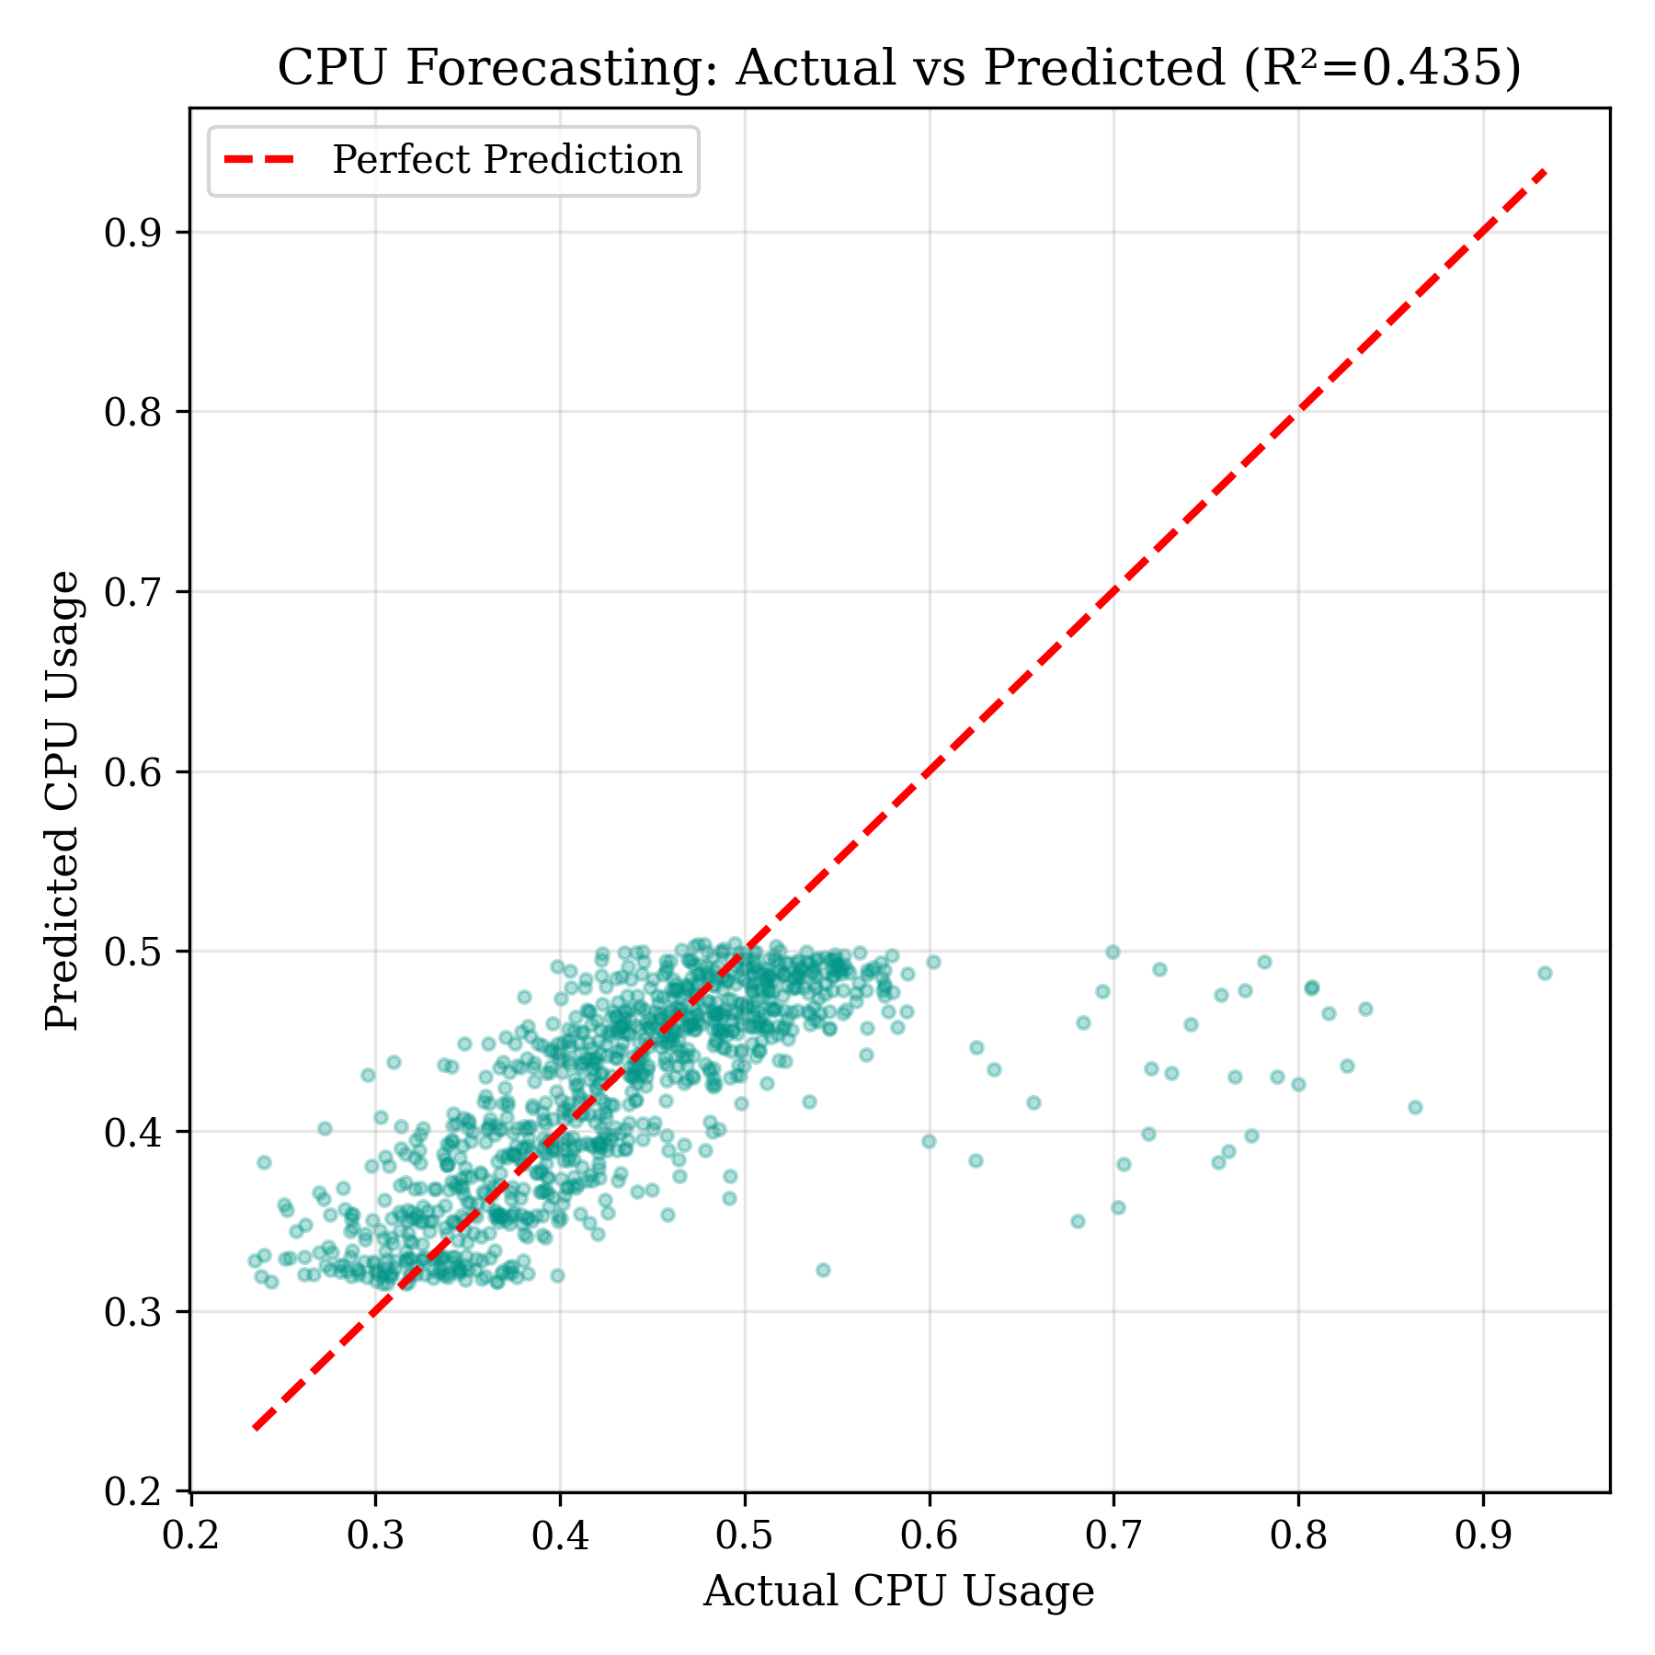
Model 3: LSTM — CPU Forecasting
Metric | Value
MSE | 0.0050
MAE | 0.0436
RMSE | 0.0710
MAPE | 9.56%
R² | 0.435
Input: 60-minute CPU history (sliding window)
Output: Predicted CPU usage 10 minutes ahead
Architecture: LSTM(128) → LSTM(64) → Dense(32) → Dense(1)
MinMaxScaler normalization to [0, 1]
10,000+ training sequences
Early stopping + LR reduction on plateau
Dept of Computer Science and Engineering
COEP Technological University, Pune
14

Slide 15
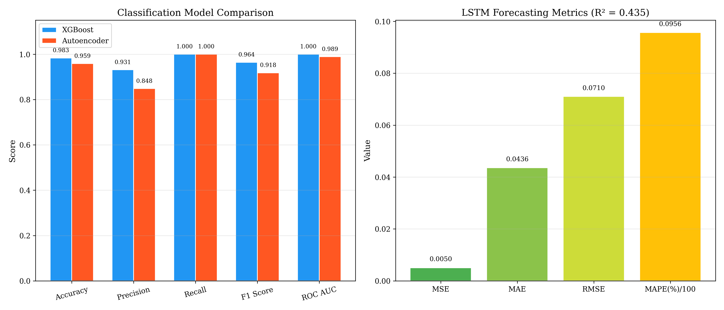
Combined Model Performance Summary
Module | Algorithm | Key Metric | ROC AUC / R²
Failure Prediction | XGBoost | F1 = 0.964 | AUC = 1.000
Anomaly Detection | TF-IDF + Autoencoder | F1 = 0.918 | AUC = 0.989
CPU Forecasting | LSTM | RMSE = 0.071 | R² = 0.435
Dept of Computer Science and Engineering
COEP Technological University, Pune
15

Slide 16
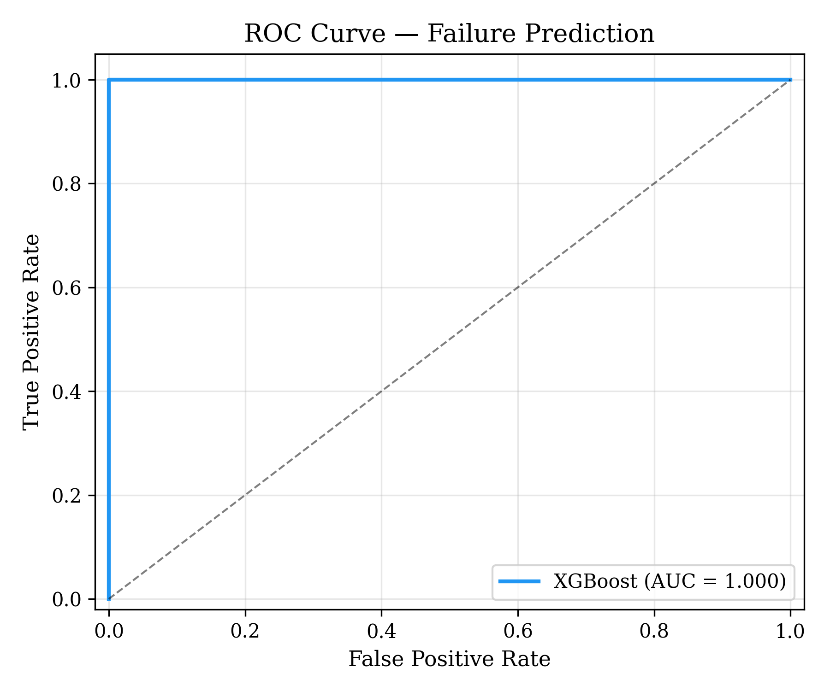
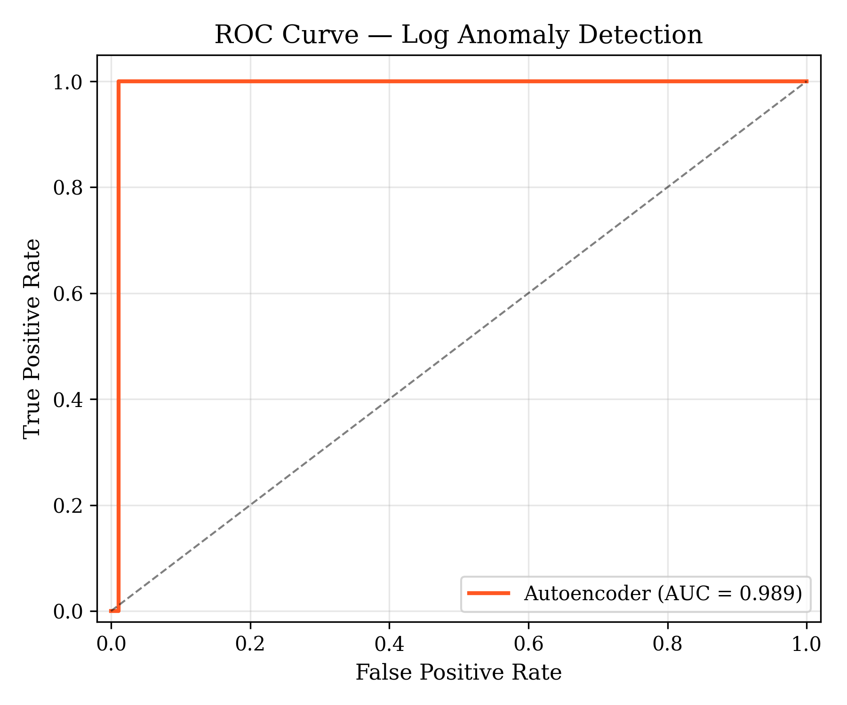
ROC Curves — Classification Models
XGBoost: AUC = 1.000
Autoencoder: AUC = 0.989
Dept of Computer Science and Engineering
COEP Technological University, Pune
16

Slide 17
Future Plan
Phase III: Integration
Connect all models to FastAPI AIOps Orchestrator
Implement APIs: failure, anomaly, CPU forecast
Build predictive autoscaler using ML outputs
Connect autoscaler to Kubernetes API
Phase IV: Testing & Finalization
End-to-end CI/CD testing
Compare predictive autoscaler vs default HPA
Create monitoring dashboard
Final tuning + final documentation
Dept of Computer Science and Engineering
COEP Technological University, Pune
17

Slide 18
References
[1] I. Pintye, B. Goldschmidt, P. Holicza and A. Kertesz, "Enhancing Machine Learning-Based Autoscaling for Cloud Resource Orchestration," J. Grid Computing, vol. 22, 2024.
[2] P. B. Guruge and Y. H. P. P. Priyadarshana, "Time Series Forecasting-Based Kubernetes Autoscaling Using Prophet and LSTM," Frontiers in CS, vol. 5, 2025.
[3] M. A. Yahya, W. Bakhtawar and M. Usman, "Deep Learning for Multivariate Time Series Anomaly Detection: A Survey," AI Review, 2025.
[4] A. Hrusto, "Towards Optimization of Anomaly Detection in DevOps," IST, vol. 158, 2023.
[5] S. Das and P. Raj, "AI-Enhanced Platform Engineering: Revolutionizing CI/CD Pipelines," IJCEST, 2025.
[6] P. Mathew and A. Baswareddy, "Predictive Failure Analysis in CI Pipelines Using Ensemble Trees," IJACS, 2025.
[7] H. Guo et al., "LogBERT: Transformer-Based Log Anomaly Detection for CI/CD Systems," ICSE, 2021.
[8] A. Houerbi et al., "Empirical Analysis on CI/CD Pipeline Evolution: Failures and Bottlenecks," JSME, 2024.
Dept of Computer Science and Engineering
COEP Technological University, Pune
18

Slide 19
Thank You !!!
Dept of Computer Science and Engineering
COEP Technological University, Pune
19

