Slide 1

Intelligent AIOps Framework for Predictive CI/CD
Pipeline Management and Autonomous Resource
Optimization
Tejas Annasaheb Jagtap
MTech Information Security | 712442021
Guide: Dr. V. K. Pachghare
Phase-II: Model Training & Evaluation
Dept of Computer Science and Engineering
COEP Technological University, Pune
1

Slide 2
Contents
1. Introduction & Motivation
2. Literature Survey
3. Research Gap & Problem Statement
4. Research Objectives
5. Proposed System Architecture
6. Phase-II Implementation
• Synthetic Data Generation
• Data Collection Infrastructure
• Model Training (XGBoost, Autoencoder, LSTM)
7. Evaluation Results
8. Future Plan (Phase-III)
9. References
Dept of Computer Science and Engineering
COEP Technological University, Pune
2

Slide 3
Introduction
• Modern software systems rely heavily on CI/CD pipelines for rapid delivery
• These pipelines generate massive volumes of logs and metrics
• DevOps teams struggle with:
– Unpredictable build failures wasting time & resources
– Manual debugging of thousands of log lines
– Reactive (not proactive) Kubernetes scaling decisions
• AIOps (AI for IT Operations) integrates Machine Learning + Automation
to enhance CI/CD reliability and infrastructure management
• Our framework addresses 3 key problems:
1. Predict build failures BEFORE execution
2. Detect anomalies in logs automatically
3. Forecast CPU usage for proactive autoscaling
Dept of Computer Science and Engineering
COEP Technological University, Pune
3

Slide 4
Motivation
• Frequent build failures lead to deployment delays and wasted compute
• Manual root-cause analysis is slow and error-prone
• Traditional Kubernetes HPA reacts AFTER resource spikes occur
• DevOps teams spend significant effort analyzing logs and failures
• Need for an automated, self-learning system that:
– Predicts failures early using historical build patterns
– Detects anomalies in logs immediately using ML
– Allocates resources proactively based on forecasts
– Reduces operational burden and improves delivery speed
Dept of Computer Science and Engineering
COEP Technological University, Pune
4

Slide 5
Literature Survey
Sr. | Paper Name | Work Done | Limitations
1 | Enhancing ML-Based Autoscaling for Cloud (2024) | Evaluates ML models for autoscaling; compares architectures for predicting load. | Focuses on autoscaling alone; no CI/CD or log integration.
2 | Time-series Forecasting-Based K8s Autoscaling (2025) | Hybrid Prophet+LSTM approach for cluster metric prediction and scaling. | No CI/CD signals or log anomalies; evaluates autoscaling in isolation.
3 | Deep Learning for Multivariate Time-Series Anomaly Detection (2025) | Survey of autoencoders, VAEs for anomaly detection; benchmarks thresholds. | Survey-level; no concrete DevOps pipeline application for CI logs.
Dept of Computer Science and Engineering
Dept of Computer Science and Engineering
COEP Technological University, Pune
COEP Technological University, Pune
5
5

Slide 6
Literature Survey (contd.)
Sr. | Paper Name | Work Done | Limitations
4 | Predictive Failure Analysis in CI Pipelines (2025) | Ensemble tree models for CI build failure prediction from metadata. | Limited dataset; no anomaly detection or predictive scaling integration.
5 | LogBERT: Transformer-Based Log Anomaly Detection (2021) | BERT-style models for log anomaly detection; improved over TF-IDF baselines. | Computationally heavy; needs large datasets and GPU. Not lightweight.
6 | Empirical Analysis on CI/CD Pipeline Evolution (2024) | Identifies common failure causes, temporal patterns, and bottlenecks. | Descriptive study; no automated ML solutions proposed.
Dept of Computer Science and Engineering
Dept of Computer Science and Engineering
COEP Technological University, Pune
COEP Technological University, Pune
6
6

Slide 7
Research Gaps
• No unified AIOps framework combining:
– Build failure prediction
– Log anomaly detection
– CPU forecasting
– Predictive autoscaling
• Kubernetes autoscaling is fundamentally reactive (HPA)
• Existing works treat CI/CD failures, log anomalies, and scaling as isolated problems
• Limited availability of real-world CI/CD datasets for ML training
• No closed-loop automation: Jenkins → ML Models → Kubernetes
Dept of Computer Science and Engineering
COEP Technological University, Pune
7

Slide 8
Problem Statement & Objectives
"To design and implement an intelligent AIOps-based framework that can proactively predict CI/CD pipeline failures, detect anomalies in Jenkins logs in real time, and autonomously optimize Kubernetes resources through predictive autoscaling."
Research Objectives:
1. Develop Data Collection Framework for CI/CD and Cluster Metrics
2. Build ML Models for Failure Prediction, Anomaly Detection, and CPU Forecasting
3. Implement a FastAPI-Based AIOps Orchestrator
4. Design a Predictive Autoscaling Engine for Kubernetes
Dept of Computer Science and Engineering
Dept of Computer Science and Engineering
COEP Technological University, Pune
COEP Technological University, Pune
8
8

Slide 9
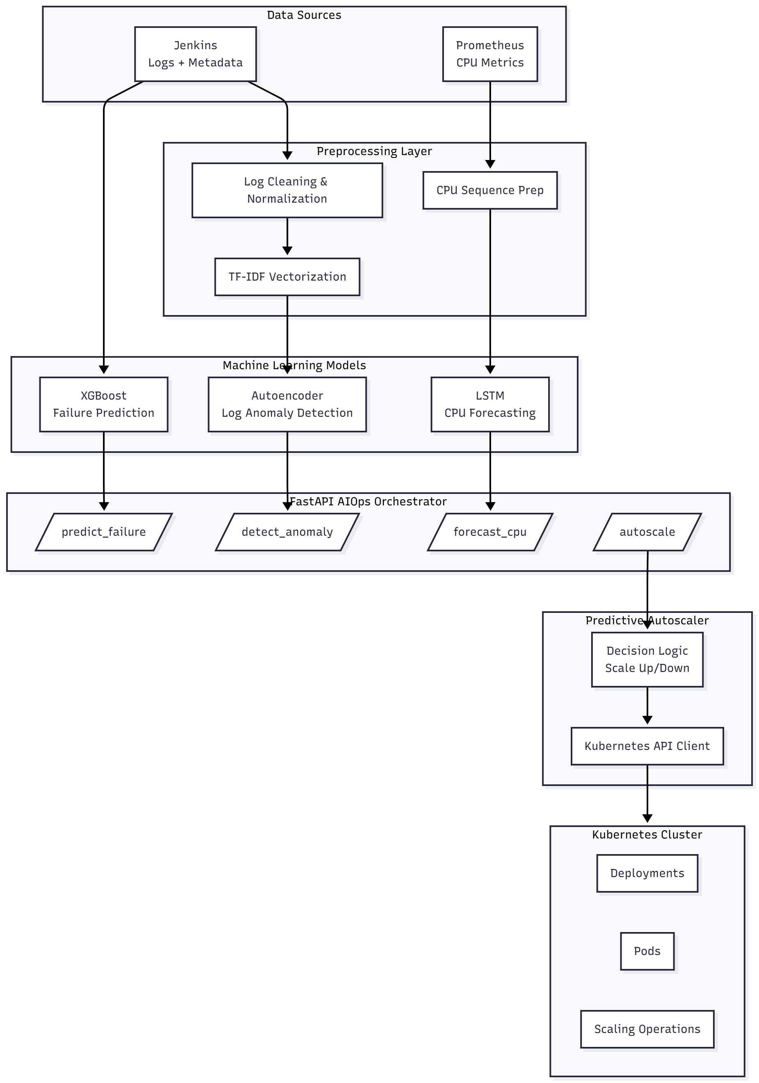
Proposed System Architecture
Dept of Computer Science and Engineering
COEP Technological University, Pune
9

Slide 10
Phase-II: Implementation Overview
Data Pipeline:
• Synthetic data generator for:
- 600 Jenkins build records
- 600+ console log files
- 10,000+ CPU time-series points
• Jenkins REST API collector
• Prometheus HTTP API collector
• Real-time streaming collector
Models Trained:
• XGBoost → Failure Prediction
Accuracy: 98.3%, F1: 96.4%
• TF-IDF + Autoencoder → Anomaly Detection
Accuracy: 95.9%, F1: 91.8%
• LSTM → CPU Forecasting
RMSE: 0.071, MAPE: 9.56%
• Comprehensive evaluation suite
• All models saved for integration
Dept of Computer Science and Engineering
COEP Technological University, Pune
10

Slide 11
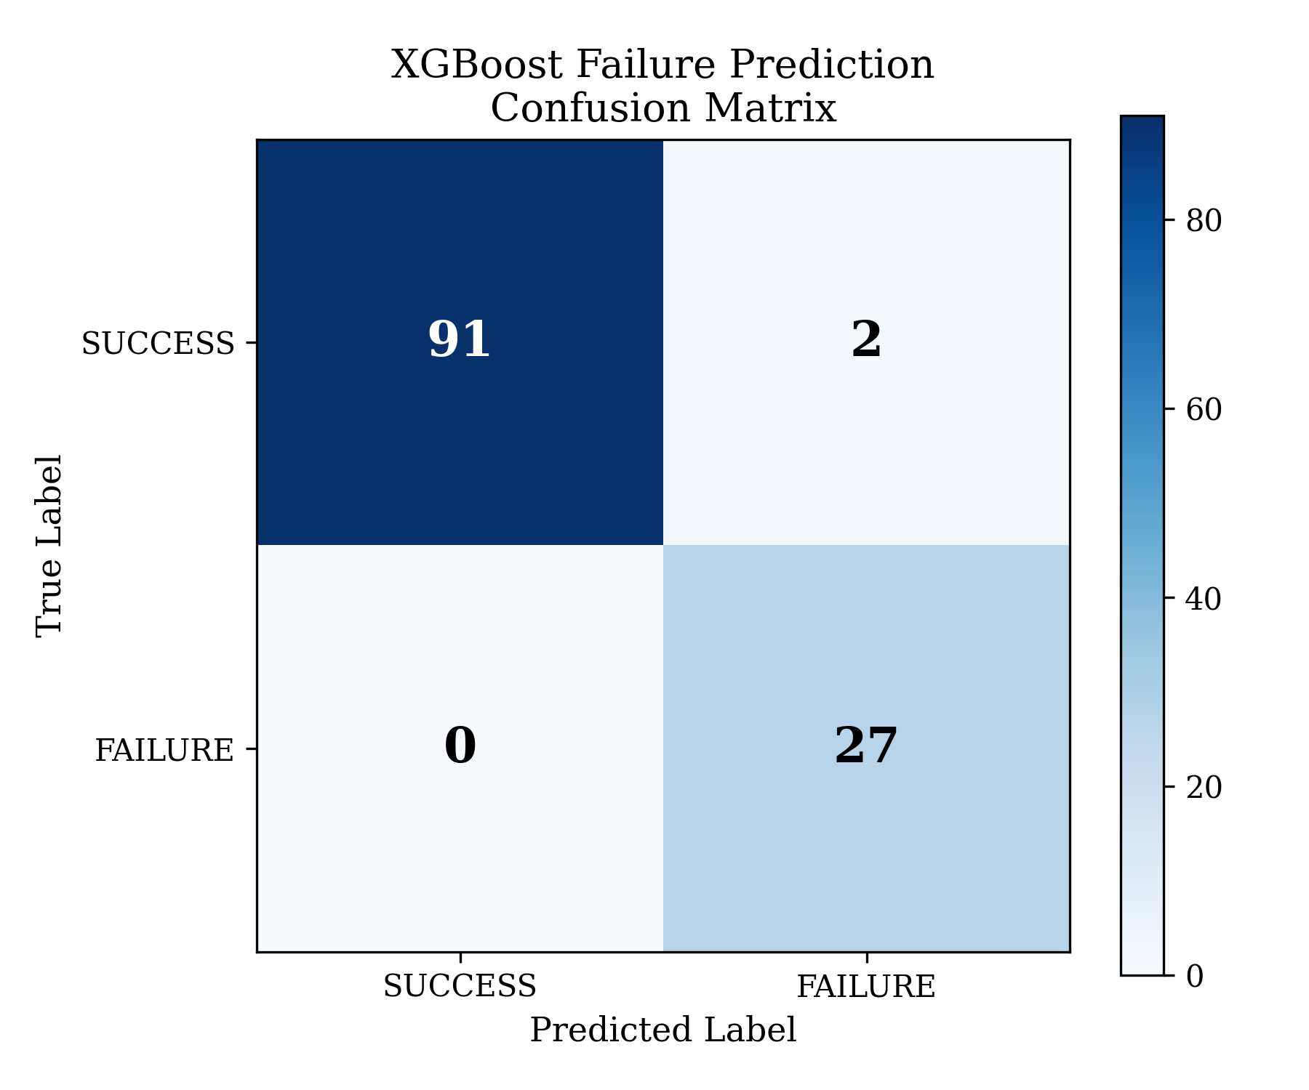
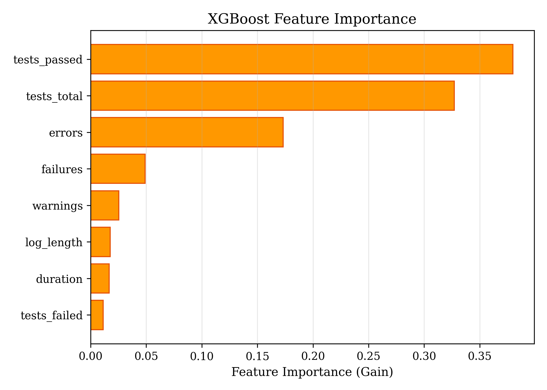
Model 1: XGBoost — Failure Prediction
Approach:
• Gradient boosted ensemble of 100 decision trees
• Input: 8 features (duration, errors, warnings,
failures, log_length, tests_failed/passed/total)
• Output: Failure probability (0–1)
• Handles class imbalance via scale_pos_weight
• 80/20 stratified train-test split
Metric | Value
Accuracy | 98.33%
Precision | 93.10%
Recall | 100.00%
F1-Score | 96.43%
ROC AUC | 100.00%
5-Fold CV: 99.0% ± 0.6% accuracy
Dept of Computer Science and Engineering
COEP Technological University, Pune
11

Slide 12
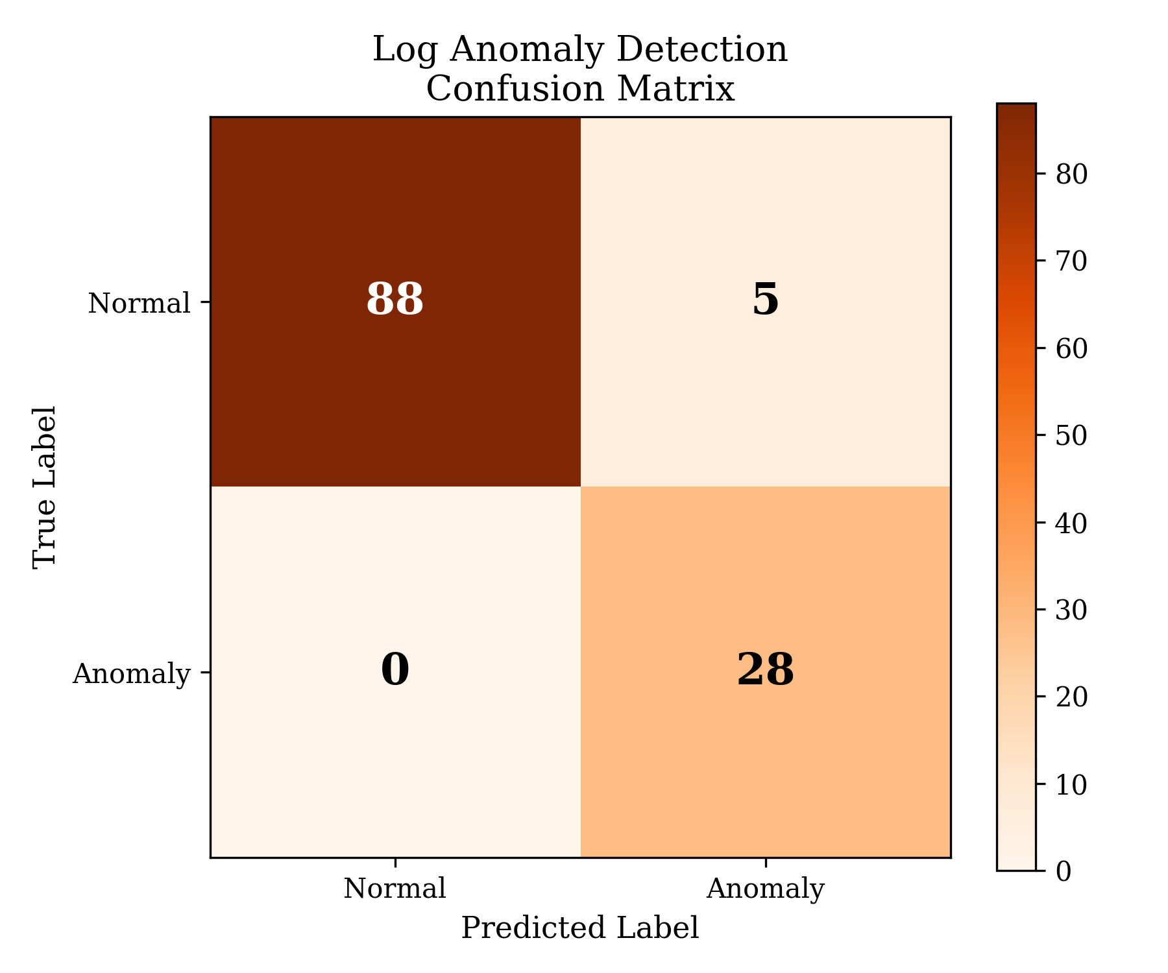
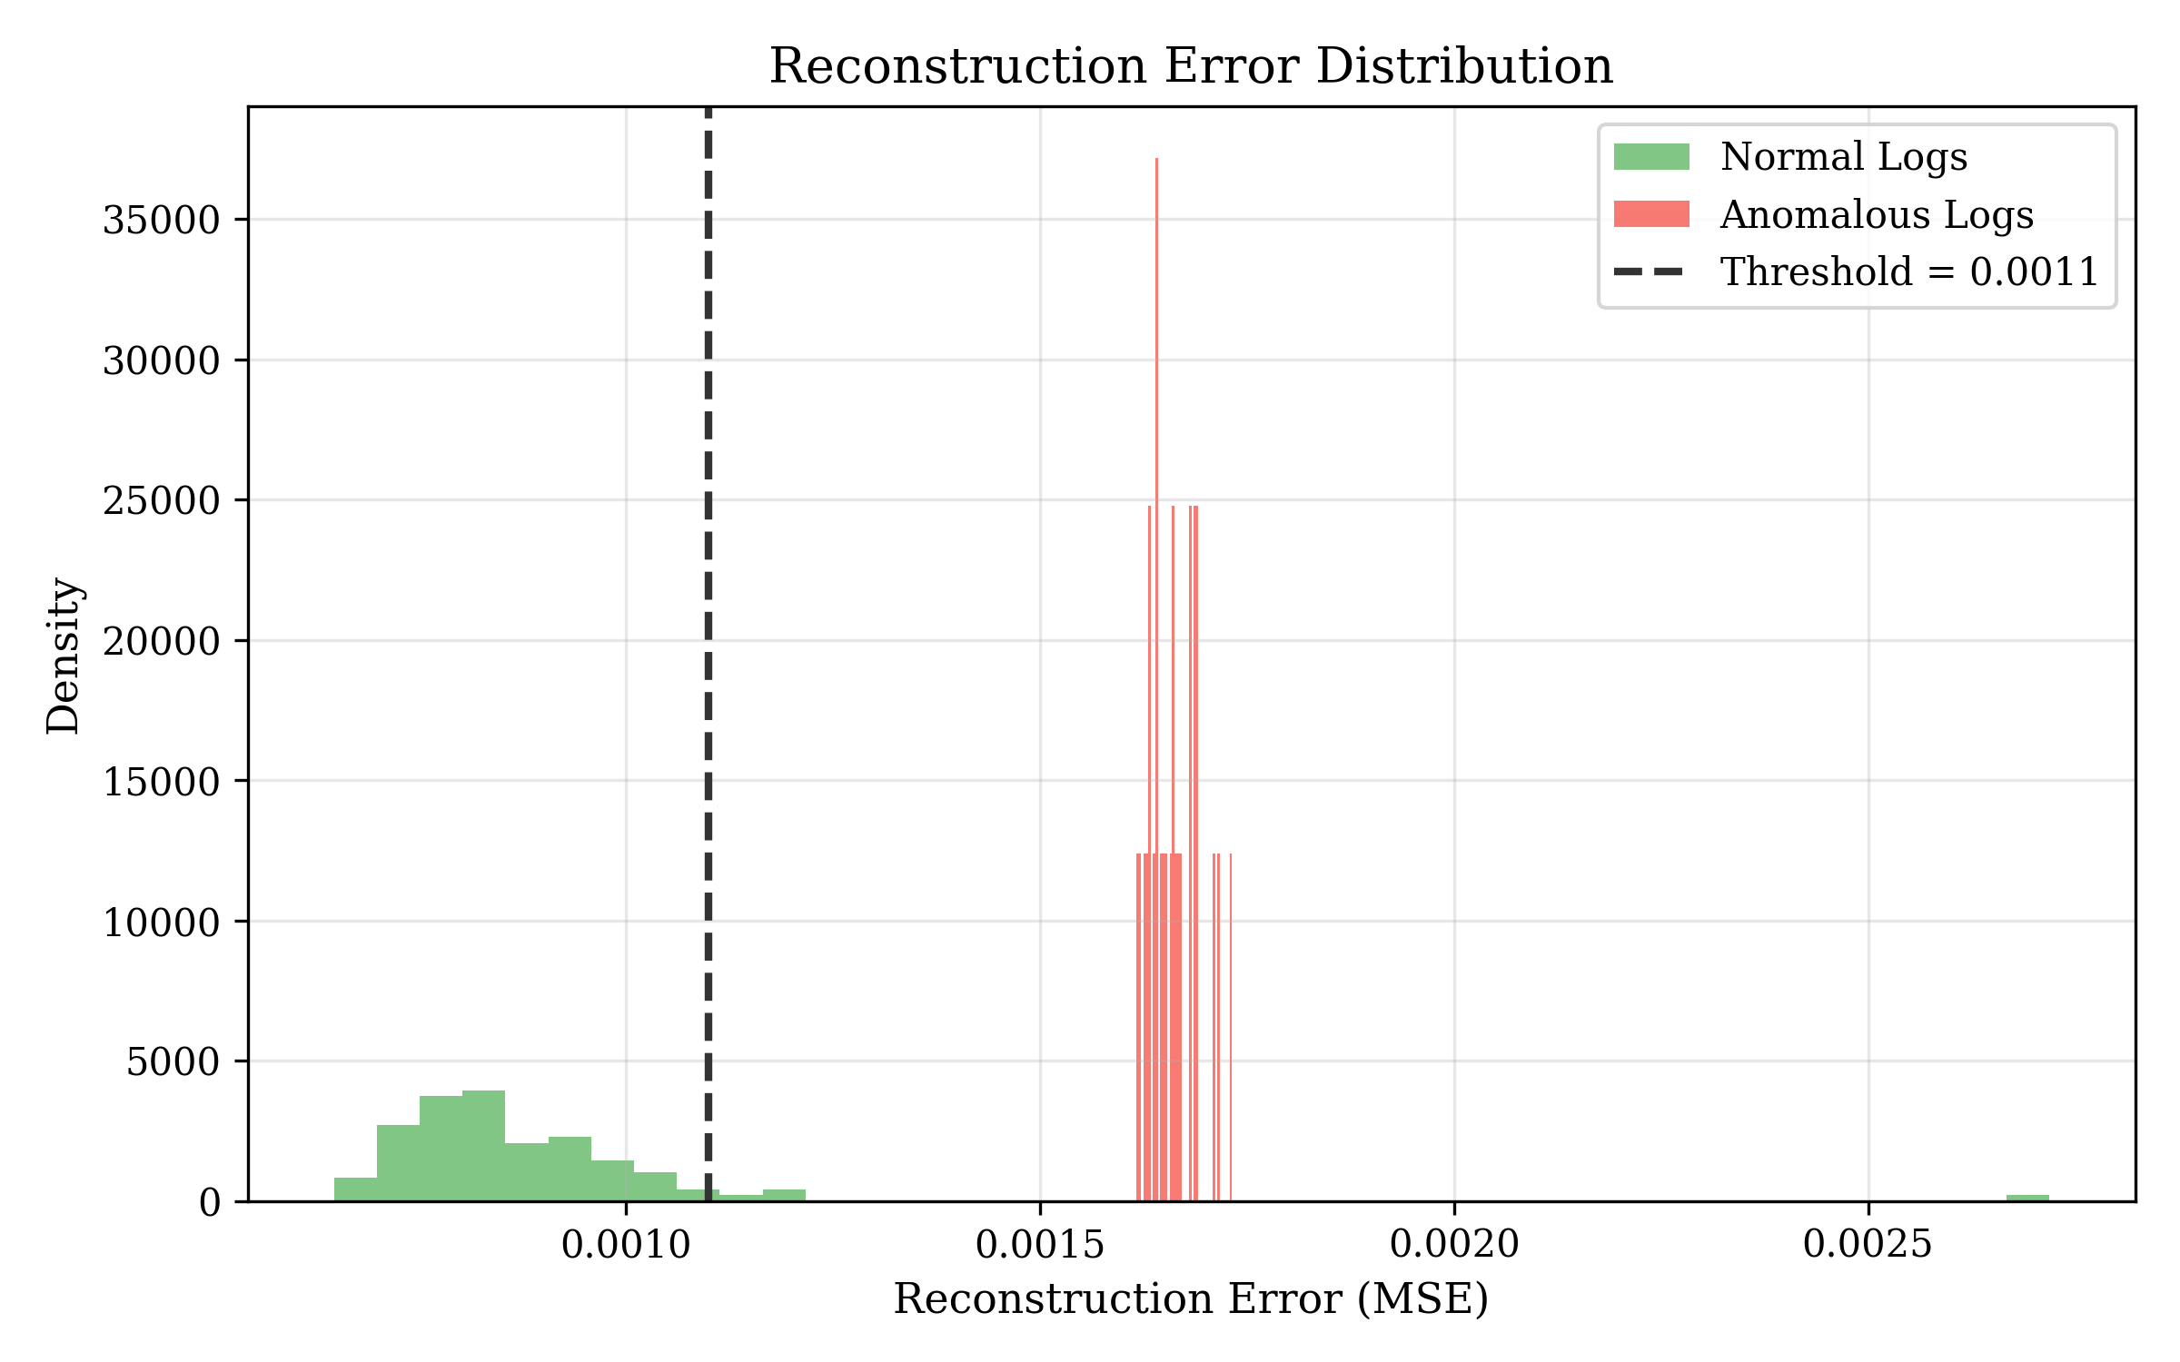
Model 2: TF-IDF + Autoencoder — Anomaly Detection
Two-Stage Pipeline:
• Stage 1: TF-IDF vectorization (500 features)
- ngram range (1,2), sublinear TF scaling
• Stage 2: Autoencoder neural network
- Architecture: 500→128→64→32→64→128→500
- Trained on normal logs only (unsupervised)
- Anomaly = high reconstruction error
• Threshold: 95th percentile of normal errors
Metric | Value
Accuracy | 95.87%
Precision | 84.85%
Recall | 100.00%
F1-Score | 91.80%
ROC AUC | 98.92%
Dept of Computer Science and Engineering
COEP Technological University, Pune
12

Slide 13
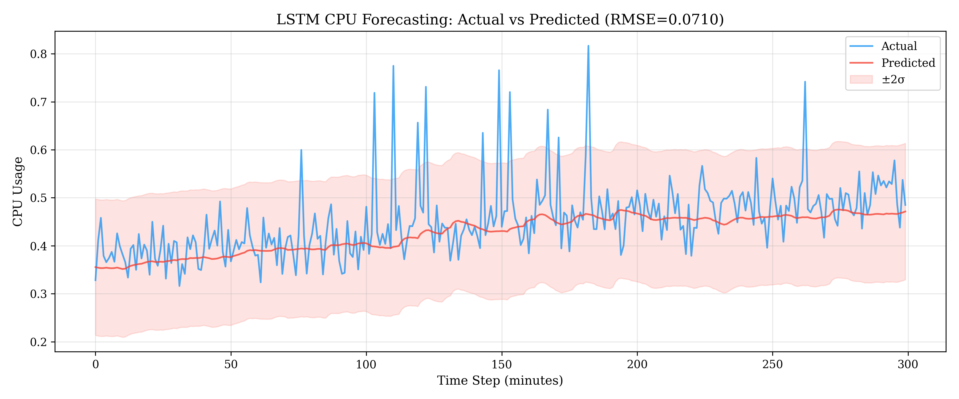
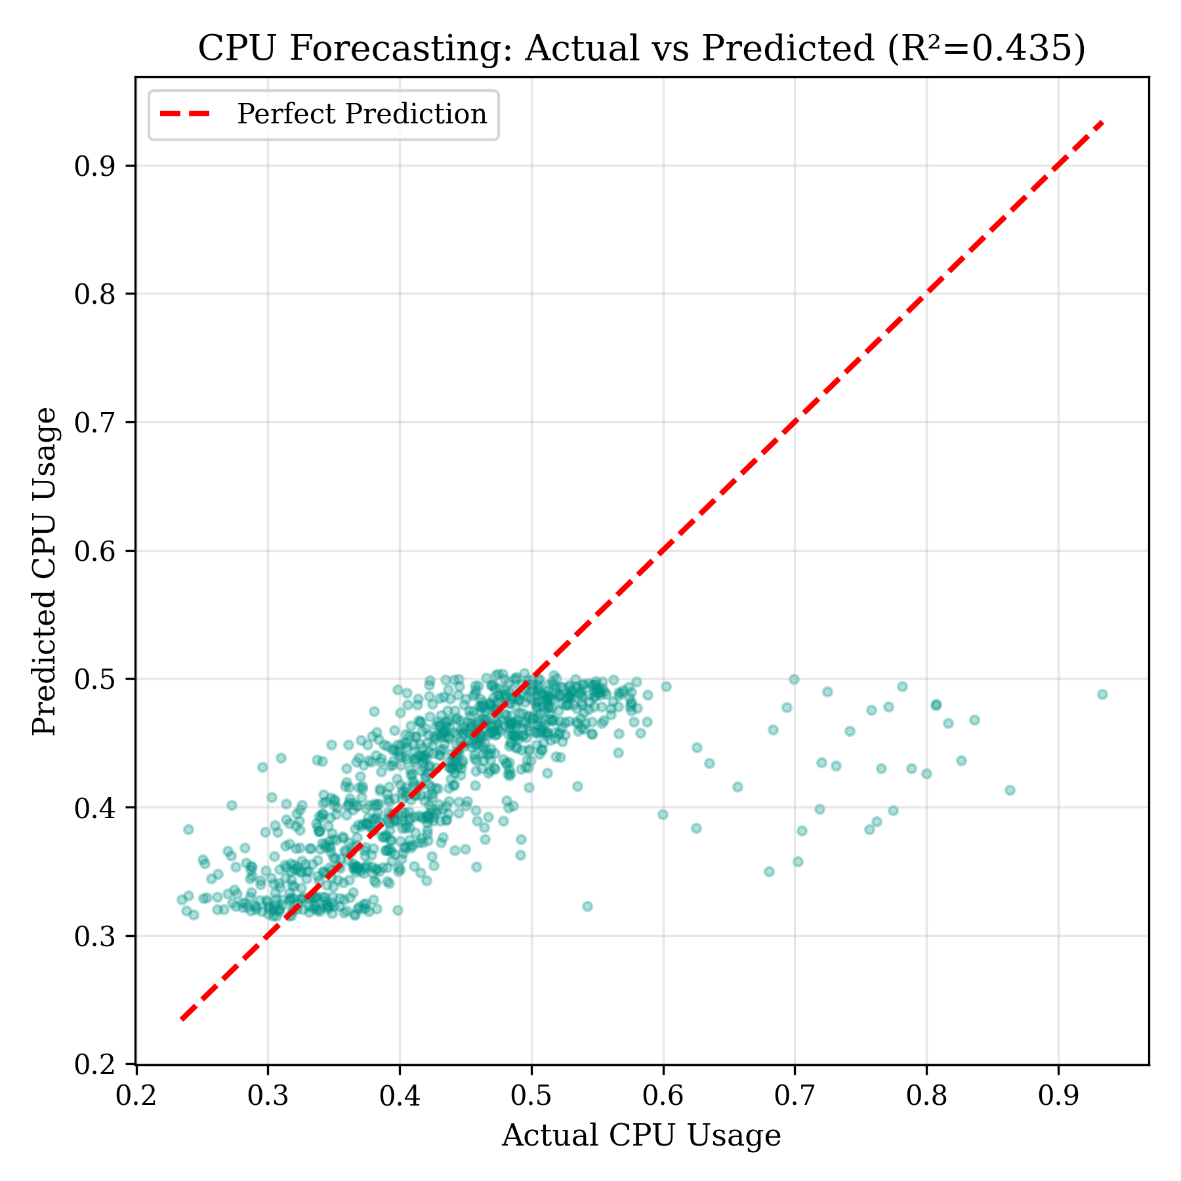
Model 3: LSTM — CPU Forecasting
Approach:
• Input: 60-minute CPU history (sliding window)
• Output: Predicted CPU usage 10 minutes ahead
• Architecture: LSTM(128) → LSTM(64) → Dense(32) → Dense(1)
• MinMaxScaler normalization to [0, 1]
• 10,000+ training sequences
• Early stopping + LR reduction on plateau
Metric | Value
MSE | 0.0050
MAE | 0.0436
RMSE | 0.0710
MAPE | 9.56%
R² | 0.435
Dept of Computer Science and Engineering
COEP Technological University, Pune
13

Slide 14
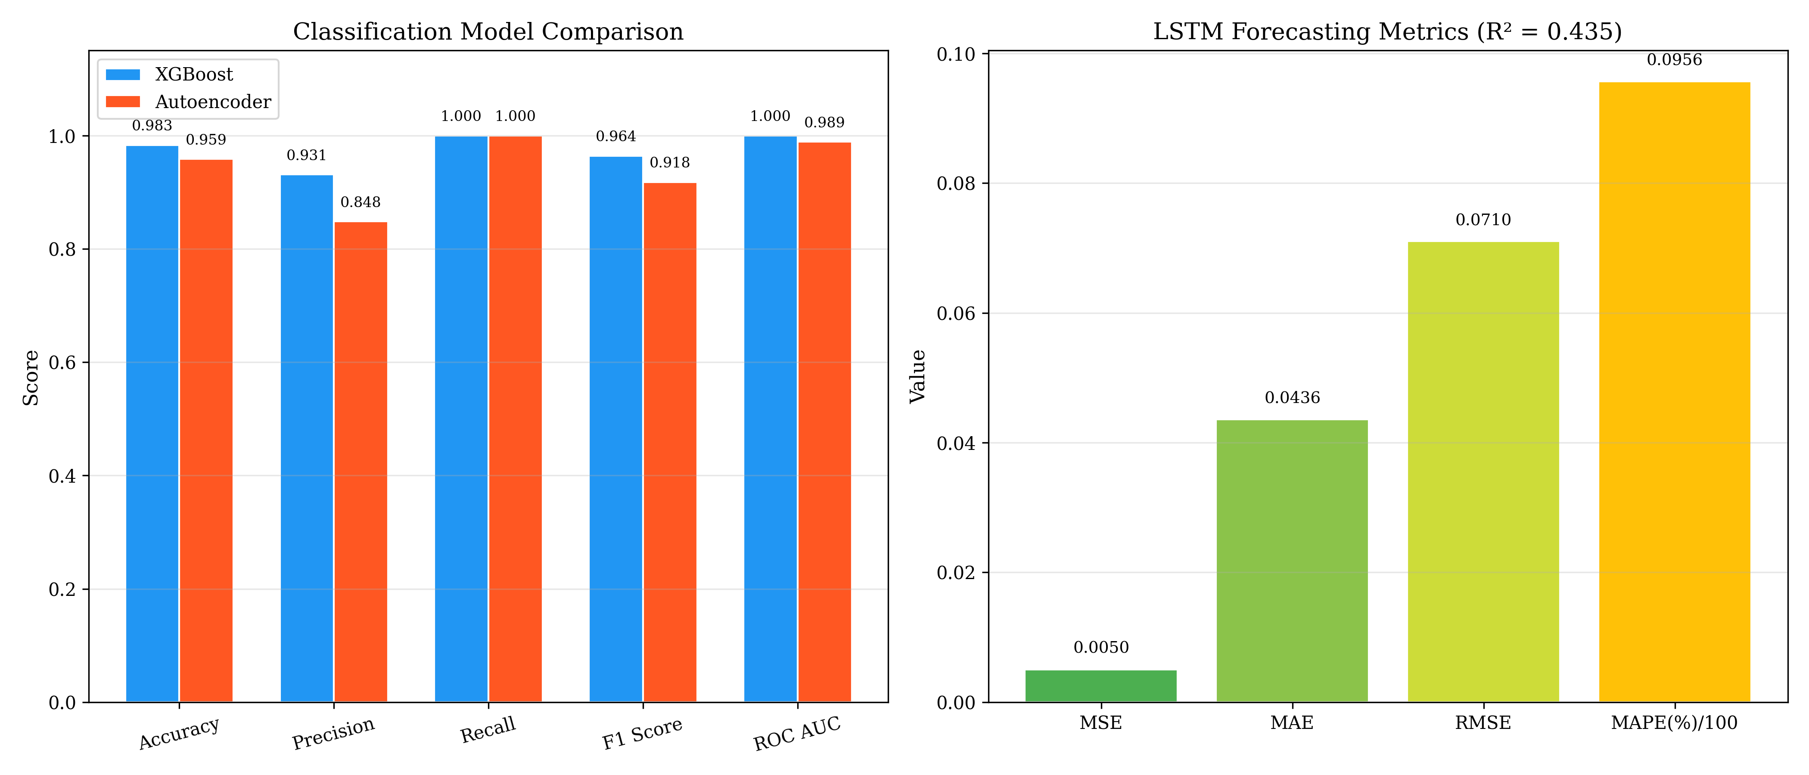
Combined Model Performance Summary
Module | Algorithm | Key Metric | ROC AUC / R²
Failure Prediction | XGBoost | F1 = 0.964 | AUC = 1.000
Anomaly Detection | TF-IDF + Autoencoder | F1 = 0.918 | AUC = 0.989
CPU Forecasting | LSTM | RMSE = 0.071 | R² = 0.435
Dept of Computer Science and Engineering
COEP Technological University, Pune
14

Slide 15
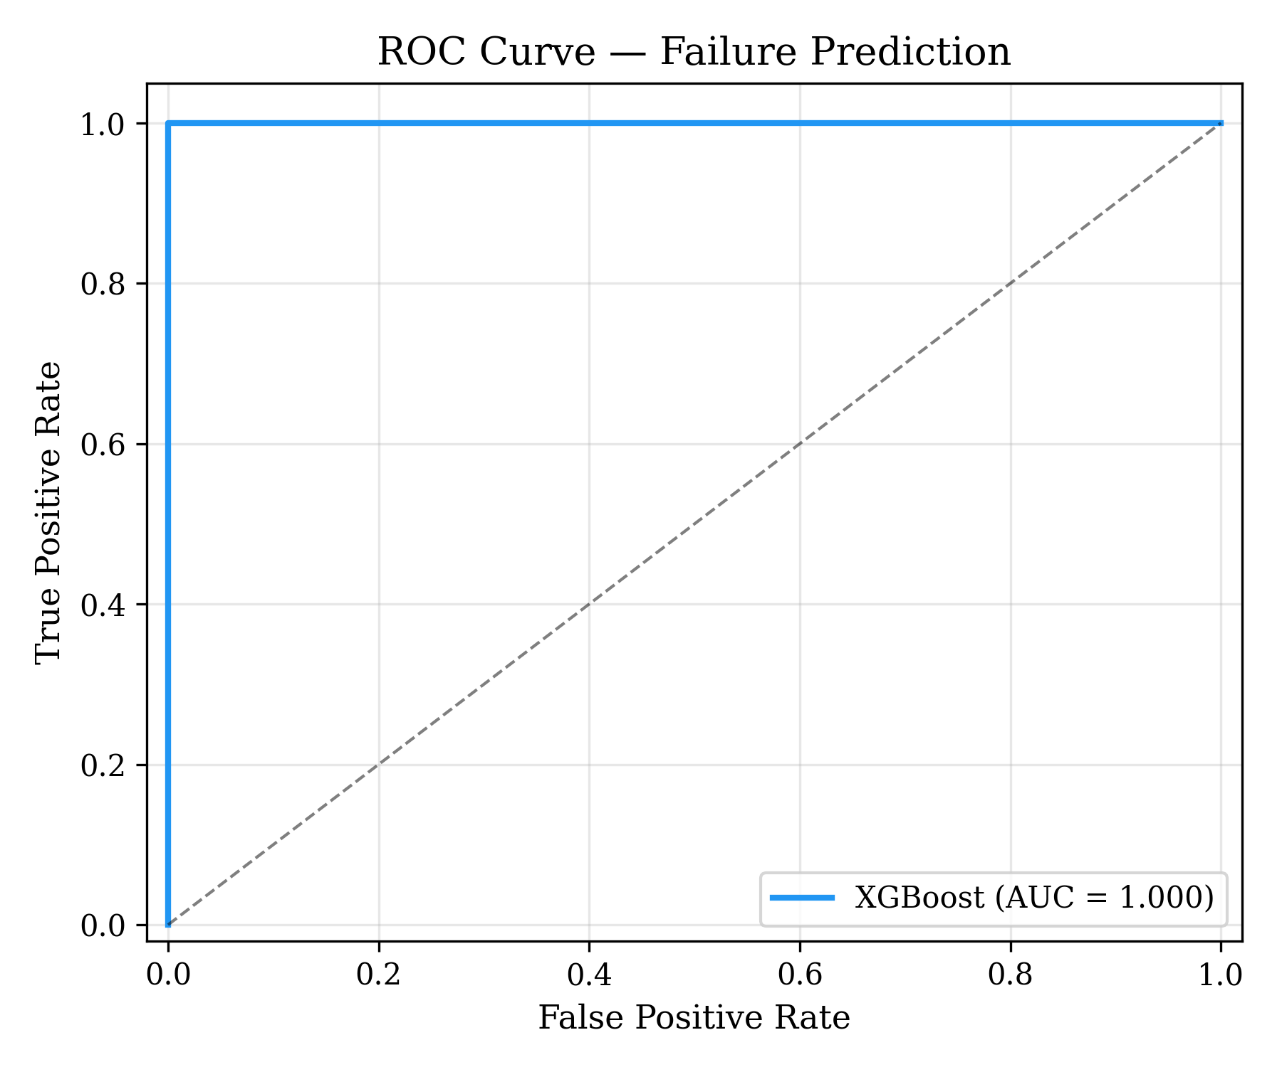
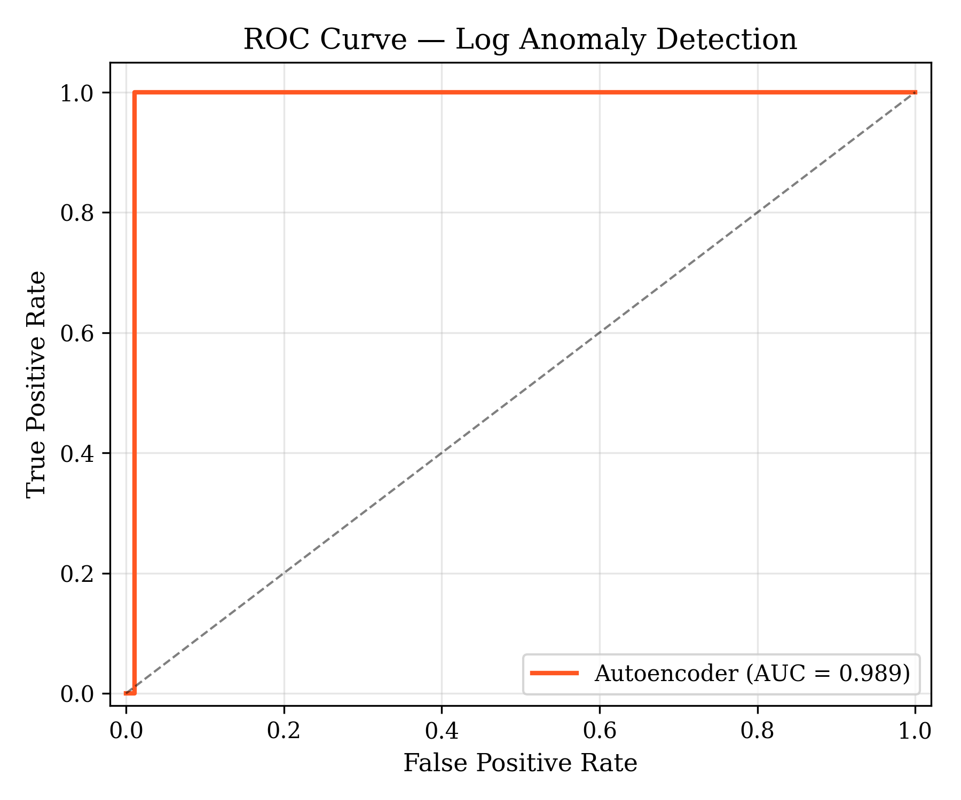
ROC Curves — Classification Models
XGBoost: AUC = 1.000
Autoencoder: AUC = 0.989
Dept of Computer Science and Engineering
COEP Technological University, Pune
15

Slide 16
Future Plan — Phase-III
Integration & Deployment:
• Connect all 3 trained models to
FastAPI AIOps Orchestrator
• Expose REST APIs:
/predict_failure, /detect_anomaly,
/forecast_cpu, /autoscale
• Implement predictive autoscaler
using ML outputs for Kubernetes
• Deploy on Minikube with Docker
Testing & Finalization:
• End-to-end system testing
• Compare predictive autoscaler
vs default HPA
• Load generation & stress testing
• Monitoring dashboard
(Grafana/Streamlit)
• Hyperparameter tuning
• Final documentation & report
Dept of Computer Science and Engineering
COEP Technological University, Pune
16

Slide 17
References
[1] Pintye et al., "Enhancing ML-Based Autoscaling for Cloud Resource Orchestration," J. Grid Computing, 2024.
[2] Guruge & Priyadarshana, "Time Series Forecasting-Based K8s Autoscaling Using Prophet and LSTM," Frontiers in CS, 2025.
[3] Yahya et al., "Deep Learning for Multivariate Time Series Anomaly Detection: A Survey," AI Review, 2025.
[4] Hrusto, "Towards Optimization of Anomaly Detection in DevOps," IST, vol. 158, 2023.
[5] Das & Raj, "AI-Enhanced Platform Engineering: Revolutionizing CI/CD Pipelines," IJCEST, 2025.
[6] Mathew & Baswareddy, "Predictive Failure Analysis in CI Pipelines Using Ensemble Trees," IJACS, 2025.
[7] Guo et al., "LogBERT: Transformer-Based Log Anomaly Detection for CI/CD Systems," ICSE, 2021.
[8] Houerbi et al., "Empirical Analysis on CI/CD Pipeline Evolution: Failures and Bottlenecks," JSME, 2024.
Dept of Computer Science and Engineering
COEP Technological University, Pune
17

Slide 18
Thank You!
Questions?
Tejas Annasaheb Jagtap | 712442021 | MTech Information Security
COEP Technological University, Pune
Dept of Computer Science and Engineering
COEP Technological University, Pune
18

