Slide 1


Indian Railways Train Insight Analysis
By
Purven Nitin Zambre-239536
Tejas dnyandeo kolambe-239523
Mrs. Priti Take Mr. Rohit Puranik
Project Guide Centre Coordinator

Slide 2
Indian Railways Train Insight Analysis
Context
Collection
ETL
Combined
Data
Database Creation
Processing
PySpark
Sources

Slide 3
Introduction
Problem: Though travel planning with one train is easy, there are no systems that help plan the long multi-days multi-train travel which is a problem.
Background: Evolution of train transportation technology
Objective: To Collect data
To Extract Data
To Load Data

Slide 4
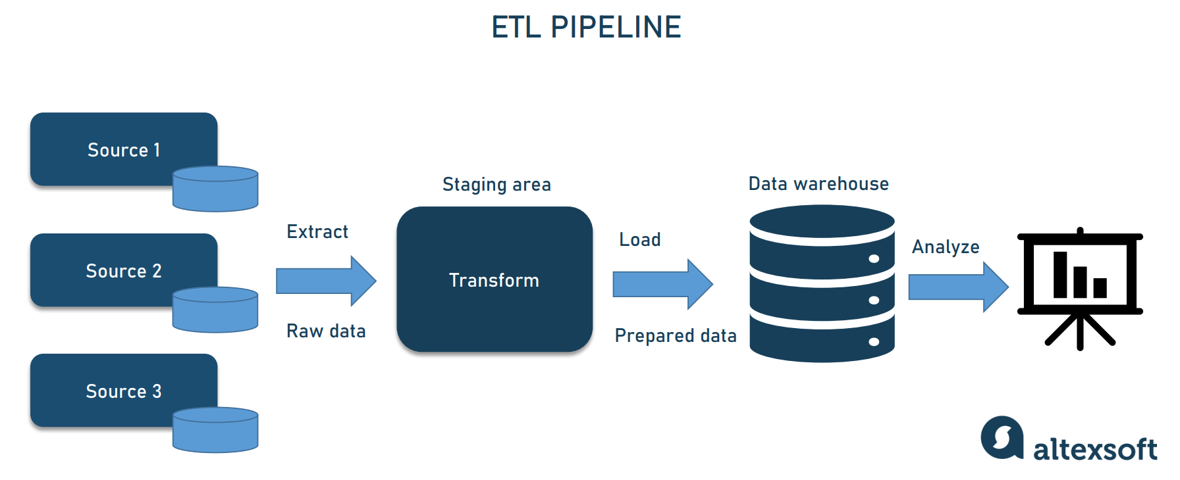
ETL Pipeline Development for IRCTC Data
This project involves the development of an ETL pipeline to collect, clean, and organize the raw data of IRCTC (Indian Railways Catering and Tourism Corporation).

Slide 5
Transformation
Involves cleaning, structuring, and enriching the extracted data. This may include tasks such as removing duplicates, handling missing values, converting data types, and applying business rules or calculations to derive new fields.
Here we transformed the data by splitting the important column by removing the unnecessary columns which may cause data in efficiency.

Slide 6
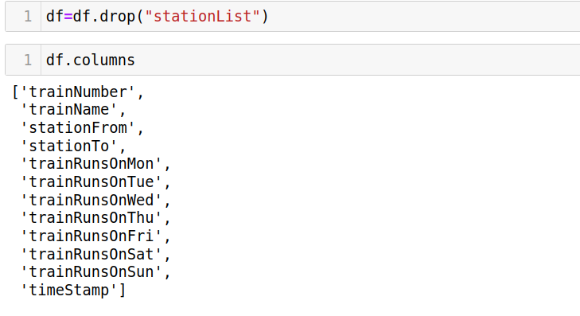
Data cleaning:-
Drop the column which are not necessary

Slide 7
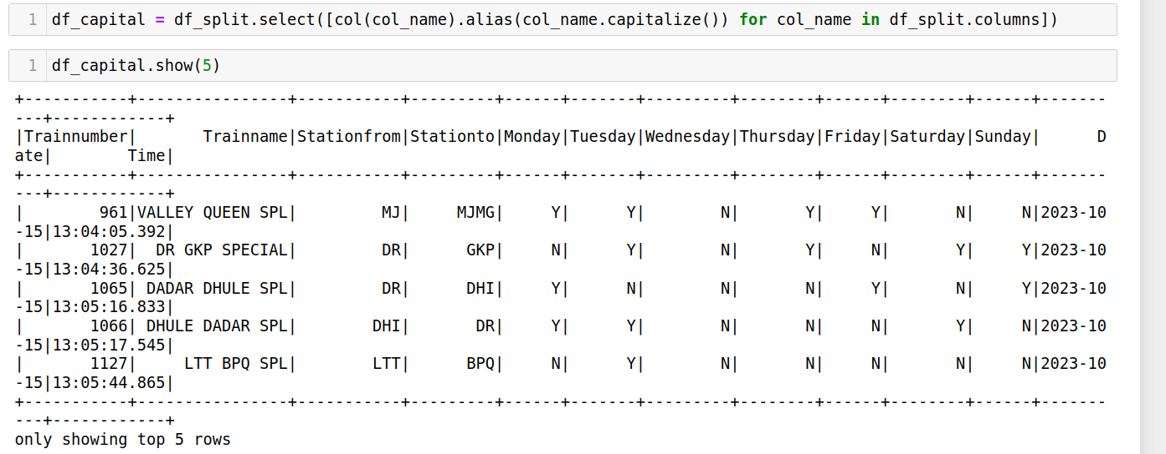
Capitalize :-To capitalize the first letter of each word in a column using PySpark

Slide 8
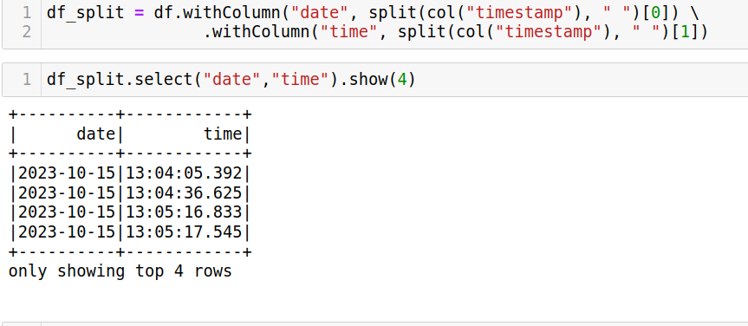
Splitting Columns:-
The Split() function splits a string column into an array of substrings based on a delimiter.

Slide 9
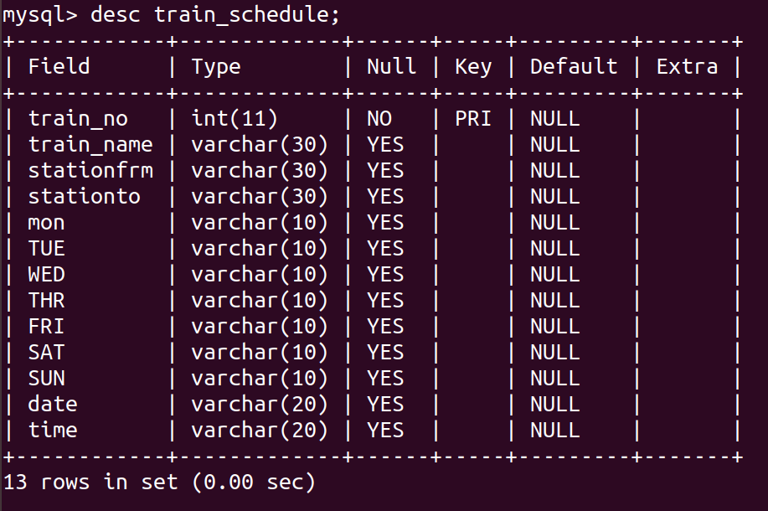
Transformed schema

Slide 10
Commands used in Pyspark
df.withColumn – To create new column
df_split.drop("timeStamp") – To drop particular column
col_name.capitalize() – Convert to upper case
df_col.printSchema() – To print the schema of the the data
df.show() – to show the data
mysql_url = "jdbc:mysql://127.0.0.1:3306/project?useSSL=false&allowPublicKeyRetrieval=true"

Slide 11
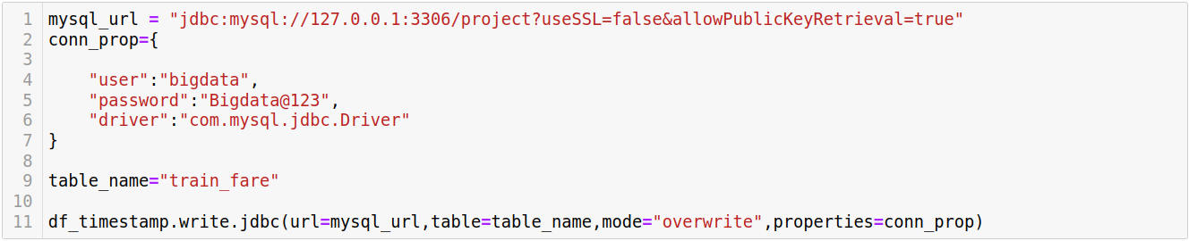
Load data
Finally, the transformed data is loaded into a destination such as a data warehouse, data lake, or a database, where it can be accessed and analyzed by users or applications.

Slide 12
My-sql connectivity
MySQL connectivity with Spark refers to the ability to connect and interact with a MySQL database from a Spark application. This allows you to read data from MySQL tables into Spark DataFrames for analysis, and also to write data from Spark Data Frames back to MySQL tables.

Slide 13
Advantages:-
Data Integration: It helps in integrating data from various sources such as ticket booking systems, train schedules, passenger information, etc., into a unified platform for analysis.
Data Quality: ETL processes can clean, filter, and standardize data, improving its quality and reliability for analysis.
Scalability: Big data technologies used in ETL pipelines, such as Apache Spark or Hadoop, enable processing large volumes of data efficiently, allowing for scalability as the dataset grows.
Performance: ETL pipelines can optimize data processing tasks, leading to faster query performance and overall improved system performance.
Real-time Insights: By using real-time data processing techniques in ETL pipelines, such as stream processing, the project can gain real-time insights into train operations, passenger trends, etc.
Cost Efficiency: ETL pipelines can help in reducing storage costs by optimizing data storage and eliminating redundant or unnecessary data.

Slide 14
Applications:-
Demand Forecasting: Analyzing historical booking data to predict future demand for train tickets, helping in better allocation of resources and optimizing ticket pricing.
Route Optimization: Analyzing train schedule and passenger data to optimize train routes, schedules, and stoppages for improved efficiency and customer satisfaction.
Customer Segmentation: Using passenger data to segment customers based on their travel patterns, preferences, and behaviors, enabling targeted marketing and personalized services.

Slide 15


