Slide 1
ABRASIVE JET MACHINING (AJM)
Lecture 22

Slide 2
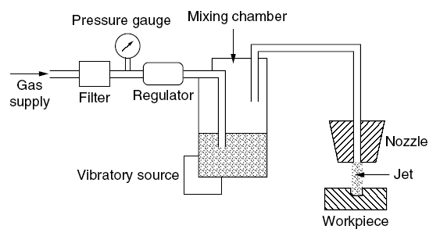
Abrasive Jet Machining (AJM)
A process that removes material from a workpiece through the use of abrasive particles entrained in a high velocity gas steam.
Basic components
Gas supply at least 690 to 830 kPa
Gas filter and water separator
Vibrating chamber
Nozzle, hand held or mounted in a fixture for automatic operation
Foot valve for pulsed operation or manual valve for continues operation
Dust hood or collection cabinet
AJM System
Notes:
Engagement of entire blade into cutting need higher forces. Therefore, inclined blade is used to reduce force.

Slide 3
Carrier Gas
Nitrogen or CO₂ or air is supplied under pressure of 2-8 kg/cm².
Oxygen should never be used because it causes a violent chemical reaction with the workpiece chips or the abrasives.
It is not practical to reuse the abrasive powder because contaminations and worn grit cause a decline of the machining rate.
Abrasives
Aluminum oxide (Al₂O₃) and silicon carbide (SiC) powders are used for heavy cleaning, cutting, and deburring.
Magnesium carbonate is recommended for light cleaning and etching. Sodium bicarbonate is used for fine cleaning and cutting of soft materials.
The abrasive grains should have sharp edges with optimal diameters of 10-50 μm.

Slide 4
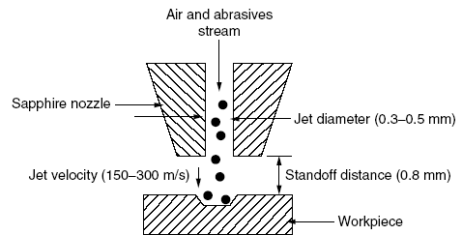
Nozzle
Made of tungsten carbide or sapphire.
Sapphire nozzles (300 hrs) last longer than tungsten carbide nozzles (12-30 hrs), but are more expensive and are only available with round holes.
Tungsten carbide nozzles can have either round or rectangular holes.

Slide 5

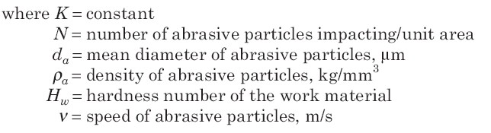
Volume Removal Rate (VRR)

Slide 6
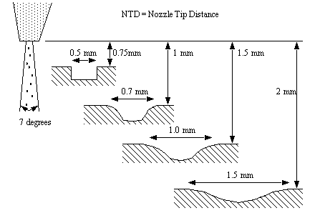
Stand off distance (STD) or Nozzle tip distance (NTD)
Gas stream remains cylindrical only for a short distance of 1.6 mm after exiting the nozzle.
At greater Distances, the jet begins to diverge into cone-shaped pattern with an included angle of about 7 degrees.

Slide 7
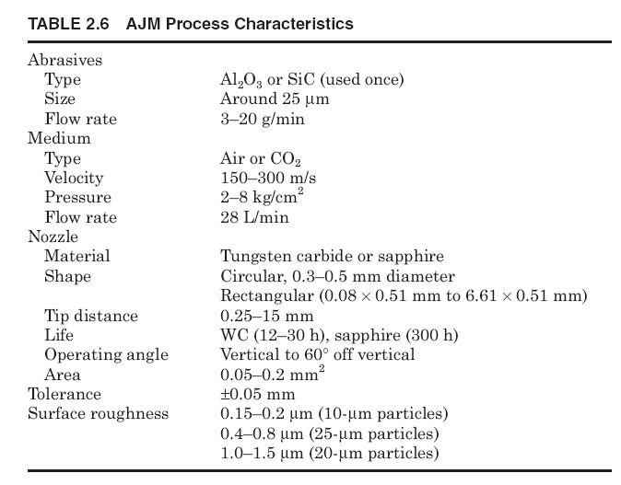
AJM Process Characteristics

Slide 8
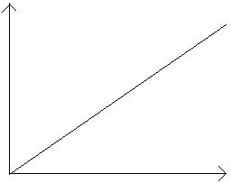
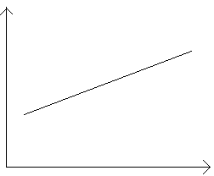
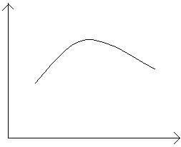
Effect of process parameters
VRR first increases with abrasive flow rate due to more particle impacts, but beyond the optimum it decreases because excessive particles collide and lose velocity before striking the workpiece.
VRR increases with particle velocity because higher kinetic energy enhances cutting and erosion, but at very high velocities particle fracture and nozzle wear can reduce effectiveness.
VRR increases with gas pressure since higher pressure accelerates particles to greater velocities, but excessive pressure may cause particle fragmentation and reduced cutting efficiency.
.
VRR
VRR
VRR
Abrasive flow rate
Velocity of particles
Gas pressure

Slide 9
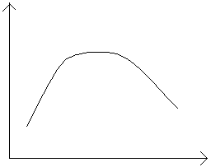
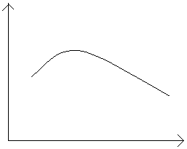
Effect of process parameters contd…
VRR increases with stand-off distance up to an optimum where the jet is well-focused but decreases at larger distances as the jet spreads and particle velocity drops.
VRR increases with mixing ratio up to an optimum due to balanced particle concentration and velocity but decreases beyond it as excess abrasives reduce carrier gas velocity and energy transfer.
VRR
VRR
Stand-off-distance
Mixing ratio

Slide 10
Advantages and Disadvantages of AJM
Advantages
Disadvantages
Slow volume removal rate.
Stray cutting can't be avoided (low accuracy ±0.1 mm).
Tapering effect may occur specially when drilling in metals.
Abrasive may get impeded in the work surface.
Suitable dust collecting systems should be provided. Silica dust may be a health hazard.
Soft materials can't be machined by the process.
Ordinary shop air should be filtered to remove moisture and oil.
Best suited for machining brittle and heat sensitive materials like glass, quartz, sapphire, ceramics, etc. It can machine super alloys, ceramics, glass and refractory materials.
Not reactive with any workpiece material.
No tool changes are required.
Intricate parts of sharp corners can be machined.
Workpiece material does not experience hardening.
It can machine thin materials.

Slide 11
Applications of AJM
Drilling holes, cutting slots, cleaning hard surfaces, deburring, polishing and radiusing.
Deburring of cross holes, slots, and threads in small precision parts that require a burr free finish such as hydraulic valves, aircraft fuel systems and medical appliances.
Machining intricate shapes or holes in sensitive, brittle, and thin or difficult-to-machine materials.
Insulation stripping and wire cleaning without affecting the conductor.
Micro-deburring of hypodermic needles.
Frosting glass and trimming of circuit boards, hybrid circuit resistors, capacitors, silicon and gallium
Removal of films and delicate cleaning of irregular surfaces because the abrasive stream is able to follow contours.

