Slide 1
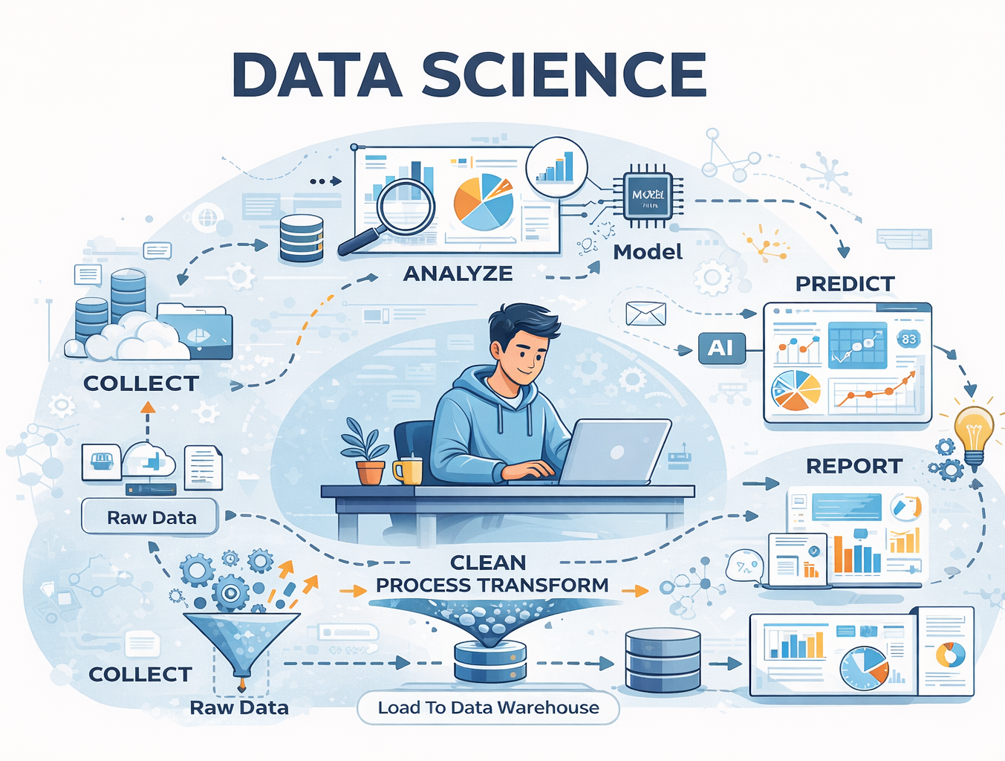
Data Warehouse OLTP VS OLAP and ETL
TEJAS NALAWADE

Slide 2
Agenda
1
2
3
4
5
What is Data Science
Data Warehouse
OLTP vs OLAP
ETL
Summary

Slide 3
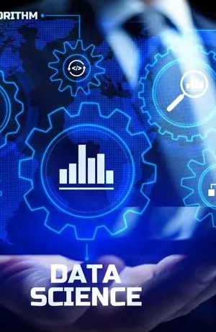
What is Data Science
Data Science is the discipline of collecting, processing, and transforming raw data into meaningful insights that help leaders and decision-makers make informed and data-driven decisions.

Slide 4
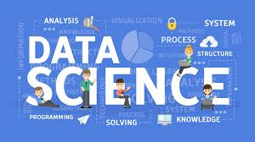
What will happen if Data Science is not use
Wrong or Poor Decision making
High Risk to business
Less Efficient
Slower Growth
Decision would be Guess based
Competitive Disadvantage
No real time insights
Poor Resource utilization

Slide 5
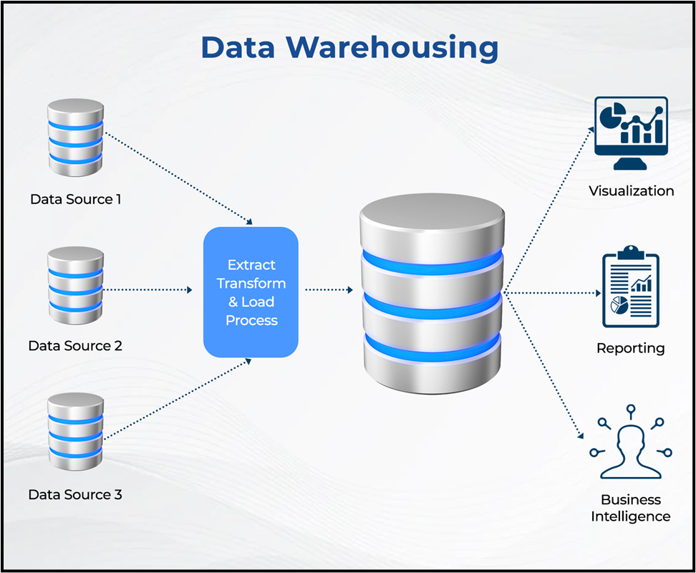
DATA WAREHOUSE
A data warehouse is a centralized repository that stores integrated and historical data to support analysis and decision-making.
Centralized Data storage
Stores Historical Data
Use ETL process
Works with BI tools
Support decision making

Slide 6
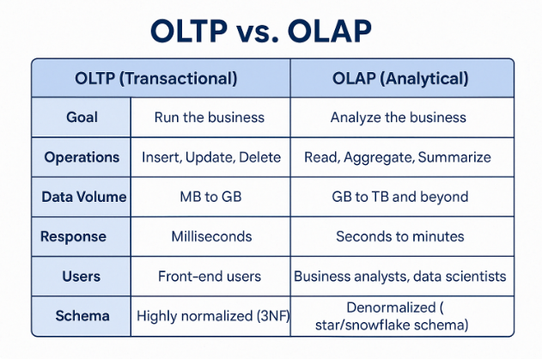
OLTP and OLAP
OLTP : Online Transaction Process
OLAP: Online Analytical Processing
OLTP for common people ETL
OLAP for expert Analysis
OLAP use Historical data
OLTP use the current data
Example: Online Food Booking App where order place is OLTP but Top Selling Food item is OLAP

Slide 7
ETL
EXTRACT
TRANSFORM
LOAD
Collect data from different sources.
Sources: Database, Excel, API, logs.
Data is in raw form
No Changes to data
First step to ETL
Clean the raw data
Remove Duplicate and errors
Convert data format
Apply Business Logic
Make day ready for analysis
Store data to the data warehouse.
Data is structured
Further used for the BI tools for Analysis
Final step of ETL

Slide 8
SUMMARY
Learned about what data science is and why it is required.
What would happen if data science is not use.
Data warehouse concept and what exactly it is
OLTP and OLAP what are they and they are the fundamentals of Data science
What are ELT and what are its different components.
Installation of Oracle DB and Setting up the database server

