Slide 1
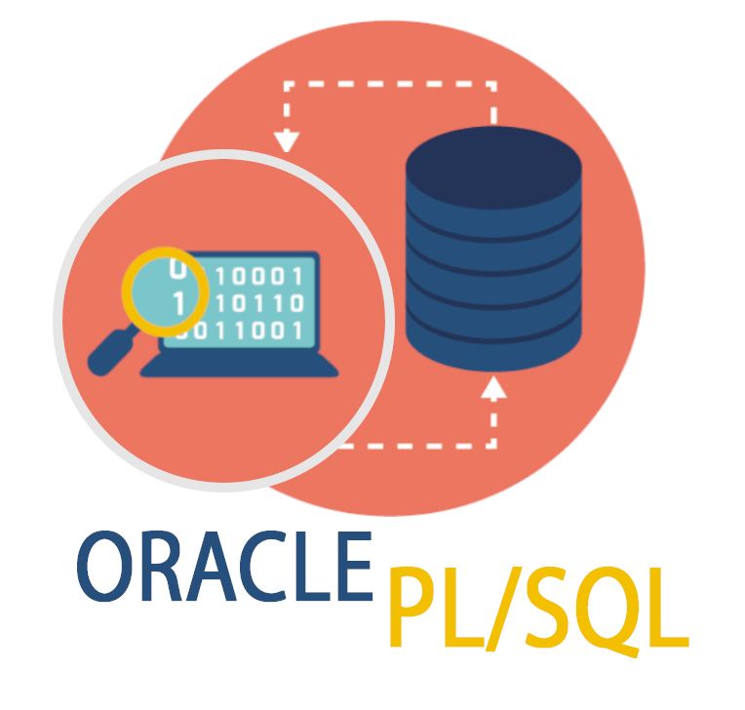
Database Schema SQL and PL/SQL
TEJAS NALAWADE

Slide 2
Agenda
1
2
3
4
5
Database Schema and Tables
SQL Sub-language
Operator and Functions
Subquery and Analytical Functions
PL/SQL cursor and trigger

Slide 3
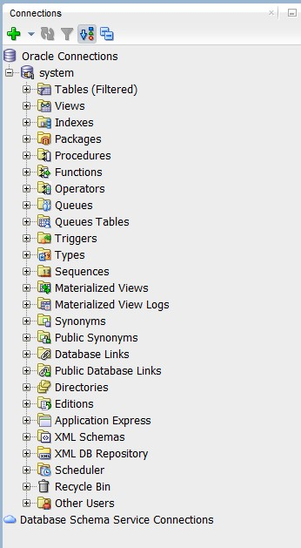
Database Schema
A database schema tells the database what data to store, where to store it and how it is connected.
Tables
Views
Indexes
Sequences
Synonyms

Slide 4
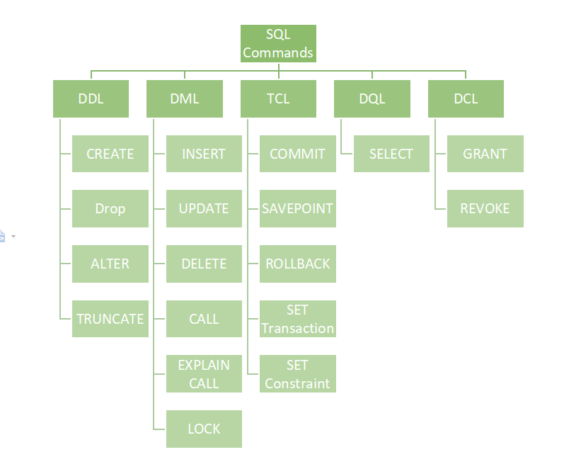
SQL SUB-LANGUAGE
DDL (Data Definition Language) is use to create or change the structure of database. CREATE, ALTER, DROP, TRUNCATE
DML (Data Manipulation Language) is use to work with data inside the table. INSERT, UPDATE, DELETE
TCL (Transaction Control Language) is use to manage transaction in the database. COMMIT, ROLLBACK, SAVEPOINT.
DQL (Data Query Language) is use to fetch data in database. SELECT
DCL (Data Control Language) is used to control access permission in the database. GRANT, REVOKE

Slide 5
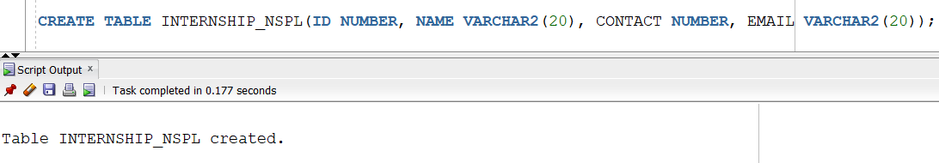
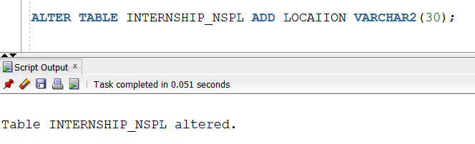
DDL – DATA DEFINITION LANGUAGE
CREATE : Creates a new database object and table
ALTER: Used to modify the structure of an existing table.
SQL DATA TYPES
NUMBER: Stores number with or without decimal -> salary NUMBER(7,2)
INTEGER : Store the whole number only -> age INTEGER
DECIMAL: Store decimal (fractional) numbers -> price DECIMAL(5,2)
CHAR: Stores fixed-length characters -> gender CHAR(1)
VARCHAR: Stores variable-length characters -> name VARCHAR(20)
VARCHAR2: Store variable-length character with no extra space -> email VARCHAR2(50)
Types of ALTER Command
ADD
DROP
MODIFY
RENAME

Slide 6
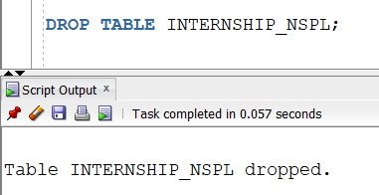
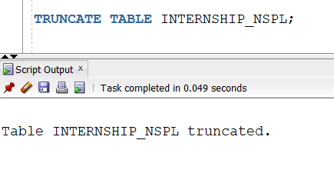
DDL – DATA DEFINITION LANGUAGE
DROP : Used to permanently delete a table and its structure.
TRUNCATE: Used to delete all records from a table but keep the structure.

Slide 7
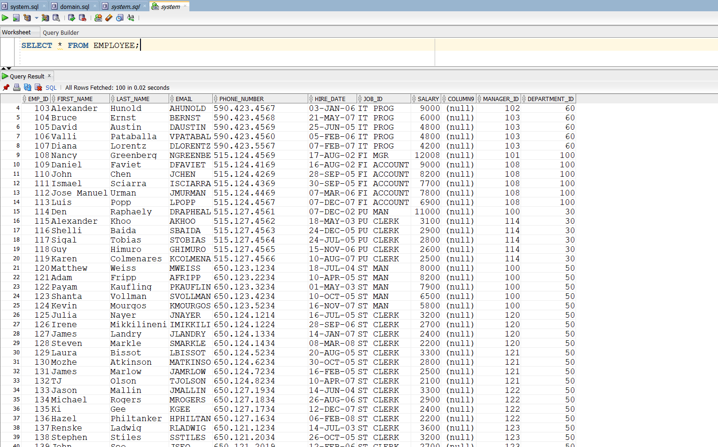
DQL – DATA QUERY LANGUAGE
SELECT : Used to fetch data from a table.
WHERE : Used to filter records based on a condition.
ORDER BY : Used to sort records in ascending or descending order.
HAVING : Used to filter groups after applying GROUP BY.

Slide 8
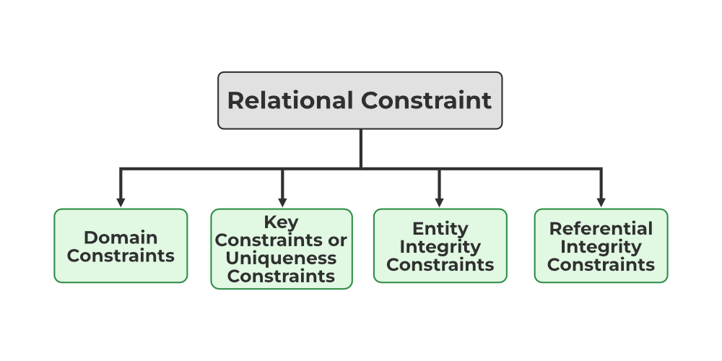
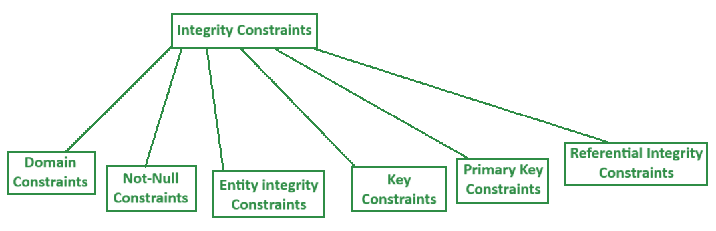
CONSTRAINTS
Constraints: Constraints are rules or restrictions applied to table columns to maintain data accuracy, integrity, and reliability.
NOT NULL: Does not allow NULL values in a column.
UNIQUE: Does not allow duplicate values in a column.
PRIMARY KEY: A combination of UNIQUE and NOT NULL constraints.
FOREIGN KEY: Used to create a parent–child relationship between tables.
CHECK: Applies a condition on column values.
DEFAULT: Assigns a default value if no value is provided.

Slide 9
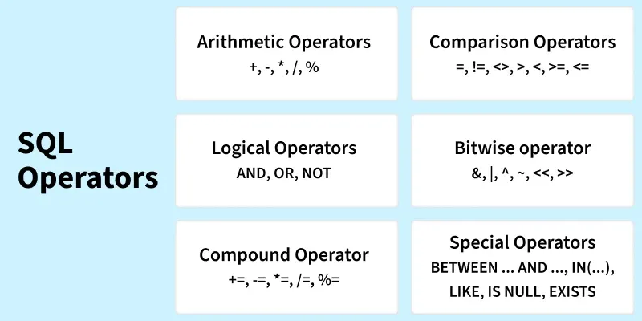
SQL Operators
SQL Operators are symbols or keywords used in SQL queries to perform operations on data, such as comparison, calculation, filtering, and logical checks.
Arithmetic Operators
Comparison (Relational) Operators
Logical Operators
Special Operators
BETWEEN
IN
NOT IN
LIKE
IS NULL / IS NOT NULL
Set Operators
Concatenation Operator

Slide 10
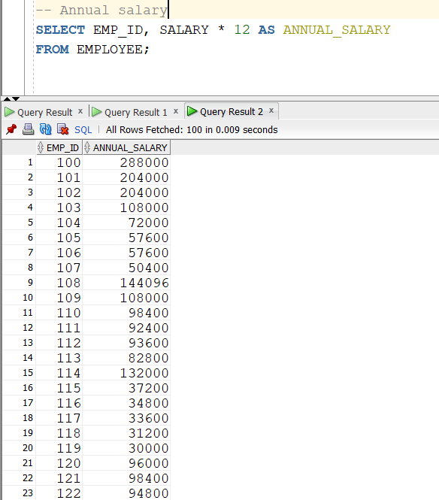
ARITHMETIC OPERATORS
Arithmetic Operators:
Used to perform mathematical calculations.
Addition (+)
Subtraction (-)
Multiplication (*)
Division (/)

Slide 11
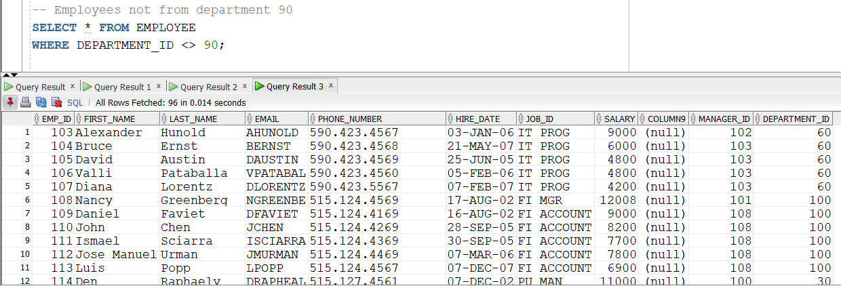
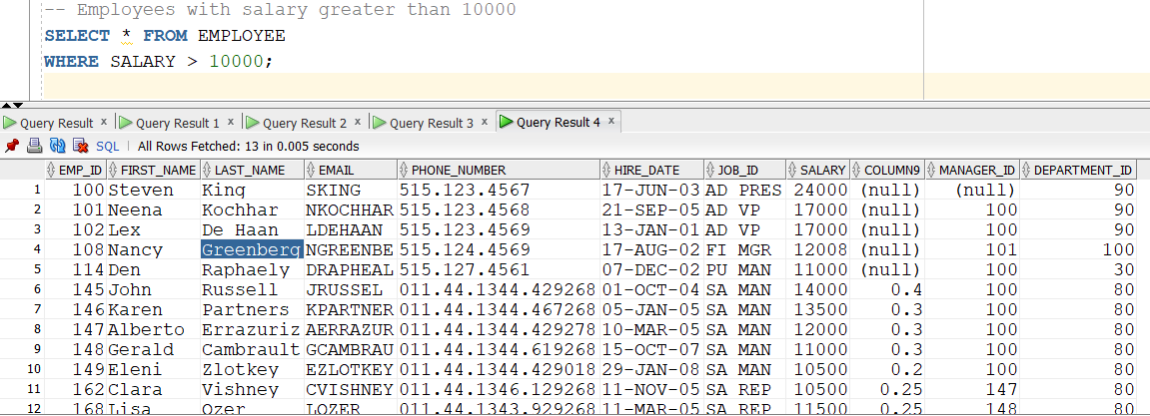
COMPARISON OPERATORS
Comparison (Relational) Operators: Used to compare values.
Equal to (=)
Not equal (!= or <>)
Greater than (>)
Less than (>)
Greater than equal to (>=)
Less than or equal to (<=)

Slide 12
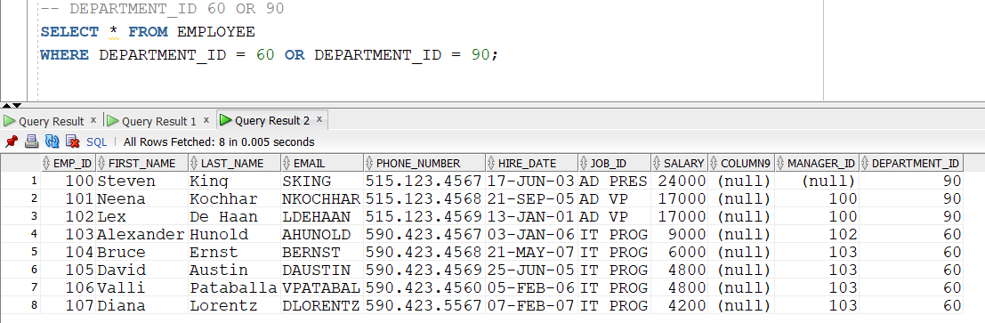
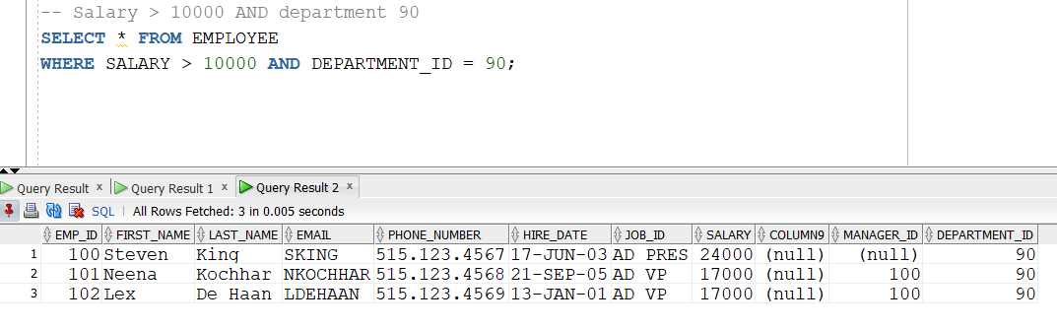
LOGICAL OPERATORS
Logical Operator: Used to combine multiple conditions.
AND
OR
NOT

Slide 13
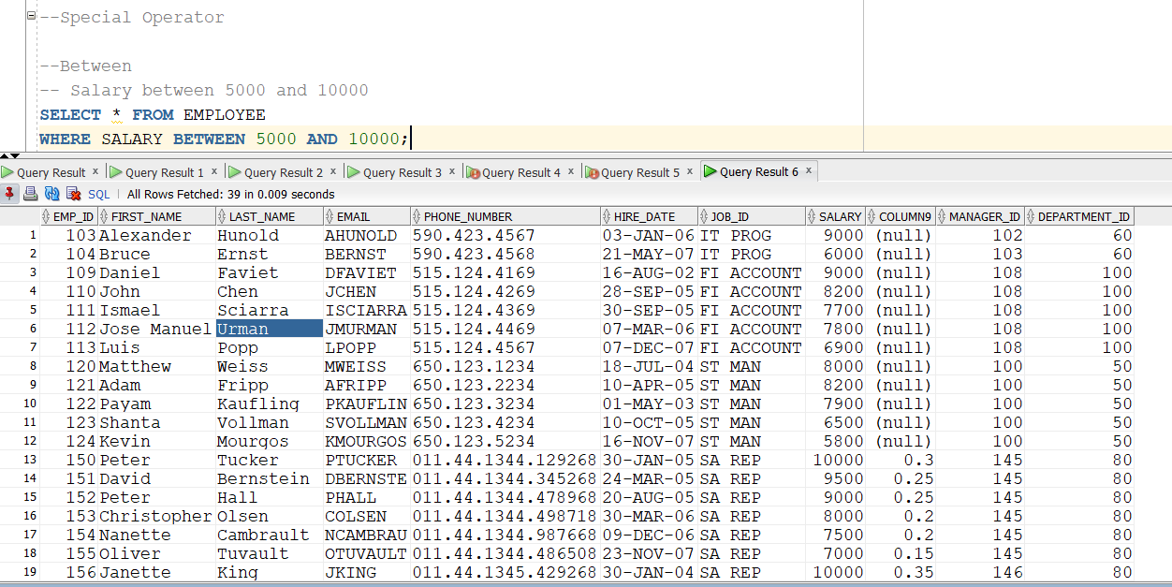
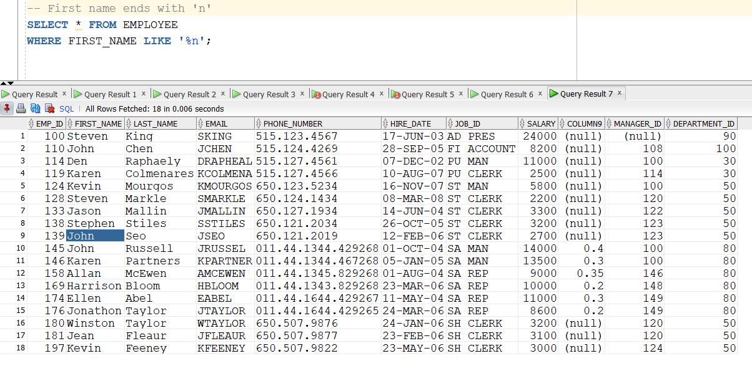
SPECIAL OPERATORS
Special Operators:
Used for range, list, pattern, and NULL checks.
BETWEEN
IN
NOT IN
LIKE
% (Any number of character)
_ (Single Character)
IS NULL / IS NOT NULL

Slide 14
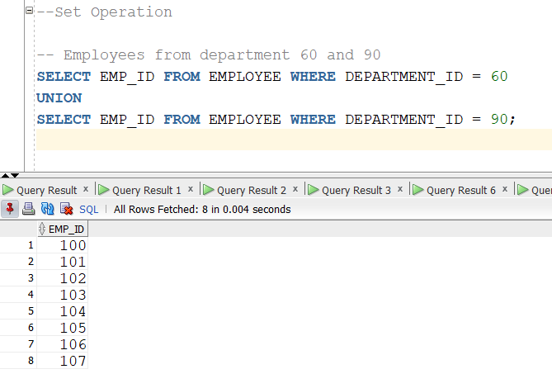
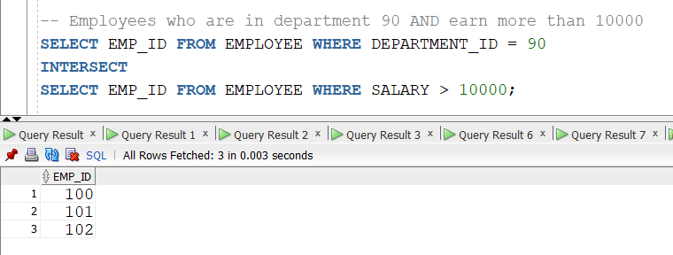
SET OPERATORS
Set Operators:
Used to combine results of two SELECT queries.
UNION
UNION ALL
INTERSECT
MINUS

Slide 15
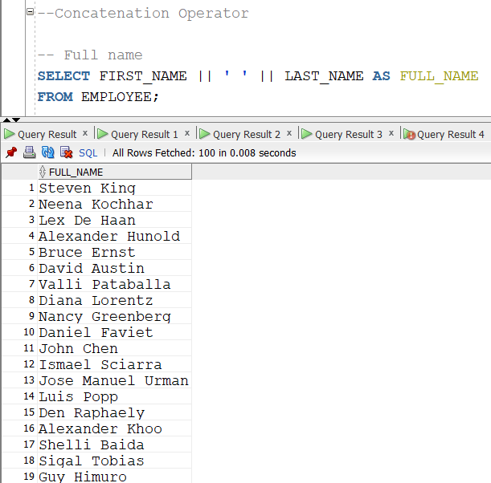
CONCATENATION OPERATORS
Concatenation Operator (||) is used to combine two or more strings into a single string.

Slide 16
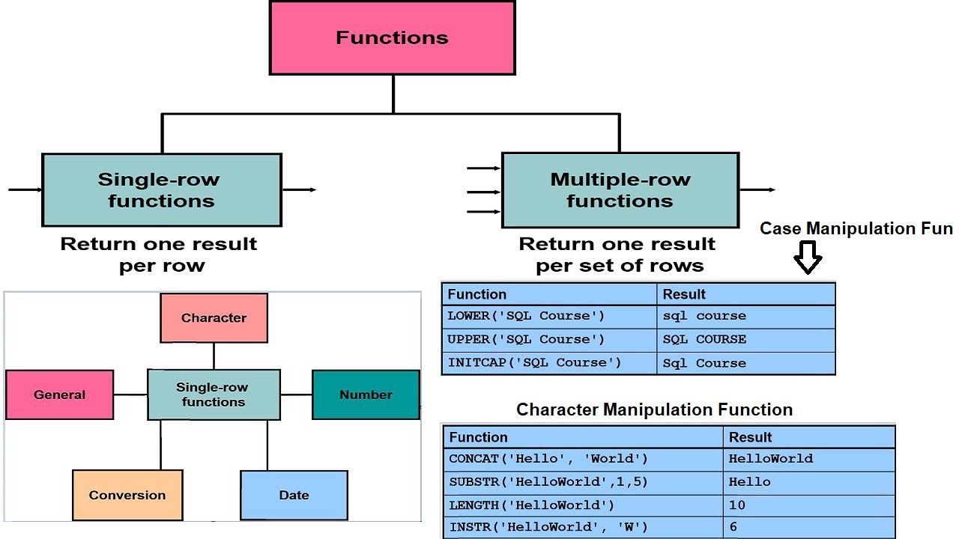
FUNCTIONS
An SQL function is a predefined program that performs a specific operation on input values and returns a single value or a set of values.
Single-Row Functions:
Multi-Row (Aggregate) Functions

Slide 17
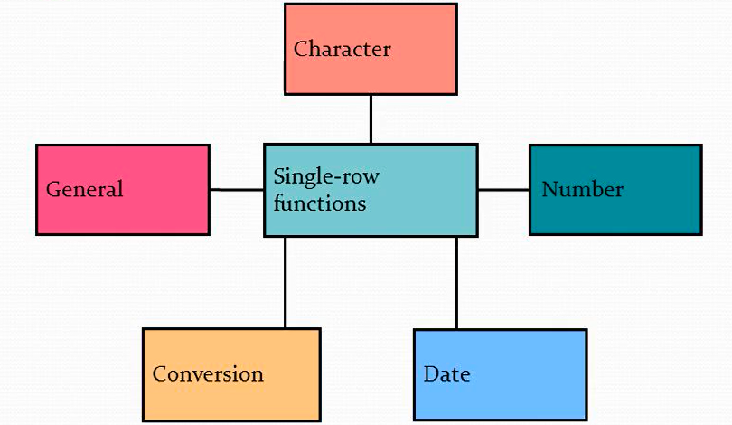
SINGLE ROW FUNCTIONS
A single-row function operates on one row at a time and returns one result per row.
Character Function
Numeric Function
Date Function
Conversion Functions
General (NULL-handling) Functions

Slide 18
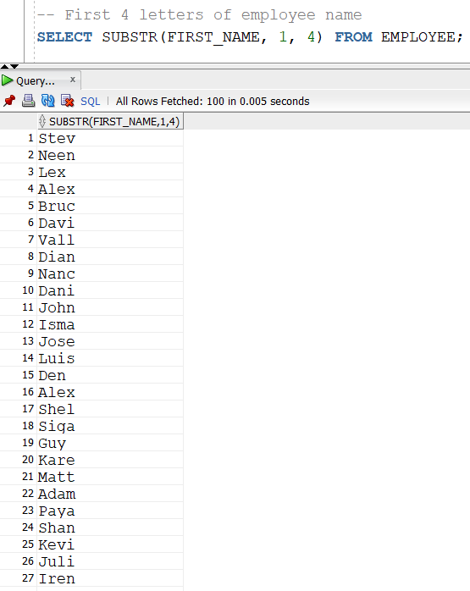
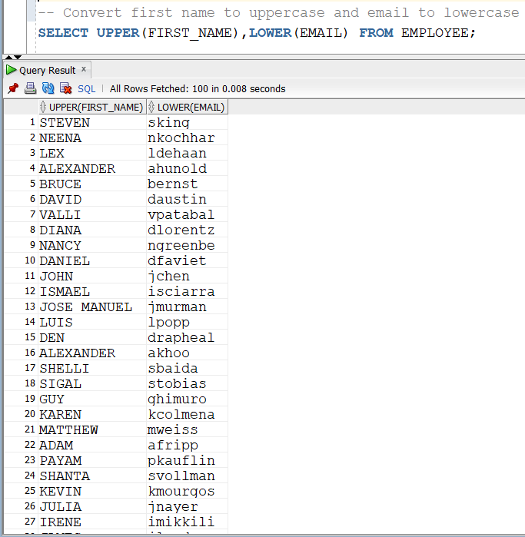
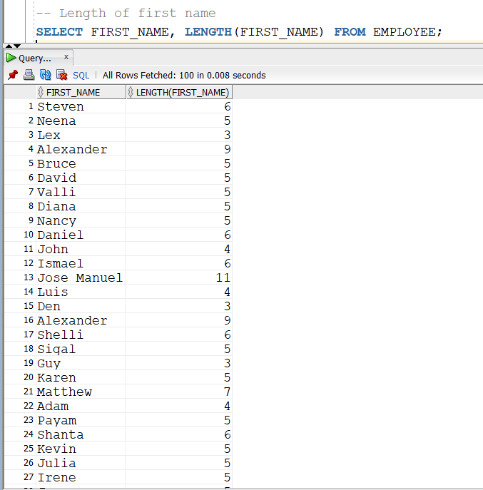
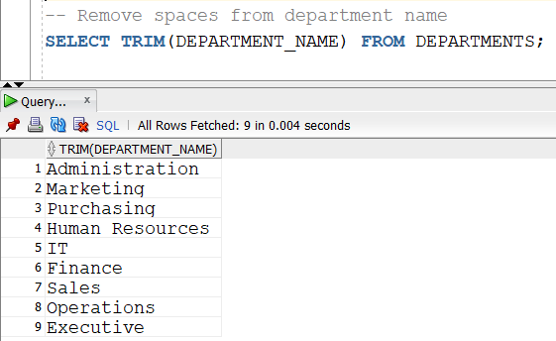
CHARACTER (STRING) FUNCTIONS
Used to manipulate text data.
UPPER()
LOWER()
LENGTH()
SUBSTR()
CONCAT()
TRIM()

Slide 19
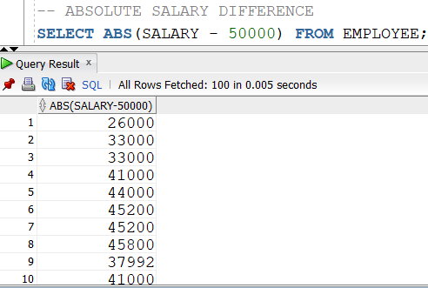
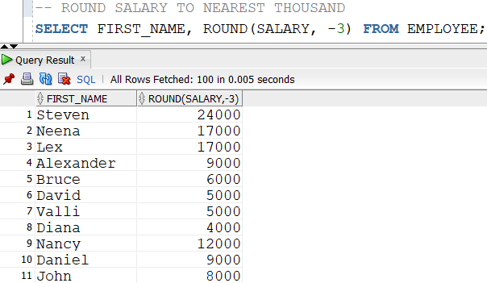
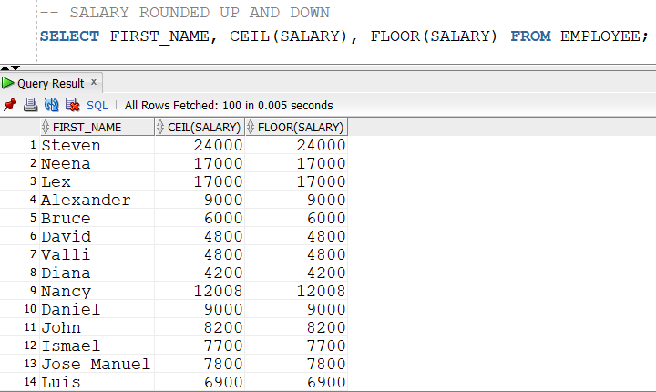
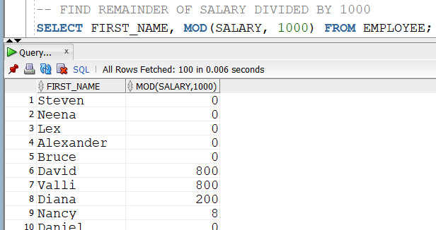
NUMERIC FUNCTIONS
Used to perform mathematical operations.
ROUND()
CEIL()
FLOOR()
MOD()
ABS()

Slide 20
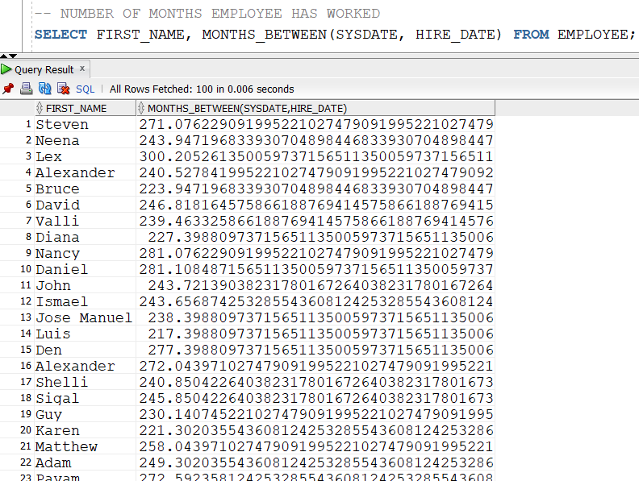
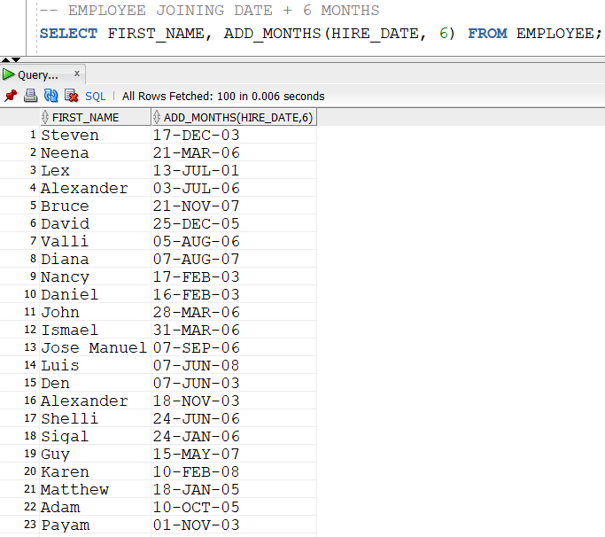
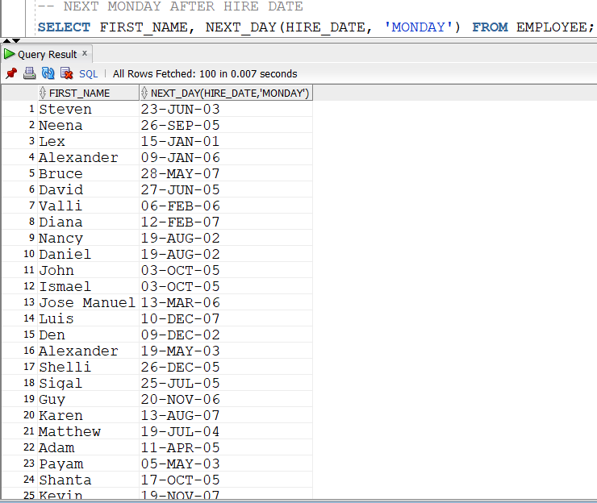
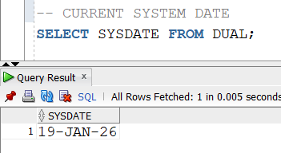
DATE FUNCTIONS
Used to work with dates.
SYSDATE
MONTHS_BETWEEN()
ADD_MONTHS()
NEXT_DAY()

Slide 21
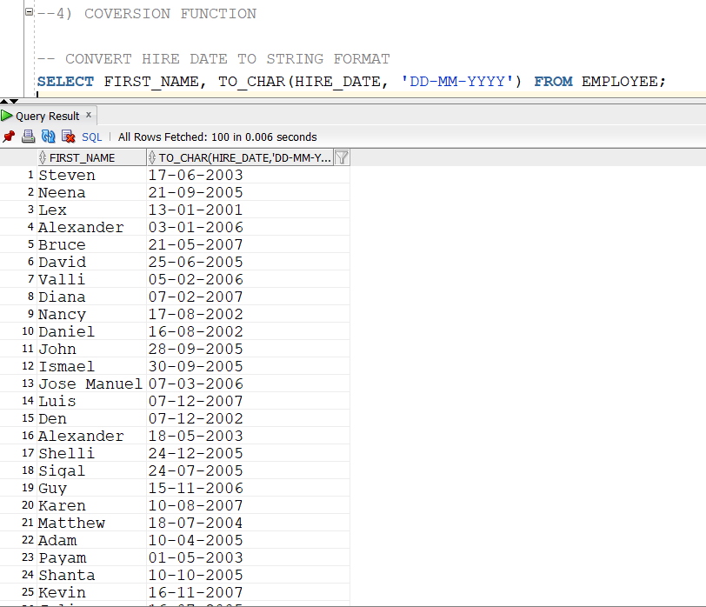
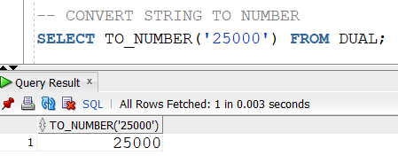
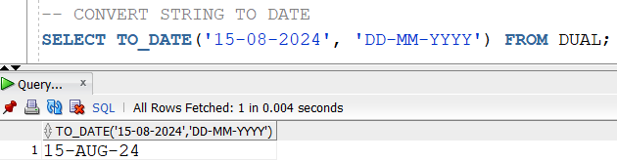
CONVERSION FUNCTIONS
Convert one datatype to another.
TO_CHAR()
TO_DATE()
TO_NUMBER()

Slide 22
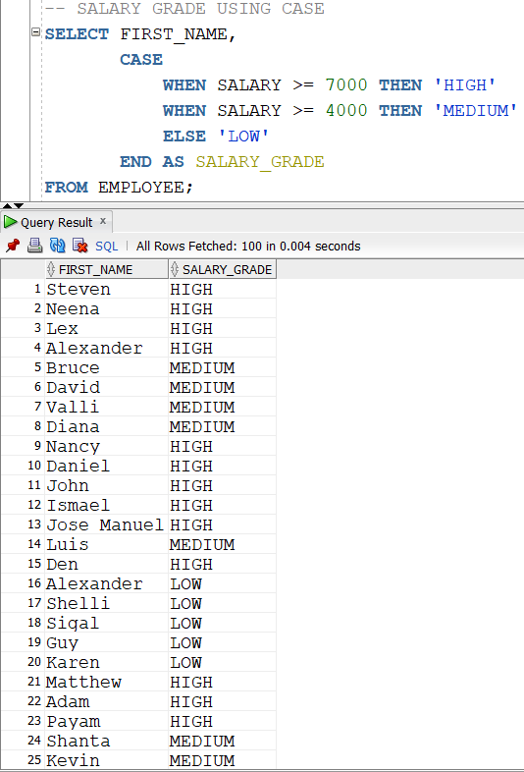
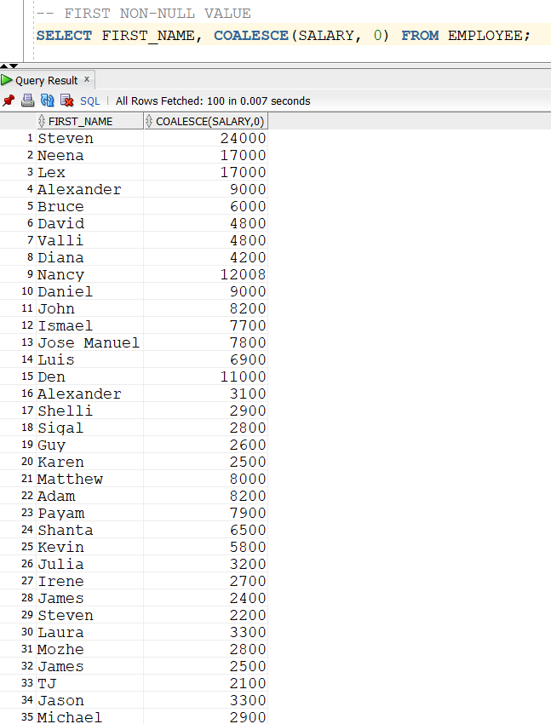
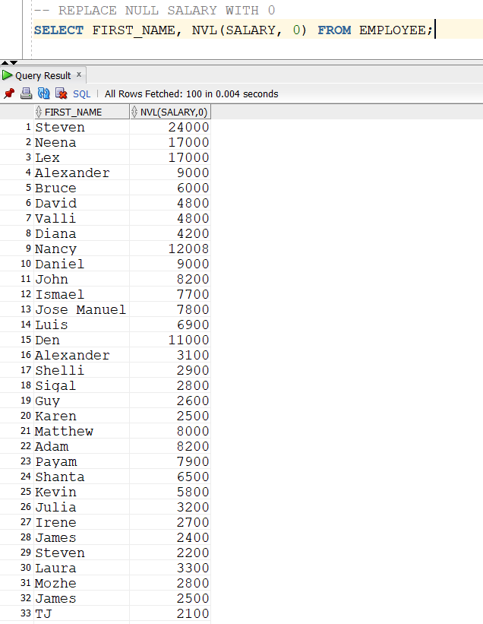
GENERAL/CONDITIONAL FUNCTIONS
Handle NULLs and conditions.
NVL()
COALESCE()
CASE

Slide 23
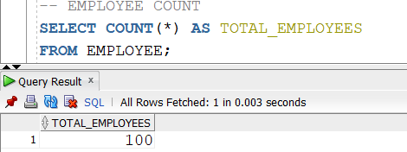
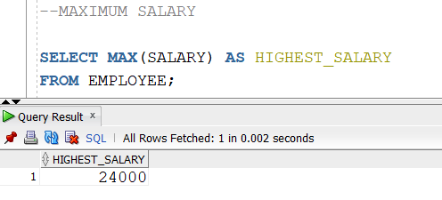
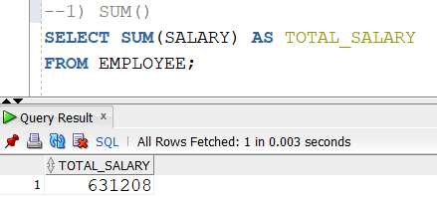
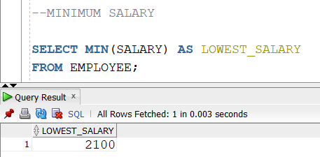
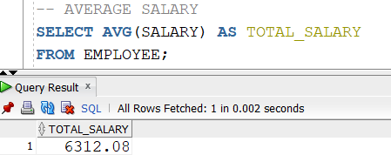
MULTI ROW FUNCTIONS
A multi-row function (also called a group function or aggregate function) operates on multiple rows of a table and returns a single result for each group.
SUM()
AVG()
COUNT()
MAX()
MIN()

Slide 24
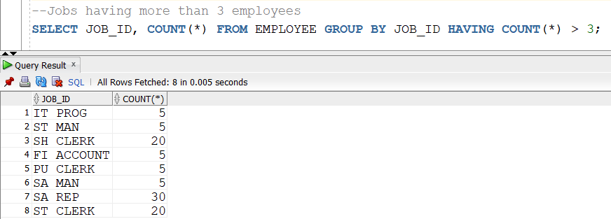
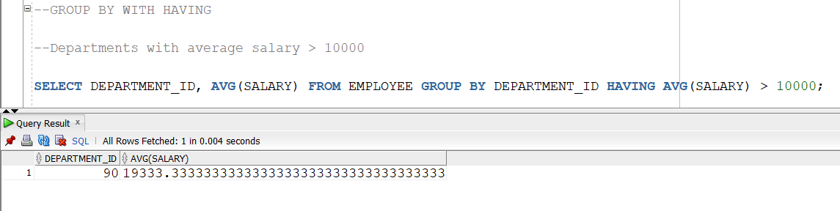
HAVING CLAUSE
The HAVING clause is used to filter groups created by the GROUP BY clause based on aggregate conditions.

Slide 25
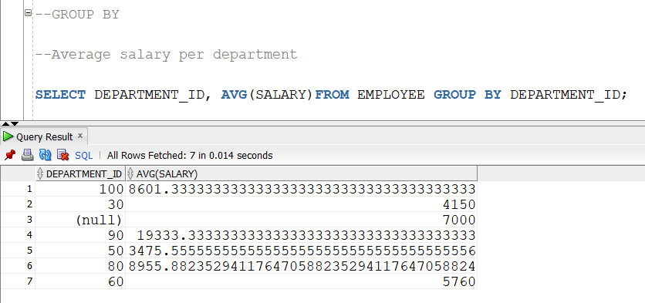
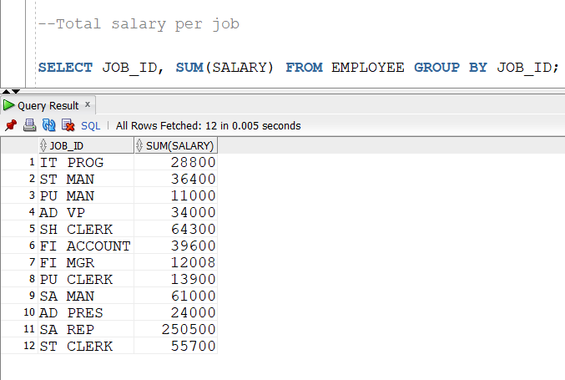
GROUP BY CLAUSE
The GROUP BY clause is used to group rows that have the same values in specified columns and apply multi-row (aggregate) functions like SUM, AVG, COUNT, MAX, and MIN on each group.

Slide 26



ORDER BY CLAUSE
The ORDER BY clause is used to sort the result set of a SQL query in ascending or descending order based on one or more columns.
Ascending Order (ASC)
Descending Order (DESC)
Order By

Slide 27

JOINS
An SQL JOIN is used to combine data from two or more tables based on a related column between them (usually a primary key and foreign key).
INNER JOIN
LEFT OUTER JOIN
RIGHT OUTER JOIN
FULL OUTER JOIN
CROSS JOIN
SELF JOIN
NATURAL JOIN
NON EQUI JOIN
GREATER THEN
BETWEEN

Slide 28

INNER JOIN
Returns only the rows that have matching values in both tables.

Slide 29


LEFT AND RIGHT OUTER JOIN
LEFT OUTER JOIN: Returns all rows from the left table and matching rows from the right table.
RIGHT OUTER JOIN: Returns all rows from the right table and matching rows from the left table.

Slide 30

FULL OUTER JOIN
Returns all rows from both tables.

Slide 31

CROSS JOIN
Returns the Cartesian product (all possible combinations)

Slide 32

SELF JOIN
A table is joined with itself

Slide 33

NATURAL JOIN
A NATURAL JOIN is a type of JOIN that automatically joins two tables using all columns with the same name and compatible data types.

Slide 34


NON EQUI JOIN
NON-EQUI JOIN is a type of JOIN where the join condition uses comparison operators
GREATER THEN
LESS THEN
GREATER THEN EQUAL TO
LESS THEN EQUAL TO
BETWEEN

Slide 35

SET OPERATIONS
SQL Set Operations are used to combine the results of two or more SELECT statements into a single result set.
UNION
UNION ALL
INTERSECT
MINUS

Slide 36


UNION AND UNION ALL
UNION: The operator combines the results of two SELECT statements and removes duplicate records.
UNION ALL: Returns all rows from the right table and matching rows from the left table.

Slide 37

INTERSECT
The INTERSECT operator returns only the common rows that exist in both SELECT statements.

Slide 38

MINUS
The MINUS operator returns rows from the first SELECT statement that are not present in the second SELECT statement.

Slide 39

SUBQUERY
A subquery is a query inside another SQL query. The inner query executes first, and its result is used by the outer query.
SIMPLE QUERY
SINGLE ROW SUBQUERY
MULTI ROW SUBQUERY
CORRLEATED SUBQUERY
ANY AND ALL OPERATOR

Slide 40


SINGLE ROW SUBQUERY
A single-row subquery returns exactly one row, firstly, the inner query is run then the outer one

Slide 41


MULTI ROW SUBQUERY
A multi-row subquery is a subquery that returns more than one row. It is used when the outer query needs to compare a column's value against a list of values.

Slide 42

ANALYTICAL FUNCTIONS
Analytical functions perform calculations on a group of rows without reducing the number of rows returned, these are the special SQL function and widely used in industry
SYNTAX : FUNCTION() OVER (PARTITION BY column ORDER BY column)
ROW_NUMBER
RANK
DENSE_RANK

Slide 43


ROW_NUMBER
Assigns a unique number to each row without considering ties.

Slide 44


RANK
Assigns the same rank for equal values but skips the next rank.

Slide 45


DENSE_RANK
Assigns the same rank for equal values, does NOT skip rank numbers.

Slide 46
SUMMARY
Learned about database schema.
Data warehouse concept and what exactly it is
OLTP and OLAP what are they and they are the fundamentals of Data science
What are ELT and what are its different components.
Installation of Oracle DB and Setting up the database server

