Slide 1

POWER BI DATA ANALYSIS
TEJAS NALAWADE

Slide 2
Agenda
1
2
3
4
5
Power BI and its phases
Get Data Phase
Model Building Phase
Data Enhancement Phase
Visual Building Phase

Slide 3
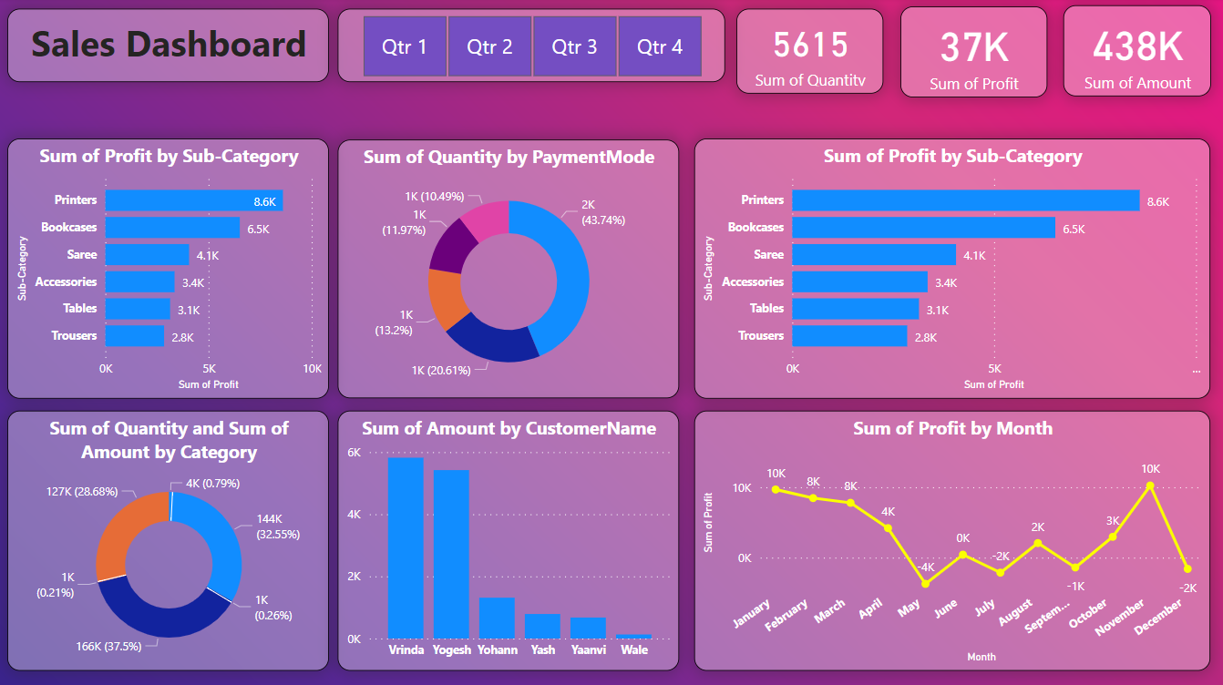
Introduction
Power BI is a data visualization and business intelligence tool used to collect, transform, analyze, and visualize data to support better decision-making.
Phases in Power BI:
Get Data Phase
Data Modeling Phase
Model Enhancement Phase
Visual Building Phase

Slide 4
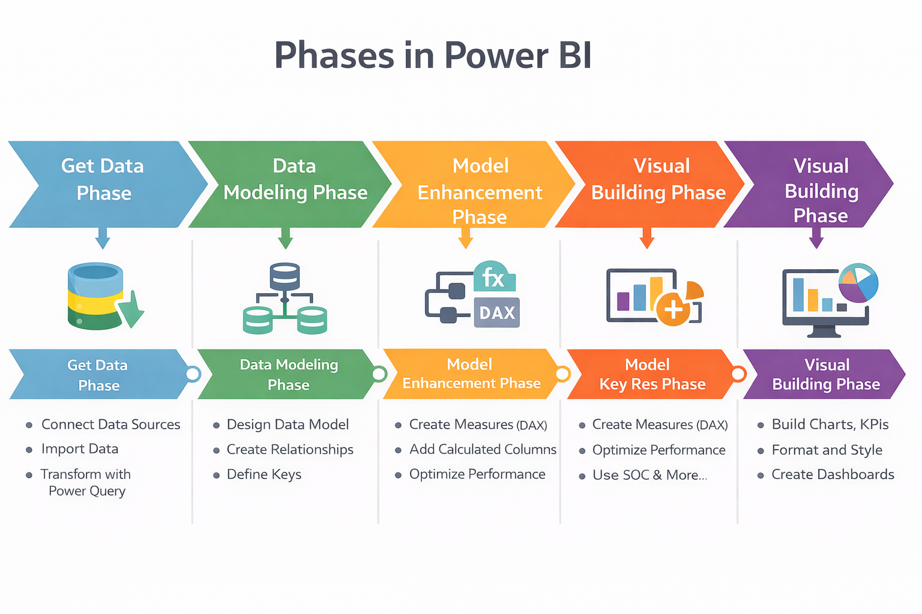
Power BI Phases
Get Data Phase : The Get Data phase is where data is collected from different sources like databases, Excel, CSV files, or cloud services and cleaned using Power Query.
Data Modelling Phase: The Data Modeling phase is where relationships are created between tables and the data structure is designed for analysis.
Model Enhancement Phase: The Model Enhancement phase is where calculations, measures, and calculated columns are created using DAX to improve analysis.
Visual Building Phase: The Visual Building phase is where charts, tables, and dashboards are created to display insights in an interactive and visual way.

Slide 5
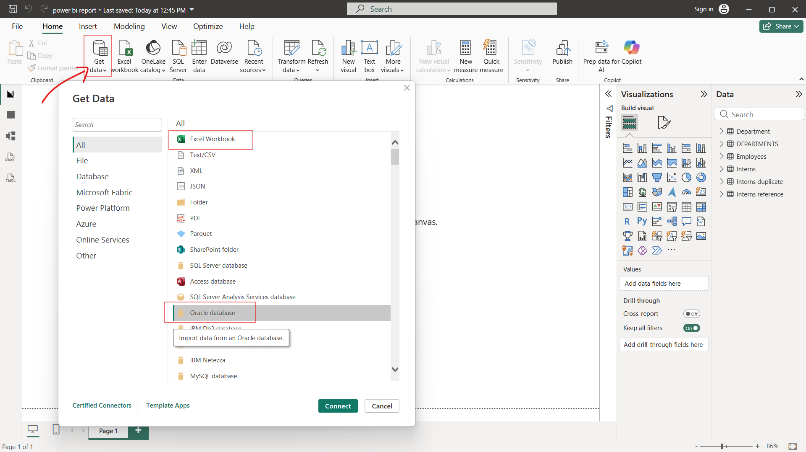
GET DATA PHASE
The Get Data phase is the first step in Power BI where data is imported or connected from different sources into Power BI for analysis.
Excel Workbook
Text / CSV
XML
JSON
PDF
Folder
Oracle Database
Azure SQL Database
SQL Server Database

Slide 6
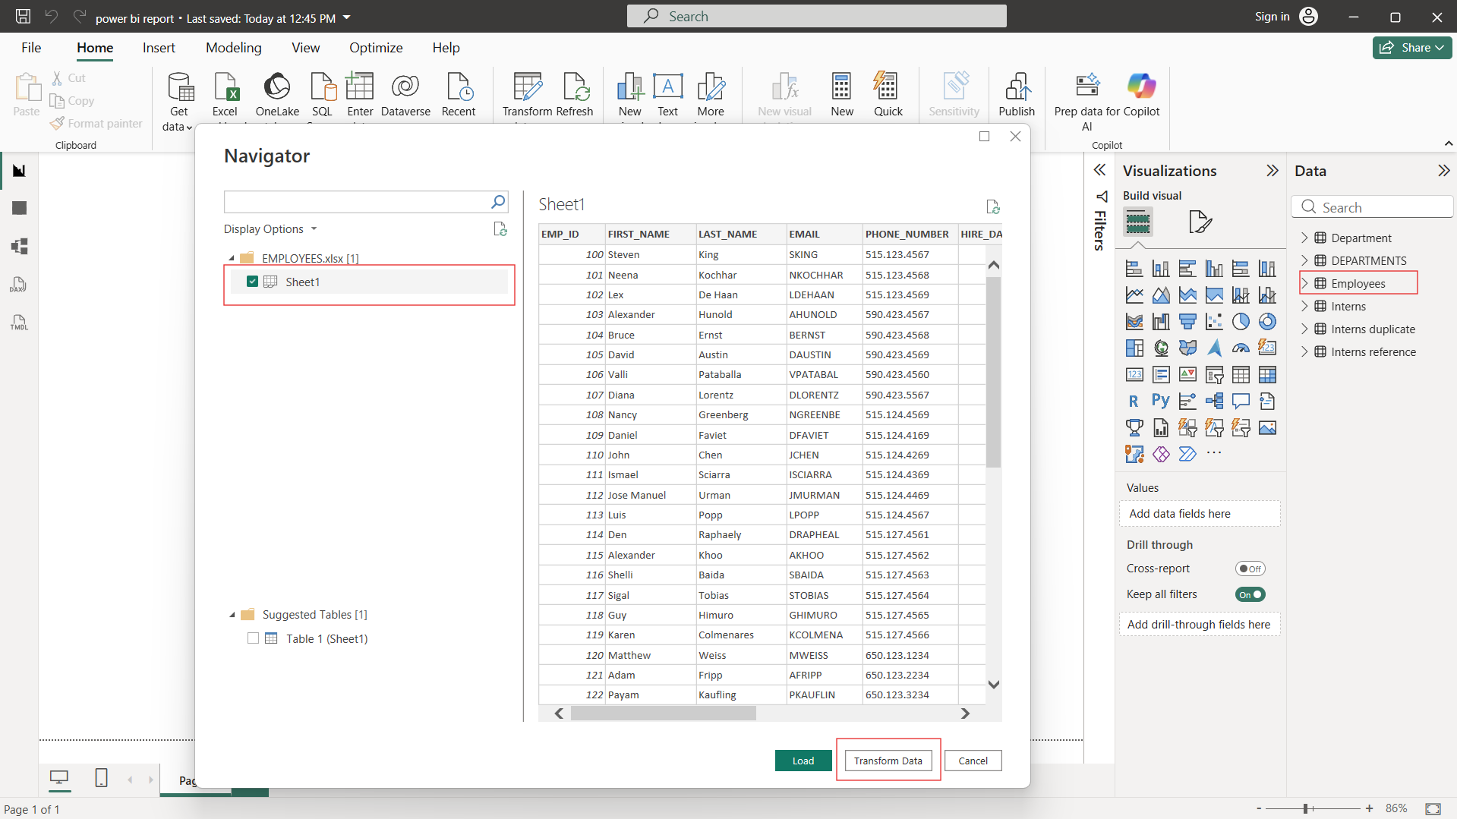
LOAD AND TRANSFORM
Steps to Import Excel Data into Power BI
Open Power BI Desktop
Click Home → Get Data
Select Excel Workbook
Browse and select the Excel file
Click Open
Load: Imports data directly into Power BI and use when data clean
Transform: Opens Power Query Editor and use to clean and modify data

Slide 7
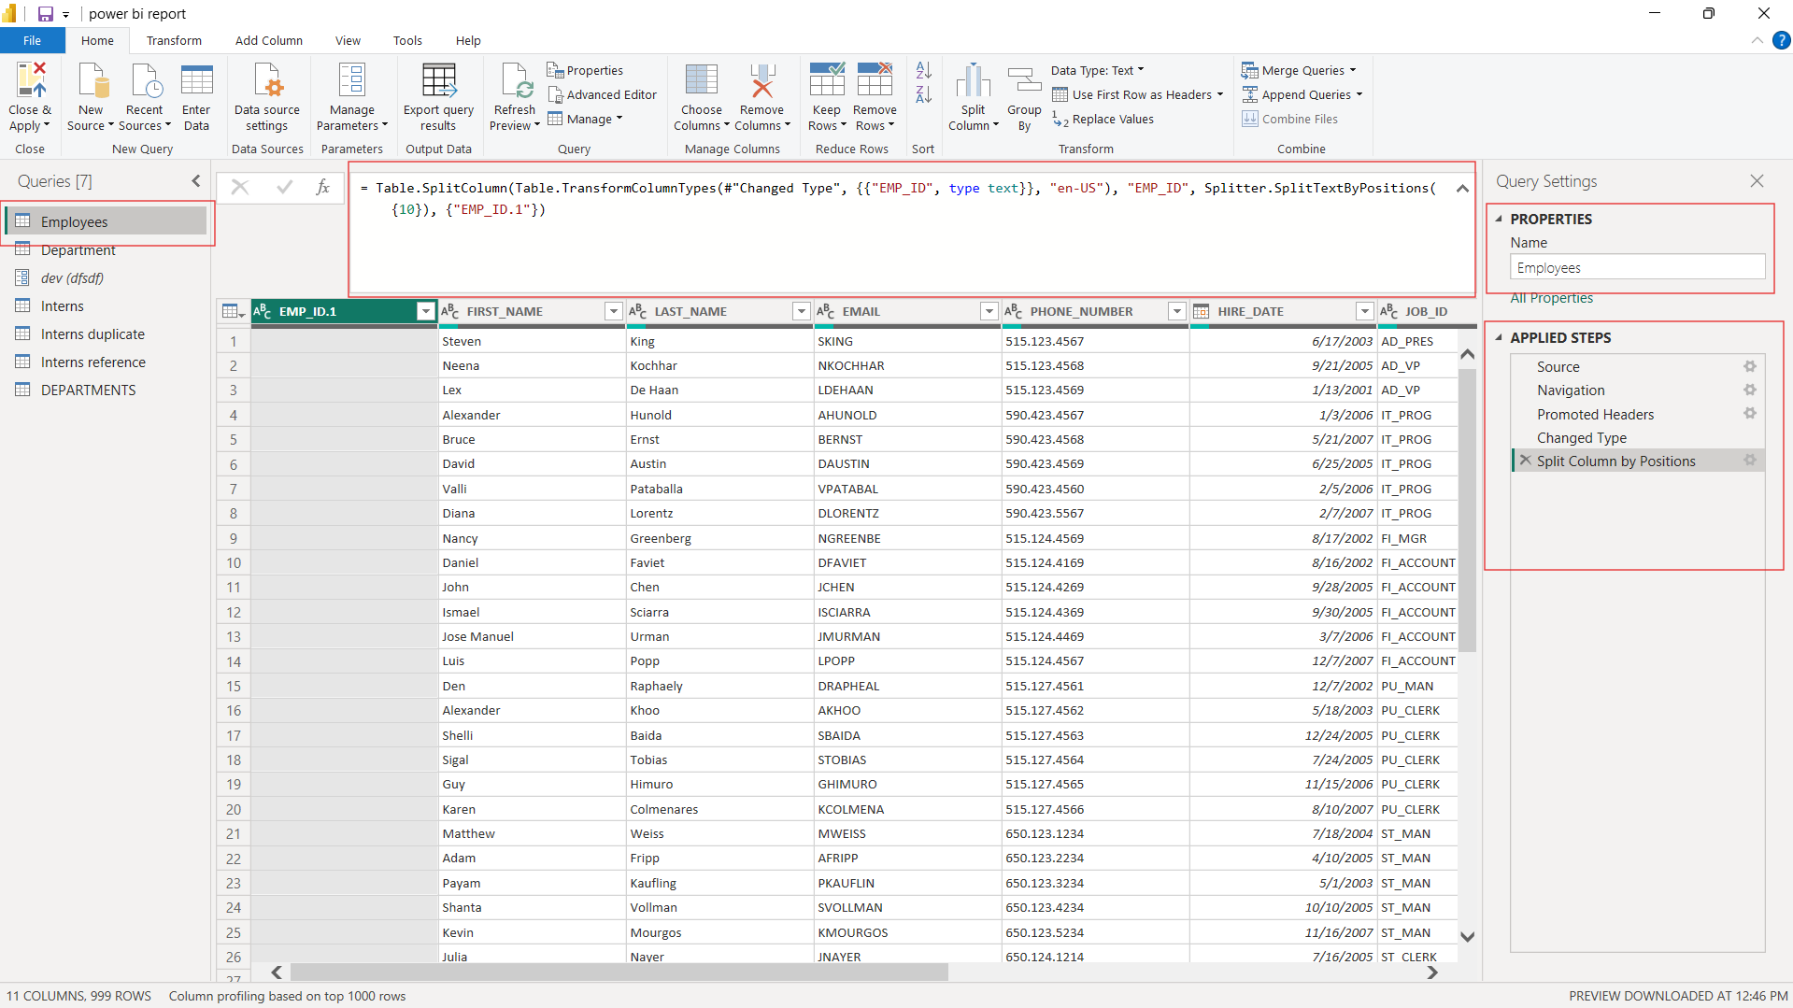
POWER QUERY EDITOR
Power Query Editor is a tool in Power BI used to clean, transform, and prepare data before loading it into the data model.
Clean raw data
Transform data into usable format
Perform ETL (Extract, Transform, Load) operations
How to Open Power Query Editor:
Open Power BI Desktop
Click Home → Transform Data
Power Query Editor window opens

Slide 8
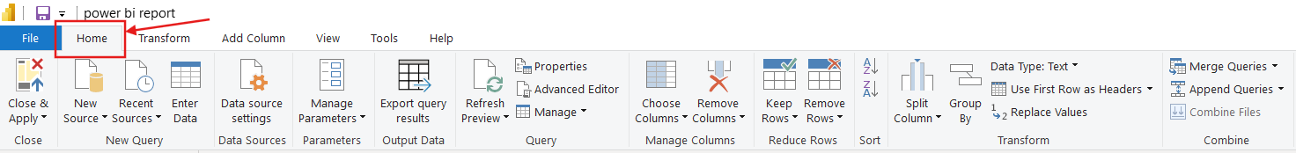
HOME
The Home tab in Power Query Editor contains all the basic and most frequently used commands required to manage data sources, queries, and transformations.
Close & Apply
New Source
Recent Sources
Enter Data
Data Source Settings
Manage Parameters and Refresh Preview
Properties and Advance Editor
Manage: Duplicate and Reference
Manage Column and Reduce Row
Sort and Group By
Transform and Combine

Slide 9
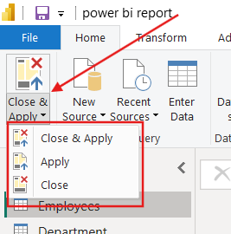
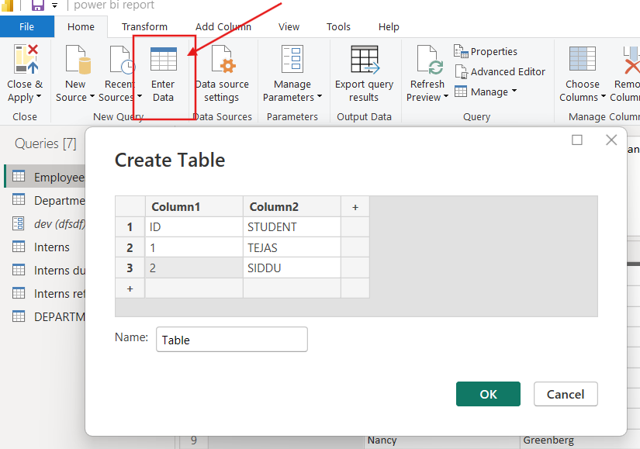
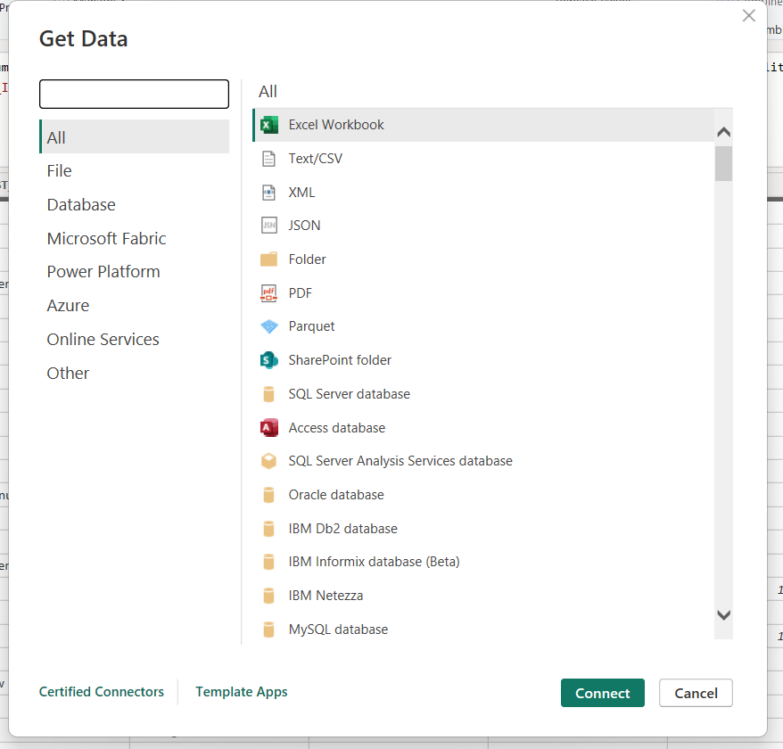
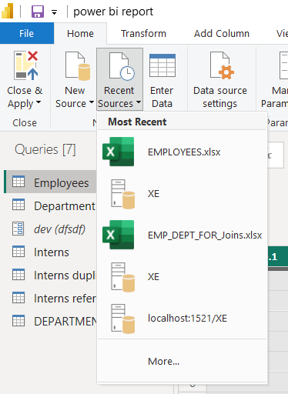
HOME
CLOSE APPLY
Close & Apply: Applies all the changes and closes the Power Query Editor window.
Apply: Applies the changes without closing the Power Query Editor window.
Close: Closes the Power Query Editor without applying changes.
NEW SOURCE :
Used to add new data sources while already working in Power Query Editor.
Supports Excel, CSV, Databases, Web, Folder, etc.
RECENT SOURCES
Shows a list of recently used data sources.
Helps reconnect to data sources quickly.
ENTER DATA
Used to manually enter data into Power BI.
Helpful for creating small lookup or reference tables.

Slide 10
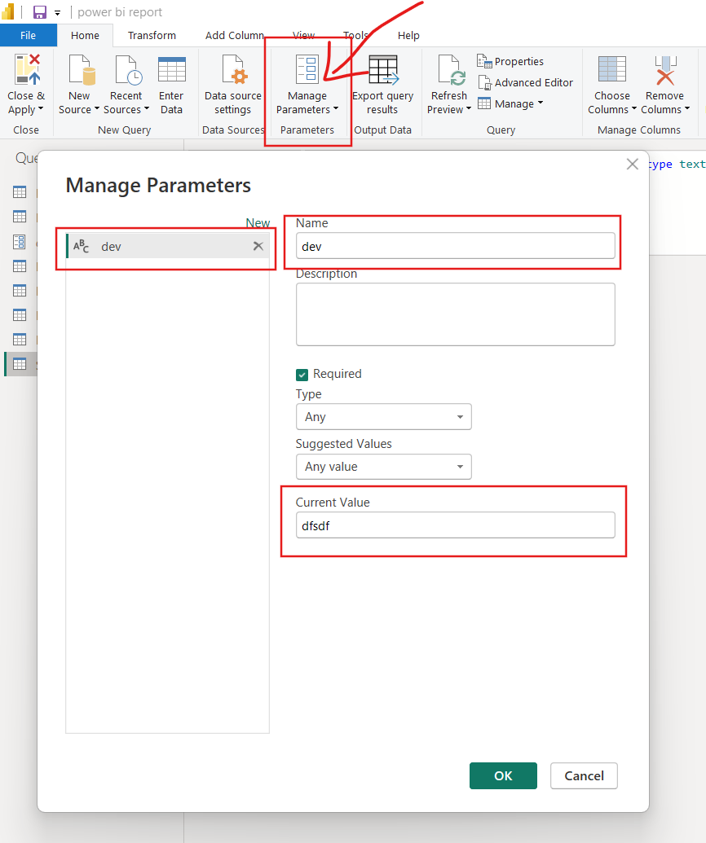
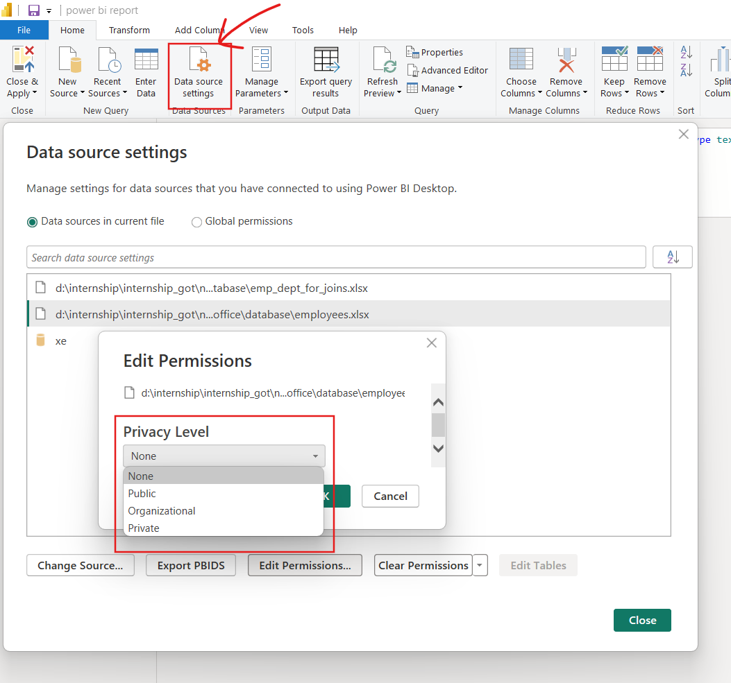
HOME
DATA SOURCE SETTINGS
Used to view, edit, or delete data source connections.
Allows changing credentials and permissions..
MANAGE PARAMETER:
To create different environment
Helps avoid hard-coding values in queries

Slide 11
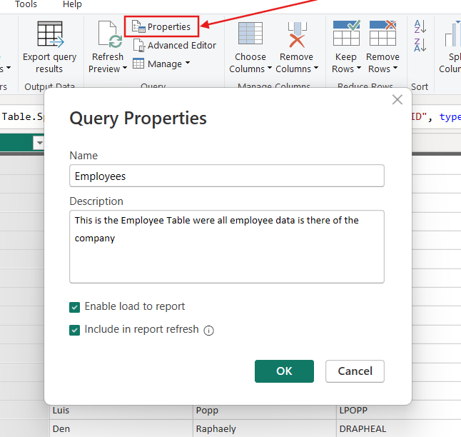
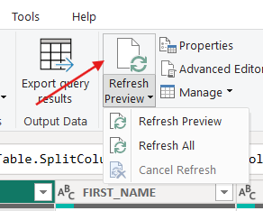
HOME
REFRESH PREVIEW
Refresh Preview: Refresh the preview result for the query
Refresh All: Refresh the preview result for the whole query.
Cancel Refresh: Cancel the refresh of the query
PROPERTIES:
Rename a Query and adding a description to the query

Slide 12
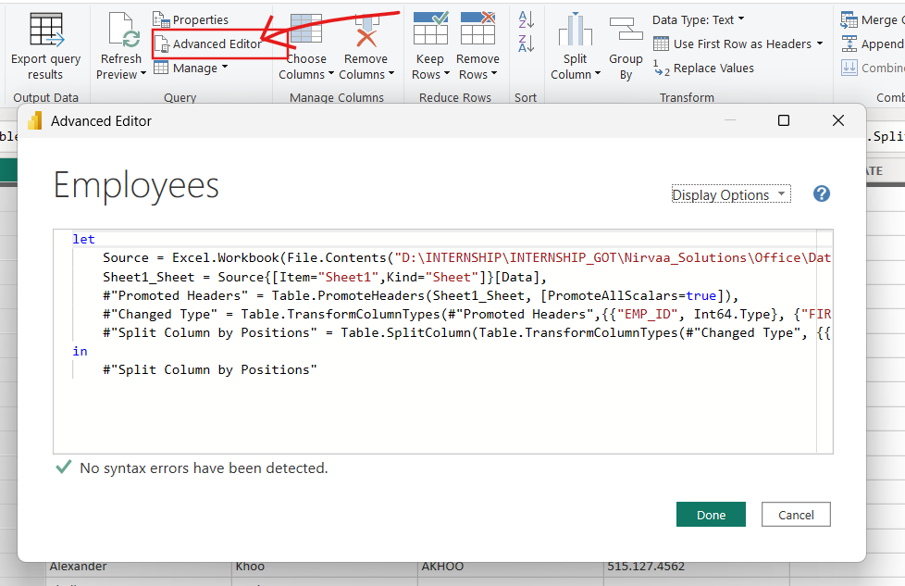
HOME
ADVANCE EDITOR
The Advanced Editor is used to view and edit Power Query (M language) code.
It shows all transformation steps applied to the data in a single script.
Helps users understand how Power BI transforms data internally.
Key Components in Advanced Editor:
Let: Defines all transformation steps
Source: Specifies data source (Excel, SQL, Oracle, etc.)
Transformation Steps: Column changes, data type changes, split, merge, filters
In: Returns the final output step to Power BI

Slide 13
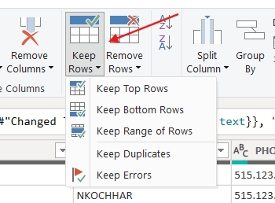
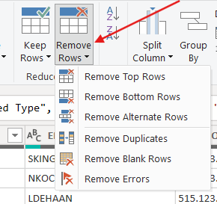
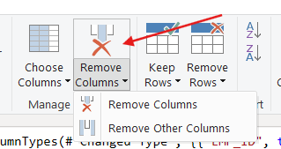
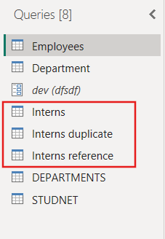
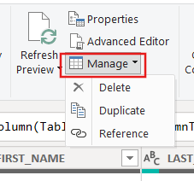
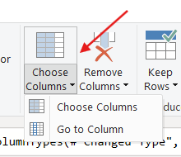
HOME
MANAGE
Delete – Removes the selected query
Duplicate – Creates a copy of the query
Reference – Creates a new query linked to the original query
CHOOSE COLUMNS
Choose Columns – Select which columns to keep
Go To Column – Quickly jump to a specific column
REMOVE COLUMNS
Remove Columns – Deletes selected columns.
Remove Other Columns – Keeps selected columns, removes rest
KEEP ROWS
Keep Top Rows – Keeps first N rows
Keep Bottom Rows – Keeps last N rows
Keep Range of Rows – Keeps rows from a specific position
Keep Duplicates – Keeps only duplicate rows
Keep Errors – Keeps only rows with errors
REMOVE ROWS
The Advanced Editor is used to view and edit Power Query (M language) code.
Remove Top Rows – Removes first N rows
Remove Bottom Rows – Removes last N rows
Remove Alternate Rows – Removes rows in a pattern
Remove Duplicates – Deletes duplicate rows
Remove Errors – Deletes rows with errors
Remove Blank Rows – Deletes empty rows

Slide 14
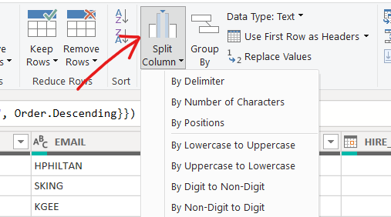
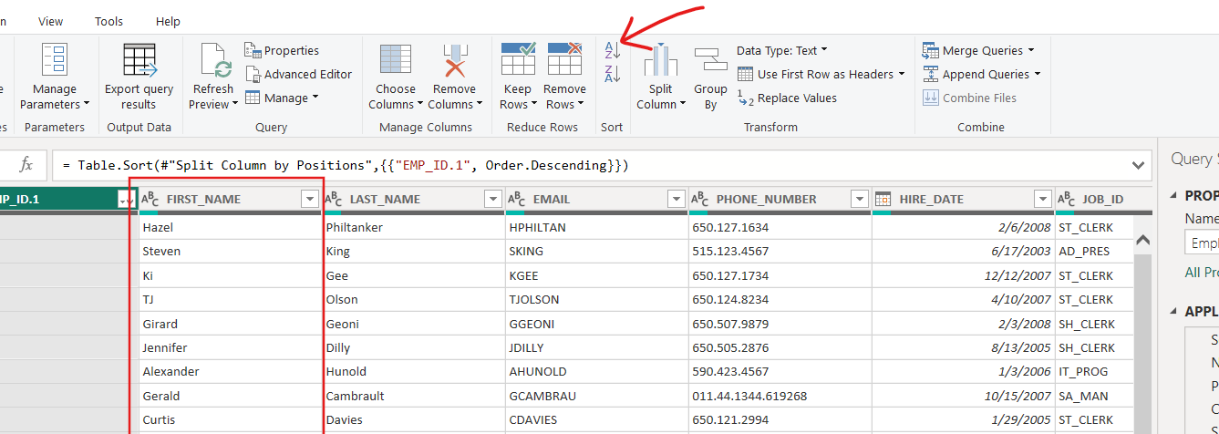
HOME
SORT
Arranges data in Ascending or Descending order
Sorts rows based on one or more columns
Helps organize data before loading into Power BI
SPLIT COLUMN
By Delimiter : Splits using comma, space, dash, etc.
By Number of Characters: Splits after fixed characters
By Position: Splits at a specific position
Lowercase to Uppercase : hello -> HELLO
Uppercase to Lowercase: WORLD -> world
Digit to Non-Digit: 123ABC-> 123 | ABC
Non-Digit to Digit: ABC123 → ABC | 123

Slide 15
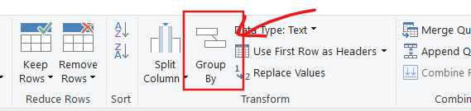
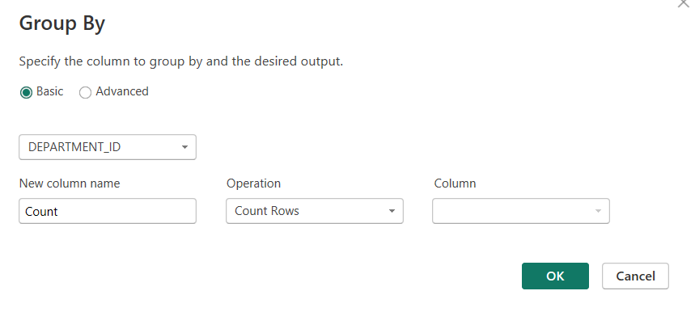
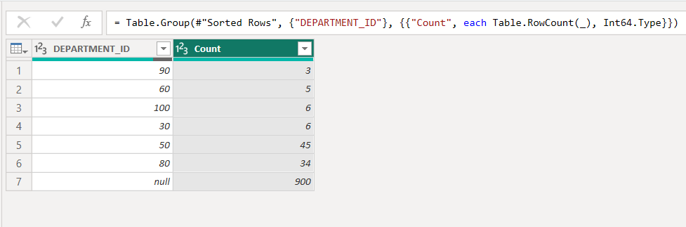
HOME
GROUP BY
Group By is used to combine rows with the same values in one or more columns.
After grouping, it applies aggregate functions to summarize data.
Similar to GROUP BY in SQL.

Slide 16
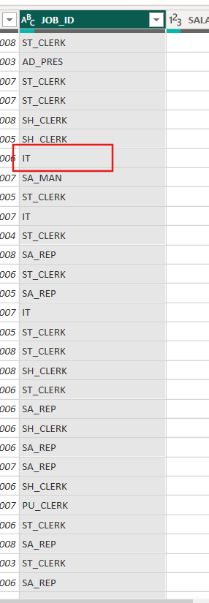
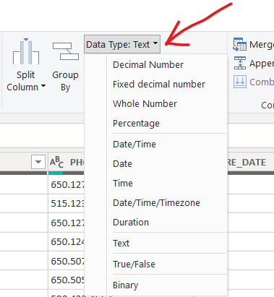
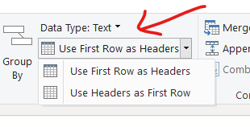
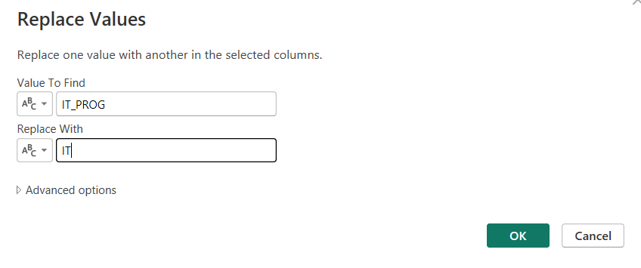
HOME
REPLACE VALUES
Finds specific text or numbers
Replaces them with new values
Used for data cleaning and correction
DATA TYPE
Defines the type of data in a column
Examples: Text, Number, Date
Helps Power BI process data correctly
USE FIRST ROW AS HEADERS.
Use First Row as Headers – First row becomes column names
Use Headers as First Row – Column names move to first row

Slide 17
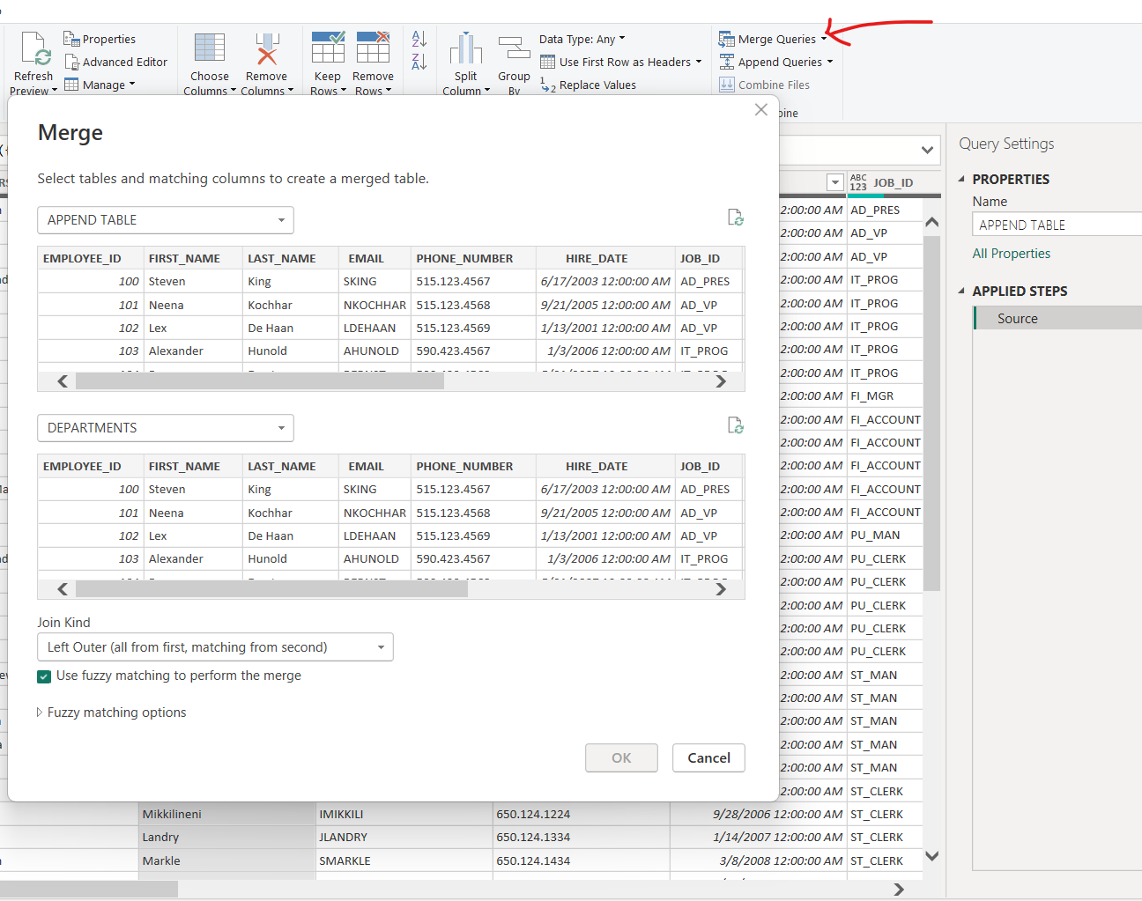
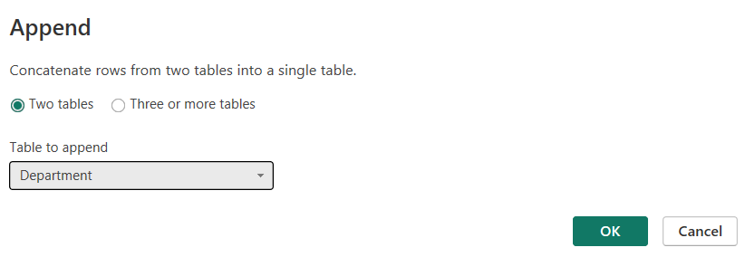
HOME
Merge Queries :
Merge Query: Combine two table directly into current table
Left Outer: All from first and matching from second
Right Outer: All from second matching from first.
Full Outer :
Inner: Only matching rows
Left Anti: Rows only in first
Right Anti: Rows only in second
Merge Query as New : Create new table merge without change in existing table.
Append Queries : Adding row from one table
Append Query as New : Combine table into new table.

Slide 18
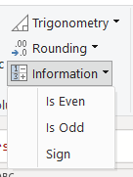
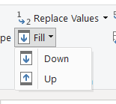
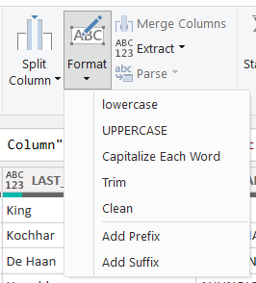
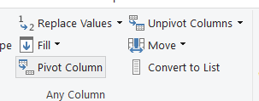
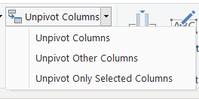
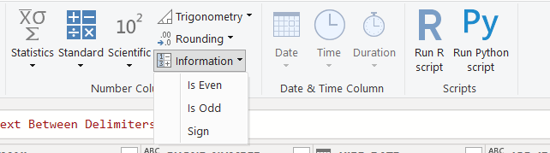
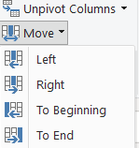
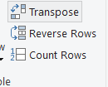
TRANSFORM
TRANSPOSE: Row as Column and Column as Row
REVERSE ROWS: Flip order last to first and first to last
COUNT ROWS: Gives count of the rows
FILL: Down and Up copy above and below into empty cell
PIVOT: Row value to column header
UNPIVOT: Convert column to row
MOVE : Left, Right, To Beginning, To End
LIST: Selected column into list
FORMAT: Lowercase, Uppercase, Capitalize, Trim, Clean, Prefix, Suffix
EXTRACT: Length, First Character, Last Character, Range, Text Before/After/Between Delimiter

Slide 19
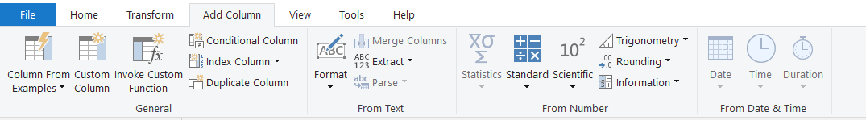
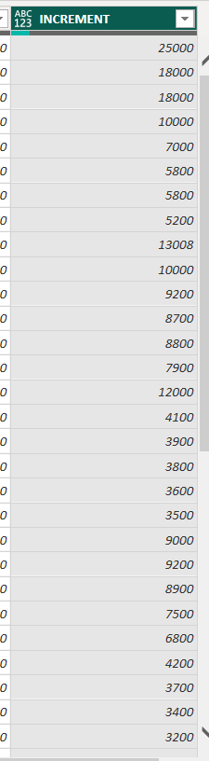
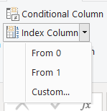
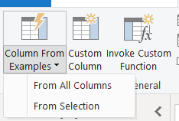
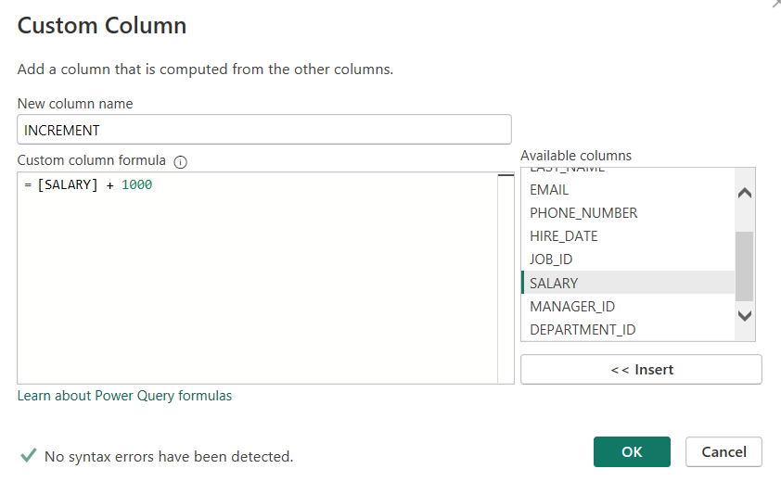
ADD COLUMN
Column From Examples: Create a new column by learning pattern from sample value.
Custom Column: Adds a new column using user-defined formulas to transform data, such as reversing text, calculations, or conditional logic.
Index Column : Adds a sequential row number to the table to uniquely identify or order rows.
Conditional Column: Creates a column based on if–then–else conditions; for filling missing values from adjacent rows, Fill Up or Fill Down is used instead.
Duplicate Column: Creates a copy of an existing column, often used when row values need to be transformed into column headers (typically followed by a Pivot operation).

Slide 20
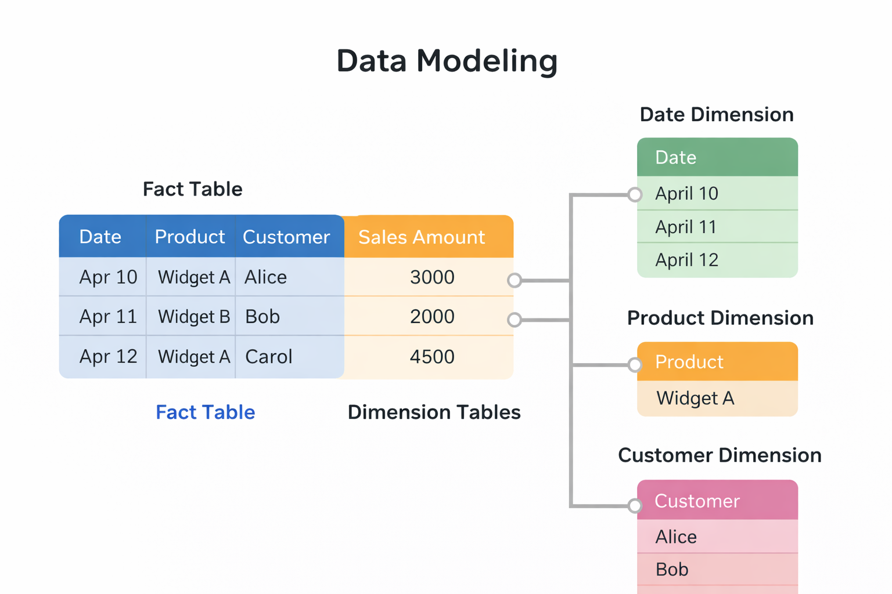
MODEL BUILDING PHASE
Data Modeling means organizing data into tables and connecting them so Power BI understands how data is related and can create accurate reports and visuals.
There are two main types of tables used while building a data model:
Fact Table: Measurable Quantitative Data Referential Integrity and Duplicate data is there
Dimension Table: Stores descriptive information, using aggregate function

Slide 21
TYPES OF RELATIONSHIP
In data modeling, relationships define how tables are connected. There are four main types of relationships, also called cardinality ratios:
One-to-Many (1 : *) : One record in a dimension table is linked to many records in a fact table.
Many-to-One (* : 1): This is the reverse view of One-to-Many.
Many-to-Many (* : *): Both tables contain repeated values.
One-to-One (1 : 1): Each record in one table matches exactly one record in the other table.

Slide 22
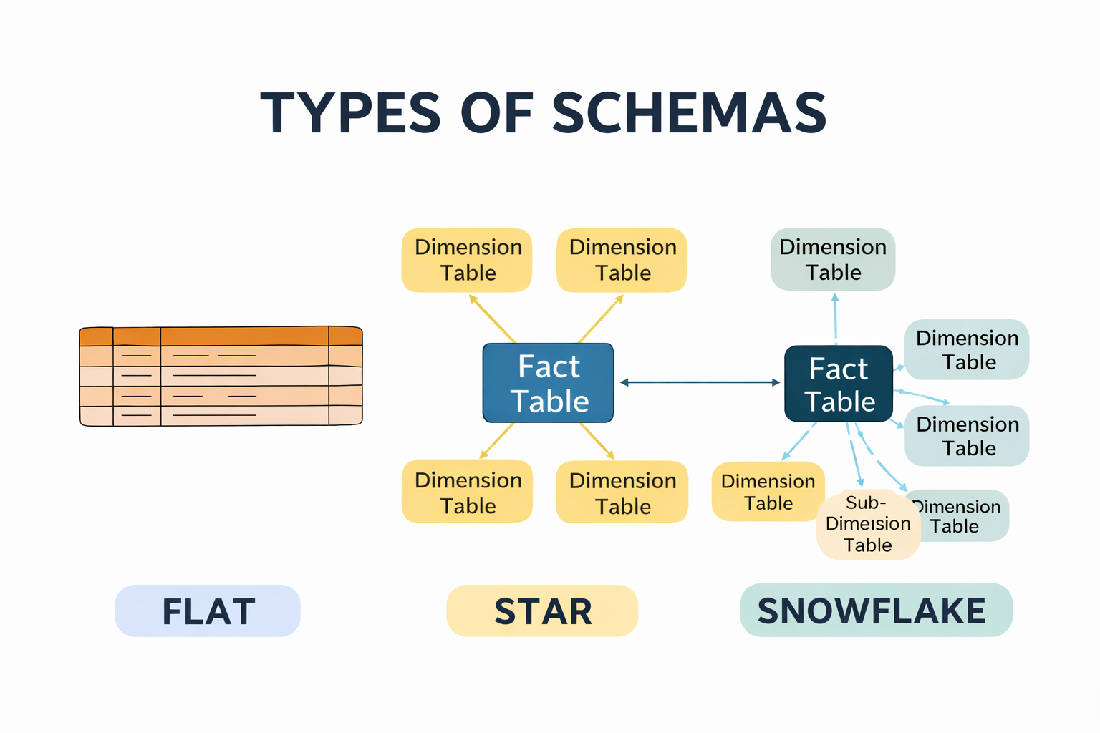
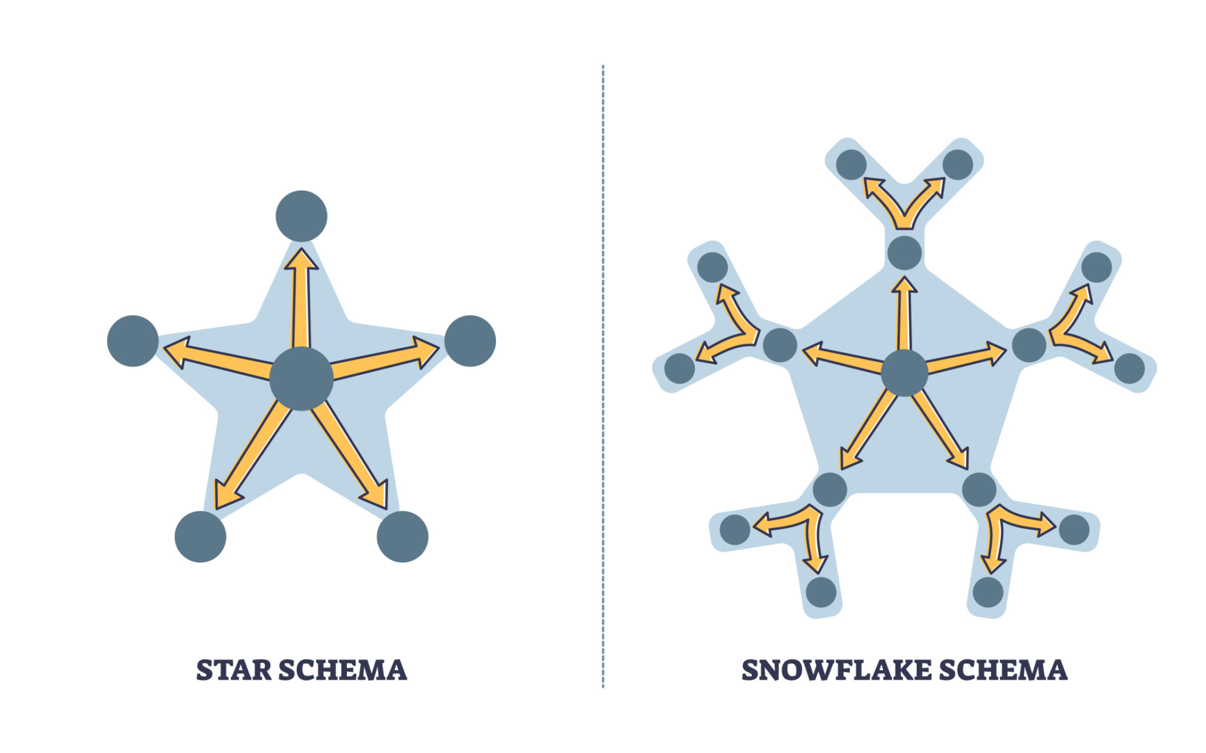
TYPES OF SCHEMA
A schema defines how tables are structured and connected in a data model. Choosing the right schema helps improve performance, readability, and maintenance.
There are three main types of schemas:
FLAT SCHEMA (Denormalized Schema): All data is stored in one single table, Data is denormalized.
STAR SCHEMA: One central fact table and multiple dimension table
SNOWFLAKE SCHEMA : Fact table at the centre dimension table are further split into sub dimension table and highly normalised structure

Slide 23
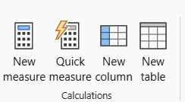
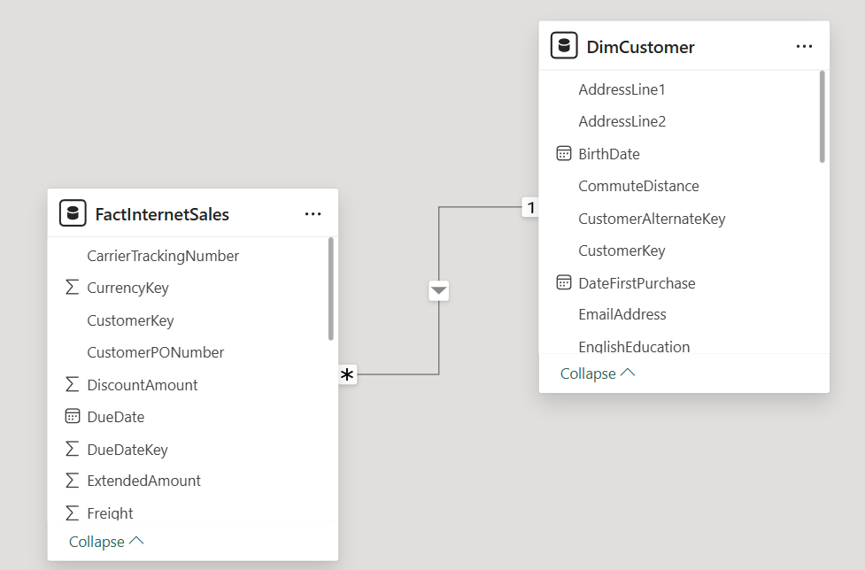
MODEL ENHANCEMENT PHASE
Model Enhancement means improving the data model by refining relationships, optimizing tables, and adding calculations so Power BI delivers faster, more accurate, and meaningful reports.
New Measure: A New Measure is a DAX calculation that is evaluated at query time and changes dynamically based on filters, slicers, and visuals.
Example Total Sales = SUM(Sales[SalesAmount])
Quick Measure: A Quick Measure is an automatically generated DAX measure created by Power BI using built-in templates without writing DAX manually.
New Column: A New Column is a DAX calculation that is evaluated row by row and stored permanently in the table.
Example : Profit = Sales[Revenue] - Sales[Cost]
New Table: A New Table is a table created using DAX that stores calculated or summarized data for modeling and analysis.
Example: Sales Summary = SUMMARIZE(Sales, Sales[Year], "Total Sales", SUM(Sales[SalesAmount]))

Slide 24

DAX - DATA ANALYSIS EXPRESSION
DAX is a formula language used in Power BI, Excel Power Pivot, and SSAS Tabular models to create calculations and data analysis logic.
Calculated Column: A calculated column is created row by row in a table using DAX and is stored in the data model.
Example : Total Price = Sales[Quantity] * Sales[Unit Price]
Calculated Measure: A calculated measure is computed at query time based on filters and visuals and is not stored in the table. Example : Total Sales = SUM(Sales[Sales Amount])

Slide 25

CALCULATED COLUMN
Calculate customer age from BirthDate (row-by-row calculation)
Age is calculated per customer
Stored in the table
Does not change with filters
DAX FUNCTION : Customer Age =
DATEDIFF(DimCustomer[BirthDate], TODAY(), YEAR)

Slide 26





FUNCTIONS IN DAX
DATE & TIME FUNCTION – TODAY(): Returns the current date.
TEXT FUNCTION – CONCATENATE(): Joins two text values into one.
LOGICAL FUNCTION – IF(): Applies condition-based logic.
FILTER FUNCTION – CALCULATE(): Modifies filter context to calculate values.
INFORMATION FUNCTION – ISBLANK(): Checks whether a value is blank.

Slide 27
TIME INTELLIGENCE FUNCTION
TOTAL YTD: Calculates the total from the start of the year to the selected date.
TOTAL QTD: Calculates the total from the start of the quarter to the selected date.
TOTAL MTD: Calculates the total from the start of the month to the selected date.
SAMEPERIODLASTYEAR: Returns values for the same period in the previous year.
DATEADD: Shifts dates forward or backward by a specified interval.

Slide 28

DATA VISUALISATION
Data Visualization is the process of representing data in visual form (charts, graphs, maps, tables) so users can understand patterns, trends, and insights quickly.

Slide 29

DATA VISUALISATION
Bar & Column Charts
Clustered Column Chart
Stacked Column Chart
100% Stacked Column Chart
Clustered Bar Chart
Stacked Bar Chart
100% Stacked Bar Chart

Slide 30
SUMMARY
Learned about database schema.
Data warehouse concept and what exactly it is
OLTP and OLAP what are they and they are the fundamentals of Data science
What are ELT and what are its different components.
Installation of Oracle DB and Setting up the database server

