Slide 1
Multithreading

Slide 2
Multithreading
Process:
A process is an active program, i.e., a program that is under execution.
Thread:
Thread is the segment of a process.
It is also called as light weight process.
A process can have multiple threads and these multiple threads are contained within a process.

Slide 3
Multitasking
Ability to execute two or more tasks in parallel or simultaneously is known as multitasking.
Multitasking is of two types:
1) Process based multitasking and
2) Thread based multitasking.

Slide 4
Process based multitasking
Process based multitasking:
Executing two or more processes simultaneously is known as process based multitasking.
For example, we can listen to music and browse internet at the same time.
The processes in this example are the music player and browser.

Slide 5
Thread based multitasking:
Thread based multitasking:
If two or more such threads execute simultaneously, it is known as thread based multitasking or multithreading.
For example, using a browser we can navigate through the webpage and at the same time download a file.
In this example, navigation is one thread and downloading is another thread
Computer Games(race games) are best example of multithreading

Slide 6
Uses of Multithreading
A multithreaded application performs two or more activities concurrently.
Multithreading ca n be used in animations, downloading files, or handling multiple client requests simultaneously.

Slide 7
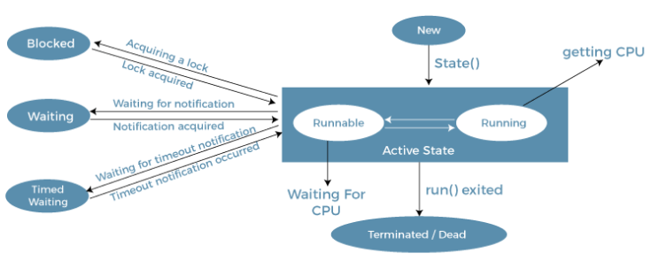
Life Cycle of Thread

Slide 8
Creating thread
There are two ways to create a thread:
By extending Thread class
By implementing Runnable interface.

Slide 9
Creating thread
By extending Thread class
Thread class provide constructors and methods to create and perform operations on a thread.
Create a class that extends Thread class.
Create instance of that class.
The class which extends Thread class must override the run( ) method of Thread class.
It must call start( ) to begin execution of new thread.

Slide 10
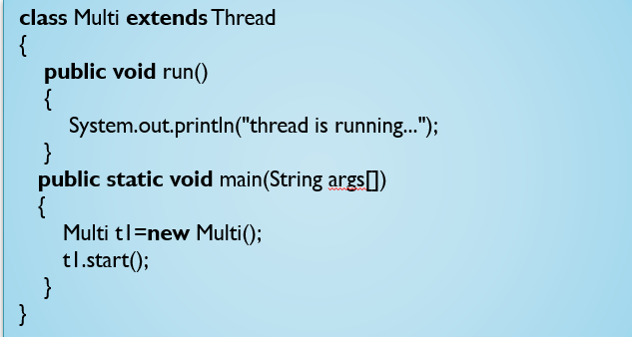

Creating thread
By extending Thread class

Slide 11
Creating Thread
By implementing Runnable interface.
Create a class that implements Runnable interface.
Create instance of the Thread class.
The class that implements Runnable interface must implement the run() method.
It must call start( ) to begin execution of new thread.

Slide 12
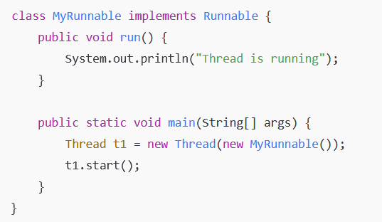
Creating Thread
By implementing Runnable interface.

Slide 13
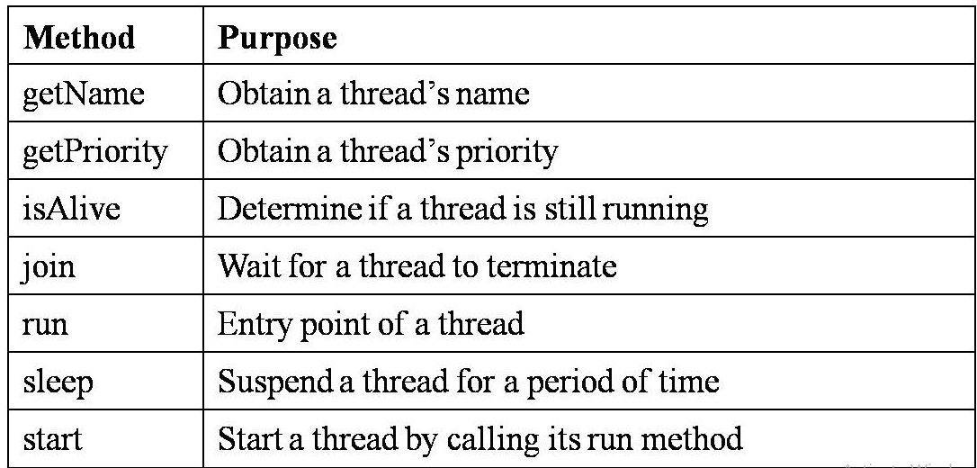
Creating Thread
Commonly used Thread Methods

Slide 14
Thread Priorities
Each thread has a priority.
Priorities are represented by a number between 1 and 10.
In most cases, the thread scheduler schedules the threads according to their priority

Slide 15
Thread Priorities
There are two methods to set and get the priority of thread-
setPriority()
The java.lang.Thread.setPriority() method set or assign the priority of the thread.
getPrioriy()
The java.lang.Thread.getPriority() method returns the priority of the given thread.

Slide 16
Thread Priorities
3 constants defined in Thread class:
public static int MIN_PRIORITY=1
public static int NORM_PRIORITY=5
public static int MAX_PRIORITY=10

Slide 17
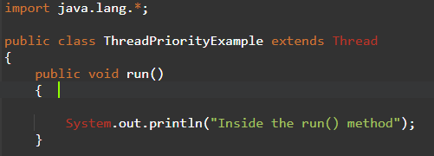
Thread Priorities
Example:

Slide 18
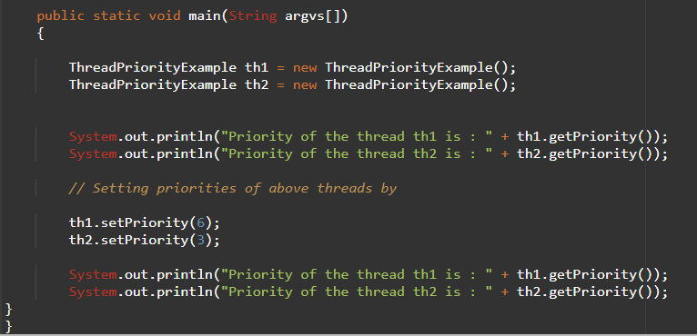
Thread Priorities

Slide 19

Thread Priorities
Output:

Slide 20
Creating Multiple Threads in Java
There are two commonly used methods for handling more than one thread in Java-
isAlive()
join()

Slide 21
Creating Multiple Threads in Java
isAlive() method:
This method tests if the thread is alive.
A thread is considered alive when the start() method of thread class has been called and the thread is not yet dead.
The primary purpose of the isAlive() method is to check the status of a thread during runtime
This method will return true if the thread is alive otherwise returns false.
Syntax: public final boolean isAlive()

Slide 22
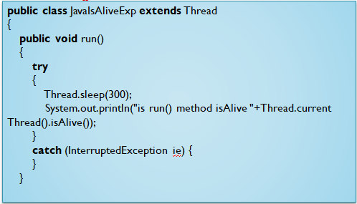
Creating Multiple Threads in Java
isAlive() method:

Slide 23
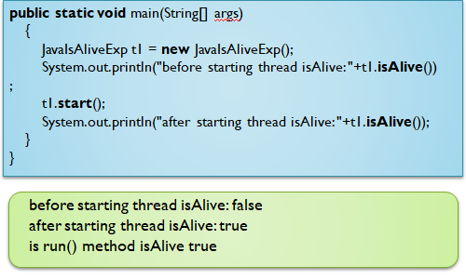
Creating Multiple Threads in Java
isAlive() method:

Slide 24
Creating Multiple Threads in Java
join() method:
When the join() method is invoked, the current thread stops its execution and the thread goes into the wait state.
The current thread remains in the wait state until the thread on which the join() method is invoked has achieved its dead state.
Syntax:
public final void join() throws InterruptedException

Slide 25
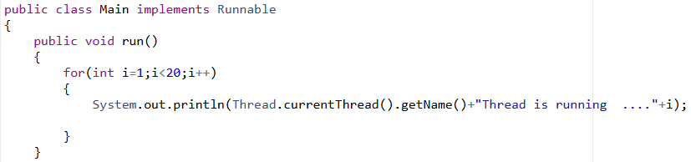
Creating Multiple Threads in Java
join() method:

Slide 26
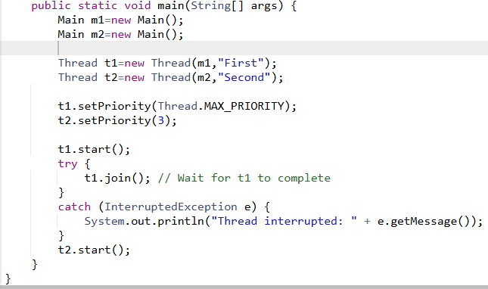
Creating Multiple Threads in Java
join() method:

Slide 27
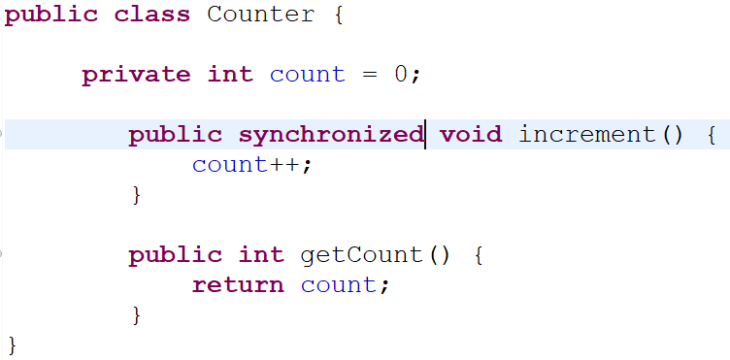
Synchronization
First create a Counter class:

Slide 28
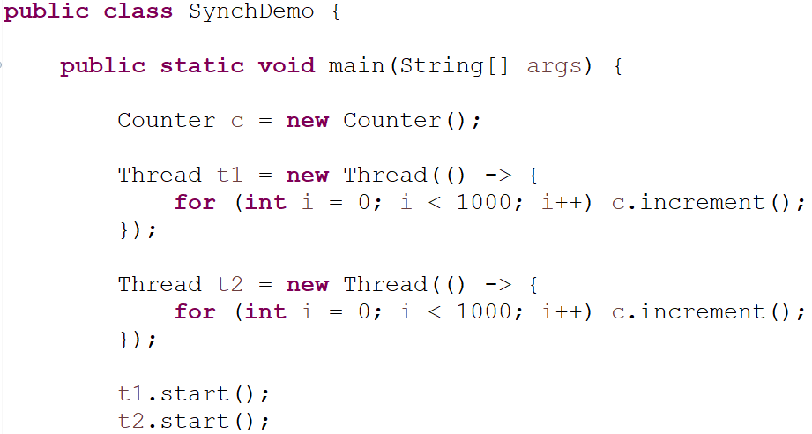
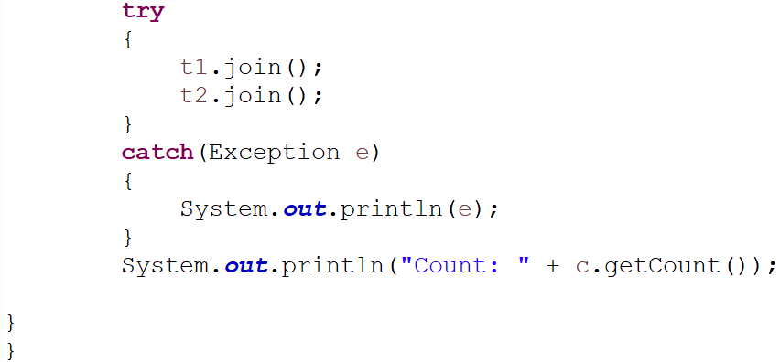
Synchronization
Then create a SynchDemo class:

