Slide 1
Interface

Slide 2
Interface
The interface in Java is a mechanism to achieve abstraction.
There can be only abstract methods in the Java interface, not the method body.
It is used to achieve multiple inheritances in Java .
Syntax:
interface <interface_name>
{
// declare constant fields
// declare methods that abstract
// by default.
}

Slide 3
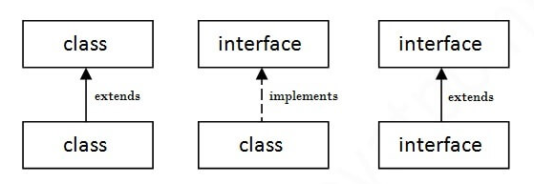
Interface
Implementing Interface
To use an interface, a class must implement it using the implements keyword.
A class can implement multiple interfaces, separated by commas.

Slide 4
Interface: Points to Remember
Interface variable is implicitly public, static, and final.
Interface variables should always be declared and assigned a value. They cannot be left uninitialized.
No access modifier is allowed except the public for interface variables
Interface methods are by default abstract and public.
On implementation of an interface, you must override all of its methods.
Interfaces cannot be used to create objects

Slide 5
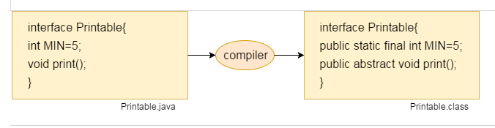
Variables in Interfaces

Slide 6
Extending Interface
Interfaces can be extended similar to the classes
An interface can extend multiple interfaces.
An interface can implement neither an interface nor a class.
An interface is not extended by a class; it is implemented by a class.

Slide 7
Extending Interface
Syntax:
interface interface_name2 extends interface_name1
{
……// body of interface
}

Slide 8
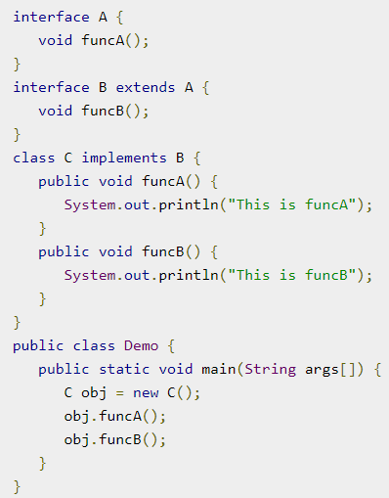
Extending Interface
Output:
This is funcA
This is funcB

Slide 9
Assignments
Create an interface animal with method makeSound. Implement it in class Cat, Dog and Cow. Call the method using interface references to print respective sounds.
Create an interface Shape with a method double getArea(). Implement this interface in classes Circle, Rectangle and Triangle. Call the method and displaying their areas.

Slide 10
Assignments
Define an interface Order with methods placeOrder and cancelOrder. Implement it in classes GroceryOrder and ClothingOrder. Simulate order placing and canceling using user input.

Slide 11
Static Keyword
It is mainly used for memory management.
The static keyword belongs to the class rather than an instance of the class.
The static keyword is used to share the same variable or method of a given class.
It can be used for variables, methods, blocks, and nested classes.

Slide 12
Static Keyword: Characteristics
Static members can not access non-static members.
We do not need to create objects of the class to use static methods
We can call static members using the class name directly.
Static methods cannot be overridden in subclasses because they belong to the class, not to an object.

Slide 13
Static Variable(Class Variable)
A single copy of the static variable is created and shared among all objects at the class level.
Memory is allocated only once, at the time of class loading.
Static variables are, essentially, global variables
We can create static variables at the class level only.
You can call a static variable using ClassName.variableName.

Slide 14
Static Variable(Class Variable)
Example:
class Counter
{
static int count = 0; // static variable
Counter()
{
count++;
System.out.println(count);
}
}

Slide 15
Static Method
Belong to the class, not instances.
Can be called without creating an object of the class.
Static methods cannot use this or super keyword.
You can call a static method using ClassName.methodName

Slide 16
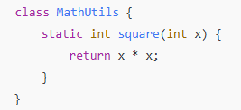
Static Method
Example:

Slide 17
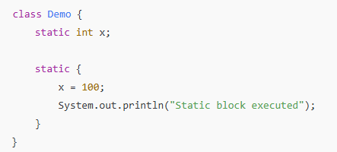
Static Block
Used to initialize static variables.
Executed only once when the class is loaded.

Slide 18
Static Class
A class can be made static only if it is a nested class
We cannot declare a top-level class with a static modifier.
A static class cannot access non-static members of the Outer class.

Slide 19
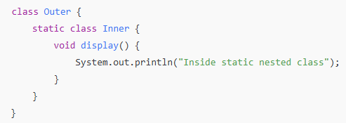
Static Class
Example:

Slide 20
Assignments
Create a class Employee with:
A static variable companyName
A non-static variable employeeName
A method display() that prints both values.
Create two objects of Employee with different names and call display()
Create a class AreaCalculator with static methods:
areaOfCircle(double radius)
areaOfRectangle(double length, double width) Call these methods from the main() method to display areas.

Slide 21
Assignments
Create a Book class with a static variable totalBooksIssued. Each time a book is issued (via a method issueBook()), increment this counter. Display the total number of books issued using a static method getTotalIssued()

