Slide 1
OOP Concepts

Slide 2
Object Oriented Programming
Object means a real-world entity such as a mobile, book, table, computer, watch, etc.
Object-Oriented Programming is a methodology or paradigm to design a program using classes and objects.

Slide 3
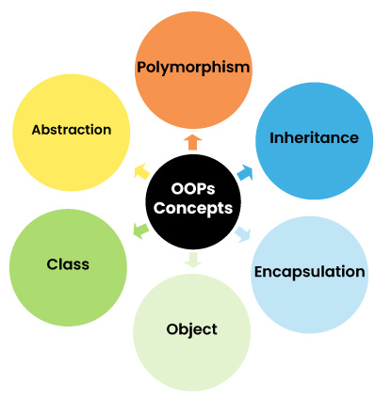
Object Oriented Programming

Slide 4
Classes in Java
It is a user-defined blueprint or prototype from which objects are created.
Class does not occupy memory.
Class is a group of variables of different data types and a group of methods.

Slide 5
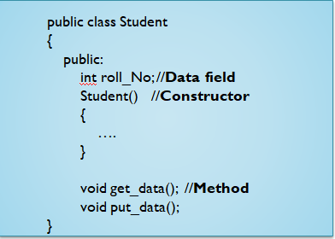
Classes in Java

Slide 6
Objects in Java
An object is an instance of a class.
The object is an entity which has state and behavior.
State represents the data of an object
Behavior represents the behavior of an object such as deposit, withdraw

Slide 7
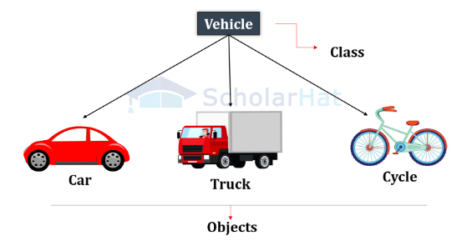
Objects in Java

Slide 8

Objects in Java
Creating an Object
Using the new keyword is the most popular way to create an object or instance of the class.
The syntax for creating an object is:

Slide 9
Methods in Java
Methods are nothing but the function defined by particular class.
Methods are declared within a class, and that they are used to perform certain actions.
It is used to achieve the reusability of code.

Slide 10
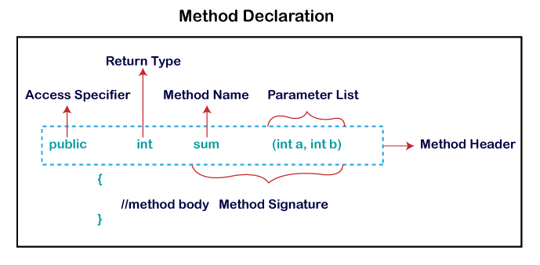
Methods in Java

Slide 11
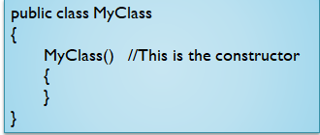
Constructor
It is a special type of method which is used to initialize the object.
It is called when an instance of the class is created.
Every time an object is created using the new() keyword, at least one constructor is called.
Example:

Slide 12
Constructor
Rules for creating Java constructor
Constructor name must be the same as its class name
A Constructor must have no explicit return type
A Java constructor cannot be abstract, static, final, and synchronized

Slide 13
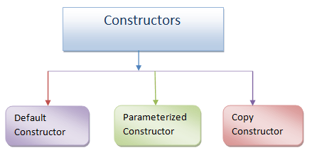
Types of Constructor

Slide 14
Assignments
Create a Student class with fields like rollNo, name, and marks. Create multiple student objects and display their details using a method.
Create a BankAccount class with attributes: accountNumber, accountHolder, and balance. Include methods to deposit(), withdraw(), and checkBalance().
Create a class Item with attributes itemId, name, and price. Create methods to calculate total price for a given quantity and apply discount if total is above 1000.

Slide 15
Inheritance
Inheritance is the procedure in which one class inherits the attributes and methods of another class.
The idea behind inheritance in Java is that you can create new classes that are built upon existing classes.
Inheritance represents the IS-A relationship which is also known as a parent-child relationship.

Slide 16
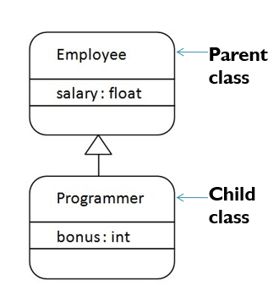
Inheritance

Slide 17
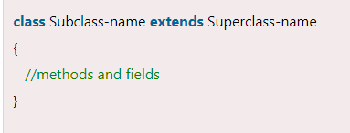
Inheritance
Syntax

Slide 18
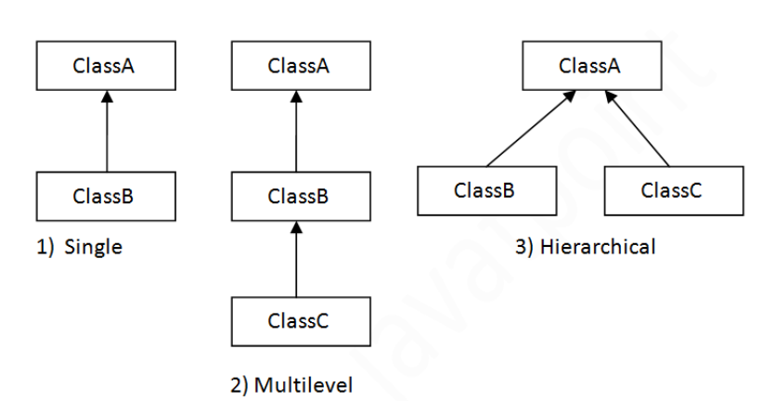
Types of Inheritance

Slide 19
Member access and Inheritance
The access modifiers in Java specifies the accessibility or scope of a field, method, constructor, or class.
There are four types of Java access modifiers:
Private:
Default:
Protected:
Public:

Slide 20
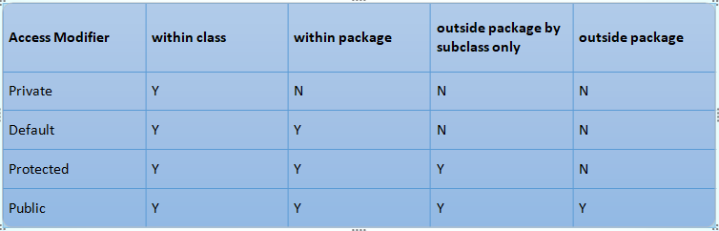
Member access and Inheritance

Slide 21
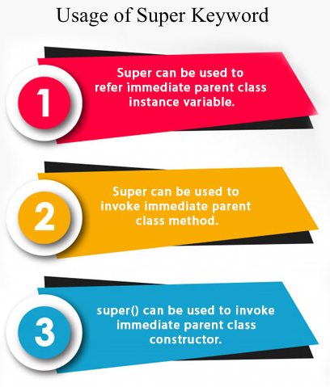
Using super

Slide 22
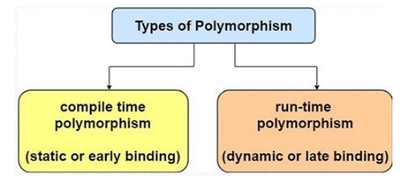
Polymorphism
The word “poly” means many and “morphs” means forms, So it means many forms.

Slide 23
Assignments
Create a Person class with attributes like name and age. Derive a Student class that includes attributes like roll number and course. Write a program to accept and display details of a student.
Create a class Person: name, age, gender.
Subclasses: Doctor (specialization, salary), Patient (disease, admissionDate), Nurse (shift, assignedWard).Implement methods to display individual roles and responsibilities.

Slide 24
Assignments
Create a base class Shape with method area(). Create subclasses Circle, Rectangle, and Triangle, each overriding the area() method to calculate and return area accordingly.
Create a class Product with attributes like ID, name, and price. Inherit Electronics, Clothing, and Grocery classes with additional features (e.g., warranty, size, expiry date). Write methods to calculate discount and display final price.

