Slide 1
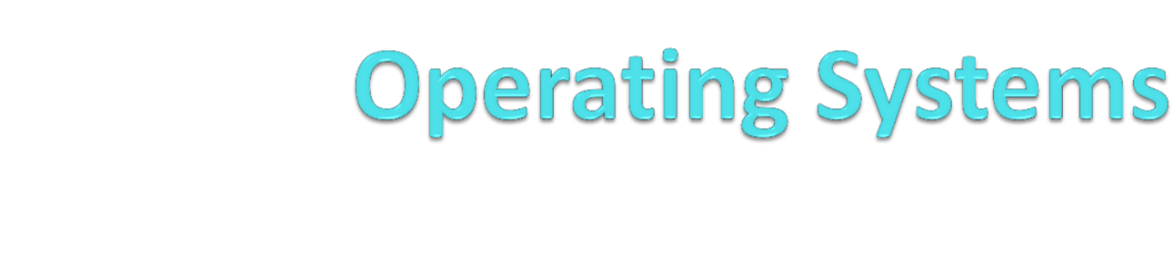
Unit 4

Slide 2
Syllabus
TE_Computer_2019_Course_22.06.2021 (1).pdf
Introduction: Evolution of OS, Operating System Services, Functions of Operating System.
Process Management: Process, Process States: 5 and 7 state model, Process control block, Threads, Thread lifecycle, Multithreading Model, Process control system calls.
Process Scheduling: Uni-processor Scheduling, Scheduling: Preemptive, Non-preemptive, Long- term, Medium-term, Short term scheduling.
Scheduling Algorithms: FCFS, SJF, RR, and Priority.

Slide 3

Book by
Silberschatz, Galvin, Gagne, "Operating System
Principles", 9th Edition, Wiley, ISBN 978- 1-118-06333-0

Slide 4


Application software
System software
System Software
Operating Systems
Schedules computer events
Allocates computer resources
Monitor events
Hardware
Users
Language translators
Interpreters
Compilers
Application Software
Programming languages
Assembly language, FORTRAN, BASIC, PL/1, PASCAL, C, “4th generation” languages, Airway reservation system, banking system, etc.
Utility programs
Routine operations
(e.g. sort, list, print)
Manage data
(e.g. create files, merge files
Unit-I of System programming and operating system

Slide 5
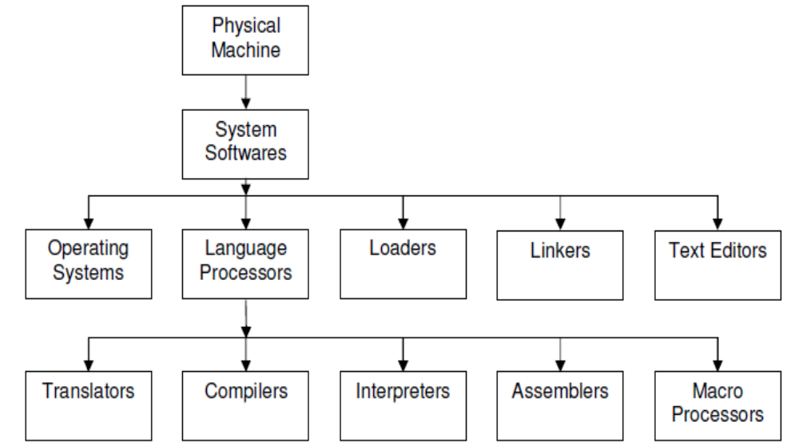
Components of computer system programming
Unit-I of System programming and operating system

Slide 6
Introduction - Operating Systems
An OS is system software that manages Computer hardware, software resources, and provides common services for computer programs.
An operating system is an interface between user and the computer hardware.
  Convenience
  Efficiency
  Resource allocator
  Control Program
Notes:
--A computer system can be divided roughly into four components: the hardware, the operating system, the application programs, and the users.
--The operating system controls the hardware and coordinates its use among the various application programs for the various users.
--- If you don't have an operating system, you're stuck doing one -- and only one -- process at a time.
---Like a government, it performs no useful function by itself. It simply provides an environment within which other programs can do useful work.
--TO understand operating systems we must see both viewpoints: that of the user and that of the system
--for single user-Convenience- ease of use
--for multiple user-main frame -Efficiency - resource utilization
--resource allocator-In this context, we can view an operating system as a resource allocator.
--control program- A slightly different view of an operating system emphasizes the need to control the various I/O devices and user programs.
A control program manages the execution of user programs to prevent errors and improper use of the computer.

Slide 7
Functions :
  Resource Management :
    CPU : Process Management → Scheduling Algorithm
    Memory : how main memory allocated to process
    I/O device:
    Storage management : Secondary memory management : file management

Slide 8
Operating System Service
Program execution
I/O operations
File System manipulation
Communication
Error Detection
Resource Allocation
Protection

Slide 9
Introduction to different types of operating systems
Batch Operating System
Multiprogramming Operating System
Time sharing OS
Multitasking OS
Multiprocessing OS
Distributed operating System
Network operating
Real time operating system
Notes:
--batch os-Sequence of jobs in a program on a computer without manual interventions- Lower CPU utilization
--Multiprogramming os--Sharing the processor, when two or more programs reside in memory at the same time, is referred as multiprogramming.
--Multitasking os- Allows many users to share the computer - Multi-programming with preemption
--Multiprocessing OS- Multiple processors
--Distributed os- Manages a group of different computers and make appear to be a single computer.
--Network operating system- computers running in different operating system can participate in common network (It is used for security purpose).
--Real time operating system -- It is meant for applications having fix deadlines.
RTOS guarantees a certain capability within a specified time constraint. ex,. OS for robot on assembly line

Slide 10
Operating System structure
Simple or Monolithic Architecture
Layered
Microlevel Architecture
Hybrid Architecture
Notes:
--Monolithic kernel manages system resources between application and hardware, but user services and kernel services are implemented under same address space.
-- layered- Less efficient: Each layer adds overhead to system call which in result takes longer time than non-layered system
---Microlevel Architecture- provides minimal process and memory management. Provides communication between client program and services running in user space.
--Hybrid- This means that the kernel structure should be similar to a microkernel but the structure should be implemented like a monolithic kernel. Ex. Apple Mac OS
ios
Android

Slide 11
Process Management
Process Concept
Process Scheduling
Operations on Processes

Slide 12
Process Concept
Process is a program in execution.
Program is passive entity, process is active
A process includes:
  Text section
  program counter
  stack
  data section
  Heap
Notes:
Program becomes process when executable file loaded into memory
Execution of program started via GUI mouse clicks, command line entry of its name, etc
One program can be several processes-- Consider multiple users executing the same program
The program code, also called text section
Current activity including program counter, processor registers
Stack containing temporary data
Function parameters, return addresses, local variables
Data section containing global variables
Heap containing memory dynamically allocated during run time

Slide 13


Temporary data
Global variables
Program code

Slide 14
Process Control Block (PCB)
PCB stores data needed for correct and efficient process management.
  Process identification, Process state, Process control
  Information associated with each process
  Process Id
  Process state
  Program counter
  CPU registers
  CPU scheduling information
  Memory-management information
  Accounting information- amount of CPU used for process execution, time limits, execution ID
  I/O status information

Slide 15



Slide 16
Process State
As a process executes, it changes state
  new: The process is being created
  ready: The process is waiting to be assigned to a processor
  running: Instructions are being executed
  waiting: The process is waiting for some event to occur
  terminated: The process has finished execution

Slide 17

Diagram of 5 Process State model

Slide 18
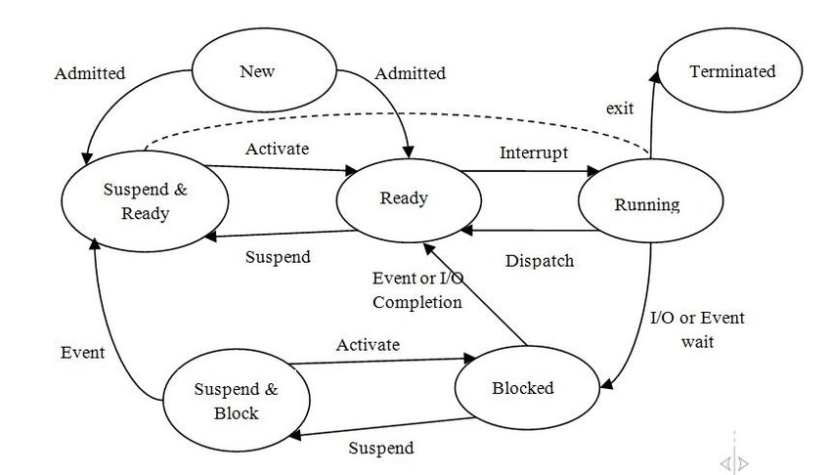
7 state model
Notes:
SUSPENDED & BLOCKED- If all the processes in the main memory are blocked and the processor is idle, some blocked processes can be moved to secondary storage and their state changed to BLOCK&SUSPEND.
SUSPENDED & READY and If the event that the process in the secondary storage was waiting for occurs, the process changes its state to this state and remains in secondary storage

Slide 19



Slide 20
What is Thread ?
Thread is basic unit of CPU Utilization . A thread is a path that a program takes during execution. The majority of modern applications run in a single thread.
A thread is a flow of execution through the process code, with its own program counter, system registers and stack.
It provides a way to improve application performance through parallelism.
Each thread belongs to exactly one process and no thread can exist outside a process.

Slide 21

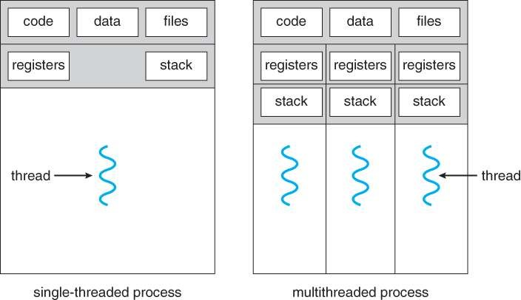

Slide 22
There are two types of multitasking: processor-based and thread-based. The Operating System entirely controls processor-based multitasking; however, multitasking via multithreading can be directed to some extent by the programmer.
A method is a program that is being run. Threads are independent units that can be separated from a process.
Ex 1. A web browser might have one thread display images or text while another thread retrieves data from the network.
Ex 2. A word processor may have a thread for displaying graphics, another thread for responding to keystrokes from the user, and a third thread for performing spelling and grammar checking in the background.
Ex 3. A busy web server may have several clients concurrently accessing it.

Slide 23
Difference between Process and Threads
S.N. | Process | Threads
1. | Process is heavy weight or resource intensive. | Thread is light weight taking lesser resources than a process.
2. | Process switching needs interaction with operating system. | Thread switching does not need to interact with operating system.
3. | In multiple processing environments each process executes the same code but has its own memory and file resources. | All threads can share same set of open files, child processes.
4. | If one process is blocked then no other process can execute until the first process is unblocked. | While one thread is blocked and waiting, second thread in the same task can run.
5. | Multiple processes without using threads use more resources. | Multiple threaded processes use fewer resources.
6. | In multiple processes each process operates independently of the others. | One thread can read, write or change another thread's data.

Slide 24
Advantages of Threads
Thread minimizes context switching time.
Use of threads provides concurrency within a process.
Efficient communication.
Economy- It is more economical to create and context switch threads.
Utilization of multiprocessor architectures to a greater scale and efficiency.
Disadvantages of Threads
Blocking of parent threads will stop all child thread.

Slide 25
Multi-Threading Models
What is Multithreading Operating System?
The phenomenon of running many threads simultaneously is known as multithreading
Threads are implemented in following two ways −
  User Level Threads − User managed threads.
  Kernel Level Threads − Operating System managed threads acting on kernel, an operating system core.
Some operating system provides a combined user level thread and kernel level thread facility.
Solaris is a good example of this combined approch.
Multi-Threading models are three types.
Many-to-One Model
One-to-One Model
Many-to-Many Model
Notes:
User level- kernel is not aware of the existence of threads. The thread library contains code for creating and destroying threads, for passing message and data between threads, for scheduling thread execution and for saving and restoring thread contexts.
Adva- User level thread can run on any operating system.
Disadvantage
In a typical operating system, most system calls are blocking.
Multithreaded application cannot take advantage of multiprocessing.
Kernel level- thread management is done by the Kernel. There is no thread management code in the application area. Kernel threads are supported directly by the operating system
Advantages
Kernel can simultaneously schedule multiple threads from the same process on multiple processes.
If one thread in a process is blocked, the Kernel can schedule another thread of the same process.
Disadvantages
Kernel threads are generally slower to create and manage than the user threads.
Transfer of control from one thread to another within the same process requires a mode switch to the Kernel.

Slide 26
User level- kernel is not aware of the existence of threads. The thread library contains code for creating and destroying threads, for passing message and data between threads, for scheduling thread execution for saving & restoring thread contexts.
Advantages- User level thread can run on any operating system.
Disadvantage
  In a typical operating system, most system calls are blocking.
  Multithreaded application cannot take advantage of multiprocessing.
Kernel level- thread management is done by the Kernel. There is no thread mgnt code in the application area. Kernel threads are supported directly by the OS.
Advantages
  Kernel can simultaneously schedule multiple threads from the same process on multiple processes.
  If one thread in a process is blocked, the Kernel can schedule another thread of the same process.
Disadvantages
  Kernel threads are generally slower to create and manage than the user threads.
  Transfer of control from one thread to another within the same process requires a mode switch to the Kernel.

Slide 27
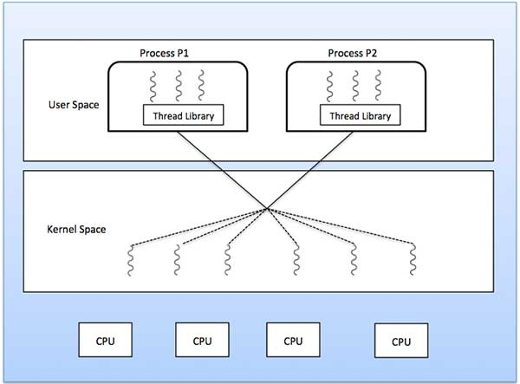
Many to Many
Notes:
In this model, developers can create as many user threads as necessary and the corresponding Kernel threads can run in parallel on a multiprocessor machine. This model provides the best accuracy on concurrency and when a thread performs a blocking system call, the kernel can schedule another thread for execution.
The many-to-many model (many user level thread to many kernel level thread) avoids many of the limitations of the one-to-one model, while extending multithreading capabilities even further. The many- to-many model also called two-level model, minimize programing effort while reducing the cost and weight of each thread.

Slide 28
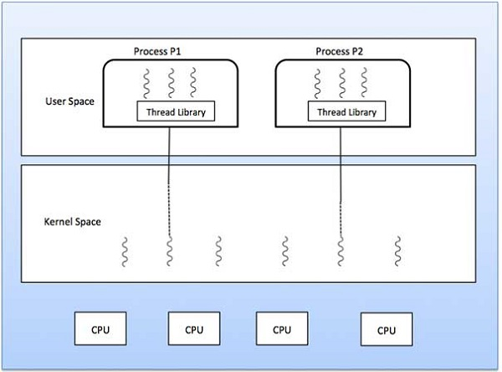
Many to one
Notes:
Many-to-one model maps many user level threads to one Kernel-level thread. Thread management is done in user space by the thread library. When thread makes a blocking system call, the entire process will be blocked. Only one thread can access the Kernel at a time, so multiple threads are unable to run in parallel on multiprocessors.

Slide 29
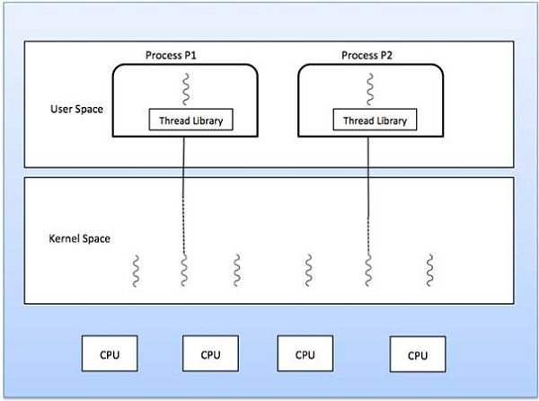
One to One
Notes:
This model provides more concurrency than the many-to-one model. It also allows another thread to run when a thread makes a blocking system call. It supports multiple threads to execute in parallel on microprocessors.
The one-to-one model (one user level thread to one kernel level thread) is among the earliest implementations of true multithreading. In this implementation, each ULT created by the application is known to the kernel,and all threads ca access the kernel at the same time

Slide 30
Advantages of Multithreading Operating System
1. Resource sharing: Because threads can share any process memory and resources, every program can perform several tasks inside the same address space.
2. Multiple Processor Architecture: Different threads can execute in parallel on many processors, allowing for high processor usage and efficiency.
3. Reduced Context Switching Time: As with Thread Context Switching, the threads reduce context switching time while keeping the virtual memory space the same.
4. Cost-effective: Allocating memory and resources throughout the process generation process has a cost. Context-switch threads are more affordable to construct since they can distribute process resources.

Slide 31
Disadvantages of Multithreading Operating System
Due to the fact that numerous user threads are routed to a single kernel thread. So, if one user thread makes a blocking system call, the kernel thread will be blocked, and all other threads will be blocked as well.
Multiple threads cannot run in parallel in a multiprocessor system because only one thread can reach the kernel thread at a time. Despite the fact that we have several processors, one kernel thread will only operate on one of them. As a result, the user thread will only run in the processor where the mapped kernel thread is active.
The kernel thread is assigned to many user threads. So, if one user thread makes a blocking system call, the kernel thread will be blocked, and all other threads will be blocked as well.
Multiple threads cannot run in parallel in a multiprocessor system because only one thread can access the kernel thread at any given moment. One kernel thread will execute on only one CPU, despite the fact that we have several processors. As a result, the user thread will execute in the same processor as the mapped kernel thread.

Slide 32
Parameter | Multiprogramming | Multitasking
Definition | It lets multiple programs use the CPU at the same time. | Multitasking refers to the simultaneous execution of numerous programs, processes and threads with a certain timestamp.
Objective | It is useful for cutting down on CPU idle time and boosting throughput as much as possible. | It may be used to execute numerous tasks at once, significantly improving CPU and system throughput.
Mechanism | The context switching method is used. | Based on a time-sharing mechanism.
Time | Multiprogramming demands comparatively more time to complete tasks. | Multitasking allows you to complete tasks in less time.
Execution | In a multitasking system, when one job or process completes its execution or changes to an I/O task, the system temporarily suspends that process. It chooses a new process to execute from the process scheduling pool. | Multiple processes can run concurrently in this system by assigning the CPU for a fixed duration of time.
CPU Switching | The CPU shifts between processes swiftly in this environment. | The CPU shifts between the processes pf several programs in a single-user environment.

Slide 33
Process Scheduling
Uni- processor scheduling
Maximize CPU use, quickly switch processes onto CPU for time sharing
Process scheduler- selects process among available processes in ready queue for next execution on CPU
Maintains scheduling queues of processes
  Job queue – set of all processes in the system
  Ready queue – set of all processes residing in main memory, ready and waiting to execute
  Device queues – set of processes waiting for an I/O device
  Processes migrate among the various queues
Notes:
: Uni-processor Scheduling, Scheduling: Preemptive, Non-preemptive, Long- term, Medium-term, Short term scheduling.

Slide 34



Slide 35
Schedulers
Long-term scheduler (Process or job scheduler
Medium term scheduler-
Short-term scheduler (or CPU scheduler)
Notes:
Long-term scheduler (or job scheduler) – selects which processes should be brought into the ready queue
Medium term scheduler- sometimes it can be advantageous to remove a process from memory (and from active contention for the CPU) and thus reduce the degree of multiprogramming
Short-term scheduler (or CPU scheduler) – selects which process should be executed next and allocates CPU
Sometimes the only scheduler in a system

Slide 36
Parameters of Process
Arrival Time
Burst Time
Completion time
Turn around time
Waiting time
Response time
Notes:
Burst time(BT):
Burst time is the amount of time required by a process for executing on CPU. It is also called as execution time or running time. Burst time of a process can not be known in advance before executing the process.
Burst Time (B.T.) = Completion Time (C.T.) - Waiting Time (W.T.)
Completion time (CT)
Completion time is the point of time at which a process completes its execution on the CPU and takes exit from the system. It is also called as exit time.
Turn around time: (TAT)
It is the time interval from the time of submission of a process to the time of the completion of the process. It can also be considered as the sum of the time periods spent waiting to get into memory or ready queue, execution on CPU and executing input/output.
TAT=WT+BT
Or
TAT=CT-AT(Arrival time)
Waiting Time:
Waiting time is the total time spent by the process in the ready queue waiting for CPU.
WT=TAT-BT
Response time- time from the submission of a request until the first response is produced by CPU.CPU response time Response time is the total amount of time it takes to respond to a request for service.

Slide 37
Scheduling Algorithms
First Come First Serve
Shortest Remaining Time First -- SRTF (SJF with preemption)
Shortest Job First with nonpreemption
Priority scheduling
Round Robin

Slide 38
FCFS Scheduling (First Come First Serve)
First job that requests the CPU gets the CPU
Non preemptive
– Process continues till the burst cycle ends

Slide 39
Example
P.no. | Arrival time | Burst time | Completion time | Turn around time | Waiting time
P1 | 0 | 4
P2 | 1 | 3
P3 | 2 | 1
P4 | 3 | 2
P5 | 4 | 5

Slide 40
Example
P.no. | Arrival time | Burst time | Completion time | Turn around time | Waiting time
P1 | 0 | 4 | 4
P2 | 1 | 3
P3 | 2 | 1
P4 | 3 | 2
P5 | 4 | 5
Gantt Chart (graphical illustration of a process scheduling
p1
0
4

Slide 41
Example
P.no. | Arrival time | Burst time | Completion time | Turn around time | Waiting time
P1 | 0 | 4 | 4
P2 | 1 | 3 | 7
P3 | 2 | 1
P4 | 3 | 2
P5 | 4 | 5
Gantt Chart
p1 | p2
0
4
7

Slide 42
Example
P.no. | Arrival time | Burst time | Completion time | Turn around time | Waiting time
P1 | 0 | 4 | 4
P2 | 1 | 3 | 7
P3 | 2 | 1 | 8
P4 | 3 | 2
P5 | 4 | 5
Gantt Chart
p1 | p2 | p3
0
4
7
8

Slide 43
Example
P.no. | Arrival time | Burst time | Completion time | Turn around time | Waiting time
P1 | 0 | 4 | 4
P2 | 1 | 3 | 7
P3 | 2 | 1 | 8
P4 | 3 | 2 | 10
P5 | 4 | 5
Gantt Chart
p1 | p2 | p3 | p4
4
7
8
10

Slide 44
Example
P.no. | Arrival time | Burst time | Completion time | Turn around time | Waiting time
P1 | 0 | 4 | 4
P2 | 1 | 3 | 7
P3 | 2 | 1 | 8
P4 | 3 | 2 | 10
P5 | 4 | 5 | 15
Gantt Chart
p1 | p2 | p3 | p4 | p5
4
7
8
10
15

Slide 45
Example
P.no. | Arrival time | Burst time | Completion time | Turn around Time=CT-AT | Waiting time
P1 | 0 | 4 | 4 | 4
P2 | 1 | 3 | 7 | 6
P3 | 2 | 1 | 8 | 6
P4 | 3 | 2 | 10 | 7
P5 | 4 | 5 | 15 | 11
Gantt Chart
p1 | p2 | p3 | p4 | p5
4
7
8
10
15

Slide 46
Example
P.no. | Arrival time | Burst time | Completion time | Turn around Time=CT-AT | Waiting Time=TAT-BT
P1 | 0 | 4 | 4 | 4 | 0
P2 | 1 | 3 | 7 | 6 | 3
P3 | 2 | 1 | 8 | 6 | 5
P4 | 3 | 2 | 10 | 7 | 5
P5 | 4 | 5 | 15 | 11 | 6
Gantt Chart
p1 | p2 | p3 | p4 | p5
4
7
8
10
15

Slide 47
Average TAT=(4+6+6+7+11)/5
  = 5
Average WT=(0+3+5+5+6)/5
=3.8

Slide 48
Shortest Remaining Time First -- SRTF (SJF with preemption)
If a new process arrives with a shorter burst time than
remaining of current process, then schedule new process
Further reduces average waiting time and average response time.
Preemption is the act of temporarily interrupting a task being carried out by a computer system
Notes:
Preemption is the act of temporarily interrupting a task being carried out by a computer system, without requiring its cooperation, and with the intention of resuming the task at a later time

Slide 49
Example
P.No. | A.T. | B.T. | C.T. | TAT =C.T.-A.T | WT=TAT-BT
1 | 0 | 7
2 | 1 | 5
3 | 2 | 3
4 | 3 | 1
5 | 4 | 2
6 | 5 | 1

Slide 50
Example
P.No. | A.T. | B.T. | C.T. | TAT =C.T.-A.T | WT=TAT-BT
P1 | 0 | 7
P2 | 1 | 5
P3 | 2 | 3
P4 | 3 | 1
P5 | 4 | 2
p6 | 5 | 1
Gantt Chart
p1
0
1

Slide 51
Example
P.No. | A.T. | B.T. | C.T. | TAT =C.T.-A.T | WT=TAT-BT
P1 | 0 | 6
P2 | 1 | 5
P3 | 2 | 3
P4 | 3 | 1
P5 | 4 | 2
p6 | 5 | 1
Gantt Chart
p1 | p2
0
1
2

Slide 52
Example
P.No. | A.T. | B.T. | C.T. | TAT =C.T.-A.T | WT=TAT-BT
P1 | 0 | 6
P2 | 1 | 4
P3 | 2 | 3
P4 | 3 | 1
P5 | 4 | 2
p6 | 5 | 1
Gantt Chart
p1 | p2 | p3
0
1
2
3

Slide 53
Example
P.No. | A.T. | B.T. | C.T. | TAT =C.T.-A.T | WT=TAT-BT
P1 | 0 | 6
P2 | 1 | 4
P3 | 2 | 2
P4 | 3 | 1
P5 | 4 | 2
p6 | 5 | 1
Gantt Chart
p1 | p2 | p3 | p4
0
1
2
3
4

Slide 54
Example
P.No. | A.T. | B.T. | C.T. | TAT =C.T.-A.T | WT=TAT-BT
P1 | 0 | 6
P2 | 1 | 4
P3 | 2 | 2
P4 | 3 | 0
P5 | 4 | 2
p6 | 5 | 1
Gantt Chart
p1 | p2 | p3 | p4 | p3
0
1
2
3
4
5

Slide 55
Example
P.No. | A.T. | B.T. | C.T. | TAT =C.T.-A.T | WT=TAT-BT
P1 | 0 | 6
P2 | 1 | 4
P3 | 2 | 1
P4 | 3 | 0
P5 | 4 | 2
p6 | 5 | 1
Gantt Chart
p1 | p2 | p3 | p4 | p3 | p3
0
1
2
3
4
5
6

Slide 56
Example
P.No. | A.T. | B.T. | C.T. | TAT =C.T.-A.T | WT=TAT-BT
P1 | 0 | 6
P2 | 1 | 4
P3 | 2 | 0
P4 | 3 | 0
P5 | 4 | 2
p6 | 5 | 1
Gantt Chart
p1 | p2 | p3 | p4 | p3 | p3 | p6
0
1
2
3
4
5
6
7

Slide 57
Example
P.No. | A.T. | B.T. | C.T. | TAT =C.T.-A.T | WT=TAT-BT
P1 | 0 | 6
P2 | 1 | 4
P3 | 2 | 0
P4 | 3 | 0
P5 | 4 | 2
p6 | 5 | 0
Gantt Chart
p1 | p2 | p3 | p4 | p3 | p3 | p6 | p5
0
1
2
3
4
5
6
7
9

Slide 58
Example
P.No. | A.T. | B.T. | C.T. | TAT =C.T.-A.T | WT=TAT-BT
P1 | 0 | 6
P2 | 1 | 4
P3 | 2 | 0
P4 | 3 | 0
P5 | 4 | 0
p6 | 5 | 0
Gantt Chart
p1 | p2 | p3 | p4 | p3 | p3 | p6 | p5 | p2
0
1
2
3
4
5
6
7
9
13

Slide 59
Example
P.No. | A.T. | B.T. | C.T. | TAT =C.T.-A.T | WT=TAT-BT
P1 | 0 | 6
P2 | 1 | 0
P3 | 2 | 0
P4 | 3 | 0
P5 | 4 | 0
p6 | 5 | 0
Gantt Chart
p1 | p2 | p3 | p4 | p3 | p3 | p6 | p5 | p2 | p1
0
1
2
3
4
5
6
7
9
13
19

Slide 60
Example
P.No. | A.T. | B.T. | C.T. | TAT =C.T.-A.T | WT=TAT-BT
P1 | 0 | 0
P2 | 1 | 0
P3 | 2 | 0
P4 | 3 | 0
P5 | 4 | 0
p6 | 5 | 0
Gantt Chart
p1 | p2 | p3 | p4 | p3 | p3 | p6 | p5 | p2 | p1
0
1
2
3
4
5
6
7
9
13
19

Slide 61
Example
P.No. | A.T. | B.T. | C.T. | TAT =C.T.-A.T | WT=TAT-BT
P1 | 0 | 0 | 19 | 19 | 12
P2 | 1 | 0 | 13 | 12 | 7
P3 | 2 | 0 | 6 | 4 | 1
P4 | 3 | 0 | 4 | 1 | 0
P5 | 4 | 0 | 9 | 5 | 3
p6 | 5 | 0 | 7 | 2 | 1
Response time
P1=0
P2=0
P3=0
P4=0
P5=3 (7-4)
P6=1(6-5)
Response time- is the time from the submission of a request until the first response is produced.
Gantt Chart
p1 | p2 | p3 | p4 | p3 | p3 | p6 | p5 | p2 | p1
0
1
2
3
4
5
6
7
9
13
19
Find avg.TAT and avg WT?? (HW)

Slide 62
Shortest Job First (SJF) no preemption
Schedule process with the shortest burst time
  FCFS if same
Advantages
  Minimizes average wait time and average response time
Disadvantages
  May starve long jobs

Slide 63
Round Robin Scheduling
Run process for a time slice or time quantum, then move to FIFO

Slide 64
Example:- let time quantum=2
P.No. | A.T. | B.T. | C.T. | TAT =C.T.-A.T | WT=TAT-BT
P1 | 0 | 4
P2 | 1 | 5
P3 | 2 | 2
P4 | 3 | 1
P5 | 4 | 6
p6 | 6 | 3
Process queue
p1
Gantt Chart
p1
0
2

Slide 65
Example:- let time quantum=2
P.No. | A.T. | B.T. | C.T. | TAT =C.T.-A.T | WT=TAT-BT
P1 | 0 | 2
P2 | 1 | 5
P3 | 2 | 2
P4 | 3 | 1
P5 | 4 | 6
p6 | 6 | 3
Process queue
p1 | p2 | p3 | p1
Gantt Chart
p1
0
2

Slide 66
Example:- let time quantum=2
P.No. | A.T. | B.T. | C.T. | TAT =C.T.-A.T | WT=TAT-BT
P1 | 0 | 2
P2 | 1 | 5
P3 | 2 | 2
P4 | 3 | 1
P5 | 4 | 6
p6 | 6 | 3
Process queue
p1 | p2 | p3 | p1
0
1
2
Gantt Chart
p1 | p2
0
2
4

Slide 67
Example:- let time quantum=2
P.No. | A.T. | B.T. | C.T. | TAT =C.T.-A.T | WT=TAT-BT
P1 | 0 | 2
P2 | 1 | 3
P3 | 2 | 2
P4 | 3 | 1
P5 | 4 | 6
p6 | 6 | 3
Process queue
p1 | p2 | p3 | p1 | p4 | p5 | p2
Gantt Chart
p1 | p2
0
2
4

Slide 68
Example:- let time quantum=2
P.No. | A.T. | B.T. | C.T. | TAT =C.T.-A.T | WT=TAT-BT
P1 | 0 | 2
P2 | 1 | 3
P3 | 2 | 2
P4 | 3 | 1
P5 | 4 | 6
p6 | 6 | 3
Process queue
p1 | p2 | p3 | p1 | p4 | p5 | p2
Gantt Chart
p1 | p2 | p3
0
2
4
6

Slide 69
Example:- let time quantum=2
P.No. | A.T. | B.T. | C.T. | TAT =C.T.-A.T | WT=TAT-BT
P1 | 0 | 2
P2 | 1 | 3
P3 | 2 | 0
P4 | 3 | 1
P5 | 4 | 6
p6 | 6 | 3
Process queue
p1 | p2 | p3 | p1 | p4 | p5 | p2 | p6
Gantt Chart
p1 | p2 | p3
0
2
4
6

Slide 70
Example:- let time quantum=2
P.No. | A.T. | B.T. | C.T. | TAT =C.T.-A.T | WT=TAT-BT
P1 | 0 | 2
P2 | 1 | 3
P3 | 2 | 0
P4 | 3 | 1
P5 | 4 | 6
p6 | 6 | 3
Process queue
p1 | p2 | p3 | p1 | p4 | p5 | p2 | p6
Gantt Chart
p1 | p2 | p3 | p1
0
2
4
6
8

Slide 71
Example:- let time quantum=2
P.No. | A.T. | B.T. | C.T. | TAT =C.T.-A.T | WT=TAT-BT
P1 | 0 | 0
P2 | 1 | 3
P3 | 2 | 0
P4 | 3 | 1
P5 | 4 | 6
p6 | 6 | 3
Process queue
p1 | p2 | p3 | p1 | p4 | p5 | p2 | p6
Gantt Chart
p1 | p2 | p3 | p1
0
2
4
6
8

Slide 72
Example:- let time quantum=2
P.No. | A.T. | B.T. | C.T. | TAT =C.T.-A.T | WT=TAT-BT
P1 | 0 | 0
P2 | 1 | 3
P3 | 2 | 0
P4 | 3 | 1
P5 | 4 | 6
p6 | 6 | 3
Process queue
p1 | p2 | p3 | p1 | p4 | p5 | p2 | p6
Gantt Chart
p1 | p2 | p3 | p1 | p4
0
2
4
6
8
9

Slide 73
Example:- let time quantum=2
P.No. | A.T. | B.T. | C.T. | TAT =C.T.-A.T | WT=TAT-BT
P1 | 0 | 0
P2 | 1 | 3
P3 | 2 | 0
P4 | 3 | 0
P5 | 4 | 6
p6 | 6 | 3
Process queue
p1 | p2 | p3 | p1 | p4 | p5 | p2 | p6
Gantt Chart
p1 | p2 | p3 | p1 | p4
0
2
4
6
8
9

Slide 74
Example:- let time quantum=2
P.No. | A.T. | B.T. | C.T. | TAT =C.T.-A.T | WT=TAT-BT
P1 | 0 | 0
P2 | 1 | 3
P3 | 2 | 0
P4 | 3 | 0
P5 | 4 | 6
p6 | 6 | 3
Process queue
p1 | p2 | p3 | p1 | p4 | p5 | p2 | p6
Gantt Chart
p1 | p2 | p3 | p1 | p4 | p5
0
2
4
6
8
9
11

Slide 75
Example:- let time quantum=2
P.No. | A.T. | B.T. | C.T. | TAT =C.T.-A.T | WT=TAT-BT
P1 | 0 | 0
P2 | 1 | 3
P3 | 2 | 0
P4 | 3 | 0
P5 | 4 | 4
p6 | 6 | 3
Process queue
p1 | p2 | p3 | p1 | p4 | p5 | p2 | p6 | p5
Gantt Chart
p1 | p2 | p3 | p1 | p4 | p5
0
2
4
6
8
9
11

Slide 76
Example:- let time quantum=2
P.No. | A.T. | B.T. | C.T. | TAT =C.T.-A.T | WT=TAT-BT
P1 | 0 | 0
P2 | 1 | 3
P3 | 2 | 0
P4 | 3 | 0
P5 | 4 | 4
p6 | 6 | 3
Process queue
p1 | p2 | p3 | p1 | p4 | p5 | p2 | p6 | p5
Gantt Chart
p1 | p2 | p3 | p1 | p4 | p5 | p2
0
2
4
6
8
9
11
13

Slide 77
Example:- let time quantum=2
P.No. | A.T. | B.T. | C.T. | TAT =C.T.-A.T | WT=TAT-BT
P1 | 0 | 0
P2 | 1 | 1
P3 | 2 | 0
P4 | 3 | 0
P5 | 4 | 4
p6 | 6 | 3
Process queue
p1 | p2 | p3 | p1 | p4 | p5 | p2 | p6 | p5 | p2
Gantt Chart
p1 | p2 | p3 | p1 | p4 | p5 | p2
0
2
4
6
8
9
11
13

Slide 78
Example:- let time quantum=2
P.No. | A.T. | B.T. | C.T. | TAT =C.T.-A.T | WT=TAT-BT
P1 | 0 | 0
P2 | 1 | 1
P3 | 2 | 0
P4 | 3 | 0
P5 | 4 | 4
p6 | 6 | 3
Process queue
p1 | p2 | p3 | p1 | p4 | p5 | p2 | p6 | p5 | p2
Gantt Chart
p1 | p2 | p3 | p1 | p4 | p5 | p2 | p6
0
2
4
6
8
9
11
13
15

Slide 79
Example:- let time quantum=2
P.No. | A.T. | B.T. | C.T. | TAT =C.T.-A.T | WT=TAT-BT
P1 | 0 | 0
P2 | 1 | 1
P3 | 2 | 0
P4 | 3 | 0
P5 | 4 | 4
p6 | 6 | 1
Process queue
p1 | p2 | p3 | p1 | p4 | p5 | p2 | p6 | p5 | p2 | p6
Gantt Chart
p1 | p2 | p3 | p1 | p4 | p5 | p2 | p6
0
2
4
6
8
9
11
13
15

Slide 80
Example:- let time quantum=2
P.No. | A.T. | B.T. | C.T. | TAT =C.T.-A.T | WT=TAT-BT
P1 | 0 | 0
P2 | 1 | 1
P3 | 2 | 0
P4 | 3 | 0
P5 | 4 | 4
p6 | 6 | 1
Process queue
p1 | p2 | p3 | p1 | p4 | p5 | p2 | p6 | p5 | p2 | p6
Gantt Chart
p1 | p2 | p3 | p1 | p4 | p5 | p2 | p6 | p5
0
2
4
6
8
9
11
13
15
17

Slide 81
Example:- let time quantum=2
P.No. | A.T. | B.T. | C.T. | TAT =C.T.-A.T | WT=TAT-BT
P1 | 0 | 0
P2 | 1 | 1
P3 | 2 | 0
P4 | 3 | 0
P5 | 4 | 2
p6 | 6 | 1
Process queue
p1 | p2 | p3 | p1 | p4 | p5 | p2 | p6 | p5 | p2 | p6 | p5
Gantt Chart
p1 | p2 | p3 | p1 | p4 | p5 | p2 | p6 | p5
0
2
4
6
8
9
11
13
15
17

Slide 82
Example:- let time quantum=2
P.No. | A.T. | B.T. | C.T. | TAT =C.T.-A.T | WT=TAT-BT
P1 | 0 | 0
P2 | 1 | 1
P3 | 2 | 0
P4 | 3 | 0
P5 | 4 | 2
p6 | 6 | 1
Process queue
p1 | p2 | p3 | p1 | p4 | p5 | p2 | p6 | p5 | p2 | p6 | p5
Gantt Chart
p1 | p2 | p3 | p1 | p4 | p5 | p2 | p6 | p5 | p2
0
2
4
6
8
9
11
13
15
17
18

Slide 83
Example:- let time quantum=2
P.No. | A.T. | B.T. | C.T. | TAT =C.T.-A.T | WT=TAT-BT
P1 | 0 | 0
P2 | 1 | 0
P3 | 2 | 0
P4 | 3 | 0
P5 | 4 | 2
p6 | 6 | 1
Process queue
p1 | p2 | p3 | p1 | p4 | p5 | p2 | p6 | p5 | p2 | p6 | p5
Gantt Chart
p1 | p2 | p3 | p1 | p4 | p5 | p2 | p6 | p5 | p2
0
2
4
6
8
9
11
13
15
17
18

Slide 84
Example:- let time quantum=2
P.No. | A.T. | B.T. | C.T. | TAT =C.T.-A.T | WT=TAT-BT
P1 | 0 | 0
P2 | 1 | 0
P3 | 2 | 0
P4 | 3 | 0
P5 | 4 | 2
p6 | 6 | 1
Process queue
p1 | p2 | p3 | p1 | p4 | p5 | p2 | p6 | p5 | p2 | p6 | p5
Gantt Chart
p1 | p2 | p3 | p1 | p4 | p5 | p2 | p6 | p5 | p2
p6
0
2
4
6
8
9
11
13
15
17
18
19

Slide 85
Example:- let time quantum=2
P.No. | A.T. | B.T. | C.T. | TAT =C.T.-A.T | WT=TAT-BT
P1 | 0 | 0
P2 | 1 | 0
P3 | 2 | 0
P4 | 3 | 0
P5 | 4 | 2
p6 | 6 | 0
Process queue
p1 | p2 | p3 | p1 | p4 | p5 | p2 | p6 | p5 | p2 | p6 | p5
Gantt Chart
p1 | p2 | p3 | p1 | p4 | p5 | p2 | p6 | p5 | p2
p6
0
2
4
6
8
9
11
13
15
17
18
19

Slide 86
Example:- let time quantum=2
P.No. | A.T. | B.T. | C.T. | TAT =C.T.-A.T | WT=TAT-BT
P1 | 0 | 0
P2 | 1 | 0
P3 | 2 | 0
P4 | 3 | 0
P5 | 4 | 2
p6 | 6 | 0
Process queue
p1 | p2 | p3 | p1 | p4 | p5 | p2 | p6 | p5 | p2 | p6 | p5
Gantt Chart
p1 | p2 | p3 | p1 | p4 | p5 | p2 | p6 | p5 | p2
p6 | p5
0
2
4
6
8
9
11
13
15
17
18
19
21

Slide 87
Example:- let time quantum=2
P.No. | A.T. | B.T. | C.T. | TAT =C.T.-A.T | WT=TAT-BT
P1 | 0 | 0
P2 | 1 | 0
P3 | 2 | 0
P4 | 3 | 0
P5 | 4 | 0
p6 | 6 | 0
Process queue
p1 | p2 | p3 | p1 | p4 | p5 | p2 | p6 | p5 | p2 | p6 | p5
Gantt Chart
p1 | p2 | p3 | p1 | p4 | p5 | p2 | p6 | p5 | p2
p6 | p5
0
2
4
6
8
9
11
13
15
17
18
19
21

Slide 88
Example:- let time quantum=2
P.No. | A.T. | B.T. | C.T. | TAT =C.T.-A.T | WT=TAT-BT
P1 | 0 | 0 | 8 | 8 | 4
P2 | 1 | 0 | 18 | 17 | 12
P3 | 2 | 0 | 6 | 4 | 2
P4 | 3 | 0 | 9 | 6 | 5
P5 | 4 | 0 | 21 | 17 | 11
p6 | 6 | 0 | 19 | 13 | 10
Process queue
p1 | p2 | p3 | p1 | p4 | p5 | p2 | p6 | p5 | p2 | p6 | p5
Gantt Chart
p1 | p2 | p3 | p1 | p4 | p5 | p2 | p6 | p5 | p2
p6 | p5
0
2
4
6
8
9
11
13
15
17
18
19
21

Slide 89
Round Robin Scheduling
Advantages
  Fair (Each process gets a fair chance to run on the CPU)
  Low average wait time, when burst times vary
  Faster response time
Disadvantages
  Increased context switching
    Context switches are overheads!!!
  High average wait time, when burst times have equal lengths
  If TQ(time quantum) is greater, context switching is less

Slide 90
Priority based Scheduling
•
Not all processes are equal
Lower priority for compute intensive processes
Higher priority for interactive processes (can’t keep the user waiting)
Priority based Scheduling
Each process is assigned a priority
Scheduling policy : pick the process in the ready queue having the highest priority
Advantage : mechanism to provide relative importance to processes
Disadvantage : could lead to starvation of low priority processes
•
Notes:
Priorities can be set internally (by scheduler) or externally (by users)
Dynamic vs Static
Static priority : priority of a process is fixed
Dynamic priority : scheduler can change the process priority during execution in order to achieve scheduling goals
eg1. decrease priority of a process to give another process a chance to execute
eg.2. increase priority for I/O bound processes

Slide 91
Priority Scheduling non preemptive
P.No. | priority | A.T. | B.T. | C.T. | TAT =C.T.-A.T | WT=TAT-BT
P1 | 2(l) | 0 | 4
P2 | 4 | 1 | 2
P3 | 6 | 2 | 3
P4 | 10 | 3 | 5
P5 | 8 | 4 | 1
p6 | 12(h) | 5 | 4
p7 | 9 | 6 | 6
Gantt Chart
p1
0
4

Slide 92
Priority Scheduling non preemptive
P.No. | priority | A.T. | B.T. | C.T. | TAT =C.T.-A.T | WT=TAT-BT
P1 | 2(l) | 0 | 0
P2 | 4 | 1 | 2
P3 | 6 | 2 | 3
P4 | 10 | 3 | 5
P5 | 8 | 4 | 1
p6 | 12(h) | 5 | 4
p7 | 9 | 6 | 6
Gantt Chart
p1 | p4
0
4
9

Slide 93
Priority Scheduling non preemptive
P.No. | priority | A.T. | B.T. | C.T. | TAT =C.T.-A.T | WT=TAT-BT
P1 | 2(l) | 0 | 0
P2 | 4 | 1 | 2
P3 | 6 | 2 | 3
P4 | 10 | 3 | 0
P5 | 8 | 4 | 1
p6 | 12(h) | 5 | 4
p7 | 9 | 6 | 6
Gantt Chart
p1 | p4 | p6
0
4
9
13

Slide 94
Priority Scheduling non preemptive
P.No. | priority | A.T. | B.T. | C.T. | TAT =C.T.-A.T | WT=TAT-BT
P1 | 2(l) | 0 | 0
P2 | 4 | 1 | 2
P3 | 6 | 2 | 3
P4 | 10 | 3 | 0
P5 | 8 | 4 | 1
p6 | 12(h) | 5 | 0
p7 | 9 | 6 | 6
Gantt Chart
p1 | p4 | p6 | p7
0
4
9
13
19

Slide 95
Priority Scheduling non preemptive
P.No. | priority | A.T. | B.T. | C.T. | TAT =C.T.-A.T | WT=TAT-BT
P1 | 2(l) | 0 | 0
P2 | 4 | 1 | 2
P3 | 6 | 2 | 3
P4 | 10 | 3 | 0
P5 | 8 | 4 | 1
p6 | 12(h) | 5 | 0
p7 | 9 | 6 | 0
Gantt Chart
p1 | p4 | p6 | p7 | p5
0
4
9
13
19
20

Slide 96
Priority Scheduling non preemptive
P.No. | priority | A.T. | B.T. | C.T. | TAT =C.T.-A.T | WT=TAT-BT
P1 | 2(l) | 0 | 0
P2 | 4 | 1 | 2
P3 | 6 | 2 | 3
P4 | 10 | 3 | 0
P5 | 8 | 4 | 0
p6 | 12(h) | 5 | 0
p7 | 9 | 6 | 0
Gantt Chart
p1 | p4 | p6 | p7 | p5 | p3
0
4
9
13
19
20
23

Slide 97
Priority Scheduling non preemptive
P.No. | priority | A.T. | B.T. | C.T. | TAT =C.T.-A.T | WT=TAT-BT
P1 | 2(l) | 0 | 0
P2 | 4 | 1 | 2
P3 | 6 | 2 | 0
P4 | 10 | 3 | 0
P5 | 8 | 4 | 0
p6 | 12(h) | 5 | 0
p7 | 9 | 6 | 0
Gantt Chart
p1 | p4 | p6 | p7 | p5 | p3 | p2
0
4
9
13
19
20
23
25

Slide 98
Priority Scheduling non preemptive
P.No. | priority | A.T. | B.T. | C.T. | TAT =C.T.-A.T | WT=TAT-BT
P1 | 2(l) | 0 | 0
P2 | 4 | 1 | 0
P3 | 6 | 2 | 0
P4 | 10 | 3 | 0
P5 | 8 | 4 | 0
p6 | 12(h) | 5 | 0
p7 | 9 | 6 | 0
Gantt Chart
p1 | p4 | p6 | p7 | p5 | p3 | p2
0
4
9
13
19
20
23
25

Slide 99
Priority Scheduling non preemptive
P.No. | priority | A.T. | B.T. | C.T. | TAT =C.T.-A.T | WT=TAT-BT | RT
P1 | 2(l) | 0 | 4 | 4 | 4 | 0 | 0
P2 | 4 | 1 | 2 | 25 | 24 | 22 | 22
P3 | 6 | 2 | 3 | 23 | 21 | 18 | 18
P4 | 10 | 3 | 5 | 9 | 6 | 1 | 1
P5 | 8 | 4 | 1 | 20 | 16 | 15 | 15
p6 | 12(h) | 5 | 4 | 13 | 8 | 4 | 4
p7 | 9 | 6 | 6 | 19 | 13 | 7 | 7
Gantt Chart
p1 | p4 | p6 | p7 | p5 | p3 | p2
0
4
9
13
19
20
23
25

Slide 100
Priority Scheduling preemptive
P.No. | priority | A.T. | B.T. | C.T. | TAT =C.T.-A.T | WT=TAT-BT | RT
P1 | 2(l) | 0 | 4
P2 | 4 | 1 | 2
P3 | 6 | 2 | 3
P4 | 10 | 3 | 5
P5 | 8 | 4 | 1
p6 | 12(h) | 5 | 4
p7 | 9 | 6 | 6
Gantt Chart
p1
0
1

Slide 101
Priority Scheduling preemptive
P.No. | priority | A.T. | B.T. | C.T. | TAT =C.T.-A.T | WT=TAT-BT | RT
P1 | 2(l) | 0 | 3
P2 | 4 | 1 | 2
P3 | 6 | 2 | 3
P4 | 10 | 3 | 5
P5 | 8 | 4 | 1
p6 | 12(h) | 5 | 4
p7 | 9 | 6 | 6
Gantt Chart
p1 | p2
0
1
2

Slide 102
Priority Scheduling preemptive
P.No. | priority | A.T. | B.T. | C.T. | TAT =C.T.-A.T | WT=TAT-BT | RT
P1 | 2(l) | 0 | 3
P2 | 4 | 1 | 1
P3 | 6 | 2 | 3
P4 | 10 | 3 | 5
P5 | 8 | 4 | 1
p6 | 12(h) | 5 | 4
p7 | 9 | 6 | 6
Gantt Chart
p1 | p2 | p3
0
1
2
3

Slide 103
Priority Scheduling preemptive
P.No. | priority | A.T. | B.T. | C.T. | TAT =C.T.-A.T | WT=TAT-BT | RT
P1 | 2(l) | 0 | 3
P2 | 4 | 1 | 1
P3 | 6 | 2 | 2
P4 | 10 | 3 | 5
P5 | 8 | 4 | 1
p6 | 12(h) | 5 | 4
p7 | 9 | 6 | 6
Gantt Chart
p1 | p2 | p3 | p4
0
1
2
3
5

Slide 104
Priority Scheduling preemptive
P.No. | priority | A.T. | B.T. | C.T. | TAT =C.T.-A.T | WT=TAT-BT | RT
P1 | 2(l) | 0 | 3
P2 | 4 | 1 | 1
P3 | 6 | 2 | 2
P4 | 10 | 3 | 3
P5 | 8 | 4 | 1
p6 | 12(h) | 5 | 4
p7 | 9 | 6 | 6
Gantt Chart
p1 | p2 | p3 | p4 | p6
0
1
2
3
5
9

Slide 105
Priority Scheduling preemptive
P.No. | priority | A.T. | B.T. | C.T. | TAT =C.T.-A.T | WT=TAT-BT | RT
P1 | 2(l) | 0 | 3
P2 | 4 | 1 | 1
P3 | 6 | 2 | 2
P4 | 10 | 3 | 3
P5 | 8 | 4 | 1
p6 | 12(h) | 5 | 0
p7 | 9 | 6 | 6
Gantt Chart
p1 | p2 | p3 | p4 | p6 | p4
0
1
2
3
5
9
12

Slide 106
Dealing with Starvation
•
Scheduler adjusts priority of processes to ensure that they all eventually execute
Several techniques possible. For example,
•
–
–
Every process is given a base priority
After every time slot increment the priority of all other process
This ensures that even a low priority process will eventually execute
After a process executes, its priority is reset
•
–

Slide 107
Priority based Scheduling with large number of processes
Several processes get assigned the same base priority
– Scheduling begins to behave more like round robin

Slide 108
Process control Linux System calls
System call
  A system call is a way for programs to interact with the operating system.
  System call provides the services of the operating system to the user programs via Application Program Interface(API).
Notes:
system call is the programmatic way in which a computer program requests a service from the kernel of the operating system it is executed on.
A system call is a way for programs to interact with the operating system.
A computer program makes a system call when it makes a request to the operating system’s kernel.
System call provides the services of the operating system to the user programs via Application Program Interface(API).
--It provides an interface between a process and operating system to allow user-level processes to request services of the operating system.
--System calls are the only entry points into the kernel system. All programs needing resources must use system calls.
--Implement UNIX system calls like ps, fork, join, exec family, and wait for process management (use shell script/ Java/ C programming).

Slide 109
  fork (to create new process)
  exec (to overlay image of program onto running process)
  exit (to finish executing process)
  wait (synchronize process execution with exit of previously forked process)
  signal (to control process response to extraordinary events)
Notes:
The exec system call is used to execute a file which is residing in an active process. When exec is called the previous executable file is replaced and new file is executed.
The wait() system call suspends execution of the current process until one of its children terminates.

Slide 110
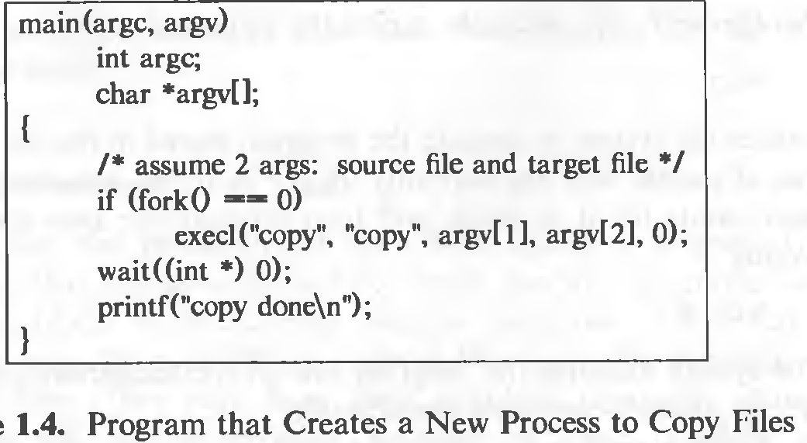
Notes:
In execl() system function takes the path of the executable binary file (i.e. /bin/ls) as the first and second argument.

Slide 111
Case study
Process Management in Linux
  There are basically 2 types of processes.
    Foreground processes- interactive – initiated by user or programmer
    Background processes- non interactive - initiated by the system itself or by users

Slide 112
Practically managing the processes
Example of foreground process
  $./a.out
Stopping a process in between - we may press CTRL+Z to force stop it.
To get the list of jobs that are either running or stopped.
  $jobs
To run all the pending and force stopped jobs in the background.
  $ bg

Slide 113
To get details of a process running in background.
  $ ps -ef | grep sleep
To run all the pending and force stopped jobs in the foreground.
  $fg
To run a process in the background without getting impacted by the closing of the terminal.
  $ nohup sleep 100 &
To run some processes in the background directly.
  $sleep 100&
To run processes with priority(The top priority is -20 but as it may affect the system processes so we have used the priority 5.)
  nice -n 5 sleep 100

