Slide 1
Unit 4: Operating Systems Process Scheduling Algorithms
DPU
Dr. D.Y. Patil Institute of Technology Pimpri, Pune
By
Asst. Prof. Adsure S. S.

Slide 2
Syllabus
TE_Computer_2019_Course_22.06.2021 (1).pdf
Introduction: Evolution of OS, Operating System Services, Functions of Operating System.
Process Management: Process, Process States: 5 and 7 state model, Process control block, Threads, Thread lifecycle, Multithreading Model, Process control system calls.
Process Scheduling: Uni-processor Scheduling, Scheduling: Preemptive, Non-preemptive, Long- term, Medium-term, Short term scheduling.
Scheduling Algorithms: FCFS, SJF, RR, and Priority.

Slide 3
INDEX
What is Operating System?
What OS does?
Structure of OS
Evolution of OS
Batch Processing, Multiprogramming, Time sharing systems
Operating System Functions
Main Funtions of OS
Types of OS
Single User, Multi User systems

Slide 4
Text Book :-
Silberschatz, Galvin, Gagne, "Operating System
Principles", 9th Edition, Wiley, ISBN 978- 1-118-06333-0

Slide 5
What is Operating System?
Operating System is a software, which makes a computer to actually work.
It is the software the enables all the programs we use.
The OS organizes and controls the hardware.
OS acts as an interface between the application programs and the machine hardware.
Examples: Windows, Linux, Unix and Mac OS, etc.,

Slide 6
What OS does?
An operating system performs basic tasks such as,
controlling and allocating memory,
prioritizing system requests,
controlling input and output devices,
facilitating networking and
managing file systems.

Slide 7
Operating Systems functions:
The main functions of operating systems are:
Program creation
Program execution
Input/Output operations
Error detection
Resource allocation
Accounting
protection

Slide 8
The major types of software
Application software
System software
System Software
Operating Systems
Schedules computer events
Allocates computer resources
Monitor events
Hardware
Users
Language translators
Interpreters
Compilers
Application Software
Programming languages
Assembly language, FORTRAN, BASIC, PL/1, PASCAL, C, “4th generation” languages, Airway reservation system, banking system, etc.
Utility programs
Routine operations
(e.g. sort, list, print)
Manage data
(e.g. create files, merge files

Slide 9
Structure of Operating System
The structure of OS consists of 4 layers:
Hardware
Hardware consists of CPU, Main memory, I/O Devices, etc,
Software (Operating System)
Software includes process management routines, memory management routines, I/O control routines, file management routines.
System programs
This layer consists of compilers, Assemblers, linker etc.
Application programs
This is dependent on users need. Ex. Railway reservation system, Bank database management etc.,

Slide 10
Evolution of OS:
The evolution of operating systems went through seven major phases.
Six of them significantly changed the ways in which users accessed computers through the open shop, batch processing, multiprogramming, timesharing, personal computing, and distributed systems.
In the seventh phase the foundations of concurrent programming were developed and demonstrated in model operating systems.

Slide 11
Evolution of OS (contd..):
Major Phases | Technical Innovations | Operating Systems
Open Shop | The idea of OS | IBM 701 open shop (1954)
Batch Processing | Tape batching, First-in, first-out scheduling. | BKS system (1961)
Multi- Programming | Processor multiplexing, Indivisible operations, Demand paging, Input/output spooling, Priority scheduling, Remote job entry | Atlas supervisor (1961), Exec II system (1966)
Timesharing | Simultaneous user interaction, On-line file systems | Multics file system (1965), Unix (1974)
Concurrent Programming | Hierarchical systems, Extensible kernels, Parallel programming concepts, Secure parallel languages | RC 4000 system (1969), 13 Venus system (1972), 14 Boss 2 system (1975).
Personal Computing | Graphic user interfaces | OS 6 (1972) Pilot system (1980)
Distributed Systems | Remote servers | WFS file server (1979) Unix United RPC (1982) 24 Amoeba system (1990)

Slide 12
Batch Processing:
In Batch processing same type of jobs batch (BATCH- a set of jobs with similar needs) together and execute at a time.
The OS was simple, its major task was to transfer control from one job to the next.
The job was submitted to the computer operator in form of punch cards. At some later time the output appeared.
The OS was always resident in memory. (Ref. Fig)
Common Input devices were card readers and tape drives.
Common output devices were line printers, tape drives, and card punches.
Users did not interact directly with the computer systems, but he prepared a job (comprising of the program, the data, & some control information).
OS
User program area

Slide 13
Multiprogramming:
Multiprogramming is a technique to execute number of programs simultaneously by a single processor.
In Multiprogramming, number of processes reside in main memory at a time.
The OS picks and begins to executes one of the jobs in the main memory.
If any I/O wait happened in a process, then CPU switches from that job to another
Hence CPU in not idle at any time.
OS
Job 1
Job 2
Job 3
Job 4
Job 5
Figure shows the layout of multiprogramming system.
The main memory consists of 5 jobs at a time, the CPU executes one by one.
Advantages:
Efficient memory utilization
Throughput increases
CPU is never idle, so performance increases.

Slide 14
Time Sharing Systems:
Time sharing, or multitasking, is a logical extension of multiprogramming.
Multiple jobs are executed by switching the CPU between them.
In this, the CPU time is shared by different processes, so it is called as “Time sharing Systems”.
Time slice is defined by the OS, for sharing CPU time between processes.
Examples: Multics, Unix, etc.,

Slide 15
Types of OS:
Operating System can also be classified as,-
Single User Systems
Multi User Systems

Slide 16
Single User Systems:
Provides a platform for only one user at a time.
They are popularly associated with Desk Top operating system which run on standalone systems where no user accounts are required.
Example: DOS
Multi-User Systems:
Provides regulated access for a number of users by maintaining a database of known users.
Refers to computer systems that support two or more simultaneous users.
Another term for multi-user is time sharing.
Ex: All mainframes and are multi-user systems.
Example: Unix

Slide 17
Introduction to different types of operating systems
Batch Operating System
Multiprogramming Operating System
Time sharing OS
Multitasking OS
Multiprocessing OS
Multiprogramming OS
Distributed operating System
Network operating
Real time operating system
Notes:
--batch os-Sequence of jobs in a program on a computer without manual interventions- Lower CPU utilization
--Multitasking os- Allows many users to share the computer - Multi-programming with preemption
--Multiprocessing OS- Multiple processors doing the one job at a time.
--Multiprogramming os--Sharing the processor, when two or more programs reside in memory at the same time,one CPU divided it’s time between more than one job.
Time sharing the special case of multiprogramming where single CPU serve a no.of user at time at interactive terminal, with quick response time.
--Distributed os- Manages a group of different computers and make appear to be a single computer.
--Network operating system- computers running in different operating system can participate in common network (It is used for security purpose).
--Real time operating system -- It is meant for applications having fix deadlines.
RTOS guarantees a certain capability within a specified time constraint. ex,. OS for robot on assembly line
RTOS qick response time, more resource utilization, sophisticated interrupt magmt.Speed of access is main concern.

Slide 18
Components of computer system programming

Slide 19
Introduction - Operating Systems
An OS is system software that manages Computer hardware, software resources, and provides common services for computer programs.
An operating system is an interface between user and the computer hardware.
Convenience
Efficiency
Resource allocator
Control Program
Notes:
--A computer system can be divided roughly into four components: the hardware, the operating system, the application programs, and the users.
--The operating system controls the hardware and coordinates its use among the various application programs for the various users.
--- If you don't have an operating system, you're stuck doing one -- and only one -- process at a time.
---Like a government, it performs no useful function by itself. It simply provides an environment within which other programs can do useful work.
--TO understand operating systems we must see both viewpoints: that of the user and that of the system
--for single user-Convenience- ease of use
--for multiple user-main frame -Efficiency - resource utilization
--resource allocator-In this context, we can view an operating system as a resource allocator.
--control program- A slightly different view of an operating system emphasizes the need to control the various I/O devices and user programs.
A control program manages the execution of user programs to prevent errors and improper use of the computer.

Slide 20
Functions :
Resource Management :
CPU : Process Management → Scheduling Algorithm
Memory : how main memory allocated to process
I/O device:
Storage management : Secondary memory management : file management

Slide 21
Operating System structure
Simple or Monolithic Architecture
Layered
Microlevel Architecture
Hybrid Architecture
Notes:
--Monolithic kernel manages system resources between application and hardware, but user services and kernel services are implemented under same address space.
-- layered- Less efficient: Each layer adds overhead to system call which in result takes longer time than non-layered system
---Microlevel Architecture- provides minimal process and memory management. Provides communication between client program and services running in user space.
--Hybrid- This means that the kernel structure should be similar to a microkernel but the structure should be implemented like a monolithic kernel. Ex. Apple Mac OS
ios
Android

Slide 22
Process Management
Process Concept
Process Scheduling
Operations on Processes

Slide 23
Process Concept
Process is a program in execution.
Program is passive entity, process is active
A process includes:
Text section
program counter
stack
data section
Heap
Notes:
Program becomes process when executable file loaded into memory
Execution of program started via GUI mouse clicks, command line entry of its name, etc
One program can be several processes-- Consider multiple users executing the same program
The program code, also called text section
Current activity including program counter, processor registers
Stack containing temporary data
Function parameters, return addresses, local variables
Data section containing global variables
Heap containing memory dynamically allocated during run time

Slide 24

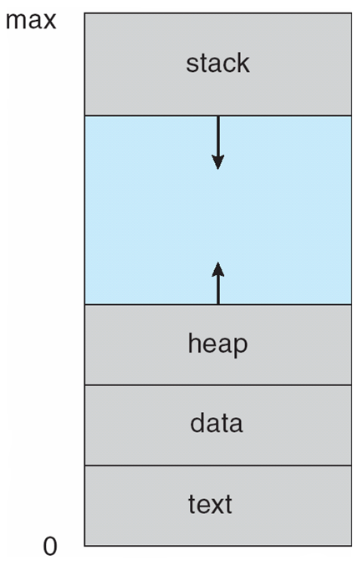
Temporary data
Global variables
Program code

Slide 25
Process Control Block (PCB)
PCB stores data needed for correct and efficient process management.
Process identification, Process state, Process control
Information associated with each process
Process Id
Process state
Program counter
CPU registers
CPU scheduling information
Memory-management information
Accounting information- amount of CPU used for process execution, time limits, execution ID
I/O status information

Slide 26

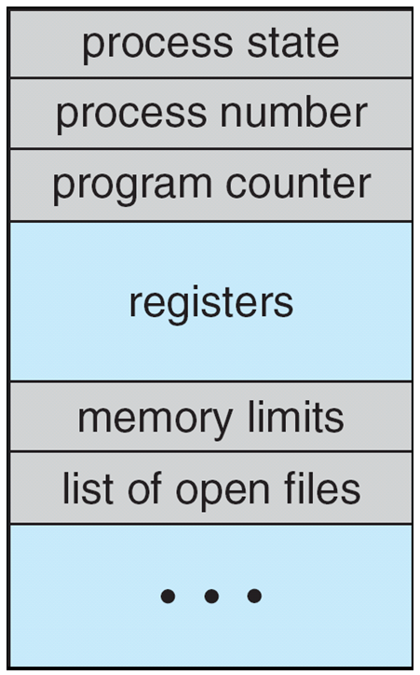

Slide 27
Process State
As a process executes, it changes state
new: The process is being created
ready: The process is waiting to be assigned to a processor
running: Instructions are being executed
waiting: The process is waiting for some event to occur
terminated: The process has finished execution

Slide 28

Diagram of 5 Process State model

Slide 29
7-state Model
Suspend ready – Process that was initially in the ready state but was swapped out of main memory(refer Virtual Memory topic) and placed onto external storage by scheduler is said to be in suspend ready state. The process will transition back to ready state whenever the process is again brought onto the main memory.
Suspend wait or suspend blocked – Similar to suspend ready but uses the process which was performing I/O operation and lack of main memory caused them to move to secondary memory. When work is finished it may go to suspend ready.

Slide 30
Suspended Ready
A process in the ready state, which is moved to secondary memory from the main memory due to lack of the resources (mainly primary memory) is called in the suspend ready state.
If the main memory is full and a higher priority process comes for the execution then the OS have to make the room for the process in the main memory by throwing the lower priority process out into the secondary memory. The suspend ready processes remain in the secondary memory until the main memory gets available.

Slide 31
Suspended Wait
Instead of removing the process from the ready queue, it's better to remove the blocked process which is waiting for some resources in the main memory. Since it is already waiting for some resource to get available hence it is better if it waits in the secondary memory and make room for the higher priority process. These processes complete their execution once the main memory gets available and their wait is finished.

Slide 32
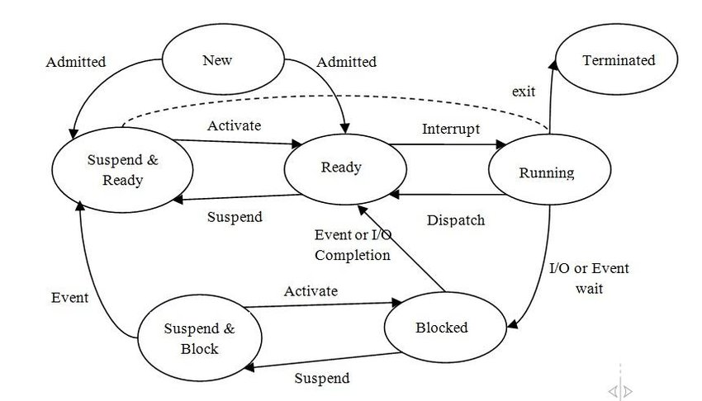
7 state model
Notes:
SUSPENDED & BLOCKED- If all the processes in the main memory are blocked and the processor is idle, some blocked processes can be moved to secondary storage and their state changed to BLOCK&SUSPEND.
SUSPENDED & READY and If the event that the process in the secondary storage was waiting for occurs, the process changes its state to this state and remains in secondary storage

Slide 33
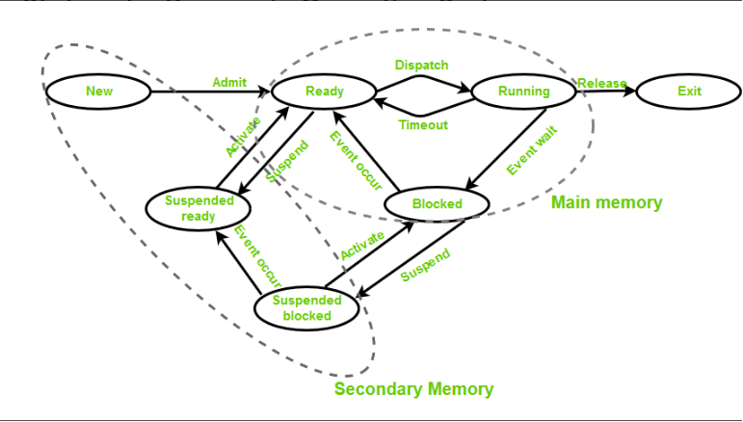

Slide 34
Types of Scheduler
Long term – performance – Makes a decision about how many processes should be made to stay in the ready state, this decides the degree of multiprogramming. Once a decision is taken it lasts for a long time hence called long term scheduler.
Short term – Context switching time – Short term scheduler will decide which process to be executed next and then it will call dispatcher. A dispatcher is a software that moves process from ready to run and vice versa. In other words, it is context switching.
Medium term – Swapping time – Suspension decision is taken by medium term scheduler. Medium term scheduler is used for swapping that is moving the process from main memory to secondary and vice versa.

Slide 35



Slide 36
What is Thread ?
Thread is basic unit of CPU Utilization
A thread is a flow of execution through the process code, with its own program counter, system registers and stack.
It provides a way to improve application performance through parallelism.
Each thread belongs to exactly one process and no thread can exist outside a process.

Slide 37

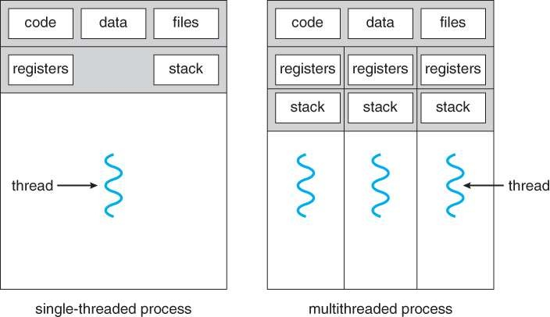

Slide 38
Ex. A web browser might have one thread display images or text while another thread retrieves data from the network.
Ex. A word processor may have a thread for displaying graphics, another thread for responding to keystrokes from the user, and a third thread for performing spelling and grammar checking in the background.
Ex. A busy web server may have several clients concurrently accessing it.

Slide 39
Difference between Process and Threads
S.N. | Process | Threads
1. | Process is heavy weight or resource intensive. | Thread is light weight taking lesser resources than a process.
2. | Process switching needs interaction with operating system. | Thread switching does not need to interact with operating system.
3. | In multiple processing environments each process executes the same code but has its own memory and file resources. | All threads can share same set of open files, child processes.
4. | If one process is blocked then no other process can execute until the first process is unblocked. | While one thread is blocked and waiting, second thread in the same task can run.
5. | Multiple processes without using threads use more resources. | Multiple threaded processes use fewer resources.
6. | In multiple processes each process operates independently of the others. | One thread can read, write or change another thread's data.

Slide 40
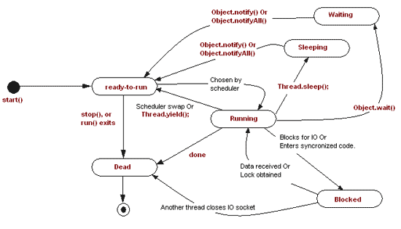

Slide 41
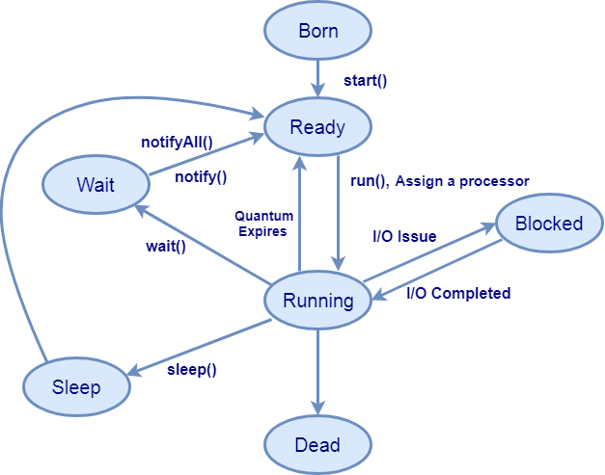
Notes:
Ready: In this state thread is ready to execute but not running.
When the start() method calls thread enters from born to ready state.
Running: When a run() method executes highest priority ready thread assigned a processor and enter in a running state for execution.
Thread can visit more than ones in a running state.
Blocked: When a running thread has a input-output issue it enters in a blocked state from running state and when input-output issue solves it again comes in a running thread.
Sleep : A running thread enter in a sleep state for a specified number of milliseconds when a sleep() method calls.
When sleep time expires then thread moves to ready state.
Wait : When a low priority thread executing and high priority thread comes then high priority thread get preference and enter in a running state. Then low priority thread leaves a running state and moves to wait state for indefinite time.
When a high priority thread execution completes it calls waiting thread for execution by notify () & notifyall () method.
Dead: A running thread is enter in a dead state when its execution completes (run() method completes) or terminate for any reason.

Slide 42
Life Cycle States :
1.New State: A thread has been created but not started yet. A thread will be started by calling its start() method.
2.Runnable State: This state is also called ready to run stage also called queue. A thread starts in runnable state by calling start() method. The Thread scheduler decides which thread runs and how long.
3.Running State: If a Thread is executing that means Thread is in Running stage.
4.Dead State: Once a Thread reached dead state it can not run again.
5. Non runnable States:
A Running Thread transit to one of the non runnable states, depending upon the circumstances. A Thread remains non runnable until a special transition occurs. A Thread does not go directly to the running state from non runnable state. But transits first to runnable state.
Sleeping: The Threas sleeps for specified amount of time.
Blocked for I/O: The Thread waits for a blocking operation to complete.
Blocked for join completion: The Thread waits for completion of another Thread.
Waiting for notification: The Thread waits for notification another Thread.
Blocked for lock acquisition: The Thread waits to acquire the lock of an object.

Slide 43
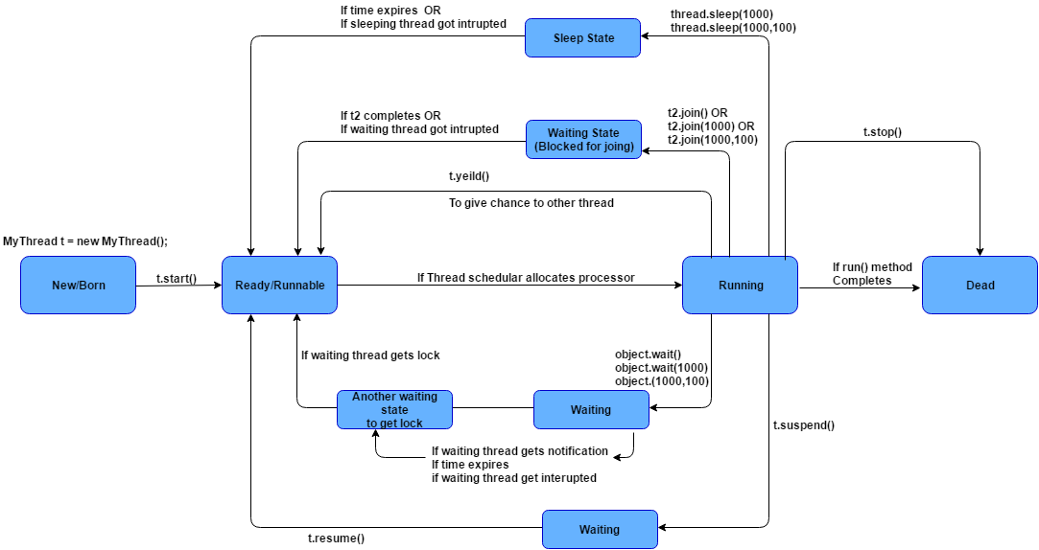

Slide 44
Advantages of Threads
Thread minimizes context switching time.
Use of threads provides concurrency within a process.
Efficient communication.
Economy- It is more economical to create and context switch threads.
Utilization of multiprocessor architectures to a greater scale and efficiency.

Slide 45
Disadvantages of Threads
Blocking of parent threads will stop all child thread.

Slide 46
Multithreading
Multithreading is the ability of a program or an operating system to enable more than one user at a time without requiring multiple copies of the program running on the computer. Multithreading can also handle multiple requests from the same user

Slide 47
Multi-Threading Models
Threads are implemented in following two ways −
User Level Threads − User managed threads.
Kernel Level Threads − Operating System managed threads acting on kernel, an operating system core.
Some operating system provides a combined user level thread and kernel level thread facility.
Solaris is a good example of this combined approch.
Multi-Threading models are three types.
Many-to-One Model
One-to-One Model
Many-to-Many Model
Notes:
User level- kernel is not aware of the existence of threads. The thread library contains code for creating and destroying threads, for passing message and data between threads, for scheduling thread execution and for saving and restoring thread contexts.
Adva- User level thread can run on any operating system.
Disadvantage
In a typical operating system, most system calls are blocking.
Multithreaded application cannot take advantage of multiprocessing.
Kernel level- thread management is done by the Kernel. There is no thread management code in the application area. Kernel threads are supported directly by the operating system
Advantages
Kernel can simultaneously schedule multiple threads from the same process on multiple processes.
If one thread in a process is blocked, the Kernel can schedule another thread of the same process.
Disadvantages
Kernel threads are generally slower to create and manage than the user threads.
Transfer of control from one thread to another within the same process requires a mode switch to the Kernel.

Slide 48
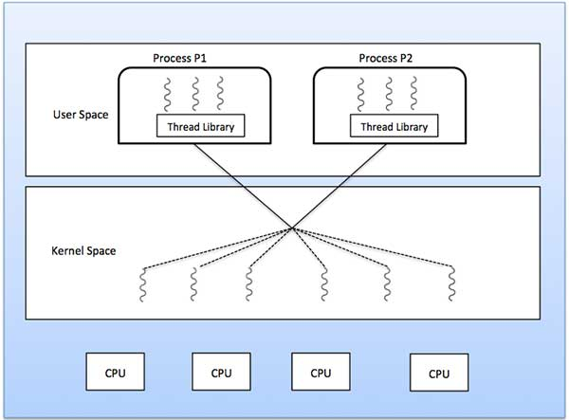
Many to Many
In this model, we have multiple user threads multiplex to same or lesser number of kernel level threads. Number of kernel level threads are specific to the machine, advantage of this model is if a user thread is blocked we can schedule others user thread to other kernel thread. Thus, System doesn’t block if a particular thread is blocked.
Notes:
In this model, developers can create as many user threads as necessary and the corresponding Kernel threads can run in parallel on a multiprocessor machine. This model provides the best accuracy on concurrency and when a thread performs a blocking system call, the kernel can schedule another thread for execution.
The many-to-many model (many user level thread to many kernel level thread) avoids many of the limitations of the one-to-one model, while extending multithreading capabilities even further. The many- to-many model also called two-level model, minimize programing effort while reducing the cost and weight of each thread.

Slide 49
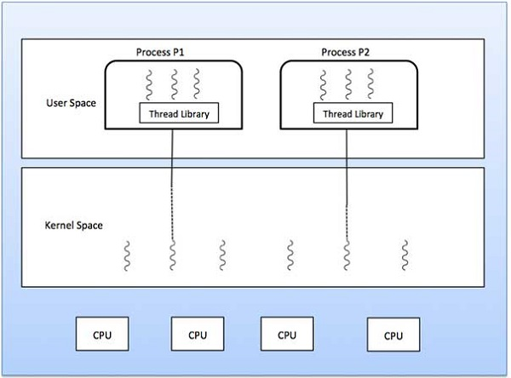
Many to one
In this model, we have multiple user threads mapped to one kernel thread. In this model when a user thread makes a blocking system call entire process blocks. As we have only one kernel thread and only one user thread can access kernel at a time, so multiple threads are not able access multiprocessor at the same time.
Notes:
Many-to-one model maps many user level threads to one Kernel-level thread. Thread management is done in user space by the thread library. When thread makes a blocking system call, the entire process will be blocked. Only one thread can access the Kernel at a time, so multiple threads are unable to run in parallel on multiprocessors.

Slide 50
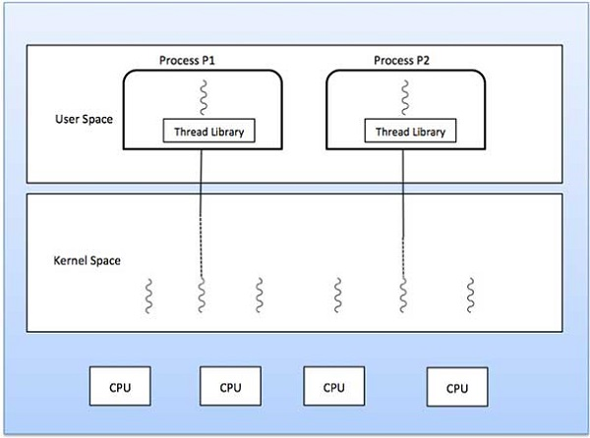
One to One
In this model, one to one relationship between kernel and user thread. In this model multiple thread can run on multiple processor. Problem with this model is that creating a user thread requires the corresponding kernel thread.
As each user thread is connected to different kernel , if any user thread makes a blocking system call, the other user threads won’t be blocked.
Notes:
This model provides more concurrency than the many-to-one model. It also allows another thread to run when a thread makes a blocking system call. It supports multiple threads to execute in parallel on microprocessors.
The one-to-one model (one user level thread to one kernel level thread) is among the earliest implementations of true multithreading. In this implementation, each ULT created by the application is known to the kernel, and all threads can access the kernel at the same time

Slide 51
Process Scheduling
Uni- processor scheduling
Maximize CPU use, quickly switch processes onto CPU for time sharing
Process scheduler- selects process among available processes in ready queue for next execution on CPU
Maintains scheduling queues of processes
Job queue – set of all processes in the system
Ready queue – set of all processes residing in main memory, ready and waiting to execute
Device queues – set of processes waiting for an I/O device
Processes migrate among the various queues
Notes:
: Uni-processor Scheduling, Scheduling: Preemptive, Non-preemptive, Long- term, Medium-term, Short term scheduling.

Slide 52

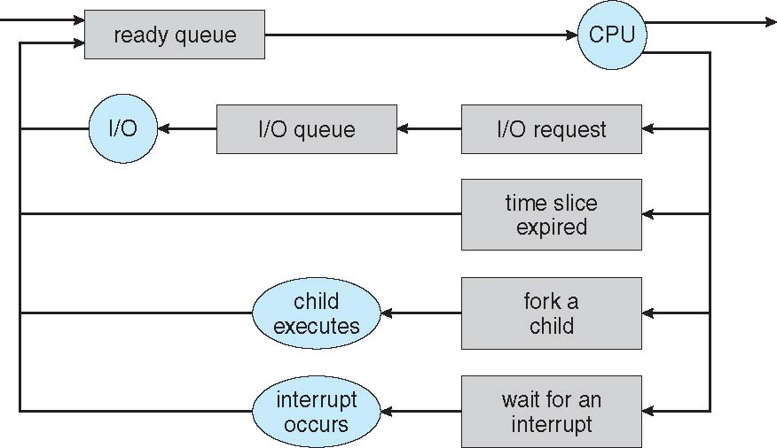

Slide 53
Schedulers
Long-term scheduler (Process or job scheduler
Medium term scheduler-
Short-term scheduler (or CPU scheduler)
Notes:
Long-term scheduler (or job scheduler) – selects which processes should be brought into the ready queue
Medium term scheduler- sometimes it can be advantageous to remove a process from memory (and from active contention for the CPU) and thus reduce the degree of multiprogramming
Short-term scheduler (or CPU scheduler) – selects which process should be executed next and allocates CPU
Sometimes the only scheduler in a system

Slide 54
Parameters of Process
Arrival Time
Burst Time
Completion time
Turn around time
Waiting time
Response time
Notes:
Burst time(BT):
Burst time is the amount of time required by a process for executing on CPU. It is also called as execution time or running time. Burst time of a process can not be known in advance before executing the process.
Burst Time (B.T.) = Completion Time (C.T.) - Waiting Time (W.T.)
Completion time (CT)
Completion time is the point of time at which a process completes its execution on the CPU and takes exit from the system. It is also called as exit time.
Turn around time: (TAT)
It is the time interval from the time of submission of a process to the time of the completion of the process. It can also be considered as the sum of the time periods spent waiting to get into memory or ready queue, execution on CPU and executing input/output.
TAT=WT+BT
Or
TAT=CT-AT(Arrival time)
Waiting Time:
Waiting time is the total time spent by the process in the ready queue waiting for CPU.
WT=TAT-BT
Response time- time from the submission of a request until the first response is produced by CPU.CPU response time Response time is the total amount of time it takes to respond to a request for service.

Slide 55
Scheduling Algorithms
First Come First Serve
Shortest Remaining Time First -- SRTF (SJF with preemption)
Shortest Job First with nonpreemption
Priority scheduling
Round Robin

Slide 56
FCFS Scheduling (First Come First Serve)
First job that requests the CPU gets the CPU
Non preemptive
– Process continues till the burst cycle ends

Slide 57
Example
P.no. | Arrival time | Burst time | Completion time | Turn around time | Waiting time
P1 | 0 | 4
P2 | 1 | 3
P3 | 2 | 1
P4 | 3 | 2
P5 | 4 | 5

Slide 58
Example
P.no. | Arrival time | Burst time | Completion time | Turn around time | Waiting time
P1 | 0 | 4 | 4
P2 | 1 | 3
P3 | 2 | 1
P4 | 3 | 2
P5 | 4 | 5
Gantt Chart (graphical illustration of a process scheduling
p1
0
4

Slide 59
Example
P.no. | Arrival time | Burst time | Completion time | Turn around time | Waiting time
P1 | 0 | 4 | 4
P2 | 1 | 3 | 7
P3 | 2 | 1
P4 | 3 | 2
P5 | 4 | 5
Gantt Chart
p1 | p2
0
4
7

Slide 60
Example
P.no. | Arrival time | Burst time | Completion time | Turn around time | Waiting time
P1 | 0 | 4 | 4
P2 | 1 | 3 | 7
P3 | 2 | 1 | 8
P4 | 3 | 2
P5 | 4 | 5
Gantt Chart
p1 | p2 | p3
0
4
7
8

Slide 61
Example
P.no. | Arrival time | Burst time | Completion time | Turn around time | Waiting time
P1 | 0 | 4 | 4
P2 | 1 | 3 | 7
P3 | 2 | 1 | 8
P4 | 3 | 2 | 10
P5 | 4 | 5
Gantt Chart
p1 | p2 | p3 | p4
4
7
8
10

Slide 62
Example
P.no. | Arrival time | Burst time | Completion time | Turn around time | Waiting time
P1 | 0 | 4 | 4
P2 | 1 | 3 | 7
P3 | 2 | 1 | 8
P4 | 3 | 2 | 10
P5 | 4 | 5 | 15
Gantt Chart
p1 | p2 | p3 | p4 | p5
4
7
8
10
15

Slide 63
Example
P.no. | Arrival time | Burst time | Completion time | Turn around Time=CT-AT | Waiting time
P1 | 0 | 4 | 4 | 4
P2 | 1 | 3 | 7 | 6
P3 | 2 | 1 | 8 | 6
P4 | 3 | 2 | 10 | 7
P5 | 4 | 5 | 15 | 11
Gantt Chart
p1 | p2 | p3 | p4 | p5
4
7
8
10
15

Slide 64
Example
P.no. | Arrival time | Burst time | Completion time | Turn around Time=CT-AT | Waiting Time=TAT-BT
P1 | 0 | 4 | 4 | 4 | 0
P2 | 1 | 3 | 7 | 6 | 3
P3 | 2 | 1 | 8 | 6 | 5
P4 | 3 | 2 | 10 | 7 | 5
P5 | 4 | 5 | 15 | 11 | 6
Gantt Chart
p1 | p2 | p3 | p4 | p5
4
7
8
10
15

Slide 65
Average TAT=(4+6+6+7+11)/5
= 5
Average WT=(0+3+5+5+6)/5
=3.8

Slide 66
Shortest Remaining Time First -- SRTF (SJF with preemption)
If a new process arrives with a shorter burst time than
remaining of current process, then schedule new process
Further reduces average waiting time and average response time.
Preemption is the act of temporarily interrupting a task being carried out by a computer system
Notes:
Preemption is the act of temporarily interrupting a task being carried out by a computer system, without requiring its cooperation, and with the intention of resuming the task at a later time

Slide 67
Example
P.No. | A.T. | B.T. | C.T. | TAT =C.T.-A.T | WT=TAT-BT
1 | 0 | 7
2 | 1 | 5
3 | 2 | 3
4 | 3 | 1
5 | 4 | 2
6 | 5 | 1

Slide 68
Example
P.No. | A.T. | B.T. | C.T. | TAT =C.T.-A.T | WT=TAT-BT
P1 | 0 | 7
P2 | 1 | 5
P3 | 2 | 3
P4 | 3 | 1
P5 | 4 | 2
p6 | 5 | 1
Gantt Chart
p1
0
1

Slide 69
Example
P.No. | A.T. | B.T. | C.T. | TAT =C.T.-A.T | WT=TAT-BT
P1 | 0 | 6
P2 | 1 | 5
P3 | 2 | 3
P4 | 3 | 1
P5 | 4 | 2
p6 | 5 | 1
Gantt Chart
p1 | p2
0
1
2

Slide 70
Example
P.No. | A.T. | B.T. | C.T. | TAT =C.T.-A.T | WT=TAT-BT
P1 | 0 | 6
P2 | 1 | 4
P3 | 2 | 3
P4 | 3 | 1
P5 | 4 | 2
p6 | 5 | 1
Gantt Chart
p1 | p2 | p3
0
1
2
3

Slide 71
Example
P.No. | A.T. | B.T. | C.T. | TAT =C.T.-A.T | WT=TAT-BT
P1 | 0 | 6
P2 | 1 | 4
P3 | 2 | 2
P4 | 3 | 1
P5 | 4 | 2
p6 | 5 | 1
Gantt Chart
p1 | p2 | p3 | p4
0
1
2
3
4

Slide 72
Example
P.No. | A.T. | B.T. | C.T. | TAT =C.T.-A.T | WT=TAT-BT
P1 | 0 | 6
P2 | 1 | 4
P3 | 2 | 2
P4 | 3 | 0
P5 | 4 | 2
p6 | 5 | 1
Gantt Chart
p1 | p2 | p3 | p4 | p3
0
1
2
3
4
5

Slide 73
Example
P.No. | A.T. | B.T. | C.T. | TAT =C.T.-A.T | WT=TAT-BT
P1 | 0 | 6
P2 | 1 | 4
P3 | 2 | 1
P4 | 3 | 0
P5 | 4 | 2
p6 | 5 | 1
Gantt Chart
p1 | p2 | p3 | p4 | p3 | p3
0
1
2
3
4
5
6

Slide 74
Example
P.No. | A.T. | B.T. | C.T. | TAT =C.T.-A.T | WT=TAT-BT
P1 | 0 | 6
P2 | 1 | 4
P3 | 2 | 0
P4 | 3 | 0
P5 | 4 | 2
p6 | 5 | 1
Gantt Chart
p1 | p2 | p3 | p4 | p3 | p3 | p6
0
1
2
3
4
5
6
7

Slide 75
Example
P.No. | A.T. | B.T. | C.T. | TAT =C.T.-A.T | WT=TAT-BT
P1 | 0 | 6
P2 | 1 | 4
P3 | 2 | 0
P4 | 3 | 0
P5 | 4 | 2
p6 | 5 | 0
Gantt Chart
p1 | p2 | p3 | p4 | p3 | p3 | p6 | p5
0
1
2
3
4
5
6
7
9

Slide 76
Example
P.No. | A.T. | B.T. | C.T. | TAT =C.T.-A.T | WT=TAT-BT
P1 | 0 | 6
P2 | 1 | 4
P3 | 2 | 0
P4 | 3 | 0
P5 | 4 | 0
p6 | 5 | 0
Gantt Chart
p1 | p2 | p3 | p4 | p3 | p3 | p6 | p5 | p2
0
1
2
3
4
5
6
7
9
13

Slide 77
Example
P.No. | A.T. | B.T. | C.T. | TAT =C.T.-A.T | WT=TAT-BT
P1 | 0 | 6
P2 | 1 | 0
P3 | 2 | 0
P4 | 3 | 0
P5 | 4 | 0
p6 | 5 | 0
Gantt Chart
p1 | p2 | p3 | p4 | p3 | p3 | p6 | p5 | p2 | p1
0
1
2
3
4
5
6
7
9
13
19

Slide 78
Example
P.No. | A.T. | B.T. | C.T. | TAT =C.T.-A.T | WT=TAT-BT
P1 | 0 | 0
P2 | 1 | 0
P3 | 2 | 0
P4 | 3 | 0
P5 | 4 | 0
p6 | 5 | 0
Gantt Chart
p1 | p2 | p3 | p4 | p3 | p3 | p6 | p5 | p2 | p1
0
1
2
3
4
5
6
7
9
13
19

Slide 79
Example
P.No. | A.T. | B.T. | C.T. | TAT =C.T.-A.T | WT=TAT-BT
P1 | 0 | 0 | 19 | 19 | 12
P2 | 1 | 0 | 13 | 12 | 7
P3 | 2 | 0 | 6 | 4 | 1
P4 | 3 | 0 | 4 | 1 | 0
P5 | 4 | 0 | 9 | 5 | 3
p6 | 5 | 0 | 7 | 2 | 1
Response time
P1=0
P2=0
P3=0
P4=0
P5=3 (7-4)
P6=1(6-5)
Response time- is the time from the submission of a request until the first response is produced.
Gantt Chart
p1 | p2 | p3 | p4 | p3 | p3 | p6 | p5 | p2 | p1
0
1
2
3
4
5
6
7
9
13
19
Find avg.TAT and avg WT?? (HW)

Slide 80
Shortest Job First (SJF) no preemption
Schedule process with the shortest burst time
FCFS if same
Advantages
Minimizes average wait time and average response time
Disadvantages
May starve long jobs

Slide 81
Round Robin Scheduling
Run process for a time slice or time quantum, then move to FIFO

Slide 82
Example:- let time quantum=2
P.No. | A.T. | B.T. | C.T. | TAT =C.T.-A.T | WT=TAT-BT
P1 | 0 | 4
P2 | 1 | 5
P3 | 2 | 2
P4 | 3 | 1
P5 | 4 | 6
p6 | 6 | 3
Process queue
p1
Gantt Chart
p1
0
2

Slide 83
Example:- let time quantum=2
P.No. | A.T. | B.T. | C.T. | TAT =C.T.-A.T | WT=TAT-BT
P1 | 0 | 2
P2 | 1 | 5
P3 | 2 | 2
P4 | 3 | 1
P5 | 4 | 6
p6 | 6 | 3
Process queue
p1 | p2 | p3 | p1
Gantt Chart
p1
0
2

Slide 84
Example:- let time quantum=2
P.No. | A.T. | B.T. | C.T. | TAT =C.T.-A.T | WT=TAT-BT
P1 | 0 | 2
P2 | 1 | 5
P3 | 2 | 2
P4 | 3 | 1
P5 | 4 | 6
p6 | 6 | 3
Process queue
p1 | p2 | p3 | p1
0
1
2
Gantt Chart
p1 | p2
0
2
4

Slide 85
Example:- let time quantum=2
P.No. | A.T. | B.T. | C.T. | TAT =C.T.-A.T | WT=TAT-BT
P1 | 0 | 2
P2 | 1 | 3
P3 | 2 | 2
P4 | 3 | 1
P5 | 4 | 6
p6 | 6 | 3
Process queue
p1 | p2 | p3 | p1 | p4 | p5 | p2
Gantt Chart
p1 | p2
0
2
4

Slide 86
Example:- let time quantum=2
P.No. | A.T. | B.T. | C.T. | TAT =C.T.-A.T | WT=TAT-BT
P1 | 0 | 2
P2 | 1 | 3
P3 | 2 | 2
P4 | 3 | 1
P5 | 4 | 6
p6 | 6 | 3
Process queue
p1 | p2 | p3 | p1 | p4 | p5 | p2
Gantt Chart
p1 | p2 | p3
0
2
4
6

Slide 87
Example:- let time quantum=2
P.No. | A.T. | B.T. | C.T. | TAT =C.T.-A.T | WT=TAT-BT
P1 | 0 | 2
P2 | 1 | 3
P3 | 2 | 0
P4 | 3 | 1
P5 | 4 | 6
p6 | 6 | 3
Process queue
p1 | p2 | p3 | p1 | p4 | p5 | p2 | p6
Gantt Chart
p1 | p2 | p3
0
2
4
6

Slide 88
Example:- let time quantum=2
P.No. | A.T. | B.T. | C.T. | TAT =C.T.-A.T | WT=TAT-BT
P1 | 0 | 2
P2 | 1 | 3
P3 | 2 | 0
P4 | 3 | 1
P5 | 4 | 6
p6 | 6 | 3
Process queue
p1 | p2 | p3 | p1 | p4 | p5 | p2 | p6
Gantt Chart
p1 | p2 | p3 | p1
0
2
4
6
8

Slide 89
Example:- let time quantum=2
P.No. | A.T. | B.T. | C.T. | TAT =C.T.-A.T | WT=TAT-BT
P1 | 0 | 0
P2 | 1 | 3
P3 | 2 | 0
P4 | 3 | 1
P5 | 4 | 6
p6 | 6 | 3
Process queue
p1 | p2 | p3 | p1 | p4 | p5 | p2 | p6
Gantt Chart
p1 | p2 | p3 | p1
0
2
4
6
8

Slide 90
Example:- let time quantum=2
P.No. | A.T. | B.T. | C.T. | TAT =C.T.-A.T | WT=TAT-BT
P1 | 0 | 0
P2 | 1 | 3
P3 | 2 | 0
P4 | 3 | 1
P5 | 4 | 6
p6 | 6 | 3
Process queue
p1 | p2 | p3 | p1 | p4 | p5 | p2 | p6
Gantt Chart
p1 | p2 | p3 | p1 | p4
0
2
4
6
8
9

Slide 91
Example:- let time quantum=2
P.No. | A.T. | B.T. | C.T. | TAT =C.T.-A.T | WT=TAT-BT
P1 | 0 | 0
P2 | 1 | 3
P3 | 2 | 0
P4 | 3 | 0
P5 | 4 | 6
p6 | 6 | 3
Process queue
p1 | p2 | p3 | p1 | p4 | p5 | p2 | p6
Gantt Chart
p1 | p2 | p3 | p1 | p4
0
2
4
6
8
9

Slide 92
Example:- let time quantum=2
P.No. | A.T. | B.T. | C.T. | TAT =C.T.-A.T | WT=TAT-BT
P1 | 0 | 0
P2 | 1 | 3
P3 | 2 | 0
P4 | 3 | 0
P5 | 4 | 6
p6 | 6 | 3
Process queue
p1 | p2 | p3 | p1 | p4 | p5 | p2 | p6
Gantt Chart
p1 | p2 | p3 | p1 | p4 | p5
0
2
4
6
8
9
11

Slide 93
Example:- let time quantum=2
P.No. | A.T. | B.T. | C.T. | TAT =C.T.-A.T | WT=TAT-BT
P1 | 0 | 0
P2 | 1 | 3
P3 | 2 | 0
P4 | 3 | 0
P5 | 4 | 4
p6 | 6 | 3
Process queue
p1 | p2 | p3 | p1 | p4 | p5 | p2 | p6 | p5
Gantt Chart
p1 | p2 | p3 | p1 | p4 | p5
0
2
4
6
8
9
11

Slide 94
Example:- let time quantum=2
P.No. | A.T. | B.T. | C.T. | TAT =C.T.-A.T | WT=TAT-BT
P1 | 0 | 0
P2 | 1 | 3
P3 | 2 | 0
P4 | 3 | 0
P5 | 4 | 4
p6 | 6 | 3
Process queue
p1 | p2 | p3 | p1 | p4 | p5 | p2 | p6 | p5
Gantt Chart
p1 | p2 | p3 | p1 | p4 | p5 | p2
0
2
4
6
8
9
11
13

Slide 95
Example:- let time quantum=2
P.No. | A.T. | B.T. | C.T. | TAT =C.T.-A.T | WT=TAT-BT
P1 | 0 | 0
P2 | 1 | 1
P3 | 2 | 0
P4 | 3 | 0
P5 | 4 | 4
p6 | 6 | 3
Process queue
p1 | p2 | p3 | p1 | p4 | p5 | p2 | p6 | p5 | p2
Gantt Chart
p1 | p2 | p3 | p1 | p4 | p5 | p2
0
2
4
6
8
9
11
13

Slide 96
Example:- let time quantum=2
P.No. | A.T. | B.T. | C.T. | TAT =C.T.-A.T | WT=TAT-BT
P1 | 0 | 0
P2 | 1 | 1
P3 | 2 | 0
P4 | 3 | 0
P5 | 4 | 4
p6 | 6 | 3
Process queue
p1 | p2 | p3 | p1 | p4 | p5 | p2 | p6 | p5 | p2
Gantt Chart
p1 | p2 | p3 | p1 | p4 | p5 | p2 | p6
0
2
4
6
8
9
11
13
15

Slide 97
Example:- let time quantum=2
P.No. | A.T. | B.T. | C.T. | TAT =C.T.-A.T | WT=TAT-BT
P1 | 0 | 0
P2 | 1 | 1
P3 | 2 | 0
P4 | 3 | 0
P5 | 4 | 4
p6 | 6 | 1
Process queue
p1 | p2 | p3 | p1 | p4 | p5 | p2 | p6 | p5 | p2 | p6
Gantt Chart
p1 | p2 | p3 | p1 | p4 | p5 | p2 | p6
0
2
4
6
8
9
11
13
15

Slide 98
Example:- let time quantum=2
P.No. | A.T. | B.T. | C.T. | TAT =C.T.-A.T | WT=TAT-BT
P1 | 0 | 0
P2 | 1 | 1
P3 | 2 | 0
P4 | 3 | 0
P5 | 4 | 4
p6 | 6 | 1
Process queue
p1 | p2 | p3 | p1 | p4 | p5 | p2 | p6 | p5 | p2 | p6
Gantt Chart
p1 | p2 | p3 | p1 | p4 | p5 | p2 | p6 | p5
0
2
4
6
8
9
11
13
15
17

Slide 99
Example:- let time quantum=2
P.No. | A.T. | B.T. | C.T. | TAT =C.T.-A.T | WT=TAT-BT
P1 | 0 | 0
P2 | 1 | 1
P3 | 2 | 0
P4 | 3 | 0
P5 | 4 | 2
p6 | 6 | 1
Process queue
p1 | p2 | p3 | p1 | p4 | p5 | p2 | p6 | p5 | p2 | p6 | p5
Gantt Chart
p1 | p2 | p3 | p1 | p4 | p5 | p2 | p6 | p5
0
2
4
6
8
9
11
13
15
17

Slide 100
Example:- let time quantum=2
P.No. | A.T. | B.T. | C.T. | TAT =C.T.-A.T | WT=TAT-BT
P1 | 0 | 0
P2 | 1 | 1
P3 | 2 | 0
P4 | 3 | 0
P5 | 4 | 2
p6 | 6 | 1
Process queue
p1 | p2 | p3 | p1 | p4 | p5 | p2 | p6 | p5 | p2 | p6 | p5
Gantt Chart
p1 | p2 | p3 | p1 | p4 | p5 | p2 | p6 | p5 | p2
0
2
4
6
8
9
11
13
15
17
18

Slide 101
Example:- let time quantum=2
P.No. | A.T. | B.T. | C.T. | TAT =C.T.-A.T | WT=TAT-BT
P1 | 0 | 0
P2 | 1 | 0
P3 | 2 | 0
P4 | 3 | 0
P5 | 4 | 2
p6 | 6 | 1
Process queue
p1 | p2 | p3 | p1 | p4 | p5 | p2 | p6 | p5 | p2 | p6 | p5
Gantt Chart
p1 | p2 | p3 | p1 | p4 | p5 | p2 | p6 | p5 | p2
0
2
4
6
8
9
11
13
15
17
18

Slide 102
Example:- let time quantum=2
P.No. | A.T. | B.T. | C.T. | TAT =C.T.-A.T | WT=TAT-BT
P1 | 0 | 0
P2 | 1 | 0
P3 | 2 | 0
P4 | 3 | 0
P5 | 4 | 2
p6 | 6 | 1
Process queue
p1 | p2 | p3 | p1 | p4 | p5 | p2 | p6 | p5 | p2 | p6 | p5
Gantt Chart
p1 | p2 | p3 | p1 | p4 | p5 | p2 | p6 | p5 | p2
p6
0
2
4
6
8
9
11
13
15
17
18
19

Slide 103
Example:- let time quantum=2
P.No. | A.T. | B.T. | C.T. | TAT =C.T.-A.T | WT=TAT-BT
P1 | 0 | 0
P2 | 1 | 0
P3 | 2 | 0
P4 | 3 | 0
P5 | 4 | 2
p6 | 6 | 0
Process queue
p1 | p2 | p3 | p1 | p4 | p5 | p2 | p6 | p5 | p2 | p6 | p5
Gantt Chart
p1 | p2 | p3 | p1 | p4 | p5 | p2 | p6 | p5 | p2
p6
0
2
4
6
8
9
11
13
15
17
18
19

Slide 104
Example:- let time quantum=2
P.No. | A.T. | B.T. | C.T. | TAT =C.T.-A.T | WT=TAT-BT
P1 | 0 | 0
P2 | 1 | 0
P3 | 2 | 0
P4 | 3 | 0
P5 | 4 | 2
p6 | 6 | 0
Process queue
p1 | p2 | p3 | p1 | p4 | p5 | p2 | p6 | p5 | p2 | p6 | p5
Gantt Chart
p1 | p2 | p3 | p1 | p4 | p5 | p2 | p6 | p5 | p2
p6 | p5
0
2
4
6
8
9
11
13
15
17
18
19
21

Slide 105
Example:- let time quantum=2
P.No. | A.T. | B.T. | C.T. | TAT =C.T.-A.T | WT=TAT-BT
P1 | 0 | 0
P2 | 1 | 0
P3 | 2 | 0
P4 | 3 | 0
P5 | 4 | 0
p6 | 6 | 0
Process queue
p1 | p2 | p3 | p1 | p4 | p5 | p2 | p6 | p5 | p2 | p6 | p5
Gantt Chart
p1 | p2 | p3 | p1 | p4 | p5 | p2 | p6 | p5 | p2
p6 | p5
0
2
4
6
8
9
11
13
15
17
18
19
21

Slide 106
Example:- let time quantum=2
P.No. | A.T. | B.T. | C.T. | TAT =C.T.-A.T | WT=TAT-BT
P1 | 0 | 0 | 8 | 8 | 4
P2 | 1 | 0 | 18 | 17 | 12
P3 | 2 | 0 | 6 | 4 | 2
P4 | 3 | 0 | 9 | 6 | 5
P5 | 4 | 0 | 21 | 17 | 11
p6 | 6 | 0 | 19 | 13 | 10
Process queue
p1 | p2 | p3 | p1 | p4 | p5 | p2 | p6 | p5 | p2 | p6 | p5
Gantt Chart
p1 | p2 | p3 | p1 | p4 | p5 | p2 | p6 | p5 | p2
p6 | p5
0
2
4
6
8
9
11
13
15
17
18
19
21

Slide 107
Round Robin Scheduling
Advantages
Fair (Each process gets a fair chance to run on the CPU)
Low average wait time, when burst times vary
Faster response time
Disadvantages
Increased context switching
Context switches are overheads!!!
High average wait time, when burst times have equal lengths
If TQ(time quantum) is greater, context switching is less

Slide 108
Priority based Scheduling
•
Not all processes are equal
Lower priority for compute intensive processes
Higher priority for interactive processes (can’t keep the user waiting)
Priority based Scheduling
Each process is assigned a priority
Scheduling policy : pick the process in the ready queue having the highest priority
Advantage : mechanism to provide relative importance to processes
Disadvantage : could lead to starvation of low priority processes
•
Notes:
Priorities can be set internally (by scheduler) or externally (by users)
Dynamic vs Static
Static priority : priority of a process is fixed
Dynamic priority : scheduler can change the process priority during execution in order to achieve scheduling goals
eg1. decrease priority of a process to give another process a chance to execute
eg.2. increase priority for I/O bound processes

Slide 109
Priority Scheduling non preemptive
P.No. | priority | A.T. | B.T. | C.T. | TAT =C.T.-A.T | WT=TAT-BT
P1 | 2(l) | 0 | 4
P2 | 4 | 1 | 2
P3 | 6 | 2 | 3
P4 | 10 | 3 | 5
P5 | 8 | 4 | 1
p6 | 12(h) | 5 | 4
p7 | 9 | 6 | 6
Gantt Chart
p1
0
4

Slide 110
Priority Scheduling non preemptive
P.No. | priority | A.T. | B.T. | C.T. | TAT =C.T.-A.T | WT=TAT-BT
P1 | 2(l) | 0 | 0
P2 | 4 | 1 | 2
P3 | 6 | 2 | 3
P4 | 10 | 3 | 5
P5 | 8 | 4 | 1
p6 | 12(h) | 5 | 4
p7 | 9 | 6 | 6
Gantt Chart
p1 | p4
0
4
9

Slide 111
Priority Scheduling non preemptive
P.No. | priority | A.T. | B.T. | C.T. | TAT =C.T.-A.T | WT=TAT-BT
P1 | 2(l) | 0 | 0
P2 | 4 | 1 | 2
P3 | 6 | 2 | 3
P4 | 10 | 3 | 0
P5 | 8 | 4 | 1
p6 | 12(h) | 5 | 4
p7 | 9 | 6 | 6
Gantt Chart
p1 | p4 | p6
0
4
9
13

Slide 112
Priority Scheduling non preemptive
P.No. | priority | A.T. | B.T. | C.T. | TAT =C.T.-A.T | WT=TAT-BT
P1 | 2(l) | 0 | 0
P2 | 4 | 1 | 2
P3 | 6 | 2 | 3
P4 | 10 | 3 | 0
P5 | 8 | 4 | 1
p6 | 12(h) | 5 | 0
p7 | 9 | 6 | 6
Gantt Chart
p1 | p4 | p6 | p7
0
4
9
13
19

Slide 113
Priority Scheduling non preemptive
P.No. | priority | A.T. | B.T. | C.T. | TAT =C.T.-A.T | WT=TAT-BT
P1 | 2(l) | 0 | 0
P2 | 4 | 1 | 2
P3 | 6 | 2 | 3
P4 | 10 | 3 | 0
P5 | 8 | 4 | 1
p6 | 12(h) | 5 | 0
p7 | 9 | 6 | 0
Gantt Chart
p1 | p4 | p6 | p7 | p5
0
4
9
13
19
20

Slide 114
Priority Scheduling non preemptive
P.No. | priority | A.T. | B.T. | C.T. | TAT =C.T.-A.T | WT=TAT-BT
P1 | 2(l) | 0 | 0
P2 | 4 | 1 | 2
P3 | 6 | 2 | 3
P4 | 10 | 3 | 0
P5 | 8 | 4 | 0
p6 | 12(h) | 5 | 0
p7 | 9 | 6 | 0
Gantt Chart
p1 | p4 | p6 | p7 | p5 | p3
0
4
9
13
19
20
23

Slide 115
Priority Scheduling non preemptive
P.No. | priority | A.T. | B.T. | C.T. | TAT =C.T.-A.T | WT=TAT-BT
P1 | 2(l) | 0 | 0
P2 | 4 | 1 | 2
P3 | 6 | 2 | 0
P4 | 10 | 3 | 0
P5 | 8 | 4 | 0
p6 | 12(h) | 5 | 0
p7 | 9 | 6 | 0
Gantt Chart
p1 | p4 | p6 | p7 | p5 | p3 | p2
0
4
9
13
19
20
23
25

Slide 116
Priority Scheduling non preemptive
P.No. | priority | A.T. | B.T. | C.T. | TAT =C.T.-A.T | WT=TAT-BT
P1 | 2(l) | 0 | 0
P2 | 4 | 1 | 0
P3 | 6 | 2 | 0
P4 | 10 | 3 | 0
P5 | 8 | 4 | 0
p6 | 12(h) | 5 | 0
p7 | 9 | 6 | 0
Gantt Chart
p1 | p4 | p6 | p7 | p5 | p3 | p2
0
4
9
13
19
20
23
25

Slide 117
Priority Scheduling non preemptive
P.No. | priority | A.T. | B.T. | C.T. | TAT =C.T.-A.T | WT=TAT-BT | RT
P1 | 2(l) | 0 | 4 | 4 | 4 | 0 | 0
P2 | 4 | 1 | 2 | 25 | 24 | 22 | 22
P3 | 6 | 2 | 3 | 23 | 21 | 18 | 18
P4 | 10 | 3 | 5 | 9 | 6 | 1 | 1
P5 | 8 | 4 | 1 | 20 | 16 | 15 | 15
p6 | 12(h) | 5 | 4 | 13 | 8 | 4 | 4
p7 | 9 | 6 | 6 | 19 | 13 | 7 | 7
Gantt Chart
p1 | p4 | p6 | p7 | p5 | p3 | p2
0
4
9
13
19
20
23
25

Slide 118
Priority Scheduling preemptive
P.No. | priority | A.T. | B.T. | C.T. | TAT =C.T.-A.T | WT=TAT-BT | RT
P1 | 2(l) | 0 | 4
P2 | 4 | 1 | 2
P3 | 6 | 2 | 3
P4 | 10 | 3 | 5
P5 | 8 | 4 | 1
p6 | 12(h) | 5 | 4
p7 | 9 | 6 | 6
Gantt Chart
p1
0
1

Slide 119
Priority Scheduling preemptive
P.No. | priority | A.T. | B.T. | C.T. | TAT =C.T.-A.T | WT=TAT-BT | RT
P1 | 2(l) | 0 | 3
P2 | 4 | 1 | 2
P3 | 6 | 2 | 3
P4 | 10 | 3 | 5
P5 | 8 | 4 | 1
p6 | 12(h) | 5 | 4
p7 | 9 | 6 | 6
Gantt Chart
p1 | p2
0
1
2

Slide 120
Priority Scheduling preemptive
P.No. | priority | A.T. | B.T. | C.T. | TAT =C.T.-A.T | WT=TAT-BT | RT
P1 | 2(l) | 0 | 3
P2 | 4 | 1 | 1
P3 | 6 | 2 | 3
P4 | 10 | 3 | 5
P5 | 8 | 4 | 1
p6 | 12(h) | 5 | 4
p7 | 9 | 6 | 6
Gantt Chart
p1 | p2 | p3
0
1
2
3

Slide 121
Priority Scheduling preemptive
P.No. | priority | A.T. | B.T. | C.T. | TAT =C.T.-A.T | WT=TAT-BT | RT
P1 | 2(l) | 0 | 3
P2 | 4 | 1 | 1
P3 | 6 | 2 | 2
P4 | 10 | 3 | 5
P5 | 8 | 4 | 1
p6 | 12(h) | 5 | 4
p7 | 9 | 6 | 6
Gantt Chart
p1 | p2 | p3 | p4
0
1
2
3
5

Slide 122
Priority Scheduling preemptive
P.No. | priority | A.T. | B.T. | C.T. | TAT =C.T.-A.T | WT=TAT-BT | RT
P1 | 2(l) | 0 | 3
P2 | 4 | 1 | 1
P3 | 6 | 2 | 2
P4 | 10 | 3 | 3
P5 | 8 | 4 | 1
p6 | 12(h) | 5 | 4
p7 | 9 | 6 | 6
Gantt Chart
p1 | p2 | p3 | p4 | p6
0
1
2
3
5
9

Slide 123
Priority Scheduling preemptive
P.No. | priority | A.T. | B.T. | C.T. | TAT =C.T.-A.T | WT=TAT-BT | RT
P1 | 2(l) | 0 | 3
P2 | 4 | 1 | 1
P3 | 6 | 2 | 2
P4 | 10 | 3 | 3
P5 | 8 | 4 | 1
p6 | 12(h) | 5 | 0
p7 | 9 | 6 | 6
Gantt Chart
p1 | p2 | p3 | p4 | p6 | p4
0
1
2
3
5
9
12

Slide 124
Dealing with Starvation
•
Scheduler adjusts priority of processes to ensure that they all eventually execute
Several techniques possible. For example,
•
–
–
Every process is given a base priority
After every time slot increment the priority of all other process
This ensures that even a low priority process will eventually execute
After a process executes, its priority is reset
•
–

Slide 125
Priority based Scheduling with large number of processes
Several processes get assigned the same base priority
– Scheduling begins to behave more like round robin

Slide 126
Process control Linux System calls
System call
A system call is a way for programs to interact with the operating system.
System call provides the services of the operating system to the user programs via Application Program Interface(API).
Notes:
system call is the programmatic way in which a computer program requests a service from the kernel of the operating system it is executed on.
A system call is a way for programs to interact with the operating system.
A computer program makes a system call when it makes a request to the operating system’s kernel.
System call provides the services of the operating system to the user programs via Application Program Interface(API).
--It provides an interface between a process and operating system to allow user-level processes to request services of the operating system.
--System calls are the only entry points into the kernel system. All programs needing resources must use system calls.
--Implement UNIX system calls like ps, fork, join, exec family, and wait for process management (use shell script/ Java/ C programming).

Slide 127
fork (to create new process)
exec (to overlay image of program onto running process)
exit (to finish executing process)
wait (synchronize process execution with exit of previously forked process)
signal (to control process response to extraordinary events)
Notes:
The exec system call is used to execute a file which is residing in an active process. When exec is called the previous executable file is replaced and new file is executed.
The wait() system call suspends execution of the current process until one of its children terminates.

Slide 128
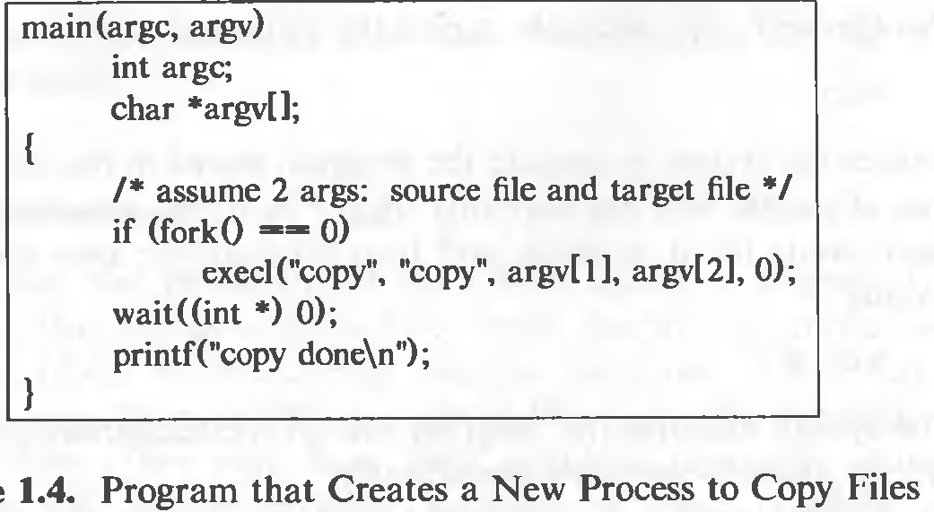
Notes:
In execl() system function takes the path of the executable binary file (i.e. /bin/ls) as the first and second argument.

Slide 129
Case study
Process Management in Linux
There are basically 2 types of processes.
Foreground processes- interactive – initiated by user or programmer
Background processes- non interactive - initiated by the system itself or by users

Slide 130
Practically managing the processes
Example of foreground process
$./a.out
Stopping a process in between - we may press CTRL+Z to force stop it.
To get the list of jobs that are either running or stopped.
$jobs
To run all the pending and force stopped jobs in the background.
$ bg

Slide 131
To get details of a process running in background.
$ ps -ef | grep sleep
To run all the pending and force stopped jobs in the foreground.
$fg
To run a process in the background without getting impacted by the closing of the terminal.
$ nohup sleep 100 &
To run some processes in the background directly.
$sleep 100&
To run processes with priority(The top priority is -20 but as it may affect the system processes so we have used the priority 5.)
nice -n 5 sleep 100

Slide 132
Any query??

Slide 133
Thank you

