Slide 1




Team MeltDown
TRAVEL OPS

Slide 2
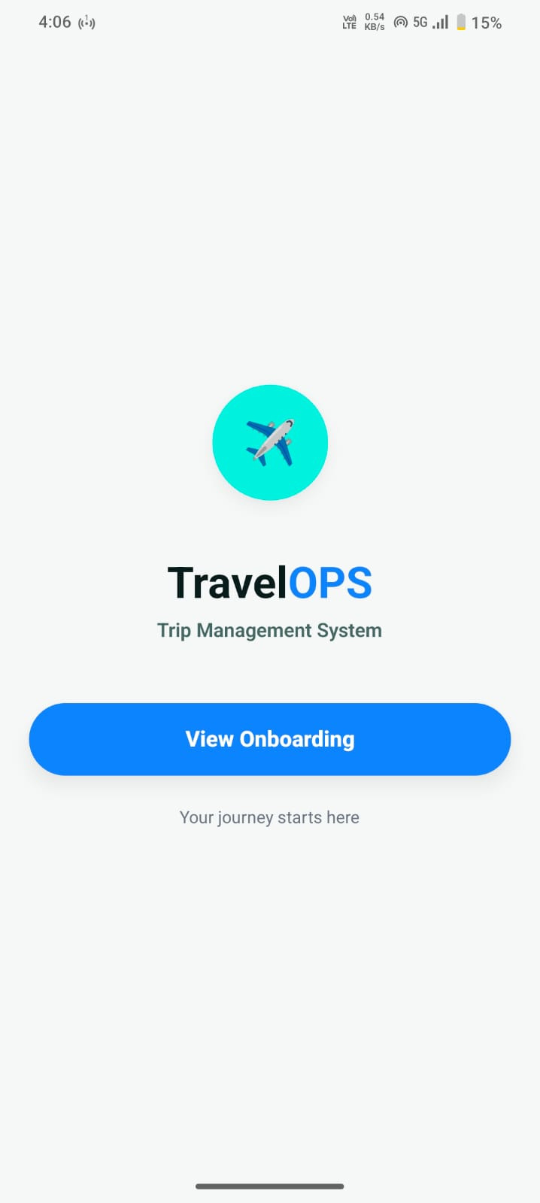

Team meltdown
our proposed solution
PROBLEM STATEMENT:
End-to-End Travel Journey Management Ecosystem Problem Definition Design and develop a centralized, resilient travel management platform that treats an entire multi-city trip as a single, connected unit rather than a collection of fragmented bookings. Currently, travel agents struggle with "distributed failures"—where a hotel confirms but a flight fails—leading to inconsistent customer experiences and manual recovery.

Slide 3








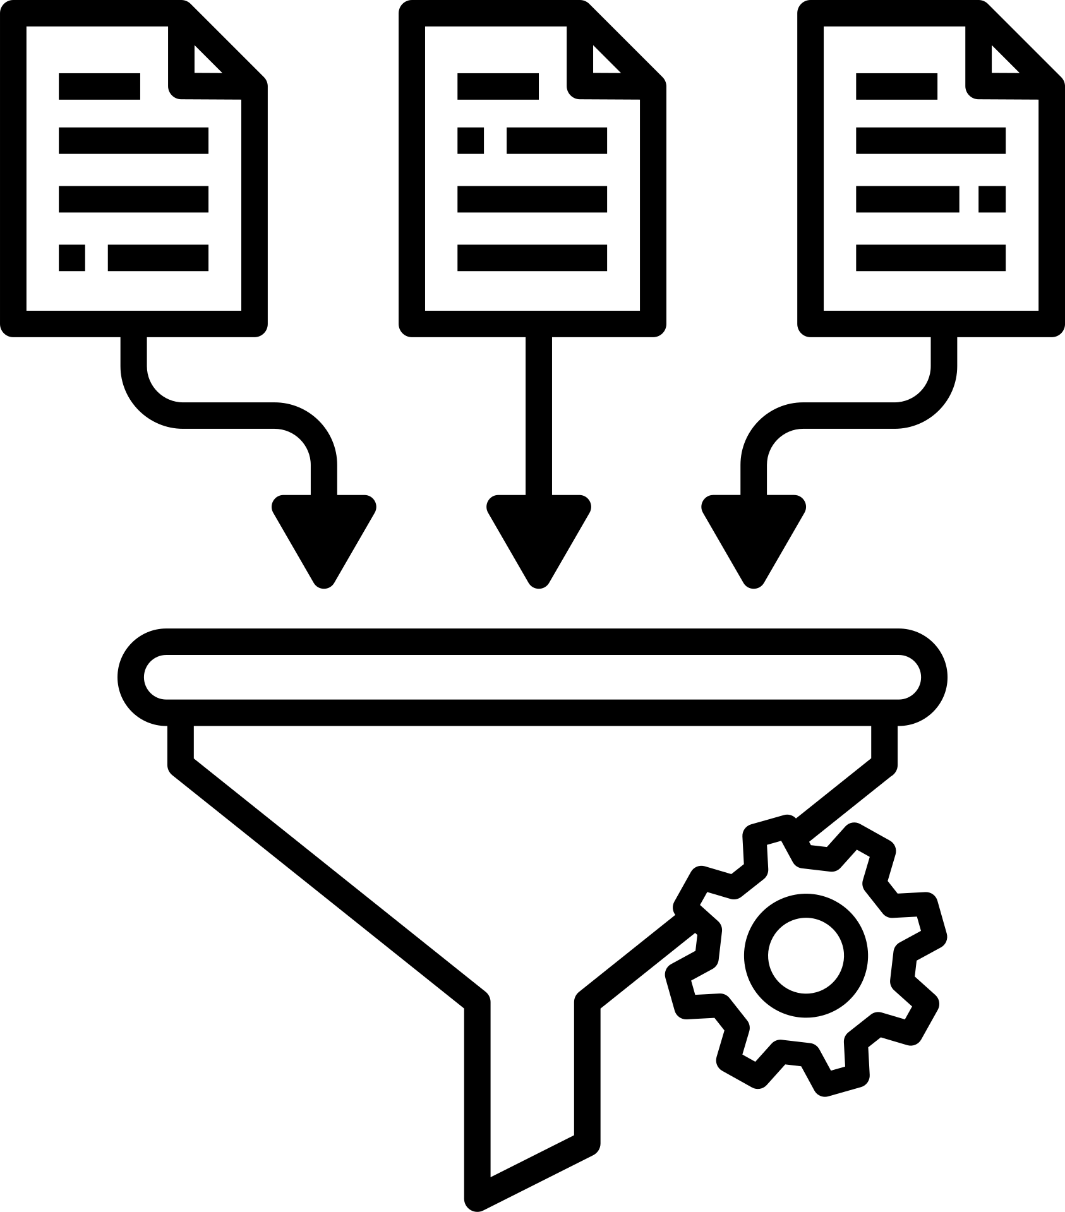


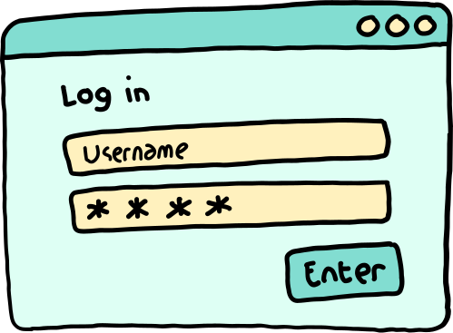






DESIGN:
JOURNEY PACKAGE GENERATION
BOOKING SEQUENCE SHOWCASE
CANCELLATION
OPTION
CUSTOMER REQUIREMENT
STATE MACHINE
AGENT ASSISTANCE
URL-based search and travel packing
Credit Card benefits aware
LOGIN/SIGN UP
OPERATION DASHBOARD
RECOVERY STRATEGY
Rule
Engine
handle
SLA breach
Manage
escalations
ADMIN DASHBOARD

Slide 4














SYSTEM FLOW
Using AI-agent
CUSTOMER REQUIREMENT
Booking Intiation
State Machine
multi-city segment add
Tracks every transaction and booking
Visualises the boking stages and failure states
finds multiple compatible and budget friendly travel options
Maintains these three states and tracks changes for every booking
Makes things abstract and intuitive
seamless travel through real time coordination
Tells the system to raise ops alert when failed state
Raises Ops alert on failure
Price comparisons and other variables
Failed

Slide 5













SYSTEM FLOW
Ops feature when ops alert is raised
Credit-Card and Discount aware system
URL- based
creator first
planner
Recovery Strategy
Chooses among the four recovery strategy
Lead generation
Always offers best prices for travel packages
Ease of decision making is proven to convert clients
Retry, Replace,
Hold, Roll back
Our AI-agent takes the input and makes the call to LLM
Decision making engine based on constraints
leisurely scrolling through plans can increase the client conversion
Source of info-web search
accomodation and restaurant

Slide 6



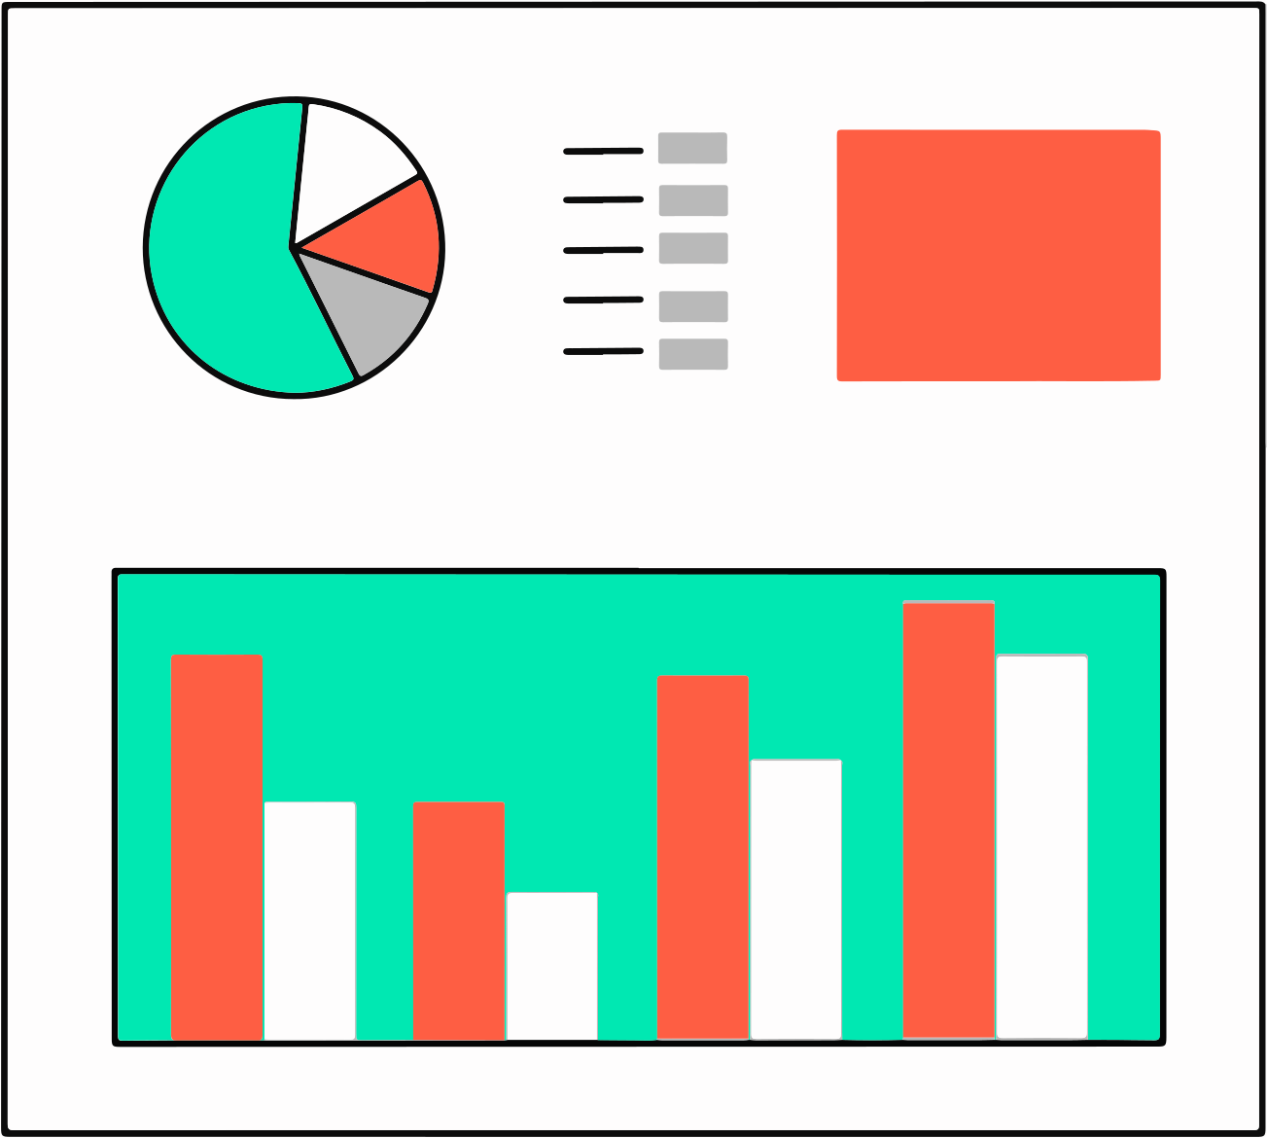



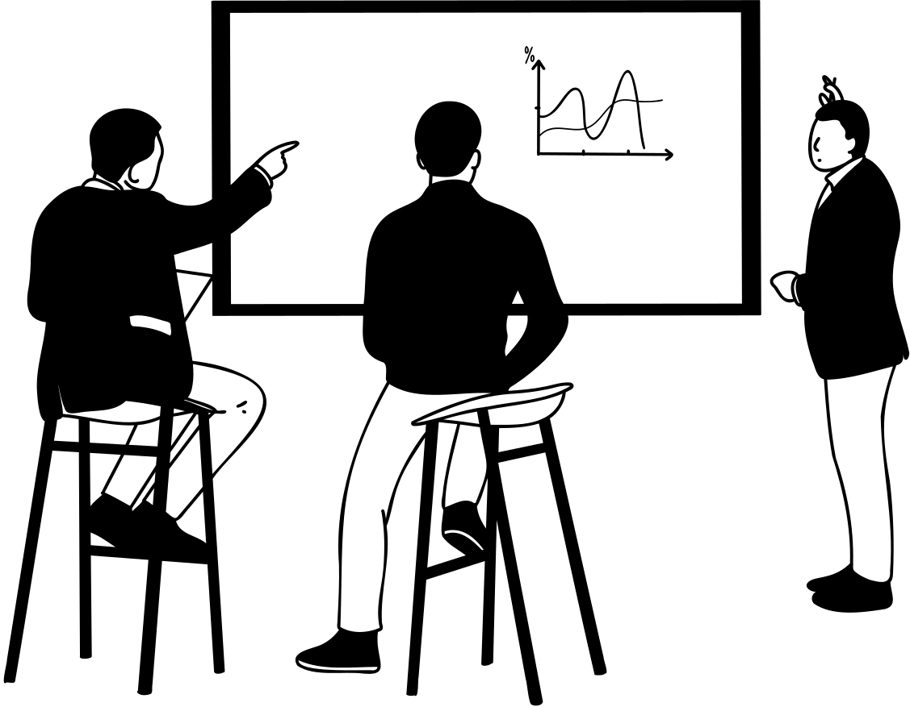

SYSTEM FLOW
Data Analytics for informed decision making
Agent Performance Analytics
Social media and trend analysis
Flaky Supplier analytics
Monitors SLA breaches from admin dashboard
Better marketing strategy planning
Our Top agents
dashboard
Provides Loyalty badges to consistent suppliers
Incentives and bonuses for top performers
informed business decisions
Supplier management Support and monitoring
Performance data management

Slide 7
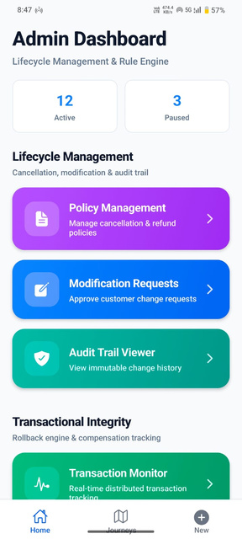
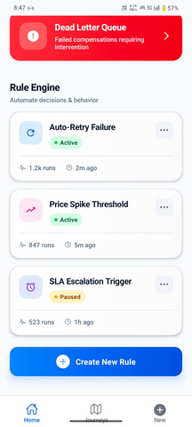
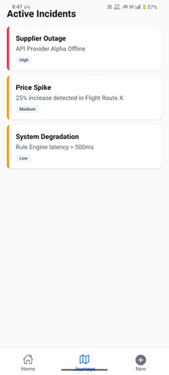
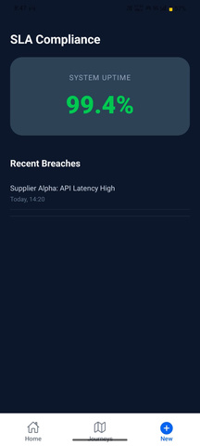

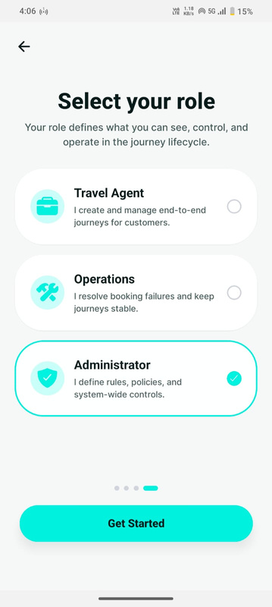
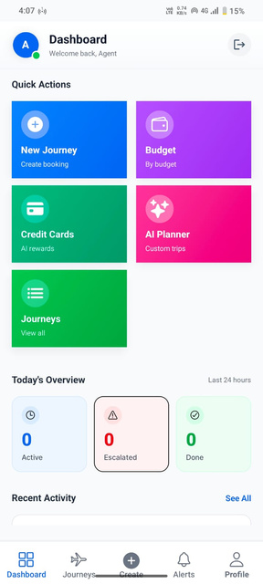
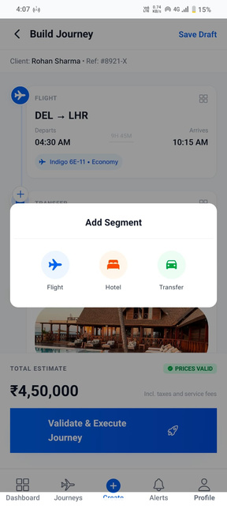
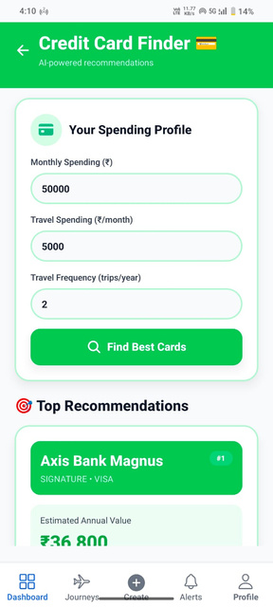
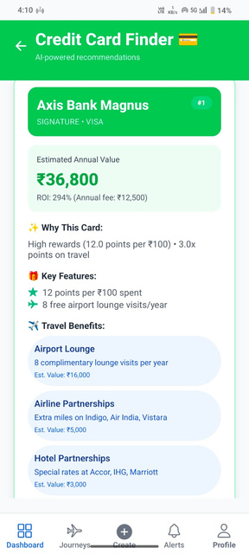
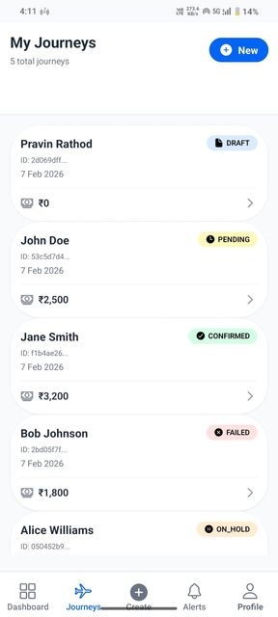
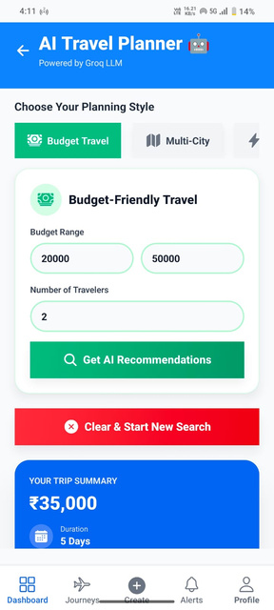
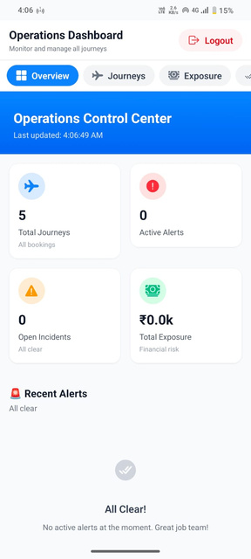
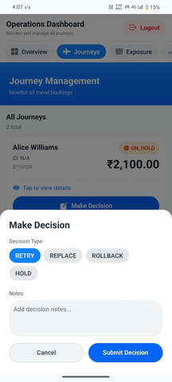
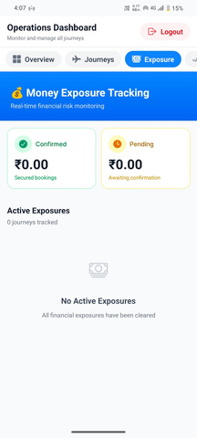
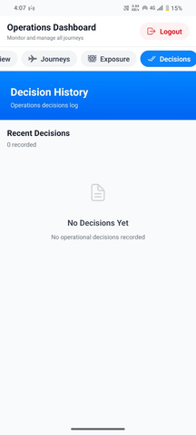
WIRE-FRAMES

