Slide 1


IntelliAudio: AI-Powered Long-Form Audio Understanding System
Transforming unstructured podcast audio into actionable insights through advanced speech recognition and natural language processing

Slide 2

The Challenge: Navigating Long-Form Audio Content
Key Main Points
•
Podcasts average 30-60 minutes with no visual structure Finding speciﬁc topics requires manual scrubbing through entire episodes No searchable text or metadata for audio-only content Diﬃcult to extract key insights or gauge sentiment without listening to full recordings
•
•
•
Users need intelligent tools to parse,
understand, and navigate audio eﬃciently.

Slide 3
Our Solution: End-to-End Audio Intelligence Pipeline
Audio Input
Long-form podcast audio ﬁles
AI Processing
Multi-stage NLP analysis
Structured Output
Searchable insights and summaries
IntelliAudio automatically transcribes audio, segments content by topic, extracts keywords, analyzes sentiment, and presents results through an interactive interface—enabling users to quickly ﬁnd and understand key moments in lengthy recordings.

Slide 4






System Architecture
Preprocess
Transcribe
Segment
Summarize
Keywords
The pipeline processes raw audio through six sequential stages, leveraging state-of-the-art models at each step. Audio preprocessing ensures quality input, Whisper provides accurate transcription, Sentence-BERT embeddings enable semantic segmentation, and downstream NLP models extract meaningful insights.

Slide 5
Dataset and Scope
6
Total Hours
Of audio processed
12
30
Avg. Minutes
English Podcasts
Diverse topics and speakers
Per episode analyzed
Data Characteristics
All podcast episodes were sourced from publicly available Kaggle datasets, ensuring diverse content including interviews, educational content, and storytelling formats. Audio quality ranges from professional studio recordings to remote interviews, providing realistic testing conditions for robustness evaluation.

Slide 6

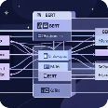
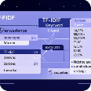

Core Technologies and Methodology
Whisper ASR
OpenAI's robust multilingual speech recognition model for accurate transcription, trained on 680,000 hours of labeled audio data
Sentence- BERT
Semantic sentence embeddings for topic boundary detection using cosine similarity across sliding windows
TF-IDF Analysis
Statistical keyword extraction to identify the most signiﬁcant terms within each topic segment
VADER Sentiment
Lexicon-based sentiment analysis optimized for social media-style conversational text, providing compound polarity scores

Slide 7
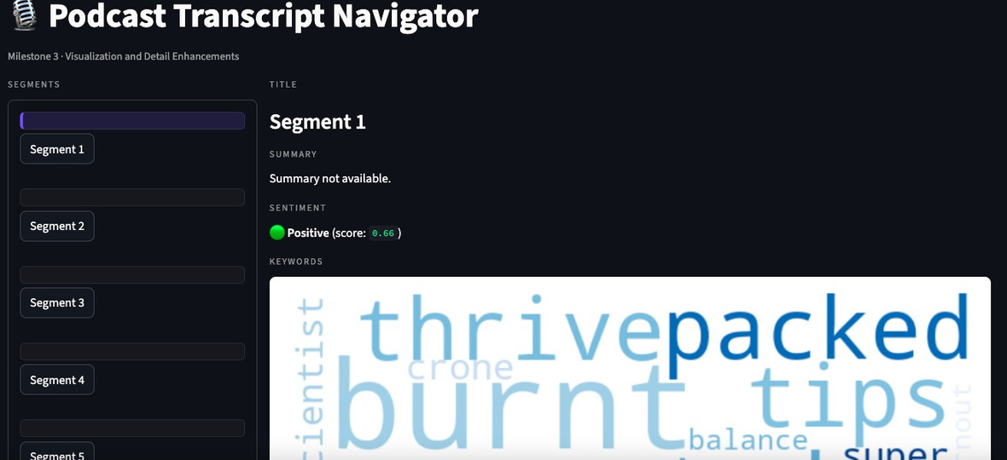


Results and System Outputs
Deliverables
The Streamlit interface provides an intuitive way to navigate results, enabling users to jump to speciﬁc topics, review sentiment trends, and explore extracted keywords.
Structured Transcripts
Topic Segments
Sentiment Tracking
Emotional tone analysis per segment
Keyword Clouds
Visual representation of key themes
Time-stamped, searchable text output
Automatic content boundaries with labels

Slide 8
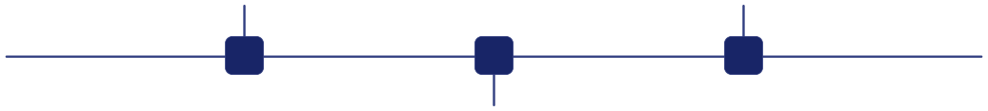
Testing and Performance Improvements
Noise Handling
Implemented spectral gating and normalization to reduce background interference in transcription accuracy
Threshold Tuning
Calibrated similarity thresholds (0.65-0.75) for topic segmentation to minimize false boundaries while capturing true topic shifts
1
2
3
Chunking Strategy
Optimized audio segment length (30-second windows) to balance processing speed and context preservation
Iterative testing revealed that preprocessing signiﬁcantly improved Whisper accuracy on lower-quality audio, while dynamic threshold adjustment reduced over-segmentation in conversational content.

Slide 9

Current Limitations
Speaker Overlap
Simultaneous speech from multiple speakers reduces transcription accuracy and complicates attribution. Cross-talk remains challenging for current ASR models.
Noise Sensitivity
Performance degrades with poor recording quality, heavy background noise, or signiﬁcant audio artifacts despite preprocessing efforts.
Gradual Topic Shifts
Embedding-based segmentation struggles with subtle, gradual transitions between related topics, potentially creating artiﬁcial boundaries or missing natural ones.

Slide 10


Future Enhancements
Next Steps
Speaker diarization will enable attribution in multi-speaker contexts using neural embeddings. Real-time processing capabilities would support live transcription and analysis for webinars and meetings.
Real-time Processing
Cloud Deployment
Multilingual Suppor t
Speaker Diarizatio
Live transcription and analysis
n
Scalable, accessible infrastructure
Attribution in
multi-speake r
Handle non- English content
Expanding to multilingual models would broaden accessibility, while cloud deployment on AWS or Azure would enable scalable, production-ready access for enterprise applications.
aud
io
Target: Production-ready system within 6-9 months with enterprise-grade performance and reliability

