Slide 1
Segmenting individual nuclei
and auditing the benchmark that scores it
Tejas Sukesh
BBBC039 · 200 fields · 23,617 hand-annotated nuclei
Notes:
I'll spend most of this on what the model gets wrong and why, because that turned out to be more interesting than the score.

Slide 2
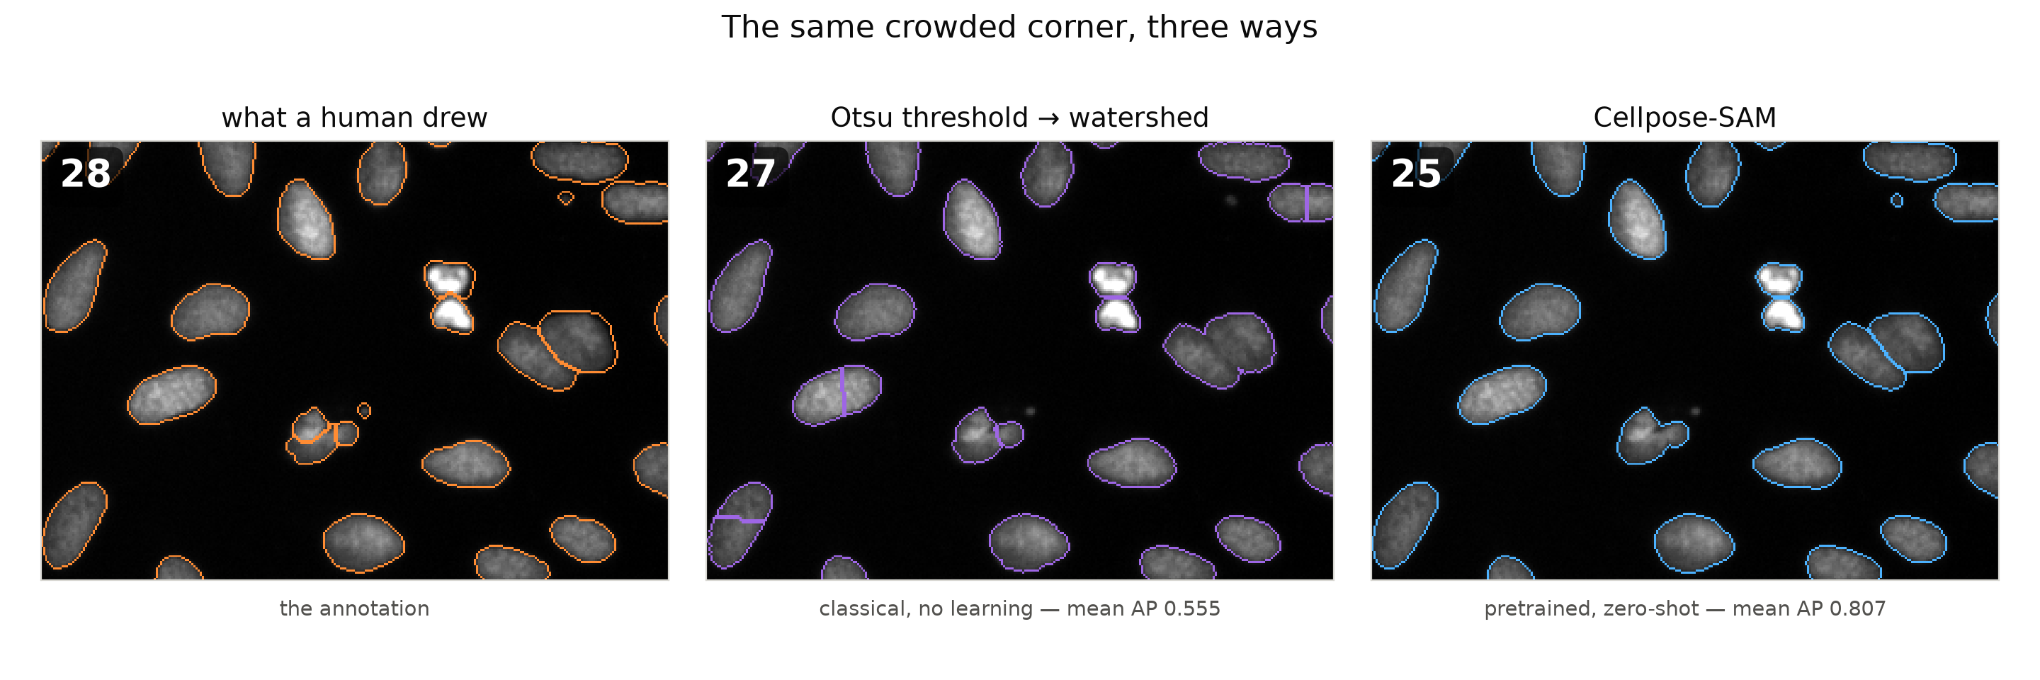
2
Cell segmentation, and how it’s done
Orientation before the results — 60 seconds
Why it matters here Drug screening asks per-cell questions: how many cells, how big, how bright. A per-image total can’t tell “twice as many cells” from “the same cells twice as bright.” So every nucleus has to come out as its own object.
Existing solutions Classical rule pipelines — Otsu threshold, then watershed. Or a learned model — Cellpose-SAM, the current standard. I built both, so I had something to compare against.
Otsu vs Cellpose-SAM Otsu picks one brightness cut, then watershed splits blobs by shape — so it slices non-round nuclei in half (405 false splits vs 24). Cellpose-SAM predicts, for every pixel, the direction to its own cell’s centre; pixels flowing to the same centre are one cell. That separates touching nuclei a threshold never can.
Notes:
Quick orientation, because this problem is probably unfamiliar. WHAT YOU'RE LOOKING AT. These are cells under a fluorescence microscope. A stain called Hoechst binds DNA, so the nucleus of every cell lights up and everything else stays dark. That's why the images are grey blobs on black. WHY IT MATTERS. The use case is high-content screening: treat plates of cells with different compounds, image them, and ask what changed. But every question is per-cell — how many cells, how big is each nucleus, how bright, what shape. 'How much total stain is in this image' is useless, because it can't distinguish twice as many cells from the same cells twice as bright. So you need each nucleus as its own object. That's instance segmentation, and it's different from just finding the foreground. Finding foreground is easy — one line of Otsu. Where nuclei touch, though, a foreground mask fuses them into one blob, and separating touching objects is the whole problem. THE CLASSICAL APPROACH. No learning; every step is a hand-set rule. Otsu looks at the histogram of pixel brightness, assumes two populations — background and object — and picks the single cut that best separates them. That gives foreground. Then, to break fused blobs apart: a distance transform (for each foreground pixel, how far to the nearest background pixel), treat the local peaks as cell centres, and flood outward from each until the floods meet. The meeting line is the cut. That works when nuclei are round. It fails when they aren't — a bean-shaped or unevenly textured nucleus gives two distance peaks and gets sliced in half. Those purple lines through the middle panel are exactly that. Across validation it makes 405 of those false splits against Cellpose's 24, which is most of why it scores 0.555. CELLPOSE-SAM. The current state of the art for cell segmentation. The key idea is that it doesn't classify pixels as foreground or background at all. For every pixel it predicts a direction — which way is the centre of MY cell. Then you follow those arrows uphill, and every pixel that flows to the same point is one cell. Touching nuclei separate because their pixels flow to different centres even though there's no visible gap between them. A threshold can never do that. The SAM part is the backbone: it's built on Segment Anything and trained across a large corpus of cell images from many microscopes and modalities. That's why it's the default — it generalises to new data without retraining, which is exactly the position I'm in. Zero-shot, it scores 0.807. One caveat I'll flag now and come back to: because its training corpus is broad, I can't fully rule out that it has seen images like these.

Slide 3
3
What I chose to do with it
200 fields · 100 for training · ~118 nuclei each · scored by mean AP over IoU 0.50 : 0.95
What I chose to build
What I deliberately didn’t
Decode the ground truth correctly Every downstream number is meaningless without it.
Train a model from scratch 100 training fields. I'd be measuring my training loop, not the problem.
Cellpose-SAM, pretrained, zero-shot The current state of the art for this modality.
Label more data 23,617 nuclei are already labelled — and the annotation is what I'm auditing.
A 72× evaluation cache Turned parameter search and ablations from hours into minutes.
Fine-tune The interesting one. See below.
Attribute the failures Where the score actually goes — the bulk of the work.
Why not fine-tune? It would probably raise AP — and that’s the problem. A fine-tuned model would gain partly by learning the annotator’s systematic tightness: a better metric, not better segmentation. So it’s a test of the boundary finding, not an improvement — which is exactly how I’d spend the next day on it.
Notes:
My read of the prompt: segment individual nuclei, and be scored on instance agreement with hand-drawn outlines. 200 fields, 100 of them training, about 118 nuclei each. Given that, the highest-value thing I could do was NOT to train a model. With 100 training fields, a from-scratch model measures my training loop, not the problem. And I didn't label more data — there are already 23,617 annotated nuclei, and the annotation turns out to be the thing I'm auditing, not a bottleneck. So: a state-of-the-art pretrained model — Cellpose-SAM — used zero-shot, and then I spent the time on making evaluation cheap and on working out where the score actually goes. The fine-tuning one is the interesting decision, and I'll own it. train_seg exists and 100 labelled fields is enough to adapt a generalist — it's the textbook biggest lever. I left it undone deliberately. Because of what's coming on the boundary slides, a fine-tuned model would improve AP partly by learning this annotator's systematic tightness — a better metric without better segmentation. That makes it a test of the ceiling claim rather than an improvement. The honest second reason: MPS training time was unmeasured against a deadline, and a probe that can't distinguish 'won't converge' from 'needs another 15 minutes' produces sunk cost rather than a decision.

Slide 4
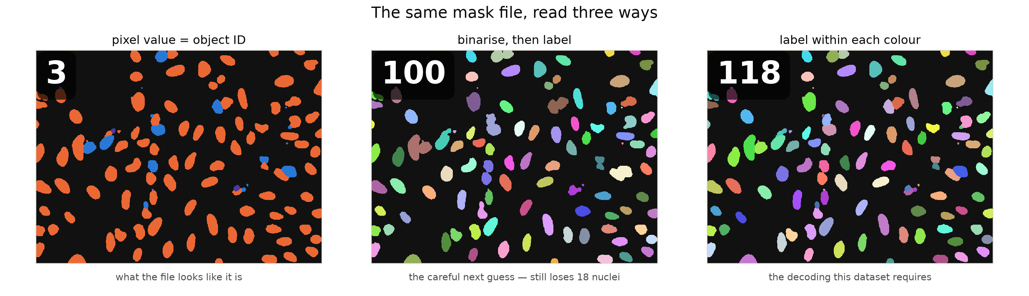
4
The trap in the data
The masks are a 3-colour graph colouring, not instance IDs
3
read as IDs
100
binarise + label
118
decoded correctly
Notes:
The answer files look like they label each nucleus with its own ID. They don't — they only use three values, arranged so touching nuclei never share one. Take the pixel value as the object ID and the whole field collapses to three objects. Binarise and run connected components instead — the careful next guess — and every touching clump still fuses: 100 instead of 118 in this field. Either way your score goes UP, because the hard cases disappear from the test. I checked my decoding two ways: it recovers 23,617 objects, matching what the dataset documentation reports, and the count is identical under 4- and 8-connectivity.

Slide 5
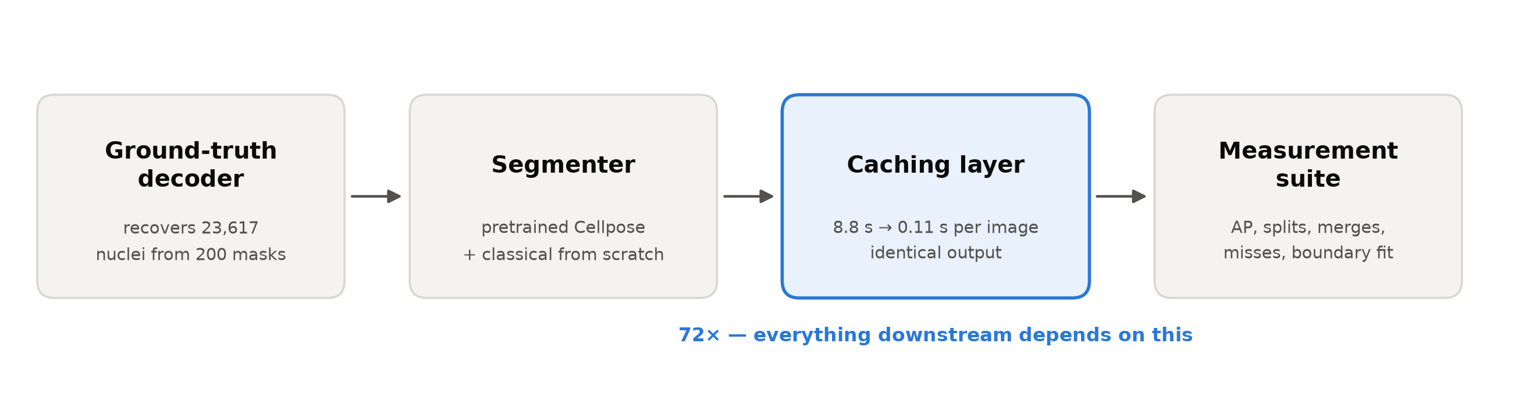
5
What I built
Byte-identical masks, verified on every cached call.
A speedup that quietly perturbs the output isn’t a speedup — so the cache asserts equality rather than assuming it.
Notes:
I used a pretrained model for the segmenting, and wrote a classical pipeline from scratch as a comparison. The piece that mattered most was a cache: testing a setting took 8.8 seconds per image, and I got it to 0.11 — about 72× faster, with byte-identical output. That's the median-based figure; the mean says 81×, but the first call includes loading the checkpoint, so 72× is the honest one. Everything after this depends on it. Pre-empts 'did you just call a library.' Don't be defensive, just state it.

Slide 6
6
The number
0.791
mean AP over IoU 0.50 : 0.05 : 0.95 · held-out test set, 50 fields
95% CI 0.766 – 0.812
F1 = 0.956
mean IoU 0.926
the spread that matters
at the loosest threshold
over matched objects
Notes:
That's the headline. But it's an average of ten increasingly strict judgments, and it's worth asking where it's actually losing points. Deliberately anticlimactic. You're setting up the pivot.

Slide 7
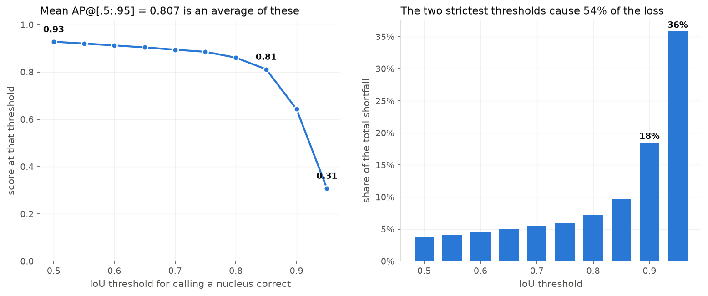
7
Where the score is actually lost
The two strictest thresholds cause 54% of the total loss
Notes:
At the loosest setting, it finds 93% correctly. At the strictest, 31%. The two strictest settings cause 54% of the total loss. Everything else — every missed object, every wrongly merged pair — is under 4% of it. So if I want to improve the number, that's where it lives. This is the pivot slide. Everything before was setup. Slow down here.

Slide 8
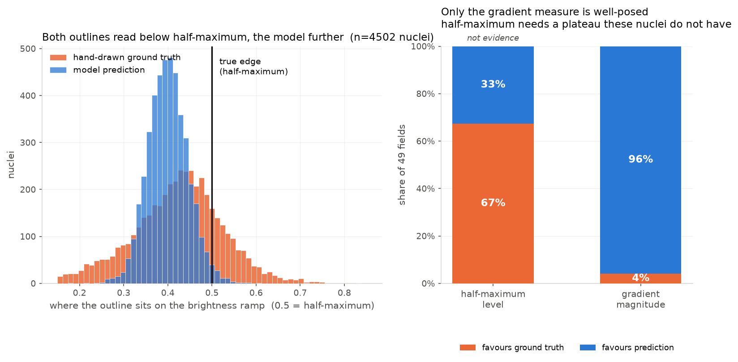
8
What are those strict thresholds measuring?
Two reasonable definitions of “where the edge is” rank the outlines oppositely
Notes:
To score at that strictness your outline must match the human's to within about half a pixel. So I asked whether a hand tracing is even that precise, using the image itself as a referee — two different definitions of where an edge is. They give opposite answers. Brightness-halfway favours the human in 67% of fields; edge-steepness favours the model in 96%. And the gradient measure is the one to weight, because it's reference-free — both outlines are divided by the same local contrast, so any calibration error cancels. The half-maximum measure needs 0.5 to be correctly located, and on this data it isn't: both outlines read about 0.40, not 0.50. Two reasonable definitions ranking them oppositely is itself the evidence that those strict thresholds are settling a convention rather than measuring correctness. Do NOT claim the annotation is wrong. Go straight to the next slide.

Slide 9
9
I got this wrong first
Synthetic sweep with a known right answer: ground truth exactly on the edge, prediction 0.25 px too large
my first version
inner-boundary ring
9 of 9
picked the wrong outline
after the fix
marching-squares contour
0 of 9
picked correctly
The original claim reported the model closer in 48 of 49 fields. It did not survive. I retracted it.
Notes:
My first version of this said the model was closer, in 48 of 49 images. Someone suggested that might be an artifact of how I sampled pixels along each outline. So I built a test with a known right answer — human's outline exactly on the edge, model's slightly outside it — and my measurement picked the wrong one nine times out of nine. I'd been sampling the ring of pixels just inside each outline, which sits half a pixel in, the same size as the effect. And it isn't common-mode: it favours whichever outline is larger, which is the model's. So the artifact alone could have produced the entire original result. I fixed the sampling, re-ran, and my headline finding inverted. So I retracted it. This is the best slide in the deck. Don't rush it.

Slide 10
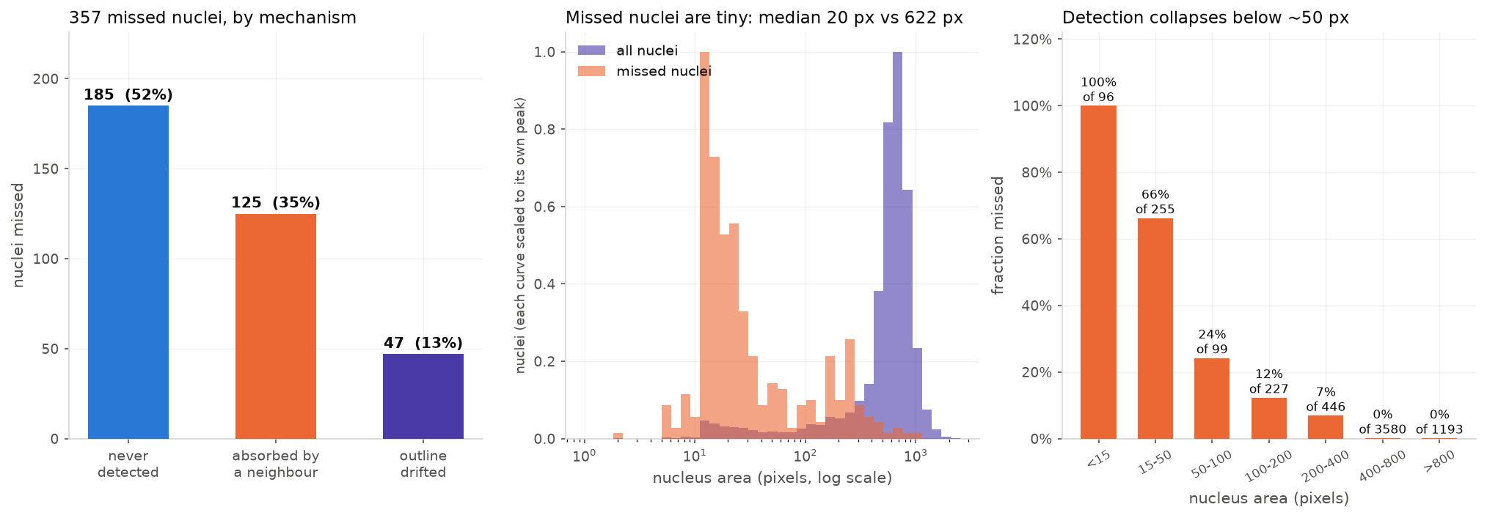
10
What actually fails
One population: small and faint
Notes:
Setting the boundary question aside — of the objects it genuinely misses, the median is 20 pixels against 622 for a normal nucleus. 81% are under 100. Above 400 pixels it misses 9 out of 4,773, which is 0.2%. And the model finds 98% of bright objects but only 86% of faint ones. So it's one population: small and faint.

Slide 11
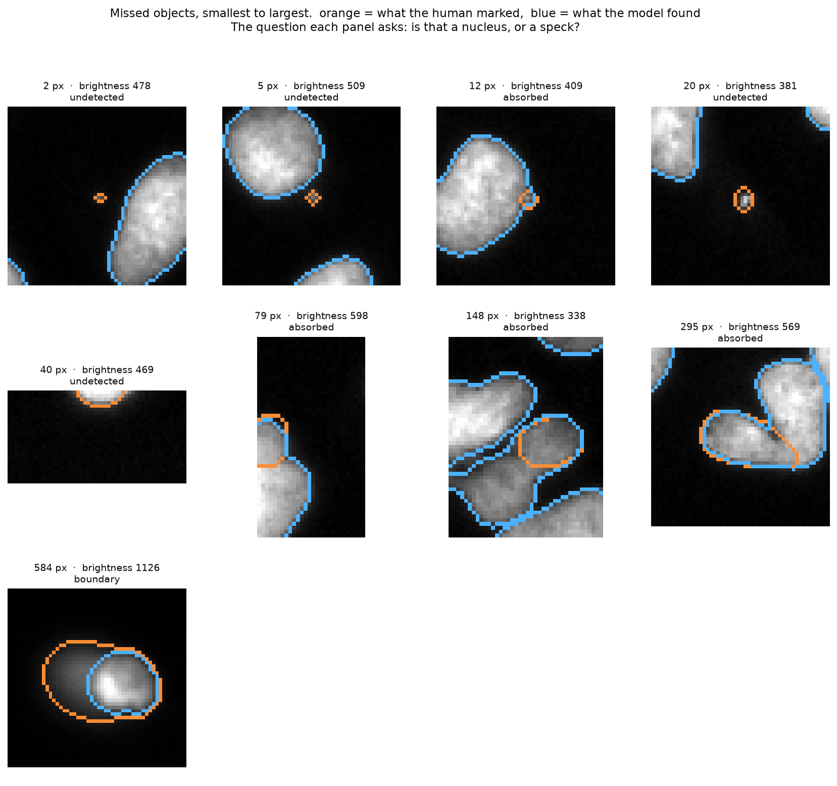
11
Are those even objects?
I couldn’t answer that from a table, so I looked
Notes:
There's a transition. Under about 15 pixels the annotation sits on visually empty background — that's label noise. Between 20 and 100 they're real but very faint. Above 100 they're unmistakable nuclei the model genuinely got wrong. So I can't dismiss the misses as bad labels, and I can't dismiss them as model failures either. Both are present.

Slide 12
12
Six experiments, five null
Each was motivated by a measurement, and each failure eliminated a cause
What I tried | What it ruled out
Threshold tuning | Defaults already optimal
Size filter | Admits more noise than signal
Bandit search | Lost to brute force — my own speedup removed the need
Averaging flipped copies | Errors are consistent, not random
2× upscaling | Small objects aren’t a resolution problem
Local brightness rebalancing | Faint objects are faint absolutely, not relatively
2× upscaling is the one that wasn’t really null. It left the score flat but moved the error profile — and broke the prediction I’d written down. That’s the next slide.
Notes:
Each of these was motivated by a measurement, and each failure eliminated a cause. The score didn't move — but I know why for every one. The bandit one is the embarrassing one, and worth owning: bandits exist to save evaluations, and my own 72× cache made evaluations cheap enough that brute force won. I killed the premise myself.

Slide 13
13
The one that broke its prediction
I wrote down what I expected before running it. The opposite happened.
Merges
Misses under 50 px
predicted: unchanged
predicted: recovered
103 → 69
265 → 266
dropped by a third
did not move at all
Resolution isn’t why small objects are missed — and merging isn’t the immovable problem I’d argued it was.
AP stayed flat (0.807 → 0.809) because it traded merges for splits. The error profile changed substantially — visible only because those are counted separately.
Notes:
I wrote down what I expected before running the last one: upscaling would recover small objects and leave merges alone. The opposite happened. Small objects didn't move at all — 265 to 266. But merges dropped by a third, 103 to 69. So resolution isn't why small objects are missed, and merging isn't the immovable problem I'd argued it was. The score stayed flat because it traded merges for splits — 24 splits up to 36 — but the error profile changed substantially, and I could only see that because I count those separately. CLOSING LINE: The score is roughly where a pretrained model puts it, and I couldn't move it. What I have instead is a map of which errors are reachable, which are definitional, and which are noise — and I can tell you which is which.

Slide 14
B1
Did the model see this data?
Raise it yourself if it comes up naturally — it reads as rigour
Cellpose-SAM's training corpus includes the 2018 Data Science Bowl.
BBBC039's own dataset page states some of its images appear in that collection.
So the test score is not cleanly held out, and I don't claim it is.
It does not affect the failure analysis, which is about error structure, not rank.

Slide 15
B2
The classical pipeline
Why opposite error types must be counted separately
 | Cellpose | Classical
Mean AP | 0.807 | 0.555
Splits | 24 | 405
Merges | 103 | 169
Object-count bias | −4.51% | −0.19%
Best object count in the project — achieved by making 574 topology errors that cancel. A count-only metric would rank it first.
Validation split

Slide 16
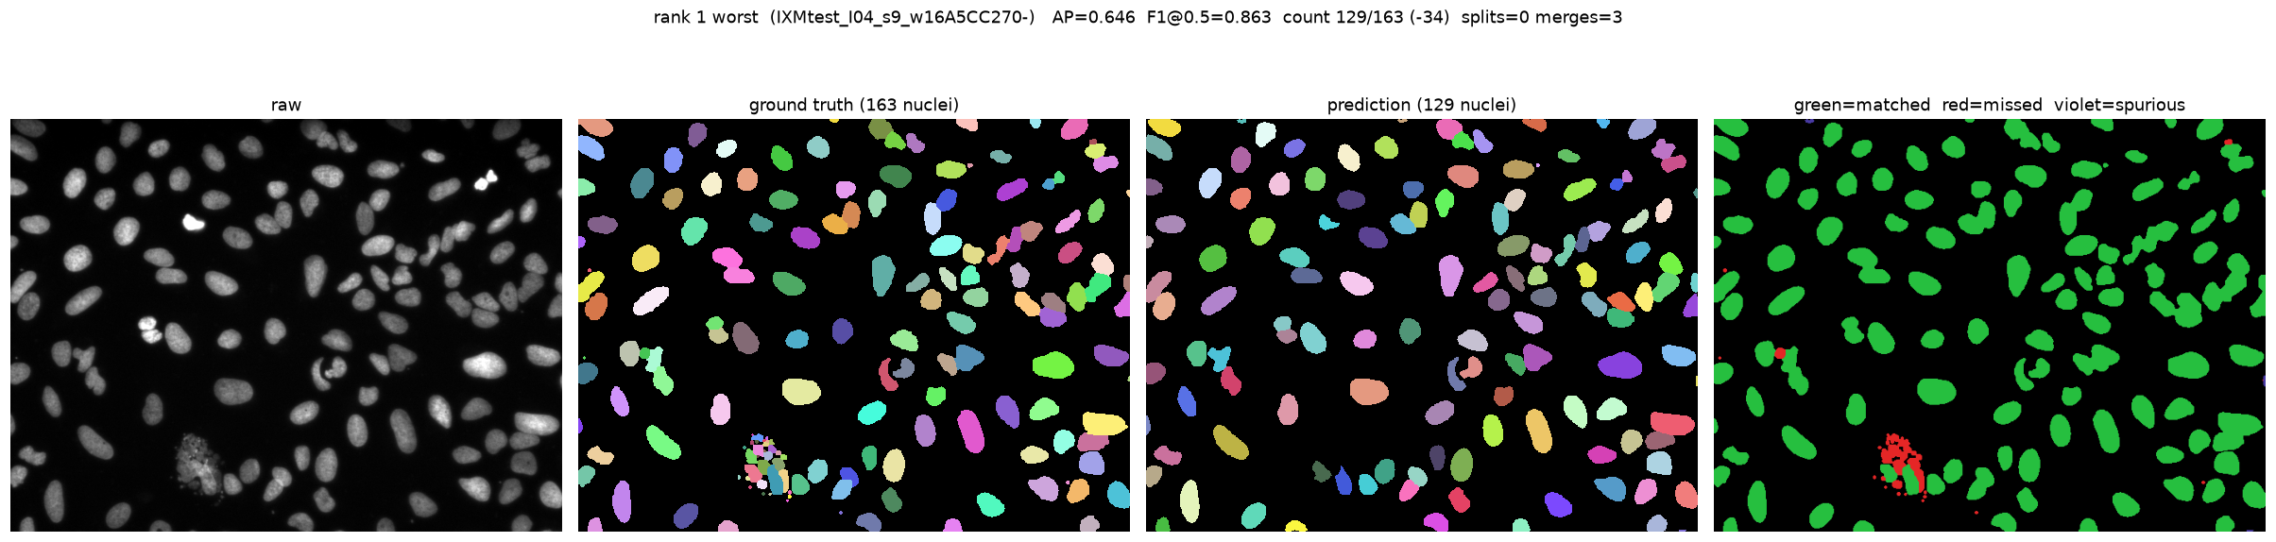
B3
Worst cases
Chosen by sorting the per-image results, never by eye
figures/worst_cases/ holds all four

Slide 17
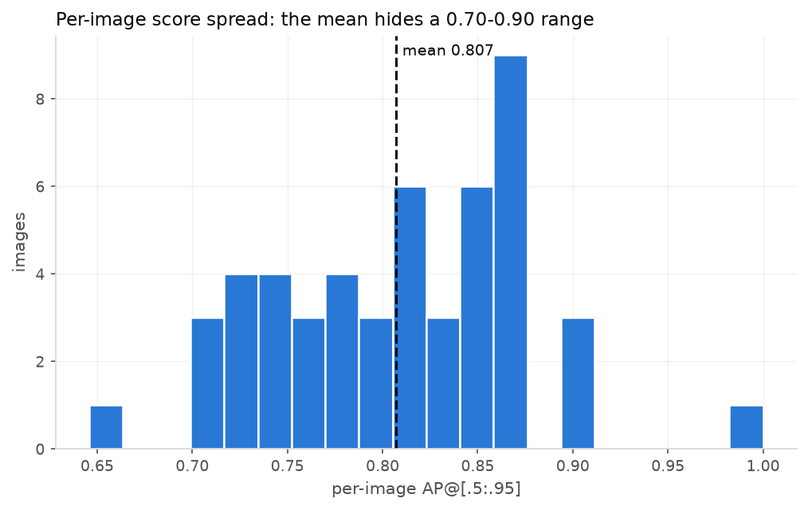
B4
Per-image spread
Why every number carries a confidence interval

Slide 18
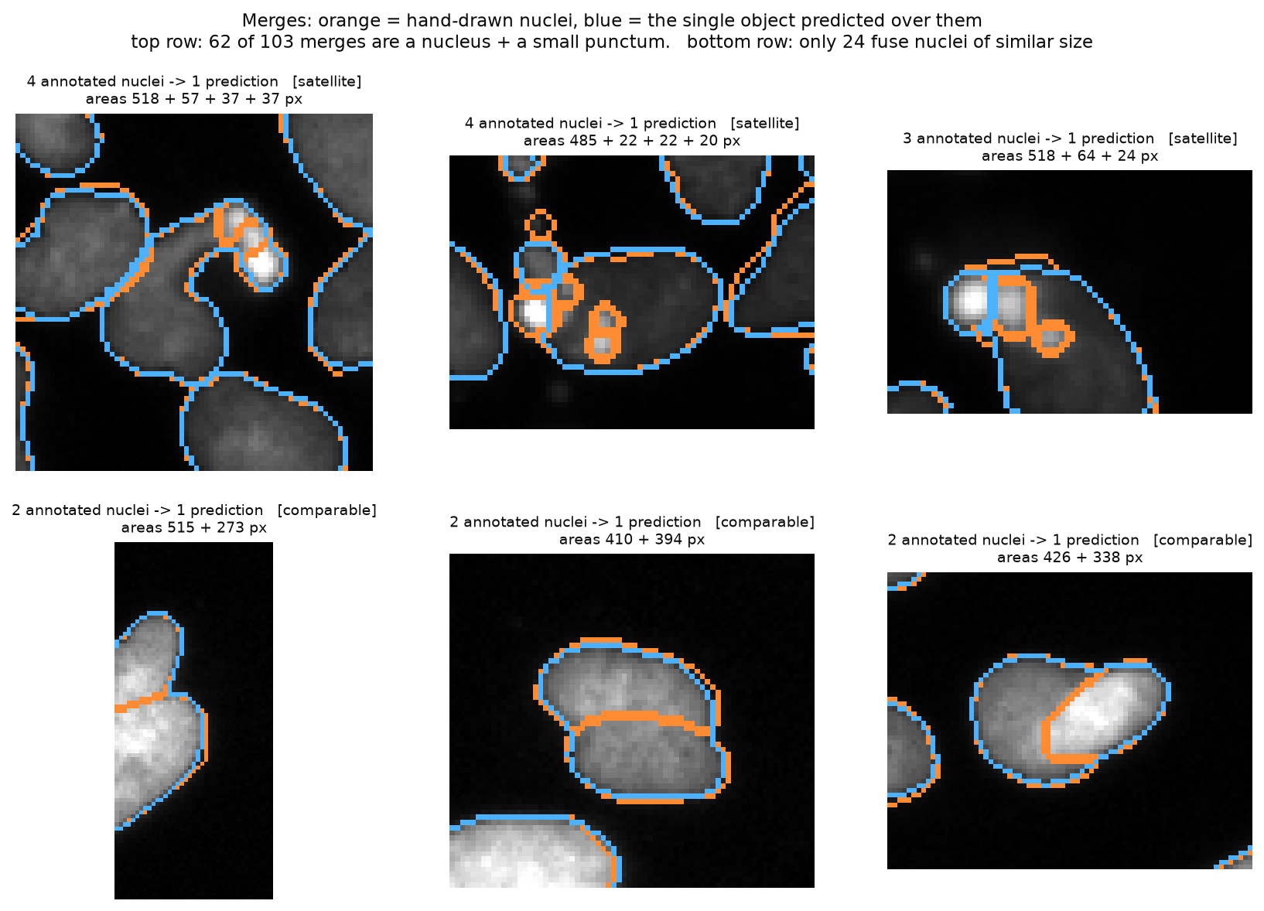
B5
Merge composition
60% of “merges” are a nucleus plus a speck, not two nuclei fused

