Slide 1


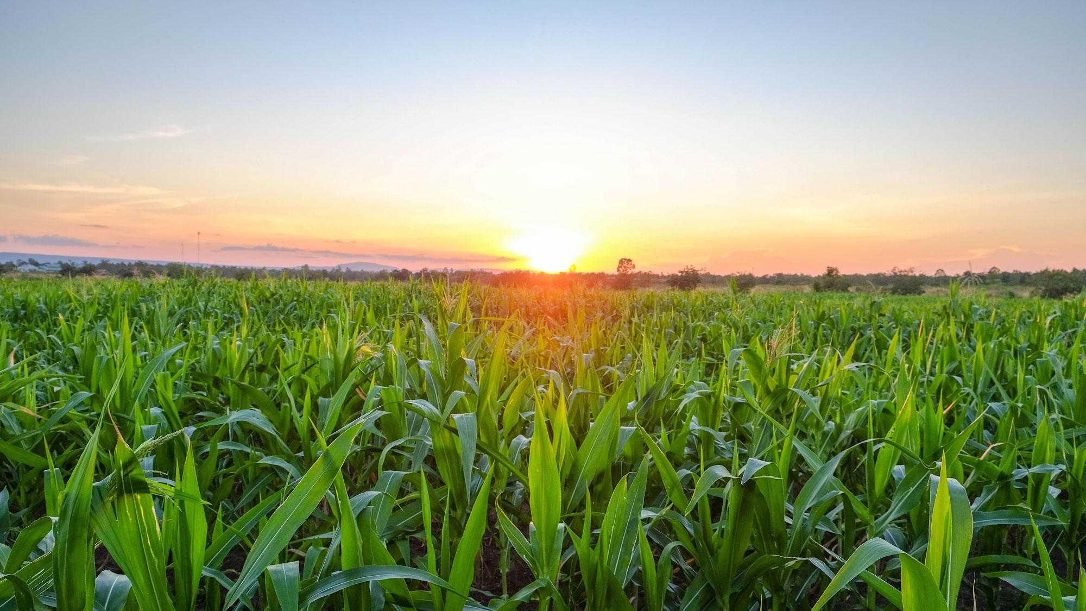


Data Scientist Interview
Tejas Tumakuru Ashok
University of Illinois Urbana - Champaign

Slide 2


Problem Statement
To determine the outcome of the harvest season, i.e., whether the crop would be healthy (alive), damaged by pesticides, or damaged by other reasons.
Features of the Dataset
ID: UniqueID
Estimated_Insects_Count: Estimated insects count per square meter
Crop_Type: Category of Crop(0,1)
Soil_Type: Category of Soil (0,1)
Pesticide_Use_Category: Type of pesticides used (1- Never, 2-Previously Used, 3-Currently Using)
Number_Doses_Week: Number of doses per week
Number_Weeks_Used: Number of weeks used
Number_Weeks_Quit: Number of weeks quit
Season: Season Category (1,2,3)
Crop_Damage: Crop Damage Category (0=alive, 1=Damage due to other causes, 2=Damage due to Pesticides)
This is a multi-class classification use case, and we predict the class label of Crop_Damage

Slide 3
Methodology/Steps implemented in the project
Business Understanding – Define the objectives of the use case
Exploratory Data Analysis and Data Pre-processing
Data Visualization
Data Cleaning
Feature Engineering
Feature Scaling
Predictive Modelling
Machine Learning
Artificial Neural Network
Model Evaluation
Deployment to AWS, Azure, Google Cloud
Data Story Telling(Communication to the Stakeholders/Product Owners/Management, etc.

Slide 4
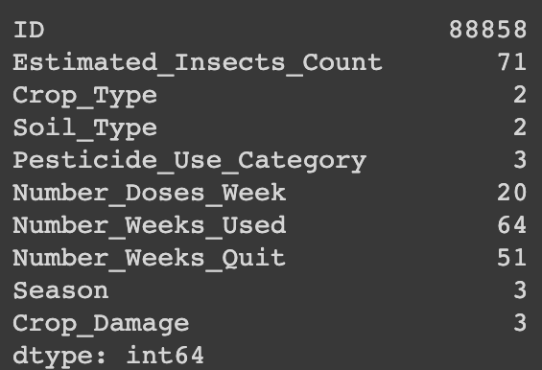
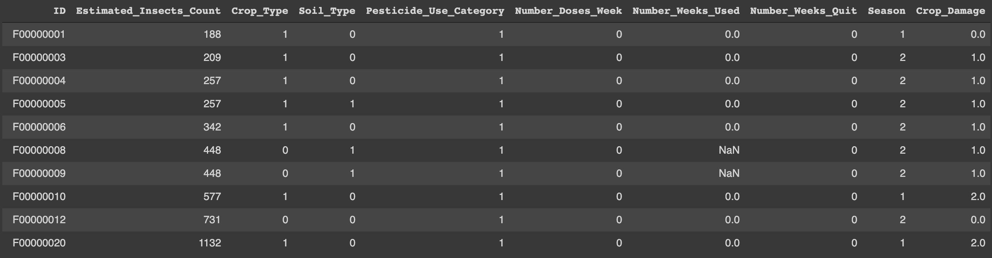
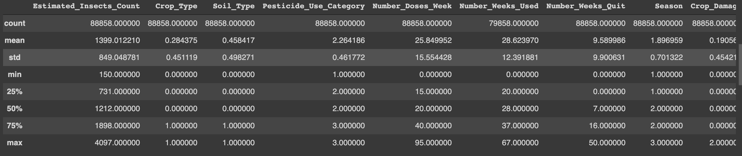
Exploratory Data Analysis
Performed EDA on the dataset to identify errors, understand patterns, detect outliers in the features, and find relationships
Some of the Operations performed are – df.info(), df.nunique(), df.isnull().sum(), df.describe(), df.shape, df.dtypes, df.values

Slide 5
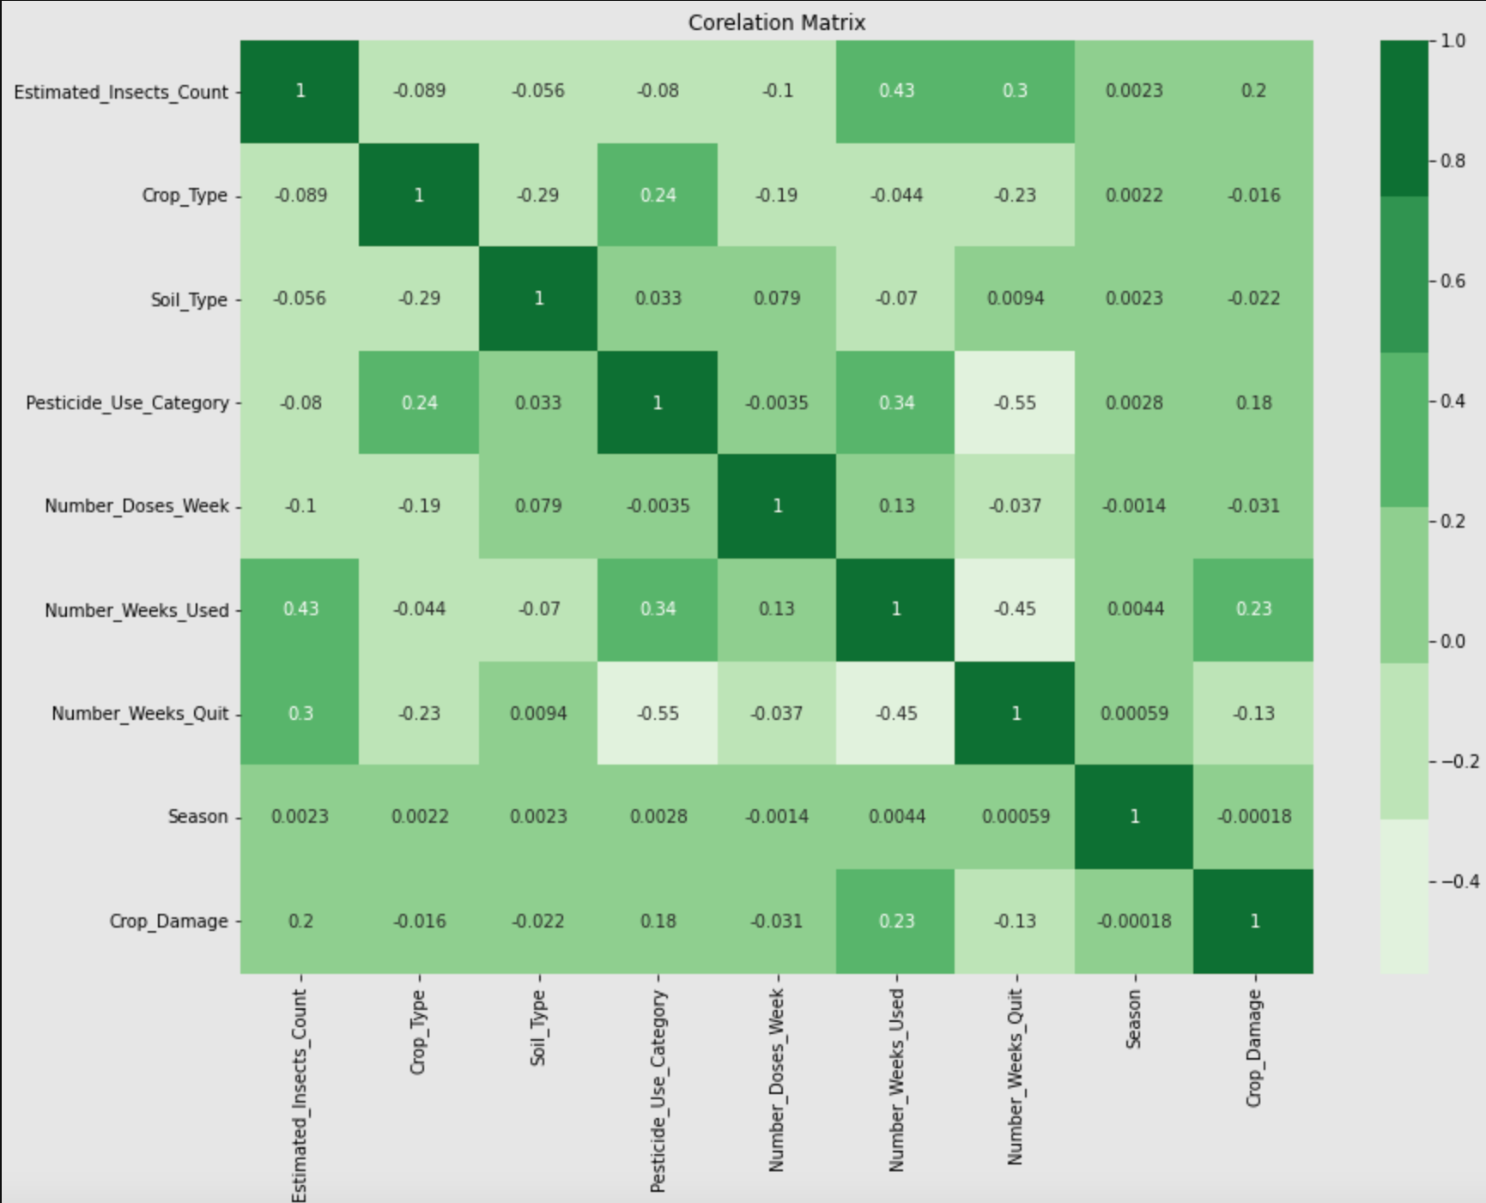
EDA (Correlation Analysis)
1.Estimated_Insects_count,Pesticide_use_category and Number_weeks_used are positively correlated with Crop damage.
2.Number_weeks_used is positively correlated with Estimated_Insects_count and Pesticide_use_category.
3.Number_weeks_Quit is highly negatively correlated with Pesticide_use_category and Number_weeks_used

Slide 6
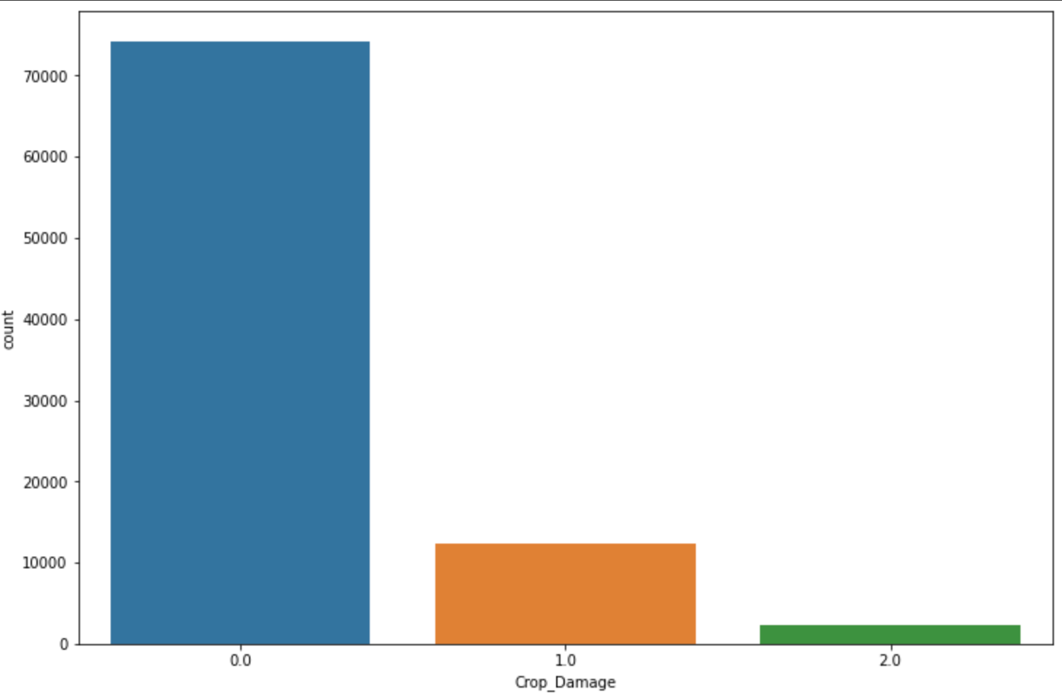
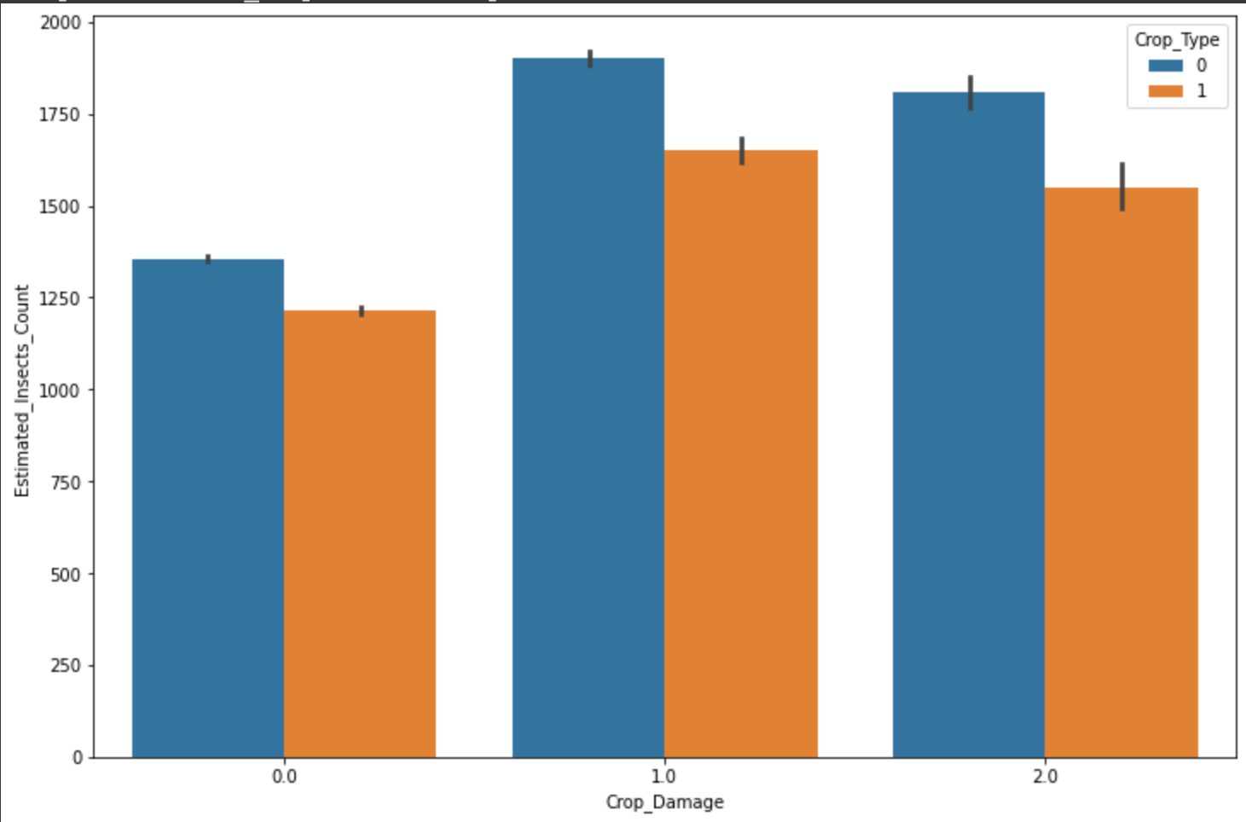
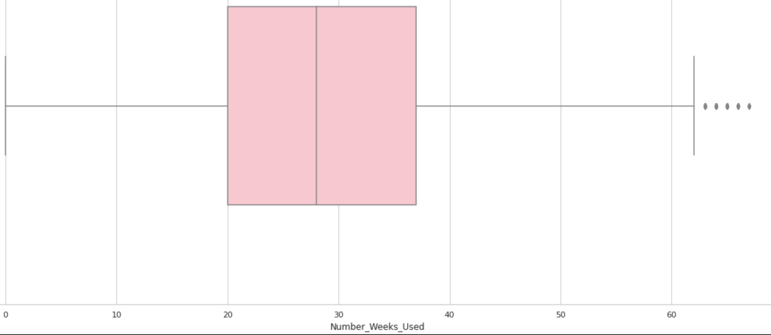
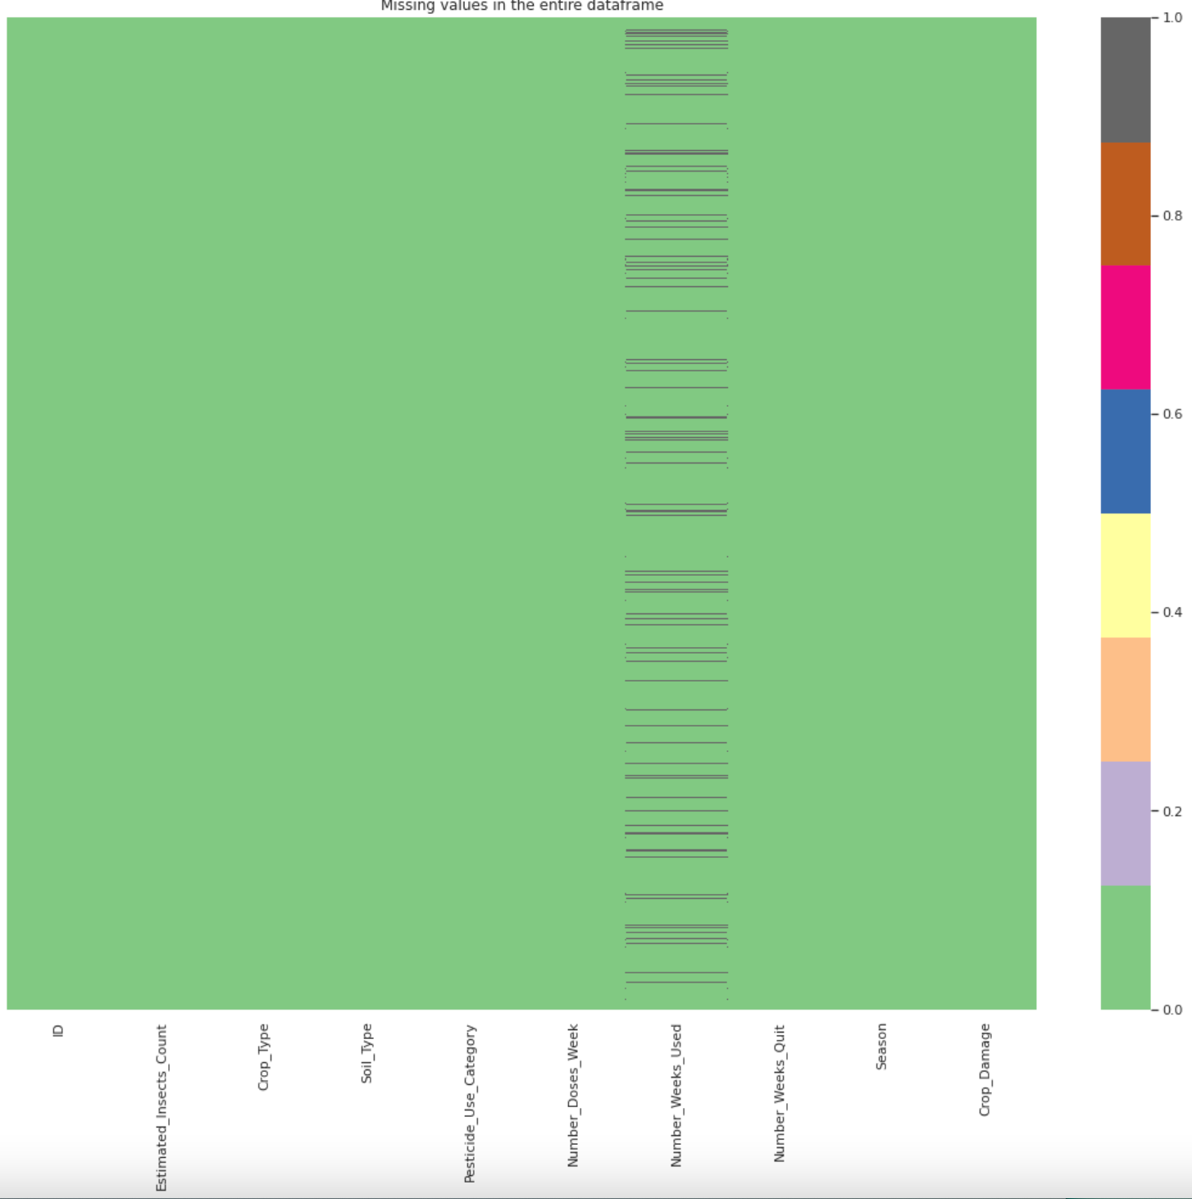
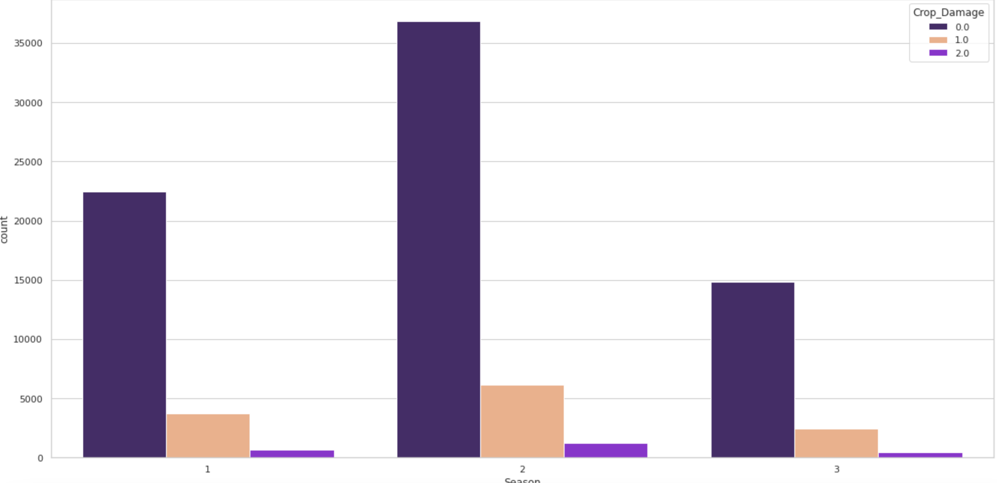
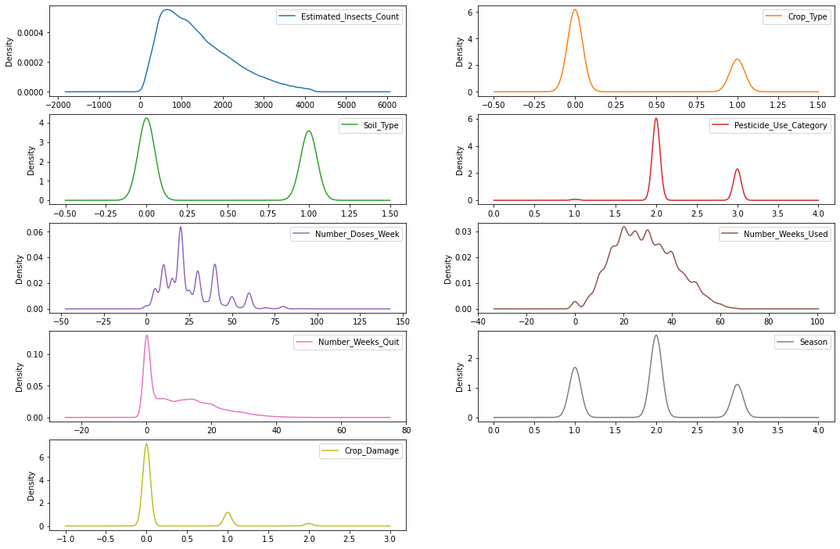
Data Visualizations

Slide 7
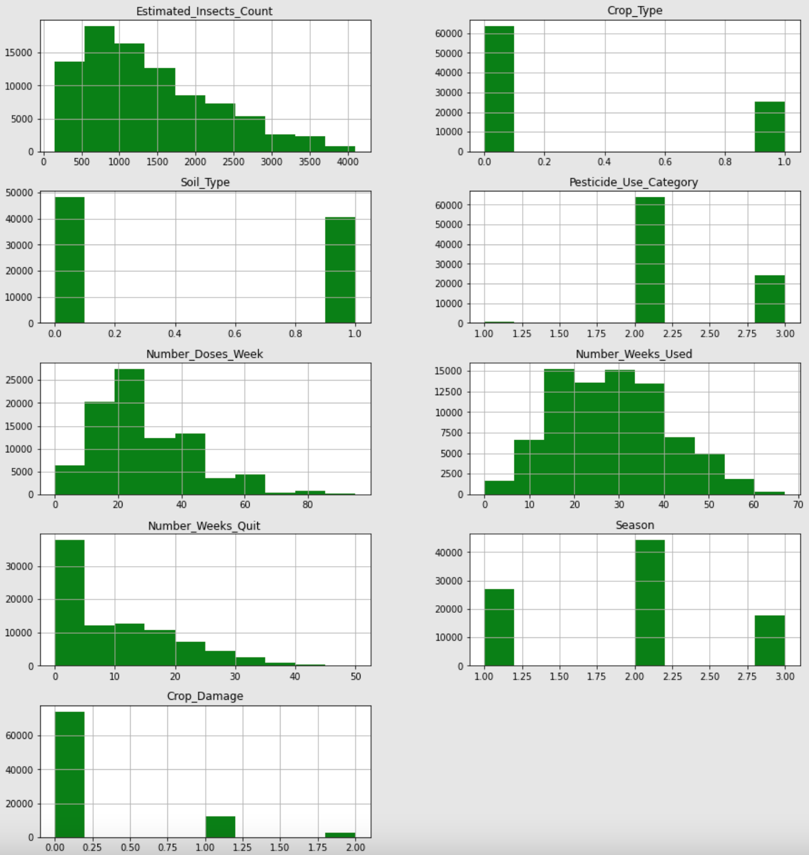
Data Visualization (contd..)
Conclusions from the Visualizations
Crop damage due to pesticides is very low. So, pesticides is recommended
Crop Type 0 will survive more than crop type 1
Soil Type is same as for 0 and 1(in the amounts)
Pesticide Category 2 is used more than 1 and 3 combined
500 - 1000 sq meter has the highest insect's count
Number_Weeks_Quit is positive skewed
Number_Weeks_Used is approximately normally distributed
Estimated Insects Count is right skewed
More Crops are alive than dead

Slide 8
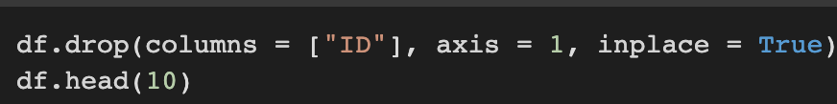
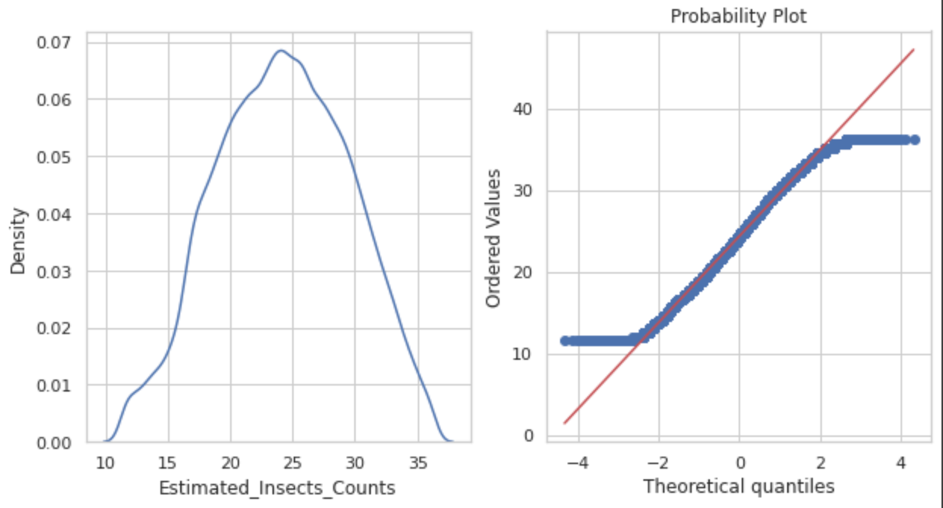
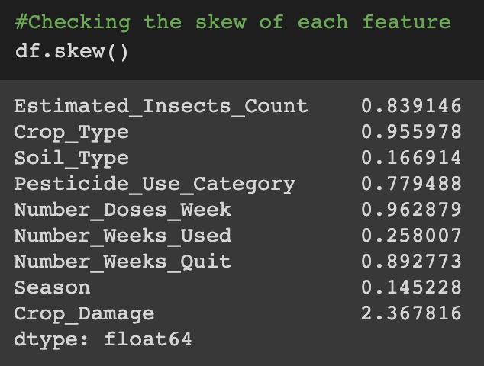

Data Cleaning and Manipulation
In this step I handle outliers and missing values, test the features for skewness and make it normally distributed, Drop columns that are not important for prediction
Number_Weeks_Used feature had 9000 missing values, replaced with mean of the feature
Dropped ‘ID’ column as it did not have impact on the model
Checked the skewness of all the features and performed Transformations such as Box-Cox, Logarithmic, Reciprocal, and Exponential
The target variable (Crop_Damage) had uneven class distribution. This is confirmed by the first visualization. So, oversampling is done
Found the mean value of each column and replacing with outlier value
As of now, Soil_Type, Number_Weeks_Used, Season are normally distributed

Slide 9
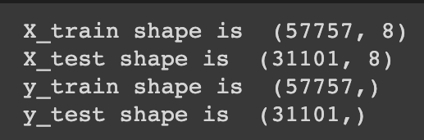
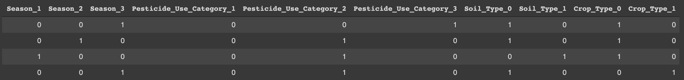
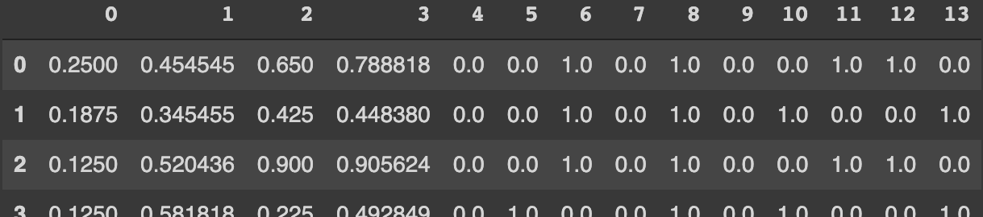
Feature Scaling
Train Size is 65% of the dataset
X is all the features except Crop_Damage(Predictors)
Y is Crop_Damage(Target)
Season, Pesticide_Use_Category, Soil_Type, Crop_Type are categorical features, so, I used get_dummies() method of pandas to create dummy variables. We could also use cat codes or One Hot Encoding.
Number_Doses_Week, Number_Weeks_Used, Number_Weeks_Quit, Estimated_Insects_Counts are in different scales so I normalized using Min Max Scaler() of sklearn. On the training data we do fit.transform() and then transform the test data

Slide 10
Machine Learning
Model | Precision | Recall | AUC | Randomized Search CV
Decision Trees | 0.4 | 0.4 | 0.5 | P = 0.5, R = 0.3, AUC = 0.75
Random Forests | 0.7 | 0.4 | 0.82 | P = 0.77, R = 0.45, AUC = 0.84
XG Boost | 0.8 | 0.8 | 0.8 | P = 0.84, R = 0.83, AUC = 0.84
Logistic | 0.4 | 0.36 | 0.78 | NA
CatBoost | 0.5 | 0.39 | 0.80 | NA
SVM | 0.6 | 0.5 | 0.77 | NA
K-Nearest Neighbors | 0.5 | 0.4 | 0.72 | NA
XG Boost and Random Forests perform better than other models on the dataset, We can perform a thorough grid search by hyperparameter tuning

Slide 11
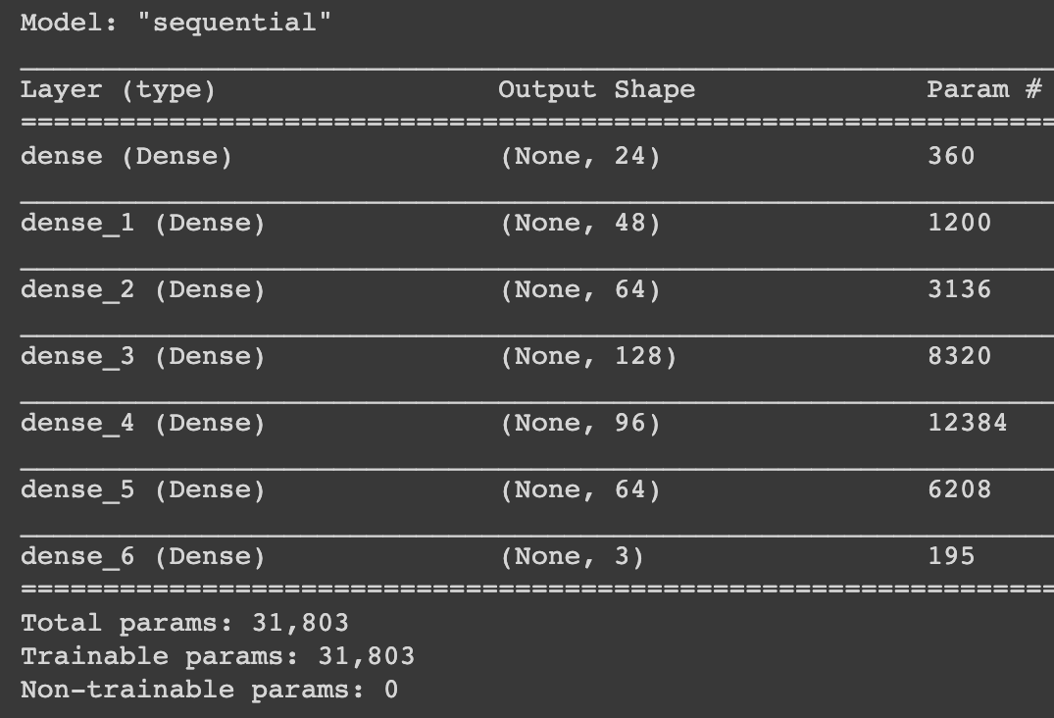
Artificial Neural Network
Keras is used to build the network.
I constructed a dense network with 5 fully connected layers, I did this using Sequential Model.
ReLu Activation function is used as activation function in all the layers
Weight Initializers such as glorot_uniform and he_uniform are used
Adam optimizer is used in the back propagation
Loss Function used is Sparse Categorical Cross Entropy
Evaluated the network on accuracy
Batch Size is 16 and Epoch's run is 7
Output Layer has 3 neurons because of 3 class labels, here, I used Softmax Activation function
Achieved Accuracy of 84%
Github – Link to the Repo

