Slide 1
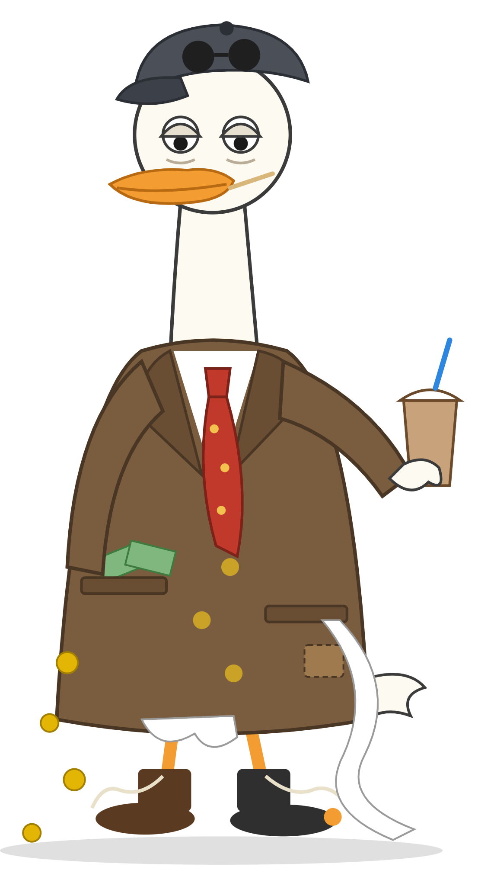
Duck Run
JPMORGAN CHASE CHALLENGE · TEAM 46
Two buttons. A whole room of players. One duck in debt to the mafia.
Notes:
Hi, we’re Team 46, and this is Duck Run. (Point at Bill.) This is Bill. Bill is a duck, Bill is broke, and Bill is about to have a very bad day.

Slide 2
Every decision in the game is left or right.
THE BRIEF
“Make something fun that uses two buttons or actions, maximum.”
OUR ANSWER
Notes:
JPMorgan asked for something fun that uses two buttons, maximum. So we built the whole game around one rule: every single decision is left or right. Dodging, swimming, even the boss fight. No third key, no menus mid-game. Two buttons, and nothing else.

Slide 3
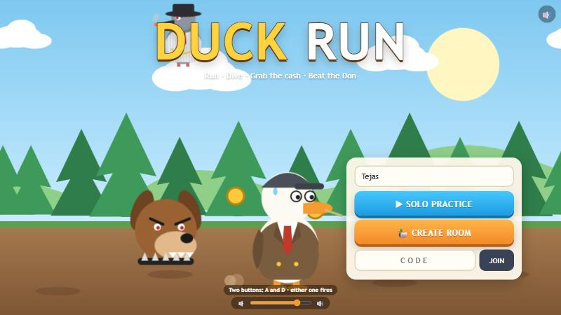
Pay the Don. Or become dinner.
THE STORY
1. Bill borrowed 1,000 breadcrumbs from Don Crumbs. Interest: 400% a week. Bill can’t read.
2. The Don sends his dog, Biscuit, to collect.
3. Bill’s only way out: the lost coins on the pond floor.
Notes:
Bill borrowed a thousand breadcrumbs from Don Crumbs, a mafia pigeon charging four hundred percent a week. Bill can’t read, so he didn’t see that part. The Don wants his bread, and sends his dog, Biscuit. Bill’s only hope is the pond, whose floor is full of lost coins. Solo players see all this as a short animated film before their first run.

Slide 4

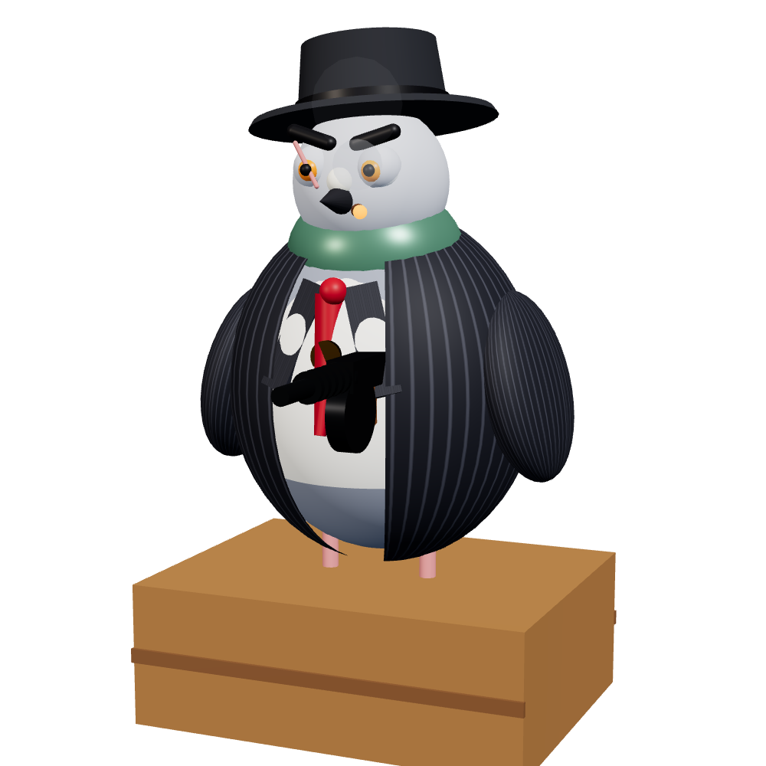
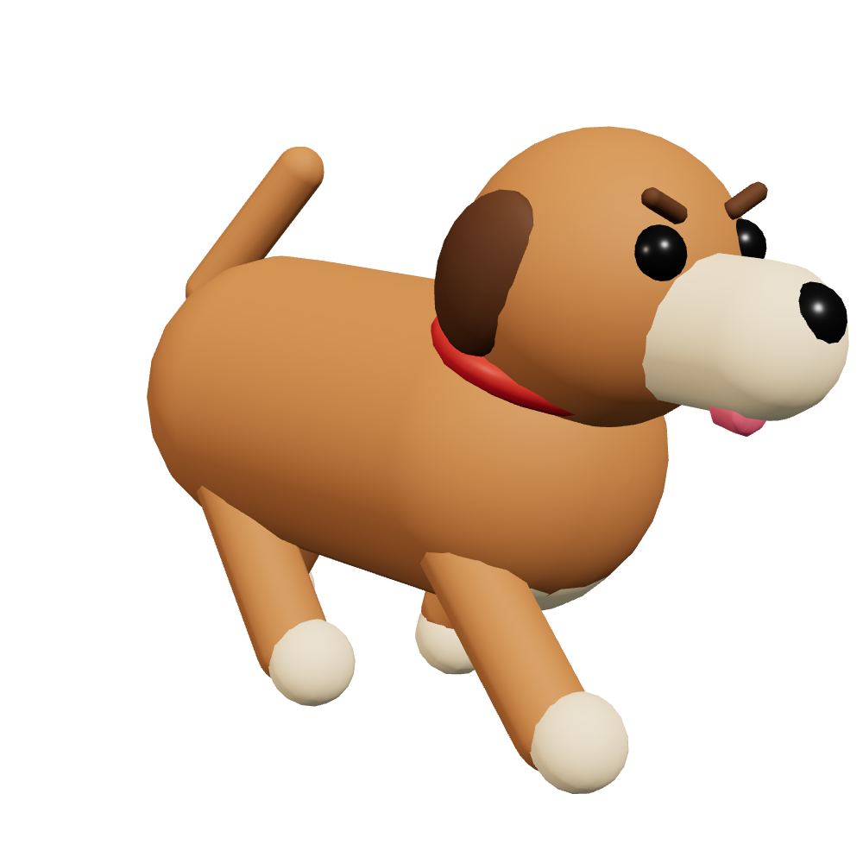
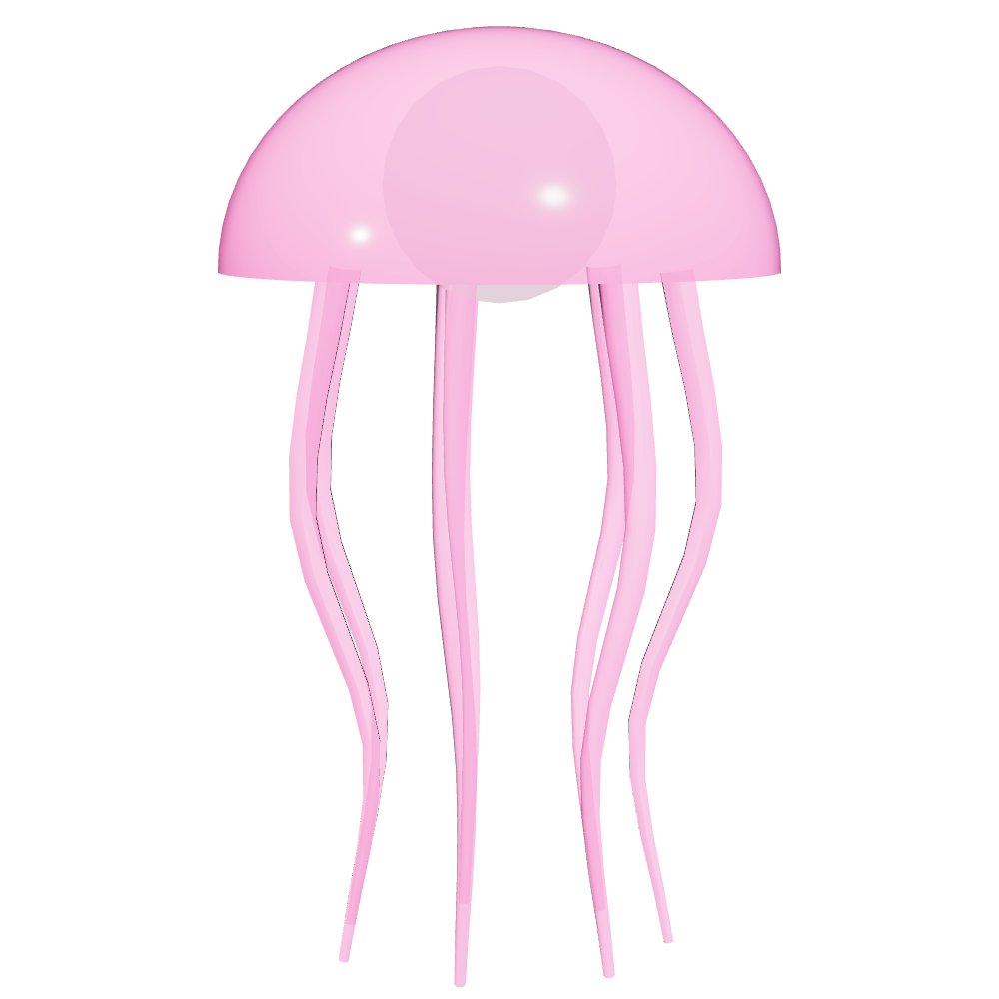
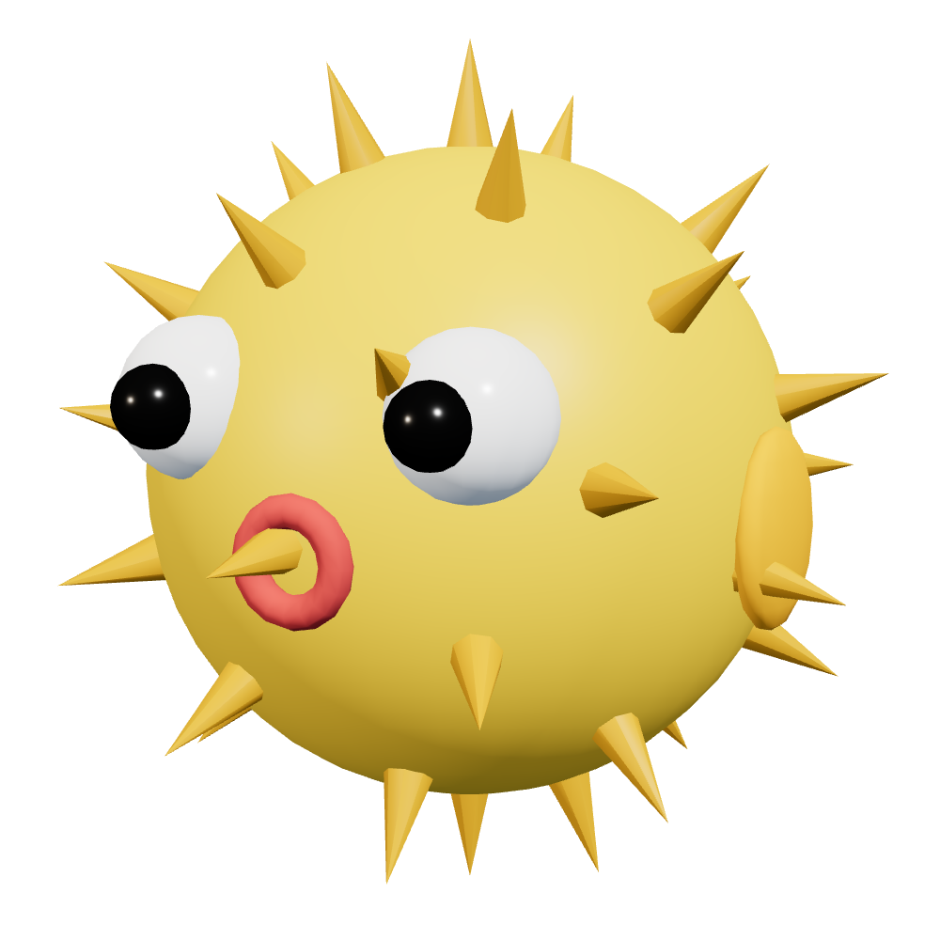
Meet the cast
OUR HERO, SORT OF
THE BOSS
THE DON’S DOG
THE POND LOCALS
Bill
Don Crumbs
Biscuit
Jelly & Puff
A duck in a suit with no job. Can’t read. Has never said no to a dollar.
Mafia pigeon. Pinstripes, fedora, tommy gun. Charges 400% a week.
Chases Bill down the forest road. Clip a log and he gains on you.
Drift through the swim. Bump one and it costs you 5 coins.
Notes:
Meet the cast. Bill: a duck in a suit, no job, can’t read, and he has never once said no to a dollar, which matters later. Don Crumbs: a mafia pigeon in pinstripes with a tommy gun, and he’s the boss you fight at the end; his face gets more battered with every hit. Biscuit: the Don’s dog, chasing Bill down the road. And the pond locals, jellyfish and pufferfish, who cost you coins if you bump them. Every character is built in code from 3D shapes; these are the actual in-game models.

Slide 5
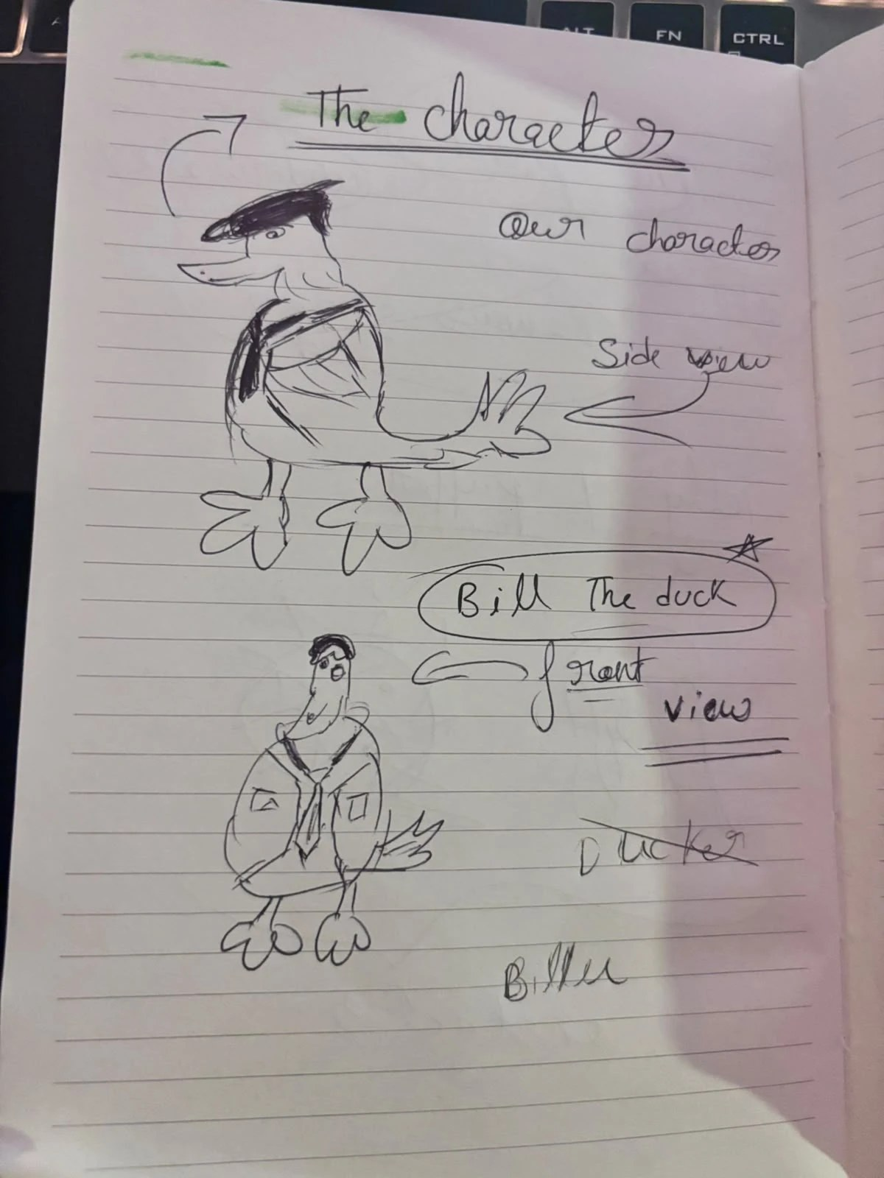
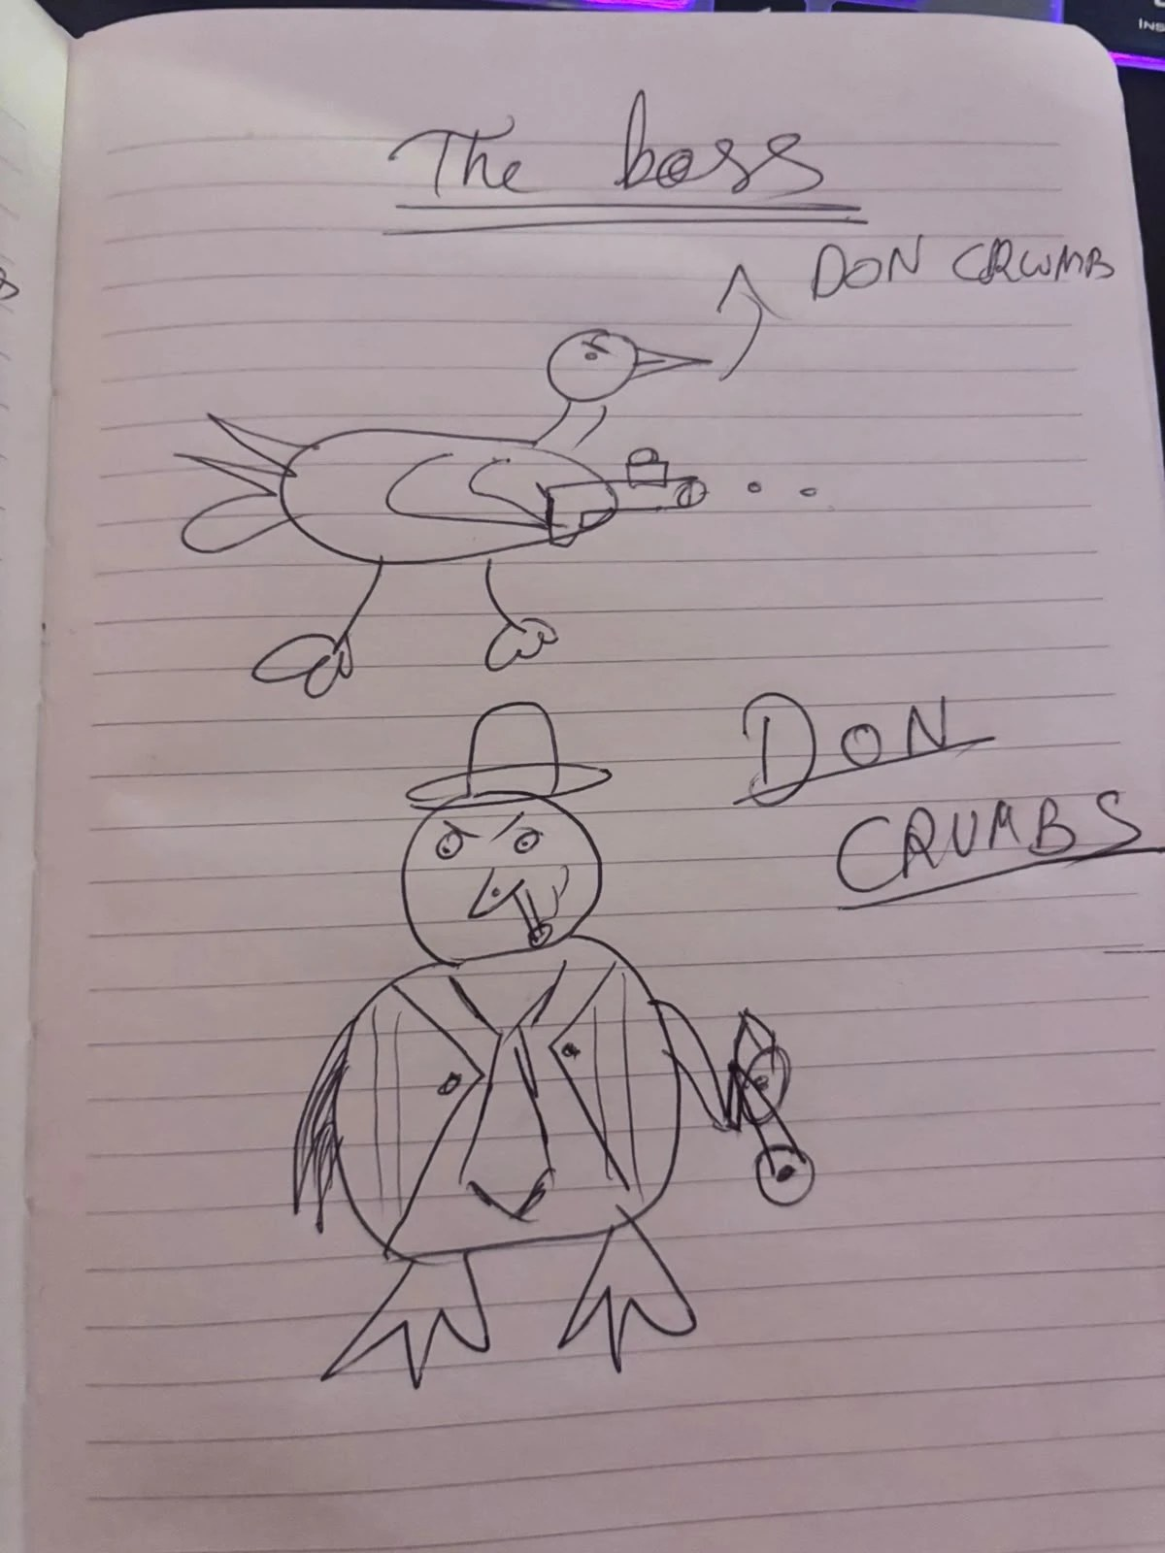
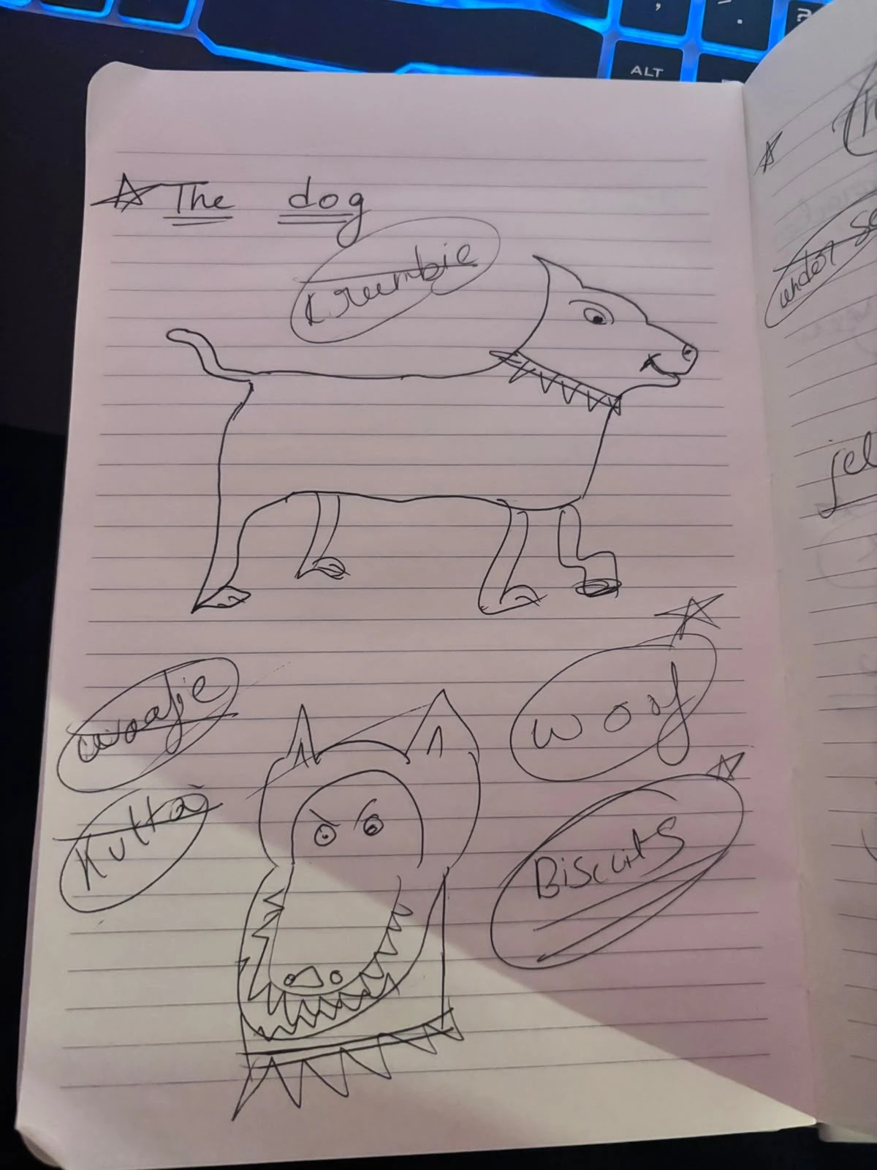
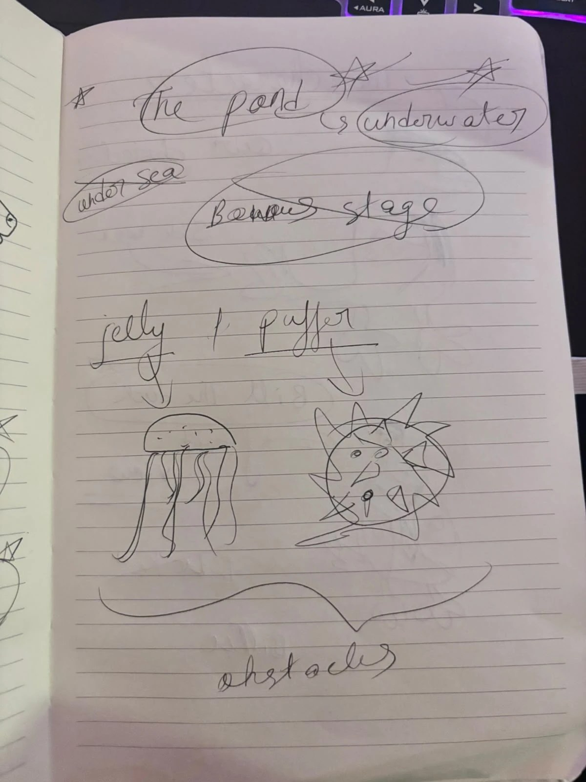
It all started in our notebook
Bill
Don Crumbs
Biscuit
The pond
Front and side views. Bill beat “Ducker”.
Hat, cigar and tommy gun, from day one.
Beat Crumbie, Woofie and Kutta to the name.
“Under sea” and “bonus stage” became the pond.
Notes:
Before we wrote a line of code, we drew everyone in this notebook. Bill, from the side and the front; he was nearly called Ducker. Don Crumbs had his hat, cigar and tommy gun from the very first sketch. The dog went through Crumbie, Woofie and Kutta before we landed on Biscuit. And the underwater stage started as “under sea” and a “bonus stage” before it became the pond, with the jellyfish and pufferfish as obstacles. Next to each sketch is what it became in the game.

Slide 6
One run, four stages
STAGE 1 · FOREST ROAD
UNDERWATER
STAGE 2 · BACK ON THE ROAD
BOSS · DON CRUMBS
~15 s
FIRE!
~20 s
~15 s
Grab coins, dodge the locals. A dollar on a hook pulls Bill back out.
Dodge three shots, then Ready… Aim… hit FIRE fast.
Dodge the logs. Hit one and Biscuit catches up.
Faster now. Breadcrumbs for points, a heart for a life.
About a minute to the boss. Three lives. Your score counts how far you got, coins and breadcrumbs, with a big bonus for beating the Don.
Notes:
One run is about a minute and a half. Stage one: dodge the logs, and if you clip one, Biscuit catches up. Then Bill dives into the pond: grab coins and dodge the jellyfish and pufferfish. Bill can’t resist a dollar, so a dollar on a fishing hook drags him back out. Back on the road, faster. And then the Don himself: dodge his shots, then Ready, Aim, FIRE, and the faster you press, the more damage you do.

Slide 7
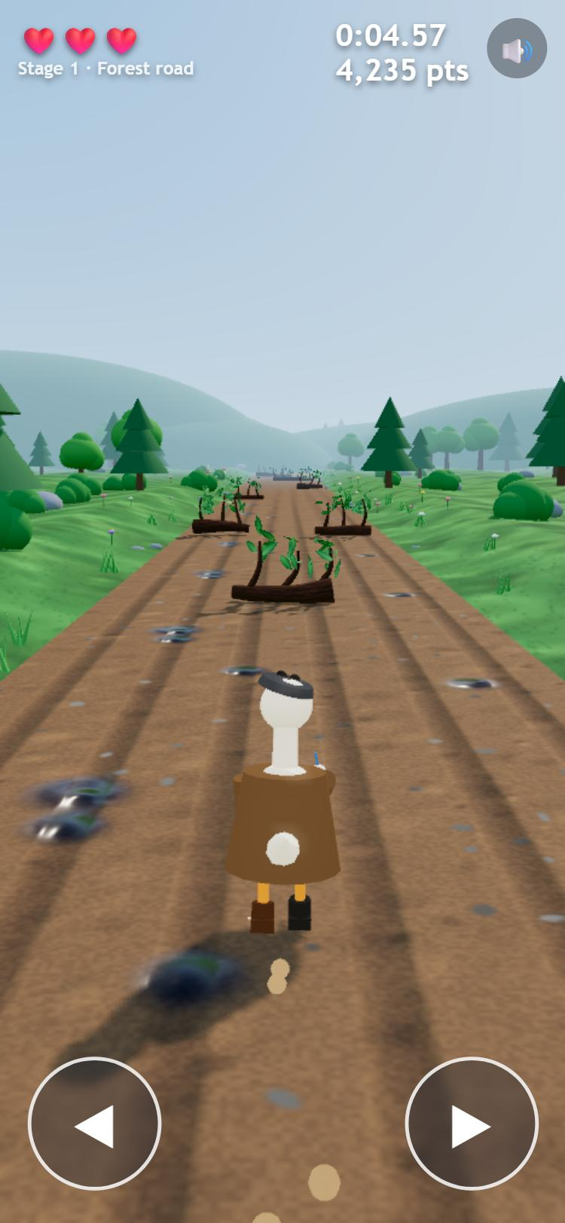
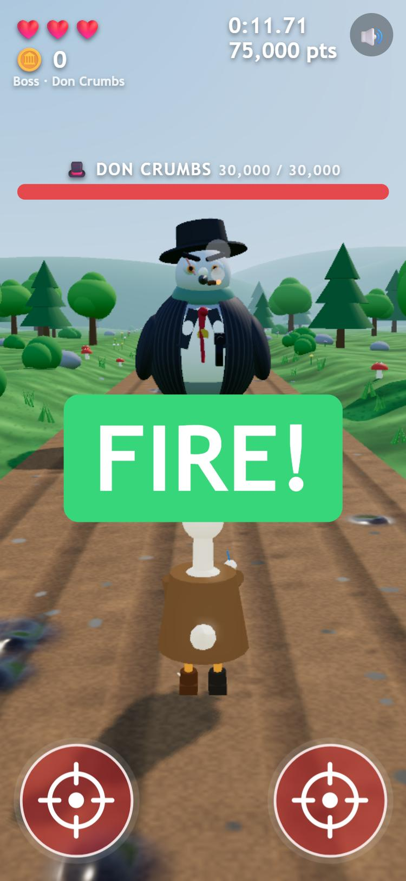
Two buttons. Really.
 | Left | Right
Laptop | A | D
Phone | left half | right half
Dodging: left and right change lane.
Boss: when FIRE flashes, either button fires.
Cards and cutscenes: either one continues.
Any two buttons work: one hand, two thumbs, or two accessibility switches.
Notes:
Here’s what two buttons means. On a laptop it’s A and D. On a phone, it’s the left half and the right half of the screen. You dodge with them, and when the Don’s FIRE prompt flashes, either button fires. That’s the whole control scheme. And because any two buttons work, you can play one-handed, with two thumbs, or with two accessibility switches.

Slide 8




The design, in four ideas
Easy to learn, hard to master
Greed pays
One rule: left or right. Then Stage 2 speeds up, and FIRE comes at a random moment: react faster, hit harder.
Coins buy the best power-up you can afford, no menu needed: a shield at 20, a boost at 50, a laser at 100.
Fair for everyone
Losing is funny too
The whole room races the identical course, and every course always has a way through.
Every way Bill goes down gets its own short ending film, and the Don roasts whoever comes last.
Notes:
Four ideas shaped the game. One: easy to learn, hard to master. The only rule is left or right, but Stage 2 is faster, and the Don’s FIRE comes after a random wait, so you can’t time it by rhythm; the faster you react, the more damage you do. Two: greed pays. The coins you grab underwater automatically buy the best power-up you can afford, so a great swim sets up the boss fight. Three: fair for everyone. Courses are built from a seed, so the whole room races the same one, and we tested a thousand seeds to prove every course can be finished. Four: losing is funny too, so even a bad run ends with a laugh.

Slide 9
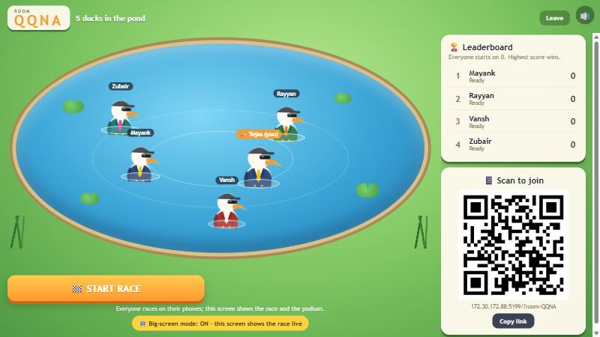
Everyone plays, on their own phone
1 · Scan the QR
No app, no account. Type a name and you’re in.
2 · Float in the pond
Every player is a Bill in their own suit.
3 · Race
Same start, same course for everyone.
4 · Podium, then again
Back to the pond for the next race.
Notes:
And it’s built to play together, in the room. The host opens a room on the big screen. Everyone scans the QR code: no app, no account, just a name. You land in the pond as a Bill in your own suit. The host hits start: the first race opens with the story, then everyone starts together on the same course, on their own phone. Up to 20 players a room.

Slide 10
Phones out.
LIVE DEMO
Scan the QR on the big screen.
Beat the Don. Take the podium.
Notes:
DEMO. Switch to the game on the projector (big-screen mode on, room already created). Say: “Get your phones out, scan the code, type a name.” Wait until 3 or more ducks are in the pond. Press Start race. While they play, narrate the big screen: the track, the commentary, who’s leading. When the podium comes up, read out the winner and the Don’s roast. If the internet fails: play the backup video.

Slide 11
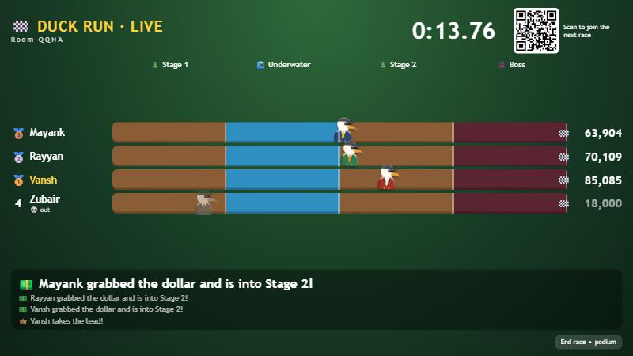
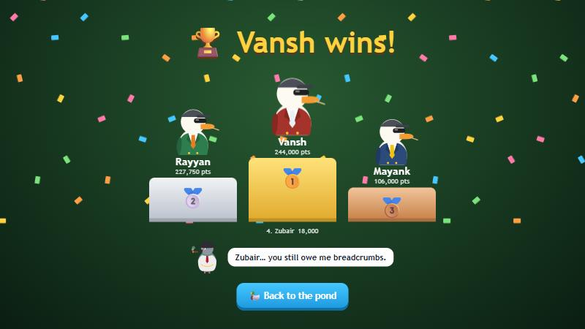
Meanwhile, on the big screen
A live track and commentary
A podium, and a roast
Every duck on one track, a live clock, and calls like “Mayank grabbed the dollar and is into Stage 2!”
Confetti for the top three. The Don reminds whoever came last that they still owe him.
Notes:
While everyone plays, the projector isn’t playing: it’s the stadium. Every duck moves along one track live, with commentary as things happen. When the race ends, a podium rises, and the Don roasts whoever came last. Then it’s straight back to the pond for a rematch.

Slide 12



How it’s built
Made in code
Fair courses
TypeScript and Three.js. Every character, texture and sound is made in code: no downloaded assets.
A room’s seed builds the same course for everyone, and every course always has a way through. Tested on 1,000 seeds.
Real multiplayer
Tested
Supabase: anonymous sign-in, row-level security, live updates, and a server clock so everyone starts together.
155 unit tests across rules, input, courses, rooms and the big screen, plus 60 database security checks.
Notes:
Quickly, how it’s built. Everything you saw is made in code with Three.js, including every sound: no downloaded models or audio files. Courses are seeded, so everyone in a room gets the same course, and every course is guaranteed to have a way through. The rooms run on Supabase with row-level security and a server clock, so everyone starts on the same beat. And it’s tested: 155 unit tests and 60 database security checks.

Slide 13
Team 46, aka Team Monster
Who | Built
Tejas Kaushik | Integration, 3D rendering, the lobby and multiplayer races, big-screen mode, phone controls
Mayank Mishra | Supabase backend: database, security rules, rooms, live scoreboard
Mohammad Rayyan Adhoni | Seeded course generator and room integration
Zubair Mohammed | Boss rules and reaction timing, stage cards
Vansh Ravibhai Thacker | Sound and music, the story and ending films, tests
Play: [live game link] · Code: github.com/zubmoh57/DYHTG-2026
Notes:
We’re Team 46: five of us, each owning a piece. (Optional: each person says their own line.) Then: thanks for listening, and on to the last slide.

Slide 14
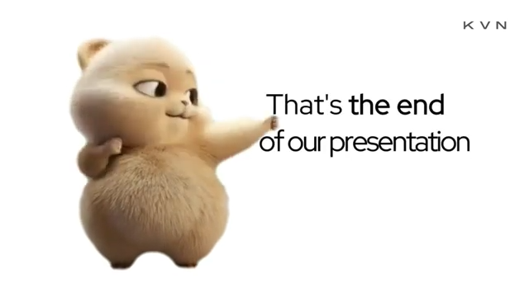
THANK YOU
DUCK RUN · TEAM 46
Notes:
Same closing slide as StrathHack26: let the meme play with sound, then take questions.

