Slide 1

NETSENTRY: Network Traffic Intelligence and Intrusion Detection
Mini-project presentation
Computer Networks Laboratory (CSE20110)
Department of Computer Engineering and Technology
Ruturaj Parit - 1272250843 Tejas Jadhav - 1272250848
Rajas Patil - 1272250847
Group 5 Panel E Batch E2
Faculty: Dr. Swati
Academic Year: 2026–2027
Presentation date: 22-10-2026
Computer Networks Laboratory CSE20110
15 seconds
Notes:
Slide 1 — NETSENTRY
15 seconds
“Greetings, respected faculty and everyone. Our mini-project is NETSENTRY, which stands for Network Traffic Intelligence and Intrusion Response. It demonstrates how network events can be processed, suspicious patterns detected, and incidents reviewed through a dashboard.
Slide 4 — Implementation and Working
55 seconds
“The implementation follows an event-to-incident pipeline.
First, the user selects a simulation scenario and the number of events. The frontend sends this information as a JSON payload to the FastAPI endpoint. The backend validates the request and passes it to the simulation engine.
The engine generates timestamped synthetic events and applies scenario-specific rules. For example, a port-scan rule checks destination-port diversity, while an outbound-traffic rule checks the total number of bytes.
When a rule matches, the system creates a detection with associated evidence and severity. The dashboard then retrieves the updated events, incidents, and metrics.
We also implemented a response dry-run feature. It records the simulated response for auditing without modifying the actual host firewall.”
Slide 5 — Testing and Results
50 seconds
“We designed our tests to verify the event-generation and detection workflow.
First, we run the port-scan scenario and inspect the diversity of destination ports. Next, we test SYN bursts and DNS spikes to check how event counts interact with the configured thresholds.
We also test repeated authentication failures to examine the severity and supporting evidence of the resulting detection.
Finally, we test the response dry-run and verify that an audit record is created without changing the host firewall.
These tests evaluate the intended application behaviour. Since the project uses synthetic events, we are not claiming real-world intrusion-detection accuracy or measured performance benchmarks.”
During the presentation: Show the actual dashboard results for at least one scenario. Explain the observed output rather than simply reading the test cases.
Slide 6 — Working Demonstration
65 seconds
“Now I will demonstrate the complete workflow.

Slide 2
Problem and Objectives
Problem
Problem: Raw network telemetry contains many events, making suspicious patterns difficult to identify manually. NETSENTRY models a lightweight SOC workflow: generate event records, evaluate explicit rules, correlate detections into incidents, and present evidence for review. It is a controlled simulation—not a live IDS.
Objectives
1. Model six scenarios: port scan, SYN burst, DNS spike, repeated authentication failures, outbound-volume anomaly and traffic spike.
2. Apply rule-based thresholds and attach evidence (counts, ports or byte totals) to each detection.
3. Expose events, incidents, metrics and audit history through a dashboard and REST API.
Computer Networks Laboratory CSE20110
40 seconds
Notes:
Slide 2 — Problem and Objectives
40 seconds
“In a real network, a large number of events are generated continuously. Manually identifying suspicious activity from these events can be difficult. NETSENTRY demonstrates a simplified Security Operations Center workflow.
Our system simulates six scenarios: port scanning, SYN bursts, DNS spikes, repeated authentication failures, unusual outbound data volume, and traffic spikes.
The main objectives are to generate network-event records, apply rule-based detection, attach evidence to alerts, and display incidents through a dashboard and REST API. An important point is that our current project uses synthetic data rather than monitoring live network traffic.”

Slide 3
Proposed Design and Tools
Analyst / Browser React + Vite localhost:5173
FastAPI REST API
localhost:8000
JSON over HTTP
Simulation Engine Synthetic TCP / DNS
flow events
rules +
threshholds
Rule Detection Incidents + Audit In-Memory state
HTTP /JASON
API call
Architecture: React + Vite dashboard → HTTP/JSON REST requests → FastAPI endpoints → SimulationEngine → in-memory events, detections, incidents and audit records. The UI refreshes data through API calls; CORS permits the local Vite origins.
Tools: React, Vite, Python, FastAPI, Uvicorn.
Networking: HTTP request/response, JSON payloads, client–server separation, TCP/UDP/DNS represented in synthetic telemetry.
Endpoints: GET /api/health, /api/events, /api/incidents, /api/metrics; POST /api/simulations/run and /api/response/dry-run. Frontend :5173; API :8000.
Computer Networks Laboratory CSE20110
45 seconds
Notes:
Slide 3 — Proposed Design and Tools
45 seconds
“Our architecture follows the client–server model. The frontend is built using React and Vite, while the backend uses Python and FastAPI.
The frontend communicates with the backend through HTTP requests and JSON data. The backend exposes REST endpoints for retrieving events, incidents, metrics, and running simulations.
The frontend runs on port 5173, and the backend API runs on port 8000. FastAPI processes the requests and invokes the simulation engine, which generates events and evaluates detection rules.
This architecture separates the user interface from the processing logic, making the application easier to maintain and extend.”

Slide 4
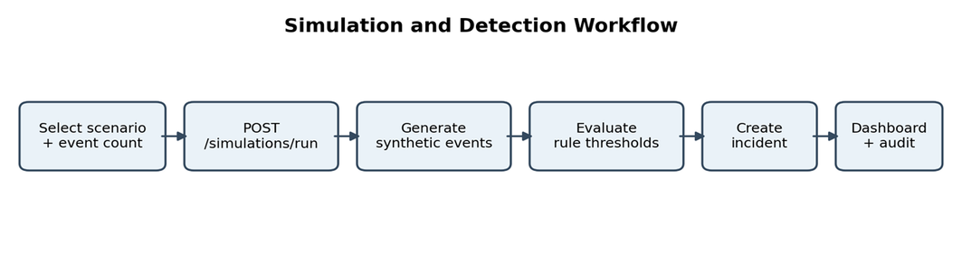
Implementation and Working
Pipeline: (1) React sends scenario_id and event_count as JSON to POST /api/simulations/run.
(2) FastAPI validates the request (5–500 events) and calls SimulationEngine.
(3) The engine creates timestamped synthetic records and applies scenario-specific rules.
(4) Matches become detections/incidents with severity and evidence; metrics and audit entries are updated in memory.
(5) The dashboard fetches refreshed events, incidents and metrics.
Rule examples: port-scan detection checks destination-port diversity; SYN and DNS rules use event-count thresholds; egress detection checks total bytes. Response is a dry-run only.
Troubleshooting: If the UI reports “Failed to fetch”, verify the API health endpoint, start Uvicorn from the backend directory, and confirm the frontend origin is allowed by CORS.
Computer Networks Laboratory CSE20110
55 seconds
Notes:
First, the user selects a simulation scenario and the number of events. The frontend sends this information as a JSON payload to the FastAPI endpoint. The backend validates the request and passes it to the simulation engine.
The engine generates timestamped synthetic events and applies scenario-specific rules. For example, a port-scan rule checks destination-port diversity, while an outbound-traffic rule checks the total number of bytes.
We also implemented a response dry-run feature. It records the simulated response for auditing without modifying the actual host firewall.”

Slide 5
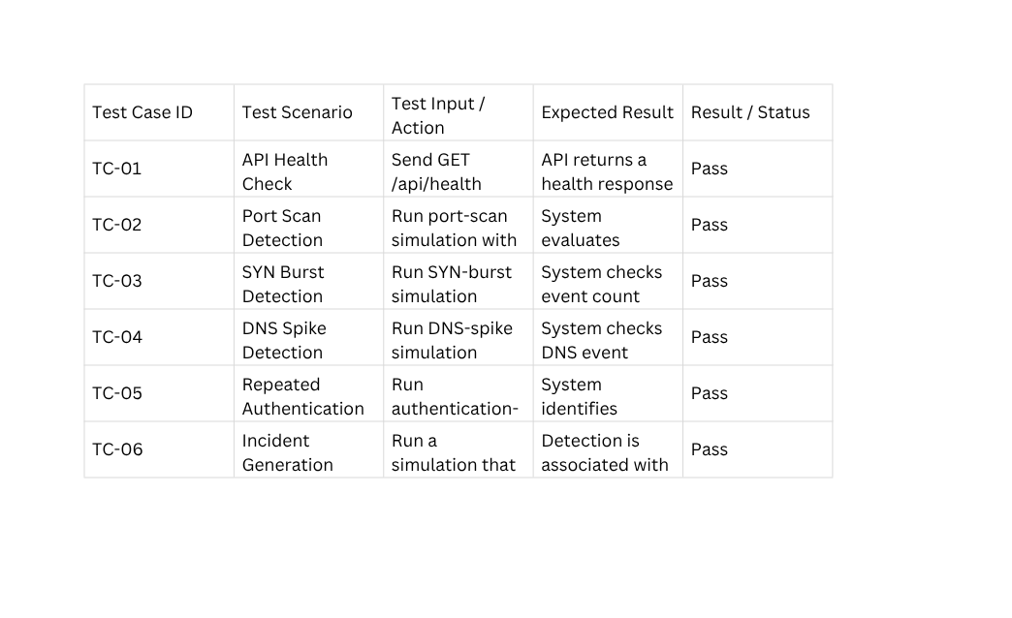
Testing
Computer Networks Laboratory CSE20110
50 seconds
Notes:
First, we run the port-scan scenario and inspect the diversity of destination ports. Next, we test SYN bursts and DNS spikes to check how event counts interact with the configured thresholds.
We also test repeated authentication failures to examine the severity and supporting evidence of the resulting detection.
Finally, we test the response dry-run and verify that an audit record is created without changing the host firewall.
These tests evaluate the intended application behaviour. Since the project uses synthetic events, we are not claiming real-world intrusion-detection accuracy or measured performance benchmarks.”
During the presentation: Show the actual dashboard results for at least one scenario. Explain the observed output rather than simply reading the test cases.

Slide 6
Working Demonstration
Function to demonstrate
Demonstrate the complete event-to-incident pipeline, including rule evidence and safe response simulation.
1. Start FastAPI in backend (127.0.0.1:8000), then run the Vite frontend (localhost:5173).
2. Open Simulation Lab; choose “Port-scan pattern” and set 40 events.
3. Run the scenario and inspect generated events, alert severity, evidence and incident timeline.
4. Open Incident Response and run the dry-run action; verify the audit record and unchanged host settings.
Success criterion: the simulation returns generated-event data; when the port-diversity rule is met, the dashboard shows a detection with rule evidence. Dry-run response is logged without changing the real firewall.
Computer Networks Laboratory CSE20110
65 seconds

Slide 7
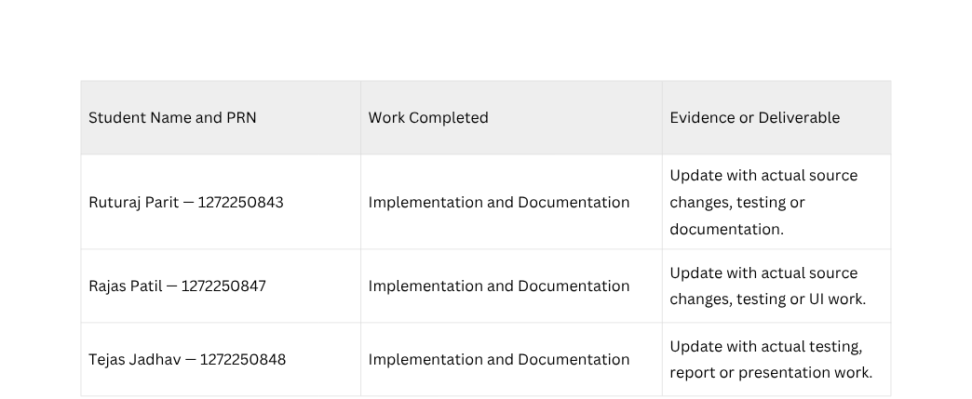
Conclusion and Contributions
Outcome: NETSENTRY demonstrates a modular client–server security-monitoring pipeline, from synthetic event generation to explainable rule-based alerts.
Application: teaching REST APIs, event processing, threshold detection and incident-response workflows.
Limitations: synthetic data only; in-memory state resets on restart; simple rules may cause false positives; no live packet capture, authentication or persistent database.
Future scope: add authorized packet capture, configurable rule windows, persistent storage, user authentication and evaluation on labelled traffic.
Computer Networks Laboratory CSE20110
30 seconds

Slide 8
References
[1] FastAPI, “FastAPI Documentation.” https://fastapi.tiangolo.com/
[2] React, “React Documentation.” https://react.dev/
[3] Vite, “Vite Guide.” https://vite.dev/guide/
[4] Python Software Foundation, “Python Documentation.” https://docs.python.org/3/
[5] NETSENTRY project source: backend/app/main.py, backend/app/engine.py and frontend/src/App.jsx (accessed 22 Oct. 2026).
Computer Networks Laboratory CSE20110
Backup slide

