Slide 1
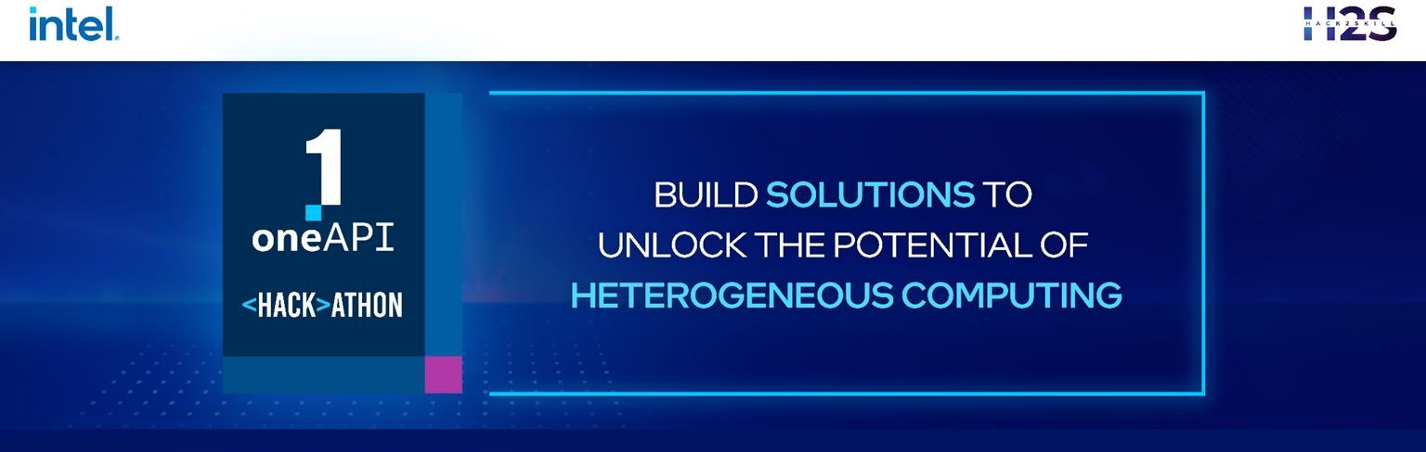
Team Name : Cuboid
Problem Statement : Medical Image Processing

Slide 2
Team Members:
Tejas Dashpute : tejasdashpute982@gmail.com,
Suyash Dubey : dsuyash38@gmail.com ,
Amey Patil : patilamey2905@gmail.com,
Arnav Singh : arnav.arn7@gmail.com

Slide 3
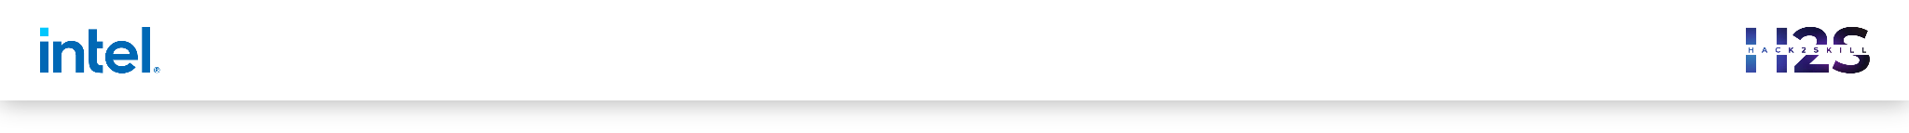

Problem Statement
Lyme Disease detection using mobile imaging technique through Artificial Intelligence Software.
Application will also provide the stage of the disease victim is currently in since Lyme has 3 major stages of growth and thus can help with the urgency and correct contact of medicines. Furthermore, it will be an offline detection mechanism and since the most major location for Lyme diseases are forests which are mostly non-networking areas, it will be a boon for hikers and mountaineers.

Slide 4
Architecture – Impact of oneAPI/SYCL (How oneAPI /SYCL helped you?)
Optimization for TensorFlow , used in Neural Compressor,used to Optimize with PyTorch.
We will use the Analytics Tools provided by intel as to get the best benefits for predicting and using them for making our neural network more efficient to use less GPU/CPU computing power.

Slide 5
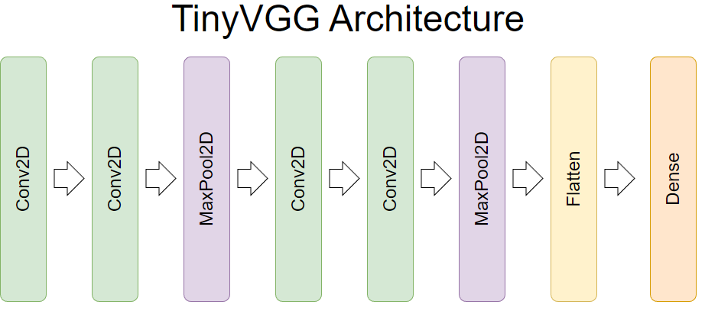

Slide 6
Core components of oneAPI/SYCL used in the project
Intel Optimization for TensorFlow
Intel Neural Compressor
Intel Optimization for PyTorch

Slide 7
GitHub Link (Codes should be public and available after hackathon also)
Github Respository:
https://github.com/Tejas1020/intel-oneAPI

Slide 8
Results Summary (focus on unique aspects of oneAPI/SYCL that you have used)
Lyme Disease detection using mobile imaging technique through Artificial Intelligence Software.
• The image database will maintain a stock of lyme symptoms photos. It will also contain photos of other skin disorders to classify the final output more efficiently.
• If the result is positive, the software will then provide further explanation about its time of exposure and what should be the immediate first aid.
• If the result is negative, then the software will compare the symptom with other rashes like ringworm, drug borne or Pityriasis rosea.
Use of oneAPI/SYCL:
Optimization for TensorFlow , used in Neural Compressor,used to Optimize with PyTorch
We will use the Analytics Tools provided by intel as to get the best benefits for predicting and using them for making our neural network more efficient to use less GPU/CPU computing power.

Slide 9
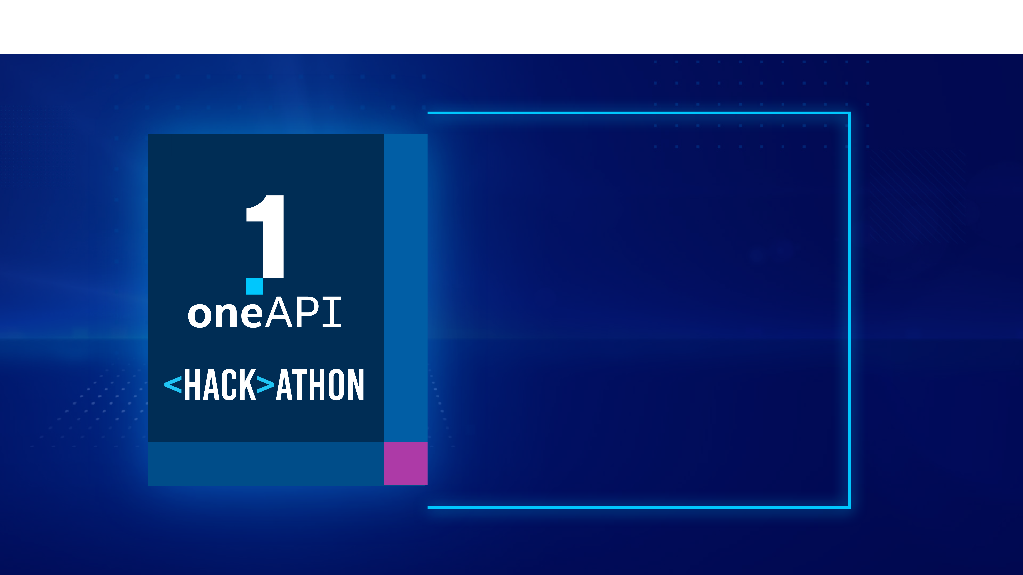
THANK YOU

