Slide 1
Language Translator Project
Title: Hexadecimal Calculator
SUBMITTED BY:
IT-015 DABGAR TEJAS
IT-016 DABHI YASH

Slide 2
Language Description/Features of the language
Description:
We have many machines which works on the hex. And for that such mathematical operations on Hex values requires. So ,we here tried to solve and want simplify this scenario. Our language works on such inputs and operates and gives us the calculation.
Supported operations:
Arithmetic operations.
Subtraction operations.
Multiplication operations.
Division operations.
Note: All operations input is in Hex-Values.

Slide 3
Compilation & execution steps
Step 1: lex cal.l
Step 2: yacc cal.y
Step 3: cc y.tab.c -ly -ll -lm
Step 4: ./a.out

Slide 4
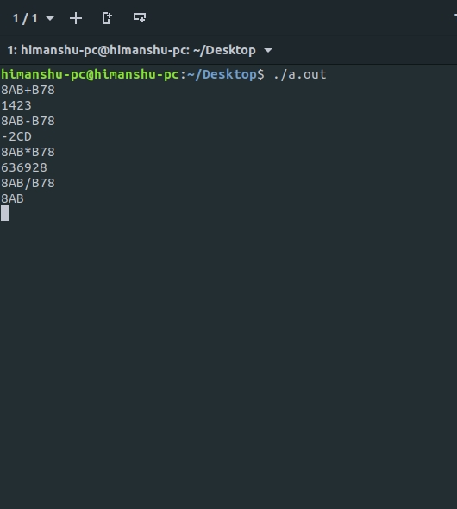
Inputs & Outputs

