Slide 1
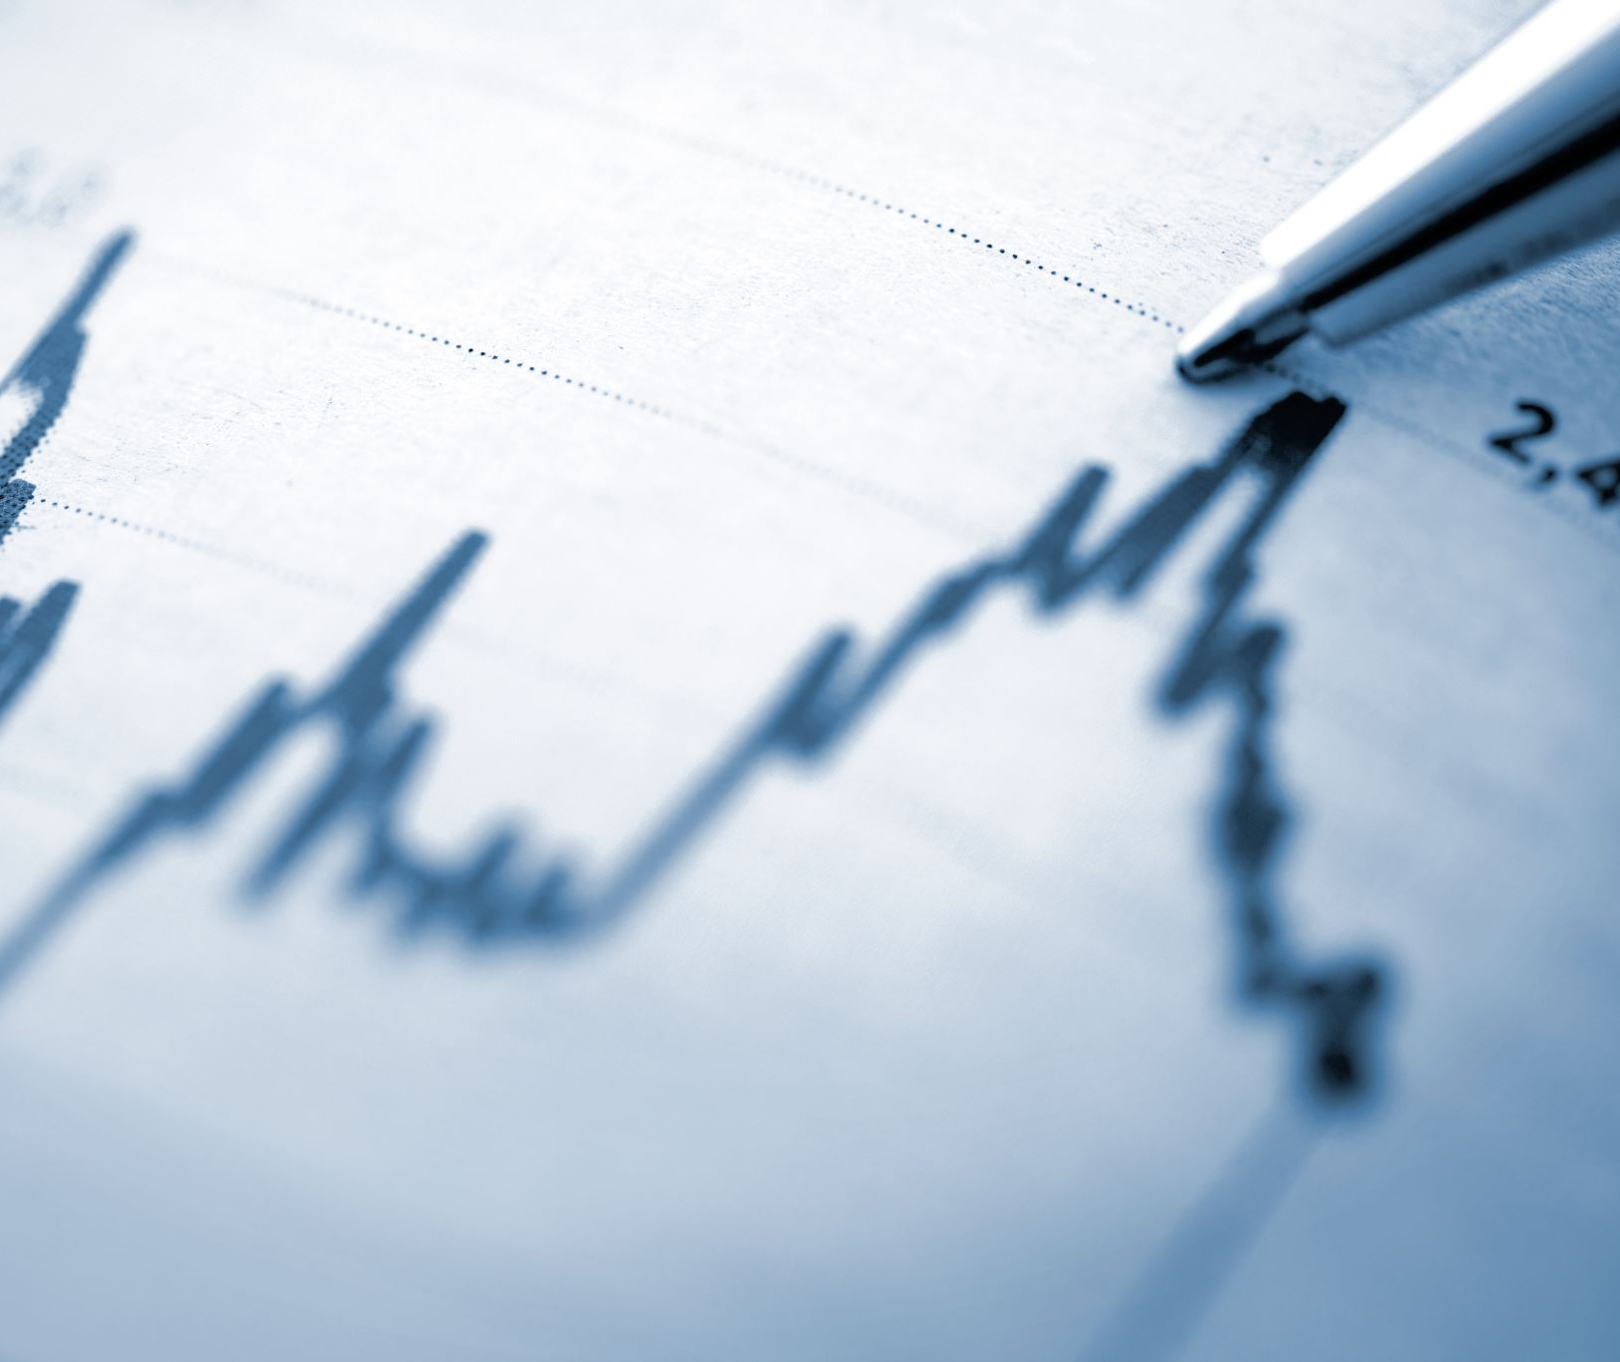
Small Cap Biotech Stock Price Movement Analysis
Tejas Krishna Reddy
Phanindrakumar Chintapalli

Slide 2
Why Is it hard to predict stock prices?
Too many factors to weigh in:
  Discounted Cash Flow
  Companies popularity
  It’s market capital
  Governmental Regulations
  Logistics and Supply chain issues
  News
  Public’s perception on the news
  Different contradictory news in the same company
  Legal Issues
  Trend in the market.
2. Every company is fundamentally different.
  A mobile-phone company is completely different to a large-scale food manufacturing company.
  Sensitivity of the news and corresponding volatility in the stocks are completely varied from one company to the other.
  Hence, developing one model that can predict any stock’s movement is very hard to achieve.
  Many investors end up developing individual models for each of their interested companies with is difficult to maintain and weigh in.

Slide 3
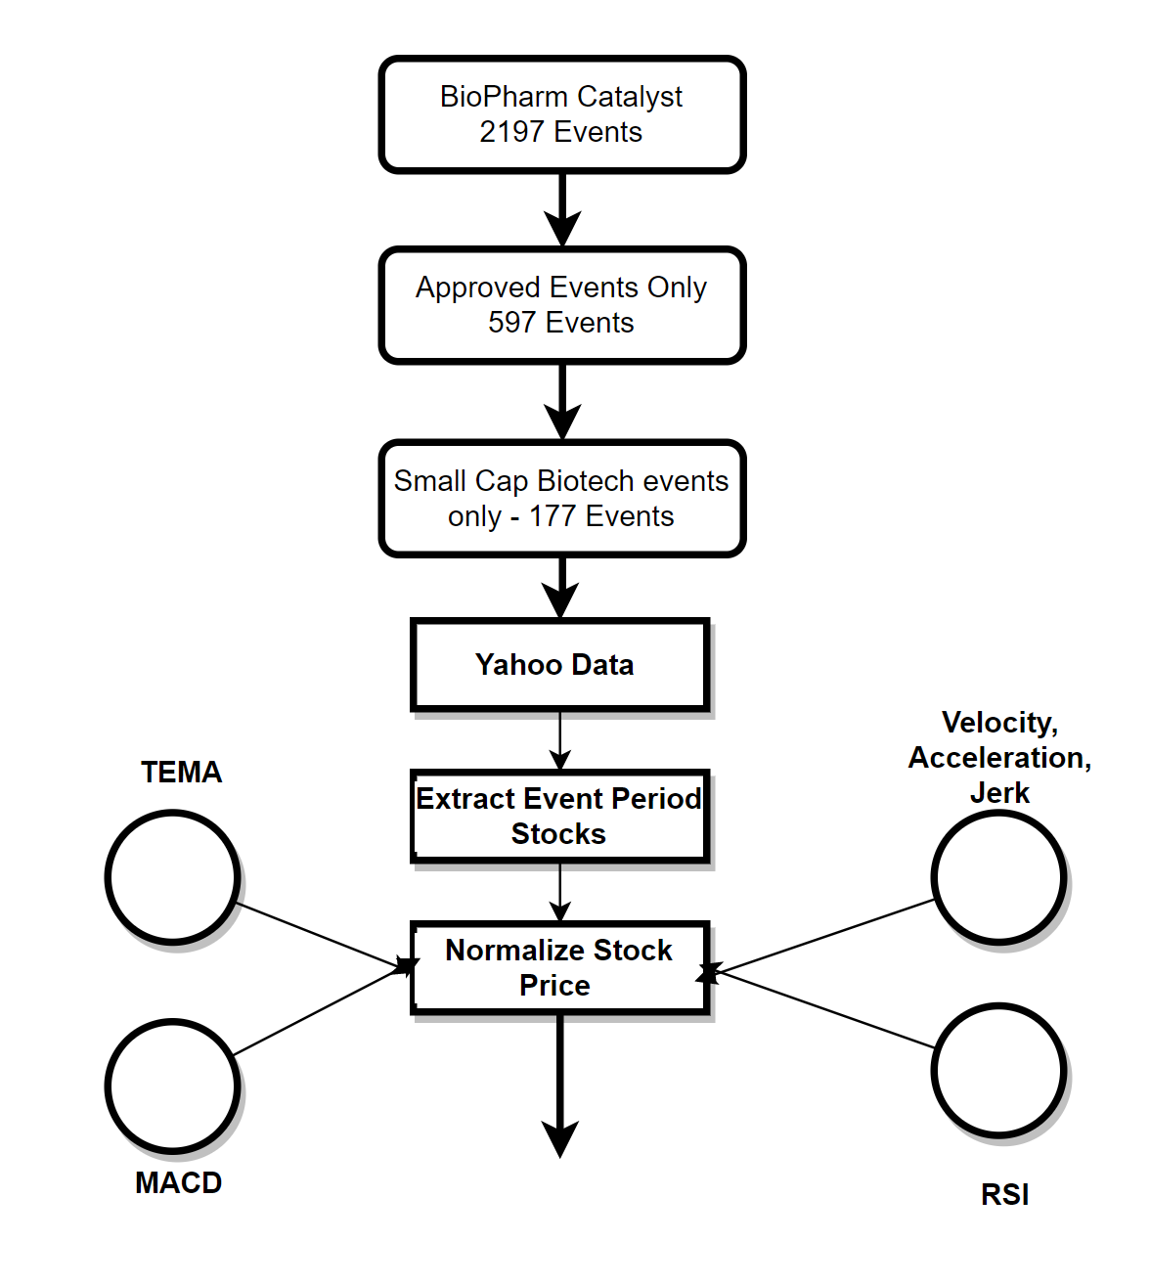
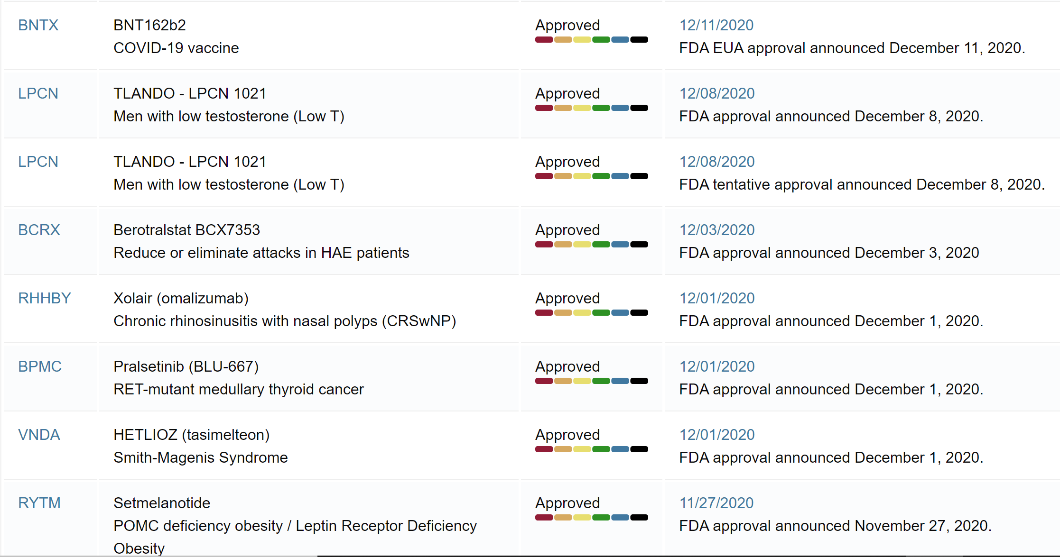
DATASET AND FEATURES:
Bio-Pharm Catalyst Website

Slide 4
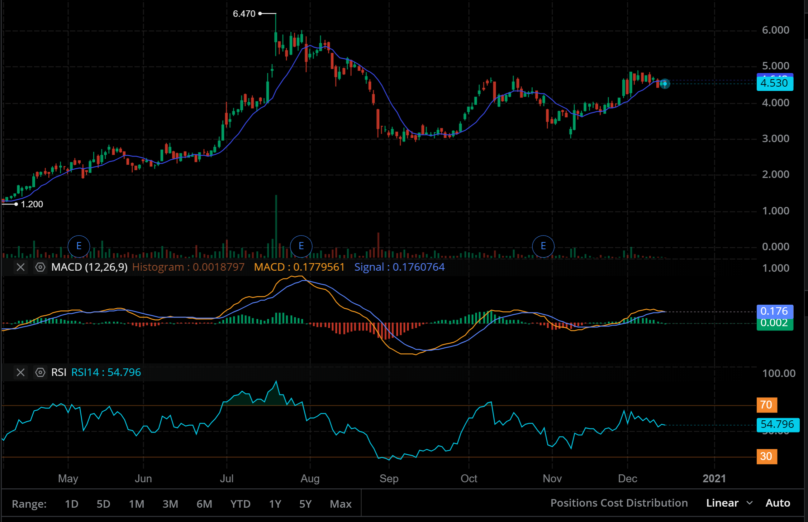
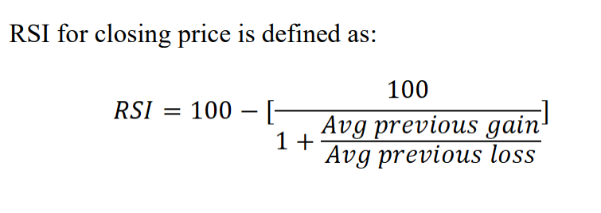
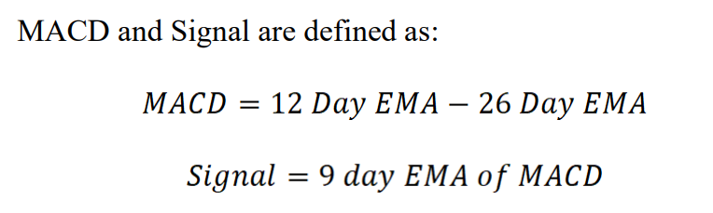
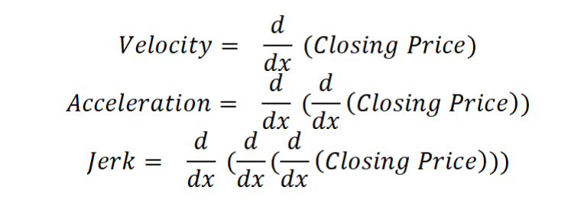
Technical Indicators

Slide 5
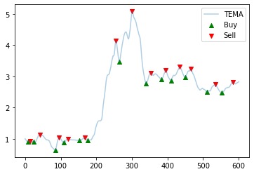
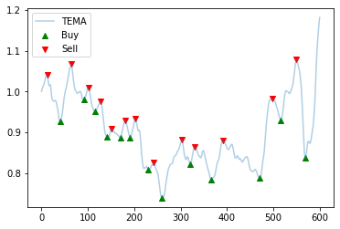
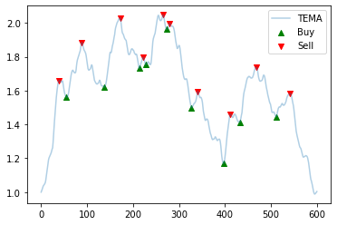
Peak Detect Algorithm to Manually Identify Labels
Look Ahead = 15 Days!

Slide 6
Final Features and Dataset:
Volume – Vol of stocks traded on that particular day.
TEMA – Triangular EMA, EMA of EMA of close price.
RSI – Relative Strength Index, above >0.7 = 1 else 0.
MACD - 12 Day EMA – 26 Day EMA.
Signal – 9 Day EMA of MACD.
MACD_Signal_Diff - Difference between Signal and MACD.
Price_TEMA_Diff – Difference between close price and TEMA.
Velocity – First Derivative of Close Price
Acceleration – Second Derivative of Close Price
Jerk – Third Derivative of Close Price
Targets – Manually marked buy and sell signals
Total 78,130 samples.
1303 – Manually marked buy signals
1289 – Manually marked sell signals
-300 Days to +300 Days of the Event

Slide 7
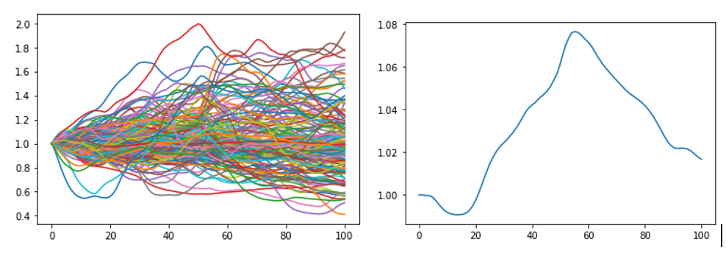
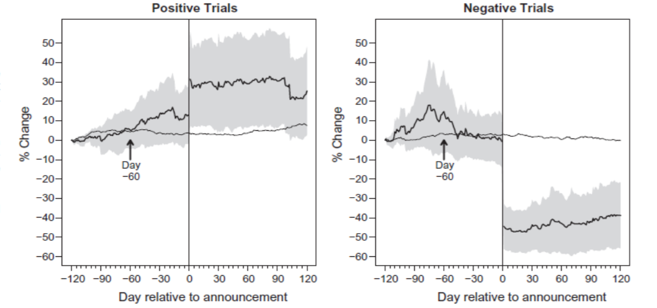
Pattern Analysis:
Fig: Stock Price reaction to positive and negative results announcement for multiple stocks compounded and normalized. (Source: [3]).
Fig (a): Stock Price reaction to Approved FDA trials for 177 small cap biotech companies. Fig (b): Daily Price Average from -50 days to +50 days.
Stock Price rise due to positive news.
Stock Price fall immediately after the event due to market realization of the public’s over-reaction for the news

Slide 8
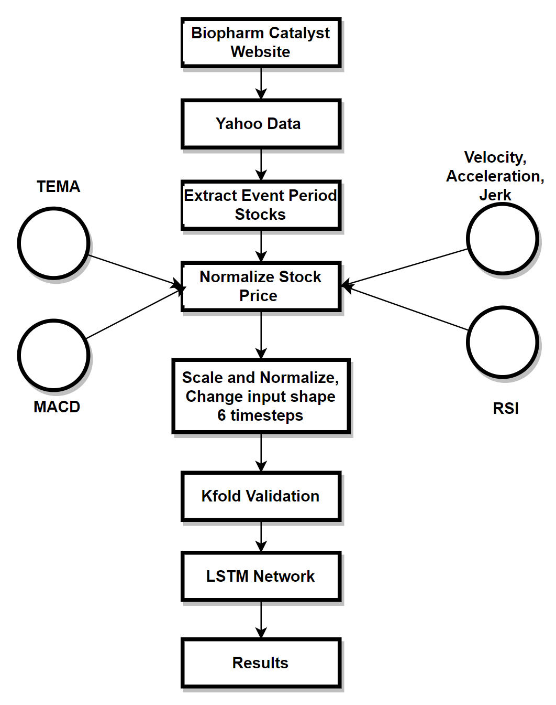
Our Approach
We normalize stocks to 100% for the first day in the analysis.
Use exponential log transformations to normalize ‘Volume’ and Triangular EMA’.
Use Standard Scaling to scale all the input features.
Use 10-Fold Cross Validation.
CuDA LSTM Layer with a dense softmax layer, categorical cross entrophy loss and Adam Optimizer.

Slide 9
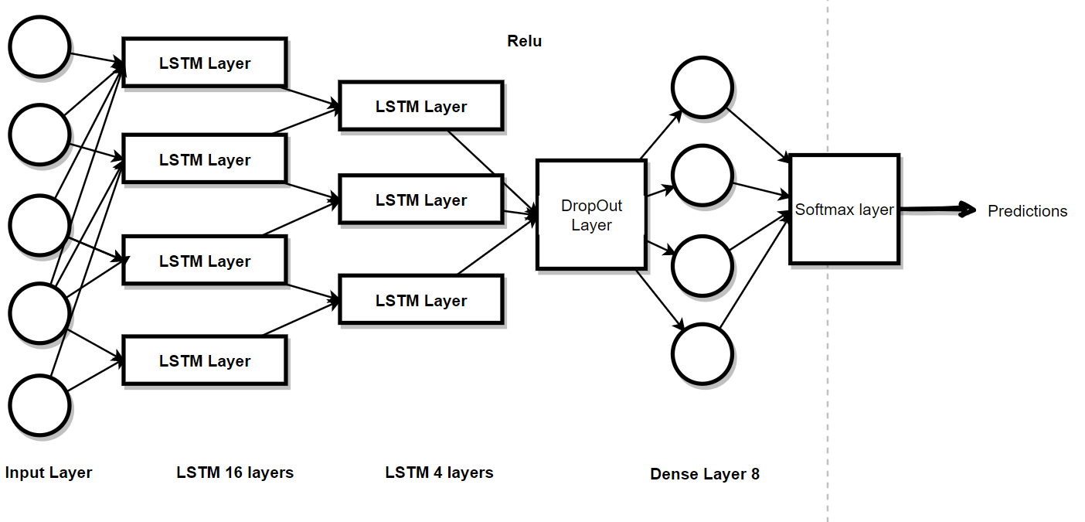
LSTM Model:
Input: Using time-series generator to generate input with 6 time_steps.
Input shape = (nSamples, time_steps, nFeatures)
Batch Size = 300
Cuda LSTM_1 with 16 units.
Cuda LSTM_2 with 4 units.
Dense_1 with 16 units.
Relu Activation
DropOut layer with 0.5 drop out.
Dense_2 with 8 layers.
Softmax layer for probability predictions.

Slide 10
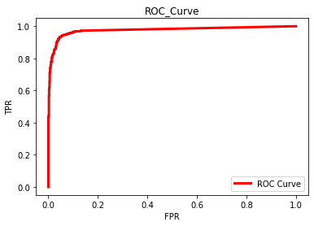
Performance Matrix:
Training Accuracy | Testing Accuracy | AUC Score | F1 Score | Precision | Recall
0.8913 | 0.8726 | 0.9754 | 0.9319 | 0.9616 | 0.9040
Confusion Matrix | Buy | Sell
Buy | 1242 | 47
Sell | 125 | 1178
ROC Curve

Slide 11
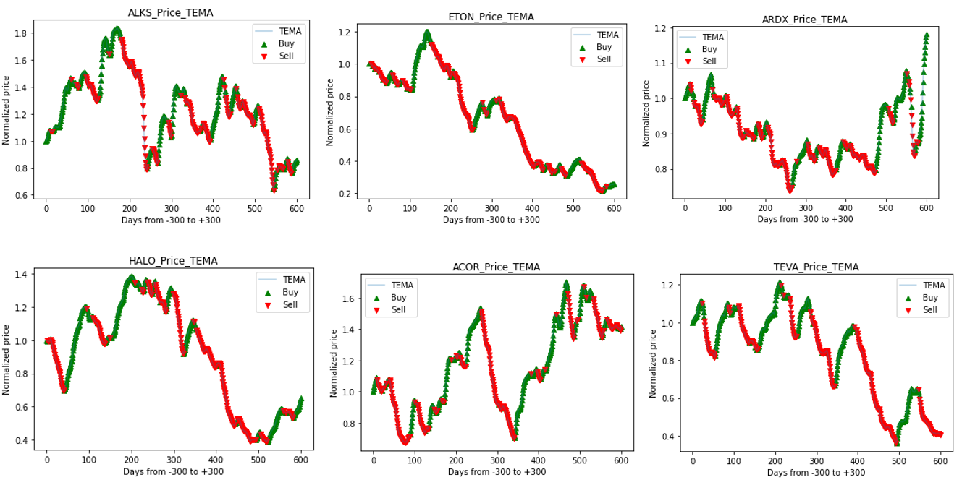
Visual Results:

Slide 12
Conclusion:
We were able to extract a group of stocks which share similar characteristics with the least feature set possible and model them as one stock to avoid building different models for each stock. This shows that stock price normalization is a good way to put together a whole dataset.
We were able to make the algorithm learn and generalize the existing patterns well, from which we could predict buy and sell signals with a fairly good accuracy.
Including technical trend indicators as features is a great way to enhance the model's capabilities in stock market related ML analysis.
LSTM’s are a great way to remember memory of past few days to forecast the future. Their capabilities are well demonstrated in this experiment.
Cuda LSTM’s are highly faster and more time efficient than normal LSTM’s due to their GPU compatibility.

Slide 13
Future Work:
Add more technical indicators to see if a better classification results can be extracted.
Build a backtrader algorithm to backtest these results over the last 10 years to check how well the algorithm functions in real-time market situations.
With more technical indicators and compiling multiple similar stocks strategy can be applied to gather large data and then apply to forecast the future through LSTM regression techniques.
Would like to test GRU’s, Weighted LSTM’s and other RNN techniques to see which is the best algorithm to contain the memory to predict better.
We could use Reinforcement Learning for training for better results.

Slide 14

Thank You!!!

