Slide 1
Multiple Moving Object Detection And Tracking System
0th Review
By,
Tejas Krishna Reddy [001423166]
Sowmya Mannava [001643835]
Leibin Xie [001783799]

Slide 2
Abstract:
In the contemporary digital world, autonomous video surveillance has been one of the most demanded advances in technology to alleviate the problem of constant human surveillance over a camera. The ability to Detect, Track and Predict the next move of an object in the video has been guiding the technology towards plethora of new advancements in the field of autonomous driving and robotics. In this project, we have implemented a state of art algorithm to detect multiple blocks of moving objects’ in a video through alpha background subtraction algorithm, track them by monitoring the similarity between their respective features obtained from parameters such as HOG features/ BoundingBox dimensions/ color histogram/ Hu’s invariant moments and finally predict the next moving frame by Ada Boosting, ensemble methods along with Kalman Filter.

Slide 3
Literature Review :
Moving object Detection has been a hot research topic back from 1988.
Object Detection – Background Subtraction, Statistical Detection, Temporal Detection and Eigen Background Detection.
Object Tracking – Tracking at every frame Vs Tracking once and Mapping, Point Tracking, Kernel Tracking and Silhouette Tracking.
Prediction – Optical Flow Problem, Kalman Filter and Other Machine Learning algorithms.

Slide 4
Block Diagram of the Implemented Algorithm.
Pre-processing a Video Sequence
Multiple Moving Objects Block Detection
Feature Extraction
Training Annotated Database
Similarity Check and Tracking Re-assignment
Model
Tracking Prediction through Kalman Filter

Slide 5
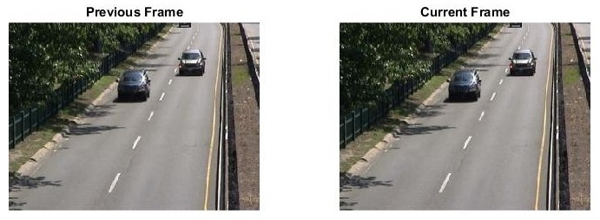
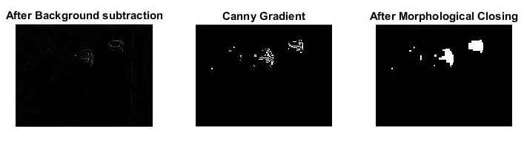
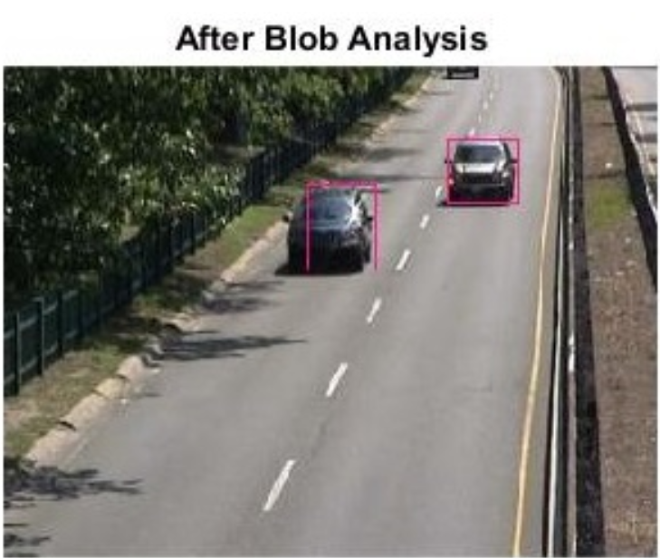
Moving Object Detection in a Video

Slide 6
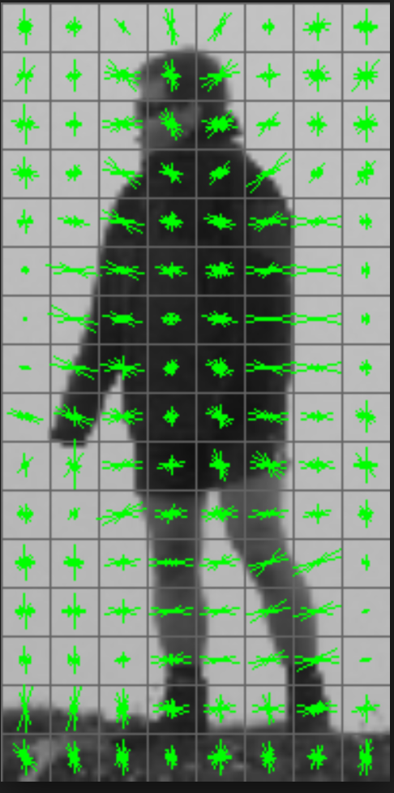
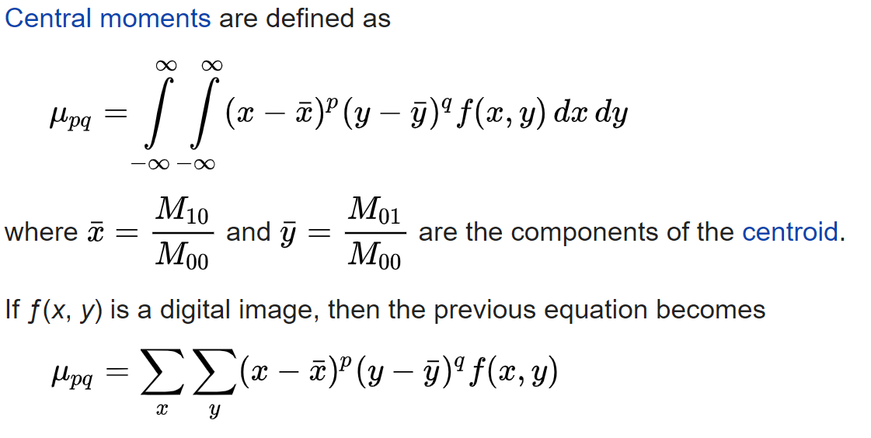
Feature Extraction Techniques
Histogram of Oriented Gradients (HOG) Features [1].
Object appearance and edge shape is described by the distribution of intensity gradients or edge directions.
Best suited for pedestrian recognition.
Can be given as input to any machine learning algorithm. Not tied to any specific algorithm.
2. Hu’s Invariant Moments [2]
An image moment is a particular weighted average of image pixel intensities.
Best suited for describing images after segmentation.
Properties such as total intensity, its centroid and orientation are stored.
These are translational, scale and rotation invariant features.
Hu’s moments are obtained from the central moments.
**Other features obtained include BoundingBox corner locations, Area, perimeter and color histogram.

Slide 7
Similarity Check
Features from current frame f(t) needs to be compared with corresponding features from the previous frame f(t-1) in order to check the similarity in the moving objects detected.
When the features are mostly histograms/ intensity weighted moments, the best measure of similarity would be through ‘Chi – Squared’ test. [3]
The Chi - Squared distance between two vectors is defined as:
If there are M moving objects in the previous frame and N objects in the current frame, then output vector D is of the dimension [M x N].
This calculated measure is provided as the input to the trained model to predict the score.
D(x, y) = sum( (xi - yi)^2 / (xi + yi) ) / 2;

Slide 8
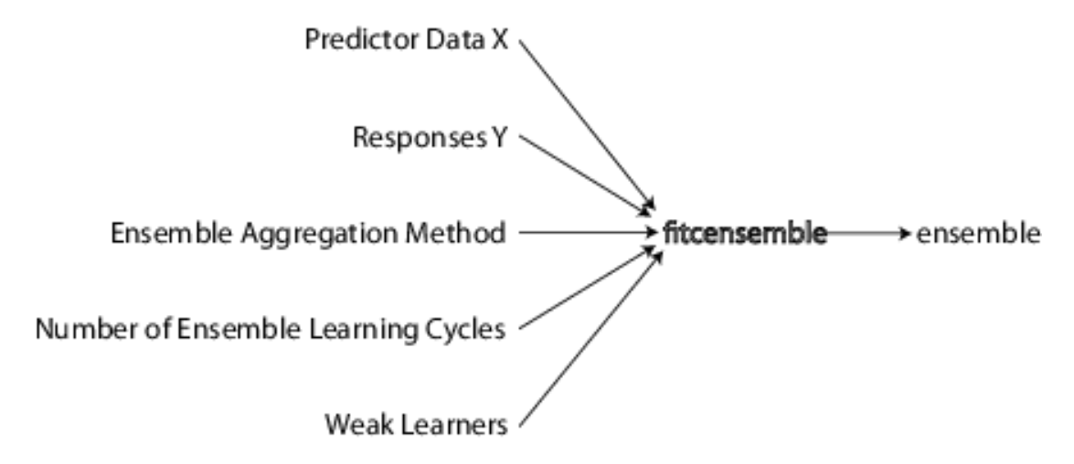
Training an Annotated Database
Adaboosting technique – Adaboost or Adaptive boosting technique is a machine learning meta algorithm which uses several weak learners to converge into a strong learner. (They are based on decision trees).
Adaboost is sensitive to noise and outliers but less susceptible to overfitting as compared to other machine learning algorithms.
Fitcensemble returns a trained classification ensemble model that contains the results boosting many (100 default) classification trees with ‘Adaboost’ ensemble aggregation method.
Boost algorithms generally have shallow trees, i.e construction uses relatively less time and memory as compared to bagging methods.
**MVI_20011 and MVI_20012 databases were used to train the model [4].

Slide 9
Tracking Re-assignment
The result score obtained as the prediction of the trained model is used to determine the track of the objects in the video.
If the score is very high of a object in a new frame, it implies that object was new in this frame and hence a new tracking section is started over this new object. Similarly if a score is not updated over few iterations, it implies that the object is no more in the given video and therefore we can end the tracking section over that particular object.

Slide 10
Kalman Filter
The Kalman filter is a recursive two-stage filter [4]. At each iteration, it performs a predict step and an update step. For example, if an object is moving with uniform velocity, we can predict its current location (a priori) from equations of motion. Then the update step takes the measurement of the object’s current location and combines this with the predicted current location to obtain an estimate of current location (a posteriori) of the object. Block diagram representation is given by
X -> state represented by bounding box
P-> Error Covariance
Z -> Measurements
Q,R-> Process and Measurement Noise

Slide 11
Results:
First step is to verify if the model distinguishes between same object and different objects in corresponding frame.
Confusion matrix for distinguishing moving objects in same track and different track is given by Confusion Matrix =
0.8780 0.1220
0.0300 0.9700

Slide 12
Epitome and Future Research Work:
Multiple moving objects were detected in the video sequence. A variety of meaningful features such as Histogram of oriented gradients (HOG), Hu’s Invariant Moments, Color Histogram counts, BoundingBox corner locations etc were extracted for each frame with moving objects. These features were compared with consecutive frame features using Chi-Squared test to know a similarity measure between them. Simultaneously, a machine learning algorithm was developed with an external annotated database where a number of weak individual learners were developed and later used Adaboosting technique to converge these weak learners into a strong learner. The Chi-Squared test results were provided as input to the trained model to predict the scores. This score was used with the Kalman Filter to predict the tracking of the moving object in the video.
Further research in this field is focused on detecting and tracking objects when both camera and objects are moving in a real-time scenario. Also, better feature extraction techniques are to be developed which are robust towards all possible distortions and reduce computational cost to implement one-time tracking system.

Slide 13
References:
[1] https://en.wikipedia.org/wiki/Histogram_of_oriented_gradients
[2] https://en.wikipedia.org/wiki/Image_moment
[3] http://www.cs.columbia.edu/~mmerler/project/code/pdist2.m
[4] http://detrac-db.rit.albany.edu/download
[5] A. Salarpour, A. Salarpour, M. Fathi, and M. Dezfoulian, “Vehicle tracking using kalman filter and features,” Signal & Image Processing: An International Journal, vol. 2, no. 2, 2011.
[6] Kuo, Cheng-Hao, Chang Huang, and Ramakant Nevatia. "Multi-target tracking by on-line learned discriminative appearance models." In Computer Vision and Pattern Recognition (CVPR), 2010 IEEE Conference on, pp. 685-692. IEEE, 2010.
[7] Luo, Wenhan, Junliang Xing, Anton Milan, Xiaoqin Zhang, Wei Liu, Xiaowei Zhao, and Tae-Kyun Kim. "Multiple object tracking: A literature review." arXiv preprint arXiv:1409.7618(2014).

Slide 14
Thank You!!! Any Questions??

