Slide 1
Predicting Santander Customer Transactions
Parallel Processing Final Project, Spring 2019
Isaac Kresse, Bruno Costa Rendon, Tejas Krishna Reddy

Slide 2
Approach
Data Preprocessing
Z-Score
Classification
Linear Regression
Random Forest
Neural Networks
Conclusion

Slide 3
Data Description
Data from Kaggle competition - “Santander Customer Transaction Prediction”
Dimension of training data provided was 200k x 202. Binary classification.
The data was highly skewed with only 10% of them belonging to class 1 and 90% of them being class 0.
This caused overfitting in the models and hence, we randomly created a dataset with 41,098 data points with 200 features, each with a balanced number of datapoints from each class.
id | target | var_0 | var_1 | var_2 | ... | var_199 | var_200
26 | 1 | 16.3699 | 1.5934 | 16.7395 | ... | 15.6064 | -10.8529

Slide 4
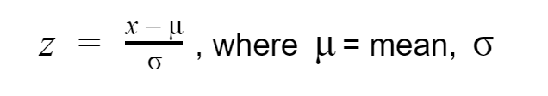
Preprocessing: Normalizing Data
The 200 features per sample had high variance in their distribution. This would eventually lead to erratic behaviour of the model and hence, Normalization was required to scale down the distribution to have zero mean and unit variance.
This method of normalizing the data is commonly termed as Standard Scaling Technique, or the z-score.
Standard Scaling Technique is best suited for classification algorithms, especially for binary classification problems.

Slide 5
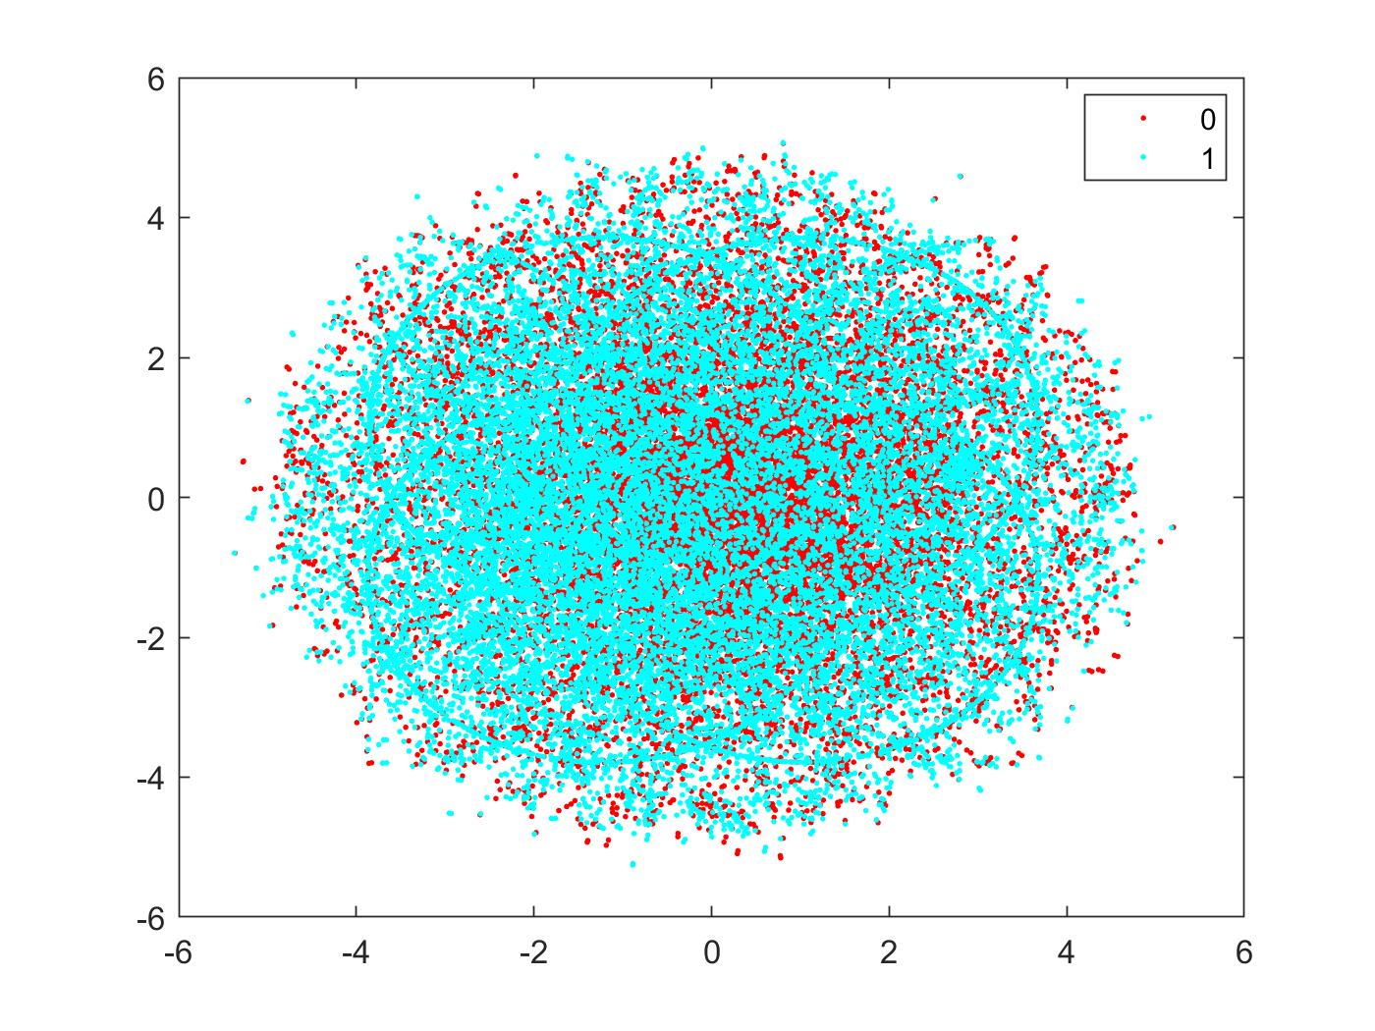
Preprocessing: Visualizing Data
t-SNE Barnes Hut
Technique for dimensionality reduction
Useful for visualization of high-dimensional datasets

Slide 6
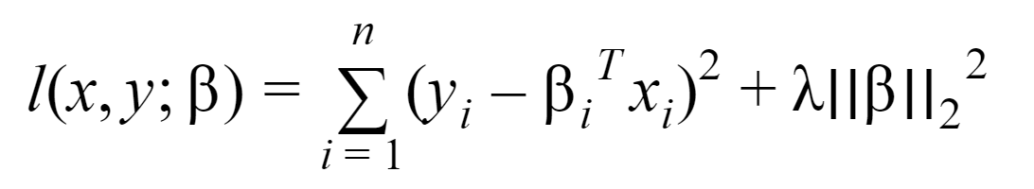
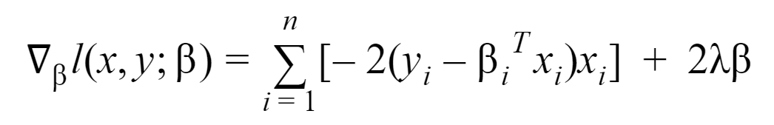
Classification: Linear Regression
Gradient Descent of loss function
Simple Classification
K-fold Cross Validation

Slide 7
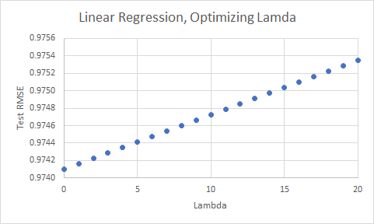
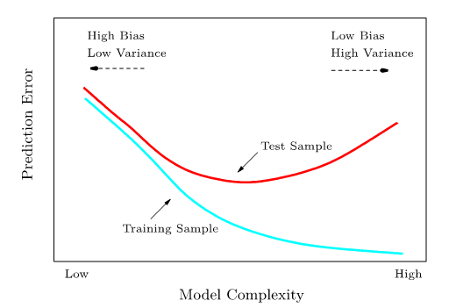
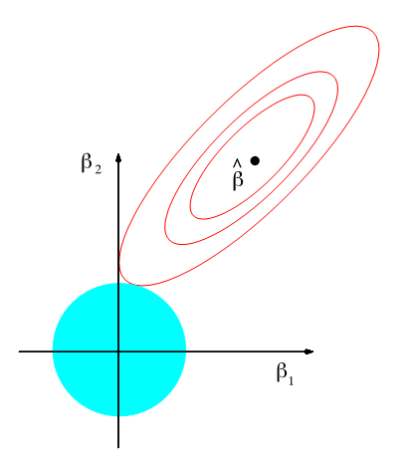
Validation: Linear Regression
Measurement | Value
Area Under the Curve | 0.7468
Accuracy | 0.6814
Precision | 0.6737
Recall | 0.6762
Test RMSE does not behave as expected
Perhaps caused by low ||β||_2
β_i = [-0.0016 - 0.0015]
Moderate results in classification

Slide 8
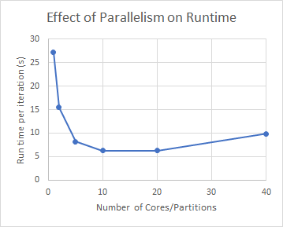
Performance: Linear Regression
Run in interactive mode
spark-submit --master local[N]
Number of Partitions = num threads
Parallel is faster
Upper limit of 36 threads

Slide 9
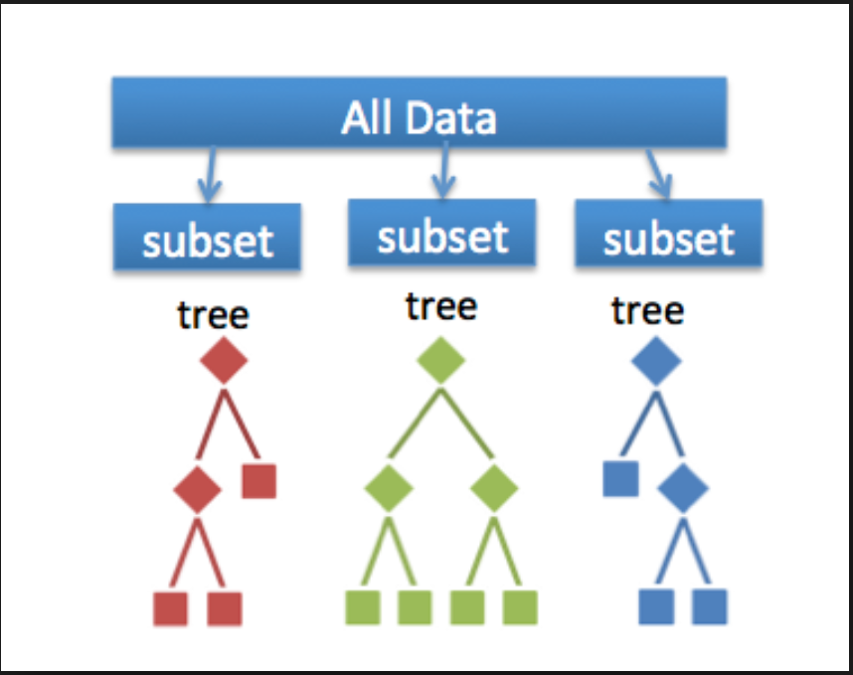
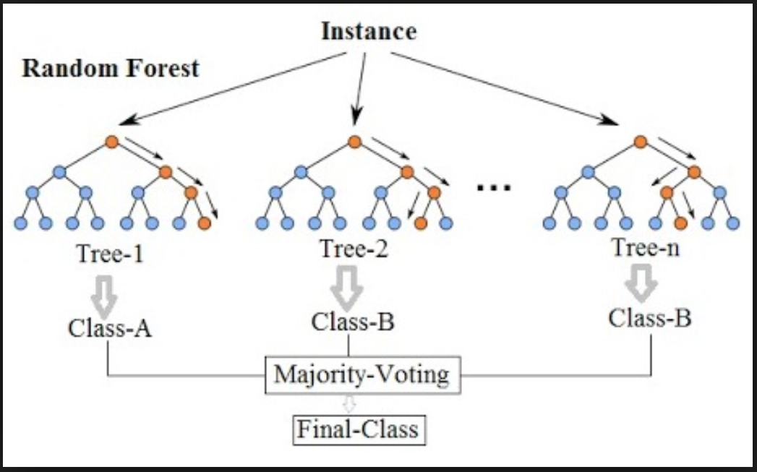
Classification: Random Forest
Random Forest is a flexible and powerful supervised machine learning that can be used for both regression and classification tasks.
It uses random subsets of data to train different trees independently and converge the results to get an accurate and more stable prediction.
Since, the trees are trained independently, multiple trees can be trained in parallel simultaneously.
Distributed ensembles can be developed using pyspark through its API, MLlib. A variable number of subtrees are trained in parallel, where the number is optimized on each iteration based on its memory constraints.

Slide 10
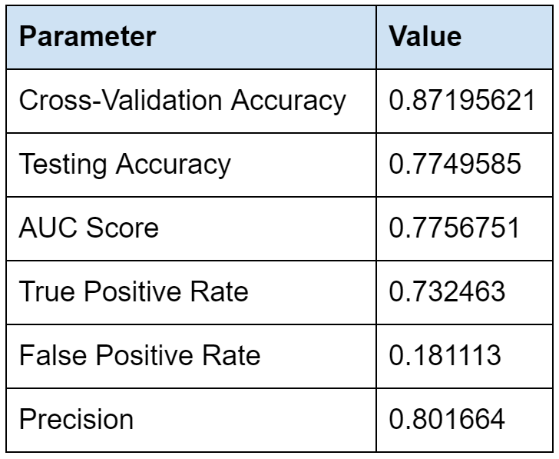
Validation: Random Forest
The hyperparameter “oob_score” was set to be True in the random forest model. This would let cross-validation happen simultaneously during the training process by including out-of-bag samples for every subtree to validate the results.
Apart from this, the data was divided into 70%, 15% and 15% for training, cross-validation and testing respectively.
The best hyperparameter optimized model over cross-validation set was then tested on testing data. The results obtained are as shown.

Slide 11
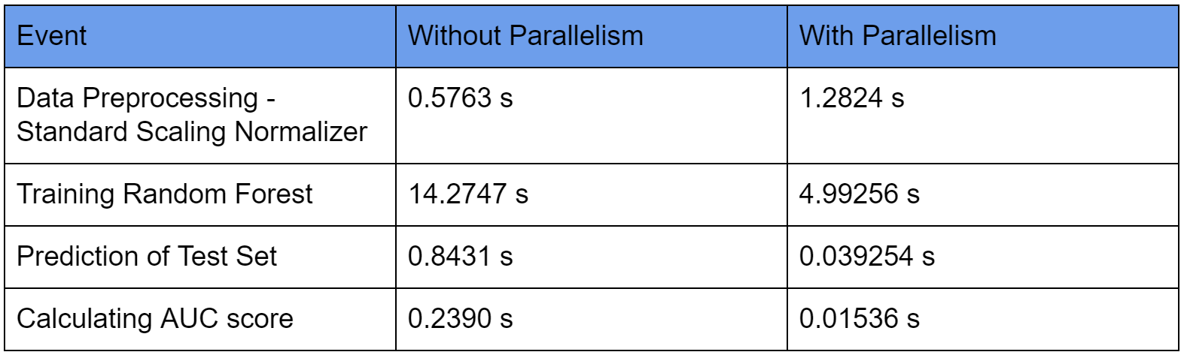
Performance of Random Forest
Two separate programs were executed with same hyperparameters and data, but with and without parallelization to compare their time of execution. We could see that Standard scaling takes more time in spark due to lot overhead of communications. The training of random forest algorithm is reduced by 1/3rd of its original time. One of the disadvantages of random forest, is that it takes longer time to predict results as compared to other ML algorithms. But this problem can be alleviated using parallel processing. The time is reduced to 1/10th of the original time taken using parallelization Techniques.

Slide 12
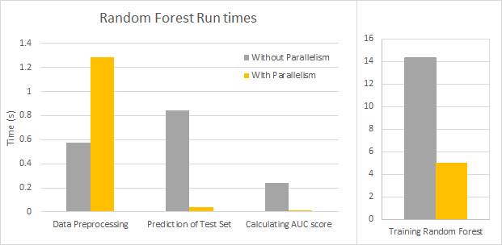
Performance of Random Forest
Two separate programs were executed with same hyperparameters and data, but with and without parallelization to compare their time of execution. We could see that Standard scaling takes more time in spark due to lot overhead of communications. The training of random forest algorithm is reduced by 1/3rd of its original time. One of the disadvantages of random forest, is that it takes longer time to predict results as compared to other ML algorithms. But this problem can be alleviated using parallel processing. The time is reduced to 1/10th of the original time taken using parallelization Techniques.

Slide 13
Additional Perks using RF
“featureImportances” attribute can be used to print the relative importance scores of the available 200 features in predicting final results. If we threshold the produced results to 0.04 importance, then the least 70 important features among 200 can be removed. The AUC score obtained after selecting only important features was found to be 72.5% over the previously trained random forest algorithm, which is just 2% less than the actual accuracy as a trade off for removing 70 features.

Slide 14
Classification: Neural Networks
Fully connected layers: 3
Layer 1: 41,098 neurons, activation: ReLU
Layer 2: 1,024 neurons, activation: ReLU
Layer 3: 1 neuron, activation: sigmoid
Epochs: 1
Batch size: 10
Loss: Mean Squared Error
Optimizer: Stochastic Gradient Descent

Slide 15
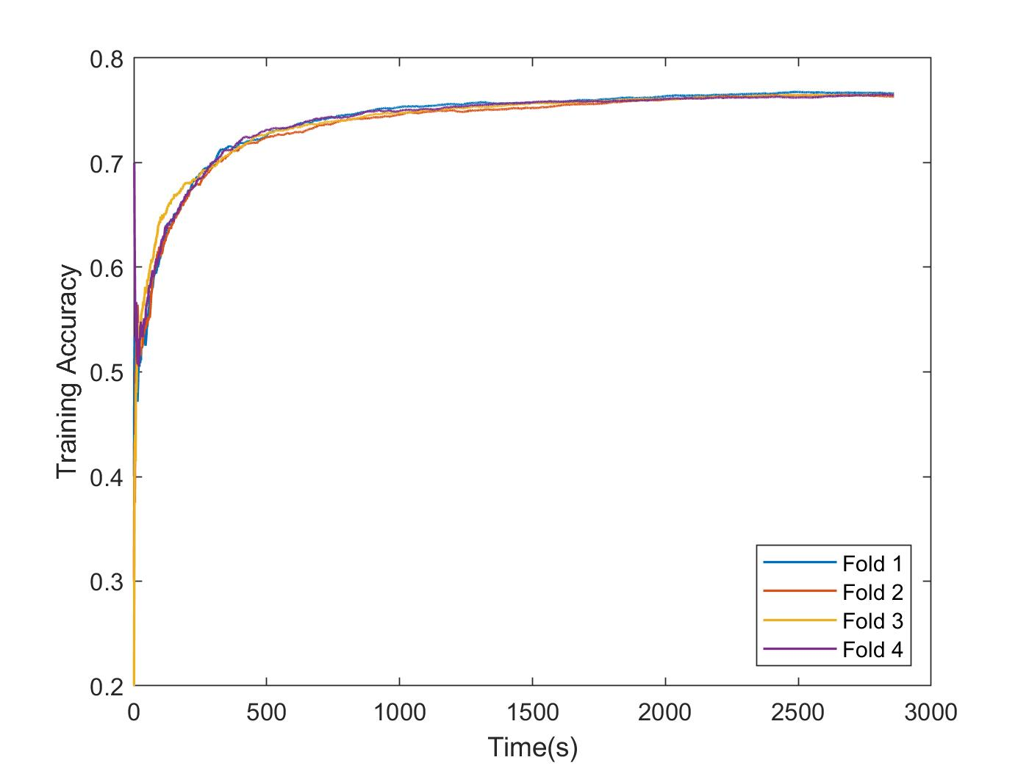
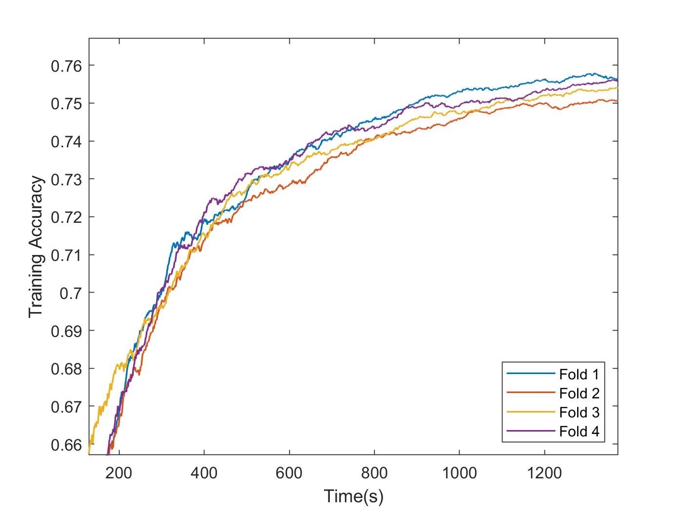
Validation: Neural Networks
Average tested accuracy: 77.57%

Slide 16
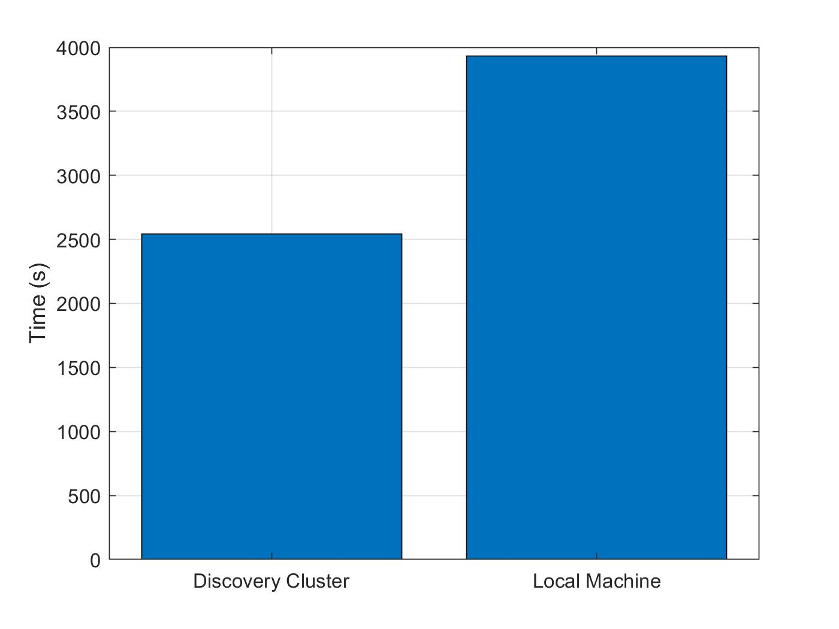
Performance: Neural Networks
Discovery Cluster
1 node
general partition group
50 GB memory
Local Machine
Intel Core i7 7th Gen

Slide 17
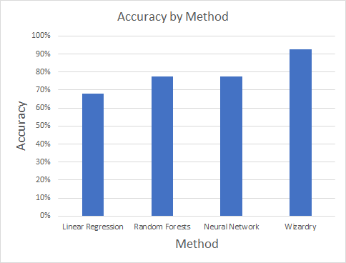
Conclusions
Possible Improvements:
Linear Regression
Lifting of Features
LASSO
Random Forests
Pruning
Number of trees
Neural Networks
More epochs
Different batch sizes
1D Convolution layers

