Slide 1
FREEDOM FIGHTER
SUBHASH CHANDRA BOSE
&
KITTUR RANI CHENNAMMA

Slide 2
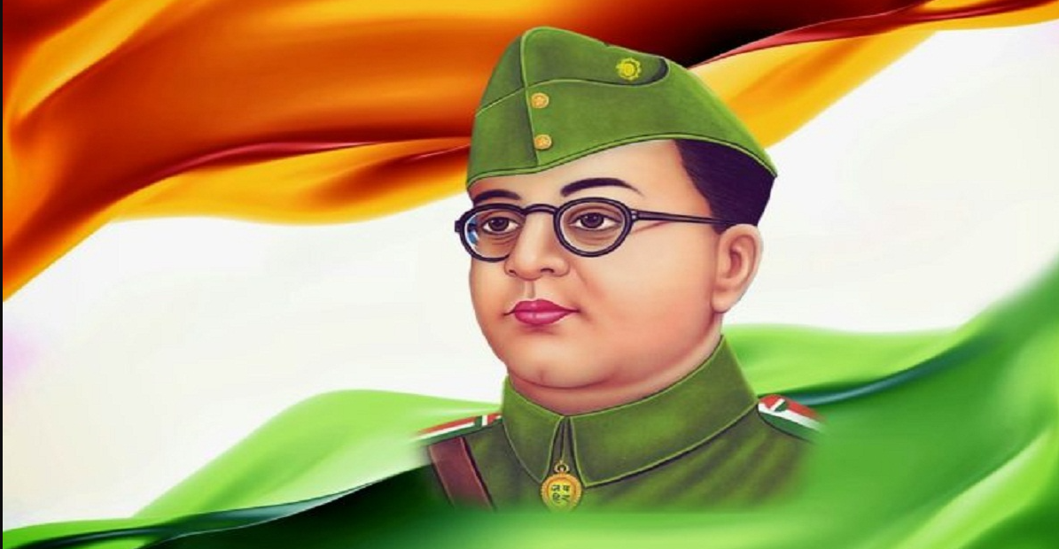
SUBHASH CHANDRA BOSE
1.EARLY LIFE
Subhash chandra bose was born on jan 23,1897 ,in cuttack ,orisa india into a bengali family
2.EDUCATION
He completed is school in from ravenshaw collegiate school in cuttack and later studied at presidency college at calcutta.
3.Civil Service
Bose cleared the Indian civil service examination in 1920 but resigned in 1921 due to his discontent with British rule in India
4.NETAJI
“NETAJI” by his supporters ,which means “RESPECTED LEADER “ in hindi

Slide 3
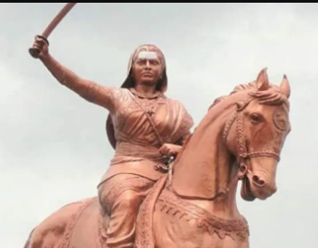
KITTUR RANI CHENNAMMA
BornChennamma
23 October 1778 Kakati, Belagavi District, present day Karnataka, India
Died21 February 1829 (aged 50) baihongal, Bombay, Company Raj NationalityIndianOther namesRani Chennamma, Kittur Rani ChennammaKnown for1857 Revolt against the British East India Company

Slide 4
SUBHASH CNANDRA BOSE
Subhash Chandra Bose: A Revolutionary Leader
Subhash Chandra Bose was a revolutionary leader who fought for India's independence from British rule.
Subhash Chandra Bose: A Revolutionary Leader
Subhash Chandra Bose was a revolutionary leader who fought for India's independence from British rule.

Slide 5
BAR GRAPH

Slide 6
LIFE CYCLE OF BUTTERFLY
Butterflies are winged insects from the lepidopteran suborder Rhopalocera, characterized by large, often brightly coloured wings that often fold together when at rest, and a conspicuous, fluttering flight. The group comprises the superfamilies Hedeyloida (moth-butterflies in the Americas) and Papilionoidea (all others). The oldest butterfly fossils have been dated to the Paleocene, about 56 million years ago, though they may have originated earlier.
EGG
CATERPILLER
CHRYSALIS
ADULT EMERGES
ADULT

Slide 7
PROJECT MANGEMENT TRIANGLE
SC OPE
COST
TIME

Slide 8
Sales
1st Qtr 8.2
2nd Qtr 3.2
3rd Qtr 1.4
4th Qtr 1.2

