Slide 1
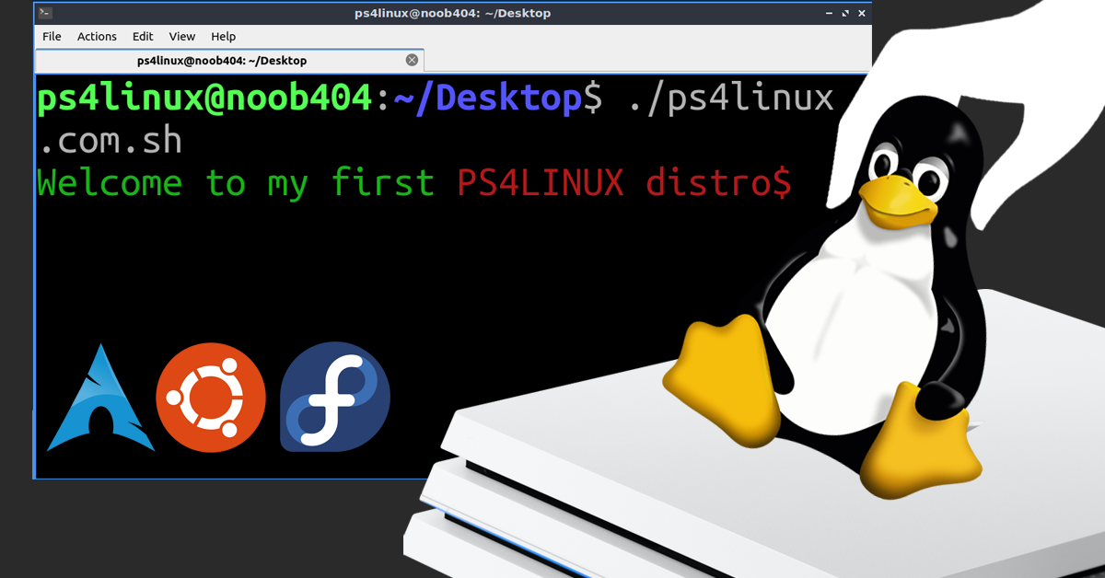

DIY LINUX – What?

Slide 2

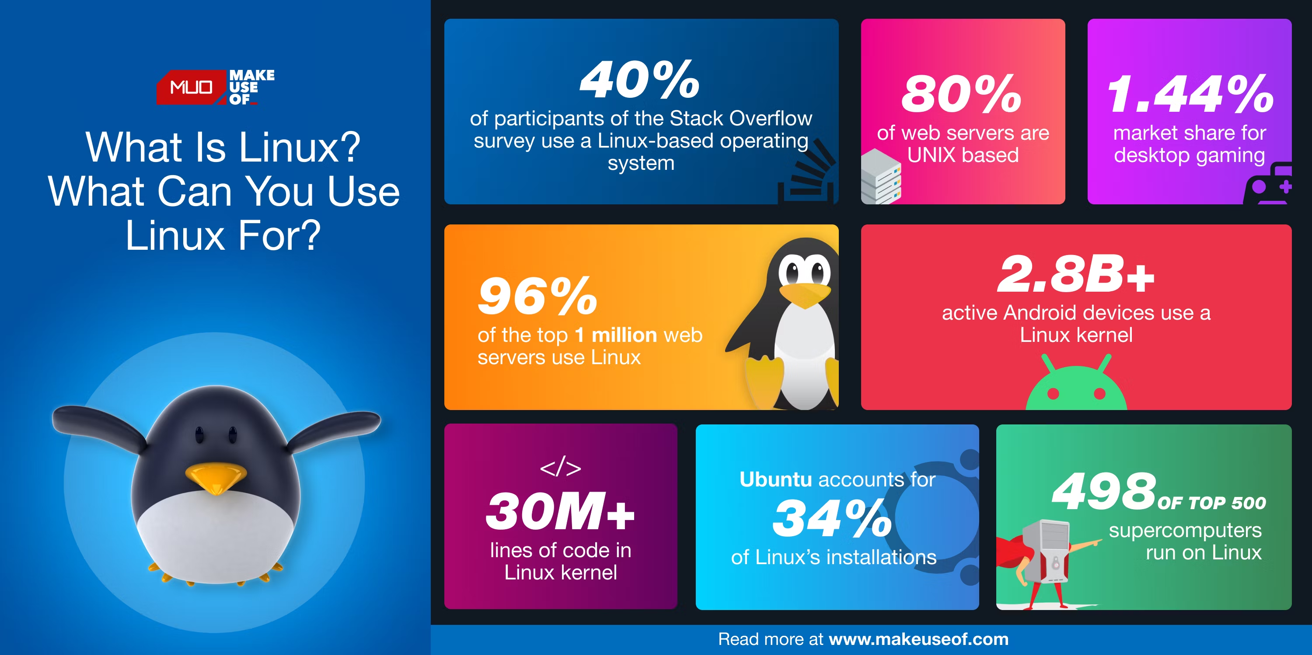
DIY LINUX – Why?

Slide 3
DIY LINUX – Where?

Slide 4
DIY LINUX – Where?

