Slide 1

RFID BASED ATTENDANCE SYSTEM
GROUP – 14
TEJAS AMRITKAR – 20D070081
AKSH GARG – 20D070008
PAVAN KALE– 180110050

Slide 2
Motivation
Everything in today’s world is becoming automatic. A new system, which reduces the human efforts, for management is needed.
RFID technology provides this solution with easy update of data, by just scanning your tags, eliminates the need for manual recording, and reduces errors and fraudulent practices.

Slide 3
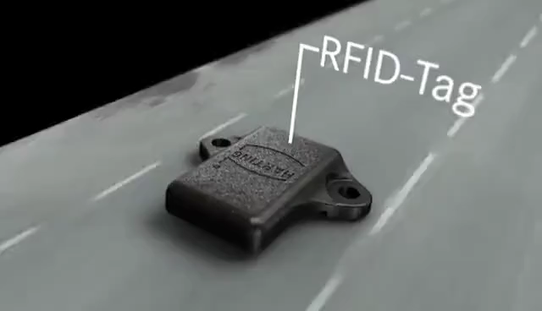
WHAT IS RFID (Radio Frequency ID)?
Form of wireless communication
Works on the principle of electromagnetic coupling to uniquely identify an object

Slide 4
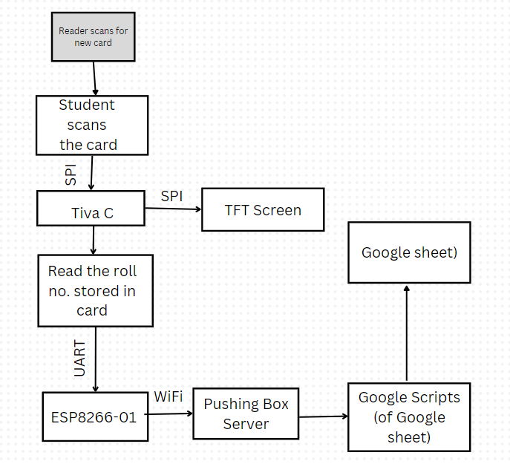
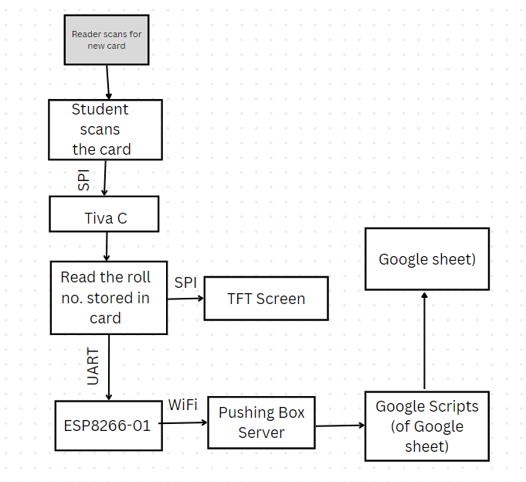
FLOW

Slide 5
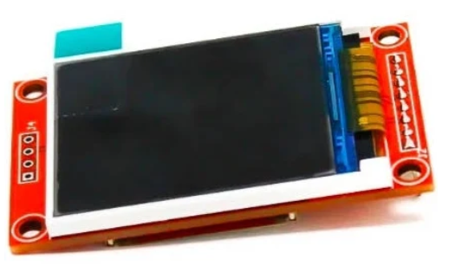
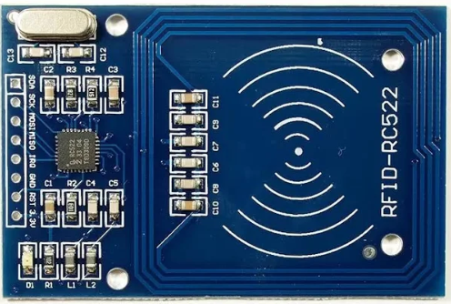
OUR PROJECT
In this project, we are implementing an attendance and registration system, which would be connected with the internet to sync the data online.
Components and their requirements in the project:
RC522 Module: Reads the data from the RF card. Uses SPI protocol to communicate with Tiva C
Tiva C: Microcontroller, which orders RC522 to read the data from the card in its vicinity, and do the required things with that data
TFT LCD Screen: Displays the required information on the LCD, to make the project user friendly. Uses SPI protocol to communicate with the Tiva C
ESP01: Helps to sync the required data on internet (online Google Sheet). Uses UART protocol to communicate with the Tiva C

Slide 6
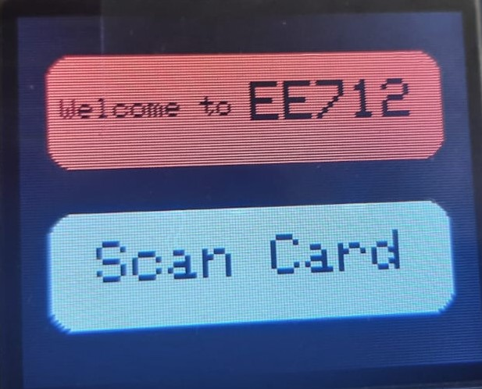
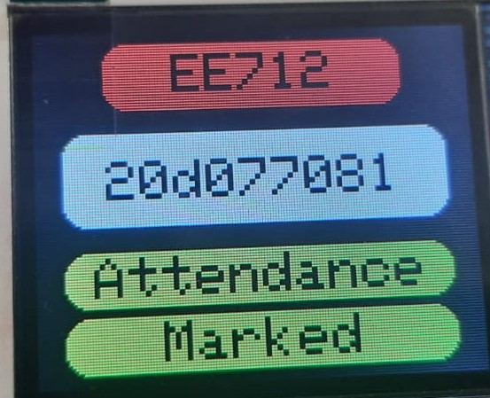
ATTENDANCE SYSTEM
We have two types of cards: Student and Professor
Student card contains his/her roll no. and first name, while the professor card contains the course code and first name.
When a professor scans the card, the course code is read from the card and stored in the internal memory of Tiva C

Slide 7
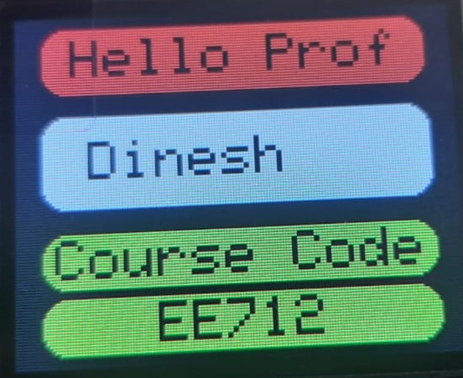
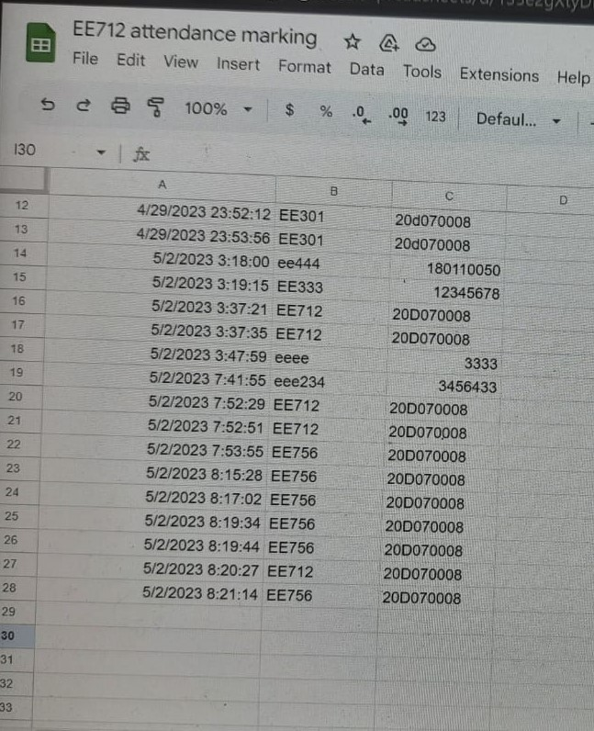
ATTENDANCE SYSTEM
When a student scans the card, this roll number, along with the course code stored in memory, is updated on the sheet with the help of ESP01.
When a new professor scans the card, that means a new course attendance started.
The sheet contains the columns Roll No., Course Code, and Time Stamp.

Slide 8
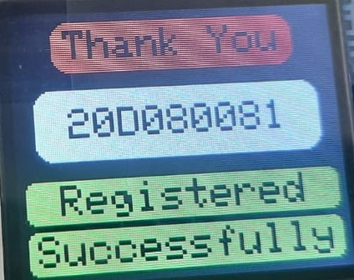
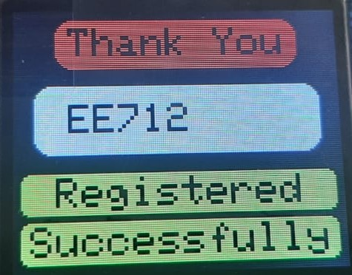
REGISTRATION SYSTEM
Whenever a card, which is neither a student nor professor card, tries to be scanned, he/she would be asked to contact admin for the registration.
The registration system asks whether the card needs to be registered as a professor or student.
If the student, it asks for the roll no. and first name.
If the professor, it asks for the first name and the course code.

Slide 9
Challenges
Updating data on Google sheet
Reading data from the RFID tags and RFID reader
Library errors for TFT Screen

Slide 10
Contributions
Aksh – worked on reading RFID tags with Tiva C and interpreting of the data
Tejas – worked on displaying the required information on the TFT screen. Worked on UART to send data from Tiva C to ESP01
Pavan – Updating the data on Google sheet over wifi through ESP01.

Slide 11
Conclusion
Moving forward, the system has the potential to be further improved and expanded to include additional features such as automated report generation and integration with management systems.
Our project is completely ready to implement to a large class.

