Slide 1

Predictive Expert Offloading for Mixture-of-Experts LLMs
23AID498 Project Phase 1 – Review 2 Presentation
Team ID: 23UG099 Panel No.: 17
S.No | Reg.No | Name of the Student | Branch
1 | BL.EN.U4AID23011 | Buvan Subbaiah KH | AIDS
2 | BL.EN.U4AID23036 | P Ananthapadmanabhan Nair | AIDS
3 | BL.EN.U4AID23052 | Tejas Raja Bhatt | AIDS
Project Guide: Dr. Ritesh Raj
Assistant Professor – School of AI

Slide 2
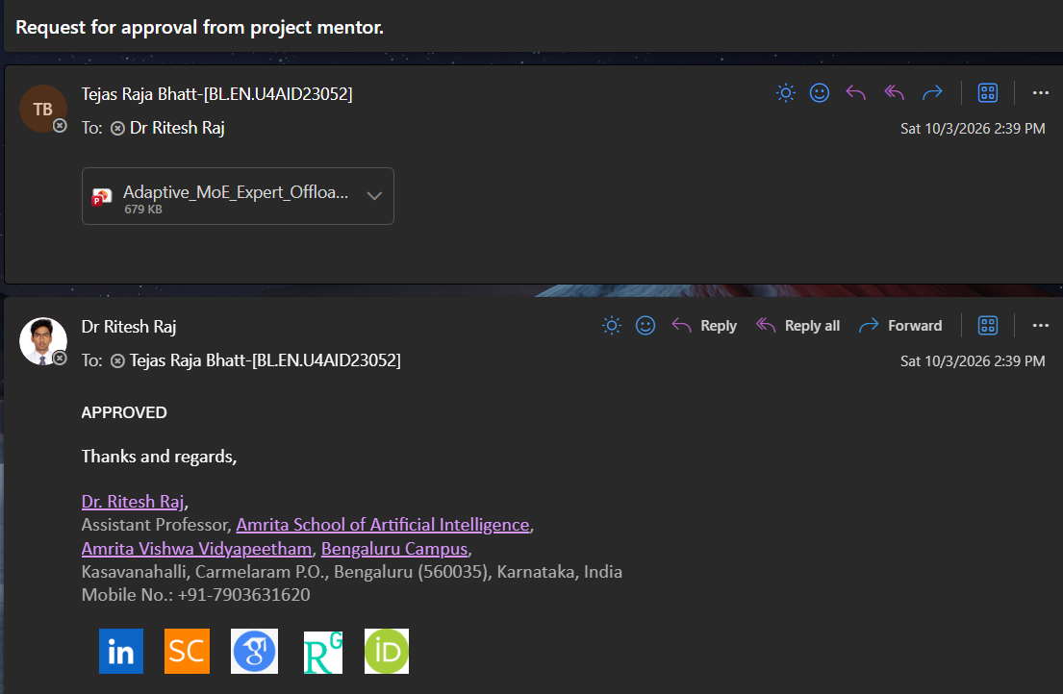
2
Approval

Slide 3
3
Introduction
• Mixture-of-Experts (MoE) models contain many expert networks, but the router activates only a small subset for each token.
• Our project uses the real allenai/OLMoE-1B-7B-0924 model to study predictive expert offloading under constrained GPU memory.
• The native router is instrumented to collect layer-wise expert activation traces from WikiText-103, GSM8K and MBPP.
• Core pipeline: observe routing → identify temporal structure → predict future experts → prefetch → measure cache impact.

Slide 4
4
Problem Definition
• OLMoE has 16 layers and 64 experts per layer, giving 1,024 layer-specific expert locations.
• Only 8 experts are selected at each layer for each token, so expert access changes over time.
• A constrained 4 GB laptop GPU cannot be treated as if every layer-specific expert is always resident.
• Reactive caching waits for a miss; fetching an expert from CPU or disk can be expensive.
• Research question: can routing behavior be predicted early enough to prefetch useful experts? Can we move from Reactive to Predictive?

Slide 5
5
Objective
• Collect reliable layer-aware expert activation traces from real OLMoE inference.
• Measure temporal locality and determine whether recent routing contains predictive information.
• Implement and compare History, layer-aware Transition and Selective prediction strategies.
• Connect predictions to a GPU/CPU/Disk cache model and measure precision, coverage, disk fetches and modeled latency.
• Extend toward EAM-based prediction, a published-method-inspired baseline, an adaptive policy and live OLMoE integration.

Slide 6
Literature Survey
S.No. | Authors name(s) | Full title of the paper with year | Inference from the paper | Open Problem (For proposed work)
1. | Eliseev, A.; Mazur, D. | Fast Inference of Mixture-of-Experts Language Models with Offloading (2023) | Introduces expert offloading with LRU caching and speculative loading to reduce GPU-memory pressure during MoE inference. | Extend reactive/speculative loading with explicit routing-history prediction and asynchronous prefetching.
2. | Xue, L.; Fu, Y.; Lu, Z.; Mai, L.; Marina, M. | MoE-Infinity: Offloading-Efficient MoE Model Serving (2024) | Uses expert activation history, caching and prefetching to improve MoE serving under memory constraints. | Compare a lightweight laptop-oriented predictor against trace-based prefetching approaches. (n-gram frequency predictor vs lightweight model)
3. | Muennighoff, N., et al. | OLMoE: Open Mixture-of-Experts Language Models (2025) | Presents the open OLMoE model family and analyzes routing and expert specialization. | Use OLMoE-1B-7B as the target model and investigate whether its routing traces are predictable across workloads.

Slide 7
Literature Survey
S.No. | Authors name(s) | Full title of the paper with year | Inference from the paper | Open Problem (For proposed work)
4. | Kamahori, K.; Tang, T.; Gu, Y.; Zhu, K.; Kasikci, B. | Fiddler: CPU-GPU Orchestration for Fast Inference of Mixture-of-Experts Models (2025) | Coordinates CPU and GPU resources to improve MoE inference when GPU memory is limited. | Build on GPU/CPU orchestration with routing-aware prediction and evaluate additional LAN-based storage.
5. | Song, Y.; Mi, Z.; Xie, H.; Chen, H. | PowerInfer: Fast Large Language Model Serving with a Consumer-grade GPU (2024) | Demonstrates that large language model inference can be made practical on consumer-grade GPUs by exploiting parameter locality and keeping frequently used components resident. | Apply the consumer-GPU locality idea specifically to MoE expert residency and investigate whether predicted expert reuse can reduce GPU↔CPU transfer stalls.

Slide 8
Literature Survey
S.No. | Authors name(s) | Full title of the paper with year | Inference from the paper | Open Problem (For proposed work)
6. | Xue, F.; Zheng, Z.; Fu, Y.; Ni, J.; Zheng, Z.; Zhou, W.; You, Y. | OpenMoE: An Early Effort on Open Mixture-of-Experts Language Models (2024) | Studies open MoE language models and their expert-routing behavior, providing evidence of specialization and non-uniform expert utilization. | Quantify whether routing patterns are sufficiently predictable across code, math, multilingual, and general workloads to support prefetching.
7. | Dai, D.; Deng, C.; Zhao, C.; et al. | DeepSeekMoE: Towards Ultimate Expert Specialization in Mixture-of-Experts Language Models (2024) | Investigates fine-grained expert specialization and routing strategies to improve parameter efficiency and expert utilization. | Use routing specialization as a possible source of predictive signal and measure how specialization affects cache hit rate and prefetch accuracy.
8. | Dunsche, M.; Maehren, M.; Erinola, N., et al. | With Great Power Come Great Side Channels: Statistical Timing Side-Channel Analyses with Bounded Type-1 Errors (2024) | Provides statistically rigorous methods for timing side-channel analysis while controlling false-positive errors. | Use its statistical perspective when evaluating whether timing traces contain measurable workload information.

Slide 9
Literature Survey
S.No. | Authors name(s) | Full title of the paper with year | Inference from the paper | Open Problem (For proposed work)
9. | Tang, P.; Liu, J.; Hou, X.; Pu, Y.; Heng, P.-A.; Li, C.; Guo, M. | HOBBIT: A Mixed Precision Expert Offloading System for Fast MoE Inference (2024) | Combines mixed-precision expert storage with offloading and caching to reduce memory footprint and expert-transfer overhead. | Compare predictive prefetching against mixed-precision/offloading strategies and study the trade-off among expert size, transfer latency, and cache capacity.
10. | Borzunov, A.; Baranchuk, D.; Dettmers, T., et al. | Petals: Collaborative Inference and Fine-tuning of Large Models (2023) | Demonstrates collaborative large-model inference by pooling compute and memory resources across networked peers. | Motivates the third cache tier: GPU → local CPU/RAM → LAN peer expert storage.
11. | Song, L.; Pang, Z.; Wang, W., et al. | The Early Bird Catches the Leak: Unveiling Timing Side Channels in LLM Serving Systems (2024) | Shows that LLM-serving optimizations and caching can create timing differences that expose information. | Directly motivates testing whether expert-cache hits/misses reveal query domain or routing behavior.

Slide 10
6
Justification & Significance
• Temporal structure means expert activations at nearby time steps are not completely random. Usage of previous expert information is vital to know about future experts.
• A larger lookback window provides more historical opportunities to find reused experts, so locality hit rate rises.
• Prediction can reduce lower-tier fetches, but wrong predictions consume cache space and transfer bandwidth.
• The problem is therefore a precision–coverage–overhead trade-off, not simply “maximize prediction accuracy”.
• The native OLMoE router remains authoritative; the predictor is an auxiliary prefetch mechanism. As in, the OLMoE router still makes the real decision about which experts are used. Our predictor does not replace or override the router.

Slide 11
13
System Architecture
Input Text
OLMoE
Transformer
Native Router
Top-8
Routing Trace
Collector
History
Layer-Aware Transition
Multi-Tier
Cache
Fig 1: System Architecture
The predictor never replaces the OLMoE router; it predicts likely future requests for prefetching.

Slide 12
10
Software/Tools Requirements
• Python + PyTorch — OLMoE inference and routing instrumentation.
• Hugging Face Transformers — OLMoE model/configuration.
• CUDA + NVIDIA RTX 3050 Laptop GPU — experimental inference hardware.
• NumPy / pandas / scikit-learn — trace processing, splitting and analysis.
• Matplotlib — result graphs and report figures.
• Git / GitHub — project version control.

Slide 13
7
Data Set
• WikiText-103 — general language modelling(https://huggingface.co/datasets/mattdangerw/wikitext-103-raw )
C4 — diverse text workload (https://huggingface.co/datasets/allenai/c4)
MBPP / HumanEval — code workload (https://huggingface.co/datasets/Muennighoff/mbpp)
GSM8K — math/reasoning workload (https://huggingface.co/datasets/madrylab/gsm8k-platinum).
• Initial strategy/cache comparisons use 10 samples per workload for fast, controlled experiments.
• Expanded trace set contains 100 samples per workload and is split 80/20 by sample ID for leakage-safe evaluation.

Slide 14

8
Data Set
WikiText-103
100 samples
GSM8K
100 samples
MBPP
100 samples
OLMoE native router instrumentation
16 layers × top-8 routing
Layer-aware JSONL routing traces
(layer_id, token_position, selected_experts, routing_weights)
Fig 2: Dataset segregation and processing
Each token produces 16 routing records and 128 expert selections.

Slide 15
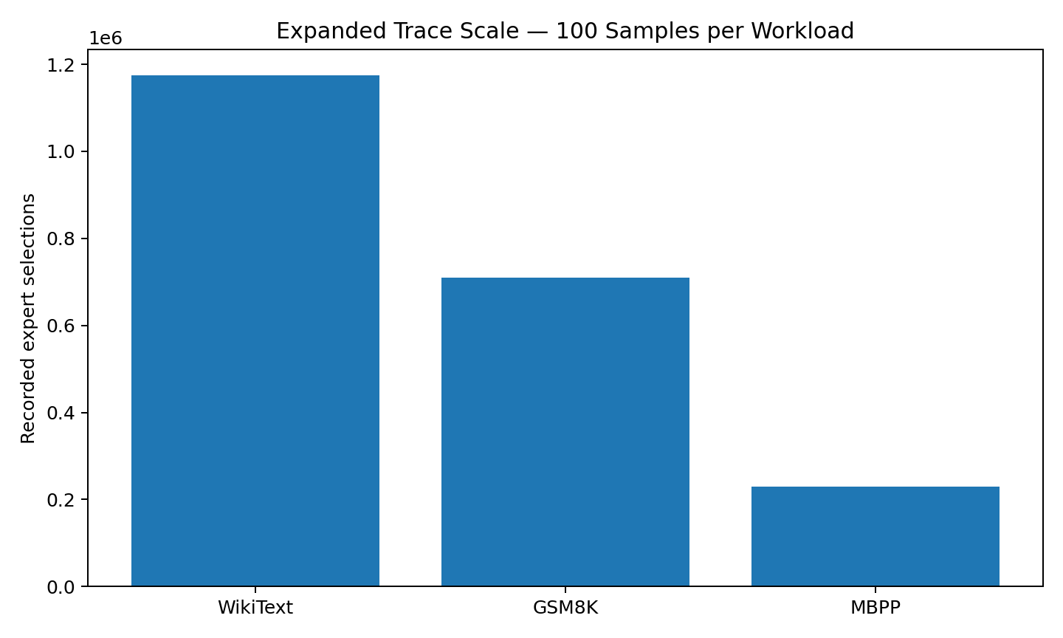
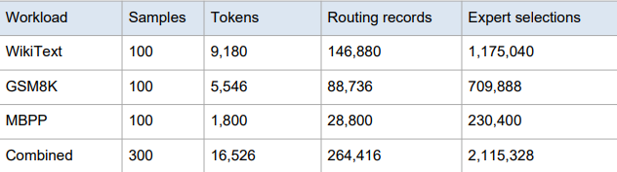
9
Data Set
• Validation checks:
  100 unique sample IDs per workload
  all 16 layers present for each token
  exactly 8 experts
  Expert IDs 0–63 and no duplicate expert IDs
• 80/20 train/test split is performed on sample IDs, preventing trace leakage.
Fig 3: Dataset validation and Expert selections

Slide 16
11
METHODOLOGY
1. Trace
Collection
2. Locality
Analysis
3. Models make Expert
Prediction
4. Prefetch
into Cache
5. Replay Actual
Requests
6. Evaluate
Precision • Coverage • Disk • Latency
Fig 4: Methodology

Slide 17
12
Preprocessing
• Raw model routing is converted into JSONL records for reproducible replay.
• Each routing event stores the layer ID, token position, selected expert IDs and routing weights.
• Trace validation enforces 16 layers × 8 selected experts per token.
• Expanded datasets: 100 samples/workload; 80 train + 20 test by sample ID.
• Scale relationships: routing records = tokens × 16; expert selections = tokens × 16 × 8.

Slide 18
15
Models Implemented
LRU
Baseline
History
Predictor
Transition
Predictor
• LRU: reactive baseline with no prediction/prefetching.
• History: ranks recently observed experts and predicts frequent candidates.
• Transition: learns layer-aware relationships between current and subsequent expert sets.
• All cache keys are layer-aware: (layer_id, expert_id).

Slide 19
14
Predictor–Cache Evaluation Pipeline
Current
Experts
Predictor
Predicted
Experts
cache.prefetch()
Actual Expert
Request
cache.request()
GPU / CPU /
Disk
Fig 5: Predictor – Cache evaluation
Prediction → prefetch → actual request → hit/miss → modeled cost

Slide 20
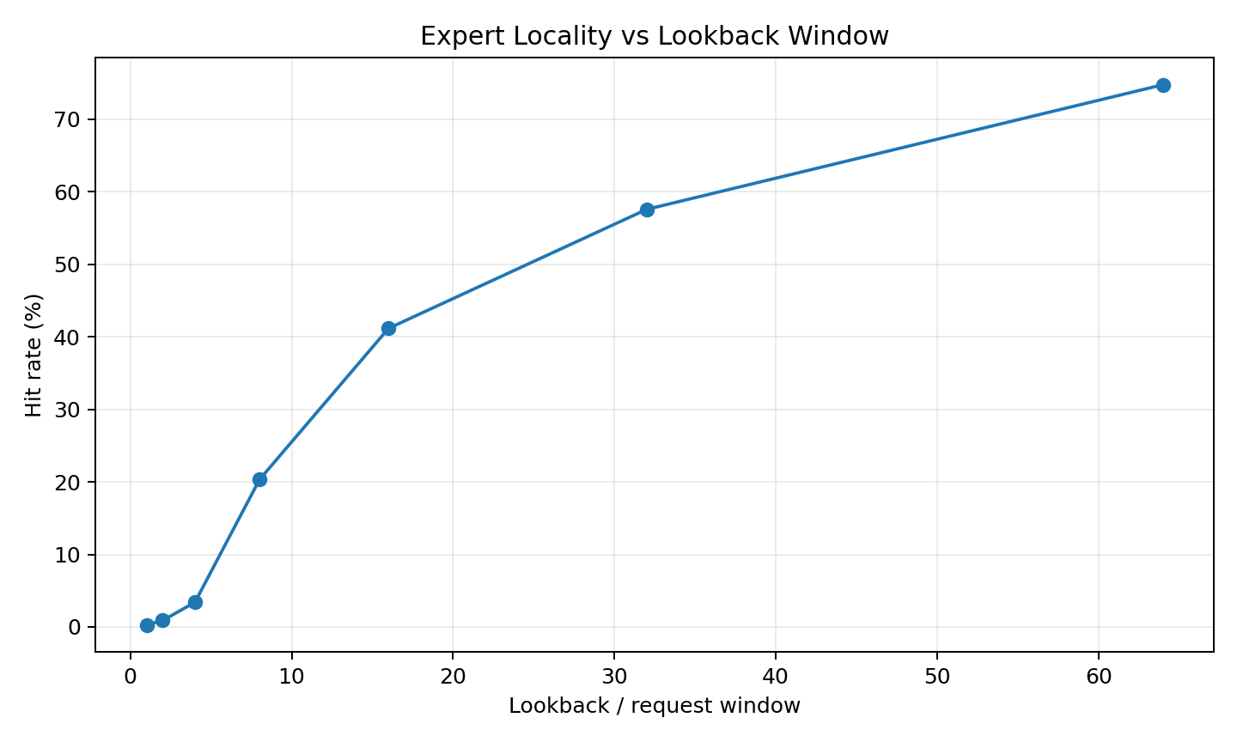
17
Locality & Temporal Structure
• Lookback window = how much past history is examined.
• WikiText hit rate rises from 0.27% at window 1 to 74.77% at window 64.
• Larger windows contain the smaller windows plus more history, so this locality measure is non-decreasing.
• This establishes measurable temporal structure worth predicting.
Fig 6: Expert Locality vs Lookback window graph

Slide 21
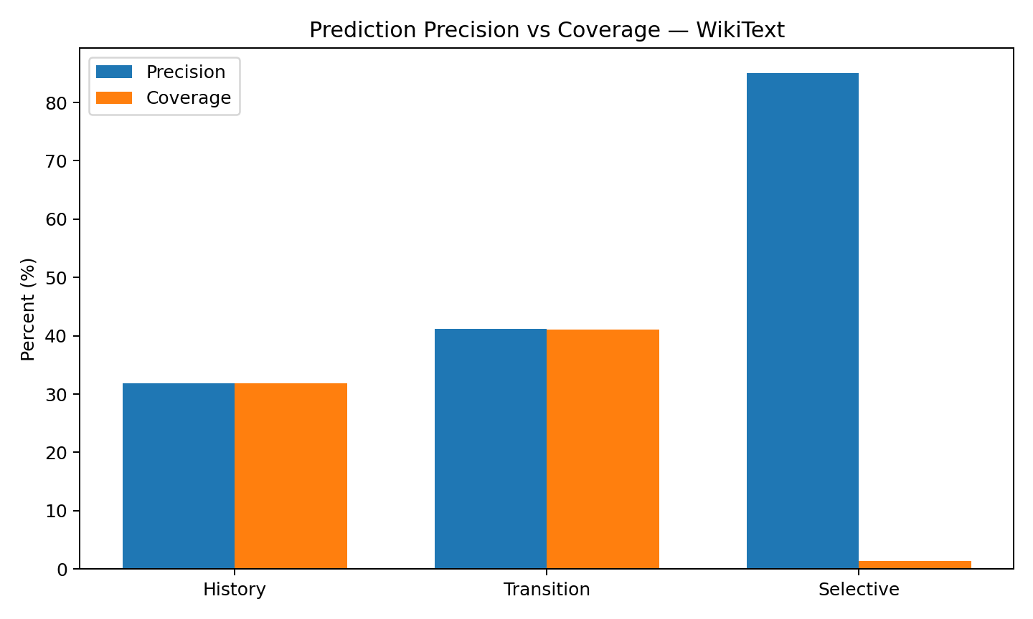
20
Prediction Results
Strategy | Precision | Coverage | Role
History | 31.83% | 31.80% | Simple reuse
Transition | 41.17% | 41.10% | High-coverage
Selective | 85.07% | 1.41% | High-confidence
• Transition provides the strongest high-coverage predictor in this preliminary WikiText comparison.

Slide 22
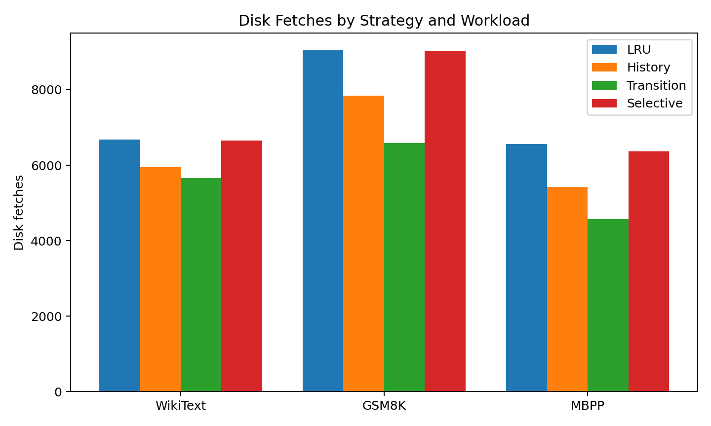
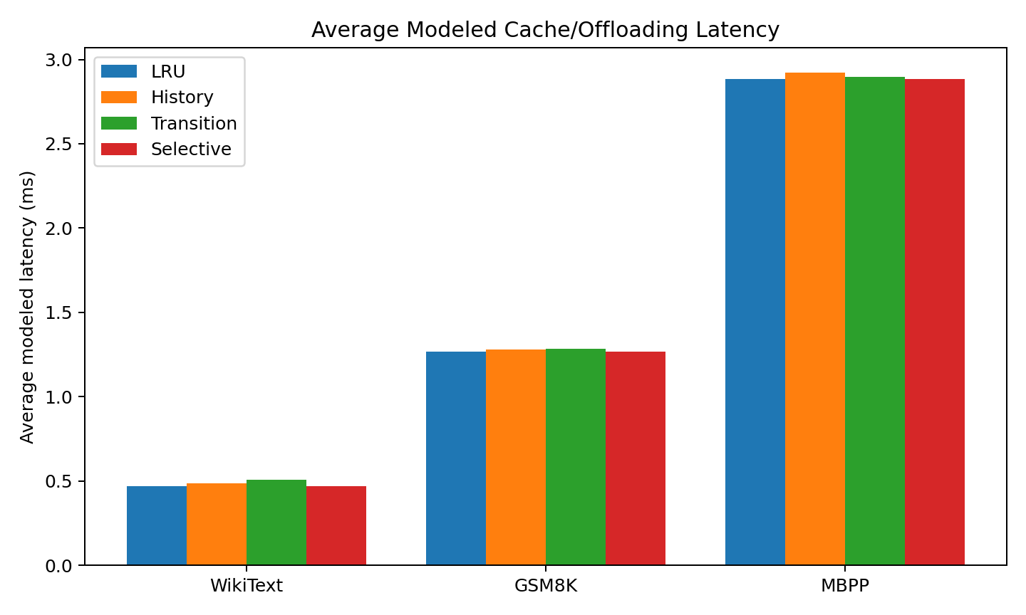
19
Cross-Workload & Cache Results
Transition generally improves coverage and reduces disk fetches, while added prefetch cost can increase modeled latency.
These strategy/cache plots are preliminary 10-sample experiments; the 100-sample traces have been collected and split, but the full strategy comparison has not yet been rerun on them.

Slide 23
Introduction to Future work
16
Expert Activation Matrix (EAM)
• Each EAM records activation counts for (layer, expert) across a sample.
• For N tokens, total EAM activations = N × 16 × 8.
• 80 training EAMs were built and compared with cosine similarity.
• The prototype retrieves similar historical samples and aggregates their future expert activity.
• This is a prototype/future predictor direction, not the final adaptive policy.
Expert Activation Matrix: 16 layers × 64 experts

Slide 24
Timeline
Literature Survey
Implementation
Testing
Document Submission
August – October 1st week (Halfway Implementation)
2nd week of November
As per guidance
Abstract Submission
21/07/2026
11/08/2026

Slide 25
20
Conclusion
• Established a routing-trace → prediction → cache-evaluation pipeline using real OLMoE.
• Collected and validated 100 samples each from WikiText-103, GSM8K and MBPP and created leakage-safe 80/20 splits.
• Demonstrated temporal structure and implemented History, Transition and Selective predictors.
• Connected predictors to a layer-aware GPU/CPU/Disk cache model and quantified the precision–coverage–overhead trade-off.
• Next: rerun full evaluations on expanded traces, evaluate a MoE-Infinity-style baseline, refine EAM prediction, develop an adaptive policy, and integrate with live OLMoE for real end-to-end measurements.

Slide 26
References
[1] Eliseev, A. and D. Mazur. “Fast Inference of Mixture-of-Experts Language Models with Offloading”, arXiv preprint arXiv:2312.17238, 2023.
[2] Xue, L., Y. Fu, Z. Lu, L. Mai, and M. Marina. “MoE-Infinity: Offloading-Efficient MoE Model Serving”, arXiv preprint arXiv:2401.14361, 2024.
[3] Muennighoff, N., L. Soldaini, D. Groeneveld, K. Lo, J. Morrison, S. Min, W. Shi, P. Walsh, O. Tafjord, N. Lambert, Y. Gu, S. Arora, A. Bhagia, D. Schwenk, D. Wadden, A. Wettig, B. Hui, T. Dettmers, D. Kiela, A. Farhadi, N. A. Smith, P. W. Koh, A. Singh, and H. Hajishirzi. “OLMoE: Open Mixture-of-Experts Language Models”, International Conference on Learning Representations (ICLR), 2025.
[4] Kamahori, K., T. Tang, Y. Gu, K. Zhu, and B. Kasikci. “Fiddler: CPU-GPU Orchestration for Fast Inference of Mixture-of-Experts Models”, International Conference on Learning Representations (ICLR), 2025.

Slide 27
[5] Song, Y., Z. Mi, H. Xie, and H. Chen. “PowerInfer: Fast Large Language Model Serving with a Consumer-grade GPU”, Proceedings of the ACM SIGOPS 30th Symposium on Operating Systems Principles (SOSP), pp. 590–606, 2024
[6] Xue, F., Z. Zheng, Y. Fu, J. Ni, Z. Zheng, W. Zhou, and Y. You. “OpenMoE: An Early Effort on Open Mixture-of-Experts Language Models”, Proceedings of the 41st International Conference on Machine Learning (ICML), Vol. 235, pp. 55625–55655, 2024.
[7] Dai, D., C. Deng, C. Zhao, R. X. Xu, H. Gao, D. Chen, J. Li, W. Zeng, X. Yu, Y. Wu, Z. Xie, Y. K. Li, P. Huang, F. Luo, C. Ruan, Z. Sui, and W. Liang. “DeepSeekMoE: Towards Ultimate Expert Specialization in Mixture-of-Experts Language Models”, Proceedings of the 62nd Annual Meeting of the Association for Computational Linguistics (ACL), Vol. 1, pp. 1280–1297, 2024.

Slide 28
[8] Tang, P., J. Liu, X. Hou, Y. Pu, J. Wang, P.-A. Heng, C. Li, and M. Guo. “HOBBIT: A Mixed Precision Expert Offloading System for Fast MoE Inference”, arXiv preprint arXiv:2411.01433, 2024.
[9] Borzunov, A., D. Baranchuk, T. Dettmers, M. Riabinin, Y. Belkada, A. Chumachenko, P. Samygin, and C. Raffel. “Petals: Collaborative Inference and Fine-tuning of Large Models”, Proceedings of the 61st Annual Meeting of the Association for Computational Linguistics (ACL), Vol. 3: System Demonstrations, pp. 558–568, 2023.
[10] Song, L., Z. Pang, W. Wang, Z. Wang, X. Wang, H. Chen, W. Song, Y. Jin, D. Meng, and R. Hou. “The Early Bird Catches the Leak: Unveiling Timing Side Channels in LLM Serving Systems”, arXiv preprint arXiv:2409.20002, 2024.
[11] Dunsche, M., M. Maehren, N. Erinola, R. Merget, N. Bissantz, J. Somorovsky, and J. Schwenk. “With Great Power Come Great Side Channels: Statistical Timing Side-Channel Analyses with Bounded Type-1 Errors”, 33rd USENIX Security Symposium (USENIX Security 24), pp. 6687–6704, 2024.

Slide 29
THANK YOU

