Slide 1
ANALYSIS OF CRYPTO CURRENCY GROWTH IN LAST 5 YEAR
Tejas Dhamane
Sinhgad Academy Of Engineering, Pune
github link

Slide 2

PROBLEM STATEMENT
To Evaluate the crypto market over last 5 years and to analyse the various cryptos present in market and giving reasonable data to investers for future investments

Slide 3
PROJECT DESCRIPTION
This Project is dedicated to analyse the crypto market in various aspects like opening, closing, high, low of various crptos present in market over last 5 years.
Since this type of investment involves higher risk for the investors. So by analysing the data which can give prior idea to investors about their respective crypto and past performance in market depending upon there marketcap in last few years in the market
This Project aims to identify patterns, trends & insights that can inform investor strategies, market prediction & a better understanding of market dynamics
This Project had generated a comprehensive report that summarize the finding and insights from the analysis. Provides actionable recommendation based on the analysis to help stockholder make informed decision .This is the detailed description about this project

Slide 4
WHO ARE THE END USERS?
The End user of the analysed data are the various investors who regularly invest in crypto market which is growing wisely in last few years so that they can invest the money statistically and can make the strategies to grow in crypto market by doing investment plans for long term goals

Slide 5

Technology Used
POWER BI
EXCEL

Slide 6
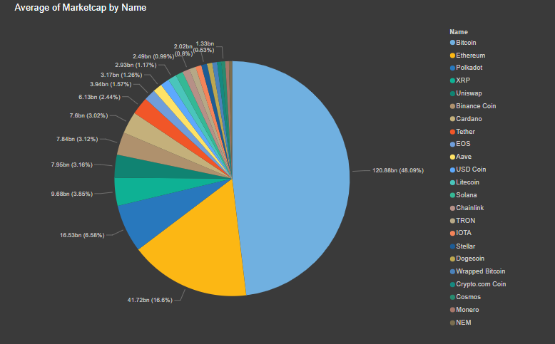
RESULTS

Slide 7
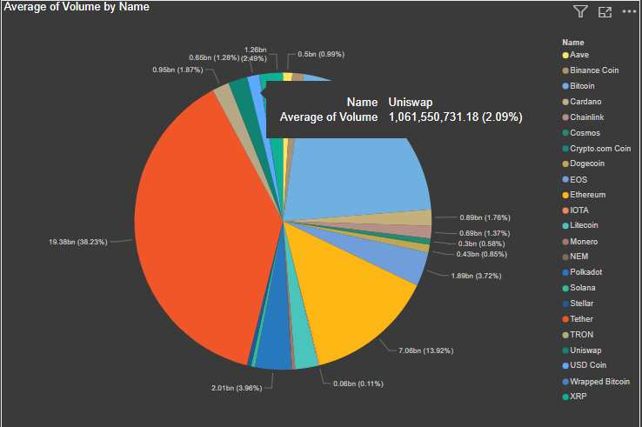

Slide 8
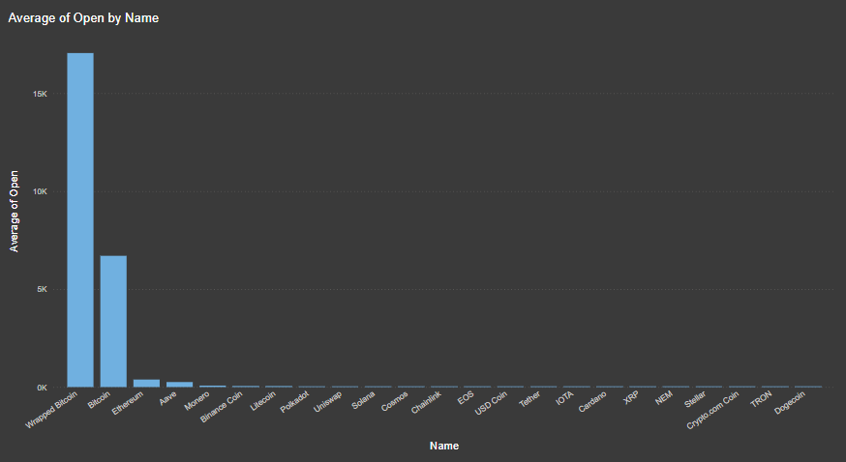

Slide 9
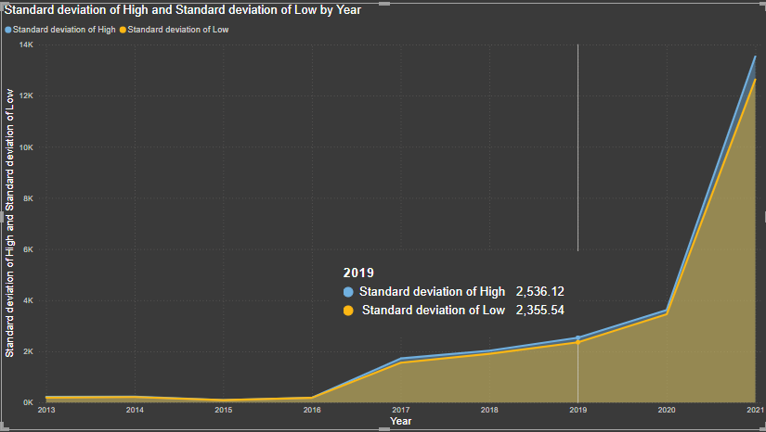

Slide 10
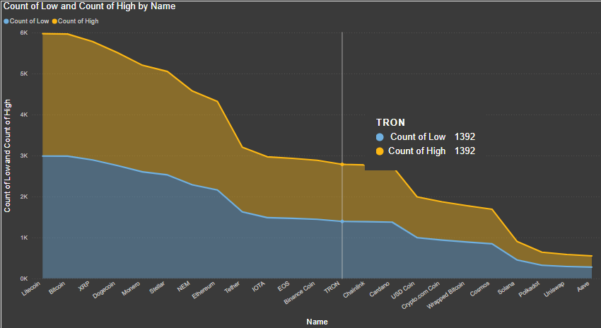

Slide 11
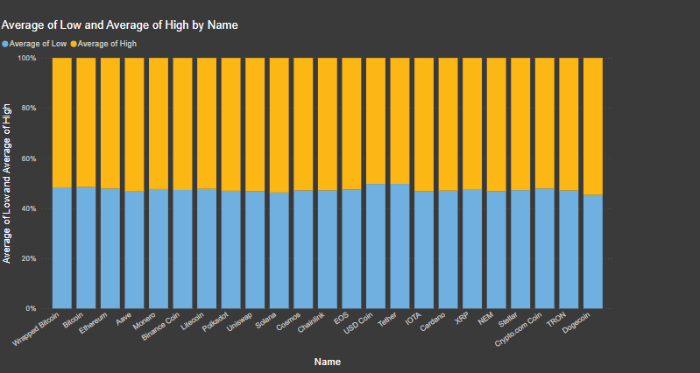

Slide 12
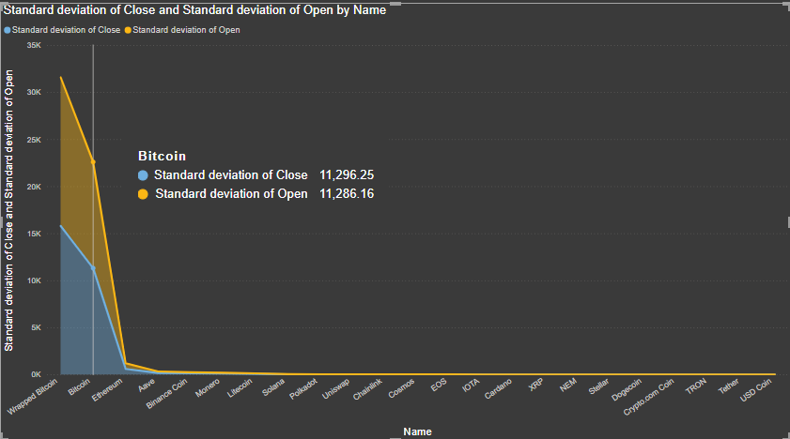

Slide 13
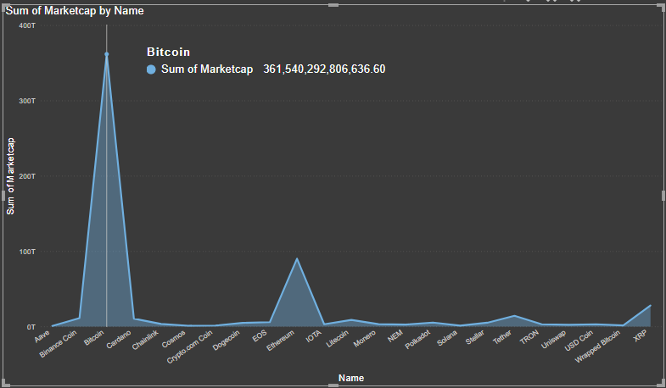

Slide 14
THANK YOU !
github link

