Slide 1
Life Expectancy Via Lance of Visualization

Slide 2
Agenda
Introduction
What is life expectancy?
1901-2019: Global Change in life expectancy and GDP
Key Findings: Economic Impact of life expectancy
Recommendation
Conclusion

Slide 3
Introduction to Data!
Life Expectancy
Population
Income per Capita

Slide 4
What is life Expectancy?
Let’s start with Understanding the life expectancy

Slide 5
Life expectancy is a measure of how long the average person lives in a given country.

Slide 6
Some information
Life Expectancy is usually calculated by just averaging out the ages at which people die to get the mean value.
Low life expectancy is highly driven by the young death
Higher life expectancy is affected by the medical facilities and its availability in the country

Slide 7
1901-2019 Global change in Life expectancy and GDP

Slide 8
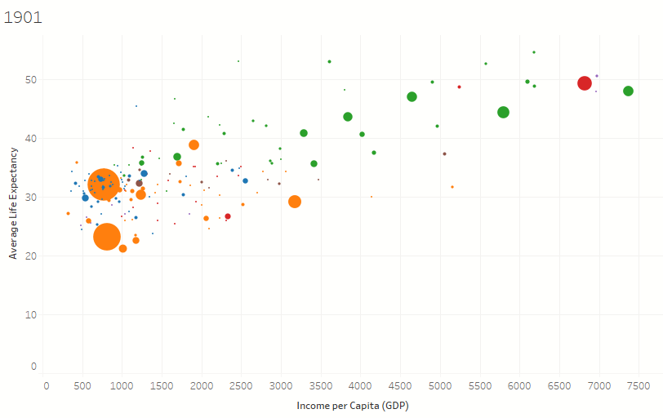
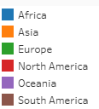
Life expectancy ranging from 20 – 55 years
Income per capita ranging from 0 – 7500 $

Slide 9
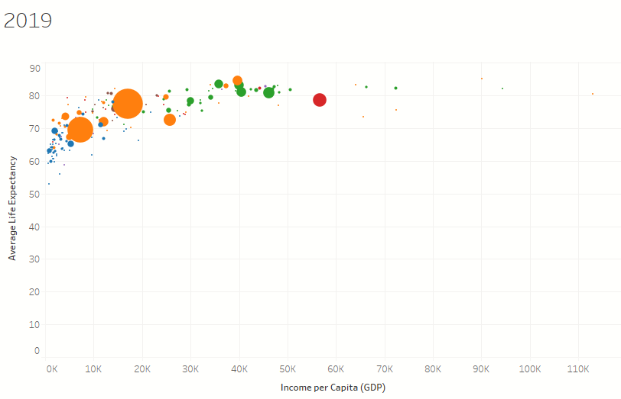
Life expectancy ranging from 55 – 85 years
Income per capita ranging from 0 – 110 $

Slide 10
Key Findings Economic impact of life expectancy

Slide 11
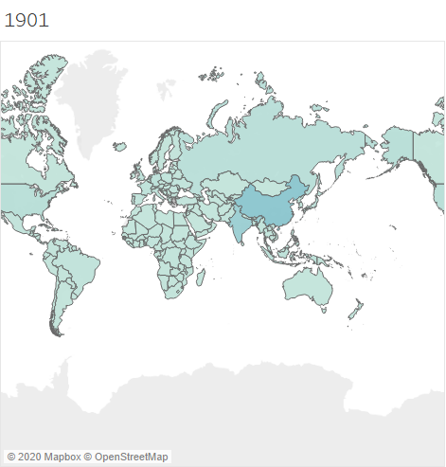
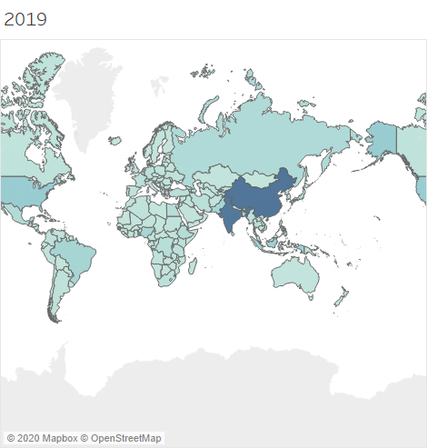
One can notice significant change in population of some Asian countries such as India, china, Pakistan etc.
Population in Europe, middle east and some African countries has not changed too much compare to other

Slide 12
Key findings: 3 Scenarios
1.Above 75 years
Too high life expectancy, leads to less fertility rate.
2.Between 65-75 years
Medium life expectancy, high fertility rate
Birth ration decreases, Population rate stays in control, Economic grows positively fast
Ex: Countries in Europe
High increment in population, Slows down the economic growth.
Ex: Asian countries such as India, China, Pakistan

Slide 13
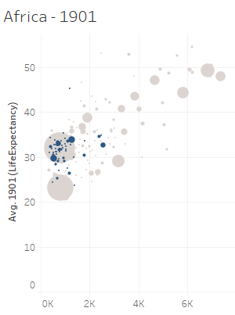
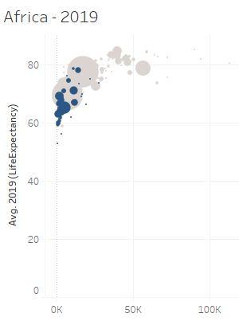
Key findings: 3 Scenarios cont…
3. Less than 65 years
Low life expectancy and low economic growth.
Total contrast from other two scenarios
Because excluding some countries most of the African countries have been left behind in technology, education and healthcare.
It leads to high young age death and poverty.

Slide 14
Recommanded Actions
1.
- High chronic illness
- Country is aging
Awareness to increase birth rate
Produce more and cheap generic medicine for chronic illnesses
2.
- High population
- Slowing down economic growth
Awareness to control birthrate
Improve education to improve awareness about problem of high population
3.
- Low healthcare facility
- Young age death
- Countries in Danger
Increase efforts to provide good food, education and health care in cheap rate to reduce the young death and to stable the economy

Slide 15
Thanks!

