Slide 1
Java ATM Project
Review 1: Project Setup, Database, and UI
Team Name : Code & Coffee
Team Lead : Tejas Singh Nirvan
Member 2 : Ashwini Kumar
Member 3 : Ansh
Member 4 : Pratayush Srivastava

Slide 2
Project Overview
• Graphical ATM simulator using Java
• Supports login, deposit, withdrawal, balance inquiry
• Swing for GUI, MySQL for database
• Follows layered architecture for maintainability

Slide 3
JDK & IDE Setup
• Java SE 17 as the development kit
• IDE: Visual Studio Code (VS Code) with Java Extension Pack
• MySQL Community Server for database management
• JDBC Connector for Java-MySQL integration
• VS Code Terminal and Debugger used for testing and execution

Slide 4
Project Structure
• model - POJOs like User
• dao - DB access classes (UserDAO, etc.)
• Ui - Swing GUI components
• main - Launcher class and init code

Slide 5
Database Schema
• Database: atm_db
• Table: users
• Columns: id (PK), username, pin, balance
• Connected via JDBC

Slide 6
JDBC Integration
• Driver: com.mysql.cj.jdbc.Driver
• Database URL: jdbc:mysql://localhost:3306/atm_db
• Operations: INSERT, UPDATE, SELECT
• Error handling with try-catch blocks

Slide 7
DAO Implementation
• UserDAO: fetch user by ID, update balance
• Reusable methods for DB access
• Encapsulates SQL logic
• Improves modularity

Slide 8
GUI Design: Screenshots
Home Screen
Successful Transaction
Insufficient Fund Warning
Flow Diagram
ER Diagram
Class Diagram

Slide 9
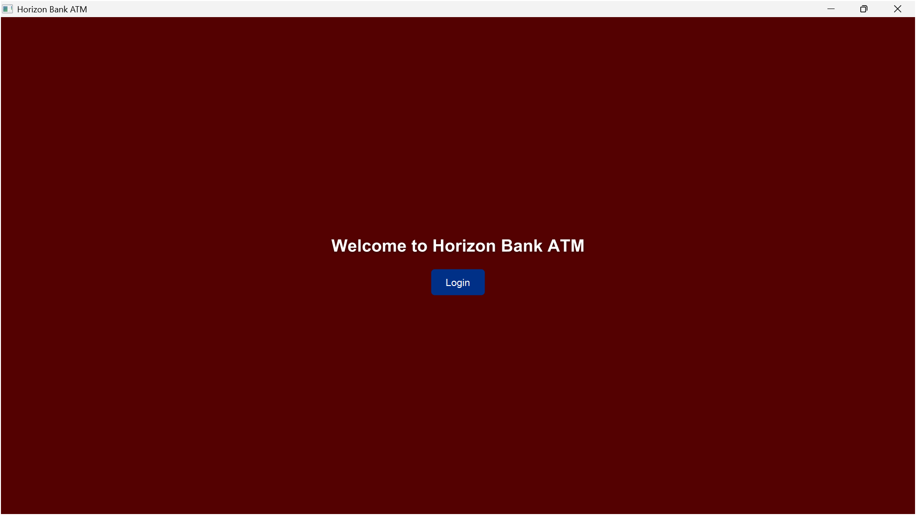
Home Screen

Slide 10
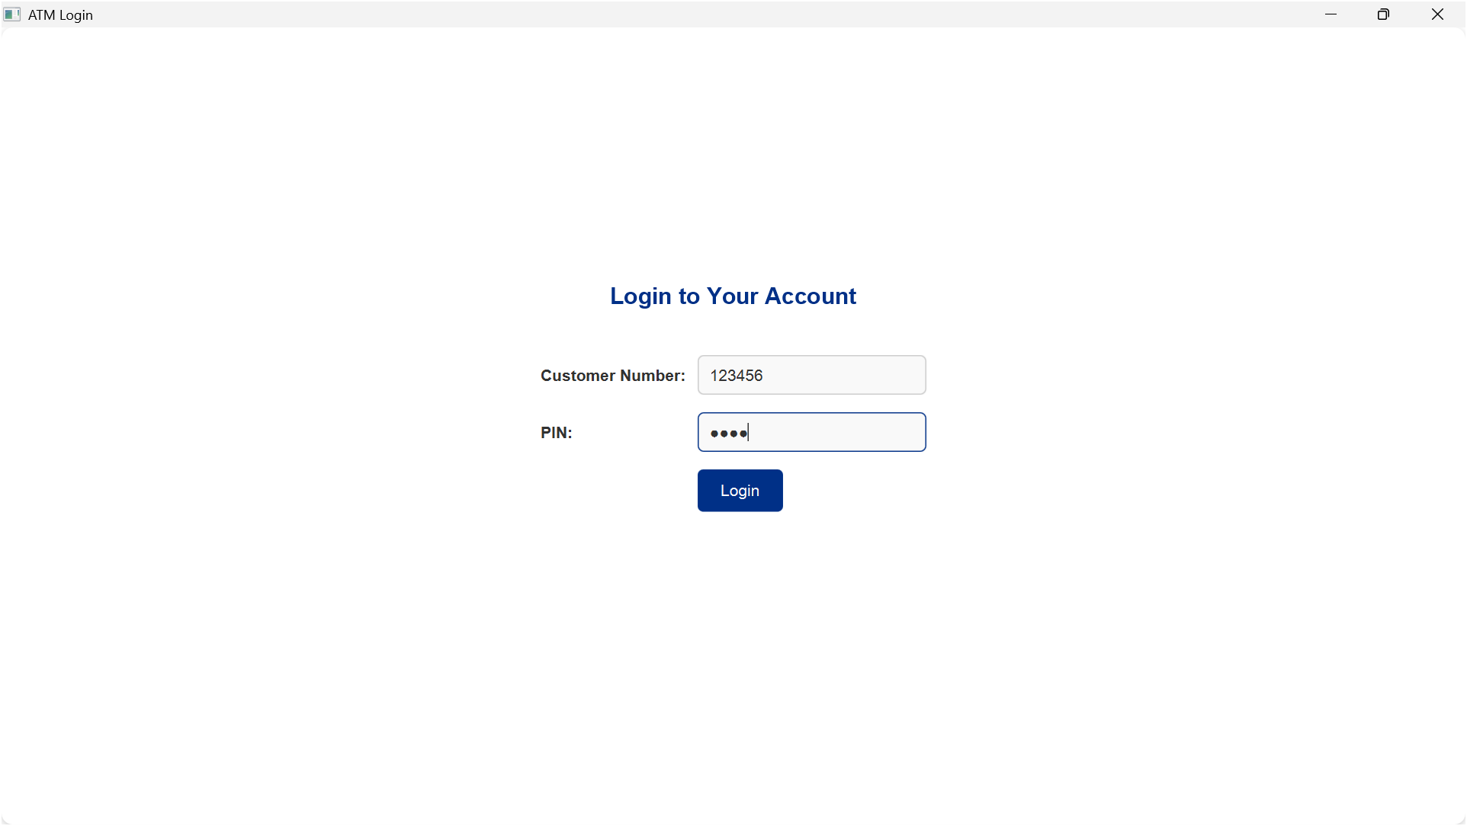
Login Screen

Slide 11
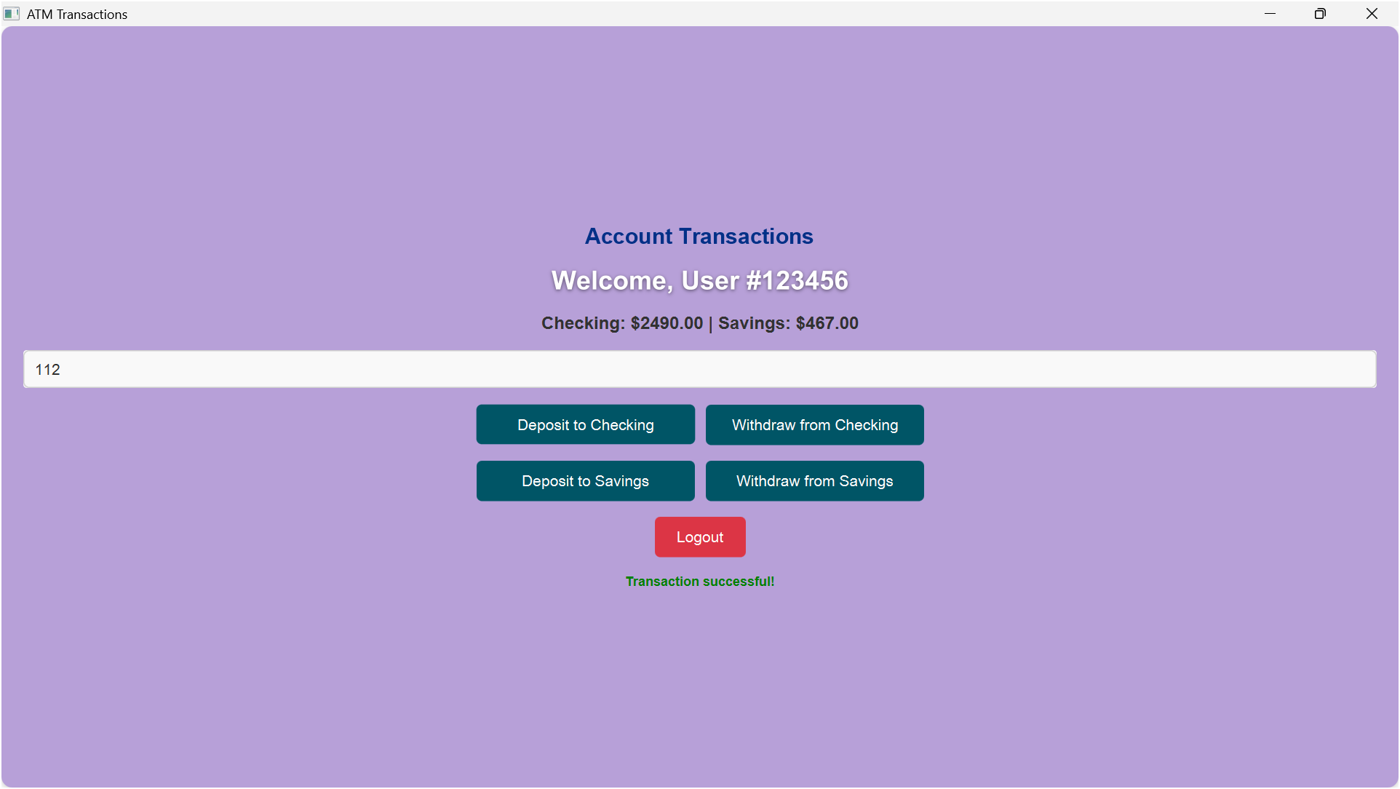
Successful Transaction

Slide 12
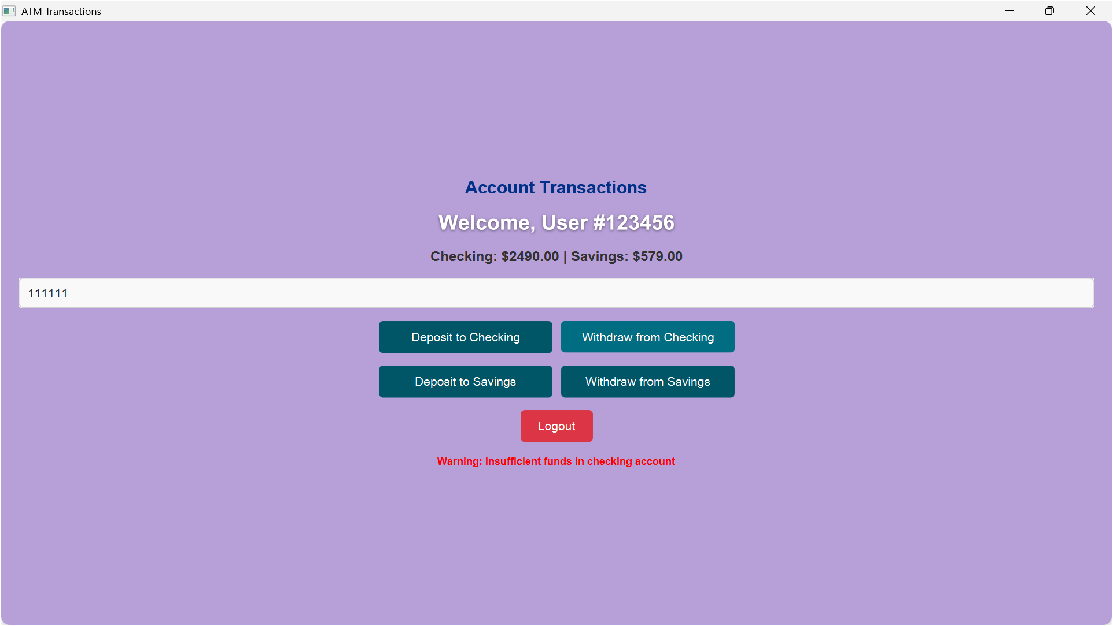
Insufficient Funds Warning

Slide 13
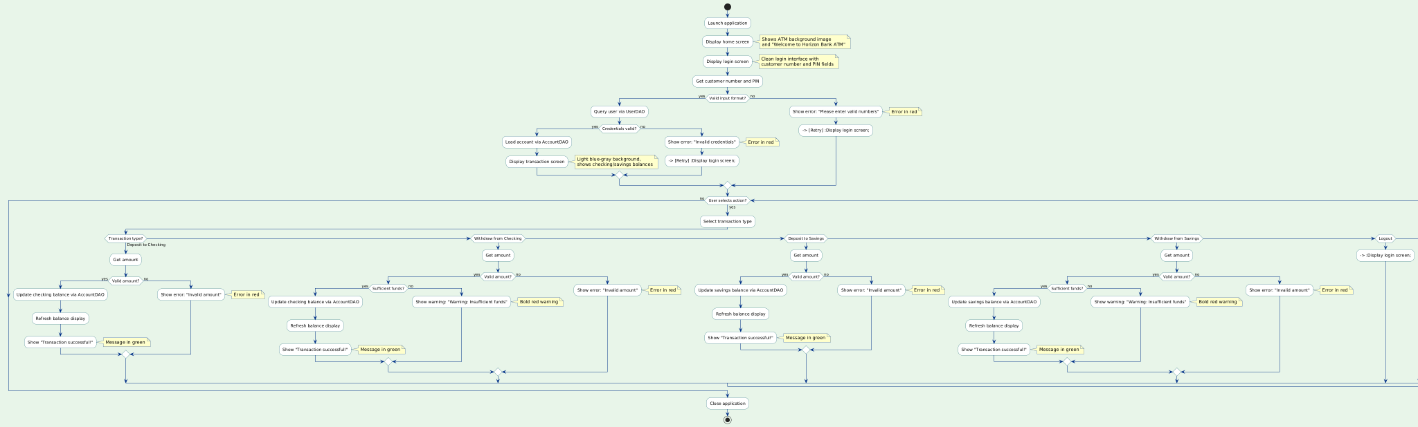
Flow Diagram

Slide 14
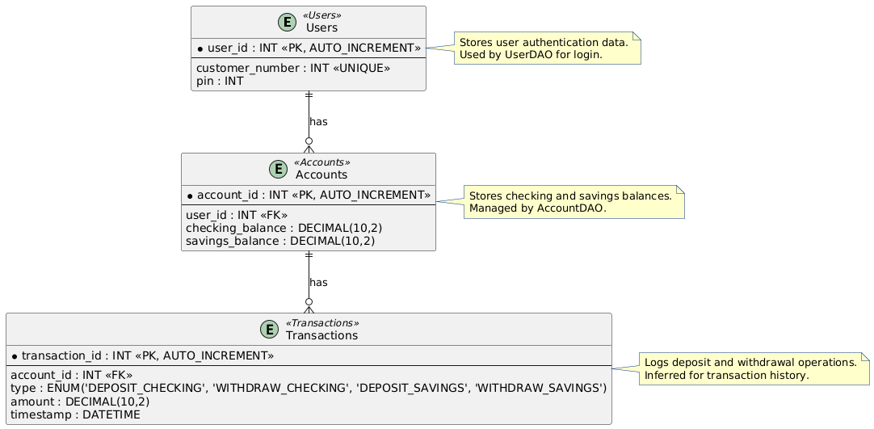
ER Diagram

Slide 15
Class Diagram :

Slide 16
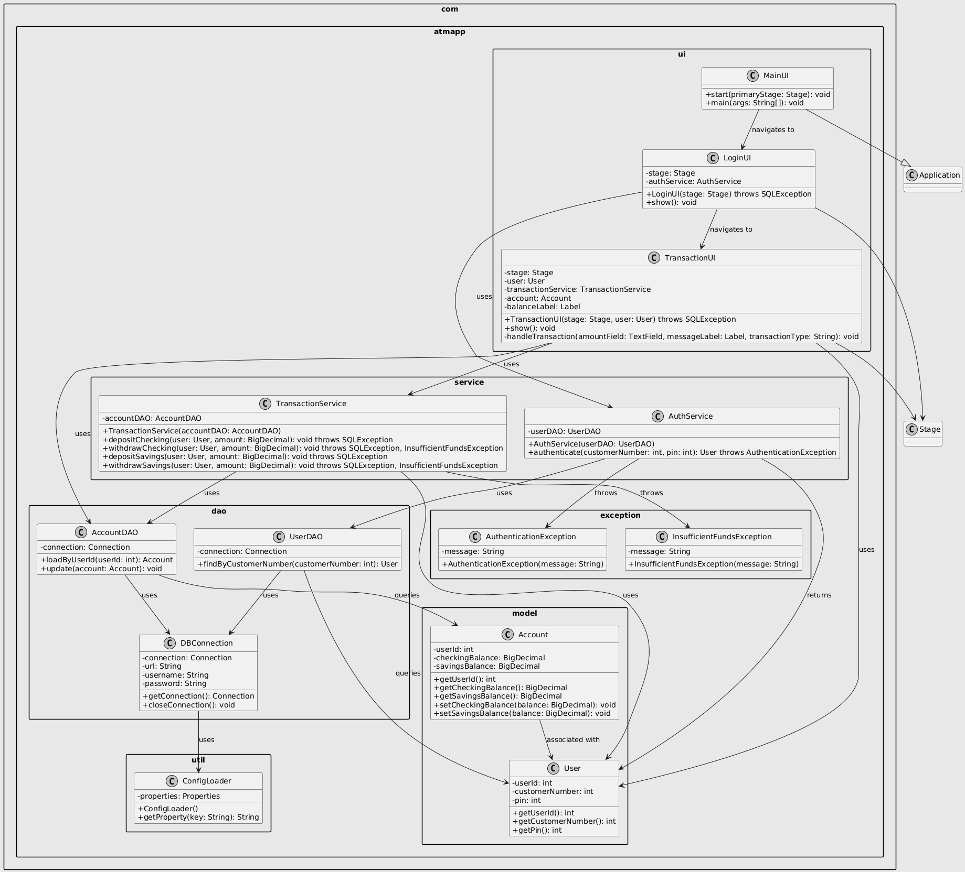

Slide 17


