Slide 1
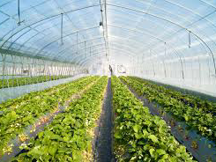
Project Presentation on
Greenhouse Monitoring System.
Presented By:
Yash Pednekar (75)
Tejas Mahajan (71)
Kaushik Dahiwale (59)

Slide 2

Relevance:
Greenhouse Environment, used to grow plants under controlled climatic conditions for efficient production, forms an important part of the agriculture and horticulture sector. To create an optimal environment the main parameters such as temperature, humidity, light intensity, ground water, etc. needs to be controlled.
The main objective of this project work is to design an automated greenhouse which is purely sensor-based system. The system inputs from various sensors and displays output.
The developed system is simple, cost efficient and easily installable. The results show that the system could be more efficient in man power saving and raising the economic value of products.

Slide 3
Problem Definition:
A green house is where plants such as flowers and vegetables are grown. Greenhouses warmup during the day when sun-rays penetrates through it, which heats the plant, soil and structure.
This greenhouse control system is powered by Atmega328 microcontroller it consists of temperature sensor, light sensor, soil moisture sensor, LDR sensor, LCD display module, 12v DC fan, Bulb and pump.
Temperature sensor, senses the level of temperature, if it goes high DC fans gets on and when the temperature goes low the fan gets off. Soil moisture sensor, senses the water level as the level decreases the pumps gets on.
In the absence of light, the LDR sensor senses and the bulb starts glowing. By this way it will become easy to monitor and control the system.

Slide 4
Present Theories And Practices:
Literature Survey:
Greenhouse is a structure, normally built from glass or clear plastic, where crops are grown inside it. Greenhouse’s main task is to offer a protective environment for the crop production while allowing natural light transmission.
the technology is much more common in the western countries
The project uses mathematical models to estimate the parameters measured such as absorption of irradiance, leaf photosynthesis, and respiration. The room temperature being controlled depending to the natural irradiance

Slide 5
Proposed Methodology:
Greenhouse Environment Monitoring and controlling project use four sensors to detect the Temperature, Light, Humidity and Soil moisture in the Greenhouse.
These four sensors is connected to 'Ardunio Uno' ,these sensors detects the activity or taking readings
These readings of sensors is sent to microcontroller & the microcontroller is connected to different relay's
One of the relay is connected to blower to decreasing the temperature and moisture
Another relay is connected to DC Motors to open water outlets for moisture control amd alo to replicate a shade for light control

Slide 6

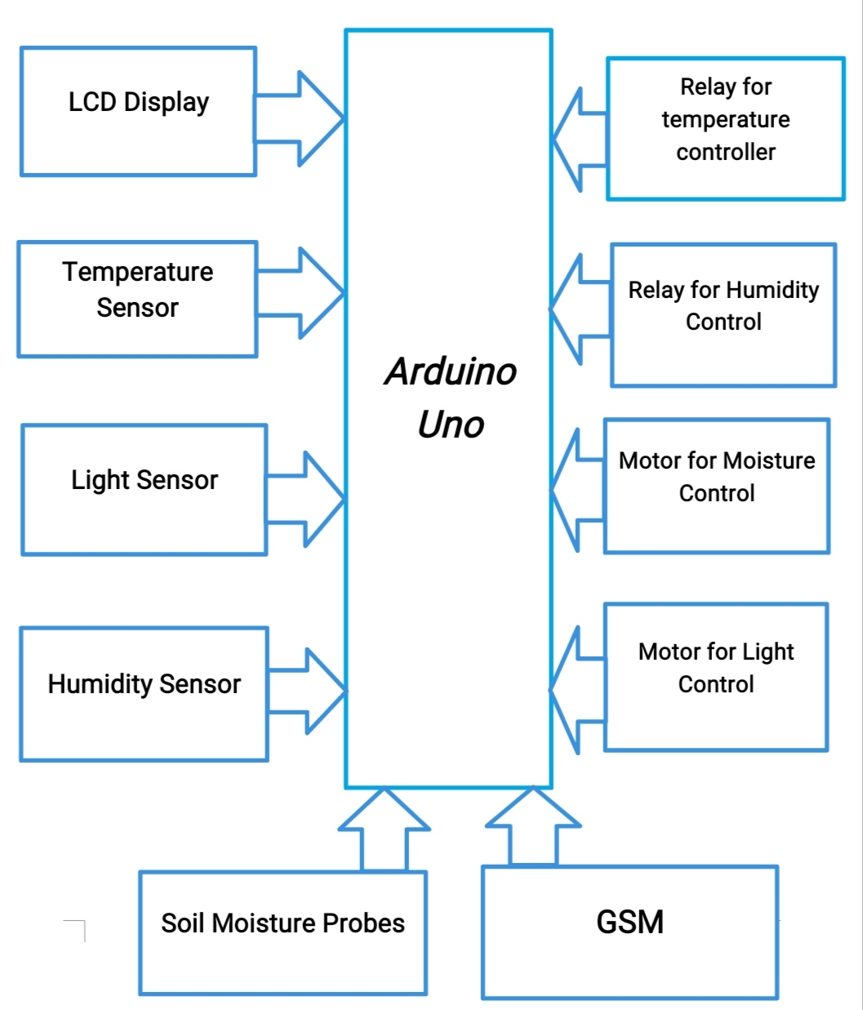
Block Diagram:

Slide 7
Conclusion:
The control system of a greenhouse is very important feature in developing crops and plants whether in small-scale or big-scale productions. Farmers nowadays realize that the investment in the control system can substantially reduce the operation and production costs when it’s been manage optimally. With the control system, manpower is no longer required heavily as what we have seen before. More, the efficiency and reliability of the system also much better that the error-prone manpower.

Slide 8
Future Scope:
IOT based wireless sensor network for monitoring greenhouse effect, global warming, industrial pollution within a greenhouse environment.
The wireless sensor networks automatically monitor the environmental parameters inside a green house and initiates the control measures to be taken.
The system checks the environmental conditions and if the value exceeds threshold level a message will be sent.

Slide 9
References:
https://www.ijser.org/researchpaper
http://www.ijarse.com/images/fullpdf/1526042086_BVNC-74.pdf
https://www.projectsof8051.com/iot-based-greenhouse-monitoring-and-control-system-project/....etc

Slide 10

Thank You!!

