Slide 1
Object navigation Using Unity 3D

Slide 2
Abstract and Scope
This project focuses on development of a
robot that can autonomously navigate
and plot a 2D map. It follows a very basic
approach and is dependent on unity 3D game
Engine.
The entire system consists of a
Car-bot and an application that is used for
monitoring and mapping.

Slide 3

Methodology
unity 3D application for developing the software.
Car-bot which includes motors, H bridge motor driver, Wi-Fi module(ESP8266), batteries etc.,
Technologies used:
1. Image processing:
to process the different frames of the video footage and draw conclusions.
2. Object tracking:
for focussing a target object to follow.

Slide 4
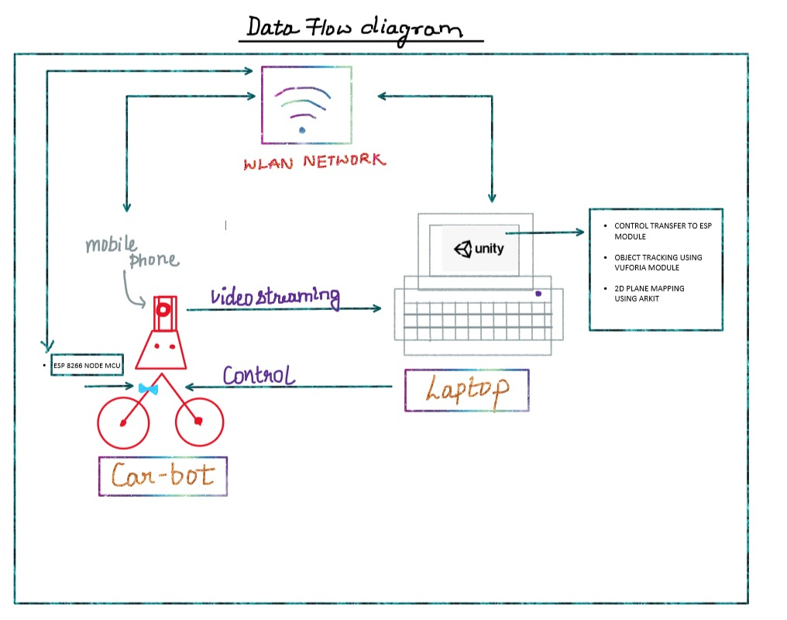

Slide 5
Implementation Details
1.) The first scene allows you to drive around the robot with a camera feed going back to your computer. You can use the arrow keys to drive it around in any direction and the video feed allows you to keep driving even when the robot is out of sight.
for this scene three script files are written
. client file
. server file
. keyboard input behaviour file.

Slide 6
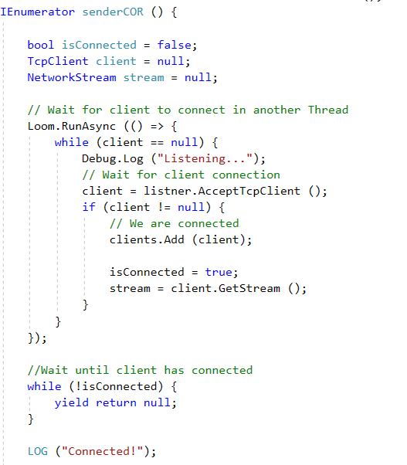
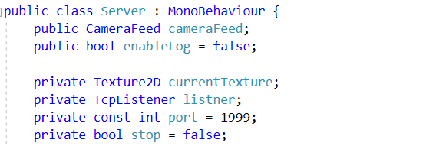
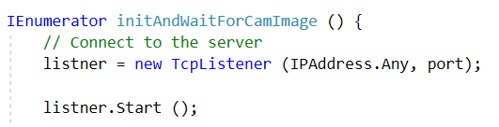
Server file:

Slide 7
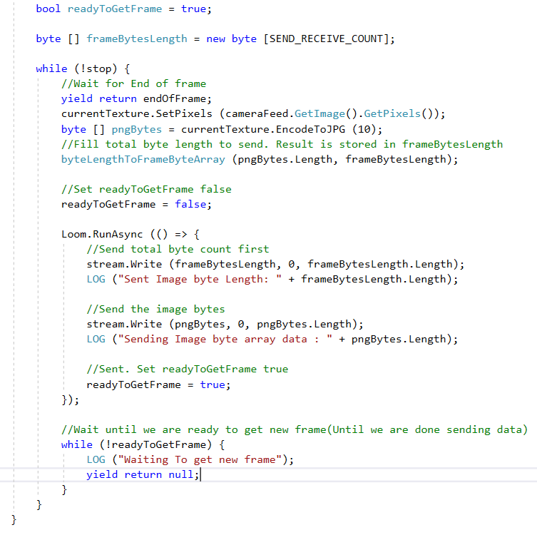

Slide 8
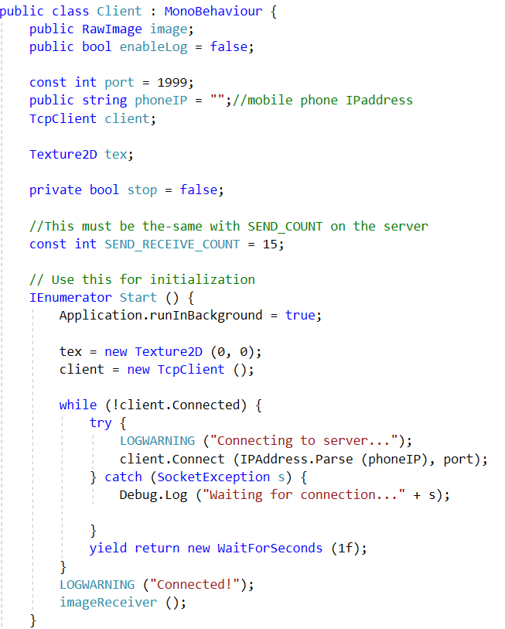
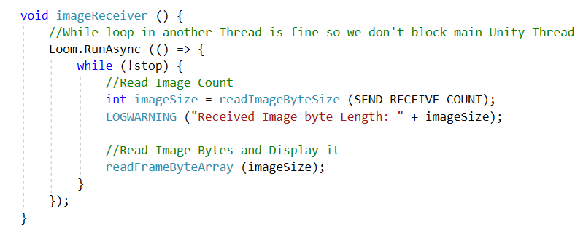
Client file:

Slide 9
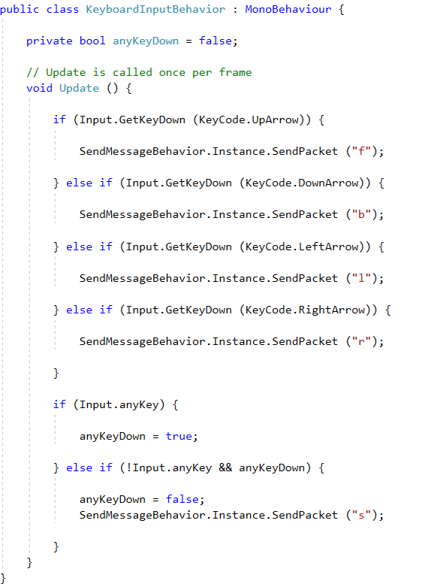
keyboard input behaviour file:

Slide 10
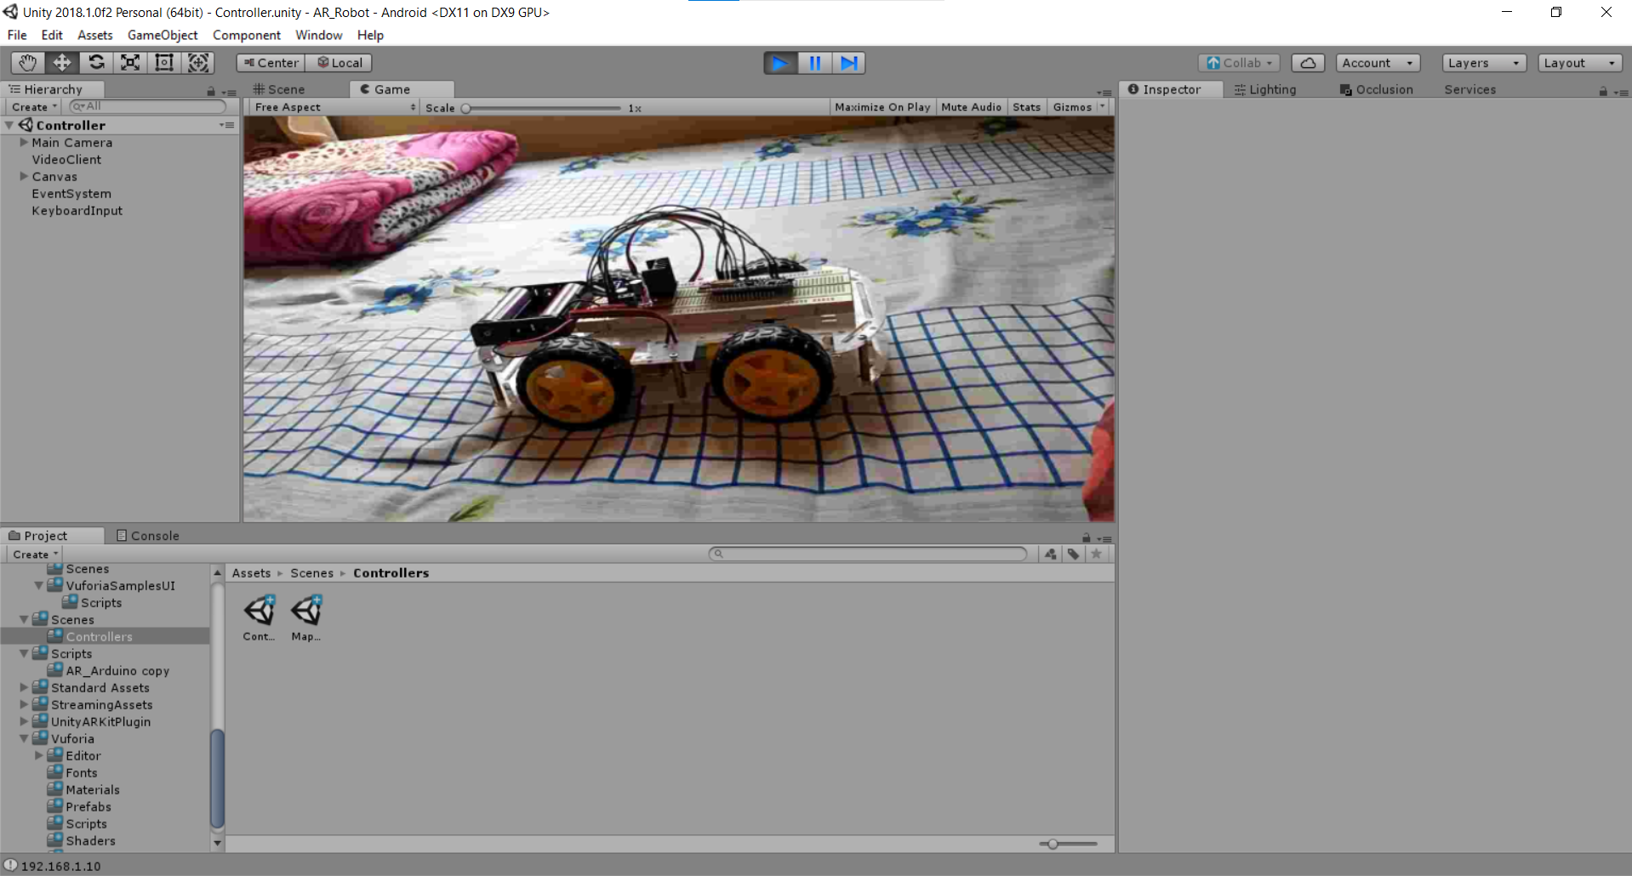

Slide 11
2.) The second scene allows the robot to track anything you put in front of it. You can click the screen to initialize the tracker and then the robot will follow around that object.
for this scene two scripts files are written:
. Send Message Behaviour file
. Robot Follow Behaviour file

Slide 12
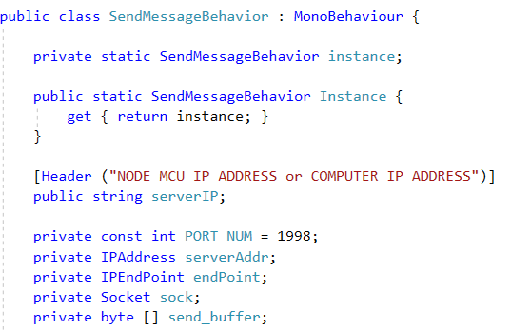
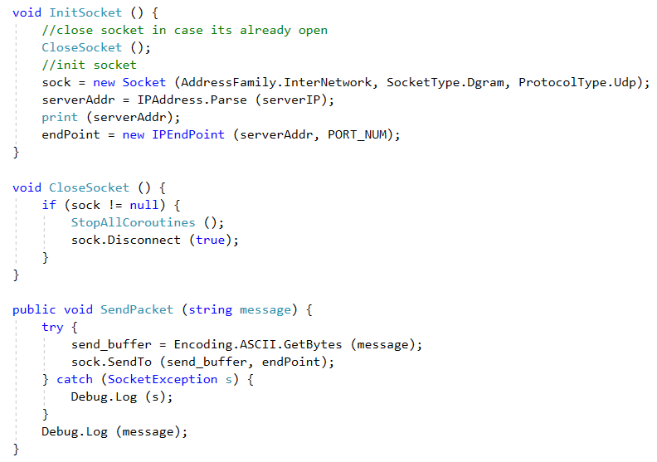
Send message Behaviour file:

Slide 13
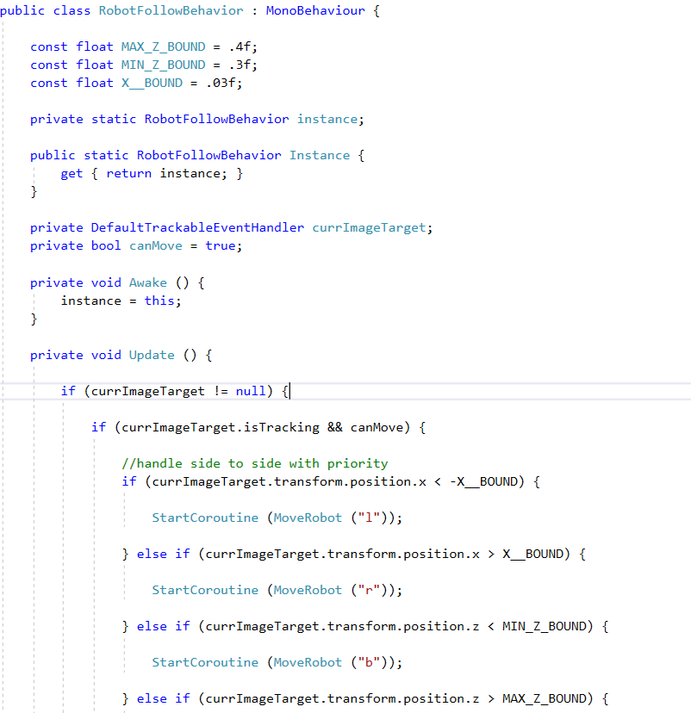
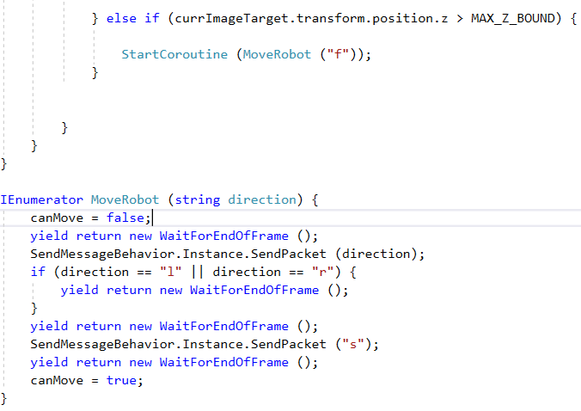
Robot follow behaviour file:

Slide 14
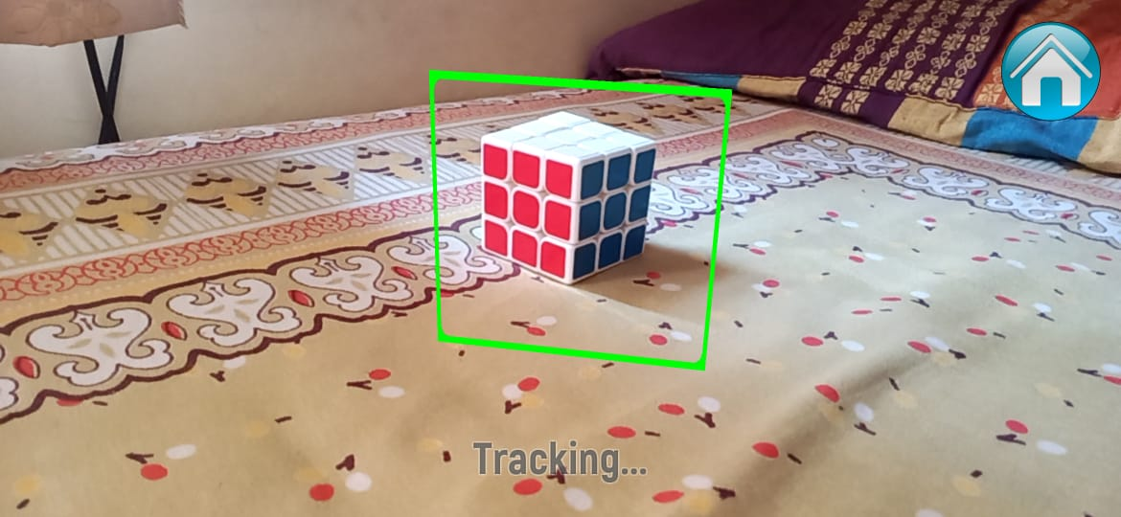

Slide 15
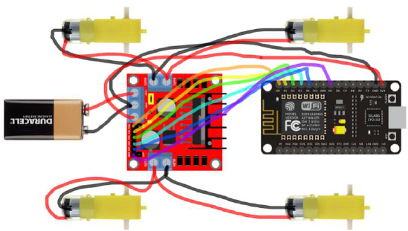
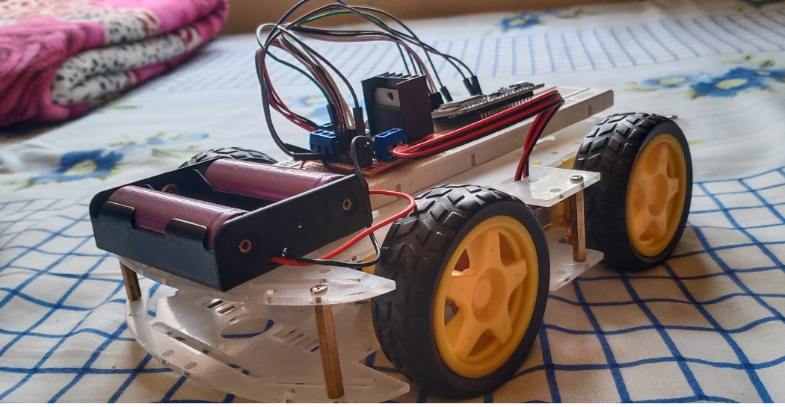
After implimentation
Project Demonstration

Slide 16
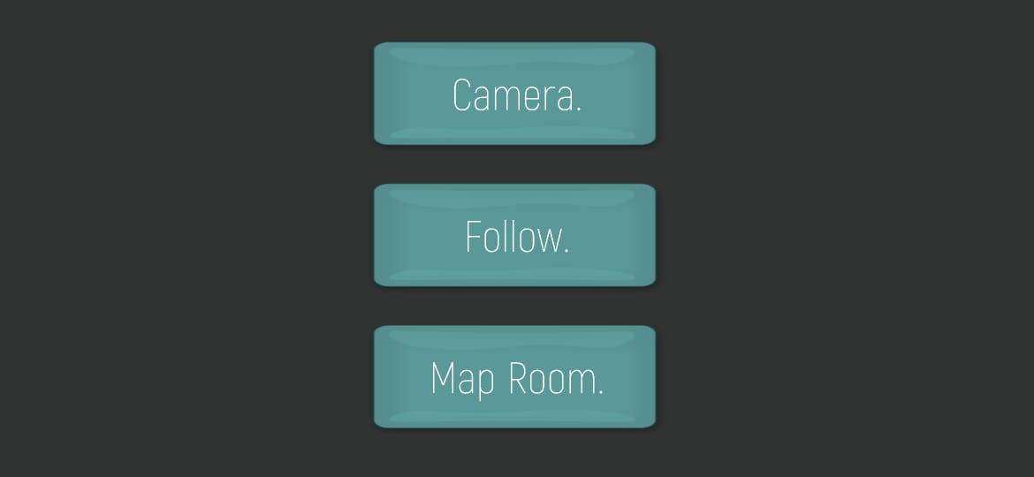
APP interface

Slide 17
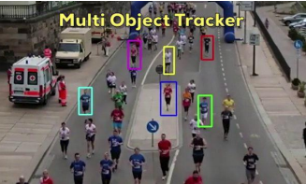
Conclusion and Future work
We have introduced a system
which included mobile robots and a host
computer.This project uses an Arduino
robot running a ESP-8266 Node MCU that
communicates (and drives around) with a
mobile phone. The phone is running an app
made in the video game engine Unity 3D
Future work:
The development features in brief: •
.room mapping
.Multiple object tracking

Slide 18
Thank You

