Slide 1
Superstore Sales Dashboard
Data Analysis Project by Tejas S
May 2025

Slide 2
Project Objective
The goal of this project is to analyze sales performance across different regions, product categories, and customer segments using interactive visuals created in Power BI. The dashboard provides an overview of key metrics such as total sales, profit, and order trends.

Slide 3
Data Model Overview
• Orders Table: Includes transaction details such as Order ID, Date, Sales, Quantity, etc.
• Customers Table: Contains customer names and segment classification.
• Geography Table: Maps customer locations including city, state, and region.
• Relationships are established using primary keys like Customer ID, and Geography Key.

Slide 4
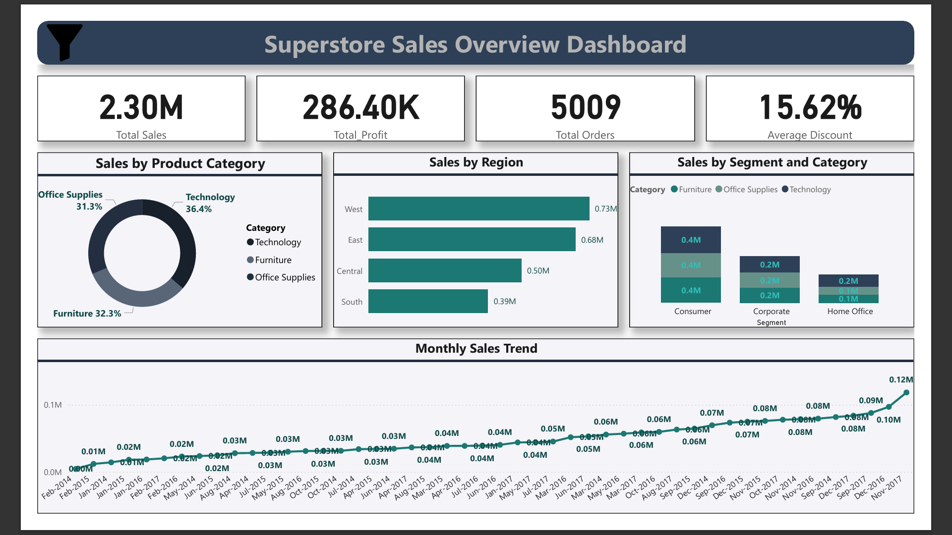
dashboard Overview

Slide 5
Key Insights from Dashboard
• Technology category generated the highest sales (36.4%).
• West region leads with 0.73M in sales.
• Consumer segment shows strong performance across all categories.
• Steady monthly sales growth observed from 2014 to 2017.
• Average discount offered is 15.62%.

Slide 6
Conclusion
This Power BI dashboard enables strategic decisions by providing a clear visual summary of sales performance. It helps identify high-performing segments, regions, and categories, and tracks growth trends to support planning.

