Slide 1
Airbnb Dynamic Pricing & Availability Dashboard
Internship Project – Elevate Labs | May 2025

Slide 2
Project Overview
This project analyzes Airbnb listings data for New York City to explore how factors like room type, pricing, and availability influence estimated revenue. Developed as the final project for my Data Analyst Internship at Elevate Labs.
Platform: Power BI
Theme: Airbnb Brand Colors
Dataset: Kaggle – NYC Airbnb Open Data (2019)

Slide 3
Objective
To help Airbnb hosts and analysts optimize pricing strategies and improve listing performance by visualizing pricing trends, availability patterns, and revenue potential using interactive dashboards.

Slide 4
Tools & Dataset Used
Power BI: Dashboard Design
Power Query: Data Transformation
DAX: KPI Calculations
Dataset: NYC Airbnb Open Data (Kaggle)
Fields: room_type, borough, price, availability_365, minimum_nights

Slide 5
KPIs Defined
Total Listings: Count of unique property IDs
Average Price: Mean price across listingsAverage
Availability: Mean days available/yearTotal Estimated
Revenue: Price × Availability_365

Slide 6
Visualizations in the Dashboard
Avg Price by Minimum Stay Group
Revenue by Borough
Listings by Borough (Pie Chart)
Avg Price by Room Type
Avg Availability by Room Type

Slide 7
Design Choices & Theme
Clean white layout for contrast
Rausch Red (#FF5A5F) for visual focus
Minimalist font + card shadows for depth
Airbnb's modern brand identity reflected in visual tone

Slide 8
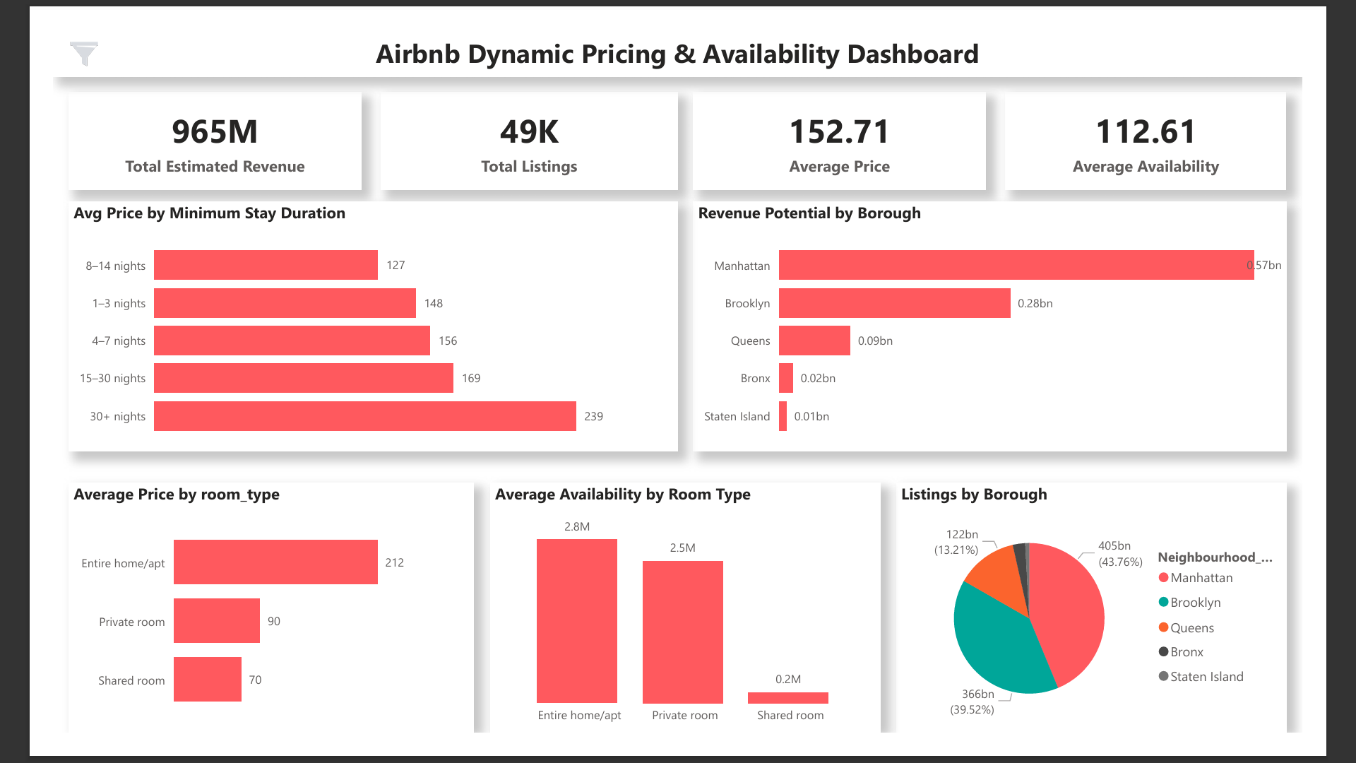
Dashboard Screenshot

Slide 9
Key Insights from Dashboard
Entire homes yield highest average prices and availability
Manhattan and Brooklyn dominate in revenue potential
Longer minimum stays often result in higher prices
Shared rooms generate least revenue and availability

Slide 10
Project Summary – Airbnb Dashboard
Project Title: Airbnb Dynamic Pricing & Availability Dashboard
Dataset: NYC Airbnb Open Data (Kaggle, 2019)
Focus: Understanding how pricing, room types, boroughs, and availability affect potential revenue
KPI Metrics: Total Listings, Average Price, Estimated Revenue, Availability
Unique Feature: Used Airbnb’s brand palette (Rausch Red theme)
Final Outcome: Dashboard deployed and shared via Power BI with all interactive visuals

