Slide 1


Acropolis Institute of Technology and Research, Indore
Department of Information Technology
Problem Statement 5
Autonomous Disaster Response Swarm Robotics
for Search and Rescue
SWARMRESCUE
A drone + rover swarm that works
with zero network: the first 72 hours, automated.
Team LOVE
Team Leader: Tejas Gogawale
Notes:
Open: 'In Nepal in 2015 rescue teams reached remote villages two weeks after the quake. We built the swarm that does not wait.' Product: SwarmRescue, Problem Statement 5. Team LOVE, leader Tejas Gogawale.

Slide 2

Team
LOVE
PROBLEM STATEMENT 5
○ Autonomous Disaster Response Swarm Robotics for Search and Rescue
What the problem asks
Build an autonomous, decentralised, heterogeneous swarm: drones (UAVs) + ground robots (UGVs)
Explore GPS-denied, cluttered disaster zones: collapsed buildings, rubble, tunnels
Find survivors with thermal + acoustic sensing and share what is learned peer to peer
Locate victims efficiently: fast, no double counting, no wasted trips
Deliver an end-to-end working, scalable, real-world-ready system
Requirement | SwarmRescue answer
Decentralised | Every robot runs the same MARL + GNN policy; talks only to neighbours in range; no ground-station dependency
Heterogeneous | 4 UAVs (wide, fast, short battery) + 2 UGVs (narrow gaps, rubble, long endurance), different roles and rewards
GPS-denied | Local-frame odometry only (simulated VIO, labelled); photo-to-map location with SIFT + RANSAC
Thermal + acoustic | Thermal/RGB on drones; rover microphone-array direction-of-arrival for victims buried under rubble
Peer-to-peer sharing | CRDT victim registry + shared voxel map between robots; phones relay via BitChat mesh; LoRa nodes
Efficient location | GNN goal allocator, frontier search, exactly-once counting, nearest-rover dispatch by route length
End-to-end, scalable | PX4 + ROS 2 + Gazebo 4-drone demo, GUI, 87 tests; lightweight sim scales to 10+ robots
THE DRONE SWARM IS THE CORE
Mesh messaging, VLM, map matching and agents plug into it to make a complete rescue ecosystem
No GPS · No tower · No cloud · One operator
AI – मंथन 2.0
2
Notes:
PS-5 asks for an autonomous, decentralised, heterogeneous swarm that works GPS-denied with thermal and acoustic sensing and shares data peer to peer. Each requirement on the right is something we built or integrated.

Slide 3
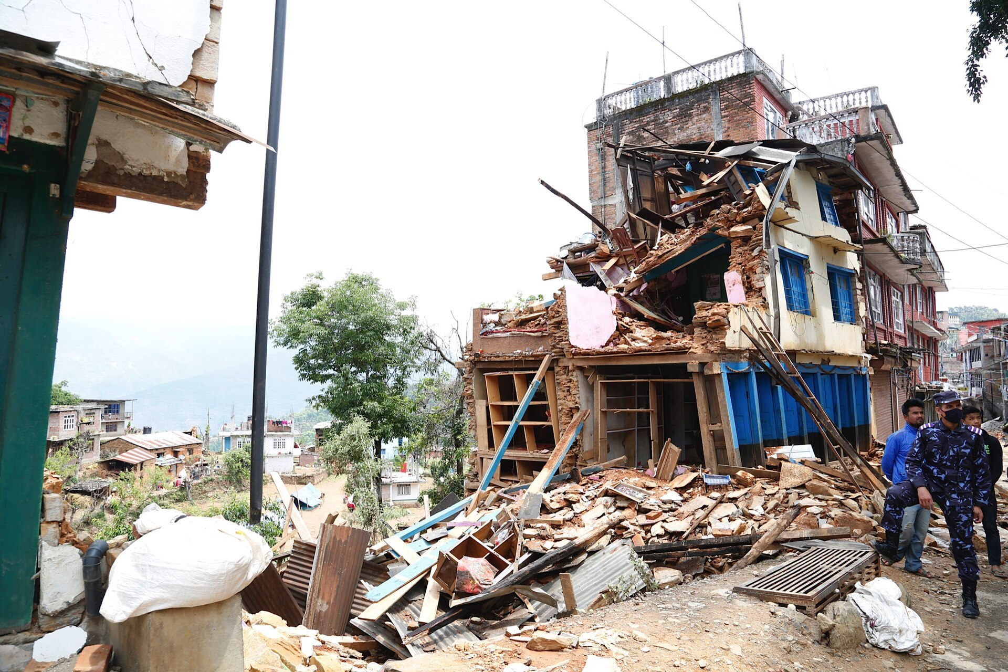
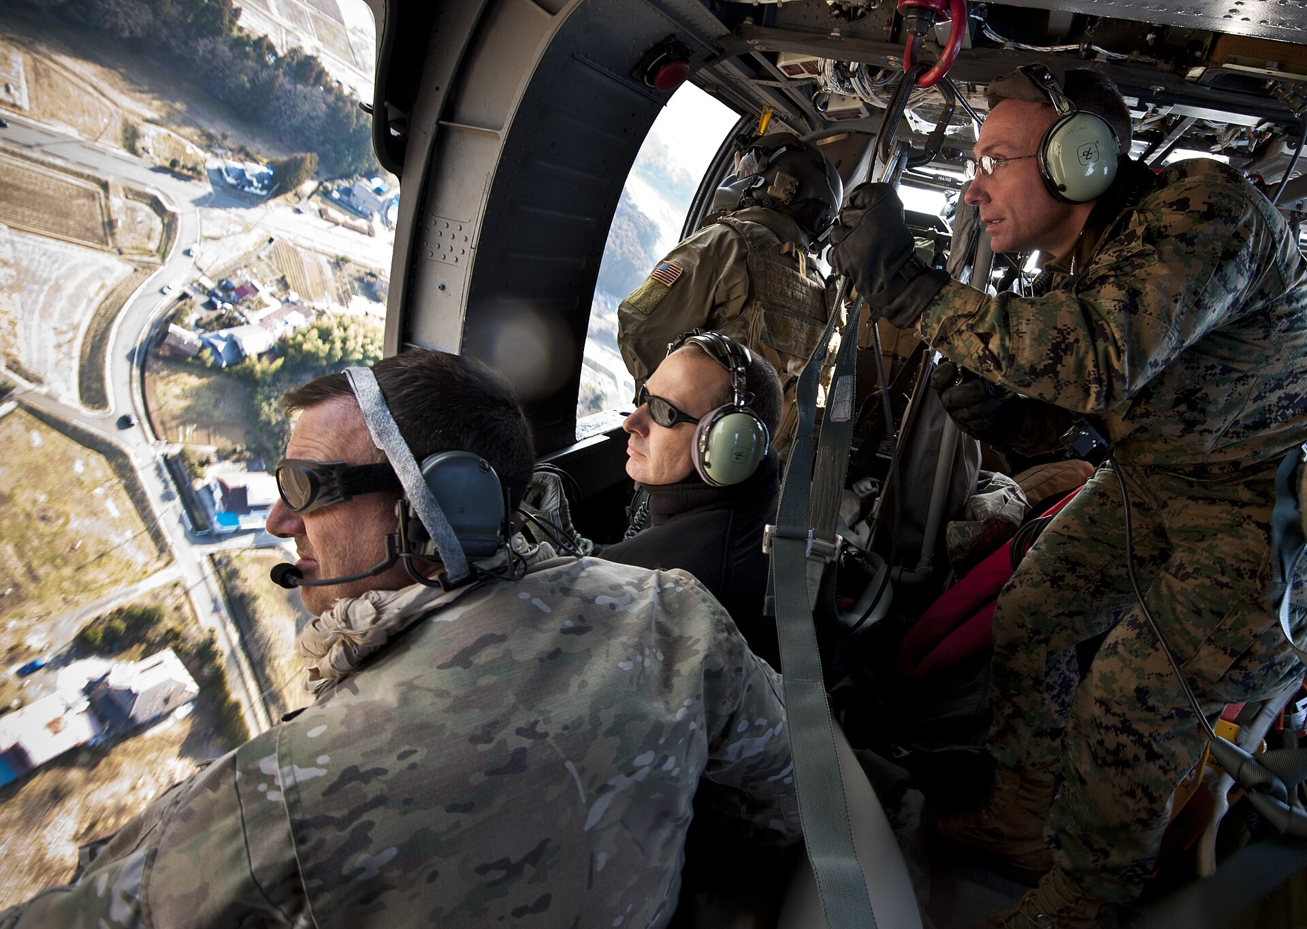
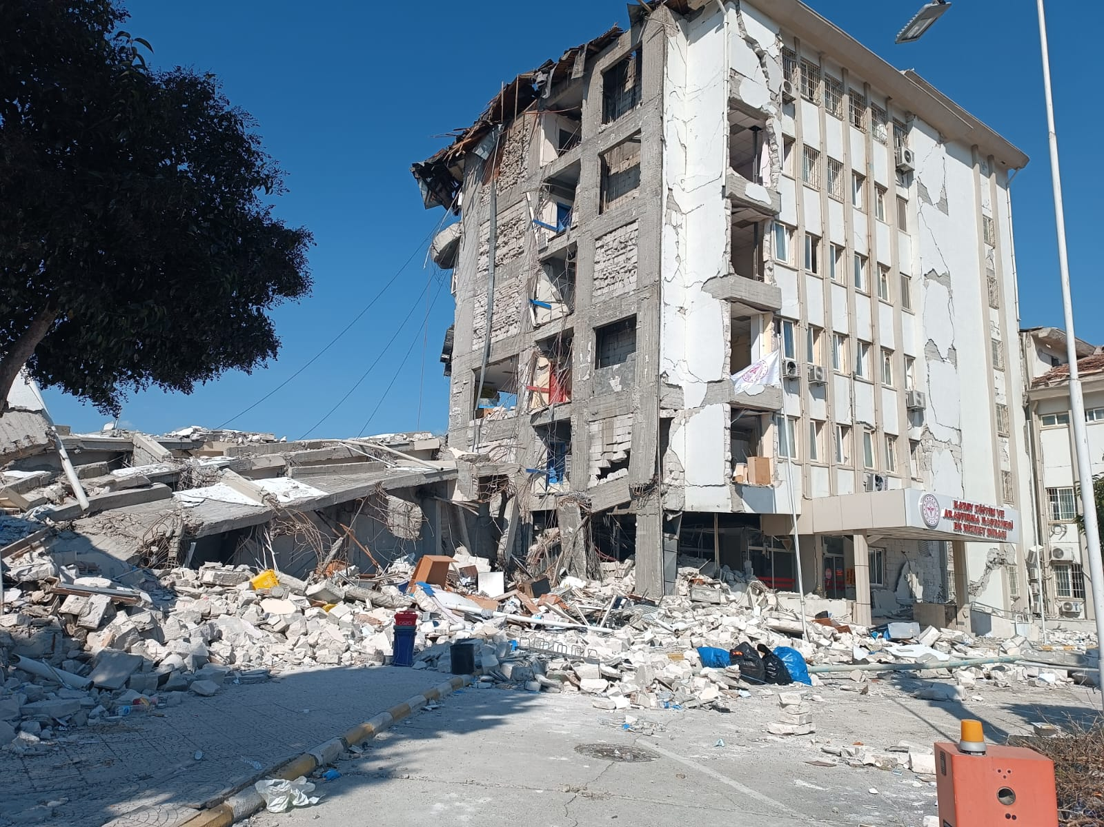
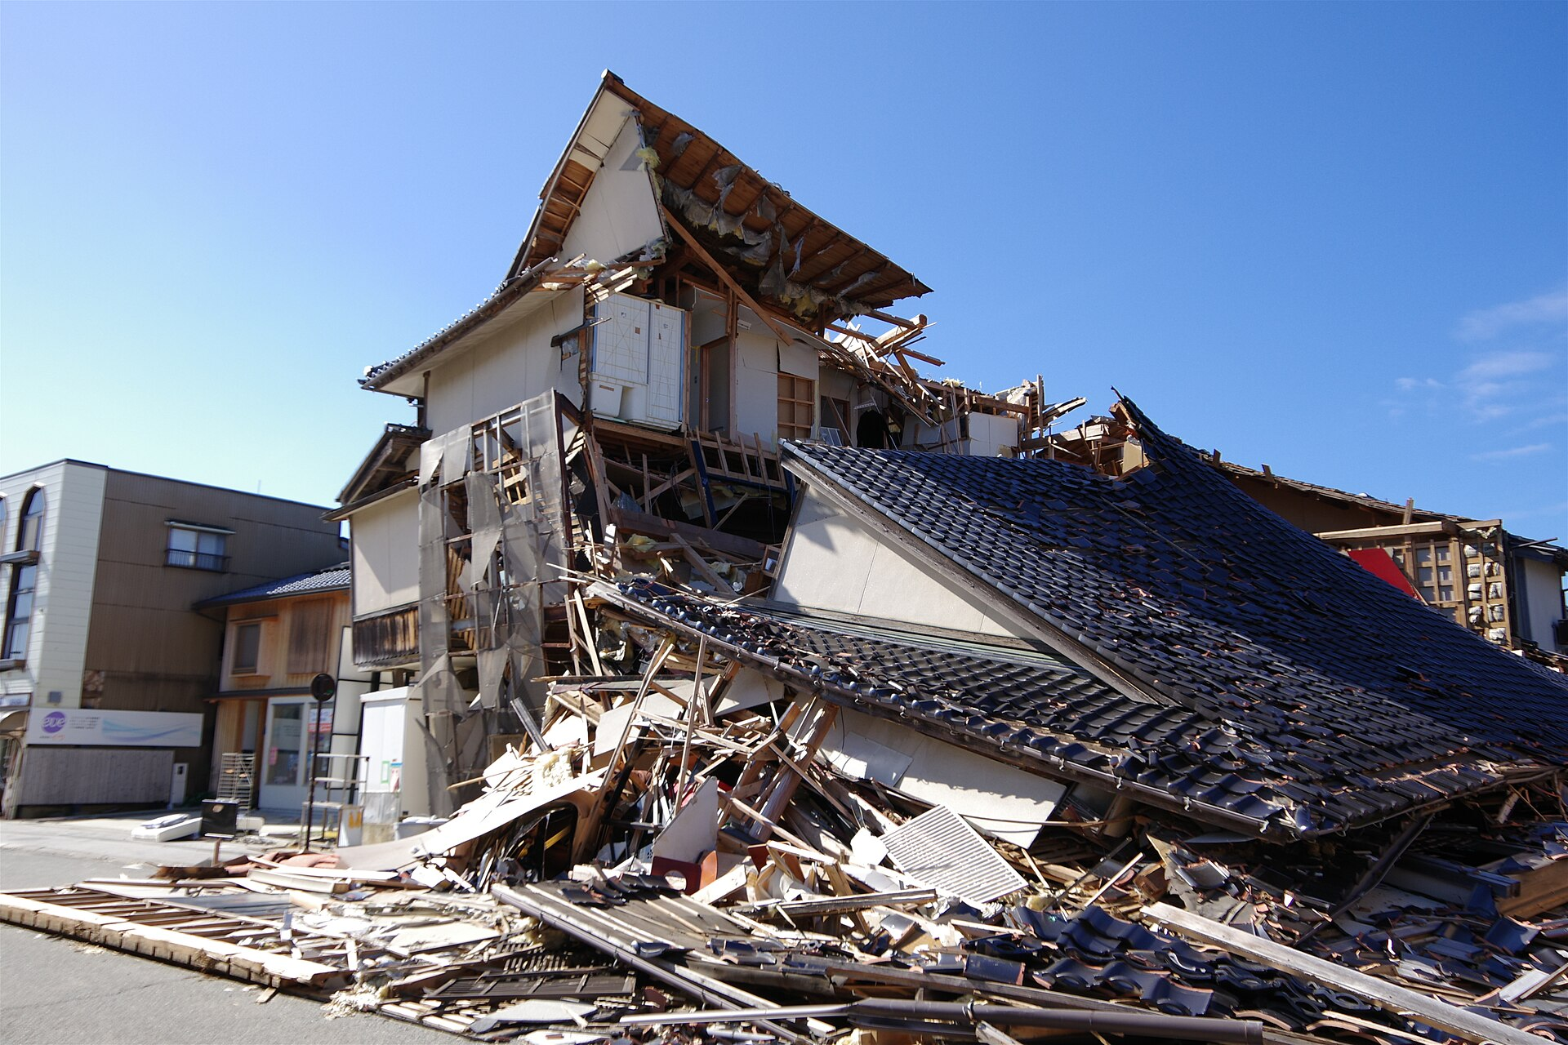
Team
LOVE
WHEN HELP CAME LATE
Nepal 2015 · Chautara
Japan 2011 · SAR team after the tsunami
Türkiye 2023 · Hatay
Noto, Japan 2024 · Wajima
Disaster | Toll | What delayed or blinded the response
Nepal, Apr 2015 (M7.8) | ~9,000 dead · 16,800–22,000 injured · 600k–800k structures hit | Roads damaged, networks down, remote villages left to cope alone; rescue teams reached all of them only after about 2 weeks
Japan, Mar 2011 (M9.0 + tsunami) | ~15,800 dead · ~3,400 missing · >90% drowned | ~1.5 million fixed-line circuits and ~6,700 base-station units hit; >80% of outages from power loss; voice traffic restricted by 70–95%
Türkiye–Syria, Feb 2023 | >59,000 dead (reported) | Destroyed roads and weather kept rescuers from the worst-hit areas; poor internet hindered teams; president admitted the response was slower than hoped
Noto, Japan, Jan 2024 | 128+ dead in a week | ~1,000 landslides cut roads; 2,000+ people isolated; power, water and mobile service still down on day 3; troops sent on foot
Gujarat, India, Jan 2001 | ~13,800–20,000 dead | ~25,000 rescuers deployed, yet survivors were still being pulled out alive at 36 h and 60 h: people were waiting
Photos (Wikimedia Commons): DFID, CC BY 2.0 · USAF, public domain · M. Kuzugüdemn, CC0 · Hurohukidaikon, CC BY 4.0. Figures: see References.
AI – मंथन 2.0
3
Notes:
Nepal 2015: remote villages waited up to two weeks. Japan 2011: more than 90 percent of deaths were drowning, and networks failed for weeks. Turkiye 2023: the president admitted the response was slower than hoped. Noto 2024: even Japan sent troops on foot. Gujarat 2001: people were still alive at 36 and 60 hours.

Slide 4

Team
LOVE
NETWORK DOWN = RESCUE BLIND
Communications fail first
Japan 2011: ~1.5 M fixed-line circuits + ~6,700 base-station units hit; >80% of outages from power loss; ~65,000 poles down; 91% of one carrier's base stations back only after ~4 weeks
Congestion: voice traffic restricted by 70–95%: a survivor had 5–30% of normal capacity
Nepal 2015, Noto 2024, Türkiye 2023: roads cut, networks down or jammed; villages reached late
India: disasters on 270 of 273 days in 2025; Cyclone Michaung cut 30% of Chennai's towers; Chamba lost 66% of telecom sites; 465 GPS-jamming cases (Punjab, J&K)
So every tool that needs a tower, the internet or GPS fails exactly when it is needed
Real news coverage: telecom collapse in recent disasters
1.5 M
fixed-line circuits hit, Japan 2011
>80%
of outages caused by power loss
70–95%
voice traffic restricted by congestion
~2 weeks
to reach every remote village, Nepal
AI – मंथन 2.0
4
Notes:
Towers fail because the power fails, not because the towers fall. In Japan 80 percent of outages were power. Whatever survives is jammed. Any rescue system that needs a tower, the internet or GPS fails exactly when it is needed.

Slide 5
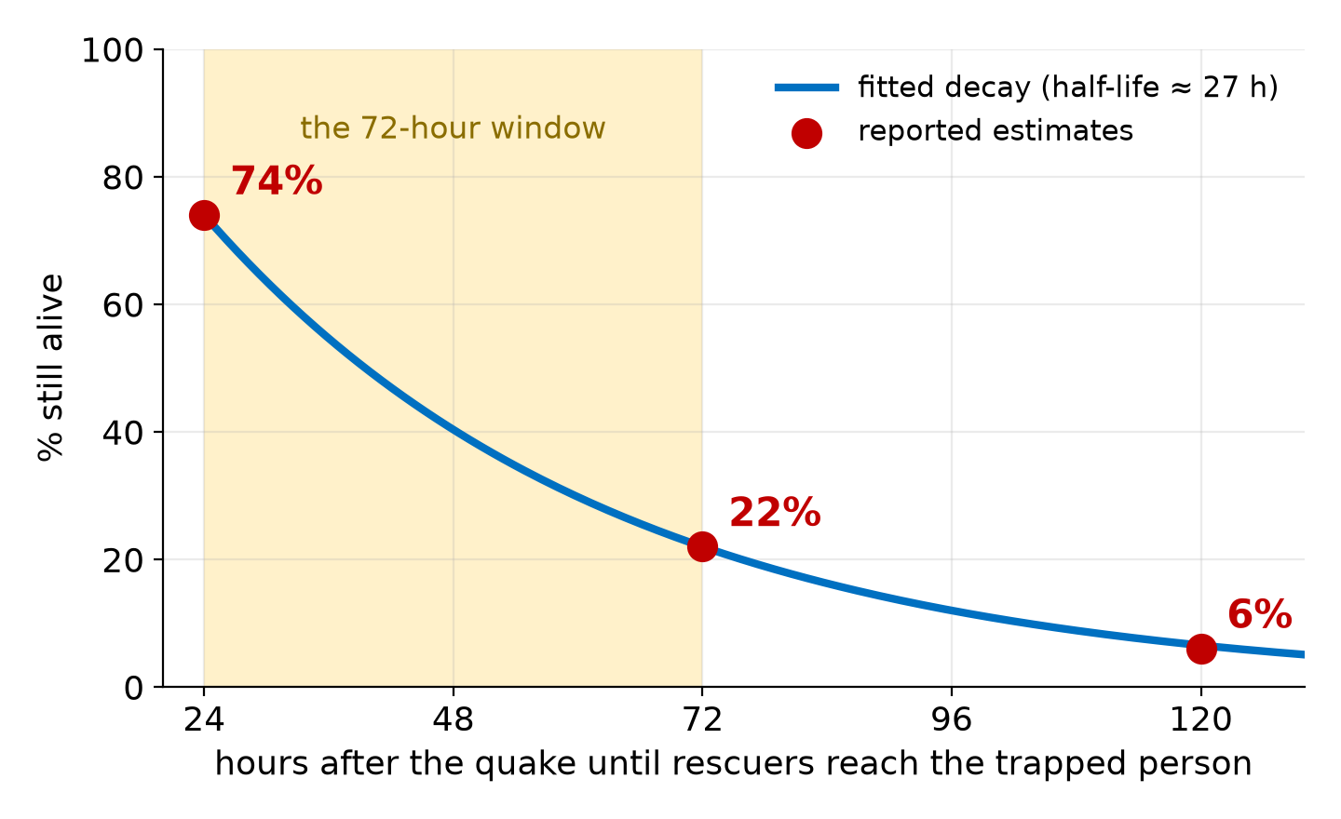
Team
LOVE
SURVIVAL HALVES EVERY ~27 HOURS
Rescuers reach the trapped at… | Alive per 1,000 trapped | Lives lost vs 24 h
24 h | 740 | —
36 h | 546 | −194
48 h | 403 | −337
60 h | 298 | −442
72 h | 220 | −520
Say it plainly
Every ~27 hours of delay halves the people still alive to be saved (24–72 h fit −2.5%/h, 72–120 h fit −2.7%/h)
Other sources (Kobe Fire Bureau: ~75% on day 1 → ~5% by day 4) show the same cliff
Survival of people trapped in collapsed buildings (Godby, via Globe and Mail; fit: our calculation)
What this demands from a rescue system:
Locate in hours
wide-area parallel search
Reach by air
ground robots for the last metres
Zero infrastructure
no tower, cloud or GPS
Thermal + acoustic
see and hear through rubble
Count once
no phantom victims
Plain-language
one operator
AI – मंथन 2.0
5
Notes:
The best estimate we have: 74 percent alive at 24 hours, 22 percent at 72, 6 percent by day 5. Fitting a curve through those points gives a half-life of about 27 hours. Per 1,000 trapped people, reaching them on day 1 instead of day 3 is about 520 lives. It is one expert's estimate, so we use it as a shape, not a law.

Slide 6
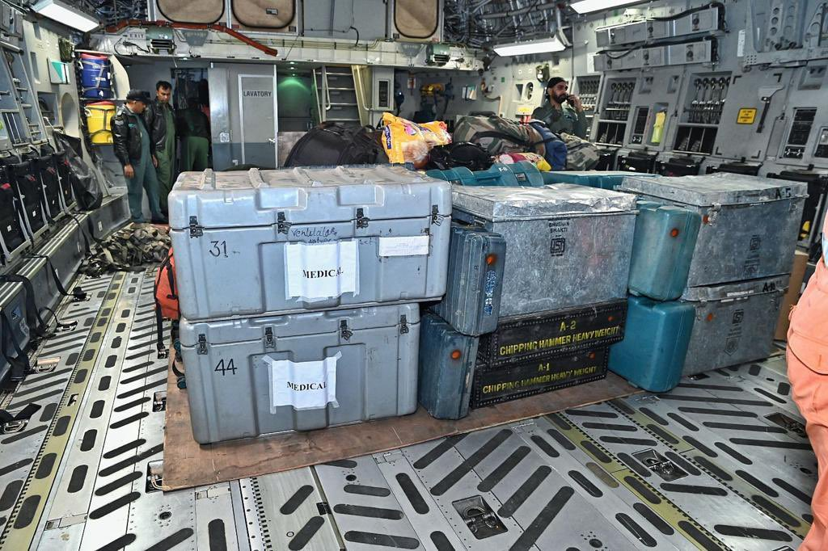
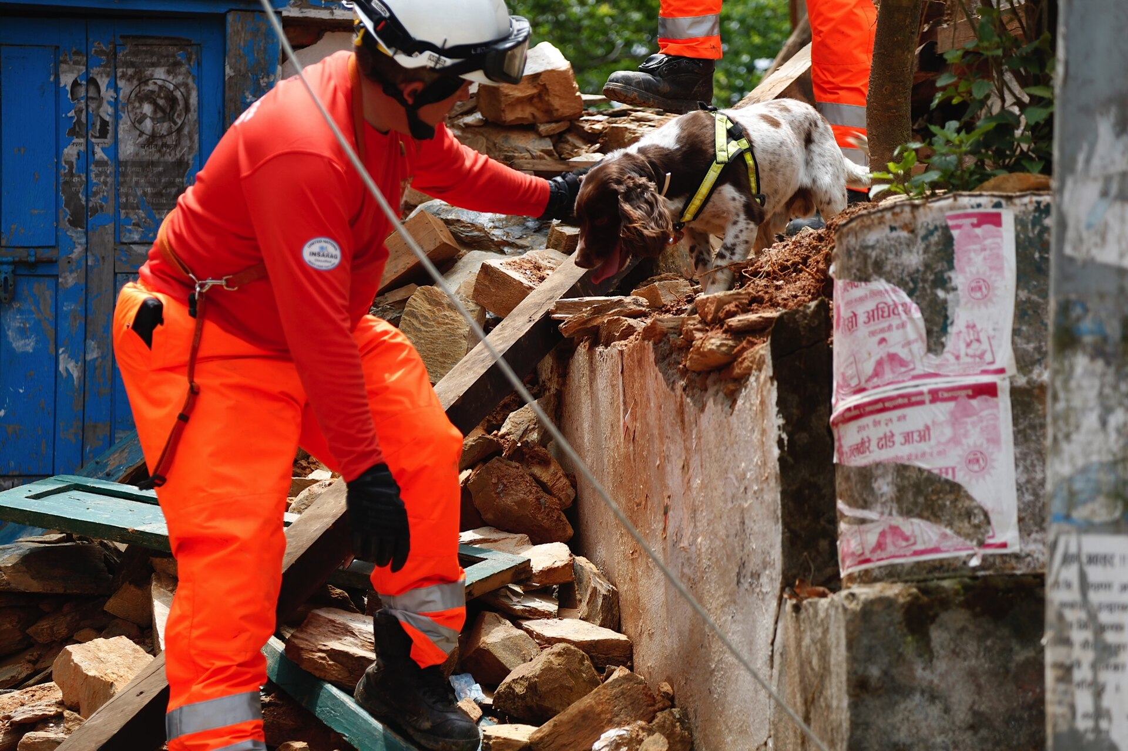
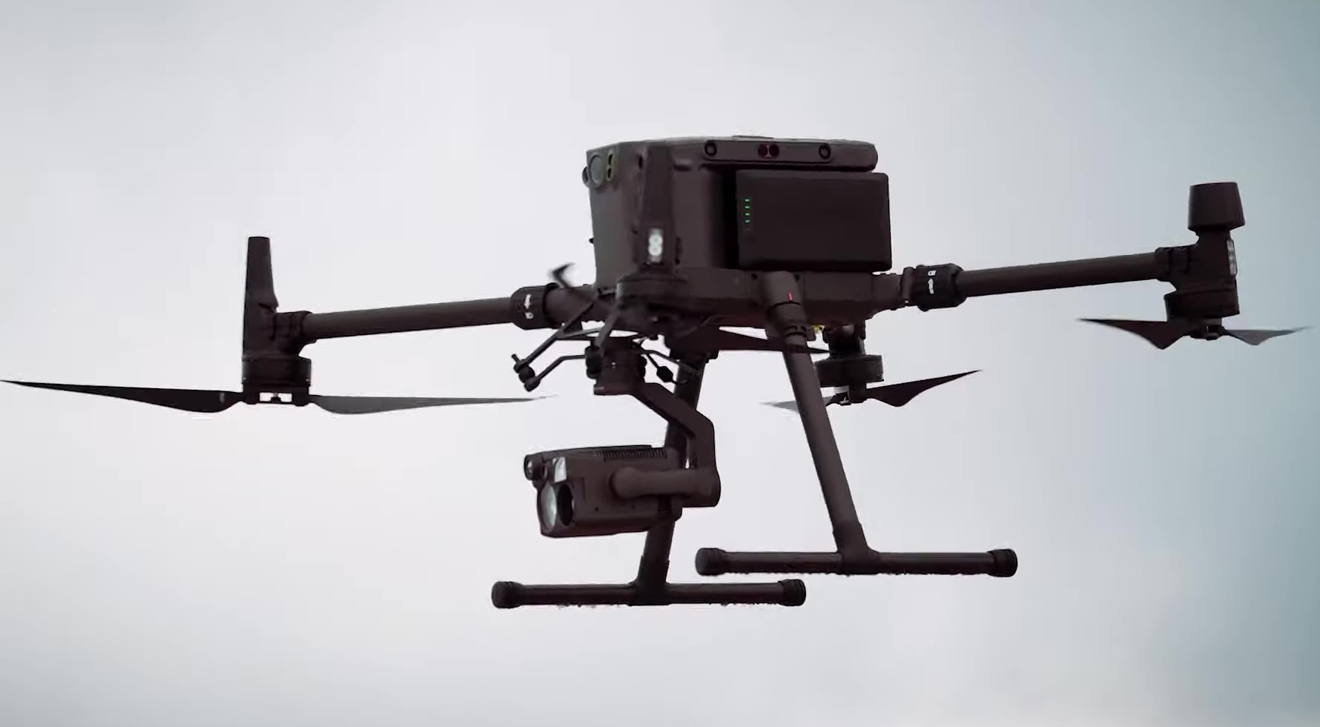
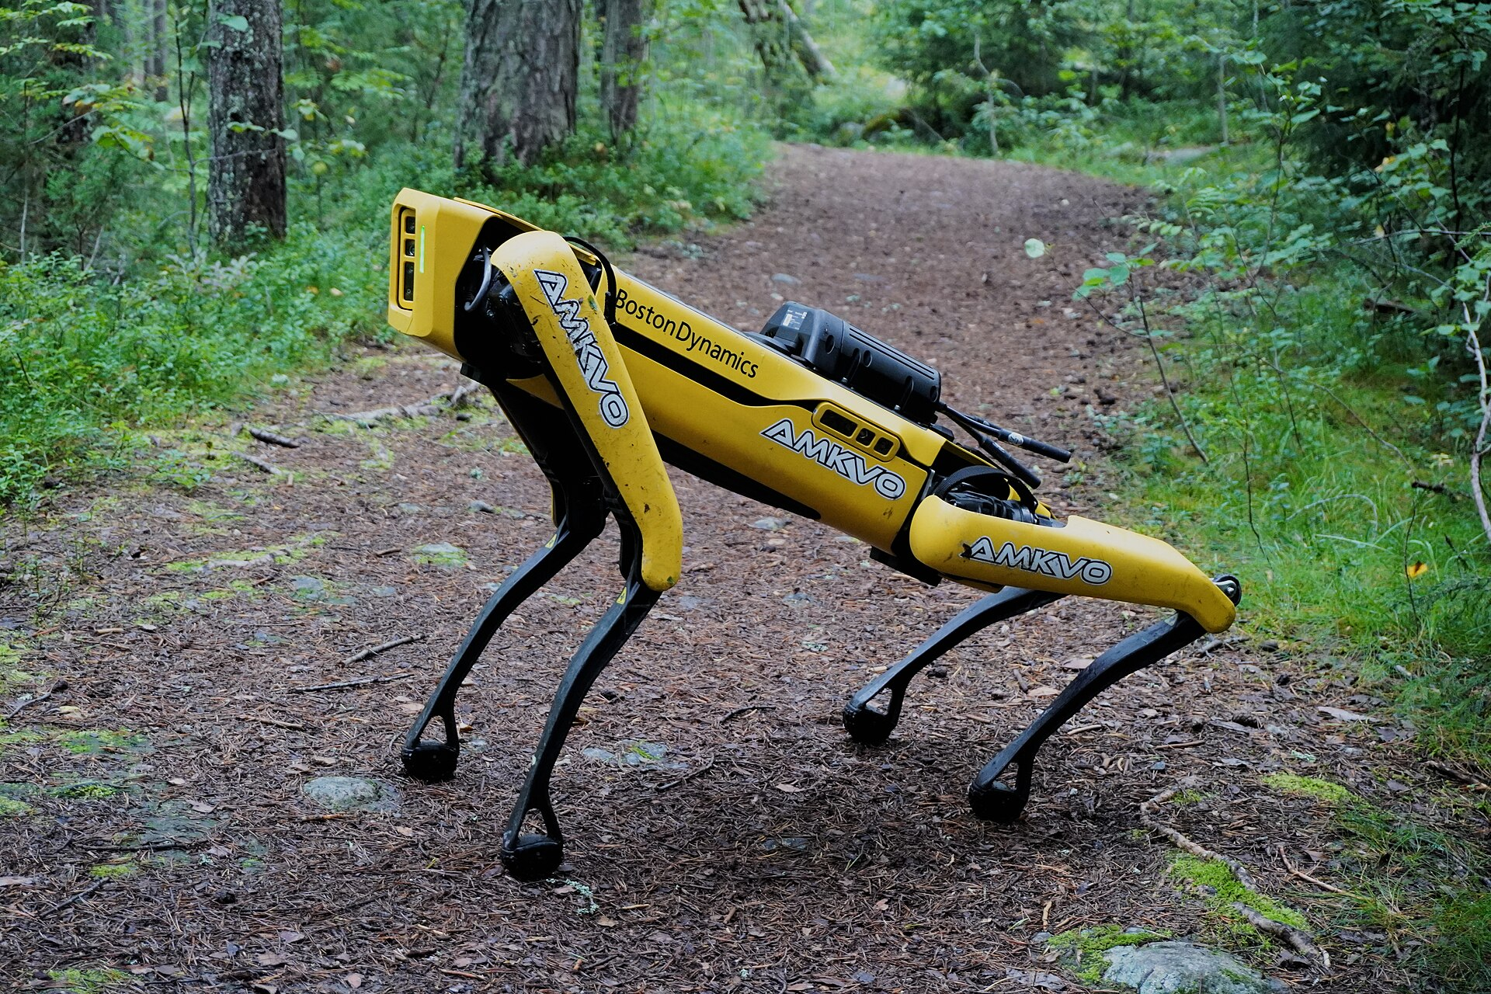
Team
LOVE
WHAT EXISTS TODAY, AND ITS GAPS
NDRF kit airlifted to Türkiye
Rescue dog team, Nepal 2015
Piloted drone (DJI Matrice 300)
Single robot (Boston Dynamics Spot)
Today's tool | Does well | Where it breaks in the first 72 hours
Manual USAR teams (50–80 people + dogs) | Skilled extraction | Must be airlifted in; ~7-day windows; tens of sites, not thousands; people enter unstable rubble
Rescue helicopters | Fast; lift casualties | $1,200–3,000 per flight hour; few aircraft; grounded by weather and smoke
Piloted enterprise drones (DJI M350 + H30T, Skydio X10, ANAFI USA) | Excellent sensors | One pilot per drone, link to the pilot needed, no shared map, same person counted once per drone
Robot dogs / single ground robots (Spot ≈ $74.5k) | Rough terrain | One robot, one operator, very costly; no aerial overview to say where to go
Phones and satellite phones | Direct voice | Towers and power fail; congestion; few survivors own a satellite phone
The gap: no product is a coordinated, infrastructure-free air + ground team that finds people, counts each once, and sends a robot to them: run by one person
Photos: Wikimedia Commons: Government of India (GODL-India) · DFID (CC BY 2.0) · HotNews/Salvamont (CC BY 3.0) · Jonte (CC BY-SA 4.0)
AI – मंथन 2.0
6
Notes:
Manual teams are skilled but slow to arrive and few. Helicopters are fast but expensive and few. Piloted drones have great sensors but one pilot each and no shared picture. Robot dogs are single and costly. Nobody sells a coordinated, infrastructure-free air-plus-ground team that counts each survivor once.

Slide 7
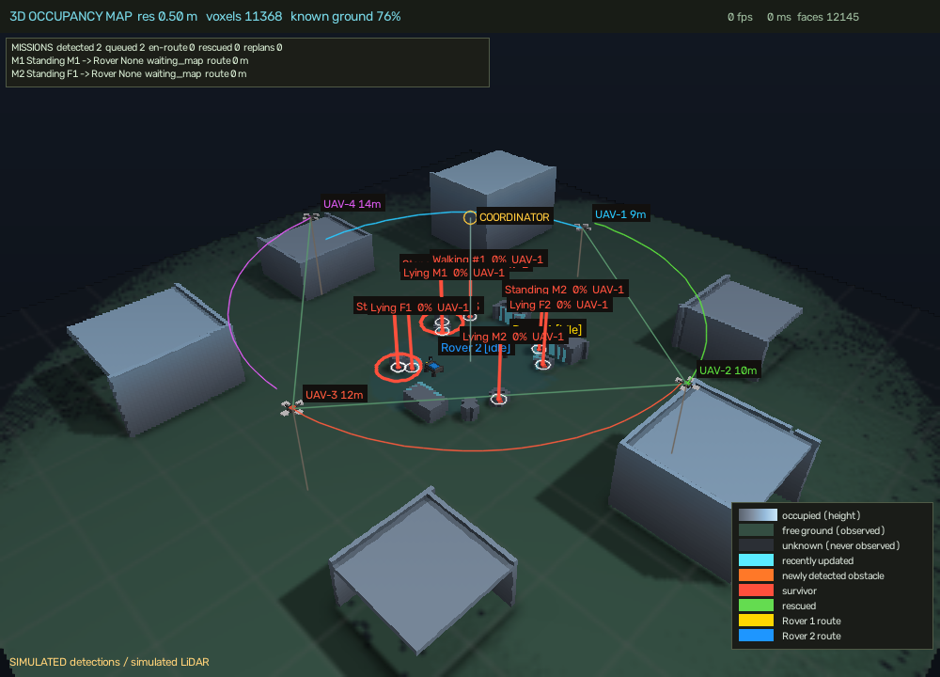
Team
LOVE
SWARMRESCUE
○ Proposed Solution: A Rescue Swarm That Works With Zero Network
How it addresses the problem
Towers, internet and GPS fail first: survival falls from 74% (24 h) to 22% (72 h)
Piloted drones need a link and a pilot each; ours coordinate by themselves: no tower, cloud or GPS
Survivors' phones keep talking over an offline mesh, so rescuers know where to look
The solution
4 drones + 2 rovers from a van; one operator, plain language
Thermal, camera, mic arrays find people in the open and under rubble
Each person counted exactly once
Live 3-D map; nearest rover sent, re-planned around rubble
Phones relay SOS; VLM briefs scenes; officers approve plans
Innovation
Zero network end to end, commodity hardware
Decentralised MARL + GNN: no central controller
Exactly-once counting (CRDT) fusing thermal, acoustic, vision
Air-to-ground rescue loop on one shared 3-D map
Every phone a relay: encrypted BLE mesh, 7 hops
GPS-free photo location: 93% exact, ~2 s on CPU
Our live 3-D map: 4 drones, 2 rovers, survivors (simulation)
Drones = eyes · Rovers = hands · Mesh = nerves
AI – मंथन 2.0
7
Notes:
One sentence: a kit of four autonomous drones and two ground rovers that launch from a van, search by themselves without GPS or a network, find and count survivors with thermal and acoustic sensing, build a 3-D map, and send a rover to each survivor, commanded in plain language by one operator.

Slide 8
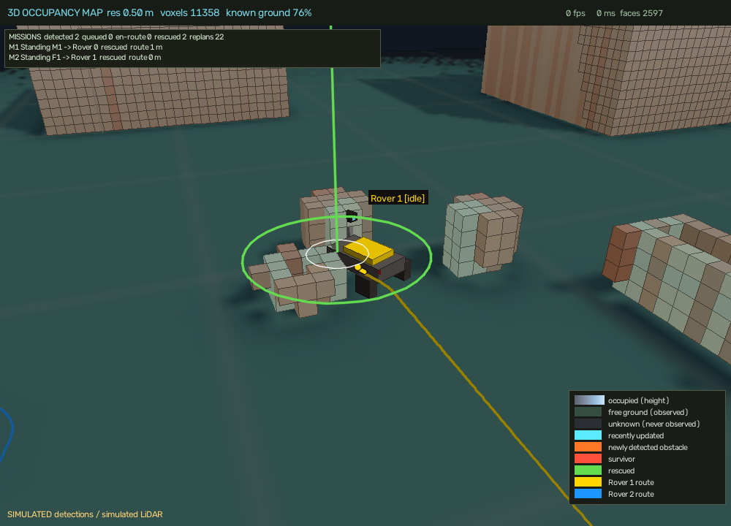
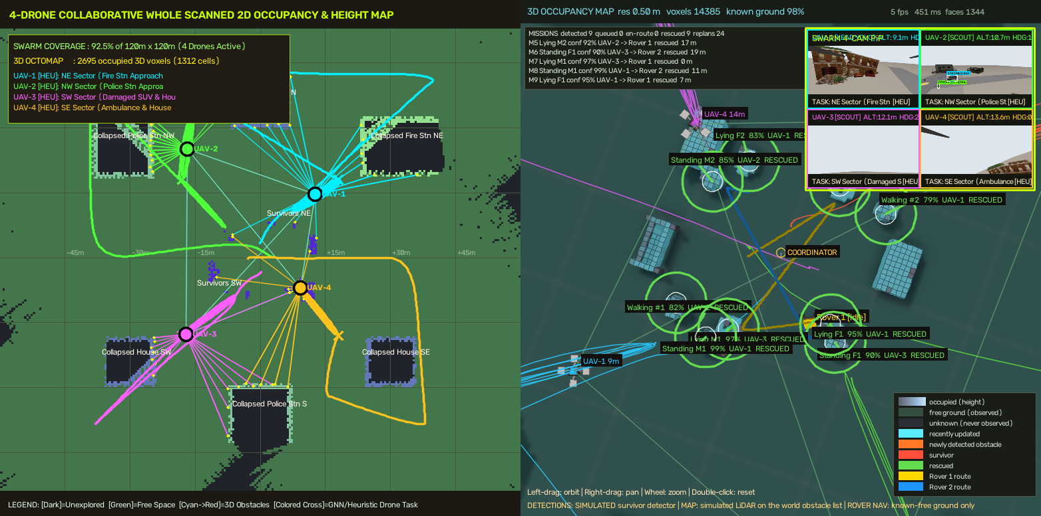
Team
LOVE
SWARMRESCUE AT A GLANCE
○ The kit: heterogeneous team, different jobs
○ The brain: three layers
Role | Units | Does
UAV mappers | 2 | High altitude, lidar-forward: coverage and 3-D map
UAV searchers | 2 | Low altitude: thermal + RGB, small-target detection, second views
UGV responder | 1 | Drives to each confirmed survivor over A* routes, replans around rubble
UGV scout / relay | 1 | Narrow gaps, rubble, microphone array for buried victims, mesh relay
Ground station | 1 | One operator, plain-language command, 3-D map, rover cams
Layer 1 · LLM commander (local Ollama; Groq / Gemini optional)
slow (10–30 s), advisory only: turns words into a task; never in the motion loop
Layer 2 · MARL + GraphSAGE policy on every robot
fast, decentralised: picks each robot's next goal from its neighbours' state
Layer 3 · Flight & navigation control (PX4, jerk-limited setpoints, A*)
steady camera, obstacle and drone-to-drone avoidance, rover driving
Resilience by design
Works with the LLM switched off (rule-based fallback)
A lost drone's area is re-auctioned to neighbours
Network splits heal automatically (CRDT merge)
Rover closing on a survivor
Operator console: 2-D + 3-D maps
AI – मंथन 2.0
8
Notes:
Two mapper drones fly high with lidar, two searcher drones fly low with thermal and camera. One rover goes to confirmed survivors, one scouts narrow gaps and listens. The brain has three layers: a slow advisory LLM, a fast learned policy on every robot, and flight and navigation control. If the LLM is off, the swarm still runs.

Slide 9
Team
LOVE
TECHNICAL APPROACH
○ Technologies to be used
○ Methodology
Layer | Technology
Swarm core | PX4 + ROS 2 Jazzy + Gazebo Harmonic; PyTorch: MAPPO + comm-weighted GraphSAGE GNN
AI vision | YOLOv8, ByteTrack, MobileNet Re-ID embeddings; Qwen2.5-VL (4-bit) scene briefs
Sensing | Thermal + RGB cameras; rover microphone array (acoustic direction of arrival)
Mapping / location | Probabilistic voxel map + A*; OpenCV SIFT + RANSAC map matching (GPS-free)
Offline comms | BitChat (Kotlin) BLE mesh with Noise encryption; Arduino + SX1278 LoRa sensor nodes
Agents | LangGraph agents + OR-Tools CP-SAT; local LLM commander; officer approval gate
Trust | SHA-256 / ECDSA DAG ledger, IPFS: tamper-proof offline log
1 Sense
thermal, RGB, microphones, LoRa, phones
2 Detect
YOLO + ByteTrack, acoustic DoA
3 Locate
ray-cast to the map, SIFT map match
4 Relay offline
peer mesh: BLE + LoRa, CRDT merge
5 Orchestrate
GNN allocator, CP-SAT, LLM commander
6 Act & re-plan
rover A*, drone re-tasking, alerts
All six steps run on the robots and phones, offline.
AI – मंथन 2.0
9
Notes:
Everything on the left is either built in this repository or built by teammates in the offline-mesh, VLM and agentic dashboard repositories. The method is six steps: sense, detect, locate, relay offline, orchestrate, act and re-plan.

Slide 10
Team
LOVE
SYSTEM FLOW
1 · SIGNALS IN
2 · EDGE AI (OFFLINE)
3 · SWARM BRAIN
4 · COMMAND LAYER
5 · ACTION
UAV thermal + RGB cameras
YOLOv8 + ByteTrack detections
MARL + GNN goal allocator
LLM commander (plain language)
Nearest rover by route length
UGV microphone arrays
Acoustic direction of arrival
Frontier + sector search
LangGraph: verify · prioritise
A* on the shared map, replan
LoRa gas / heat / shock nodes
VLM scene brief (event-gated)
Exactly-once Re-ID registry (CRDT)
CP-SAT dispatch optimiser
UAV re-tasking / second views
Citizen phones (BitChat SOS)
Voxel map + SIFT map matching
Shared 3-D map between robots
Policy gate + officer approval
Alerts hop phone to phone
CCTV where it survives
Pose-aware ground projection
Self-heal on loss or split
Signed ledger (ECDSA, IPFS)
Crews get coordinates + count
REPLAN & RETRY · rubble shifts, a drone is lost, a road is blocked → the loop closes back to the swarm brain
OFFLINE PATH (always on)
robots + mesh + LoRa: detection, location, SOS, dispatch with no network
ONLINE PATH (when connectivity returns)
agents verify, prioritise, optimise; officers approve; ledger syncs
AI – मंथन 2.0
10
Notes:
Left to right: signals come in from drones, rovers, LoRa sensors and citizen phones. Edge AI on the robots turns them into detections, a map and scene briefs. The decentralised swarm brain coordinates. Agents and the LLM commander propose; an officer approves. Actions go back out through the swarm and the offline mesh. The offline path never needs a network; the agent path uses it when it returns.

Slide 11
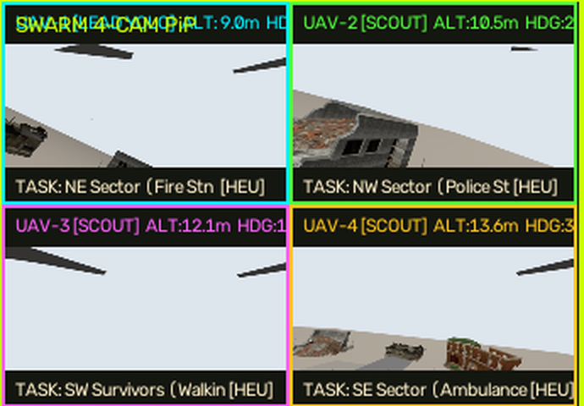









Team
LOVE
SYSTEM ARCHITECTURE
1 · OPERATOR & COMMAND
Operator
plain-language command
LLM commander (advisory only)
Ollama qwen2.5:3b local → Groq / Gemini fallback
Ground-station GUI
2-D map · 3-D voxel viewer · 4 drone + 2 rover cams
Offline ecosystem
BitChat mesh · LoRa · VLM · agents
2 · SWARM BRAIN: ROS 2 JAZZY NODES
brain_node (4 UAVs)
GraphSAGE GNN allocator → heuristic auction fallback
25 Hz jerk-limited setpoints
/swarm/state · /peer_state
yolo_detector
YOLOv8 on 4 drone cams, ~3 inferences/s each
/yolo/detections
victim_registry
Re-ID fusion: each person counted once
/swarm/victims
World model (GUI node)
voxel map · rover A* · rescue coordinator
/swarm/victims → missions
Gazebo: live feeds of the 4 PX4 drones
3 · BRIDGES
MicroXRCE-DDS Agent (UDP 8888)
PX4 uORB ⇄ ROS 2: /px4_N/fmu/in|out
ros_gz_bridge (Gazebo → ROS 2)
/uav_N/camera · /lidar · /lidar/points
GPS-denied
no GPS topic read; local odometry
4 · SIMULATION
Gazebo Harmonic · drone_demo · 4× PX4 SITL x500
Swarm world model (our software)
Rover in the world model (simulated)
PX4
UAV-1
PX4 instance 0
RGB cam + lidar
UAV-2
PX4 instance 1
RGB cam + lidar
UAV-3
PX4 instance 2
RGB cam + lidar
UAV-4
PX4 instance 3
RGB cam + lidar
UGV-1 responder
A* on voxel map
sim camera + mics
UGV-2 scout / relay
A* on voxel map
sim camera + mics
ROS 2 Jazzy
Gazebo Harmonic
PX4 SITL
PyTorch
YOLOv8
Collapsed-building world · survivors · obstacle list feeds the simulated lidar
Simulated: not Gazebo models yet (roadmap)
OpenCV
Ollama
Ultralytics
Ubuntu 24.04
Logos belong to their owners
AI – मंथन 2.0
11
Notes:
Four layers, top to bottom. Layer 1: the operator talks in plain language; an LLM commander (local Ollama qwen2.5:3b, with Groq or Gemini as fallbacks) turns it into a validated task; the ground-station GUI shows the 2-D map, the 3-D voxel map and the camera feeds. Layer 2: the ROS 2 Jazzy nodes. brain_node holds one controller per drone and picks goals with the GraphSAGE GNN allocator, falling back to a heuristic frontier auction; yolo_detector runs YOLOv8 on the four drone cameras; victim_registry fuses detections so each person is counted once; the ground-station world model holds the voxel map, the rescue coordinator and the rover A-star navigation. Layer 3: two bridges. The MicroXRCE-DDS agent connects each PX4 instance's uORB topics to ROS 2, and ros_gz_bridge carries Gazebo cameras and lidar into ROS 2. No node reads GPS. Layer 4: Gazebo Harmonic runs the drone_demo world with four PX4 SITL x500 drones, each with an RGB camera; lidar is simulated from the obstacle list. The two rovers run in our software world model on the voxel map, not as Gazebo models yet; that is a roadmap item and the slide says so. Right: real camera feeds from the four Gazebo drones, a rover in the world model, and the open-source stack logos.

Slide 12
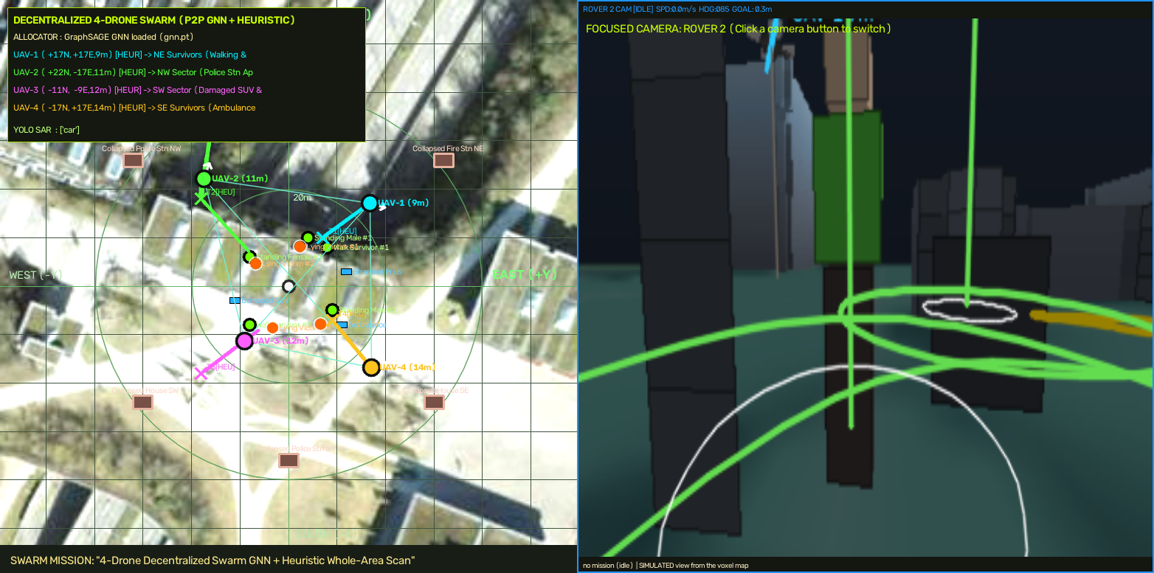
Team
LOVE
DECENTRALISED SWARM INTELLIGENCE
○ How the swarm thinks
Same policy on every robot. Each talks only to neighbours in range, via a communication graph: no ground-station dependency
MAPPO (centralised critic, decentralised actors) + comm-weighted GraphSAGE GNN scores 20 candidate goals per robot
Heterogeneous rewards: drones fast/wide/short battery; rovers slow/narrow/long endurance; the difference matters in the reward
Fallback ladder: GNN → heuristic frontier auction → sector partition; runs with the LLM off
Self-healing: a lost robot's cells are re-auctioned; split swarms keep working and merge later (CRDT)
○ Exploration baselines (2 UAV + 2 UGV, 3 maps)
Strategy | Coverage | Survivors found (step) | Collisions
Random walk | 78.9% | 104 | 4.3
Nearest frontier | 75.3% | 56 | 2.7
Explore-lite (info gain) | 81.8% | 76 | 2.0
Tactical map: 4 drones' paths, targets and peer links, with a rover camera (live GUI)
Learned GNN policy runs and is competitive (reward 0.63 vs 0.59 without the GNN): not yet a proven win.
Decentralised · Heterogeneous · Self-healing · LLM-optional
AI – मंथन 2.0
12
Notes:
This is the heart of PS-5. Every robot is identical in software and different in role. A learned graph neural network over the local communication graph picks goals; if it fails, a heuristic frontier auction takes over; if that fails, sector partitioning. We trained MAPPO with a centralised critic and decentralised actors. Honest result: the learned policy is competitive; on our evaluation its reward was 0.63 vs 0.59 without the GNN, which is not a significant difference. The baselines are strong.

Slide 13
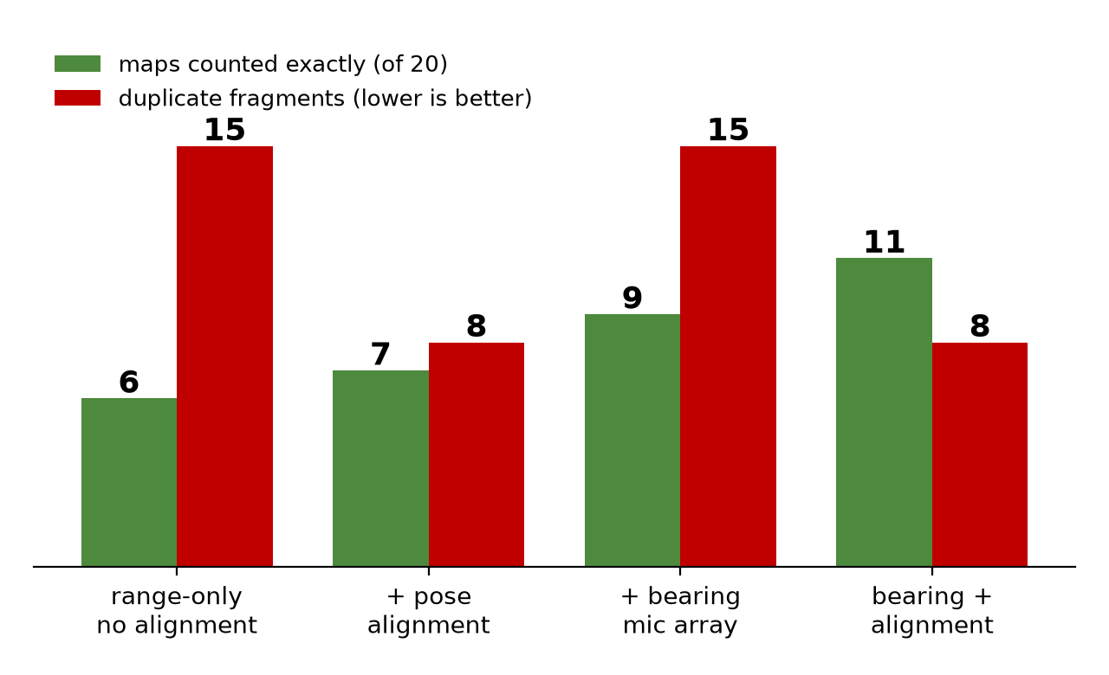
Team
LOVE
FIND SURVIVORS, COUNT EACH ONCE
Sense it, then count it once
Thermal + RGB on drones; YOLOv8 + ByteTrack; ray-cast each box onto the map with pose uncertainty
Acoustic: rover mic arrays give direction of arrival; two views cross at the source for buried victims
Dual-sensor + two-viewpoint rule: a hot rock or one drone's ghost is never confirmed
CRDT registry: every observation fused in exactly one track; merges only lower the count; IDs never reissued
Cannot-link rule: two detections in one frame are two people; look-alikes need appearance evidence
Counting method (20 maps) | Duplicates | False pos.
Naive per-robot counts (seeds 0–19) | 49 | 0
SwarmRescue: bearing mics + alignment (seeds 20–39) | 8 | 0
20 unseen maps (4 UAV + 2 UGV, drifting positions); each upgrade measured
Honest limits
Exact on 11 of 20 maps; misses are mostly victims <3 cells apart
Real-camera YOLO in Gazebo not yet accurate; demo uses a labelled simulated detector
Counts the real number: no crews sent to ghosts
AI – मंथन 2.0
13
Notes:
Thermal sees people in the open. The rovers' microphone arrays give a direction of arrival for people buried under rubble, and evidence from two robots from different directions crosses at the source. The registry is a CRDT: every observation is fused in exactly one track, merges only ever reduce the count, and a person re-entering view cannot be counted again. We measured it on 20 unseen maps: 11 exact, 8 duplicate fragments, zero false positives, against 49 duplicates for naive per-robot counting.

Slide 14
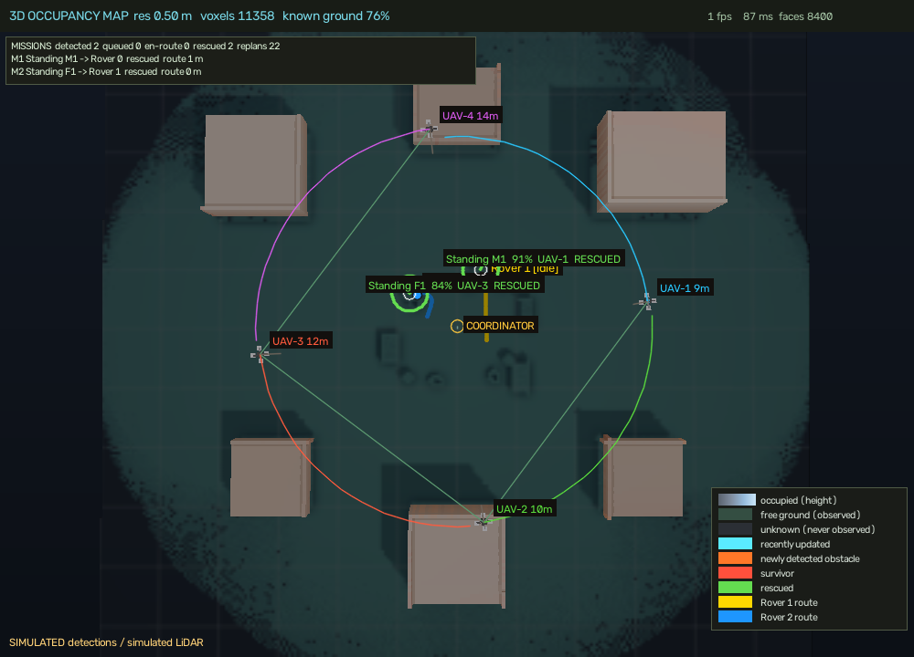
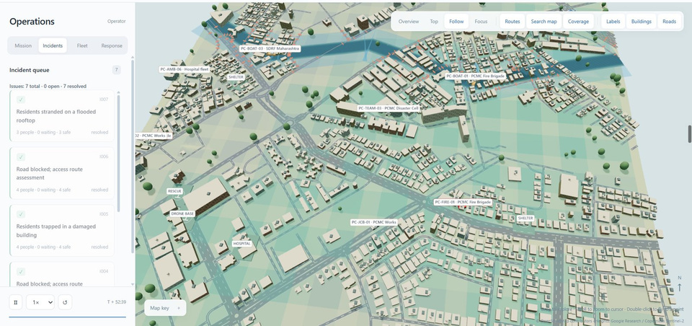
Team
LOVE
GPS-DENIED 3-D MAPPING
Shaded voxel map: buildings, drones, survivors, rover routes
Top view: free (green) vs unknown (dark) ground, coverage grows as the swarm flies
3-D map for people and robots
Per-voxel occupancy probability, free space, unknown, recently changed
Cubes at true resolution, lighting, ambient occlusion, shadows
Layers + sliders: threshold, height, opacity; orbit / pan / zoom / focus on any robot or survivor
93%
GPS-free location exact (map matching)
~2 s on CPU
no network
SIFT + RANSAC: photo → satellite map
AI – मंथन 2.0
14
Notes:
No GPS needed. The swarm builds a probabilistic voxel map from its own sensors and shows it as real shaded cubes with an orbit camera, layer toggles and survivor and rover overlays. Separately, a photo from any robot can be located on a satellite map with SIFT features and RANSAC, 93 percent exact and about two seconds on a CPU. In Gazebo the lidar is simulated from the obstacle list; on hardware it is a real lidar.

Slide 15
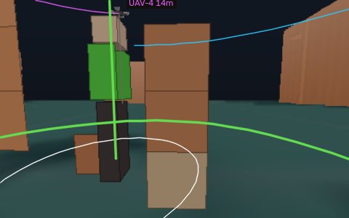
Team
LOVE
AIR-TO-GROUND RESCUE LOOP
Drone detects
De-duplicate
one mission each
Plan route for
every free rover
Nearest by route
length gets it
Drive on A*,
replan if blocked
Arrive; mark
rescued
Why it works
Routes planned on the same voxel map the commander sees
Rover size inflates obstacles; unknown ground avoided
Limited speed, turn rate and acceleration
Replans when rubble blocks the route (live + unit tests)
Missions queue when rovers are busy
Rover camera: first-person view (simulated)
Rover 1 reaches a survivor: route (yellow), ring = detection radius
9 / 9
simulated survivors found, queued, dispatched and reached by 2 rovers (24 replans)
0
blocked cells entered by a rover route (unit-tested)
2 cams
rover first-person feeds beside the 4 drone cameras
AI – मंथन 2.0
15
Notes:
When a drone finds someone, the coordinator de-duplicates it, plans a ground route for each free rover on the shared voxel map and sends the one with the shortest route. If both are busy the mission queues. The rover drives with limited speed and turn rate, so it never teleports, and replans if the map shows rubble on its route. Unknown ground is never driven through unless the operator allows it. In the live run, nine of nine simulated survivors were reached.

Slide 16
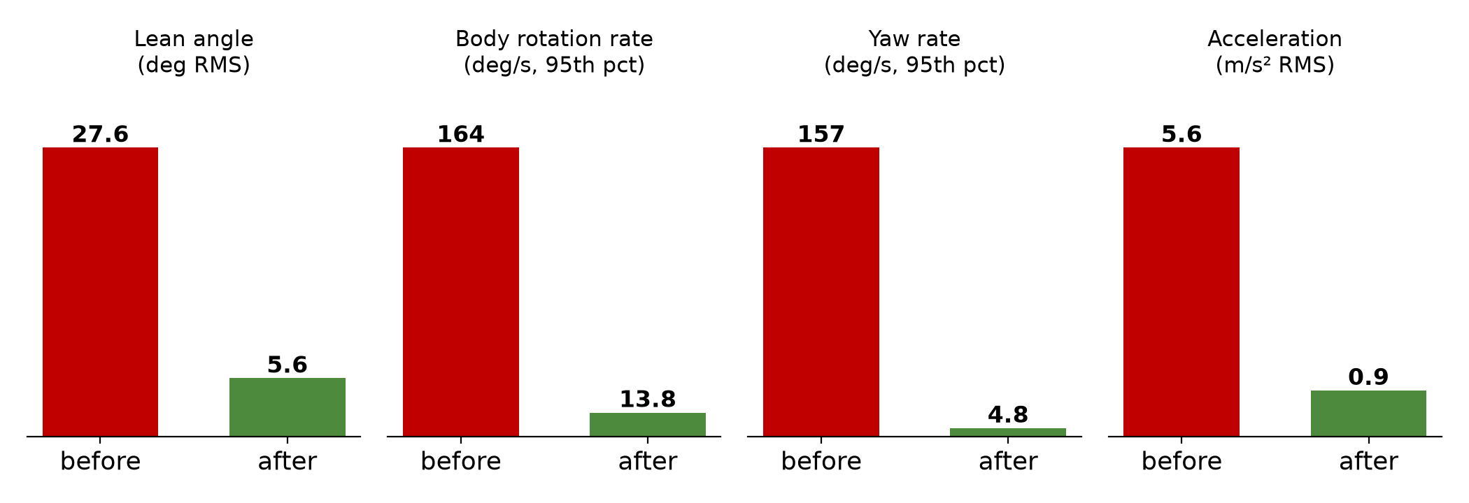
Team
LOVE
STEADY, SAFE FLIGHT: MEASURED
What fixed it
Jerk-limited reference with velocity / acceleration feed-forward at 25 Hz
Runs in simulation time (real-time factor estimated from PX4 timestamps)
Slow yaw from a low-passed direction of travel; commanded heading still wins
Gentler PX4 limits; GUI at low priority; YOLO at ~3 inferences/s per camera
PX4 odometry, 60 s of flight, mean of 4 drones (simulation); script: scripts/flight_metrics.py
Cause found | Evidence
Raw far target sent as a position setpoint at 10 Hz | PX4 chased it at full authority: 5.6 m/s² RMS acceleration
Yaw set to the bearing of every new target | Allocator re-targets every ~8 s → camera spun, 157°/s yaw rate
Limits in wall-clock time, sim at 0.58× real time | Commanded 0.8 m/s² became ~1.7 m/s² measured
CPU starvation (load ≈ 17 on 12 cores) | One PX4 instance lost its estimate in two runs; fixed by load cuts
−80%
lean angle (27.6° → 5.6°)
body-rotation rate −92%
yaw rate −97%
AI – मंथन 2.0
16
Notes:
A shaky camera finds nobody. We recorded the four drones' own attitude data from PX4 for 60 seconds. Original: 27 degrees of lean, 164 degrees per second body rotation. The causes were a raw far target sent as a setpoint, yaw snapping to every new target, and limits in wall-clock time while Gazebo ran at 0.58 times real time. The fixes: a jerk-limited reference stepped in simulation time, slow yaw from a low-passed direction of travel, 25 hertz setpoints with feed-forward, gentler PX4 limits. Result: lean 5.6, body rate 13.8, yaw 4.8.

Slide 17
Team
LOVE
GENERATIVE AI, WITH GUARDRAILS
LLM commander
Plain language → structured task (area, objective, constraints)
Local Ollama first (no internet in a disaster); Groq / Gemini optional
Validated before any robot acts; advisory only
Rule-based fallback keeps the swarm flying if it fails
VLM scene briefing
Qwen2.5-VL (4-bit): describes a frame: collapsed block, access gap, hazard, people
Event-gated: runs only on detections: 2.3 GB VRAM, ~45% less GPU time (est.)
Briefs attach to survivors and map cells for crews
Runs on drones' field server, offline
Agentic dashboard
LangGraph agents: verify · prioritise · forecast · simulate · allocate · route
AI never decides the numbers: OR-Tools CP-SAT solves allocation
Policy gate + officer approval + emergency stop
Every decision signed to a tamper-proof ledger
Where generative AI is used | Where it is deliberately NOT used
Command interpretation, scene description, report drafting, multilingual alerts (3 languages) | Motion control, collision avoidance, counting survivors, dispatch numbers: those are learned policies, geometry and solvers we can test
Use of generative AI that a disaster authority can trust: advisory, validated, auditable, and fully offline-capable
AI – मंथन 2.0
17
Notes:
Generative AI is used where it helps and never where it could hurt. The LLM turns plain language into a validated task; it is advisory and never in the motion loop. The VLM describes scenes and hazards, gated by events so the GPU only works when something happens. Agents verify, prioritise and optimise, but numbers come from the CP-SAT solver, and an officer approves.

Slide 18
Team
LOVE
THE FIRST 3 HOURS: ONE ECOSYSTEM
Time | What happens | Feature that does it
T + 0 | Earthquake. Towers and power fail; networks jam. | (the problem)
T + 5 min | Phones form an offline mesh and broadcast 'alive, here' with no infrastructure; LoRa nodes hear rubble | BitChat BLE mesh (7 hops) · LoRa IoT nodes
T + 30 min | Kit leaves the van. Operator: 'Map and scan the whole area.' | Local-LLM natural-language command
T + 40 min | 4 drones spread out and fly themselves, sharing only with neighbours: no GPS, no network, steady camera | MARL + GNN swarm · steady flight
T + 1 h | Thermal + camera find people in the open; the swarm map snaps onto the real map; the VLM explains the scene | YOLO + ByteTrack · SIFT map matching · Qwen2.5-VL
T + 1–2 h | Rovers listen along the rubble: direction of arrival reveals a buried person | Acoustic evidence map
T + 2 h | Each person counted once across all robots; dashboard shows the real number | CRDT Re-ID registry
T + 2 h | Nearest rover dispatched on a route planned on the same map; replans around new rubble | Rescue coordinator · A*
T + 3 h | Agents prioritise and allocate boats / ambulances / NDRF teams; officer approves; alerts hop phone to phone | LangGraph · CP-SAT · ledger
Nepal's two-week village search, compressed to hours: inside the window when far more people are alive
AI – मंथन 2.0
18
Notes:
This is how every feature connects. T plus zero the networks fail. Within minutes phones form a mesh and broadcast I am alive. The kit leaves the van, the operator gives one sentence, the swarm flies itself, finds people, counts them once, a rover is dispatched, and crews arrive with coordinates, routes, a map and a count instead of searching blind.

Slide 19
Team
LOVE
PROTOTYPE: WHAT WORKS TODAY
Component | Status | Evidence
Swarm sim + MARL/GNN training | Working | 11 sim files, 6 training files; baselines table
4-drone PX4 + Gazebo swarm + GUI | Working | Live: 4 UAV cams, 2-D + 3-D maps
Exactly-once counting (Re-ID, acoustic) | Working (sim) | 20 unseen maps: 8 dup., 0 false pos.
Voxel map + 3-D viewer | Working | ~60 ms/frame; 20 viewer tests
Rover navigation + dispatch + cams | Working (rovers simulated) | 9/9 reached; replans tested
Steady flight | Working | −80% lean, −92% body rate
LLM commander (local) | Working | Natural-language → swarm task
Offline mesh app, VLM, map matching, agents | Working prototypes | 3 teammate repos, live demo, 116 tests
Real hardware flight | Not yet | Next milestone (roadmap)
Operator console (live): coverage map, 3-D voxels, drone + rover cameras
87
automated tests pass in our repository
~11k
lines of our Python: sim, training, ROS, tests
4 + 2
robots in the live demo
18–25 FPS
detection, as reported for the teammates' VLM/mesh modules
AI – मंथन 2.0
19
Notes:
Be explicit: this is a working software system in simulation. We have not flown it on real hardware. The offline mesh app, VLM optimisation, map matching and agentic dashboard are working prototypes in teammates' repositories with a live demo.

Slide 20
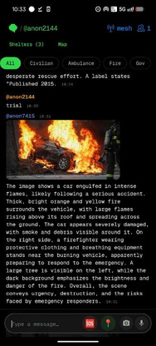
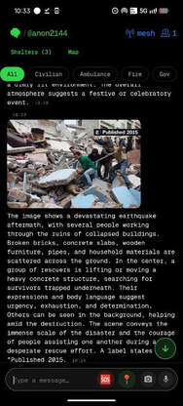
Team
LOVE
FEASIBILITY AND VIABILITY
○ Analysis of feasibility
Working prototype: sim swarm + 3 teammate repos, live demo; 87 tests here, 116 in the mesh/agent repos
Commodity hardware: PX4 airframes, Jetson-class computer, FLIR Lepton thermal (~$164), phones, ≈₹2k LoRa nodes
Open stack (PX4, ROS 2, PyTorch): no licence lock-in; local LLM, no cloud bill
○ Challenges & strategies to overcome them
Challenge / risk | Strategy
BLE reach only ~10–100 m | 7-hop mesh + km-range LoRa links; robots as relays
Heavy VLM on edge GPUs | Event gating + 4-bit: 2.3 GB VRAM
False or stale reports | Trust scoring (5 wasted crews, not 68); dual-sensor + two-viewpoint confirmation
AI acting wrongly | Advisory LLM, validated tasks, officer approval + emergency stop
Drone battery ~20 min | Hand-over between drones; long-endurance rovers; swap batteries; tethered relay later
Simulation → hardware gap | Hardware-in-the-loop on 1 UAV, then 2 UAV + 1 UGV field trial
Edge CPU starvation (seen in tests) | GUI low priority, event-gated vision, load budgets
Mesh alert, offline
VLM brief on a phone
3-D map built without GPS (simulation)
AI – मंथन 2.0
20
Notes:
Everything is commodity: PX4 flight controllers, a Jetson-class computer, cheap thermal cores, phones and 2,000 rupee LoRa nodes. We are honest about the gap between simulation and hardware, and each risk has a mitigation.

Slide 21
Team
LOVE
COST OF EXISTING SOLUTIONS
Item | Price (USD) | Source / note
DJI Matrice 350 RTK + H30T thermal kit | $31,399 per aircraft | US reseller (Maverick Drone); H30T alone $11,999
Skydio X10 (base) | ≈ $11,000–12,000 | Robotomated, Jisaku; thermal config extra
Parrot ANAFI USA (thermal) | ≈ $7,000 | BlueSkies drone shop
Boston Dynamics Spot, Explorer kit | ≈ $74,500 | 2020 launch price
SAR helicopter operation | $1,200–3,000 / flight hour | Revector (low-authority); Black Hawk ≈ $2,200–3,100/h
Urban search & rescue task force | 50–80 people + dogs | NDRF, LA County. No public per-team cost found
DJI Matrice 300 (HotNews Romania, CC BY 3.0)
○ Off-the-shelf fleet equal to our kit (4 air + 2 ground, uncoordinated)
Boston Dynamics Spot (Jonte, CC BY-SA 4.0)
Option | Hardware cost | People to run it
4× DJI M350 + H30T and 2× Spot | 4 × $31,399 + 2 × $74,500 = $274,596 | ~8 pilots/observers + 2 robot operators (est.)
4× Skydio X10 base + 2× Spot | 4 × $11,990 + 2 × $74,500 ≈ $197,000 | ~4 + 2 operators (est.)
AI – मंथन 2.0
21
Notes:
Public price points: the DJI Matrice 350 with H30T thermal kit is about 31 thousand dollars per aircraft; Skydio X10 about 11 to 12 thousand; Parrot ANAFI USA about 7 thousand; Boston Dynamics Spot about 74,500; helicopters 1,200 to 3,000 dollars per flight hour. We found no public per-team cost for a rescue task force, so we do not quote one.

Slide 22
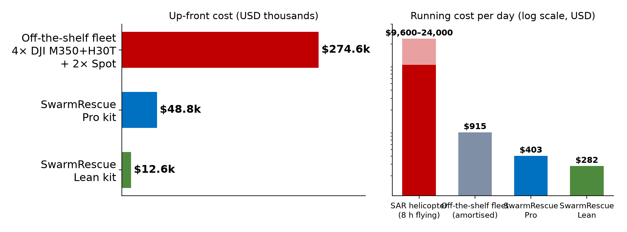
Team
LOVE
COST OF RUNNING SWARMRESCUE
Bill of materials (USD) | Lean | Pro
Airframe + PX4 controller (Holybro X500 v2) V | 508 | 508
Companion computer (Orin Nano / Orin NX) | 300 | 700
RGB camera | 60 | 60
Thermal: FLIR Lepton 3.5 V / Boson 640 V | 204 | 4,204
Lidar (2-D / 3-D) | 100 | 750
2 batteries + mesh radio + spares | 320 | 320
One UAV | 1,492 | 6,542
One UGV (chassis, computer, lidar, cams, thermal, 4-mic array) | 1,634 | 7,284
Ground station (GPU laptop, antenna, cases) | 1,700 | 1,700
Kit: 4 UAV + 2 UGV + station, +15% contingency | $12,576 | $48,801
Up-front cost and running cost per day
 | Lean | Pro | Off-the-shelf fleet | 1 SAR helicopter-day
Up-front | ≈ $12.6k | ≈ $48.8k | ≈ $274.6k | n/a
vs fleet | 22× cheaper | 5.6× cheaper | 100% | —
Per day | ≈ $282 | ≈ $403 | ≈ $915 + 10 staff | $9,600–24,000
Operators | 1–2 | 1–2 | 8–10 | pilots + crew
V = verified retail listing. All other prices are our estimates: replace with vendor quotes. ≈ ₹10.7 lakh (Lean) / ₹41.5 lakh (Pro) at ₹85/$.
We do not replace the helicopter: it lifts people, we find them. Send costly assets to the right place first
AI – मंथन 2.0
22
Notes:
Prices marked with a V are verified listings: the Holybro X500 v2 kit at 508 dollars, the FLIR Lepton at 164, the Boson 640 at 4,204. The rest are our estimates and must be replaced by vendor quotes. The lean kit is about 12.6 thousand dollars; the pro kit about 48.8 thousand. Against the 274 thousand dollar off-the-shelf fleet that is 22 times and 5.6 times cheaper. Running cost per deployment day is about 282 to 403 dollars versus 9,600 to 24,000 for a day of helicopter flying. We are not replacing the helicopter: it lifts people, we find them.

Slide 23
Team
LOVE
BUSINESS MODEL AND ROADMAP
Revenue line | Offer (proposal)
Hardware kit | District Readiness Kit (Lean) at ~$25–30k → ≈ 50–58% gross margin on a $12.6k cost; Pro kit for national forces
Software subscription | Updates, swarm policy models, local-LLM packs, map-matching regions: per kit per year
Training and drills | Annual certification with the district disaster authority
Lease option | Kit lease + annual licence per control room (as in our mesh/agent stack)
○ Roadmap
Phase | Deliverable | Done when
Now | Simulation swarm, mapping, counting, rover dispatch | 87 tests; live GUI demo
2 months | Fix allocator exploration; real detection accuracy; HIL on 1 UAV | Detection metric; flight log
3–6 months | 2 UAV + 1 UGV with thermal + mesh radio; outdoor test | Field-trial video; real metrics
6–12 months | Pilot with a district authority / fire service; mock drill | Signed pilot; drill report
12+ months | Pro kit, certification, state procurement | Purchase order
Customers
SDMA / DDMA, NDRF, SDRF, fire & 108 services
Municipal corporations and smart cities with CCTV
NGOs, UN / INSARAG teams, insurers, industrial sites and large events
Market size: bottom-up (districts × kits): verify the district count before quoting a TAM
AI – मंथन 2.0
23
Notes:
Hardware kit for districts, a software subscription for model updates and map packs, annual training and drills. Customers are disaster management authorities, NDRF and SDRF, fire services, municipal corporations, NGOs and UN INSARAG teams, insurers and infrastructure operators. Price positioning is a proposal; margins follow from the bill of materials.

Slide 24
Team
LOVE
IMPACT AND BENEFITS
Target audience
SDMA / DDMA, NDRF, SDRF, fire & 108 services
Smart cities with CCTV; citizens in flood and quake zones
Campuses, industrial sites, large events; NGOs and UN teams
Social benefit
Survivors found in hours, not days: ≈ 520 more alive per 1,000 trapped (day 1 vs day 3)
SOS, detection and location work with no network
Hears survivors under rubble; alerts in 3 languages
Rescuers stay out of unstable rubble
Economic benefit
Lean kit ≈ $12.6k vs ≈ $275k for an uncoordinated off-the-shelf fleet
≈ $282–403 per deployment day vs $9,600–24,000 per helicopter-day
Reuses CCTV, phones, servers; ≈ ₹2k sensor nodes
Environmental benefit
Fewer fuel-burning search sorties; rovers and drones on batteries
Sensor node runs 12–15 h on a power bank
Event-gated AI: GPU works only on events; smarter routing cuts wasted trips
WITHOUT SWARMRESCUE
Network down = rescue blind, late teams
→
WITH SWARMRESCUE
Network down = mesh SOS, swarm search, rover dispatch
AI – मंथन 2.0
24
Notes:
Social impact is lives: on the survival curve, finding people on day 1 instead of day 3 is about 520 more alive per 1,000 trapped. Economic: the lean kit costs about 12.6 thousand dollars against about 275 thousand for an uncoordinated off-the-shelf fleet, and about 282 to 403 dollars per deployment day against 9,600 to 24,000 for a helicopter-day. Environmental: rovers and drones replace long fuel-burning sorties; event-gated AI; battery-powered nodes.

Slide 25
Team
LOVE
SUSTAINABILITY & CROSS-DOMAIN FIT
Sustainability and feasibility
Open, maintainable stack: PX4, ROS 2, PyTorch: no vendor lock-in; spare parts are standard
Low running cost: ≈ $282–403 per deployment day; one kit per district is affordable
Energy: battery-powered robots and nodes; local models; event-gated GPU use
Reuse: works on CCTV, phones and servers agencies already own
Peacetime value: the same kit maps floods, landslides, fires, industrial accidents and large events
Capacity building: drills train district teams; software updates keep policies current
Honest feasibility: simulation-validated, hardware pilots next, each risk has a mitigation
Domain | What we integrate
Robotics | PX4 / ROS 2 UAVs + UGVs, A*, jerk-limited control
AI / ML | MARL + GraphSAGE, YOLOv8, ByteTrack, Re-ID embeddings
Generative AI | Local LLM commander, Qwen2.5-VL scene briefs, LangGraph agents
Communications | BitChat BLE mesh, LoRa, CRDT sync, peer-to-peer swarm links
IoT / sensing | Thermal, RGB, microphone arrays, gas / heat / shock LoRa nodes
Geospatial | Voxel mapping, SIFT + RANSAC map matching, road routing
Optimisation | OR-Tools CP-SAT dispatch, nearest-by-route rover assignment
Cyber-security & trust | Noise encryption, SHA-256 / ECDSA DAG ledger, IPFS, officer approval
Disaster management | SDMA / NDRF workflows, 3-language alerts, honest ETAs
AI – मंथन 2.0
25
Notes:
Sustainability: low-cost, repairable, open hardware and software; battery-powered; local models, so no cloud energy. Cross-domain: robotics, AI, generative AI, communications, IoT, geospatial, optimisation, cybersecurity and disaster management in one product.

Slide 26
Team
LOVE
MEETING THE JUDGING CRITERIA
Criterion | How we address it | Slides
Innovation & originality | Zero-network swarm; exactly-once counting (CRDT) fusing thermal, acoustic, vision; air-to-ground loop on one shared 3-D map; every phone a relay | 7, 13, 15
Problem understanding & relevance | Nepal, Japan, Türkiye, Noto, Gujarat; survival half-life ≈ 27 h; network collapse statistics; what exists and where it fails | 2–6
Technical approach & implementation | Decentralised MARL + GNN, PX4/ROS 2/Gazebo, voxel mapping, A*, Re-ID, steady flight, measured results | 8–16
Prototype functionality & completeness | 4+2 robot demo, live GUI, 87 tests, 9/9 dispatch, 3 teammate repos with live demo; honest status table | 19
Creativity & design excellence | Shaded 3-D voxel viewer, rover first-person cameras, operator console, one-sentence control | 14, 15, 19
Use of technology / generative AI | Local LLM commander, Qwen2.5-VL scene briefs, LangGraph agents with CP-SAT and officer approval; where AI is deliberately NOT used | 17
Social impact & value addition | ≈ 520 more alive per 1,000 trapped (day 1 vs 3); works offline; rescuers kept out of rubble; 3 languages | 5, 24
Sustainability & feasibility | Commodity hardware, open stack, ≈ $12.6k lean kit, risks and mitigations, roadmap | 20–23, 25
Cross-domain integration | Robotics + AI + GenAI + comms + IoT + geospatial + optimisation + security + disaster management | 18, 25
Presentation, teamwork & communication | Team LOVE: one product from phone signal to rover at the survivor's side; 3-minute story and notes in every slide | all
AI – मंथन 2.0
26
Notes:
Walk the table quickly: each criterion points to the slides with the evidence.

Slide 27
Team
LOVE
RESEARCH AND REFERENCES
○ Research work
○ Links
UNDRR / CRED: Economic Losses, Poverty & Disasters 1998–2017
Britannica; Transcend; Global Voices: Nepal 2015
UNESCAP, NTT, ITU, KDDI: Japan 2011 telecom damage and restoration
Kenken (Tōhoku casualties); Kobe Fire Bureau: survival vs rescue day
EBSCO, Al Jazeera, CBS: Türkiye–Syria 2023
Gulf News, AP: Noto 2024; ADRC, Tribune: Gujarat 2001
NCRB ADSI 2022–23; CSE State of Extreme Weather 2025
Business Standard (Chennai towers); The Statesman (Chamba telecom); Lok Sabha reply, MoCA 2025 (GPS jamming)
Godby (Nottingham Trent) survival figures, as reported by Globe and Mail
Prices: Maverick Drone, Holybro, GroupGets, BlueSkies, Lowyat, Revector
Semtech (LoRa), Bluetooth SIG, ERA5 & GloFAS; PX4, ROS 2, Gazebo, ArduPilot docs
Live demo: distro-ruddy.vercel.app/admin
Agentic dashboard (GitHub): officialayush23/DisruptionOps
Surveillance + mesh (GitHub): tusharsingh-spring/kurukshetra_hackathon
VLM optimisation (GitHub): satyamshrivastav955-dotcom/argus-vlm-optimization
Drone swarm: Team LOVE repository (README, PROGRESS.md, pitch pack)
Contact: cshivh.2000@gmail.com
tushar.singh.software@gmail.com
Team Leader: Tejas Gogawale
6,444
disaster deaths in India, 2023
30%
Chennai towers down (Michaung)
66%
Chamba telecom sites down
465
GPS jamming cases (Punjab, J&K)
AI – मंथन 2.0
27
Notes:
Sources are public pages; costs marked V are verified retail listings. Our own numbers come from the repository: scripts/flight_metrics.py, sim/run_reid.py, tests.

Slide 28
Team
LOVE
Thank You
SwarmRescue · Team LOVE
Team Leader: Tejas Gogawale
Live demo: distro-ruddy.vercel.app/admin
“The disaster doesn’t kill at second zero. It kills at hour thirty. SwarmRescue gets there first.”
AI – मंथन 2.0
28
Notes:
Close: the disaster does not kill at second zero; it kills at hour thirty. SwarmRescue gets there before that.

