Slide 1

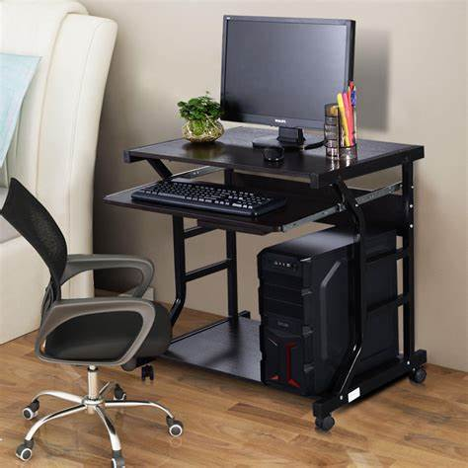
Why this product?
Generated from Quotation

Slide 2
Customer Need
• Your company requires a high-performance workstation to handle demanding professional workloads.
• Need for reliable and fast processing power to boost productivity.
• Essential to have ample memory and storage for large data and applications.
• Looking for a solution with dependable warranty and optional support services.
• Timely delivery is crucial to meet project deadlines.

Slide 3
Our Solution
• Introducing the Workstation Pro Professional tailored to meet your needs.
• Equipped with powerful Intel Xeon W-2295 CPU for superior performance.
• 32GB DDR4 RAM ensures smooth multitasking and efficient workflows.
• 1TB NVMe SSD provides fast storage and quick data access.
• Flexible warranty and optional setup support to ensure peace of mind.

Slide 4
Product Overview
• CPU: Intel Xeon W-2295 delivering exceptional processing speed.
• RAM: 32GB DDR4 for seamless multitasking and application handling.
• Storage: 1TB NVMe SSD for rapid data transfer and ample capacity.
• Quantity: 1 unit designed for professional-grade performance.
• Warranty: 1-year included for comprehensive coverage.

Slide 5
Pricing Breakdown
• Unit Price: $3,499.99 offering excellent value for top-tier hardware.
• Transparent pricing with no hidden fees.
• Optional setup and integration support available to optimize deployment.
• Investment in quality hardware reduces downtime and increases efficiency.
• Competitive pricing aligned with industry standards for professional workstations.

Slide 6
Warranty & Support
• 1-year standard warranty included for reliable protection.
• Optional setup and integration services to ensure smooth installation.
• Support options designed to minimize operational disruptions.
• Access to expert technical assistance if needed.
• Peace of mind with comprehensive after-sales support.

Slide 7
Product Comparison
• Compare three variants of our Workstation Pro Professional to suit your preferences.
• All variants feature the same high-end specifications for consistent performance.
• Choose the product name that best fits your procurement or project naming conventions.
• All options maintain the same price point and warranty coverage.
• Support options remain flexible across all variants.

Slide 8
Delivery Timeline
• Estimated delivery within 2-3 weeks after order confirmation.
• Efficient logistics ensure timely arrival to meet your project schedules.
• Regular updates provided throughout the delivery process.
• Optional expedited shipping can be discussed if urgent.
• Our commitment to prompt delivery supports your business continuity.

Slide 9
Call to Action
• Secure your Workstation Pro Professional today to enhance your operational capabilities.
• Contact us to finalize your order and discuss optional setup support.
• Leverage our expertise to ensure seamless integration into your workflow.
• Act now to benefit from our reliable delivery and comprehensive warranty.
• We look forward to partnering with your company for success.

Slide 10
Product Comparison
Product Name | Price | CPU | RAM | Storage | Warranty | Support
Workstation Pro Professional Variant 1 | $3,499.99 | Intel Xeon W-2295 | 32GB DDR4 | 1TB NVMe SSD | 1-year included | Optional setup and integration
Workstation Pro Professional Variant 2 | $3,499.99 | Intel Xeon W-2295 | 32GB DDR4 | 1TB NVMe SSD | 1-year included | Optional setup and integration
Workstation Pro Professional Variant 3 | $3,499.99 | Intel Xeon W-2295 | 32GB DDR4 | 1TB NVMe SSD | 1-year included | Optional setup and integration

