Slide 1

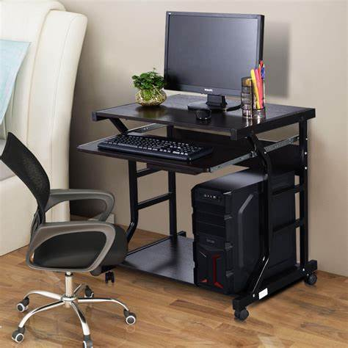
Customer Need
Your company requires a high-performance workstation to handle demanding professional tasks.
Efficient processing power is essential to improve productivity and reduce downtime.
Reliable storage solutions are critical for managing large data sets and projects.
A robust system with expandable memory ensures smooth multitasking.
Timely delivery and dependable support are key to seamless integration.

Slide 2
Our Solution
Introducing the Workstation Pro Professional tailored to meet your performance needs.
Equipped with cutting-edge Intel Xeon W-2295 CPU for superior processing power.
Generous 32GB DDR4 RAM to support multitasking and complex workflows.
Fast 1TB NVMe SSD storage for quick data access and ample space.
Flexible support options including optional setup and integration services.

Slide 3
Product Overview
CPU: Intel Xeon W-2295 – designed for professional-grade computing.
RAM: 32GB DDR4 – ensures smooth and efficient multitasking.
Storage: 1TB NVMe SSD – delivers high-speed data access and reliability.
Quantity: 1 unit – customized for your company’s specific requirements.
Warranty: 1-year included for peace of mind and reliability.

Slide 4
Pricing Breakdown
Unit Price: $3,499.99 offering excellent value for professional-grade hardware.
Transparent pricing with no hidden costs.
Optional support and integration services available to fit your budget.
Investment in quality hardware reduces long-term operational costs.
Flexible purchase options tailored to your procurement process.

Slide 5
Warranty & Support
1-year standard warranty included to protect your investment.
Optional setup and integration support available for smooth deployment.
Access to expert technical assistance to minimize downtime.
Comprehensive warranty covers hardware defects and performance issues.
Support services designed to ensure optimal system performance.

Slide 6
Product Comparison
Compare variants of the Workstation Pro Professional to find the perfect fit.
All variants share the same high-quality specifications and performance.
Choose based on your preferred product naming or internal cataloging.
Consistent pricing and warranty across all variants.
Support options remain flexible regardless of variant choice.

Slide 7
Delivery Timeline
Estimated delivery within 2-3 weeks after order confirmation.
Efficient processing to meet your project deadlines.
Regular updates provided throughout the delivery process.
Flexible scheduling options to accommodate your operational needs.
Reliable logistics ensure your workstation arrives on time and in perfect condition.
Step 1
Step 2
Step 3

Slide 8
Call to Action
Secure your Workstation Pro Professional today to boost your company’s productivity.
Contact us to customize support and integration services to your needs.
Take advantage of our competitive pricing and reliable delivery.
Partner with us for a seamless purchasing and deployment experience.
Let’s schedule a follow-up to finalize your order and answer any questions.

